Slide 1
“WHO WANTS TO BE A MILLIONAIRE ?”
Group Number:Group 4
Name-Surname 1:Ahmet Buğra Kuşcu (220611013)
Name-Surname 2: Murat Alperen Ulutaş (220611003)

Slide 2
DESIGN SOLUTION/APPROACH
In this project, we developed an interactive " Who Wants to Be a Millionaire ? " game that combines an intuitive user interface with a resilient and extendable system architecture. Our design strategy encompasses both frontend usability and backend performance, ensuring smooth real-time communication and a responsive gameplay experience. The solution integrates modern web technologies on the client side and a socket-based server bridge for scalable data exchange on the backend.
Frontend: Next + TypeScript was used. The UI can be easily extended thanks to the component-based structure.
State Management: All game data is managed centrally with the Context API.
WebSocket: A two-way connection (Socket.IO) was preferred for the synchronous flow of the game.
TCP Adapter: Adapter.js written in Node.js acts as a bridge between the web client and the game engine.
🧠 General Approach: Backend architecture is divided into three independent C++ server modules
-Main Server (host)
-Joker Server (joker)
-Common Library (common) – Contains modules that are used in common across all servers..

Slide 3
🛠 Development Environment
💻 Programming Languages:
Frontend: TypeScript (Next.js)
Backend: C++ (Modular TCP server structure)
Middleware: JavaScript (Node.js adapter.js for WebSocket ↔ TCP bridge)
🖥 Operating System:
Cross-platform (Since the project relies on Linux-specific libraries, Docker must be used to run it on non-Linux operating systems.)
🧰 Compilers & Build Tools:
C++ Compilation: g++ or clang++ with C++17 standard
Node.js Runtime: v22.14.0
Frontend Framework: Next.js

Slide 4
🛠 Development Environment
📦 Libraries & Frameworks:
Frontend: Next.js
Tailwind CSS (for responsive UI)
Backend:
Custom TCP server built with standard C++ sockets
nlohmann/json.hpp for JSON parsing
Middleware: socket.io (Node.js)
net module in Node.js for raw TCP socket communication
🧪 Development Tools:
Visual Studio Code
Browser DevTools for frontend debugging

Slide 5
🖥️ User Interface (Frontend)
layout.tsx
General appearance and availability of the application. Page structure, titles, fonts and general style are controlled here.
page.tsx
Entry point of the game interface. It is the main page where the game starts and is called.
Game.tsx
Central to the logic of the game. All management such as questions, options, joker buttons and prize ladder are managed.
OptionButton.tsx
It represents an option. After the option is selected, it transmits your information to the GameContext.
JokerButton.tsx
50:50 presents the spectator jokers personally. Checks if the joker is available.
PriceLadder.tsx
Prizes are listed from bottom to top. Highlights the current level.

Slide 6
🖥️ User Interface (Frontend)
Alert.tsx
Shows messages such as correct/wrong answers, end of game, connection alerts.
FinalScreen.tsx
Presents the result screen to the user when the game is completed (win or lose).
Welcome.tsx
Provides information and initialization at the beginning of the game.
globals.css
Contains the general style rules of the application. Basic visuals such as colors, fonts, backgrounds are provided here.
GameContext.tsx
Manages the entire state of the game. Establishes the WebSocket connection, processes incoming server messages (QUESTION, CORRECT, LOSE, JOKERS, etc.). Also provides sendAnswer() and useJoker() functions.

Slide 7
⚙️ Server-Side Logic (Backend)
1️⃣ Main Server (main.cpp, server.cpp)
Manages player connections and game flow.
In the server.cpp file, it processes requests coming over TCP and directs them according to the game logic.
Question progress, game start and end operations are carried out here.
Player information, answer accuracy and level tracking are done here.
2️⃣ Joker Server (joker.cpp, joker.h, server.cpp)
Processes joker (lifeline) usage as a separate server.
Each joker request is verified independently and is allowed to be used only once.
joker.cpp file contains the logic of jokers (50:50, audience, etc.).
server.cpp receives lifeline requests here, processes them and sends a response back to the main server.
3️⃣ Shared Logic – Common Modules
question.h: Defines the data structure where questions are stored and processed.
server_base.h / .cpp: The base server class inherited by all servers.
Operations such as opening a connection, receiving/sending messages are abstracted here.
utils.cpp: Contains auxiliary functions (e.g. reading files, formatting, etc.)
🌉 Communication Model
Each server is connected to each other via TCP sockets. All requests coming from the web are directed to TCP via adapter.js.
There is a chained flow as adapter.js → main server → (if necessary) wildcard server.

Slide 8
Build And Run
-In linux enviroment you can build and run project by following commands.
./build.sh
./start_all.sh

Slide 9
LESSONS LEARNED
✅ Key Discoveries:
Real-time communication requires careful synchronization and state management between client and server.
Modular design (splitting servers for game, lifelines, and question logic) greatly improves maintainability and scalability.
WebSocket and raw TCP integration via a Node.js adapter provided valuable experience in cross-protocol communication.
🛠 Development Challenges:
Ensuring stable and persistent WebSocket connections under different network conditions.
Handling asynchronous message flow and race conditions between server events (e.g., simultaneous lifeline use and answering).
Designing fail-safe reconnection logic when the backend or adapter crashed.
Backend side client state management with maps.

Slide 10
LESSONS LEARNED
🧪 Testing Difficulties:
Testing multi-player or multi-session scenarios required simulating concurrent users and sequencing game events properly.
Debugging low-level TCP socket issues was complex due to limited built-in error reporting.
Needed to create mock data for questions and lifelines to avoid dependency on external content.
💡 Skills & Knowledge Gained:
Deepened understanding of full-stack architecture combining C++, Node.js, and Next.js.
Hands-on experience in event-driven programming, socket communication, and context-based state sharing in Next.
Learned best practices in component-based UI design, especially for interactive game interfaces.

Slide 11
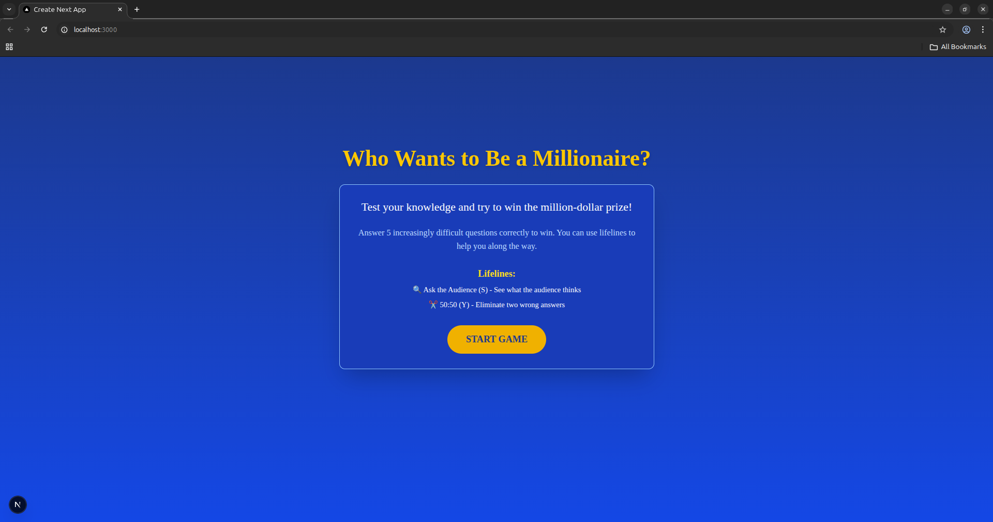
- Welcome page where we start game

Slide 12
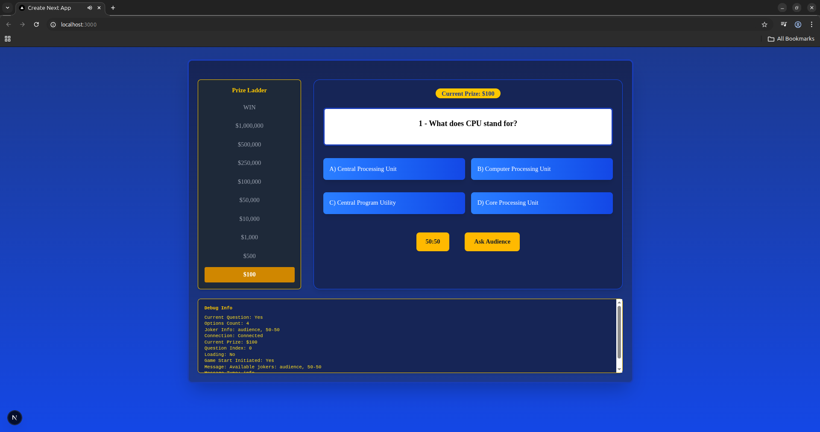
- We have debug panel that works on development process

Slide 13
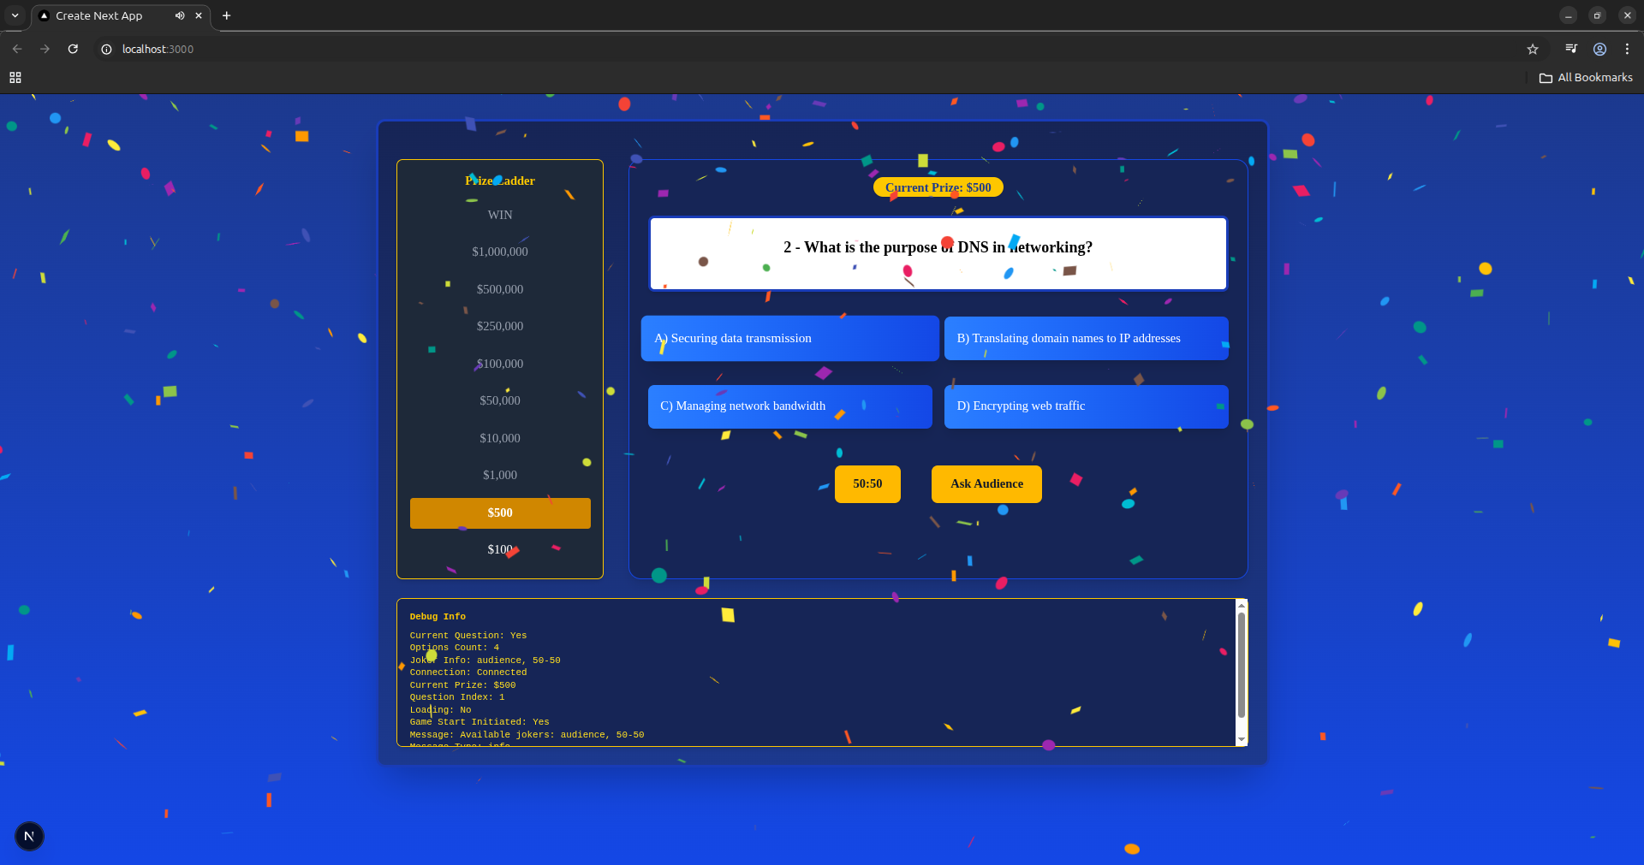
- We are showing confetti on every correct answer

Slide 14
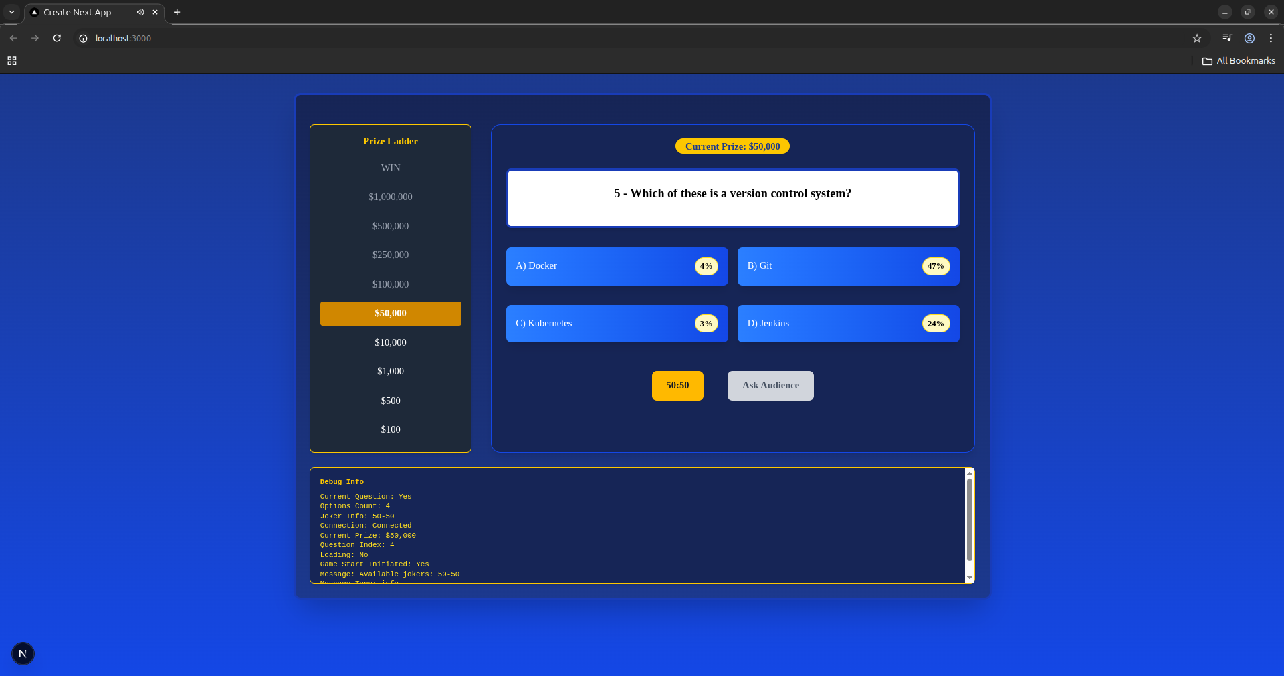
- In the audience lifeline, the percentage of each answer is displayed on beside of answer.

Slide 15
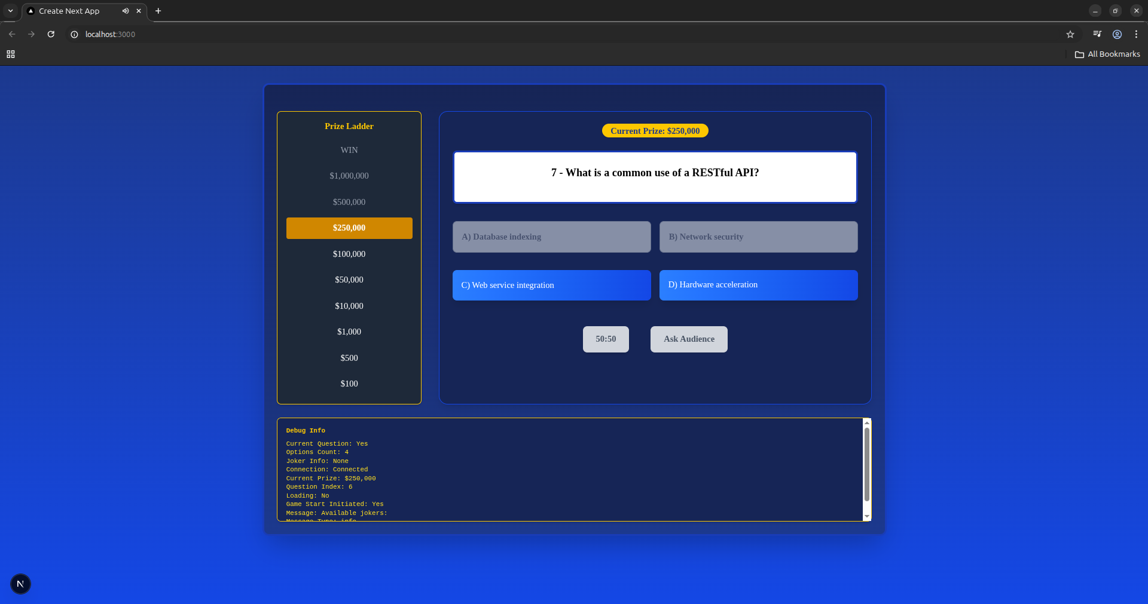
When the 50/50 lifeline is used, two incorrect options are eliminated.

Slide 16
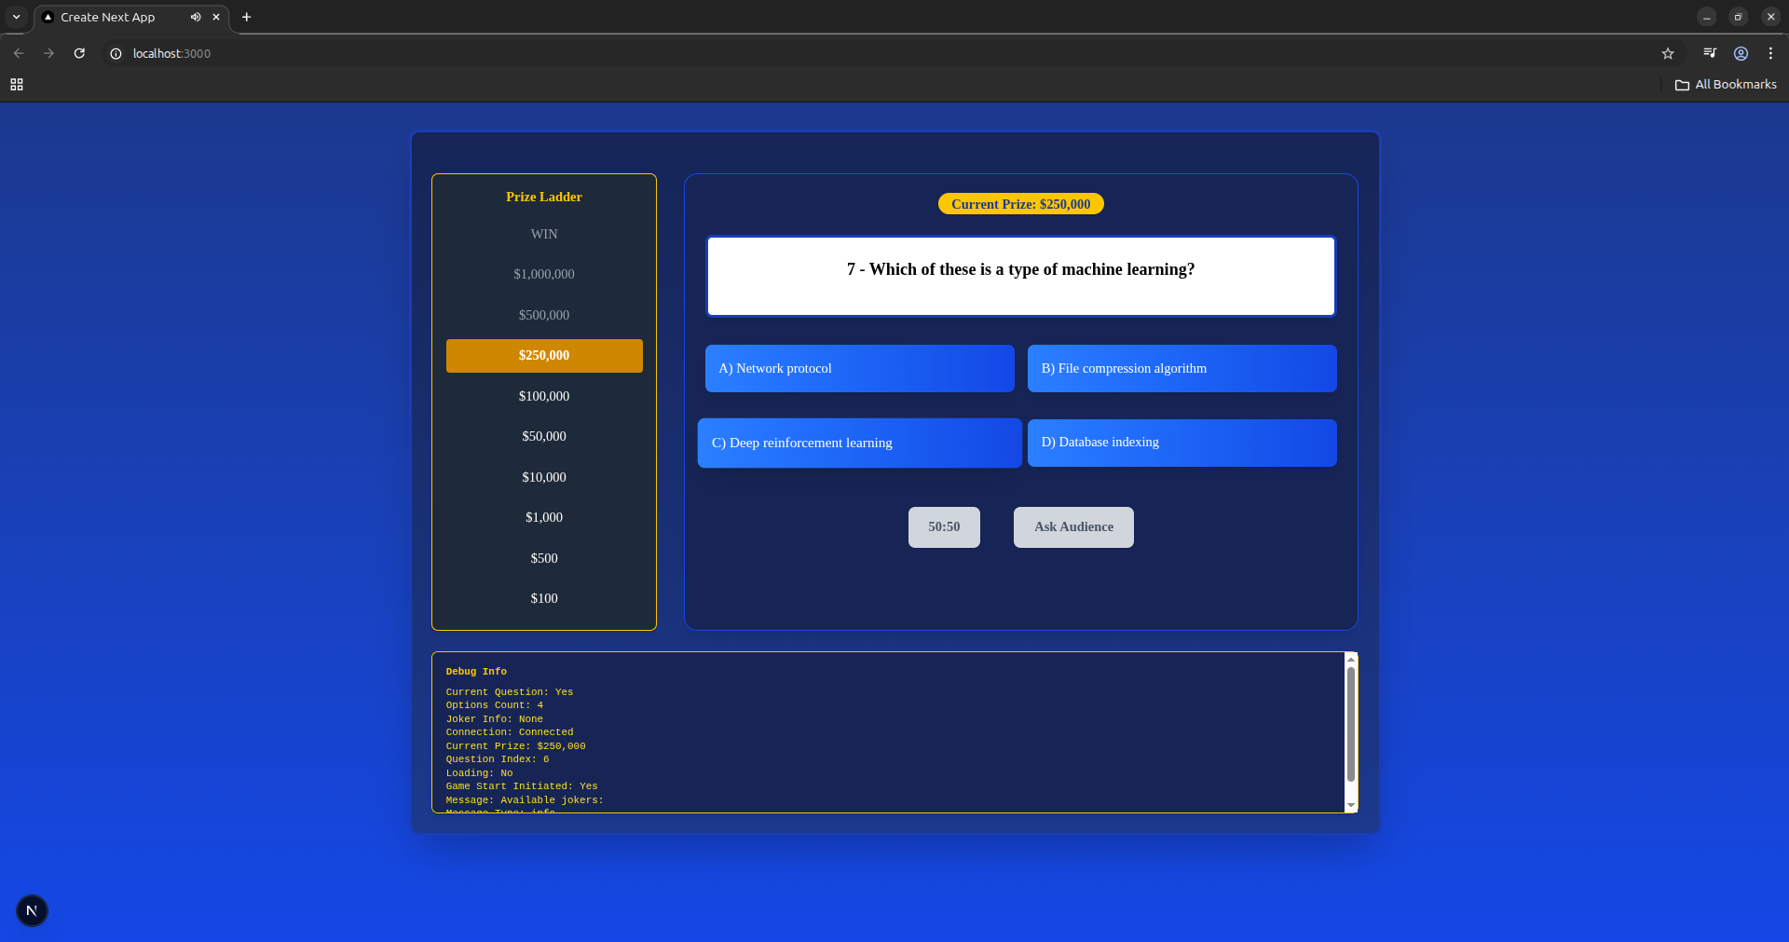
- Once lifelines are used, they become inactive and cannot be used again.

Slide 17
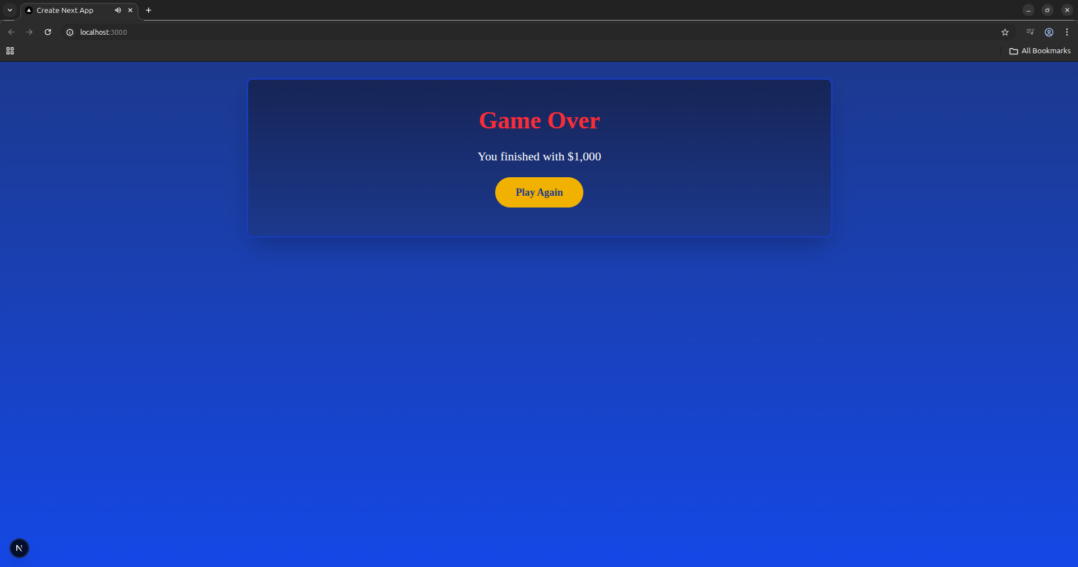
- When a wrong answer is given, Game over page opens.

Slide 18
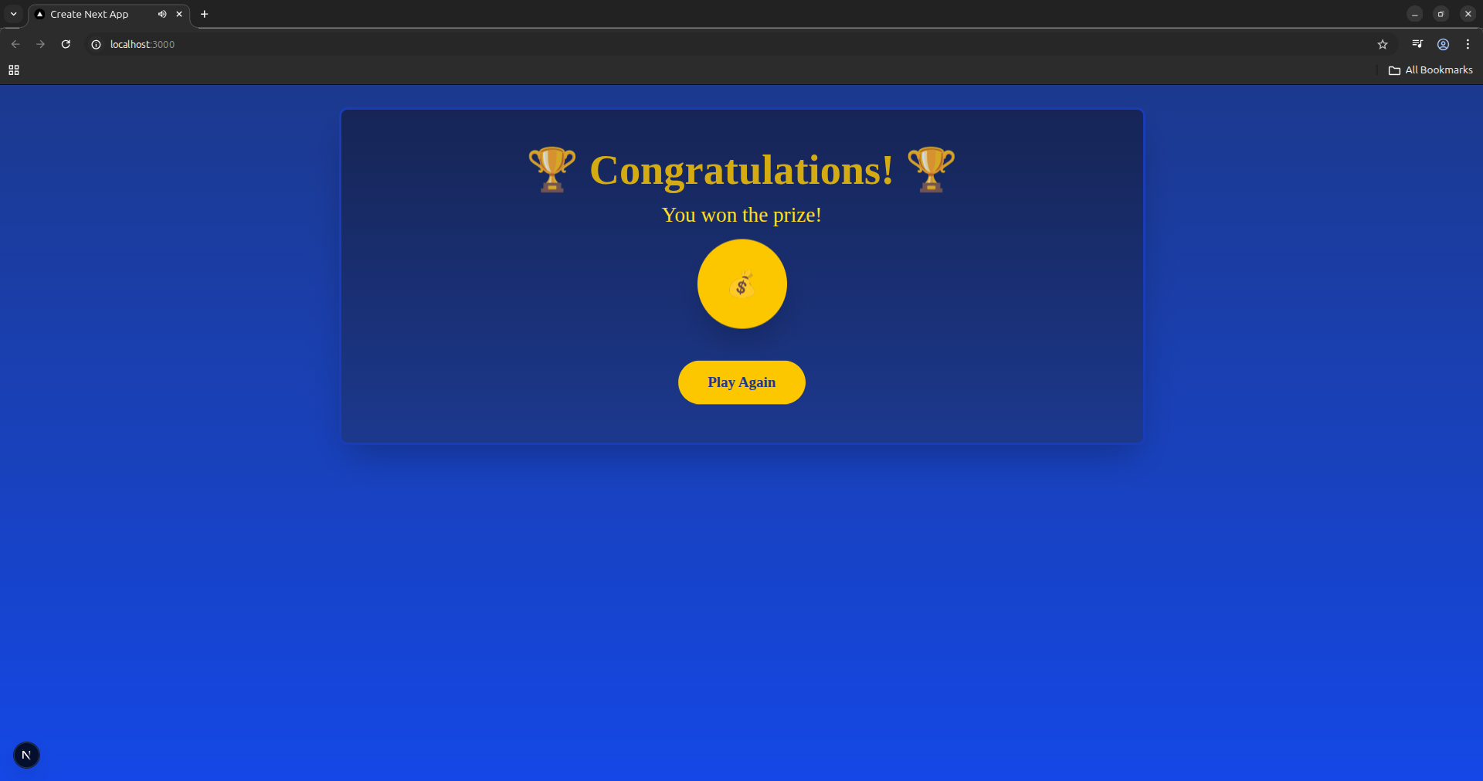
- When all questions are answered correctly, a congratulatory message is displayed on the screen.

Slide 19
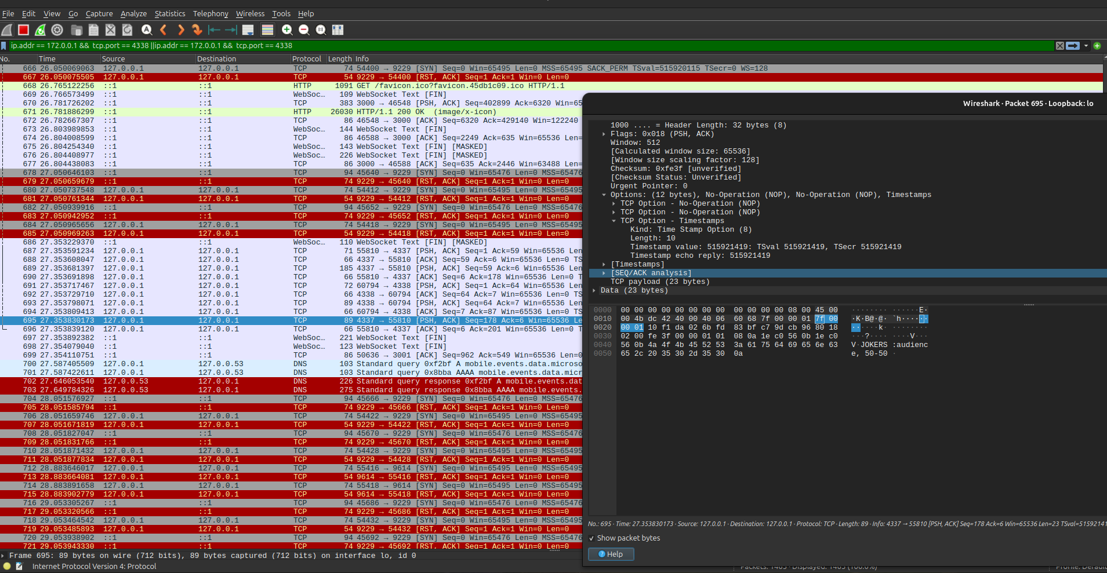
- Wireshark output.

Slide 20
🌟 Thank You! 🌟

