Slide 1
Scalable Web Application Architecture and Tools
Scalable Web Application Architecture
Distributed Computation
Apache Ignite (In Memory Distributed Database)
Mongo DB (Distributed Document Database)
Object Storage Azure Blob, Distributed Cloud Storage
Docker Container, Compose, Swarm and Kubernetes
Microservices
DevOps and Tools
DevOps
Deployment Tool (msdeploy)
Continuous Deployment (SaltStack, MS DevOps, Jenkins)
Code as Infrastructure(Chef, SaltStack)
Azure Cloud
Cloud Basics XaaS IaaS, PaaS, SaaS, DBaaS,… etc
Azure Compute Azure VM, Availability Sets, Connections, Load Balancer, Application Gateway
Azure DevOps
Azure Network Virtual, Network, Public IP, Load balancers, App Gateway
Azure Databases SQL Server, MySQL, Maria DB, SQL Elastic Pools, Cosmos DB
Programming Language
Python
Django
Go
Web Assembly and Blazor
Nodejs

Slide 2
Scalable Web Application Architecture

Slide 3
Scalable (lity) vs Elastic (ity)
Scalability: "Increasing" the capacity to meet the "increasing" workload.
Elasticity: "Increasing or reducing" the capacity to meet the "increasing or reducing" workload.
Scalability: In a scaling environment, the available resources may exceed to meet the "future demands".
Elasticity: In the elastic environment, the available resources match the "current demands" as closely as possible.
Scalability: Scalability enables a corporate to meet expected demands for services with "long-term, strategic needs".
Elasticity: Elasticity enables a corporate to meet unexpected changes in the demand for services with "short-term, tactical needs".
Scalability: Scalability adapts only to the "workload increase" by "provisioning" the resources in an "incremental" manner.
Elasticity: Elasticity adapts to both the "workload increase" as well as "workload decrease" by "provisioning and deprovisioning" resources in an "autonomic" manner.
Scalability: Increasing workload is served with increasing the power of a single computer resource or with increasing the power by a group of computer resources.
Elasticity: Varying workload is served with dynamic variations in the use of computer resources.
Scalability: It is "increasing" the capacity to serve an environment where workload is increasing.
This scalability could be "Scaling Up" or "Scaling Out".
(Example:
Scaling Up - increasing the ability of an individual server
Scaling out - increasing the ability by adding multiple servers to the individual server.)
Elasticity: It is the ability to "scale up or scale down" the capacity to serve at will.
Scalability: To use a simile, "scaling up" is an individual increasing her power to meet the increasing demands, and "scaling out" is building a team to meet the increasing demands.
Elasticity: To use a simile, a film actor increasing or reducing her body weight to meet differing needs of the film industry.

Slide 4
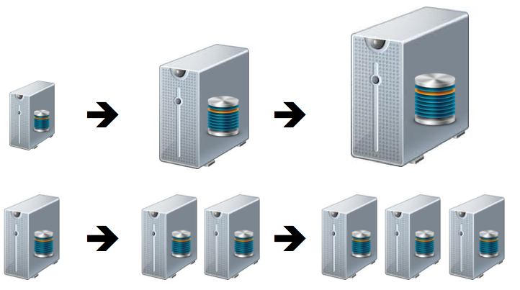
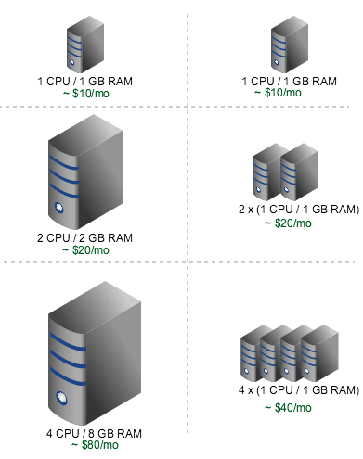
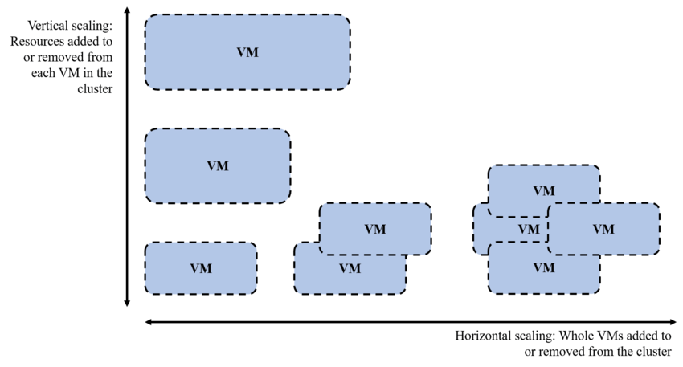
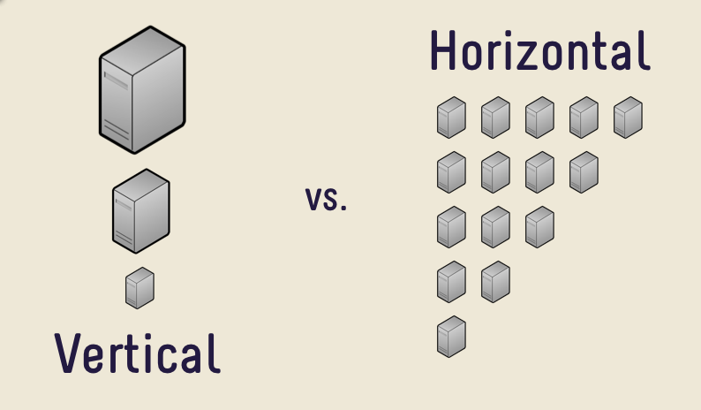
Vertical Scaling
Scale Up
Horizontal Scaling
Scale Out
Vertical Scaling
Scale Up
Vertical Scaling
Scale Up
Horizontal Scaling
Scale Out
Compare two method by management and cost !!!
Risks Management
Vendor Limitation
Open and
Closed Source (Free) Apps (Windows vs Linux)
Horizontal Scaling
Scale Out

Slide 5
Granularity is the extent to which a system is broken down into small parts, either the system itself or its description or observation. It is the extent to which a larger entity is subdivided. For example, a yard broken into inches has finer granularity than a yard broken into feet.
Coarse-grained - larger components than fine-grained, large subcomponents. Simply wraps one or more fine-grained services together into a more coarse­-grained operation.
Fine-grained - smaller components of which the larger ones are composed, lower ­level service
Granularity
Fine grained
less computation time
Program broken large no. of small task
Task assigned individual processors
Load balancing
help to achieve Parallel computation
High communication and synchronisation overhead
Higher degree of parallelism
Detect using compiler
Grain size 4–5microsec
few data element assign to single processor
Coarse grained
High computation time
Program broken large task
Task assigned not individual processors
Maybe Load imbalancing
less Parallel computation
Low communication and synchronisation overhead
Lower degree of parallelism
Detect using interprocedural parallezing compiler
Many data element assigned to single processor

Slide 6
10 Clients
Web Server
Dependencies
Storage (Disk)
Database
Ram
Processor
Hardware
Network
Others
WEB APP
LOCAL DISK
LOCAL DB
(MS ACCESS, Text File, Sqlite…etc)
LOCAL SESSION PROVIDER
LOCAL CACHE PROVIDER
LOCAL WEB SERVICE

Slide 7
Step 1:
Increase Web App Process
Result:
Increased Local Disk Space and Speed
Increased Ram (session, cache)
Increased Processor
Cannot Increase Local Db
100 Clients
Web Server
Dependencies
Storage (Disk)
Database
Ram
Processor
Network
WEB APP 1
WEB APP 1
WEB APP 1
LOCAL DISK
LOCAL DB
(MS Access, Sqlite)
LOCAL SESSION PROVIDER
LOCAL CACHE PROVIDER
LOCAL WEB SERVICE

Slide 8
Step 2:
Change Database
Result:
Still needs more local storage , Ram and Processor
Options:
Get more local resources (create a supercomputer like system) – Too Expensive
Get new server
1000 Clients
Web Server
DB server
WEB APP 1
WEB APP 1
WEB APP 1
SQL Server, Oracle, Postgre SQL
LOCAL DISK
LOCAL SESSION PROVIDER
LOCAL CACHE PROVIDER
LOCAL WEB SERVICE
Dependencies
Storage (Disk)
Database
Ram
Processor
Network

Slide 9
Step 3:
Increase Web Server
Result:
Storage, session and cache should be synced
Options:
Sync ram and disk
Use shared-distributed system
Web Server
WEB APP 1
WEB APP 1
WEB APP 1
Dependencies
Storage (Disk)
Database
Ram
Processor
Network
10000 Clients
LOCAL DISK
LOCAL SESSION PROVIDER
LOCAL CACHE PROVIDER
LOCAL WEB SERVICE
DB server
Load Balancer
Web Server
SQL Server, Oracle, Postgre SQL
WEB APP 1
WEB APP 1
WEB APP 1
LOCAL DISK
LOCAL SESSION PROVIDER
LOCAL CACHE PROVIDER
LOCAL WEB SERVICE

Slide 10
Step 3 – Session Problem:
Sync sessions with IIS session state
Web Server
Dependencies
Storage (Disk)
Database
Ram
Processor
Network
WEB APP 1
WEB APP 1
WEB APP 1
10000 Clients
LOCAL DISK
LOCAL SESSION PROVIDER
LOCAL CACHE PROVIDER
LOCAL WEB SERVICE
DB server
Load Balancer
Web Server
SQL Server, Oracle, Postgre SQL
WEB APP 1
WEB APP 1
WEB APP 1
LOCAL DISK
LOCAL SESSION PROVIDER
LOCAL CACHE PROVIDER
LOCAL WEB SERVICE

Slide 11
Step 3 – Disk Problem:
Sync Disks with MS Storage Replication or MS Distributed File System
Dependencies
Storage (Disk)
Database
Ram
Processor
Network
Web Server
WEB APP 1
WEB APP 1
WEB APP 1
10000 Clients
LOCAL DISK
LOCAL SESSION PROVIDER
LOCAL CACHE PROVIDER
LOCAL WEB SERVICE
DB server
Load Balancer
Web Server
SQL Server, Oracle, Postgre SQL
WEB APP 1
WEB APP 1
WEB APP 1
LOCAL DISK
LOCAL SESSION PROVIDER
LOCAL CACHE PROVIDER
LOCAL WEB SERVICE

Slide 12
Step 3 – Cache Problem:
MS AppFabric for distributed cache
Results:
If we need new web app, it must be part of this system.
If we need new environment for new app, we must setup same system again.
If one of the components (eg session, cache) need more ram or processor, we cannot increase the resource for it separately.
AppFabric is not supported … etc.
Web Server
Dependencies
Storage (Disk)
Database
Ram
Processor
Network
100000 ?
WEB APP 1
WEB APP 1
WEB APP 1
10000 Clients
LOCAL DISK
LOCAL SESSION PROVIDER
LOCAL CACHE PROVIDER
LOCAL WEB SERVICE
DB server
Load Balancer
!!!
Web Server
SQL Server, Oracle, Postgre SQL
WEB APP 1
WEB APP 1
WEB APP 1
LOCAL DISK
LOCAL SESSION PROVIDER
LOCAL CACHE PROVIDER
LOCAL WEB SERVICE
New Web Server

Slide 13
Step 4 – First Optimization:
isolate database, hard disk and session from the system.
Results:
All Components can be increased separately.
SQL Server, Postgres, Oracle are not distributed by default. Also they are really slow on some cases.
Options:
Distributed DBs can be used (Document and Column Based DBs)
Load Balancer
100000 Clients
Web server
Web App 1
Web App 2
Web App 3
Web server
Web server
Web Service
Web App 1
Web App 2
Web App 3
Cache server
DB server
Session server
File server
Redis, Apache Ignite…
SQL Server, Oracle, Postgre SQL
Redis, Apache Ignite…
Ceph, Minio ,Gluster, Hadoop, XtreemFS MS DFS, MS Storage replication…

Slide 14
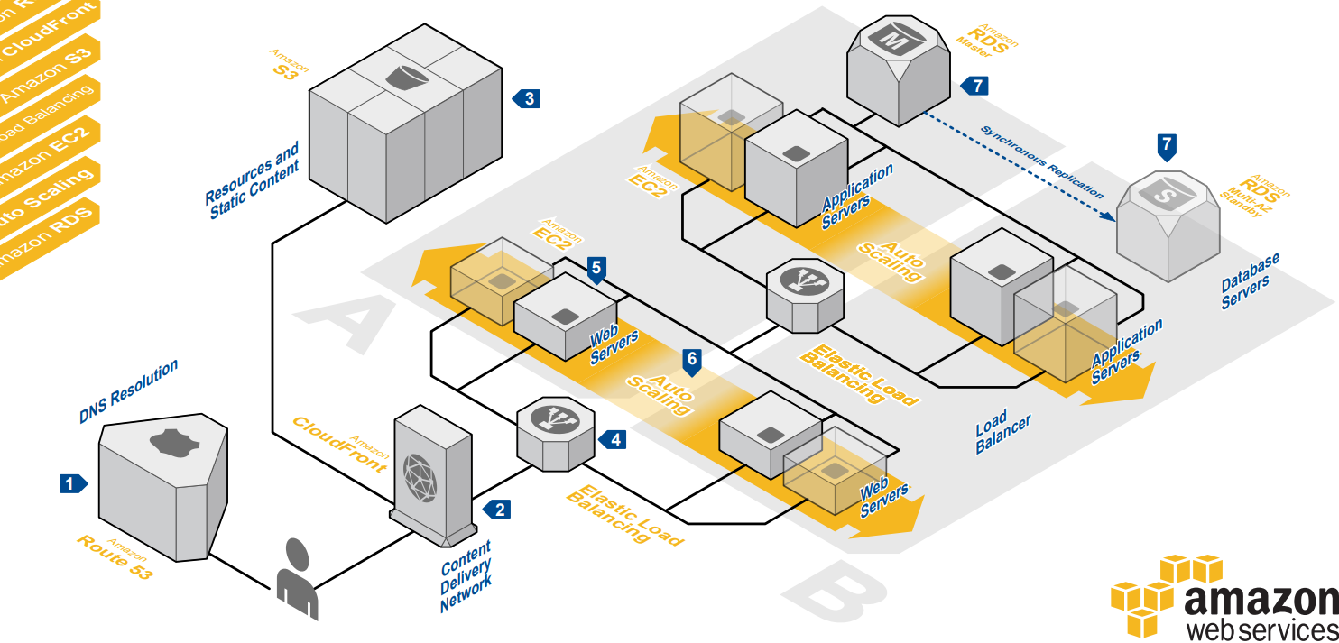
AWS Architecture Center
https://aws.amazon.com/tr/architecture/?awsf.quickstart-architecture-page-filter=highlight%23new
https://aws.amazon.com/tr/architecture/

Slide 15
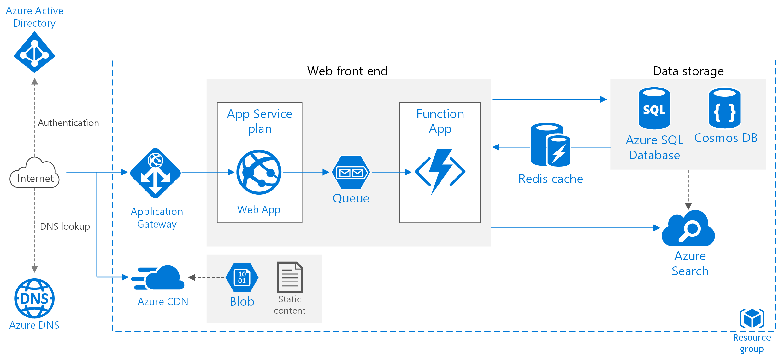
Azure Architecture Center
https://docs.microsoft.com/en-us/azure/architecture/

Slide 16
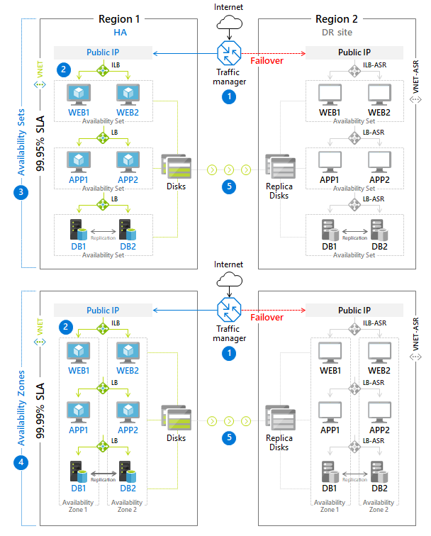
Azure Architecture Center
High Scalable vs High Available
https://docs.microsoft.com/en-us/azure/architecture/example-scenario/infrastructure/multi-tier-app-disaster-recovery

Slide 17
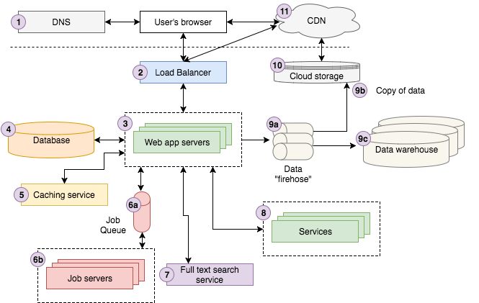
Best Practice for Monolithic Apps

Slide 18
Microservices
E-Commerce Components
Account (Identity) Management
Shipping Management
Inventory Management
Order Management
Marketing Management
Supplier Management
Etc.
Cross Cutting Concern

Slide 19
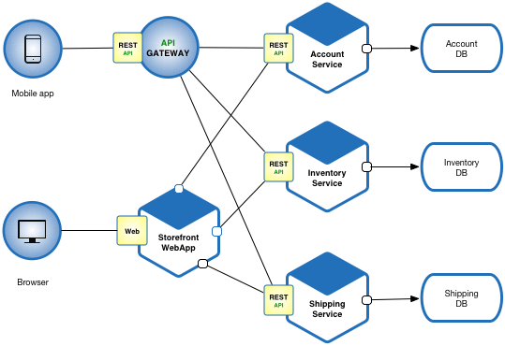
Microservices

Slide 20
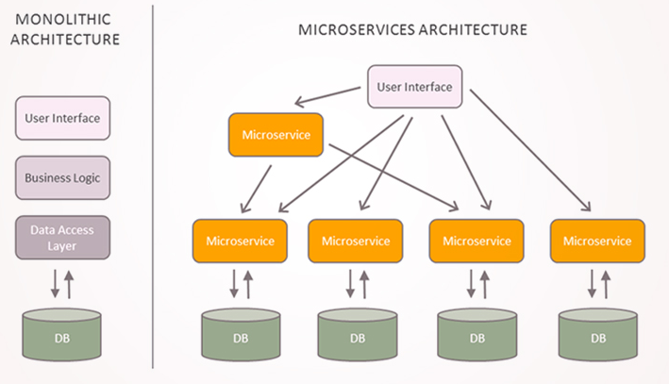
Monolith vs Microservice

Slide 21
Why Microservices
https://dzone.com/articles/why-microservices
https://docs.microsoft.com/en-us/azure/architecture/microservices/introduction
https://blog.newrelic.com/technology/microservices-what-they-are-why-to-use-them/
Concerns With the Monolith
Large applications that require a high release velocity.
Complex applications that need to be highly scalable.
Applications with rich domains or many subdomains.
Difficult to Scale
No Clear Ownership
Failure Cascade
Wall Between Dev and Ops
Stuck in a Technology/Language

Slide 22
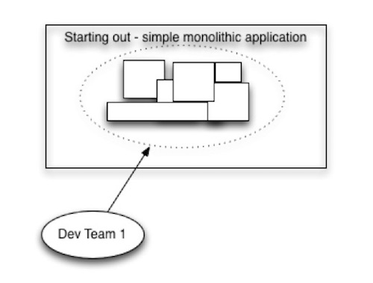
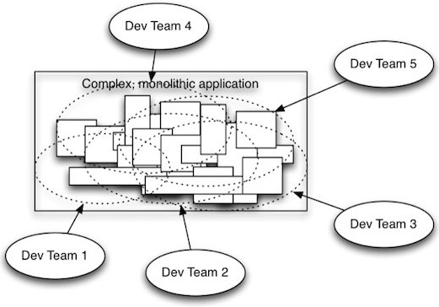
When switch to Microservices?
App Based Needs
https://blog.newrelic.com/technology/microservices-what-they-are-why-to-use-them/

Slide 23
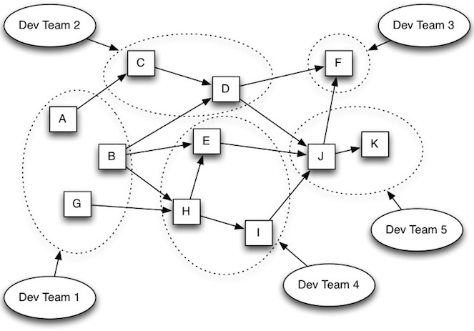
1
2
When switch to Microservices?
App Based Needs
https://blog.newrelic.com/technology/microservices-what-they-are-why-to-use-them/
3

Slide 24
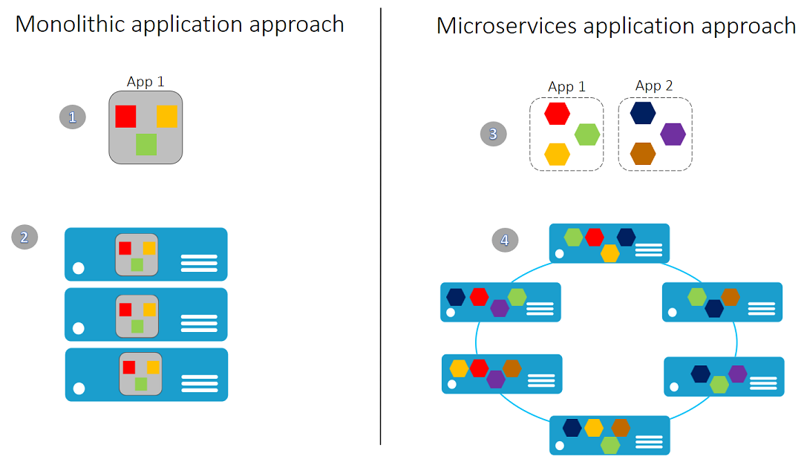
When switch to Microservices?
Hardware Based Needs
https://blog.newrelic.com/technology/microservices-what-they-are-why-to-use-them/

Slide 25
Why Microservices
https://dzone.com/articles/why-microservices
https://docs.microsoft.com/en-us/azure/architecture/microservices/introduction
https://blog.newrelic.com/technology/microservices-what-they-are-why-to-use-them/
https://www.edureka.co/blog/top-10-reasons-to-learn-microservices/
The Benefits Microservices
Improved granular scalability. Because microservices let you independently scale services up or down, the ease—and cost—of scaling is dramatically less than in a monolithic system. Adding new capabilities usually means adding discrete new microservices, not redoing the entire application, which increases both development speed and application stability.
Better fault isolation (Reduces Risks). If one microservice fails, all the others will likely continue to work. This is a key part of the microservices architectural design.
Optimized scaling decisions.With microservice architectures, scaling decisions can be made at a more granular level, allowing more efficient system optimization and organization.
Localized complexity. Microservice architectures let developers think about services as black boxes. Owners of the service need to understand the complexity of only what is within their service. Other service owners need to know only what capabilities a service provides, without having to worry about how it works internally. This compartmentalization of knowledge and complexity makes it easier to create and manage large applications.
Increased business agility. Microservices are relatively small and simple, and failure of a microservice affects only that service—not the whole application—so enterprises can afford to experiment with new processes, algorithms, and business logic. Microservices give you the freedom to experiment and “fail fast.”
Increased developer productivity. New developers can get up to speed rapidly, since it’s easier to understand a small, isolated piece of functionality than an entire monolithic application.
Simplified debugging and maintenance. For the same reasons that building individual microservices is easier than coding for a monolithic architecture, developers can be much more productive when debugging code and performing maintenance.
Better alignment of developers with business users. Since microservice architectures are organized around business capabilities, developers can more easily understand the user perspective and create microservices that are better aligned with the business.
Future-proofed applications. When innovations happen and new or updated technology disrupt your software development process, microservice architectures makes it easier to respond by replacing or upgrading the individual services affected without impacting the whole application.
Smaller and more agile development teams. In modern software organizations, teams are often organized by the microservices they work on. These teams involve fewer people, and they’re more focused on the task at hand.
Promotes the best big data practices
Flexibility to use various tools for the required task
Provides Continous Delivery

Slide 26
Challenges
https://docs.microsoft.com/en-us/azure/architecture/microservices/introduction
https://blog.newrelic.com/technology/microservices-what-they-are-why-to-use-them/
Challenges
The benefits of microservices don't come for free. Here are some of the challenges to consider before embarking on a microservices architecture.
Complexity. A microservices application has more moving parts than the equivalent monolithic application. Each service is simpler, but the entire system as a whole is more complex.
Development and testing. Writing a small service that relies on other dependent services requires a different approach than a writing a traditional monolithic or layered application. Existing tools are not always designed to work with service dependencies. Refactoring across service boundaries can be difficult. It is also challenging to test service dependencies, especially when the application is evolving quickly.
Lack of governance. The decentralized approach to building microservices has advantages, but it can also lead to problems. You may end up with so many different languages and frameworks that the application becomes hard to maintain. It may be useful to put some project-wide standards in place, without overly restricting teams' flexibility. This especially applies to cross-cutting functionality such as logging.
Network congestion and latency. The use of many small, granular services can result in more interservice communication. Also, if the chain of service dependencies gets too long (service A calls B, which calls C...), the additional latency can become a problem. You will need to design APIs carefully. Avoid overly chatty APIs, think about serialization formats, and look for places to use asynchronous communication patterns.
Data integrity. With each microservice responsible for its own data persistence. As a result, data consistency can be a challenge. Embrace eventual consistency where possible.
Management. To be successful with microservices requires a mature DevOps culture. Correlated logging across services can be challenging. Typically, logging must correlate multiple service calls for a single user operation.
Versioning. Updates to a service must not break services that depend on it. Multiple services could be updated at any given time, so without careful design, you might have problems with backward or forward compatibility.
Skillset. Microservices are highly distributed systems. Carefully evaluate whether the team has the skills and experience to be successful.
Cross-cutting Concerns Across Each Service

Slide 27
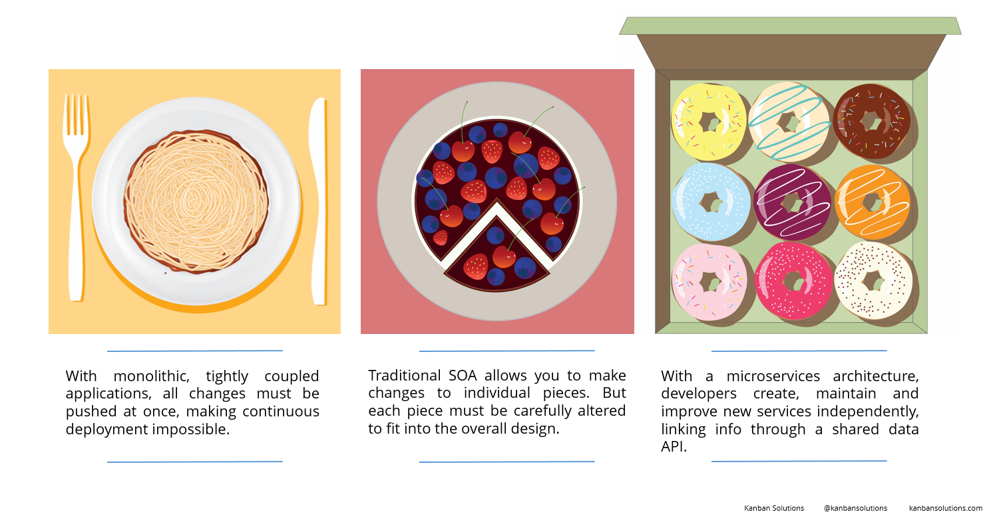
Monolithic vs. Microservices
And SOA
https://nordicapis.com/should-you-start-with-a-monolith-or-microservices/
https://dev.to/alex_barashkov/microservices-vs-monolith-architecture-4l1m

Slide 28
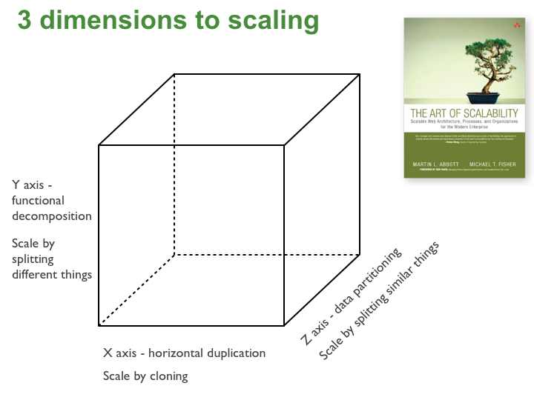
The Scale Cube
https://microservices.io/articles/scalecube.html
X-axis scaling
X-axis scaling consists of running multiple copies of an application behind a load balancer. If there are N copies then each copy handles 1/N of the load. This is a simple, commonly used approach of scaling an application. One drawback of this approach is that because each copy potentially accesses all of the data, caches require more memory to be effective. Another problem with this approach is that it does not tackle the problems of increasing development and application complexity.
Y-axis scaling
Unlike X-axis and Z-axis, which consist of running multiple, identical copies of the application, Y-axis axis scaling splits the application into multiple, different services. Each service is responsible for one or more closely related functions. There are a couple of different ways of decomposing the application into services. One approach is to use verb-based decomposition and define services that implement a single use case such as checkout. The other option is to decompose the application by noun and create services responsible for all operations related to a particular entity such as customer management. An application might use a combination of verb-based and noun-based decomposition.
Z-axis scaling
When using Z-axis scaling each server runs an identical copy of the code. In this respect, it’s similar to X-axis scaling. The big difference is that each server is responsible for only a subset of the data. Some component of the system is responsible for routing each request to the appropriate server. One commonly used routing criteria is an attribute of the request such as the primary key of the entity being accessed. Another common routing criteria is the customer type. For example, an application might provide paying customers with a higher SLA than free customers by routing their requests to a different set of servers with more capacity.

Slide 29
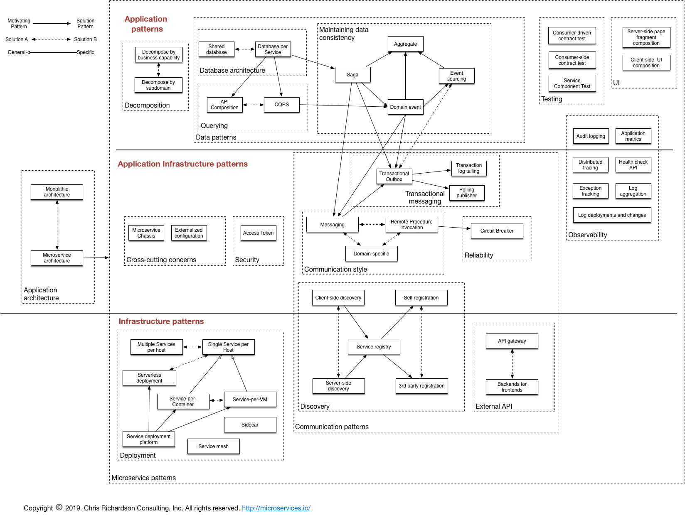
A pattern language for Microservices
https://microservices.io/patterns/index.html

Slide 30
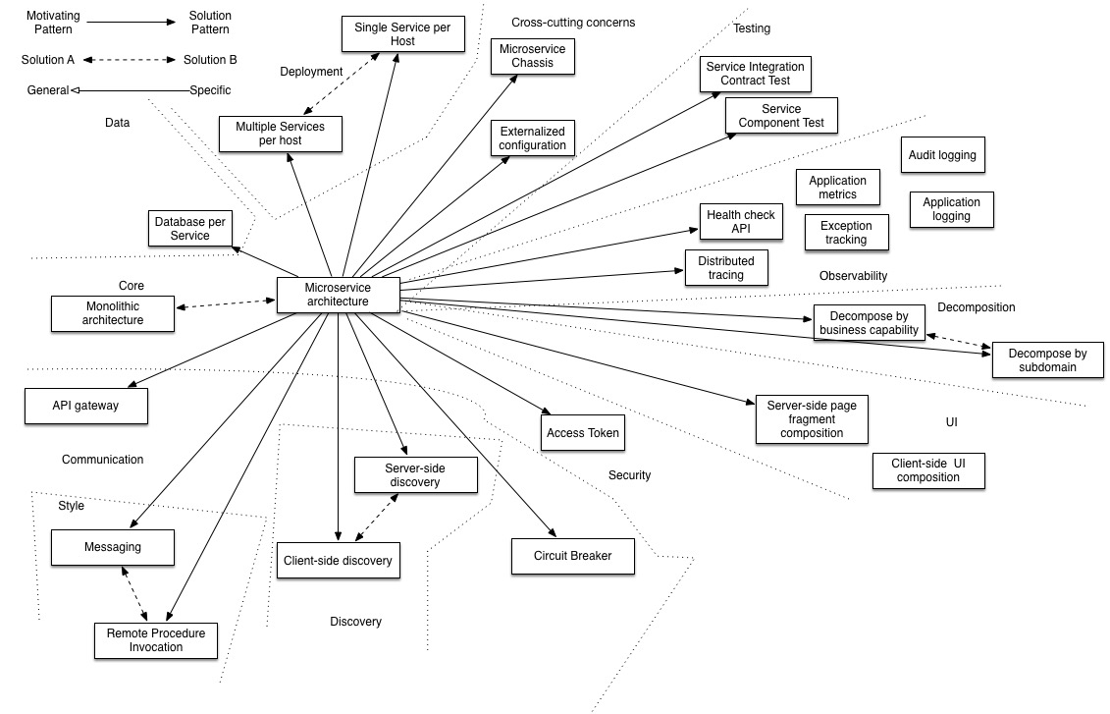
Microservice Patterns
https://microservices.io/patterns/microservices.html

Slide 31
A pattern language for Microservices
https://microservices.io/patterns/index.html
Application architecture patterns
Which architecture should you choose for an application?
Monolithic architecture - architect an application as a single deployable unit
Microservice architecture - architect an application as a collection of loosely coupled, services
Decomposition
How to decompose an application into services?
Decompose by business capability - define services corresponding to business capabilities
Decompose by subdomain - define services corresponding to DDD subdomains
Deployment patterns
How to deploy an application’s services?
Multiple service instances per host - deploy multiple service instances on a single host
Service instance per host - deploy each service instance in its own host
Service instance per VM - deploy each service instance in its VM
Service instance per Container - deploy each service instance in its container
Serverless deployment - deploy a service using serverless deployment platform
Service deployment platform - deploy services using a highly automated deployment platform that provides a service abstraction
Cross cutting concerns
How to handle cross cutting concerns?
Microservice chassis - a framework that handles cross-cutting concerns and simplifies the development of services
Externalized configuration - externalize all configuration such as database location and credentials

Slide 32
A pattern language for Microservices
https://microservices.io/patterns/index.html
Communication patterns
Style
Which communication mechanisms do services use to communicate with each other and their external clients?
Remote Procedure Invocation - use an RPI-based protocol for inter-service communication
Messaging - use asynchronous messaging for inter-service communication
Domain-specific protocol - use a domain-specific protocol
External API
How do external clients communicate with the services?
API gateway - a service that provides each client with unified interface to services
Backend for front-end - a separate API gateway for each kind of client
Service discovery
How does the client of an RPI-based service discover the network location of a service instance?
Client-side discovery - client queries a service registry to discover the locations of service instances
Server-side discovery - router queries a service registry to discover the locations of service instances
Service registry - a database of service instance locations
Self registration - service instance registers itself with the service registry
3rd party registration - a 3rd party registers a service instance with the service registry
Reliability
How to prevent a network or service failure from cascading to other services?
Circuit Breaker - invoke a remote service via a proxy that fails immediately when the failure rate of the remote call exceeds a threshold
Transactional messaging
How to publish messages as part of a database transaction?
Transactional outbox
Transaction log tailing
Polling publisher

Slide 33
A pattern language for Microservices
https://microservices.io/patterns/index.html
Data management
How to maintain data consistency and implement queries?
Database per Service - each service has its own private database
Shared database - services share a database
Saganew - use sagas, which a sequences of local transactions, to maintain data consistency across services
API Compositionnew - implement queries by invoking the services that own the data and performing an in-memory join
CQRS - implement queries by maintaining one or more materialized views that can be efficiently queried
Event sourcing - persist aggregates as a sequence of events
Security
How to communicate the identity of the requestor to the services that handle the request?
Access Token - a token that securely stores information about user that is exchanged between services
Testing
How to make testing easier?
Consumer-driven contract test - a test suite for a service that is written by the developers of another service that consumes it
Consumer-side contract test - a test suite for a service client (e.g. another service) that verifies that it can communicate with the service
Service component sest - a test suite that tests a service in isolation using test doubles for any services that it invokes
Observability
How to understand the behavior of an application and troubleshoot problems?
Log aggregation - aggregate application logs
Application metrics - instrument a service’s code to gather statistics about operations
Audit logging - record user activity in a database
Distributed tracing - instrument services with code that assigns each external request an unique identifier that is passed between services. Record information (e.g. start time, end time) about the work (e.g. service requests) performed when handling the external request in a centralized service
Exception tracking - report all exceptions to a centralized exception tracking service that aggregates and tracks exceptions and notifies developers.
Health check API - service API (e.g. HTTP endpoint) that returns the health of the service and can be pinged, for example, by a monitoring service
Log deployments and changesnew
UI patterns
How to implement a UI screen or page that displays data from multiple services?
Server-side page fragment composition - build a webpage on the server by composing HTML fragments generated by multiple, business capability/subdomain-specific web applications
Client-side UI composition - Build a UI on the client by composing UI fragments rendered by multiple, business capability/subdomain-specific UI components

Slide 34
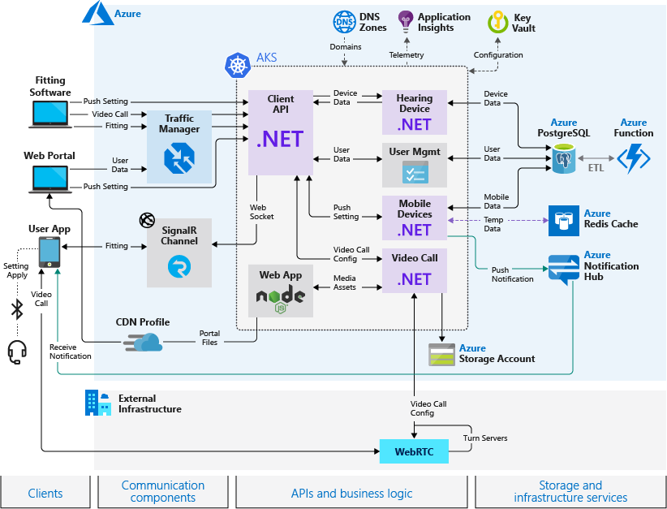
Azure Architecture Center
Telehealth System
https://docs.microsoft.com/en-us/azure/architecture/example-scenario/apps/telehealth-system

Slide 35
Serverless architectures are application designs that incorporate third-party “Backend as a Service” (BaaS) services, and/or that include custom code run in managed, ephemeral containers on a “Functions as a Service” (FaaS) platform. By using these ideas, and related ones like single-page applications, such architectures remove much of the need for a traditional always-on server component. Serverless architectures may benefit from significantly reduced operational cost, complexity, and engineering lead time, at a cost of increased reliance on vendor dependencies and comparatively immature supporting services.
Serverless computing (or serverless for short), is an execution model where the cloud provider (AWS, Azure, or Google Cloud) is responsible for executing a piece of code by dynamically allocating the resources. And only charging for the amount of resources used to run the code. The code is typically run inside stateless containers that can be triggered by a variety of events including http requests, database events, queuing services, monitoring alerts, file uploads, scheduled events (cron jobs), etc. The code that is sent to the cloud provider for execution is usually in the form of a function. Hence serverless is sometimes referred to as “Functions as a Service” or “FaaS”. Following are the FaaS offerings of the major cloud providers:
Serverless
https://martinfowler.com/articles/serverless.html
AWS: AWS Lambda
Microsoft Azure: Azure Functions
Google Cloud: Cloud Functions

Slide 36
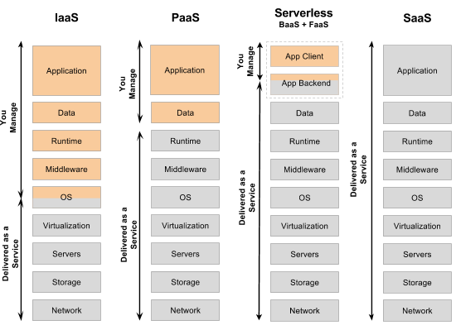
Serverless
https://specify.io/concepts/serverless-baas-faas

Slide 37
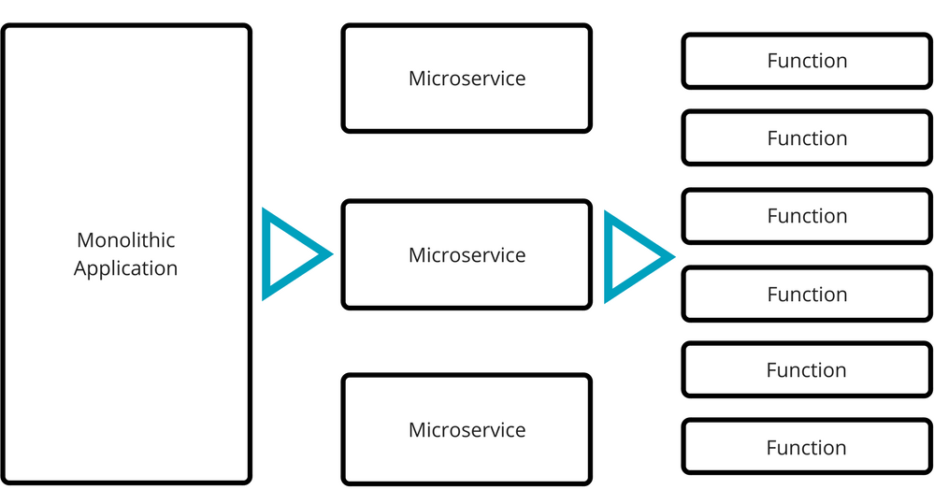
Serverless
https://specify.io/concepts/serverless-baas-faas

Slide 38
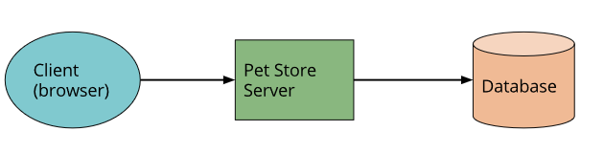
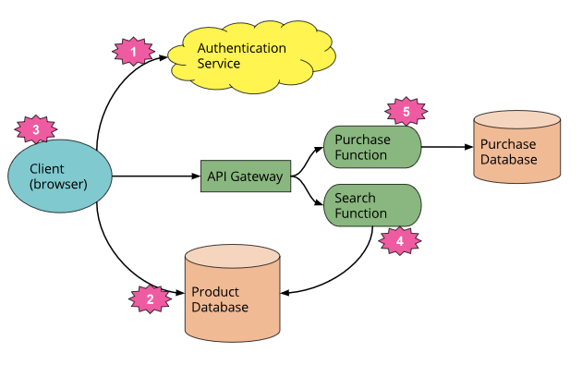
Third-party BaaS service (e.g., Auth0.)
Google Firebase, AzureCosmosDB
Server side rendering (Single Page App)
FaaS function that responds to HTTP requests via an API gateway
“purchase” functionality with another separate FaaS function
Serverless
https://martinfowler.com/articles/serverless.html

Slide 39
This is a massively simplified view, but even here we see a number of significant changes:
We’ve deleted the authentication logic in the original application and have replaced it with a third-party BaaS service (e.g., Auth0.)
Using another example of BaaS, we’ve allowed the client direct access to a subset of our database (for product listings), which itself is fully hosted by a third party (e.g., Google Firebase.) We likely have a different security profile for the client accessing the database in this way than for server resources that access the database.
These previous two points imply a very important third: some logic that was in the Pet Store server is now within the client—e.g., keeping track of a user session, understanding the UX structure of the application, reading from a database and translating that into a usable view, etc. The client is well on its way to becoming a Single Page Application.
We may want to keep some UX-related functionality in the server, if, for example, it’s compute intensive or requires access to significant amounts of data. In our pet store, an example is “search.” Instead of having an always-running server, as existed in the original architecture, we can instead implement a FaaS function that responds to HTTP requests via an API gateway (described later). Both the client and the server “search” function read from the same database for product data.
If we choose to use AWS Lambda as our FaaS platform we can port the search code from the original Pet Store server to the new Pet Store Search function without a complete rewrite, since Lambda supports Java and Javascript—our original implementation languages.
Finally, we may replace our “purchase” functionality with another separate FaaS function, choosing to keep it on the server side for security reasons, rather than reimplement it in the client. It too is fronted by an API gateway. Breaking up different logical requirements into separately deployed components is a very common approach when using FaaS.
Serverless
https://martinfowler.com/articles/serverless.html

