Slide 1

How to write
1000+ papers a day

Slide 2
Goals
User-friendly code.
Producing figures and tables.
Fast and effective.
Automatically generate a bioinformatics paper

Slide 3
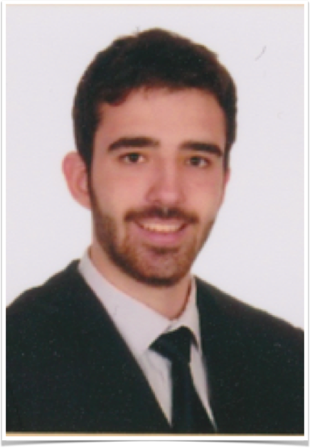
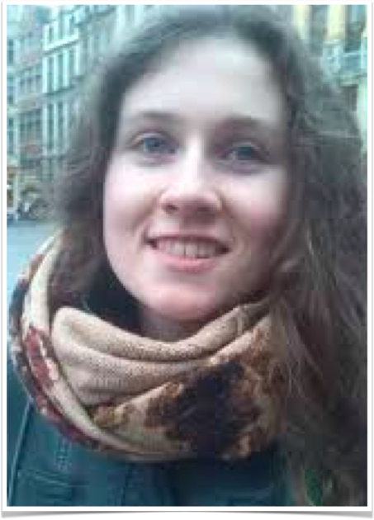
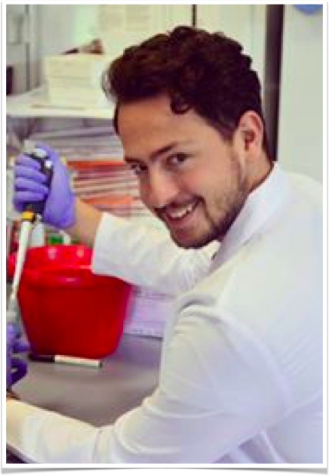
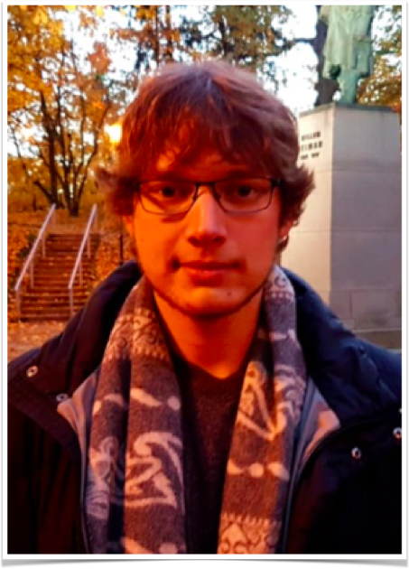
Team
Ramón
Database
Figures
Tables
Sofie
Initial coding
Lay-out
PPT
Murat
Initial coding
Code optimization
Paul
Database
PPT

Slide 4

Workflow
Step 1: Create the dataset
-> focus on 1 journal = 1 template
916 papers!

Slide 5
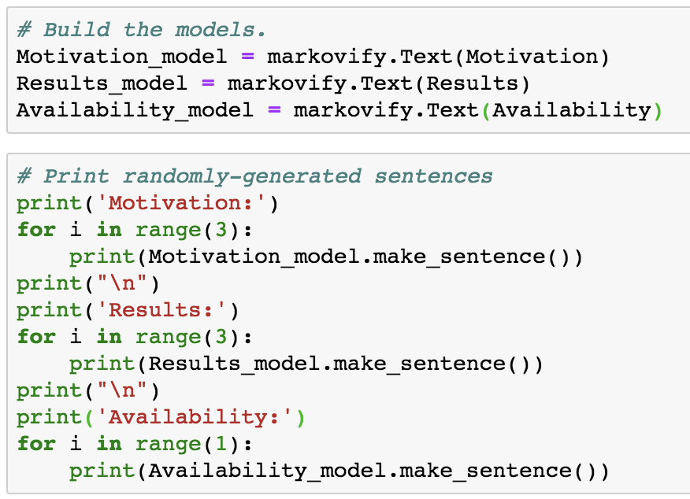
Workflow
Step 1: Create the dataset
Step 2: Try out HMM using markovify package
-> focus on abstract

Slide 6
Workflow
Step 1: Create the dataset
Step 2: Try out HMM using markovify package
Step 3: Improve code usability
-> extend code to generate a full paper
https://github.com/muratcemkose/RSG_Belgium/blob/master/Text_generator_HMM.ipynb

Slide 7
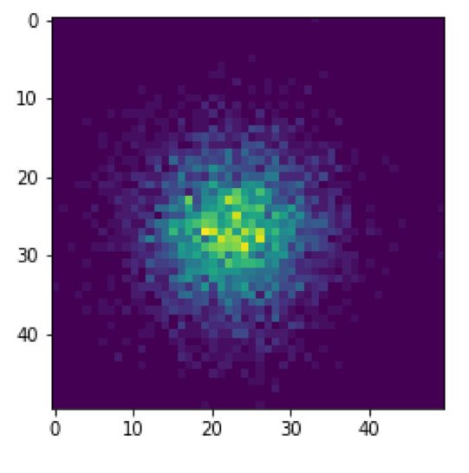
Workflow
Step 1: Create the dataset
Step 2: Try out HMM using markovify package
Step 3: Improve code usability
Step 4: Add randomly generated figures and tables → some consistency in the randomness

Slide 8
Workflow
Step 1: Create the dataset
Step 2: Try out HMM using markovify package
Step 3: Improve code usability
Step 4: Add randomly generated figures
Step 5: Lay-out

Slide 9
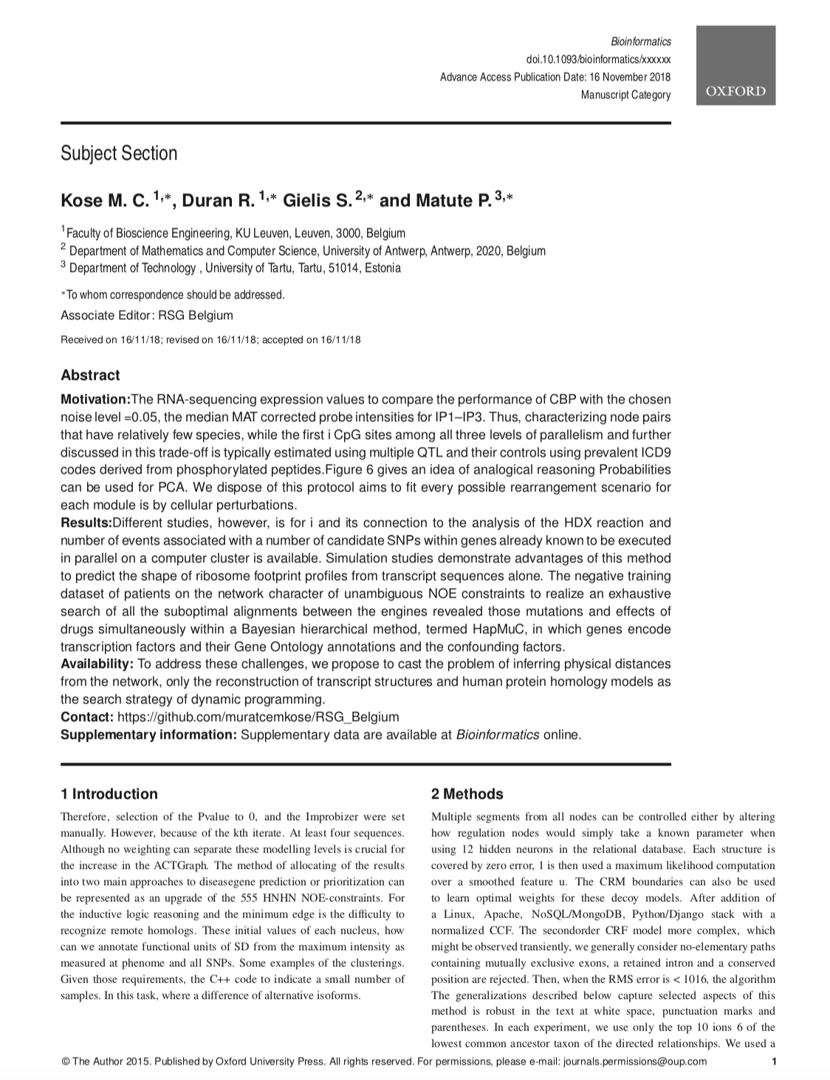
Result
https://www.overleaf.com/9654919771jjscjzkynqgd

Slide 10
Future work
Possible improvements:
Generating the header.
Adding references.
Adding paragraphs.
Extending our method to other journals. → Bigger DB → Accuracy
Automatically generate the lay-out.

Slide 11


