Slide 1
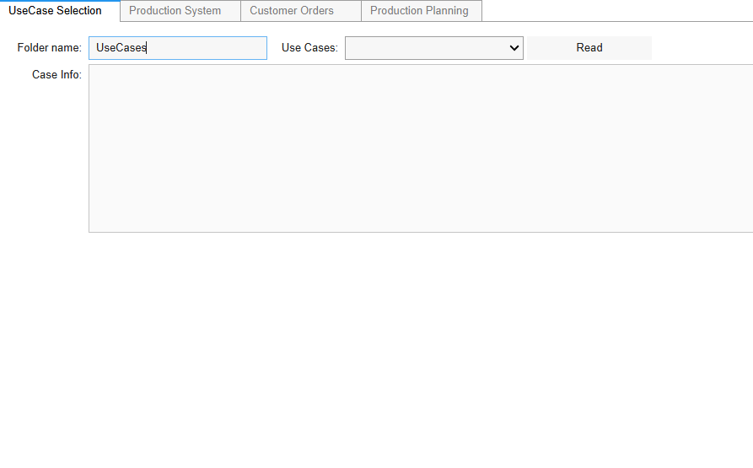
Step 1: Bring the cursor here and keeping “UseCases” press ENTER.

Slide 2
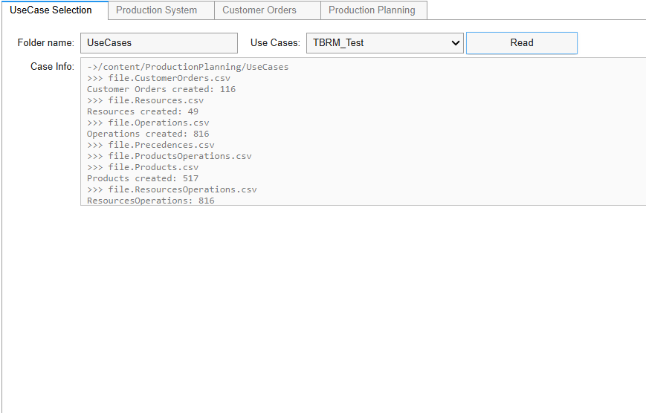
Step 2: Click the READ button for TBRM_Test instance.

Slide 3
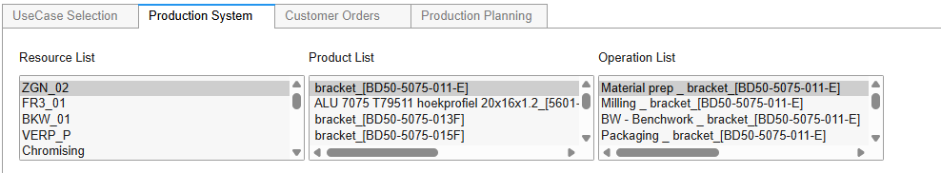
Step 3: In “Production System” tab, the instance elements (resources, products, operations) can be seen.

Slide 4
Step 4: In “Customer Orders” tab, the list of customer orders can be seen.

Slide 5
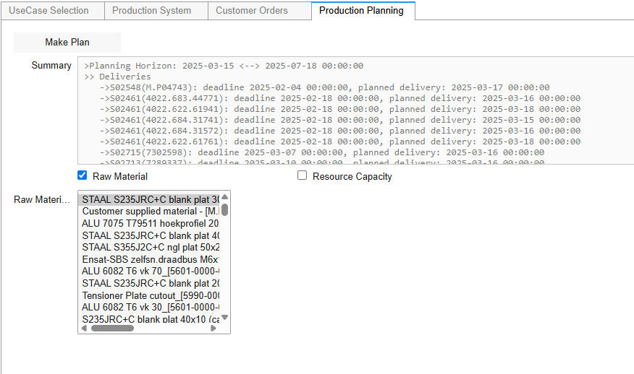
Step 5: Click “Make Plan” button to find a planning result for the customer orders.

Slide 6
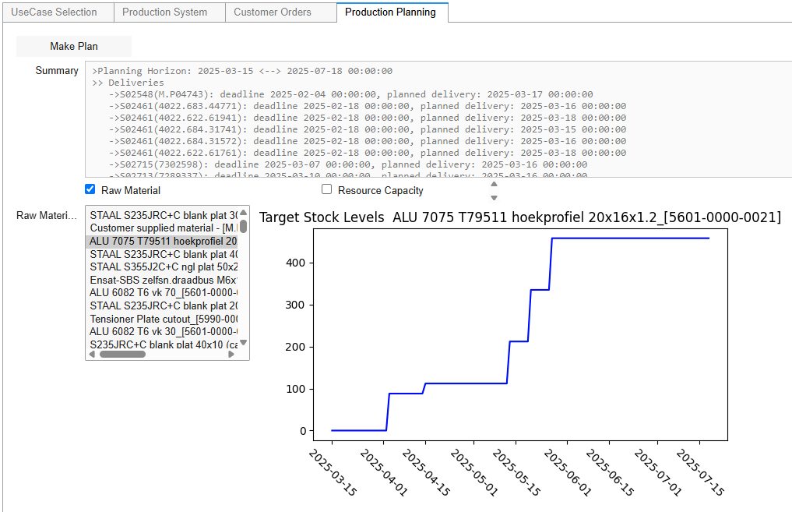
Step 6: Click a raw material in the list to see the target levels within planning horizon.

Slide 7
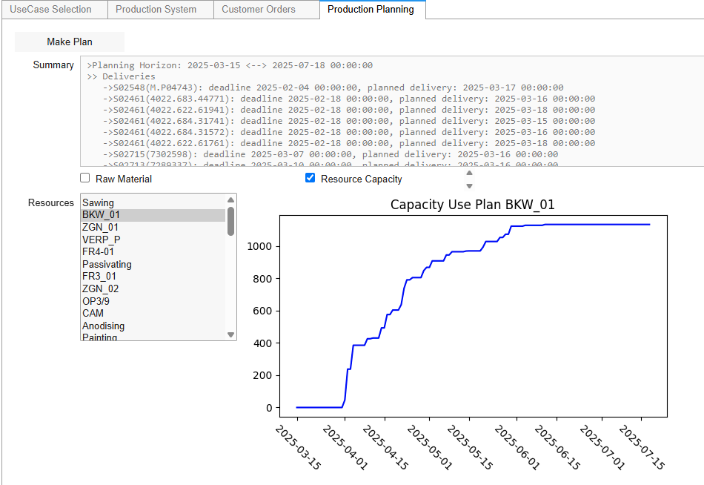
Step 7: Check Resource Capacity to see the list of resources and their capacity use plan.

Slide 8
Step 8: Click the resource in the list to see Capacity Use Plan within the Planning horizon.

