Slide 1
AURELIA BANK • MODEL RISK ANALYTICS
Banking Credit Risk
& Explainable Loan Decisioning
A governed, human-in-the-loop decision-support platform built on a deterministic synthetic portfolio.
48,000
synthetic applications
Portfolio project • v1.0.0 • 2026
Notes:
Open with the safety boundary: this is decision support, not automated credit approval.
[Sources]
- artifacts/metrics/executive_summary.json
- https://www.bis.org/bcbs/publ/d595.pdf
[/Sources]

Slide 2
BANKING CREDIT RISK
02
One platform connects credit judgement, evidence and control
OOT ROC AUC
Gini
Approval recommendation
SHAP additivity error
0.738
0.475
41.7%
2.7e-15
Temporal 2025 holdout
Rank-ordering strength
Policy threshold = 10% PD
Numerical identity check
Executive thesis
The portfolio demonstrates a credible model-risk operating pattern: calibrated PDs, transparent risk segmentation, exact additive explanations, explicit fairness escalation and monthly monitoring — with human authority retained throughout.
SYNTHETIC • DECISION SUPPORT ONLY
2 / 20
Notes:
Lead with the actual OOT evidence, then the governance boundary.
[Sources]
- artifacts/metrics/executive_summary.json
[/Sources]

Slide 3
BANKING CREDIT RISK
03
The design separates analytical recommendation from legal decision
In scope
Mandatory oversight
Explicitly out of scope
12-month PD scoring
A-F risk segmentation
Approve / refer / decline recommendation
Illustrative PD × LGD × EAD
Reason codes and monitoring
Authorized credit officer review
Policy exception workflow
Independent model validation
Fairness investigation
Jurisdiction-specific disclosure review
Automated final approval
Pricing or limit assignment
Production adverse-action notices
Real customer data
Claimed Basel, EBA, AI Act or IFRS 9 compliance
SYNTHETIC • DECISION SUPPORT ONLY
3 / 20
Notes:
[Sources]
- https://eur-lex.europa.eu/eli/reg/2024/1689/oj
- https://www.eba.europa.eu/sites/default/files/document_library/Publications/Guidelines/2020/Guidelines%20on%20loan%20origination%20and%20monitoring/884283/EBA%20GL%202020%2006%20Final%20Report%20on%20GL%20on%20loan%20origination%20and%20monitoring.pdf
- docs/governance/model-card.md
[/Sources]

Slide 4
BANKING CREDIT RISK
04
Temporal evidence is designed to resemble a real model lifecycle
2022–Jun 2024
Jul–Dec 2024
2025
Development
Validation
Out-of-time
29,901
6,034
12,065
applications
applications
applications
Application-time variables only
Protected attributes are retained solely in a restricted fairness-audit slice and never enter training or online scoring.
SYNTHETIC • DECISION SUPPORT ONLY
4 / 20
Notes:
[Sources]
- config/project.yaml
- src/credit_risk/data.py
- artifacts/metrics/executive_summary.json
[/Sources]

Slide 5
BANKING CREDIT RISK
05
Reference architecture makes every decision traceable
1
2
3
4
5
Synthetic applications
Feature boundary
Model & policy
Evidence layer
Human action
Deterministic generation
Schema & DQ gates
Application-time only
Protected fields excluded
Calibrated PD
Score • band • recommendation
Linear SHAP
Fairness • monitoring • lineage
Review queue
Override & audit record
CONTROL BOUNDARY
The platform can recommend; only an authorized person or approved downstream policy process can decide.
SYNTHETIC • DECISION SUPPORT ONLY
5 / 20
Notes:
[Sources]
- docs/architecture/system-architecture.md
- https://www.nist.gov/itl/ai-risk-management-framework
[/Sources]

Slide 6
BANKING CREDIT RISK
06
Feature governance starts before model fitting
17 numeric + 6 categorical application-time predictors with deterministic provenance.
Feature boundary
No outcome leakage: post-origination delinquency and collection events are excluded.
MODEL-ELIGIBLE
Income • DTI • bureau score • utilization • history • tenure • purpose • channel
Gender and age band never enter preprocessing, training, scoring or reason-code generation.
One-hot / standardized logistic preprocessing is persisted inside the champion pipeline.
AUDIT-ONLY
Data-quality gates cover schema, uniqueness, binary target, completeness and safety flags.
Gender • age band
SYNTHETIC • DECISION SUPPORT ONLY
6 / 20
Notes:
[Sources]
- src/credit_risk/data.py
- src/credit_risk/modeling.py
- artifacts/metrics/data_quality_checks.csv
[/Sources]

Slide 7
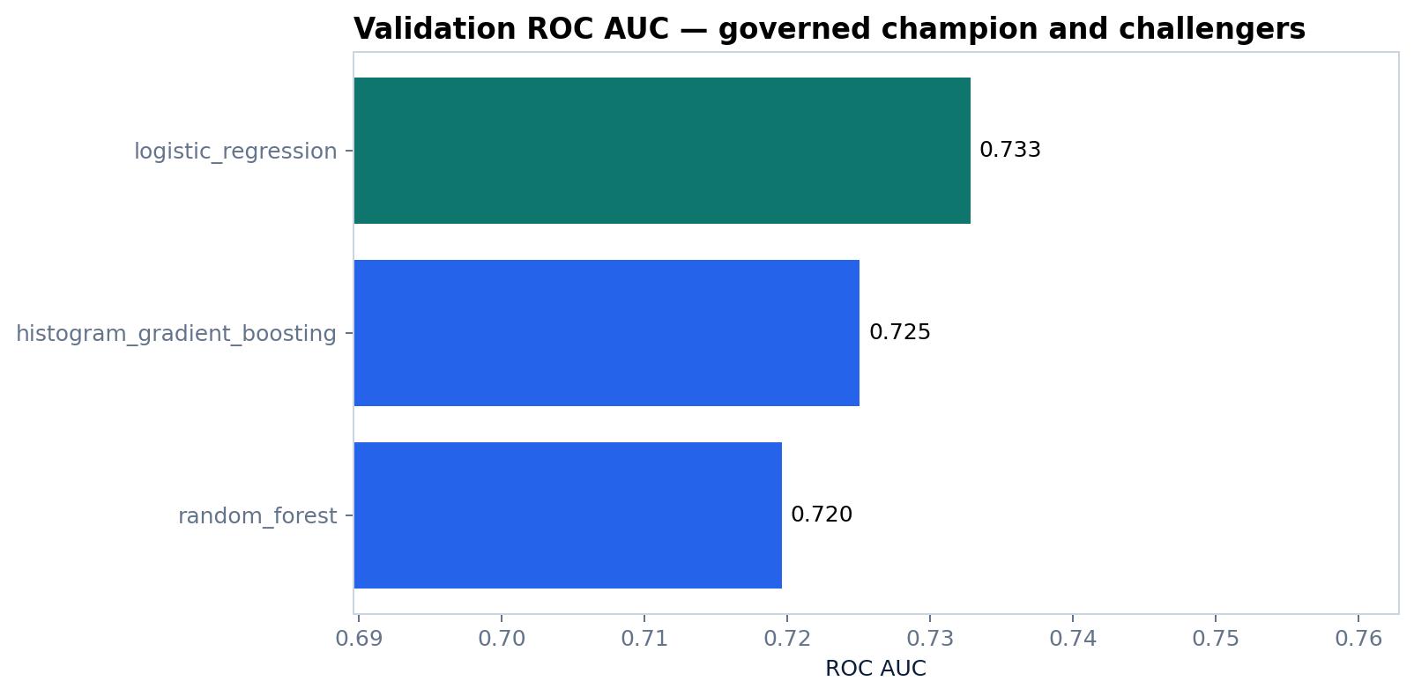
BANKING CREDIT RISK
07
The interpretable champion also leads the validation set
Champion
Logistic regression
Validation AUC 0.733
Why it wins
Best AUC and Brier in validation; probability outputs remain directly auditable.
Challenge discipline
Histogram gradient boosting and random forest remain evidence, not discarded experiments.
SYNTHETIC • DECISION SUPPORT ONLY
7 / 20
Notes:
[Sources]
- artifacts/metrics/model_comparison.csv
- artifacts/plots/model_comparison.png
- src/credit_risk/modeling.py
[/Sources]

Slide 8
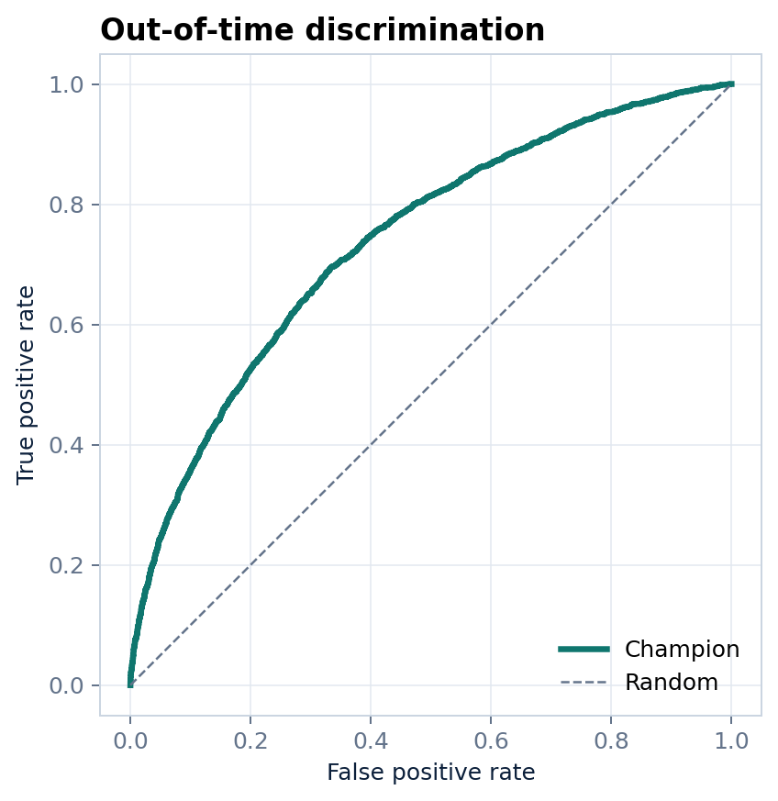
BANKING CREDIT RISK
08
Out-of-time evidence confirms stable rank ordering
ROC AUC
KS
0.738
0.361
Gate ≥ 0.700
Maximum separation
PR AUC
Brier
0.421
0.134
Default-focused precision
Probability accuracy
Performance is sufficient for this synthetic case, not proof of external validity.
SYNTHETIC • DECISION SUPPORT ONLY
8 / 20
Notes:
[Sources]
- artifacts/metrics/sample_metrics.json
- artifacts/plots/oot_roc_curve.png
- https://scikit-learn.org/stable/modules/model_evaluation.html
[/Sources]

Slide 9
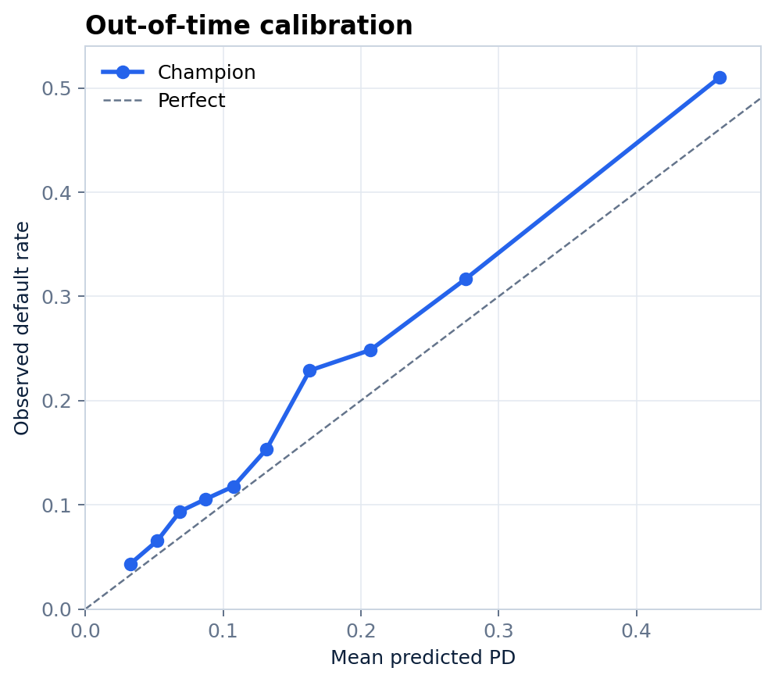
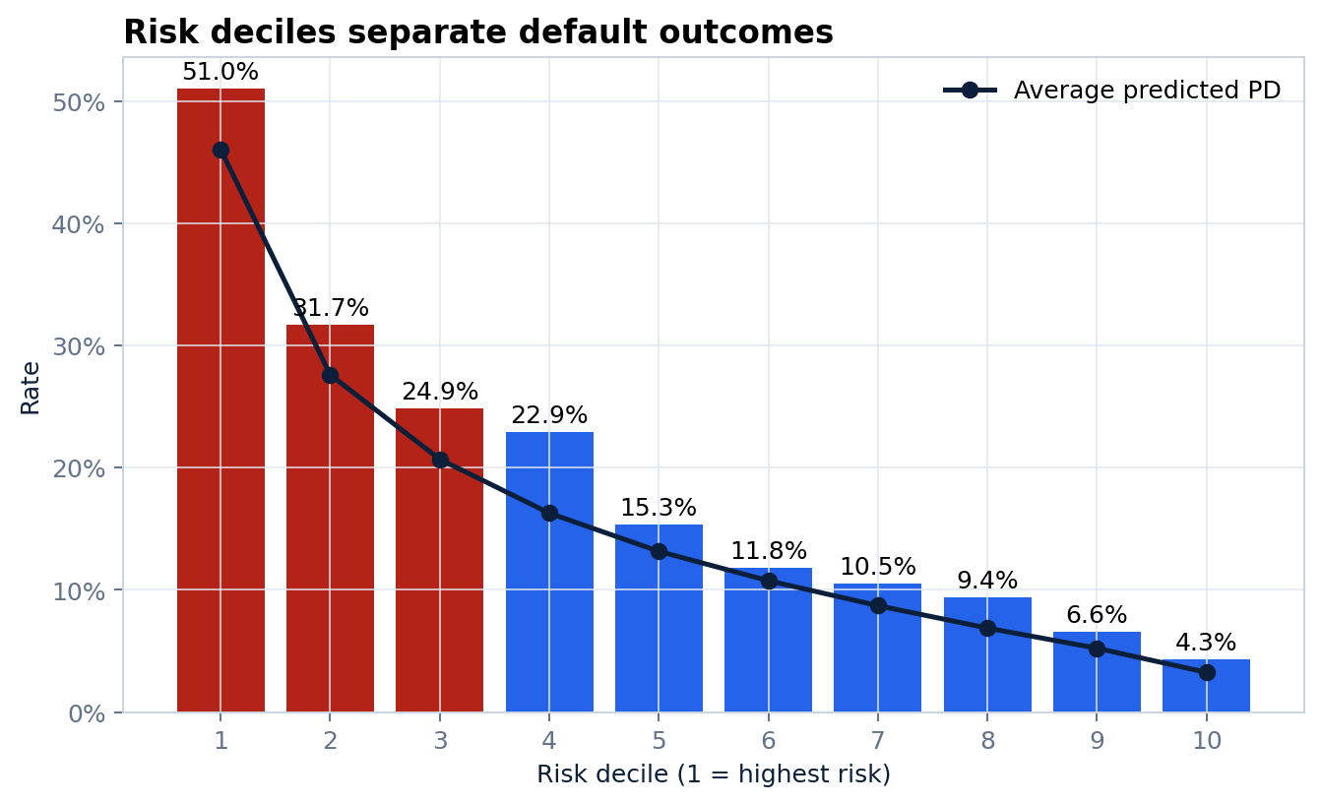
BANKING CREDIT RISK
09
Calibration and deciles answer different governance questions
Calibration slope 0.981
Rank ordering: do risk tiers separate outcomes?
Reliability: do PD levels match outcomes?
SYNTHETIC • DECISION SUPPORT ONLY
9 / 20
Notes:
[Sources]
- artifacts/plots/oot_calibration.png
- artifacts/plots/risk_deciles.png
- https://scikit-learn.org/stable/modules/calibration.html
[/Sources]

Slide 10
BANKING CREDIT RISK
10
Policy translates PD into a transparent review path
PD < 10%
10% ≤ PD < 22%
PD ≥ 22%
APPROVE
RECOMMENDATION
Human confirmation may still apply
REFER
Mandatory credit officer review
DECLINE
RECOMMENDATION
Mandatory review + disclosure workflow
Credit score mapping
650 points at 10% PD • 50 points to double the odds • clipped to 300–850
Risk bands and scores communicate model output; they do not replace policy ownership.
SYNTHETIC • DECISION SUPPORT ONLY
10 / 20
Notes:
[Sources]
- config/project.yaml
- src/credit_risk/policy.py
- reports/workbook/credit_risk_decision_workbench.xlsx
[/Sources]

Slide 11
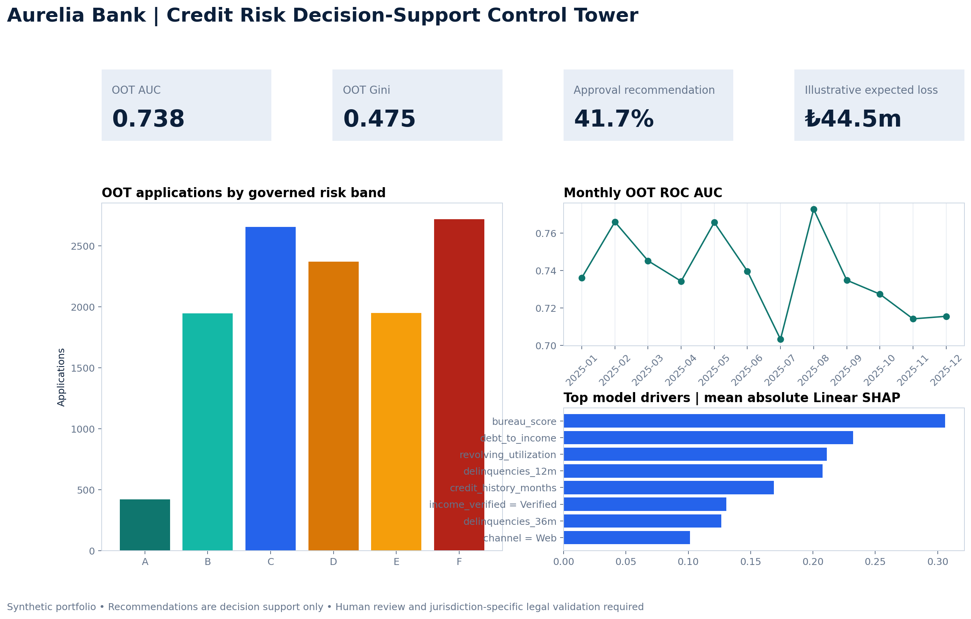
BANKING CREDIT RISK
11
Risk bands make portfolio composition visible
Largest band
F • 2,718 applications
OOT default rate
18.8%
Observed 12-month outcome
Boundary
A-F bands are communication layers over continuous PD.
SYNTHETIC • DECISION SUPPORT ONLY
11 / 20
Notes:
[Sources]
- artifacts/metrics/risk_band_summary.csv
- artifacts/plots/executive_dashboard.png
[/Sources]

Slide 12
BANKING CREDIT RISK
12
Threshold scenarios expose the volume–risk trade-off
Illustrative expected loss
₺44.5m
PD × 45% LGD × requested amount
Interpret carefully
The EL bridge is a transparent scenario aid. It is not an IFRS 9 impairment engine: no staging, lifetime PD, discounting, recoveries or forward-looking macro scenarios are claimed.
SYNTHETIC • DECISION SUPPORT ONLY
12 / 20
Notes:
[Sources]
- artifacts/metrics/policy_scenarios.csv
- https://www.ifrs.org/issued-standards/list-of-standards/ifrs-9-financial-instruments/
- reports/workbook/credit_risk_decision_workbench.xlsx
[/Sources]

Slide 13
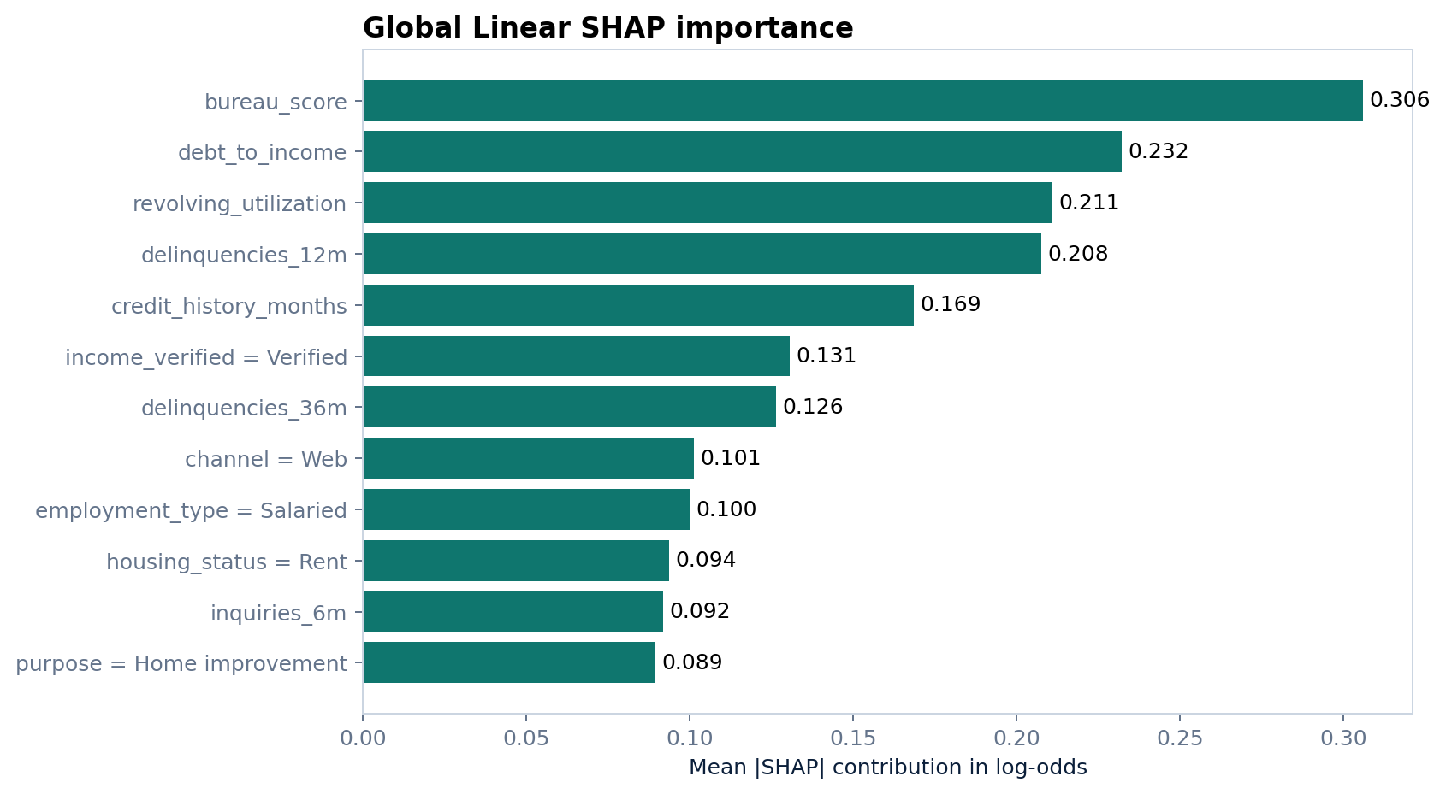
BANKING CREDIT RISK
13
Exact additive Linear SHAP makes the champion auditable
Global view
Mean absolute contribution ranks the drivers of model output.
Local view
Top risk-increasing contributions become reviewer reason codes.
Mathematical check
Maximum additivity error
2.66e-15 log-odds
SYNTHETIC • DECISION SUPPORT ONLY
13 / 20
Notes:
[Sources]
- artifacts/explanations/global_linear_shap_importance.csv
- artifacts/plots/global_linear_shap.png
- https://shap.readthedocs.io/en/latest/
- src/credit_risk/explainability.py
[/Sources]

Slide 14
BANKING CREDIT RISK
14
A reason code is evidence for review — not the final notice
Required interpretation contract
Example reviewer output
PD 14.7% • Score 604 • Band D
Recommendation: REFER
1 RISK_UP_DEBT_TO_INCOME
2 RISK_UP_REVOLVING_UTILIZATION
3 RISK_UP_BUREAU_SCORE
4 RISK_UP_DELINQUENCIES_36M
Contribution is expressed in model log-odds, not causality.
Only top risk-increasing drivers are shown to the reviewer.
Protected attributes never appear in model reason codes.
Operational notices require policy, legal and data-quality checks.
Override and final rationale belong in a separate audit record.
SYNTHETIC • DECISION SUPPORT ONLY
14 / 20
Notes:
[Sources]
- docs/governance/explainability-standard.md
- src/credit_risk/service.py
- artifacts/explanations/oot_local_reason_codes.csv.gz
[/Sources]

Slide 15
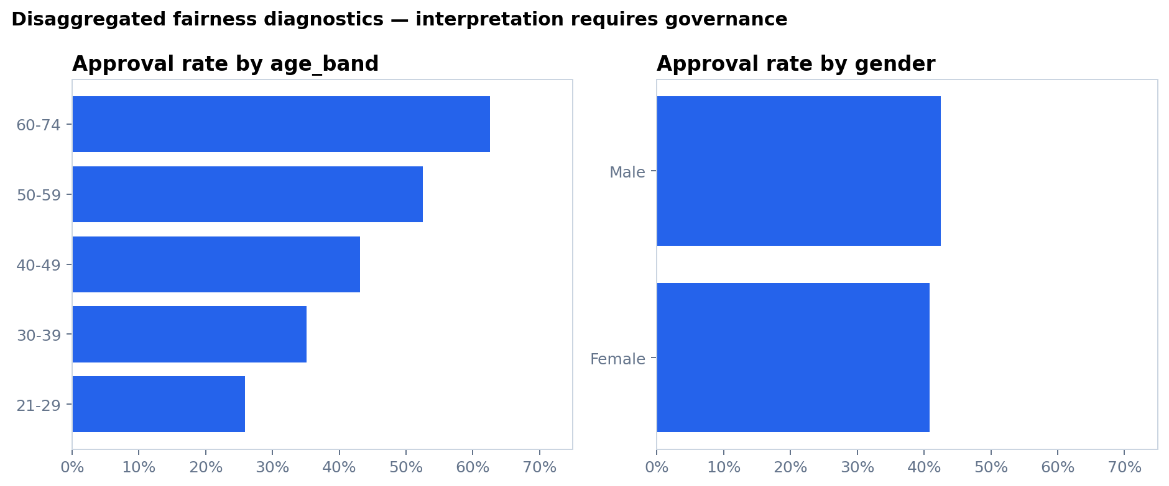
BANKING CREDIT RISK
15
The fairness review surfaces a real governance blocker
Gender DP gap
Age-band DP gap
1.6 pp
36.7 pp
Diagnostic
Escalate
Governance disposition
GOVERNANCE REVIEW REQUIRED
Investigate legitimate feature pathways, sample composition, policy thresholds, proxy effects and jurisdiction-specific obligations before any external use.
SYNTHETIC • FAIRNESS METRICS ARE DIAGNOSTIC
15 / 20
Notes:
[Sources]
- artifacts/metrics/fairness_summary.csv
- artifacts/plots/fairness_diagnostics.png
- https://fairlearn.org/main/user_guide/assessment/index.html
- docs/governance/fairness-assessment.md
[/Sources]

Slide 16
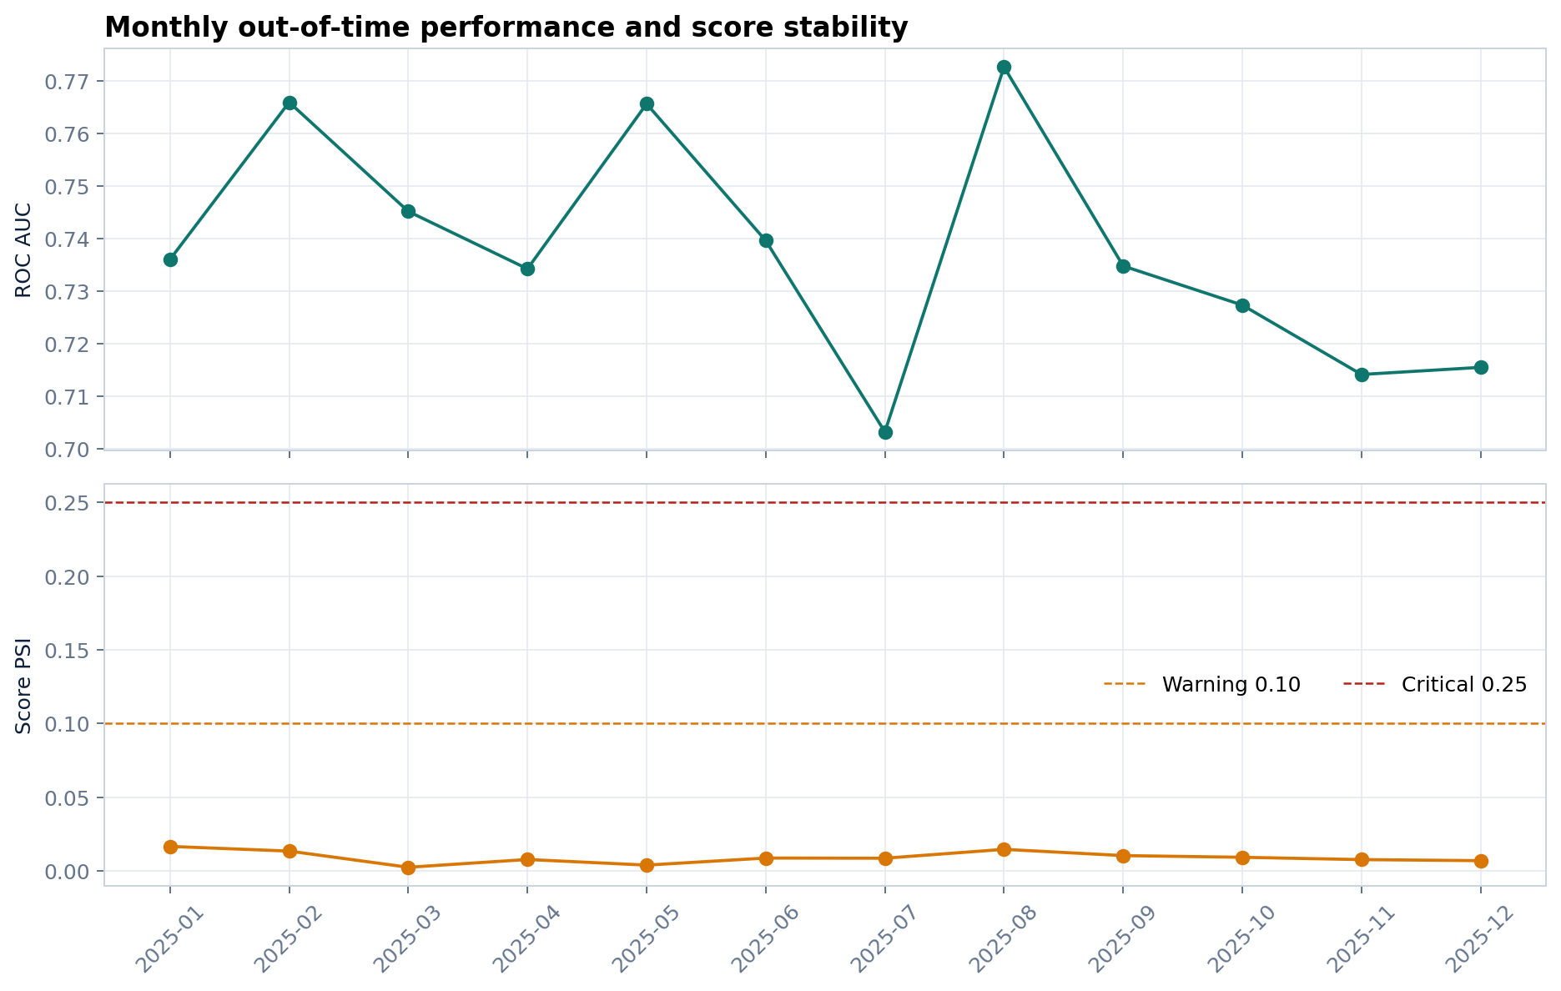
BANKING CREDIT RISK
16
Monitoring combines performance, drift and allocation signals
Performance
ROC AUC • Brier • observed default rate
Stability
Score PSI • bureau-score PSI • DTI PSI
Action
Green = observe
Amber = investigate
Red = restrict / rollback review
SYNTHETIC • DECISION SUPPORT ONLY
16 / 20
Notes:
[Sources]
- artifacts/monitoring/monthly_monitoring.csv
- artifacts/plots/model_monitoring.png
- https://docs.evidentlyai.com/metrics/preset_data_drift
- docs/operations/monitoring-runbook.md
[/Sources]

Slide 17
BANKING CREDIT RISK
17
Human oversight is designed as an operating process
1 Receive
2 Recommend
3 Review
Application and validation evidence
PD, score, band and reason codes
Credit officer evaluates context
4 Decide
5 Record
6 Learn
Authorized action outside model
Rationale, override and notice
Outcome, incident and monitoring feedback
SYNTHETIC • DECISION SUPPORT ONLY
17 / 20
Notes:
[Sources]
- docs/governance/human-oversight.md
- docs/governance/decision-policy.md
- https://www.nist.gov/itl/ai-risk-management-framework
[/Sources]

Slide 18
BANKING CREDIT RISK
18
Operational controls make the demo deployable without overstating readiness
API boundary
Runtime hardening
Observability
Pydantic validation
API-key option
No protected fields
Recommendation-only response
Non-root container
Read-only filesystem
Dropped Linux capabilities
Health and readiness probes
Prometheus metrics
Grafana dashboard
Availability / latency / error alerts
Data controls
CI security
Model controls
Separate governance schema
No credentials committed
Synthetic datasets only
Ruff • tests • coverage
CodeQL • pip-audit • Trivy
Dependabot
Versioned artifacts
Reproducible data hash
SHAP identity gate
Monitoring runbook
SYNTHETIC • DECISION SUPPORT ONLY
18 / 20
Notes:
[Sources]
- Dockerfile
- docker-compose.yml
- infra/kubernetes/deployment.yaml
- .github/workflows/ci.yml
- .github/workflows/security.yml
- https://prometheus.io/docs/practices/instrumentation/
[/Sources]

Slide 19
BANKING CREDIT RISK
19
A disciplined roadmap leads from portfolio demo to controlled pilot
Now
Gate 1
Gate 2
Gate 3
Only then
Portfolio evidence
Independent review
Legal & policy
Shadow pilot
Controlled use
Synthetic data
Temporal validation
Governance pack
Reproduce metrics
Challenge assumptions
Fairness investigation
Jurisdiction mapping
Disclosure design
Override authority
No-action scoring
Drift baselines
Incident testing
Approval committee
Restricted scope
Ongoing validation
CURRENT DISPOSITION
Portfolio-complete; not approved for real lending use because fairness and external-validity work remain open.
SYNTHETIC • DECISION SUPPORT ONLY
19 / 20
Notes:
[Sources]
- docs/governance/model-validation-report.md
- docs/governance/fairness-assessment.md
- docs/operations/production-readiness-checklist.md
[/Sources]

Slide 20
TÜRKÇE YÖNETİCİ ÖZETİ
Şeffaf model.
Kontrollü politika.
İnsan kararı.
Güçlü taraf
Tekrarlanabilir analitik, kalibrasyon, açıklanabilirlik ve operasyonel kontroller.
Açık bulgu
48.000 sentetik başvuru üzerinde OOT AUC 0.738 ve Gini 0.475 elde edildi. PD, risk bandı, SHAP neden kodları ve aylık izleme tek bir yönetişim zincirinde birleştirildi.
Yaş gruplarında belirgin tahsis farkı: gerçek kullanım öncesi yönetişim incelemesi zorunlu.
github.com/muratmiracg-dev
Thank you • Teşekkürler
Notes:
Close on credibility: the project is strong because it reports the blocker instead of hiding it.
[Sources]
- artifacts/metrics/executive_summary.json
- artifacts/metrics/fairness_summary.csv
[/Sources]

