Slide 1
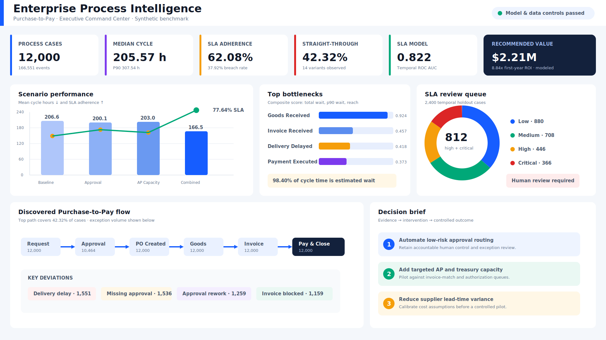
Enterprise Process Mining
& Intelligent Workflow Optimization
Purchase-to-Pay Executive Deck
Yönetici Sunumu · EN / TR
Murat Miraç Gedik
Business & Data Analyst Portfolio · July / Temmuz 2026
01
Notes:
Open with the management problem: process delay is measurable and actionable.
[Sources]
- Repository artifact: docs/images/dashboard-preview.png
- Repository evidence: reports/demo-analysis.json
[/Sources]

Slide 2
The process loses performance in waiting, not touch work
Yönetici özeti · Bekleme, çevrim süresini ve SLA'i belirliyor
12,000 deterministic cases show a control-heavy Purchase-to-Pay process with low straight-through execution and material SLA exposure.
SLA ADHERENCE
REWORK CASES
ESTIMATED WAIT SHARE
62.08%
21.98%
98.40%
4,550 breached cases
2,638 cases with repetition
cycle time minus touch time
Decision: pilot the combined scenario — 19.42% modeled cycle reduction, +13.63 pp SLA uplift, $2.21M annual value.
Synthetic benchmark · Sentetik çalışma
02
Notes:
[Sources]
- Repository evidence: reports/demo-analysis.json
- Repository method: docs/methodology.md
[/Sources]

Slide 3
Yönetim kararı: kontrollü birleşik pilot
Executive summary · Kanıttan müdahaleye
Sorun yalnızca süreç varyantı değil; bekleme, onay sapması ve fatura istisnasının birlikte oluşturduğu operasyonel kayıptır.
ÇEVRIM AZALMASI
SLA ARTIŞI
%19,42
+13,63 puan
40,12 saat
%77,64 model
Öneri; düşük riskli onay yönlendirmesi, hedefli AP/Hazine kapasitesi ve tedarikçi teslim süresi müdahalesini tek pilotta birleştirir.
YILLIK DEĞER
İLK YIL ROI
2,21M $
8,84x
sentetik
225 bin $ yatırım
Kontrol sınırı: risk skoru yalnızca insan incelemesini önceliklendirir; onay, ret veya ödeme işlemi yapmaz.
Synthetic benchmark · Sentetik çalışma
03
Notes:
[Sources]
- Repository evidence: reports/demo-analysis.json
- Repository governance: docs/security-threat-model.md
[/Sources]

Slide 4
The reference process spans six control zones
Referans süreç · 13 BPMN aktivitesi, 6 yönetim alanı
01
02
03
04
05
06
Request
Talep
Approval
Onay
Purchase order
Sipariş
Goods receipt
Mal kabul
Invoice
Fatura
Pay & close
Öde / kapat
Approval exception
Delivery exception
Invoice exception
Missing approval: 1,536 cases
Repeated approval: 1,259 cases
Delivery delayed: 1,551 cases
P90 wait: 160.82 hours
Blocked invoice: 1,159 cases
Duplicate-check repetition: 744
Synthetic benchmark · Sentetik çalışma
04
Notes:
[Sources]
- Repository process contract: src/process_optimizer/config.py
- Repository BPMN: bpmn/purchase-to-pay-reference.bpmn
- BPMN 2.0.2 specification: https://www.omg.org/spec/BPMN/2.0.2/About-BPMN
[/Sources]

Slide 5
The benchmark is reproducible and reconciled
Veri temeli · Sabit seed, sıfır zorunlu alan boşluğu
The committed event log is a versioned analytical benchmark, not a presentation-only sample.
Acceptance gate | Result | Why it matters
Event volume | 166,551 | Exceeds the 100k-event portfolio target
Case population | 12,000 | Reconciles to the event identifiers
Duplicate event keys | 0 | Unique case_id + event_index
Required-field nulls | 0 | Case, activity and timestamp complete
Timestamp ordering | Passed | Monotonic within each case
Regeneration | Byte-for-byte | Fixed seed and gzip timestamp
Tekrarlanabilirlik: CI, yeniden üretilen sıkıştırılmış olay ve vaka dosyalarını birebir karşılaştırır.
Synthetic benchmark · Sentetik çalışma
05
Notes:
[Sources]
- Repository evidence: reports/demo-analysis.json
- Repository data contract: docs/data-contracts.md
- Repository CI: .github/workflows/ci.yml
[/Sources]

Slide 6
The reference path is common, but not dominant
Süreç keşfi · 14 varyant, referans yol payı %42,32
42.32% straight-through
5,078 cases follow the exact 13-step reference path.
62.59% in the top three
The reference path, missing approval and approval rework account for most observed volume.
Management implication
Standardization must target control exceptions, not only the happy path.
Synthetic benchmark · Sentetik çalışma
06
Notes:
[Sources]
- Repository evidence: reports/tables/variants.csv
- PM4Py features: https://processintelligence.solutions/pm4py/features
[/Sources]

Slide 7
Three exception families fragment the operating model
Varyant karşılaştırması · Onay, teslimat ve fatura
Approval
Delivery
Invoice
1,536 missing approvals
1,259 repeated approvals
1,259 request-rework cases
Risk: control inconsistency and avoidable loop time.
1,551 delayed-delivery cases
100.46 h average exception wait
160.82 h p90 exception wait
Risk: supplier variability dominates elapsed time.
1,159 blocked invoices
822 three-way-match failures
744 duplicate-check repetitions
Risk: exception queues consume AP capacity.
Öncelik sırası: kontrol standardizasyonu → tedarikçi süre varyansı → AP istisna kapasitesi.
Synthetic benchmark · Sentetik çalışma
07
Notes:
[Sources]
- Repository evidence: reports/tables/deviations.csv
- Repository evidence: reports/tables/bottlenecks.csv
[/Sources]

Slide 8
High average fitness masks low exact conformance
Conformance checking · Ortalama yakınlık yüksek, tam uyum düşük
MEAN FITNESS
EXACT CONFORMANCE
NONCONFORMANT CASES
91.62%
42.32%
6,922
normalized edit distance
5,078 cases
57.68% of the population
Deviation | Cases | Interpretation
Delivery Delayed | 1,551 | Unexpected path activity
Manager Approval missing | 1,536 | Control bypass / fast track
Manager Approval repeated | 1,259 | Approval rework loop
Invoice Blocked | 1,159 | Invoice exception queue
Fitness tek başına yeterli değildir: tam uyum, sapma türü ve vaka etkisi birlikte yönetilmelidir.
Synthetic benchmark · Sentetik çalışma
08
Notes:
[Sources]
- Repository evidence: reports/tables/case_conformance.csv
- Repository method: docs/methodology.md
- PM4Py API: https://processintelligence.solutions/pm4py/api/index.html
[/Sources]

Slide 9
Goods receipt dominates wait exposure
Darboğaz analizi · Toplam bekleme, p90 ve vaka kapsaması
GOODS RECEIPT WAIT
865,100 h
all 12,000 cases
DELIVERY P90 WAIT
160.82 h
1,551 exception cases
Operational focus: supplier-to-receipt lead time first; invoice and payment queues second.
Synthetic benchmark · Sentetik çalışma
09
Notes:
[Sources]
- Repository evidence: reports/tables/bottlenecks.csv
[/Sources]

Slide 10
Cycle time is 98.40% estimated waiting
Bekleme ve yeniden işleme · Dokunma süresi sorunun küçük bölümüdür
The improvement case is a queue-and-handoff problem. Adding automation without redesigning ownership and exception flow will not remove the dominant delay.
WAIT SHARE
REWORK CASE RATE
AUTOMATION EVENT RATE
98.40%
21.98%
36.47%
cycle minus processing time
2,638 affected cases
5 governed automated activities
Türkçe özet: otomasyon, sahiplik ve istisna akışı yeniden tasarlanmadan tek başına çevrim süresini çözmez.
Synthetic benchmark · Sentetik çalışma
10
Notes:
[Sources]
- Repository evidence: reports/demo-analysis.json
- Repository evidence: reports/tables/rework.csv
[/Sources]

Slide 11
SLA risk is scored at Purchase Order creation
Tahmin tasarımı · Gelecek bilgisi kullanılmadan zamansal holdout
Event cut
80% earliest
20% latest
Human review
Feature time
Training
Holdout
Decision
Use only data known by PO creation.
Veri sızıntısını sınırla.
9,600 chronologically earlier cases.
2,400 future-like cases kept untouched.
Four risk bands prioritize analysts only.
Governance: the score cannot approve, reject, authorize or execute a transaction.
Synthetic benchmark · Sentetik çalışma
11
Notes:
[Sources]
- Repository model card: docs/sla-model-card.md
- scikit-learn LogisticRegression: https://scikit-learn.org/stable/modules/generated/sklearn.linear_model.LogisticRegression.html
[/Sources]

Slide 12
The temporal holdout supports review prioritization
Model performansı · Ayırt etme güçlü, üretim kalibrasyonu gerekli
ROC AUC
AVERAGE PRECISION
0.822
0.755
temporal discrimination
positive-class ranking
812 high + critical cases
RECALL
BRIER SCORE
69.30%
0.169
614 / 886 breaches
lower is better
Production gate: probability calibration, subgroup error analysis, drift monitoring and a cost-based threshold.
Synthetic benchmark · Sentetik çalışma
12
Notes:
[Sources]
- Repository evidence: reports/demo-analysis.json
- Repository model card: docs/sla-model-card.md
[/Sources]

Slide 13
Urgent priority and tier-C vendors lead modeled risk
Açıklanabilirlik · Katsayılar ilişkiyi gösterir, nedenselliği değil
● Higher modeled risk
● Lower modeled risk
Urgent ↑
+2.38
Interpretation
Strategic ↓
−1.98
Signed coefficients describe the fitted feature space. They do not prove a causal effect.
Vendor C ↑
+1.35
Vendor A ↓
−1.08
Fairness risk
PO lead time ↑
+0.52
Country and organizational fields may proxy for process differences; subgroup testing is required.
Standard ↓
−0.38
Early rework ↓
−0.28
Safe use
Vendor B ↓
−0.25
Prioritize analyst review and retain normal approval, matching and payment controls.
Synthetic benchmark · Sentetik çalışma
13
Notes:
[Sources]
- Repository evidence: reports/tables/sla_model_drivers.csv
- Repository model card: docs/sla-model-card.md
[/Sources]

Slide 14
The what-if model compares paired capacity scenarios
Simülasyon yöntemi · Ortak seed, 24 tekrar × 900 vaka
Observed baseline
Paired simulation
Decision metrics
Pilot gate
6 constrained stages
195 h external lead time
16% invoice rework
24 replications
900 cases each
shared random seeds
Cycle · SLA · throughput
manual hours · value
first-year ROI
Replace cost inputs
run sensitivity
measure causal effect
Simülasyon kararı destekler; nedensel etki veya garanti edilmiş tasarruf kanıtı değildir.
Synthetic benchmark · Sentetik çalışma
14
Notes:
[Sources]
- Repository methodology: docs/simulation-methodology.md
- Repository implementation: src/process_optimizer/simulation.py
[/Sources]

Slide 15
Combined optimization creates the strongest service lift
Senaryo sonuçları · Çevrim azalırken SLA yükseliyor
COMBINED MEAN CYCLE
166.48 h
−40.12 h vs baseline
COMBINED SLA
77.64%
+13.63 percentage points
AP capacity alone is the weakest investment case: 1.73% cycle reduction and 0.24x first-year ROI.
Synthetic benchmark · Sentetik çalışma
15
Notes:
[Sources]
- Repository evidence: reports/tables/simulation_scenarios.csv
[/Sources]

Slide 16
The $2.21M value case is fully assumption-driven
Değer ve ROI · Finans girdileri değiştirilebilir ve mutabık
ANNUAL VALUE
INVESTMENT
FIRST-YEAR ROI
$2.21M
$225k
8.84x
synthetic model
one-time
(value − investment) / investment
Value component | Formula | Modeled value
Delay-hour reduction | 40.12 h × $5.50 × 8,000 | $1,765,296
Manual-hour reduction | 1.39 h × $32 × 8,000 | $355,028
Avoided breach value | 13.63% × $85 × 8,000 | $92,713
Total | Reconciles to pipeline | $2,213,037
Karar kuralı: tüm katsayılar üretim öncesinde Finans tarafından sahiplenilmeli ve duyarlılık analizi yapılmalıdır.
Synthetic benchmark · Sentetik çalışma
16
Notes:
[Sources]
- Repository evidence: reports/tables/simulation_scenarios.csv
- Repository assumption model: docs/simulation-methodology.md
- Repository workbook: output/Process_Mining_Decision_Workbook.xlsx
[/Sources]

Slide 17
Fund one controlled pilot with three linked interventions
Öneri · Tek pilot, üç eşgüdümlü müdahale
1 · Approval routing
2 · AP / Treasury capacity
3 · Supplier intervention
Automate assignment and low-risk routing.
Retain accountable approval and an auditable exception path.
Owner: Procurement + Internal Control
Add targeted invoice-match and payment-authorization capacity.
Measure queue depth, SLA and workload.
Owner: AP + Treasury
Prioritize high-variance vendors.
Measure confirmation-to-receipt lead time and exception rate.
Owner: Procurement Operations
Scale only if the pilot improves SLA and cycle time without control regression or unfair subgroup impact.
Synthetic benchmark · Sentetik çalışma
17
Notes:
[Sources]
- Repository decision evidence: reports/demo-analysis.json
- Repository governance: docs/security-threat-model.md
[/Sources]

Slide 18
Analytical by design; read-only at the boundary
Mimari ve yönetişim · Kanıt → analitik → karar sunumu
Evidence layer
Analytical engines
Decision delivery
166,551 events
12,000 cases
BPMN target
Data contracts
Discovery + variants
Conformance
SLA risk
Capacity simulation
FastAPI + PostgreSQL
Power BI + Excel
Report + presentation
Prometheus + Grafana
Human-in-the-loop boundary · Analitik katman satın alma talebini onaylamaz, faturayı reddetmez veya ödeme gerçekleştirmez.
Synthetic benchmark · Sentetik çalışma
18
Notes:
[Sources]
- Repository architecture: docs/architecture.md
- Repository security: docs/security-threat-model.md
- FastAPI documentation: https://fastapi.tiangolo.com/
- PostgreSQL 17 documentation: https://www.postgresql.org/docs/17/
- Power BI Projects: https://learn.microsoft.com/en-us/power-bi/developer/projects/projects-overview
[/Sources]

Slide 19
A 90-day pilot turns the model into measured evidence
Yol haritası · Kalibre et, pilotla, karar ver
0–30 DAYS
31–60 DAYS
61–90 DAYS
Calibrate
Pilot
Decide
KPI owners
Finance assumptions
Source timestamps
Pilot baseline
Approval routing
AP / Treasury capacity
Supplier focus
Control tracking
Compare cohorts
Recalculate value
Review fairness
Scale / revise / stop
Scale gate: observed effect + calibrated value + no control regression + approved rollback.
Synthetic benchmark · Sentetik çalışma
19
Notes:
[Sources]
- Repository roadmap: ROADMAP.md
- Repository deployment guidance: docs/deployment.md
[/Sources]

Slide 20
20
Discover the process.
Quantify the risk.
Test the decision.
Süreci keşfet · Riski ölç · Kararı test et
Murat Miraç Gedik
github.com/muratmiracg-dev/Enterprise-Process-Mining-Intelligent-Workflow-Optimization
Notes:
[Sources]
- Repository: https://github.com/muratmiracg-dev/Enterprise-Process-Mining-Intelligent-Workflow-Optimization
- Repository validation: docs/validation.md
[/Sources]

