Slide 1
HUAWEI CLOUD • FINOPS
Intelligent capacity.
Defensible cloud economics.
Explainable cost allocation, forecasting and optimization
Murat Miraç Gedik • Executive portfolio deck
Notes:
Open with the decision: optimize spend while preserving capacity headroom.
[Sources]
- docs/architecture.md
- reports/demo-analysis.json

Slide 2
The demo portfolio exposes $18.2K in annualized savings
EXECUTIVE THESIS
A governed decision loop can reduce modeled run-rate without automating destructive changes.
$1.52K
24.79%
96.4
monthly savings
opportunity
maturity score
2
Notes:
Frame all numbers as deterministic demo outputs, not realized production savings.
[Sources]
- reports/demo-analysis.json

Slide 3
Cloud cost becomes actionable only when ownership meets telemetry
WHY THIS PLATFORM EXISTS
Billing explains spend. Utilization explains load.
The operating decision needs both - plus ownership, budgets and risk.
Fragmented signals
Decision system
Bills arrive after consumption
Capacity and cost live in separate views
Savings claims overlap
Canonical cost contract
P95 utilization + headroom
Conservative non-overlap model
3
Notes:
Contrast raw dashboards with a traceable recommendation record.
[Sources]
- docs/optimization-methodology.md
- docs/data-contracts.md

Slide 4
The operating loop turns evidence into governed action
OBSERVE
DECIDE
GOVERN
Normalize signals
Cost exports, inventory, utilization, tags and budgets share one contract.
Explain the trade-off
Forecast, anomaly and rightsizing logic expose evidence and confidence.
Control execution
Policy gates, owners, rollback and post-change validation remain explicit.
4
Notes:
Emphasize that the platform is read-only by design; humans own execution.
[Sources]
- docs/finops-operating-model.md
- docs/runbooks/recommendation-review.md

Slide 5
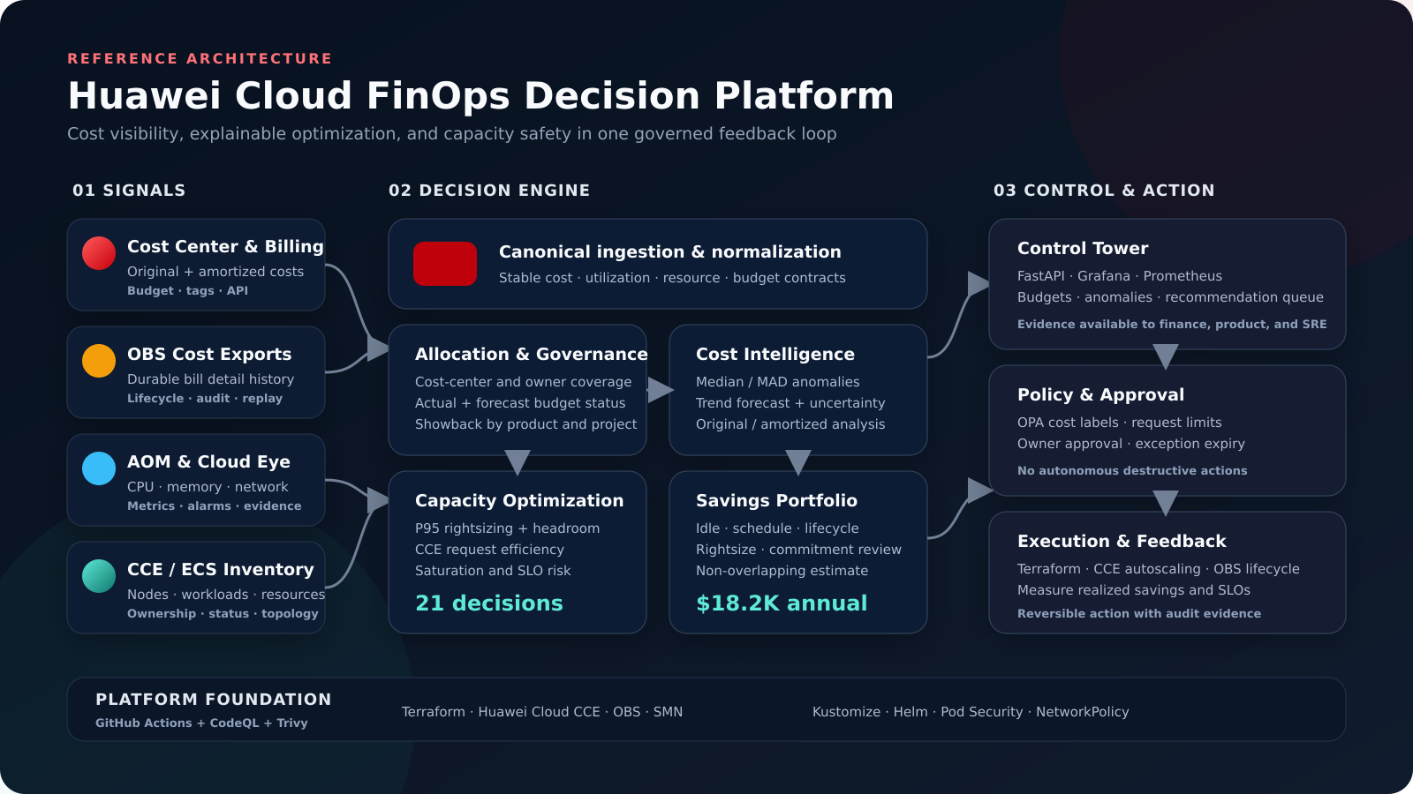
A governed architecture
READ-ONLY CONTROL PLANE
Huawei Cost Center exports and cloud telemetry feed a deterministic analytics core. FastAPI, CLI and Prometheus expose decisions; policy and runbooks govern change.
5
Notes:
Walk left to right: collect, normalize, decide, publish and govern.
[Sources]
- docs/images/architecture.png
- https://support.huaweicloud.com/intl/en-us/usermanual-cost/costcenter_0000001.html

Slide 6
One canonical contract makes every recommendation auditable
RESOURCE
Service, region, owner, cost center, product, pricing mode and capacity.
COST
Actual and amortized daily cost with usage quantity and currency.
UTILIZATION
CPU, memory, network, disk and Kubernetes request saturation.
BUDGET
Scoped limits, alert thresholds, actuals and forecast utilization.
6
Notes:
Show how the model can accept exports today and APIs later without changing decision logic.
[Sources]
- docs/data-contracts.md
- https://support.huaweicloud.com/intl/en-us/usermanual-cost/costcenter_000002_09.html

Slide 7
ECS, CCE and RDS concentrate both spend and opportunity
SERVICE ECONOMICS
The largest savings pool sits where compute run-rate is highest; storage and network still contain fast, lower-risk wins.
$5.15K
$1.27K
top-3 spend
top-3 savings
7
Notes:
Explain that savings are conservatively de-duplicated per resource.
[Sources]
- reports/demo-analysis.json
- data/demo/resources.csv

Slide 8
Three budget scopes require intervention before the next cycle
Non-production
Scheduling and idle cleanup can reset the development baseline.
Cloud portfolio
Total monthly cost already exceeds the $5.8K control limit.
Commerce
Rightsizing and commitment review address the largest product scope.
UTILIZATION
UTILIZATION
UTILIZATION
133%
106%
104%
breached
breached
breached
8
Notes:
Call out that Insights remains healthy at 78.93%, proving the model distinguishes scopes.
[Sources]
- reports/demo-analysis.json
- https://support.huaweicloud.com/intl/en-us/usermanual-cost/costcenter_0000023_1.html

Slide 9
The forecast rises gradually while uncertainty compounds
Cost grows from $6.24K to $6.45K across the three-month horizon.
$6.24K
$6.95K
July forecast
September upper band
9
Notes:
Use the upper band for budget control, not the point forecast alone.
[Sources]
- reports/demo-analysis.json
- docs/optimization-methodology.md

Slide 10
Two cost spikes are isolated for owner-led investigation
ANOMALY REVIEW
Robust historical baselines reduce noise.
Severity reflects deviation and statistical score.
CCE node spike
ML workload spike
18 May 2026
$69.21 vs $25.48 expected
+171.68% • critical
21 June 2026
$32.99 vs $17.05 expected
+93.55% • high
10
Notes:
Do not imply root cause; the system provides evidence and an investigation path.
[Sources]
- reports/demo-analysis.json
- docs/runbooks/cost-anomaly.md

Slide 11
Four prioritized actions unlock $675 per month
Rightsize CCE
$207/month using P95 CPU and memory evidence.
Release sandbox
$164/month after owner approval and snapshot check.
Schedule + rightsize
$304/month across CCE development and analytics RDS.
11
Notes:
The chart compares modeled monthly resource run-rate before and after each top action.
[Sources]
- reports/demo-analysis.json

Slide 12
Recommendations combine efficiency, resilience and governance
RIGHTSIZE
P95 utilization, confidence and required headroom.
ELIMINATE WASTE
Idle resources, schedules and storage lifecycle.
PRICE BETTER
Commit only stable production demand after review.
PROTECT CAPACITY
Flag saturation and tune CCE requests before scaling down.
12
Notes:
Make clear that capacity-risk recommendations can have zero savings and still rank first.
[Sources]
- src/finops/services/optimization.py
- docs/optimization-methodology.md

Slide 13
Capacity guardrails prevent savings from becoming an outage
ONE HIGH-RISK SIGNAL
The production CCE node exceeds safe P95 utilization after headroom.
The platform recommends capacity or autoscaling before any cost action.
P95 first
Tail behavior matters more than averages.
25% headroom
Policy remains explicit and configurable.
Rollback ready
Every action preserves owner and evidence.
13
Notes:
Lead with resilience: cost optimization is subordinate to service health.
[Sources]
- reports/demo-analysis.json
- https://support.huaweicloud.com/intl/en-us/usermanual-cce/cce_10_0081.html
- https://support.huaweicloud.com/intl/en-us/usermanual-cce/cce_10_0877.html

Slide 14
Policy makes safe cloud economics repeatable
Deployment controls convert FinOps principles into enforceable defaults.
OPA policy rejects workloads without allocation labels, resource requests or bounded autoscaling.
The API remains non-root, read-only and observable.
Cost-center and owner labels
CPU and memory requests
Non-root, read-only runtime
HPA maximum replica ceiling
No automatic resource deletion
14
Notes:
Connect each policy to a failure mode: unallocated cost, runaway scaling or unsafe execution.
[Sources]
- policies/finops/kubernetes.rego
- docs/security-threat-model.md

Slide 15
Huawei Cloud services map directly to the deployment model
COST & DATA
Cost Center exports, OBS retention and canonical CSV/API adapters.
RUNTIME
SWR image, CCE workload, HPA, PDB and network policy.
OPERATIONS
AOM-compatible metrics, Grafana views and SMN alert routing.
15
Notes:
Position the repository as deployment-ready scaffolding, not a claim of a live customer environment.
[Sources]
- docs/deployment-huawei-cloud.md
- https://support.huaweicloud.com/intl/en-us/usermanual-cost/costcenter_0000001.html

Slide 16
Quality gates make the repository deployable, not decorative
VERIFIED LOCALLY + AUTOMATED IN CI
Deterministic tests validate analytics today; infrastructure and security checks run on every main-branch change.
CONTROL | SCOPE | RESULT | EVIDENCE | GATE
Unit tests | 53 scenarios | PASS | pytest | required
Coverage | branch-aware | 97.09% | coverage.py | >= 90%
Repository | JSON/YAML | PASS | validator | required
API | endpoints | PASS | TestClient | required
Terraform | fmt/validate | CI | Terraform 1.12 | required
Container | build + smoke | CI | Docker | required
Security | code + image | CI | CodeQL/Trivy | required
Policy | tags + capacity | CI | OPA/Rego | required
16
Notes:
Separate locally verified results from CI gates that will execute after publication.
[Sources]
- docs/validation.md
- .github/workflows/ci.yml
- coverage.xml

Slide 17
A 30-day pilot proves value before any production change
WEEK 1 | WEEK 2 | WEEK 3 | WEEK 4 | ONGOING
Baseline data + ownership
Validate top 10 actions
Execute low-risk quick wins
Review capacity and budgets
Measure realized savings
Weekly governance and evidence log
17
Notes:
Ask for a read-only pilot and a named owner from Finance, Platform and product engineering.
[Sources]
- docs/finops-operating-model.md
- ROADMAP.md

Slide 18
DECISION
Approve a read-only
FinOps pilot.
30 days
Top 10 actions reviewed
Savings and capacity verified
Notes:
Close on the specific decision and the evidence the pilot will produce.
[Sources]
- docs/finops-operating-model.md
- docs/reports/executive-summary.md

