Slide 1
MANUFACTURING
Quality, OEE &
Predictive Maintenance
Control Tower
4
production lines
12
machines
98,460
CTQ measurements
A governed, recommendation-only decision system built on deterministic synthetic plant data.
24h
failure horizon
OEE
SPC
SHAP
HUMAN GATE
Executive deck • July 2026
Notes:
Open with the decision boundary: this is a portfolio-grade synthetic control tower, not an autonomous plant-control system.
[Sources]
- artifacts/results/pipeline_metrics.json
- src/manufacturing_ct/synthetic.py

Slide 2
EXECUTIVE RESULT
02
The plant clears the OEE target—model burden needs attention
85.27% OEE combines strong availability with a quality constraint; the model captures 73.51% of 24-hour failures but sends more OOT alerts than the validation capacity cap.
OEE
QUALITY / FPY
UNPLANNED STOP
OOT PR-AUC
OOT RECALL
85.27%
95.27%
2,466 h
0.389
73.51%
A × P × Q
first-pass good
synthetic period
2.52× baseline
178 misses
OPERATIONS
QUALITY
MODEL CONTROL
Availability is 98.36%, yet 2,466 unplanned downtime hours remain. Electrical and minor stops dominate the Pareto.
FPY is 95.27%. PRD-A has the lowest long-term Ppk (0.92), making it the first capability investigation.
OOT alert rate is 43.11%, above the 40% review-capacity design cap. Treat it as an operational watch item, not hidden model success.
Deterministic synthetic data • Recommendation only
Notes:
[Sources]
- artifacts/results/pipeline_metrics.json
- artifacts/results/process_capability.csv
- artifacts/results/downtime_pareto.csv

Slide 3
DATA DESIGN
03
A deterministic plant with enough structure to stress every layer
Four production lines • three machines per line • four products • three shifts
PRODUCTION SHIFTS
LINE-A
MC-01
MC-02
MC-03
19,692
8-hour machine-shift grain
LINE-B
MC-04
MC-05
MC-06
QUALITY MEASUREMENTS
98,460
n=5 CTQ subgroups
LINE-C
MC-07
MC-08
MC-09
DOWNTIME EVENTS
4,836
planned / unplanned taxonomy
LINE-D
MC-10
MC-11
MC-12
REPRODUCIBILITY
Seed 20260729 • 2024-01-01 to 2025-06-30
Deterministic synthetic data • Recommendation only
Notes:
[Sources]
- artifacts/results/pipeline_metrics.json
- artifacts/results/pipeline_config.json
- docs/data_contract.md

Slide 4
ARCHITECTURE
04
One governed feature set, five decision layers
SYNTHETIC
GENERATOR
KPI + SPC
TEMPORAL ML
SHAP + POLICY
FASTAPI
→
→
→
→
plant events + sensors
OEE, quality, reliability
calibration + threshold
reason codes + economics
recommendation only
DATA PLANE
POSTGRESQL
PBIP + EXCEL
ARTIFACTS
normalized schema + analytical views
decision-ready semantic and formula layers
metrics, figures, model bundle, reports
OPERATIONS PLANE
• Docker Compose and Kubernetes deployment profiles
• Prometheus metrics, alert rules and Grafana dashboard provisioning
• CI, CodeQL, dependency audit, container scan and ownership controls
Deterministic synthetic data • Recommendation only
Notes:
[Sources]
- docs/architecture.md
- docs/adr/001-recommendation-only-boundary.md
- sql/schema.sql
- src/manufacturing_ct/api.py
- docker-compose.yml
- k8s/
- monitoring/

Slide 5
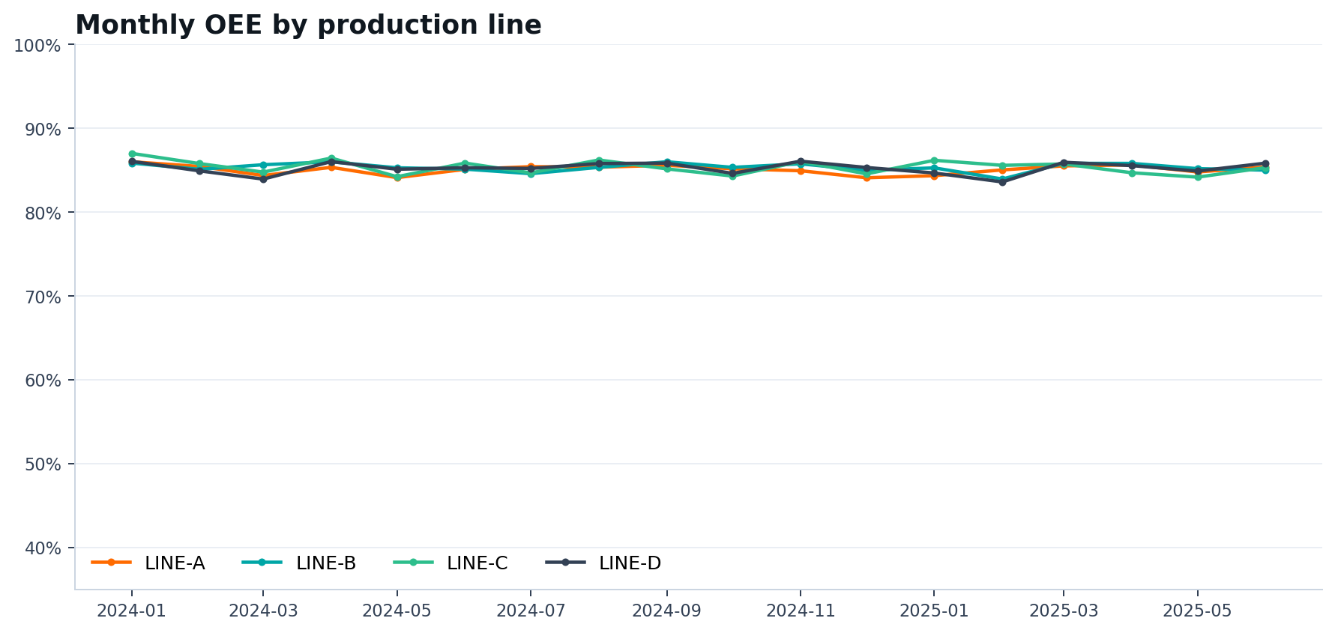
OEE
05
Stable line trends, with performance as the main OEE limiter
AVAILABILITY
98.36%
PERFORMANCE
90.99%
QUALITY
95.27%
Monthly OEE by line • computed from planned time, runtime and first-pass good units
DEFINITION
INTERPRETATION
BOUNDARY
OEE = Availability × Performance × Quality
Performance has the largest mathematical gap to 100%.
OEE is descriptive; it does not authorize production actions.
Deterministic synthetic data • Recommendation only
Notes:
[Sources]
- artifacts/results/pipeline_metrics.json
- artifacts/results/oee_monthly_line.csv
- artifacts/figures/oee_monthly_trend.png
- docs/reference_crosswalk.md

Slide 6
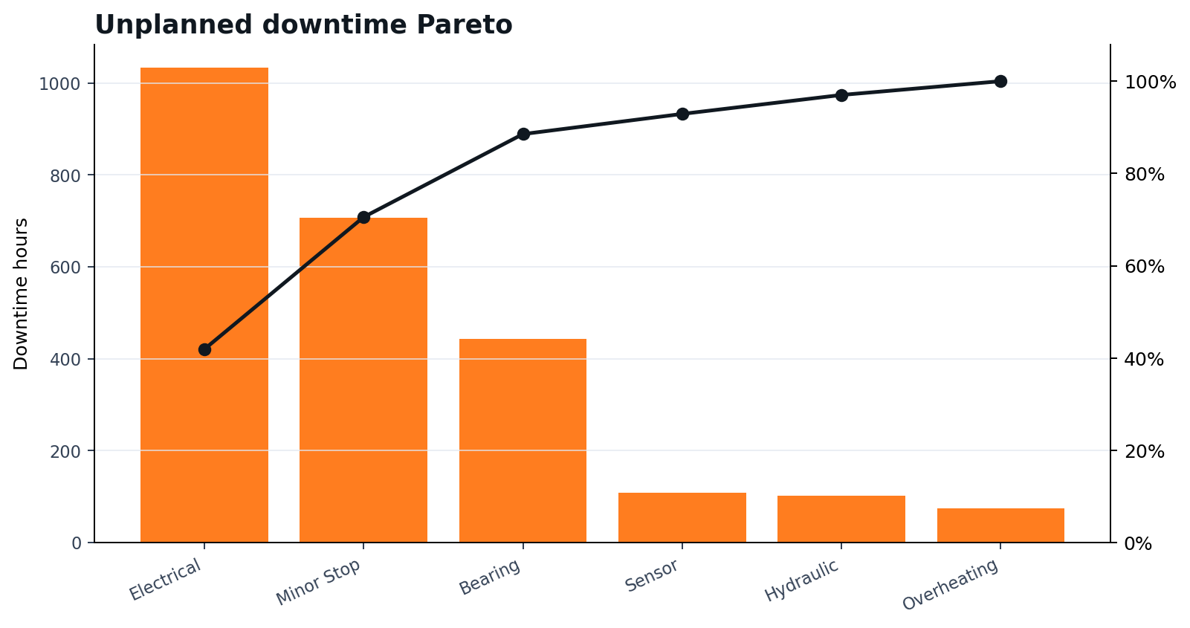
DOWNTIME & RELIABILITY
06
Electrical events and minor stops explain 70.53% of downtime
MTBF
145.96 h
operating hours / failures
MTTR
1.73 h
repair hours / failures
FAILURE EVENTS
1,015
across 12 machines
Duration bars and cumulative-share line
PARETO PRIORITY
RELIABILITY BOUNDARY
Start with electrical root causes and recurring minor stops.
Metrics describe the synthetic history; maintenance still requires planner approval.
Deterministic synthetic data • Recommendation only
Notes:
[Sources]
- artifacts/results/downtime_pareto.csv
- artifacts/results/reliability_metrics.csv
- artifacts/results/pipeline_metrics.json
- artifacts/figures/downtime_pareto.png

Slide 7
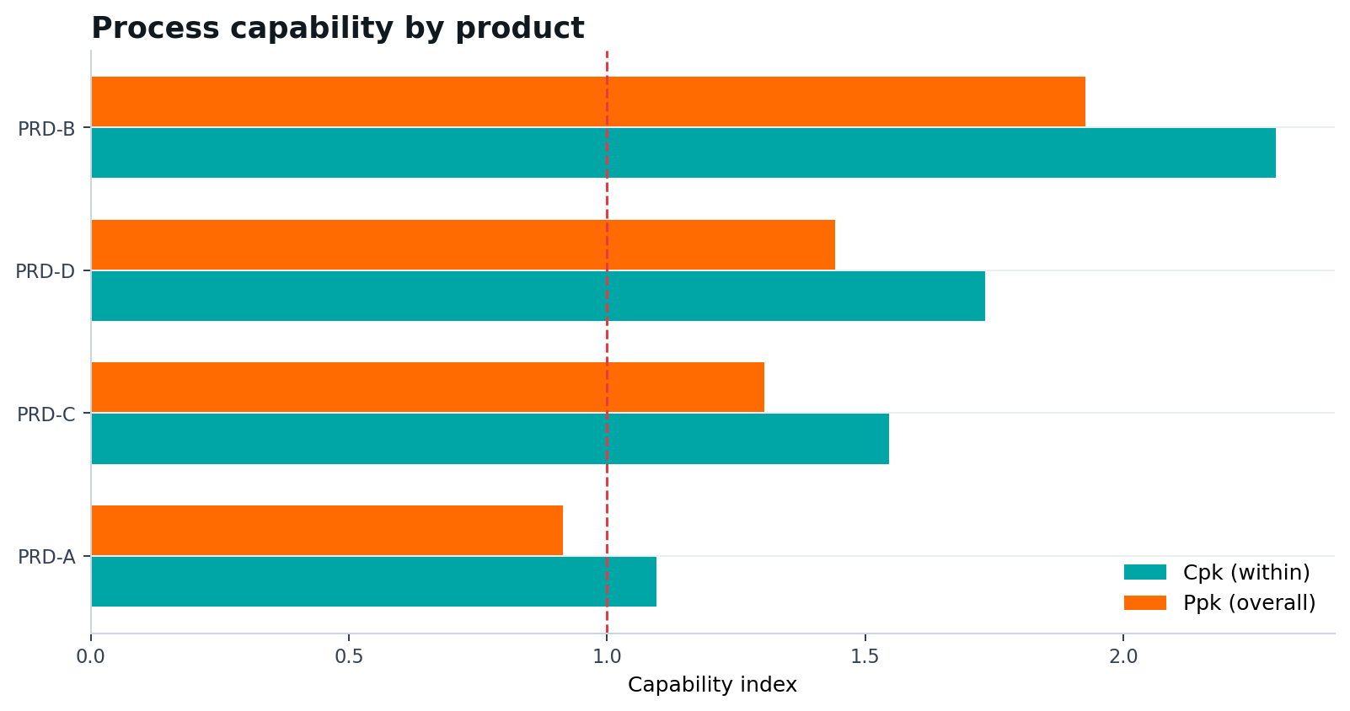
QUALITY & CAPABILITY
07
PRD-A is the long-term capability watch item
Product
Cpk
Ppk
PRD-A
1.10
0.92
PRD-B
2.30
1.93
PRD-C
1.55
1.30
PRD-D
1.73
1.44
Cp/Cpk use within variation; Pp/Ppk use overall variation
FPY
SCRAP
REWORK
COPQ
95.27%
1.99%
2.75%
12,936,906
Deterministic synthetic data • Recommendation only
Notes:
[Sources]
- artifacts/results/process_capability.csv
- artifacts/results/pipeline_metrics.json
- artifacts/figures/process_capability.png
- https://www.itl.nist.gov/div898/handbook/pmc/section1/pmc16.htm

Slide 8
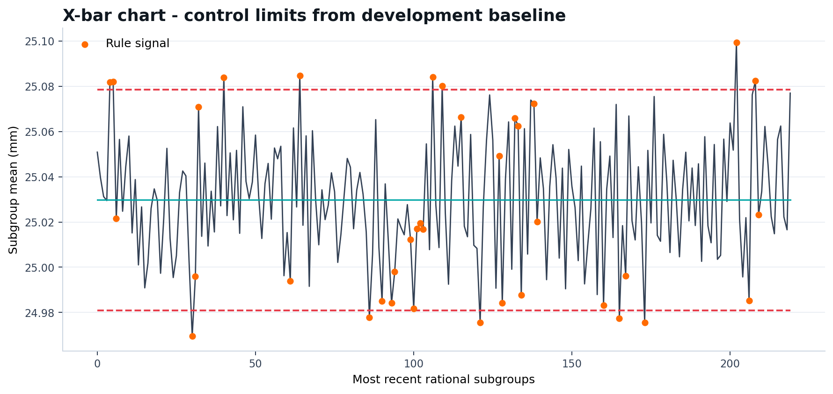
STATISTICAL PROCESS CONTROL
08
Chart selection follows data type—not convenience
Chart
Signal
Sample
X-bar/R
CTQ dimension
fixed n=5
I-MR
roughness
one observation
p
defective proportion
variable lot
u
defects / unit
variable units
Fixed n=5 CTQ subgroup means • control limits estimated from baseline behavior
DO NOT CONFLATE
ALARM RULES
Control limits estimate process behavior. LSL/USL are engineering requirements used for capability.
Beyond 3σ • 2 of 3 beyond 2σ • 4 of 5 beyond 1σ • 8 points on one side.
Deterministic synthetic data • Recommendation only
Notes:
[Sources]
- artifacts/results/spc_metadata.json
- artifacts/results/spc_xbar_r.csv
- artifacts/figures/spc_xbar.png
- docs/spc_methodology.md
- https://www.itl.nist.gov/div898/handbook/pmc/section3/pmc3.htm

Slide 9
MODEL DEVELOPMENT
09
Every model decision is made before the out-of-time window
MODEL FIT
CALIBRATION
VALIDATION
OUT-OF-TIME
Jan–Sep 2024
Oct–Nov 2024
Dec 2024–Feb 2025
Mar–Jun 2025
9,828 rows
2,160 rows
3,204 rows
4,356 rows
DECISION GATES
LEAKAGE CONTROL
CALIBRATION
THRESHOLD
Lagged and rolling features use past-only values. Labels look forward 24 hours; split boundaries are chronological.
Sigmoid calibration is fitted on a dedicated window. OOT calibration is evaluated, never tuned.
Validation selects 0.1478 under recall and review-capacity constraints. OOT stays untouched.
• Champion: random forest
• Challenger retained: logistic regression
• Class imbalance measured against the positive-rate PR baseline
Deterministic synthetic data • Recommendation only
Notes:
[Sources]
- artifacts/results/pipeline_metrics.json
- src/manufacturing_ct/modeling.py
- docs/governance/validation_report.md
- docs/adr/003-temporal-validation.md

Slide 10
CHAMPION / CHALLENGER
10
Random forest wins narrowly; logistic regression remains the fallback
Candidate
Val PR-AUC
Val ROC-AUC
Val Brier
Selection score
Status
Random forest
0.3768
0.7646
0.1099
0.4057
CHAMPION
Logistic regression
0.3771
0.7622
0.1108
0.4053
CHALLENGER
OOT CHAMPION PERFORMANCE
PR-AUC
ROC-AUC
BRIER
ECE
0.3887
0.7489
0.1137
0.0164
2.52× positive rate
rank discrimination
probability accuracy
10-bin calibration gap
VALIDATION THRESHOLD
OOT REALITY
0.1478 • recall 75.78% • alert rate 39.51%
precision 26.30% • recall 73.51% • alert rate 43.11%
Deterministic synthetic data • Recommendation only
Notes:
[Sources]
- artifacts/results/pipeline_metrics.json
- artifacts/results/oot_predictions.csv
- docs/governance/model_card.md
- docs/governance/validation_report.md

Slide 11
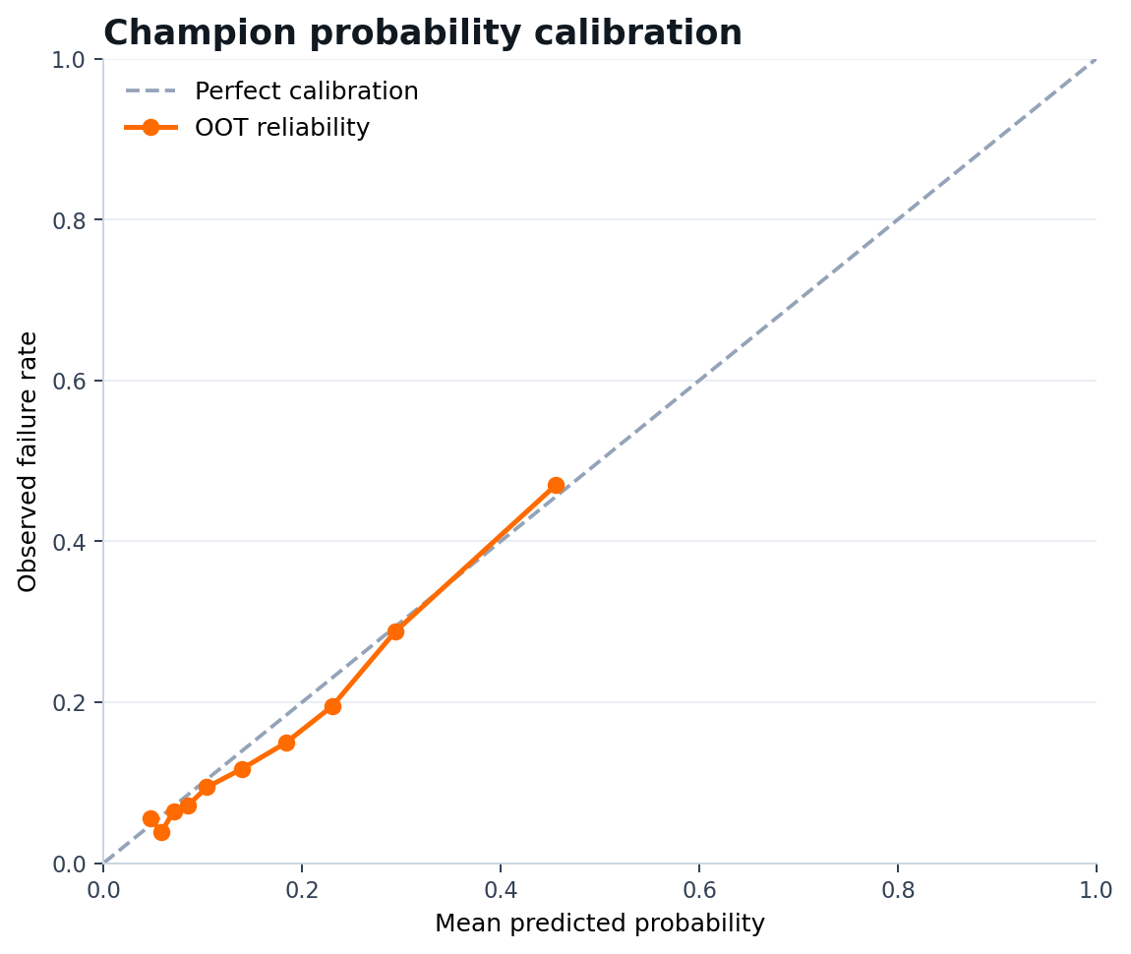
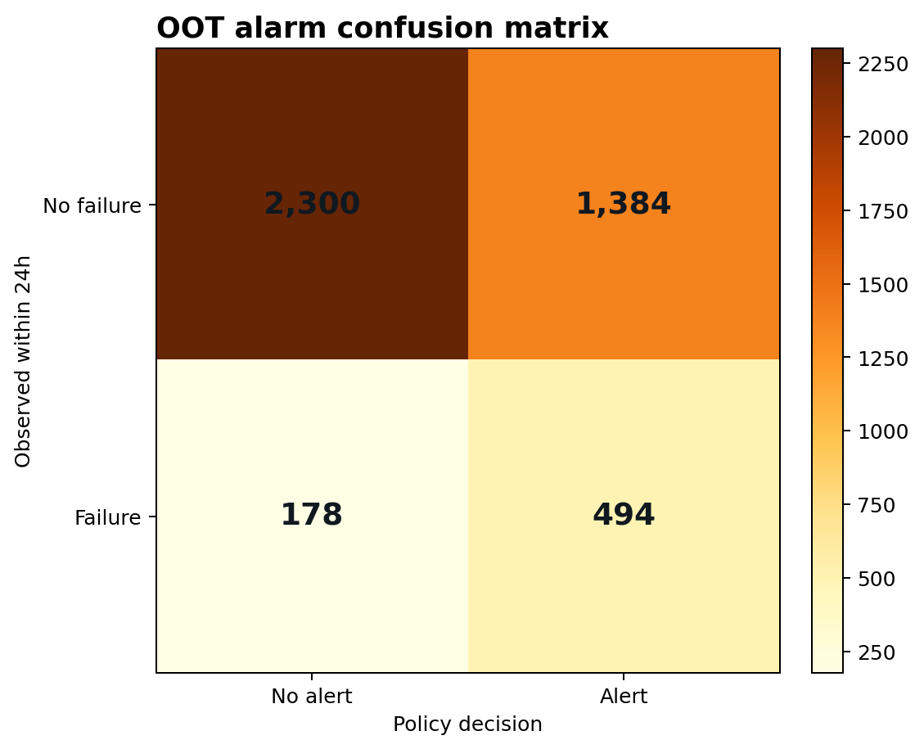
CALIBRATION & ALARM QUALITY
11
Probability quality is acceptable; alert workload is the operational issue
OOT Brier 0.1137 • ECE 0.0164
TN 2300 • FP 1384 • FN 178 • TP 494
ALERTS / DAY
MEDIAN LEAD
PRECISION
RECALL
15.65
16 h
26.30%
73.51%
Deterministic synthetic data • Recommendation only
Notes:
[Sources]
- artifacts/results/calibration_curve.csv
- artifacts/results/oot_predictions.csv
- artifacts/figures/model_calibration.png
- artifacts/figures/oot_confusion_matrix.png
- artifacts/results/pipeline_metrics.json

Slide 12
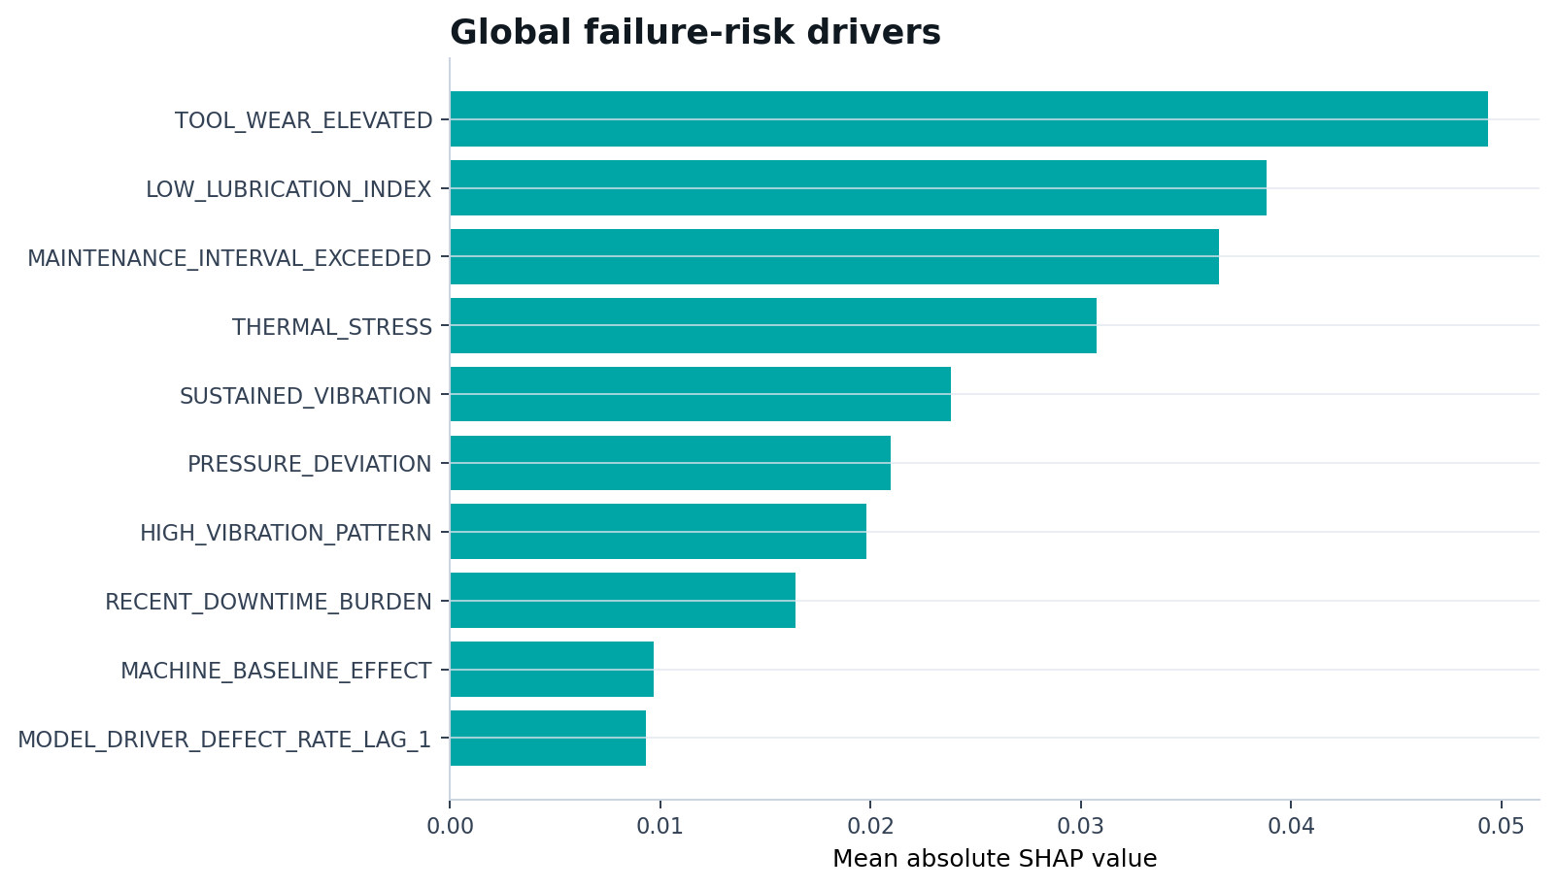
EXPLAINABILITY
12
Global drivers become local maintenance reason codes
LOCAL EXAMPLE
Risk 63.62% • SH-MC-09-2025052508
1
TOOL_WEAR_ELEVATED
SHAP 0.077
2
LOW_LUBRICATION_INDEX
SHAP 0.062
3
SUSTAINED_VIBRATION
SHAP 0.055
4
MAINTENANCE_INTERVAL_EXCEEDED
SHAP 0.053
Mean absolute SHAP across 700 explained rows
SCOPE NOTE
SHAP explains the fitted base estimator. The sigmoid calibration layer changes probabilities and is outside attribution.
Deterministic synthetic data • Recommendation only
Notes:
[Sources]
- artifacts/results/shap_global_importance.csv
- artifacts/results/shap_local_explanations.csv
- artifacts/figures/shap_global_importance.png
- artifacts/results/pipeline_metrics.json
- src/manufacturing_ct/explain.py

Slide 13
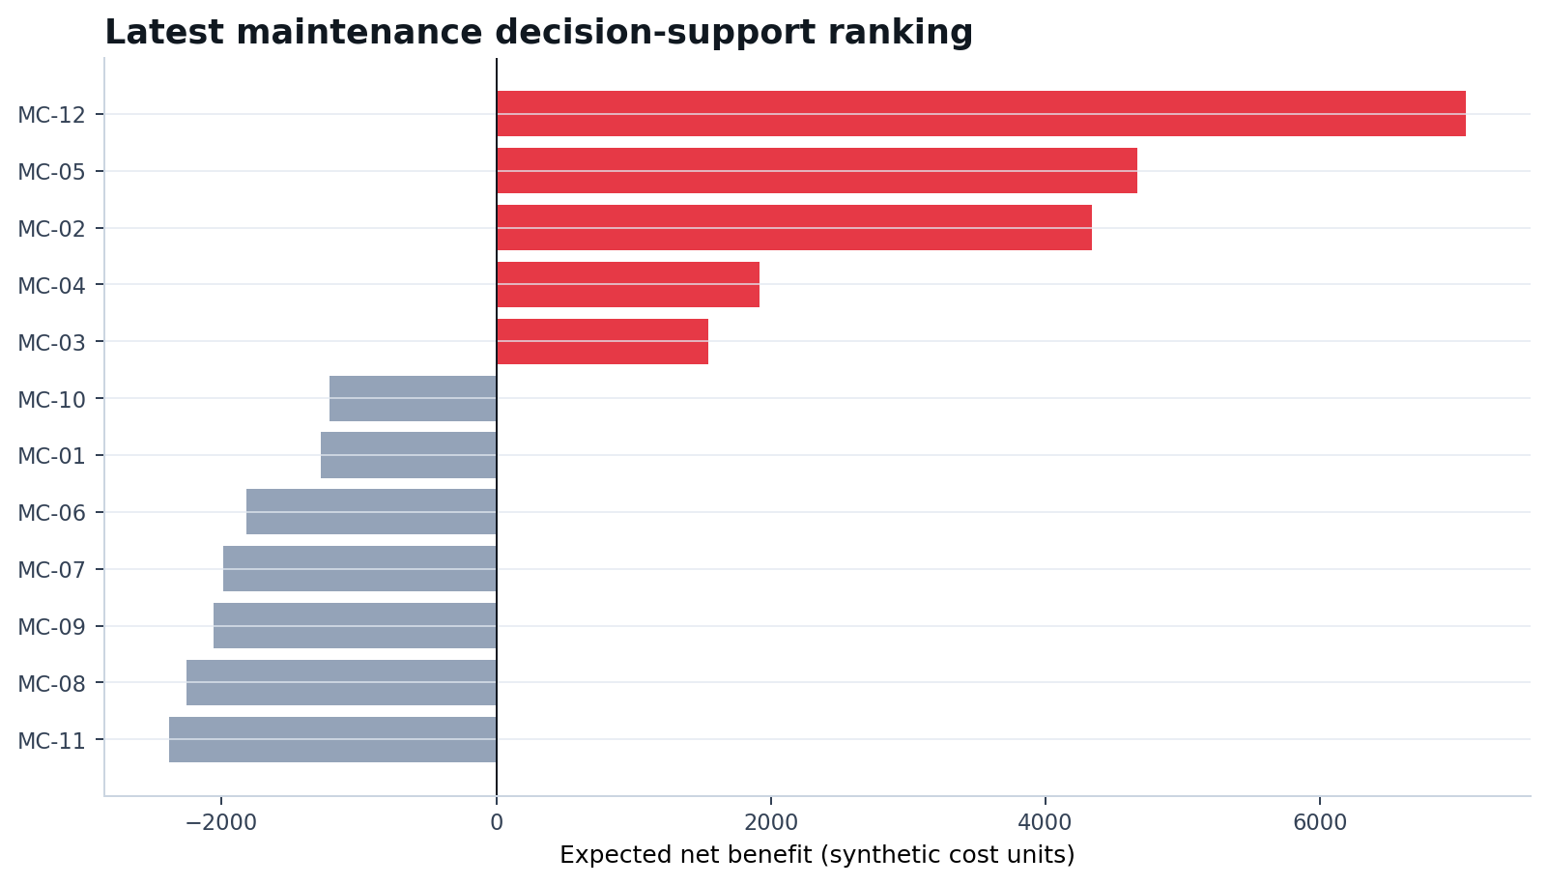
MAINTENANCE DECISION SUPPORT
13
Risk is prioritized only when economics and criticality agree
POLICY INPUTS
Calibrated probability
× asset criticality
× estimated failure cost
− maintenance cost
P1
MONITOR
5
7
planner review
no action
HUMAN GATE
Every recommendation requires maintenance-planner approval and current safety context.
Expected net benefit = avoided synthetic loss − maintenance cost
EXPLICIT EXCLUSION
No CMMS, PLC or SCADA write path; the API cannot stop equipment, create work orders or approve maintenance.
Deterministic synthetic data • Recommendation only
Notes:
[Sources]
- artifacts/results/maintenance_priority.csv
- artifacts/results/policy_config.json
- artifacts/figures/maintenance_priority.png
- src/manufacturing_ct/policy.py
- docs/adr/001-recommendation-only-boundary.md

Slide 14
DELIVERY ARCHITECTURE
14
The same governed record serves API, BI, reporting and operations
GOVERNED ANALYTICAL RECORD
PostgreSQL views + versioned artifacts + model bundle
↓
↓
↓
↓
FASTAPI
PBIP
EXCEL
PDF / PPT
recommendation endpoint
semantic starter + DAX
formula decision workbook
governance + executive
OPERABILITY
Docker Compose
Kubernetes
Prometheus
Grafana
local integrated stack
non-root API + HPA/PDB
service/model metrics
provisioned dashboard
SECURITY CONTROLS
CI • CodeQL • pip-audit • Trivy • Dependabot • CODEOWNERS • documented branch protection
Deterministic synthetic data • Recommendation only
Notes:
[Sources]
- src/manufacturing_ct/api.py
- sql/schema.sql
- powerbi/ManufacturingControlTower.pbip
- deliverables/excel/Manufacturing_Control_Tower.xlsx
- docker-compose.yml
- k8s/
- monitoring/
- .github/workflows/

Slide 15
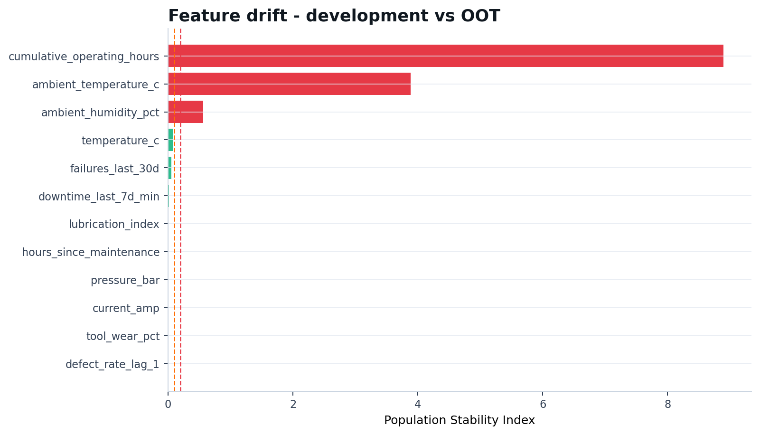
MONITORING
15
Data quality passes; temporal drift is intentionally visible
DATA CHECKS
ACTION PSI
5/5
3
pipeline gates
review features
OOT ALERT RATE
43.11%
above 40% validation capacity cap
OPERATIONAL WATCH
Large PSI values are expected from cumulative/time features across a later time window. Review meaning and redesign before promotion; do not silence the alert.
OOT versus model-fit reference distribution
MONITORING CONTRACT
Model quality, feature drift, data quality and alert burden have separate thresholds and owners.
Deterministic synthetic data • Recommendation only
Notes:
[Sources]
- artifacts/results/data_drift.csv
- artifacts/results/data_quality_checks.csv
- artifacts/results/pipeline_metrics.json
- artifacts/figures/feature_drift.png
- docs/monitoring_runbook.md
- monitoring/prometheus/rules.yml

Slide 16
GOVERNED ADOPTION
16
A proposed 90-day pilot keeps humans in the decision loop
0–30
31–60
61–90
SHADOW MODE
ASSISTED REVIEW
CONTROL REVIEW
Score silently; validate data freshness, SPC false signals and planner interpretability.
Expose ranked recommendations; record accept/reject decisions and reason codes.
Reassess threshold, workload, drift and synthetic economics before any promotion.
GO / NO-GO CRITERIA
Data-quality gates pass
Alert workload fits planner capacity
Failure capture and calibration remain acceptable
Drift reviewed with documented disposition
Safety and maintenance owners approve
BOUNDARY
This is a proposed pilot cadence, not evidence of real deployment or standard compliance.
Deterministic synthetic data • Recommendation only
Notes:
[Sources]
- docs/monitoring_runbook.md
- docs/governance/incident_response.md
- docs/governance/risk_register.md
- docs/governance/threat_model.md
- docs/reference_crosswalk.md

Slide 17
PORTFOLIO DELIVERY LAYER
17
Every reviewer can inspect outcomes and the evidence underneath
REPRODUCE
EXPLORE
SCENARIO
PYTHON + SQL
POWER BI PBIP
EXCEL
Pipeline, tests, API, schema and analytical views
Starter semantic model, DAX measures and report pages
Formula-based dashboard, model controls and planner
COMMUNICATE
ASSURE
GOVERN
PPT + PDF
GITHUB
DOCUMENTATION
Executive narrative and detailed governance evidence
CI, security scans, ownership and branch controls
Data contract, ADRs, model card and runbooks
One deterministic evidence chain across code, analytics and communication
Notes:
[Sources]
- README.md
- README_TR.md
- powerbi/
- deliverables/excel/Manufacturing_Control_Tower.xlsx
- deliverables/report/Manufacturing_Control_Tower_Governance_Report.pdf
- .github/
- docs/

Slide 18
MANUFACTURING DECISION SUPPORT
Measure the factory.
Explain the risk.
Keep the human accountable.
85.27% OEE • 95.27% FPY • 0.389 OOT PR-AUC • 73.51% recall
DECISION BOUNDARY
Recommendation only • synthetic economics • human approval required • no autonomous maintenance execution
Repository: github.com/muratmiracg-dev/Manufacturing-Quality-OEE-Predictive-Maintenance-Control-Tower
Notes:
[Sources]
- artifacts/results/pipeline_metrics.json
- README.md
- docs/adr/001-recommendation-only-boundary.md

