Slide 1
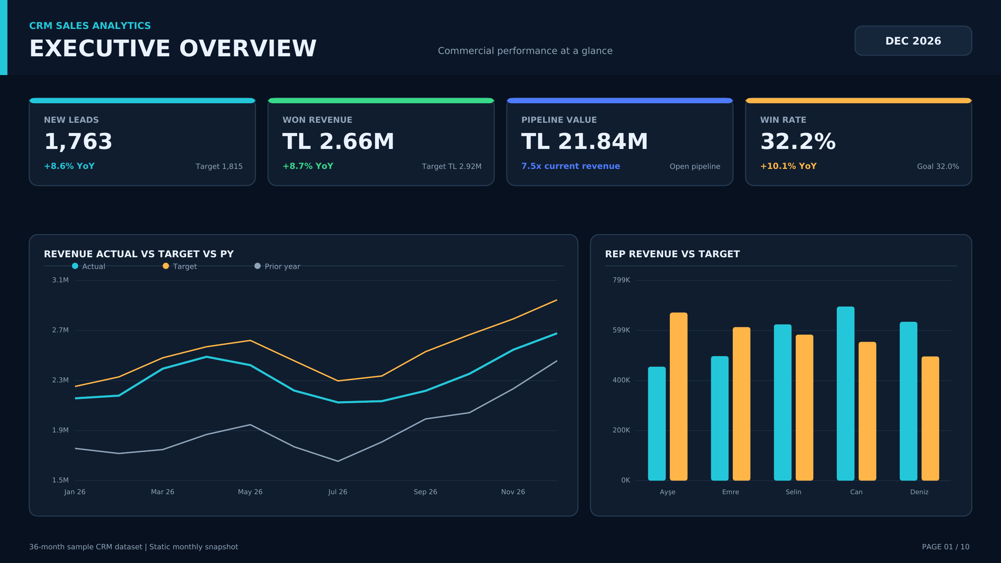
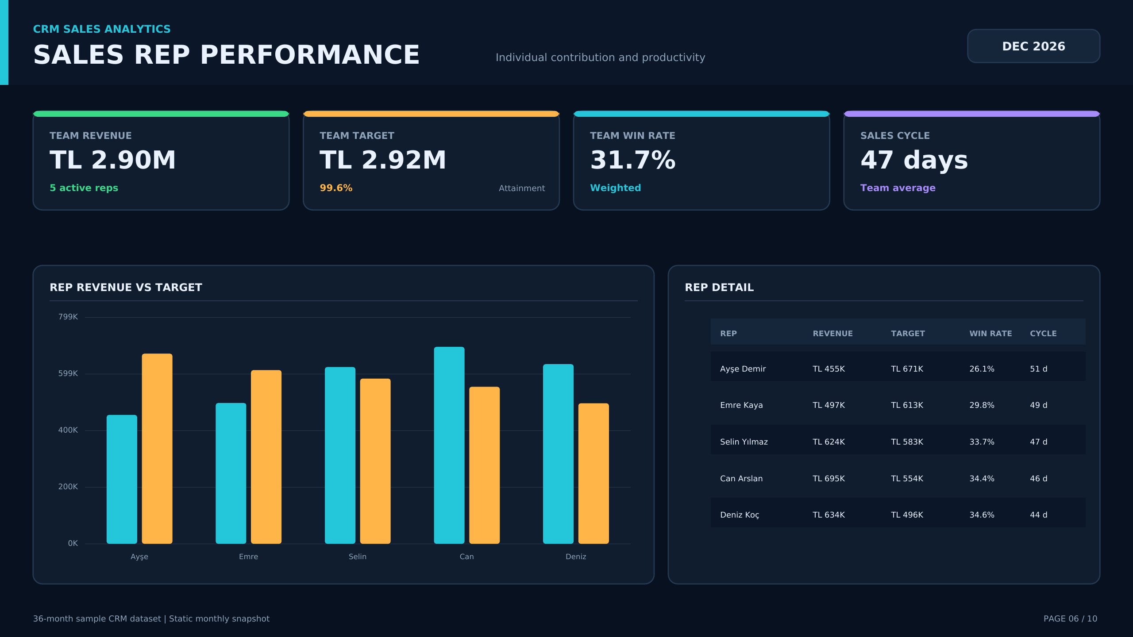
PORTFOLIO PROJECT
CRM Sales Analytics & Business Intelligence
36-Month Performance Review | Power BI, Tableau & Excel
Murat Miraç Gedik
July 2026
Notes:
Presenter note: Interpret the findings using the underlying dataset.
[Sources]
- crm_monthly.csv
- crm_rep_performance.csv
- crm_lead_sources.csv
- CRM Sales Analytics Power BI / Excel / Tableau project assets

Slide 2
Growth is strong, but target discipline is lagging
2026 REVENUE
2026 LEADS
TARGET ATTAINMENT
DECEMBER WIN RATE
TL 27.8M
18,206
92.4%
32.3%
+32.1% vs 2024
+24.1% vs 2024
+1.7 pts vs 2025
32% target
Management takeaway
Demand and revenue are scaling. The priority is to convert that growth into more consistent target delivery and balanced team performance.
CRM Sales Analytics | 36-month sample dataset
Murat Miraç Gedik
Notes:
Presenter note: Interpret the findings using the underlying dataset.
[Sources]
- crm_monthly.csv
- crm_rep_performance.csv
- crm_lead_sources.csv
- CRM Sales Analytics Power BI / Excel / Tableau project assets

Slide 3
The analysis moves from data to management action
01
02
03
04
05
Data foundation
Commercial growth
Conversion
Productivity
Action
36-month CRM data model
Lead, revenue and target trends
Funnel and channel quality
Pipeline and rep performance
Priorities and governance
Objective: not only to report results, but to improve decision quality.
CRM Sales Analytics | 36-month sample dataset
Murat Miraç Gedik
Notes:
Presenter note: Interpret the findings using the underlying dataset.
[Sources]
- crm_monthly.csv
- crm_rep_performance.csv
- crm_lead_sources.csv
- CRM Sales Analytics Power BI / Excel / Tableau project assets

Slide 4
The project covers the full CRM cycle
01
Demand
Lead generation and source mix
Delivery scope
Power BI PBIP project, Excel KPI dashboard, Tableau workbook and executive-grade 4K reporting output.
02
Quality
Qualification and opportunity conversion
03
Value
Revenue, target and pipeline
04
Productivity
Win rate and sales cycle
05
Customer
New customers and churn
CRM Sales Analytics | 36-month sample dataset
Murat Miraç Gedik
Notes:
Presenter note: Interpret the findings using the underlying dataset.
[Sources]
- crm_monthly.csv
- crm_rep_performance.csv
- crm_lead_sources.csv
- CRM Sales Analytics Power BI / Excel / Tableau project assets

Slide 5
The data foundation is compact and scalable
36
3
5
5
MONTHS
FACT TABLES
SALES REPS
LEAD SOURCES
Monthly performance
Rep performance
Lead sources
Lead, funnel, revenue, pipeline, customer and churn metrics.
Revenue, target, win rate, opportunities and sales cycle.
Volume, qualification rate and acquisition spend.
CRM Sales Analytics | 36-month sample dataset
Murat Miraç Gedik
Notes:
Presenter note: Interpret the findings using the underlying dataset.
[Sources]
- crm_monthly.csv
- crm_rep_performance.csv
- crm_lead_sources.csv
- CRM Sales Analytics Power BI / Excel / Tableau project assets

Slide 6
Calendar provides a common time axis
crm_monthly
1 → *
Monthly KPIs
Calendar
crm_rep_performance
1 → *
Rep performance
Date • Month • Year • Sort Keys
crm_lead_sources
1 → *
Channel performance
Single-direction filtering supports consistent KPIs and reliable time intelligence.
CRM Sales Analytics | 36-month sample dataset
Murat Miraç Gedik
Notes:
Presenter note: Interpret the findings using the underlying dataset.
[Sources]
- crm_monthly.csv
- crm_rep_performance.csv
- crm_lead_sources.csv
- CRM Sales Analytics Power BI / Excel / Tableau project assets

Slide 7
The KPI system answers four management questions
DEMAND
How much interest do we create?
New Leads • Lead Target • Source Share
CONVERSION
How efficiently do leads progress?
Qualification • Opportunity • Win Rate
VALUE
How much revenue does conversion create?
Won Revenue • Pipeline • Avg Deal Size
VELOCITY
How quickly do we reach revenue?
Sales Cycle • Churn • Target Attainment
CRM Sales Analytics | 36-month sample dataset
Murat Miraç Gedik
Notes:
Presenter note: Interpret the findings using the underlying dataset.
[Sources]
- crm_monthly.csv
- crm_rep_performance.csv
- crm_lead_sources.csv
- CRM Sales Analytics Power BI / Excel / Tableau project assets

Slide 8
Data flows from source to executive reporting
01
02
03
04
05
Excel
Power Query
Power BI + DAX
Tableau
PowerPoint + PDF
Data preparation and quality control
Transformation and standardization
Model, KPIs and interactive analysis
Cross-platform visualization
Executive communication and sharing
One source, multiple outputs
The same metric definitions produce consistent outcomes across platforms.
CRM Sales Analytics | 36-month sample dataset
Murat Miraç Gedik
Notes:
Presenter note: Interpret the findings using the underlying dataset.
[Sources]
- crm_monthly.csv
- crm_rep_performance.csv
- crm_lead_sources.csv
- CRM Sales Analytics Power BI / Excel / Tableau project assets

Slide 9
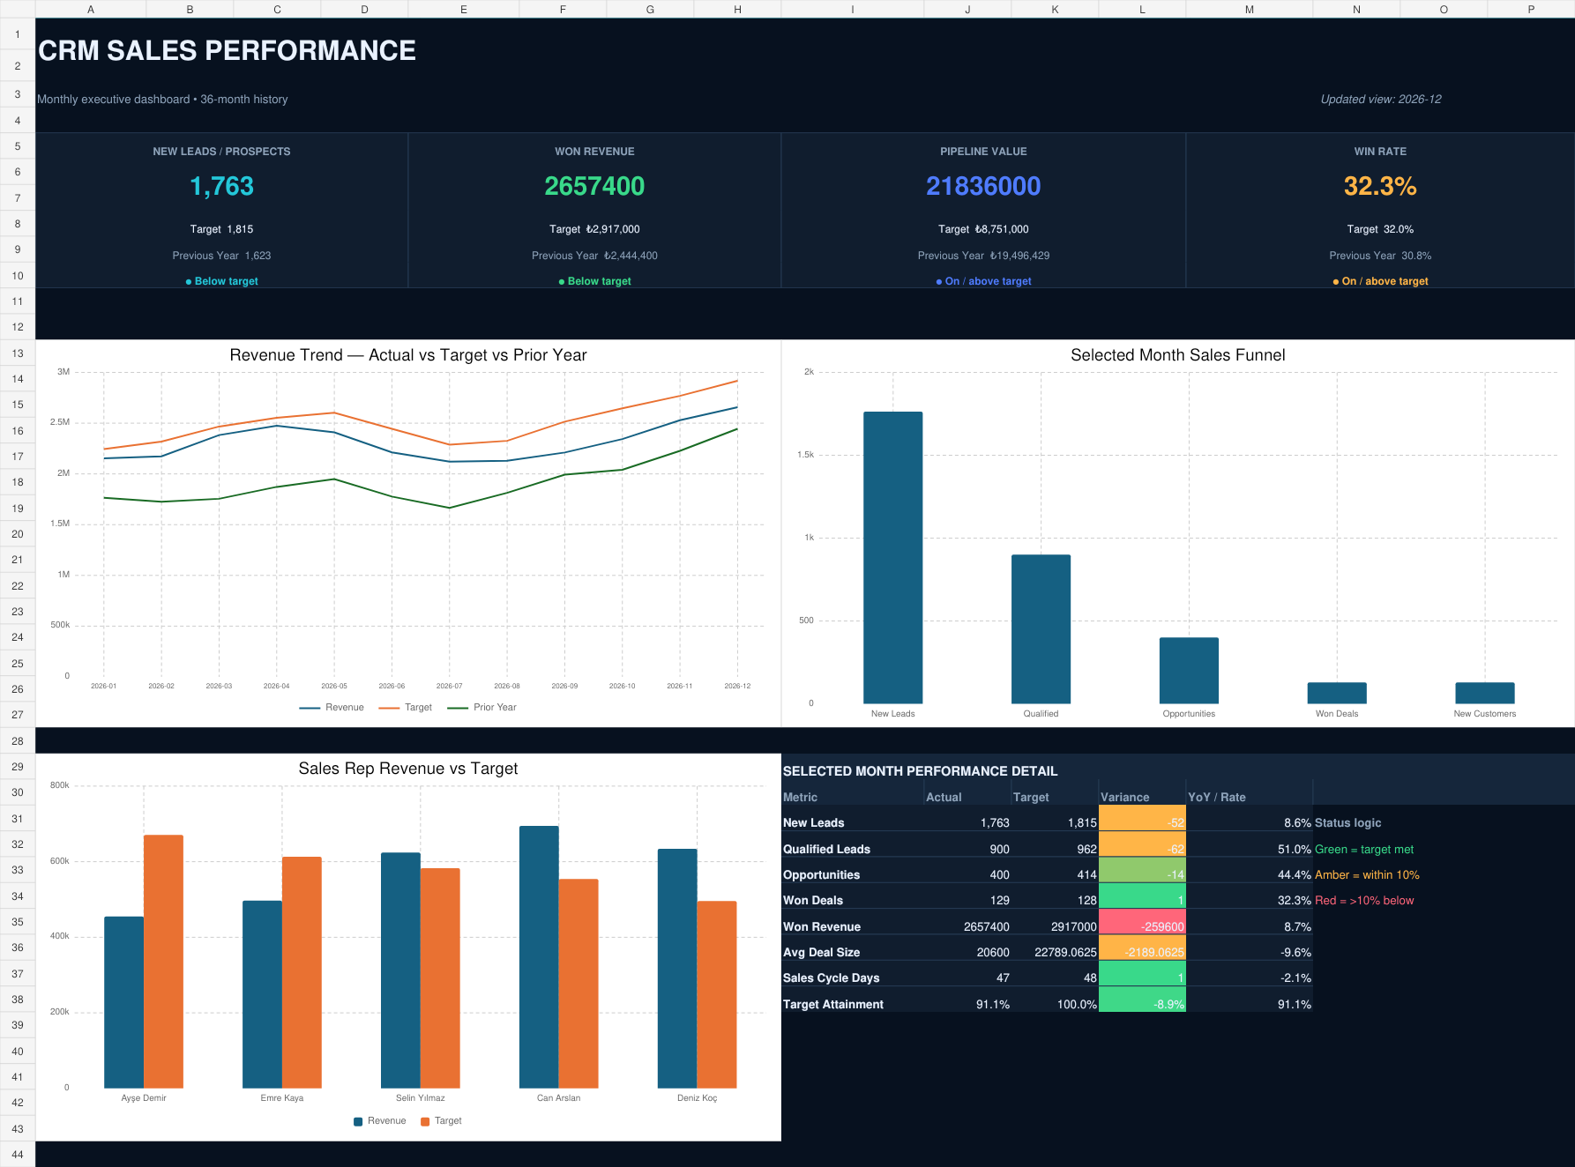
One business logic across three BI environments
Power BI
Excel
Interactive analysis and DAX-based KPI model
Auditable data foundation and executive dashboard
The Tableau output validates portability using the same source tables.
CRM Sales Analytics | 36-month sample dataset
Murat Miraç Gedik
Notes:
Presenter note: Interpret the findings using the underlying dataset.
[Sources]
- crm_monthly.csv
- crm_rep_performance.csv
- crm_lead_sources.csv
- CRM Sales Analytics Power BI / Excel / Tableau project assets

Slide 10
Revenue grew 32% while lead volume expanded 24%
Revenue scale
2024: TL 21.0M
2026: TL 27.8M
Growth: +32.1%
Demand scale
2024: 14,675 leads
2026: 18,206 leads
Growth: +24.1%
CRM Sales Analytics | 36-month sample dataset
Murat Miraç Gedik
Notes:
Presenter note: Interpret the findings using the underlying dataset.
[Sources]
- crm_monthly.csv
- crm_rep_performance.csv
- crm_lead_sources.csv
- CRM Sales Analytics Power BI / Excel / Tableau project assets

Slide 11
2026 growth partially recovered the 2025 target gap
Year | Leads | Revenue | Target | Attainment | Won Deals
2024 | 14,675 | TL 21.0M | TL 21.0M | 100.0% | 1,184
2025 | 16,477 | TL 23.0M | TL 25.4M | 90.7% | 1,203
2026 | 18,206 | TL 27.8M | TL 30.1M | 92.4% | 1,356
Critical interpretation
2024 was almost exactly on target. In 2025, targets rose faster than growth; revenue recovered in 2026, but annual attainment remained at 92.4%.
CRM Sales Analytics | 36-month sample dataset
Murat Miraç Gedik
Notes:
Presenter note: Interpret the findings using the underlying dataset.
[Sources]
- crm_monthly.csv
- crm_rep_performance.csv
- crm_lead_sources.csv
- CRM Sales Analytics Power BI / Excel / Tableau project assets

Slide 12
December conversion held; revenue missed plan
NEW LEADS
WON REVENUE
PIPELINE
WIN RATE
1,763
TL 2.7M
TL 21.8M
32.3%
97.1% of target
TL -260K variance
7.5x coverage
+10.1% YoY
Balance issue
The final funnel stage looks healthy, yet revenue misses target. The issue is not win rate alone; target allocation, deal mix and rep contribution must be managed together.
CRM Sales Analytics | 36-month sample dataset
Murat Miraç Gedik
Notes:
Presenter note: Interpret the findings using the underlying dataset.
[Sources]
- crm_monthly.csv
- crm_rep_performance.csv
- crm_lead_sources.csv
- CRM Sales Analytics Power BI / Excel / Tableau project assets

Slide 13
Lead volume reached a new high at year-end
December
1,763 / 1,815
97.1% attainment
View
Volume is expanding; source-level qualification must be monitored to protect growth quality.
CRM Sales Analytics | 36-month sample dataset
Murat Miraç Gedik
Notes:
Presenter note: Interpret the findings using the underlying dataset.
[Sources]
- crm_monthly.csv
- crm_rep_performance.csv
- crm_lead_sources.csv
- CRM Sales Analytics Power BI / Excel / Tableau project assets

Slide 14
Lead growth did not improve qualification
December
Qualification: 51.0%
Opportunity: 44.4%
Opportunity
Optimize source mix using quality and acquisition cost, not volume alone.
CRM Sales Analytics | 36-month sample dataset
Murat Miraç Gedik
Notes:
Presenter note: Interpret the findings using the underlying dataset.
[Sources]
- crm_monthly.csv
- crm_rep_performance.csv
- crm_lead_sources.csv
- CRM Sales Analytics Power BI / Excel / Tableau project assets

Slide 15
Organic search generated 29% of 2026 lead volume
Largest source
Organic Search
5,272 leads
29.0% share
Portfolio risk
The top two channels carry more than half of total volume. Channel concentration should be monitored through quality and cost.
CRM Sales Analytics | 36-month sample dataset
Murat Miraç Gedik
Notes:
Presenter note: Interpret the findings using the underlying dataset.
[Sources]
- crm_monthly.csv
- crm_rep_performance.csv
- crm_lead_sources.csv
- CRM Sales Analytics Power BI / Excel / Tableau project assets

Slide 16
Referral has the top qualification rate
Quality leader
Referral
67.0% qualification
Improvement area
Outbound
39.0% qualification
CRM Sales Analytics | 36-month sample dataset
Murat Miraç Gedik
Notes:
Presenter note: Interpret the findings using the underlying dataset.
[Sources]
- crm_monthly.csv
- crm_rep_performance.csv
- crm_lead_sources.csv
- CRM Sales Analytics Power BI / Excel / Tableau project assets

Slide 17
Paid Ads carries the highest acquisition spend
Paid Ads
TL 301K
48.0% qualification
Referral
TL 42K
67.0% qualification
CRM Sales Analytics | 36-month sample dataset
Murat Miraç Gedik
Notes:
Presenter note: Interpret the findings using the underlying dataset.
[Sources]
- crm_monthly.csv
- crm_rep_performance.csv
- crm_lead_sources.csv
- CRM Sales Analytics Power BI / Excel / Tableau project assets

Slide 18
Largest funnel loss occurs before opportunity
Lead → Qualified
51.0%
Qualified → Opp.
44.4%
Opportunity → Won
32.3%
CRM Sales Analytics | 36-month sample dataset
Murat Miraç Gedik
Notes:
Presenter note: Interpret the findings using the underlying dataset.
[Sources]
- crm_monthly.csv
- crm_rep_performance.csv
- crm_lead_sources.csv
- CRM Sales Analytics Power BI / Excel / Tableau project assets

Slide 19
Win rate ended the year above the 32% benchmark
December
32.3%
+10.1% YoY
Limit
Win rate improvement alone did not close the revenue target gap.
CRM Sales Analytics | 36-month sample dataset
Murat Miraç Gedik
Notes:
Presenter note: Interpret the findings using the underlying dataset.
[Sources]
- crm_monthly.csv
- crm_rep_performance.csv
- crm_lead_sources.csv
- CRM Sales Analytics Power BI / Excel / Tableau project assets

Slide 20
Revenue growth reaccelerated in 2026
2024 → 2026
TL 21.0M → TL 27.8M
+32.1% growth
2026 target gap
TL -2.3M
92.4% attainment
CRM Sales Analytics | 36-month sample dataset
Murat Miraç Gedik
Notes:
Presenter note: Interpret the findings using the underlying dataset.
[Sources]
- crm_monthly.csv
- crm_rep_performance.csv
- crm_lead_sources.csv
- CRM Sales Analytics Power BI / Excel / Tableau project assets

Slide 21
The monthly revenue gap persisted throughout 2026
Annual gap
TL -2.3M
92.4% attainment
Priority
Decompose targets into rep, channel and deal-mix drivers.
CRM Sales Analytics | 36-month sample dataset
Murat Miraç Gedik
Notes:
Presenter note: Interpret the findings using the underlying dataset.
[Sources]
- crm_monthly.csv
- crm_rep_performance.csv
- crm_lead_sources.csv
- CRM Sales Analytics Power BI / Excel / Tableau project assets

Slide 22
December revenue gap: TL 260K
December
TL -260K
91.1%
Interpretation
The gap is not a one-off event; it is a structural target issue repeated across most months.
CRM Sales Analytics | 36-month sample dataset
Murat Miraç Gedik
Notes:
Presenter note: Interpret the findings using the underlying dataset.
[Sources]
- crm_monthly.csv
- crm_rep_performance.csv
- crm_lead_sources.csv
- CRM Sales Analytics Power BI / Excel / Tableau project assets

Slide 23
Pipeline provides more than 7x average target coverage
December
7.5x
TL 21.8M
Question
Why is high pipeline not converting into revenue at the same rate?
CRM Sales Analytics | 36-month sample dataset
Murat Miraç Gedik
Notes:
Presenter note: Interpret the findings using the underlying dataset.
[Sources]
- crm_monthly.csv
- crm_rep_performance.csv
- crm_lead_sources.csv
- CRM Sales Analytics Power BI / Excel / Tableau project assets

Slide 24
Sales rep performance is operating at two speeds
Sales Rep | Revenue | Target | Attainment | Win Rate | Cycle
Deniz Koç | TL 6.7M | TL 5.1M | 130.5% | 35.7% | 43 days
Can Arslan | TL 6.5M | TL 5.7M | 113.0% | 33.4% | 45 days
Selin Yılmaz | TL 5.8M | TL 6.0M | 96.6% | 30.9% | 46 days
Emre Kaya | TL 5.3M | TL 6.3M | 83.6% | 28.8% | 48 days
Ayşe Demir | TL 5.1M | TL 6.9M | 73.9% | 27.4% | 50 days
Deniz and Can are above target; coaching and pipeline quality are priorities for Ayşe and Emre.
CRM Sales Analytics | 36-month sample dataset
Murat Miraç Gedik
Notes:
Presenter note: Interpret the findings using the underlying dataset.
[Sources]
- crm_monthly.csv
- crm_rep_performance.csv
- crm_lead_sources.csv
- CRM Sales Analytics Power BI / Excel / Tableau project assets

Slide 25
Deniz and Can materially outperformed their 2026 targets
Leader
Deniz
130.5%
Largest gap
Ayşe
73.9%
CRM Sales Analytics | 36-month sample dataset
Murat Miraç Gedik
Notes:
Presenter note: Interpret the findings using the underlying dataset.
[Sources]
- crm_monthly.csv
- crm_rep_performance.csv
- crm_lead_sources.csv
- CRM Sales Analytics Power BI / Excel / Tableau project assets

Slide 26
Shorter sales cycles align with higher win rates
AVERAGE SALES CYCLE (DAYS)
WIN RATE (%)
Deniz combines a 43-day cycle with a 35.7% win rate, the strongest profile.
CRM Sales Analytics | 36-month sample dataset
Murat Miraç Gedik
Notes:
Presenter note: Interpret the findings using the underlying dataset.
[Sources]
- crm_monthly.csv
- crm_rep_performance.csv
- crm_lead_sources.csv
- CRM Sales Analytics Power BI / Excel / Tableau project assets

Slide 27
Customer acquisition increased while churn remained low
December: 129 new customers
December churn: 2.4%
CRM Sales Analytics | 36-month sample dataset
Murat Miraç Gedik
Notes:
Presenter note: Interpret the findings using the underlying dataset.
[Sources]
- crm_monthly.csv
- crm_rep_performance.csv
- crm_lead_sources.csv
- CRM Sales Analytics Power BI / Excel / Tableau project assets

Slide 28
Four priorities turn growth into quality revenue
01
02
Rebalance the channel mix
Manage pipeline by age and stage
Scale Referral and Organic; set quality thresholds for Paid Ads and Outbound.
Expose where high coverage fails to convert into revenue.
03
04
Build a rep playbook
Link targets to drivers
Turn Deniz and Can's sales practices into a standard coaching module.
Track lead, deal-size, win-rate and cycle assumptions by representative.
CRM Sales Analytics | 36-month sample dataset
Murat Miraç Gedik
Notes:
Presenter note: Interpret the findings using the underlying dataset.
[Sources]
- crm_monthly.csv
- crm_rep_performance.csv
- crm_lead_sources.csv
- CRM Sales Analytics Power BI / Excel / Tableau project assets

Slide 29
Management cadence turns dashboards into decisions
WEEKLY
MONTHLY
QUARTERLY
Pipeline and funnel
Target and channel performance
Model and strategy
Aging opportunities • stage movement • rep actions
Actual vs target • source quality • budget reallocation
KPI definitions • target assumptions • capacity plan
Single owner: Sales Operations • Single source of truth: semantic model • Single output: shared action list
CRM Sales Analytics | 36-month sample dataset
Murat Miraç Gedik
Notes:
Presenter note: Interpret the findings using the underlying dataset.
[Sources]
- crm_monthly.csv
- crm_rep_performance.csv
- crm_lead_sources.csv
- CRM Sales Analytics Power BI / Excel / Tableau project assets

Slide 30
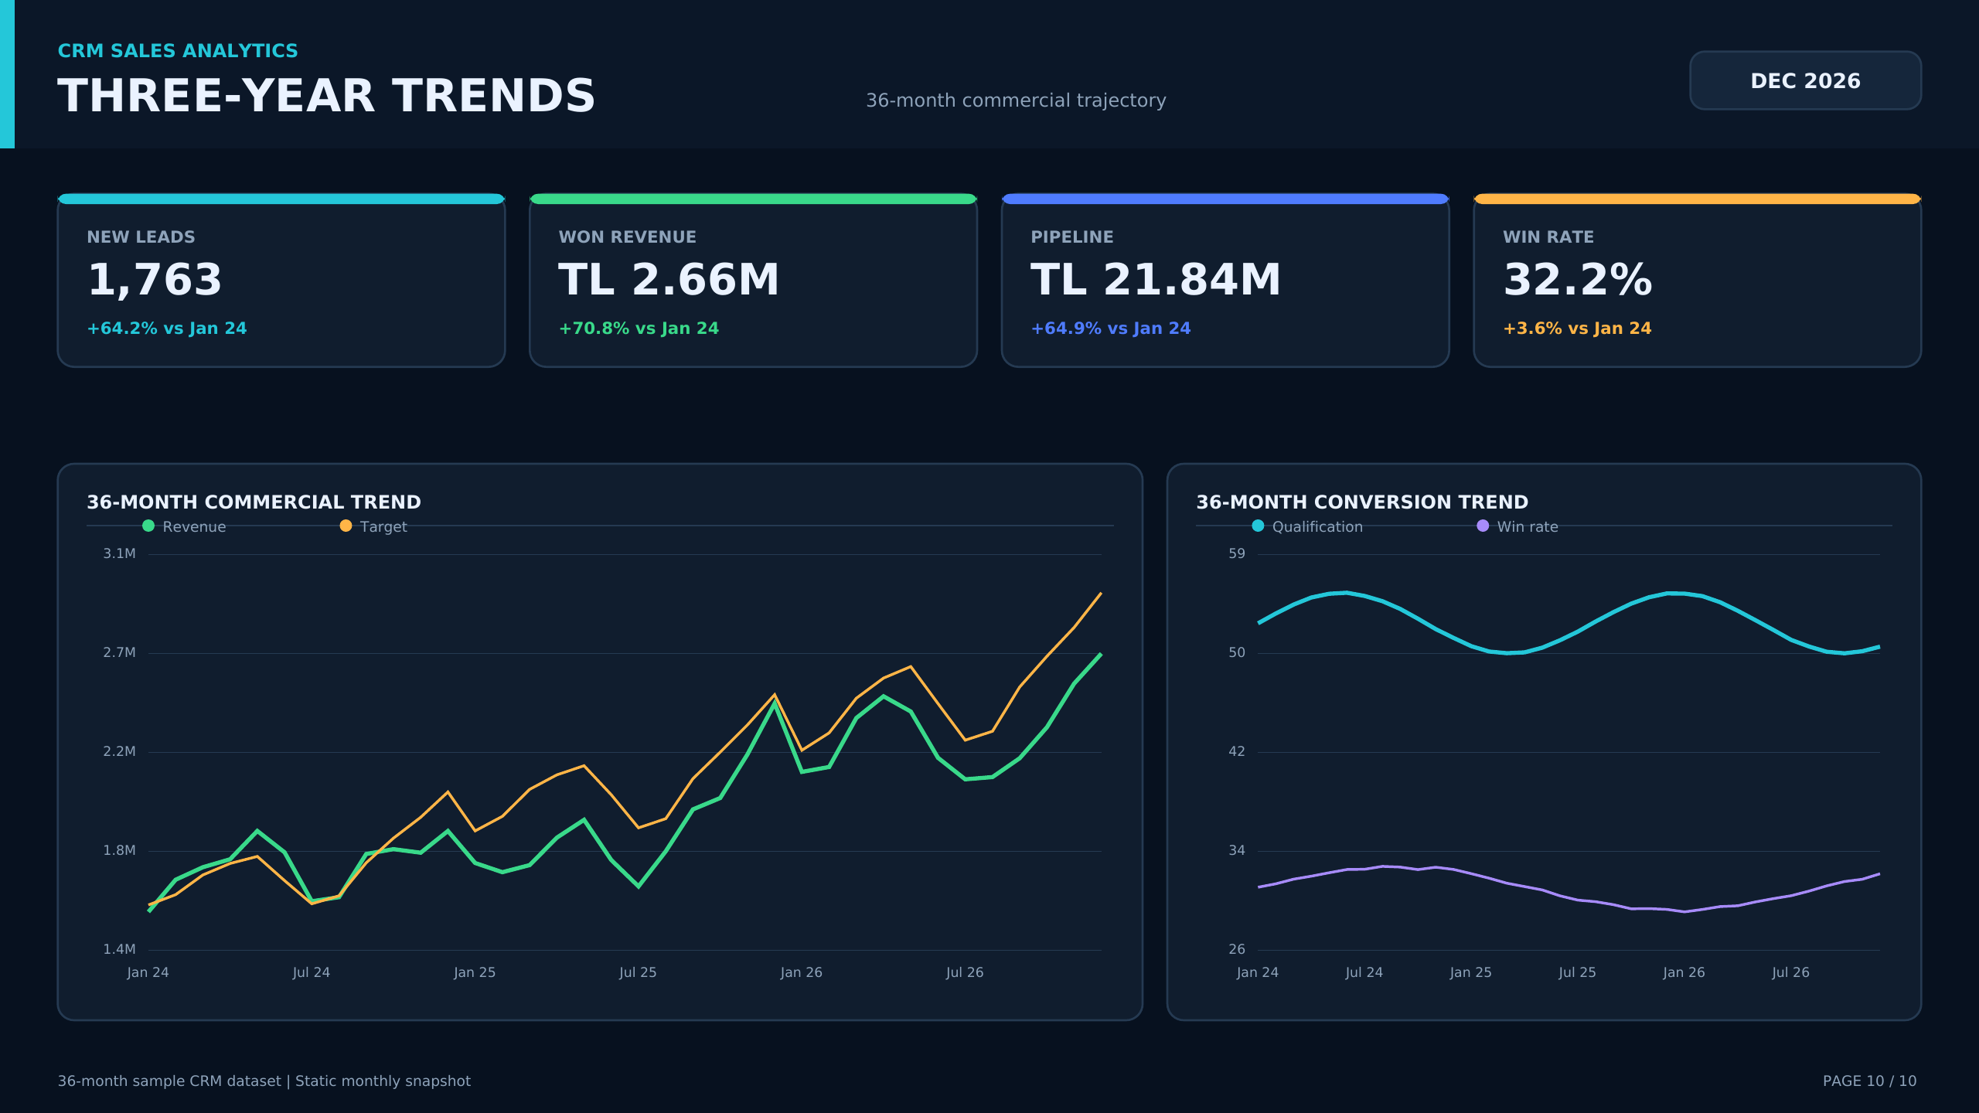
PORTFOLIO OUTCOME
End-to-end CRM analytics: data to action
36-month data • relational model • DAX KPIs • 10-page Power BI • Excel/Tableau outputs • 4K report
Business value: sales visibility, target discipline, channel optimization and rep productivity.
Notes:
Presenter note: Interpret the findings using the underlying dataset.
[Sources]
- crm_monthly.csv
- crm_rep_performance.csv
- crm_lead_sources.csv
- CRM Sales Analytics Power BI / Excel / Tableau project assets

