Slide 1
NOVARETAIL GROUP | CUSTOMER INTELLIGENCE
Customer Intelligence,
CLV & Churn Prediction Platform
RFM
CLV
CHURN
SHAP
A production-style analytics portfolio connecting customer value, retention risk, explainability and next-best-action decisions
Murat Miraç Gedik | Professional Portfolio Project | July 2026
Synthetic portfolio data • 2022–2025 • Production snapshot: 31 Dec 2025 • Currency: TRY
Notes:
[Sources]
- Internal synthetic project source: README.md
- Internal synthetic project source: Models/model_metadata.json
[/Sources]

Slide 2
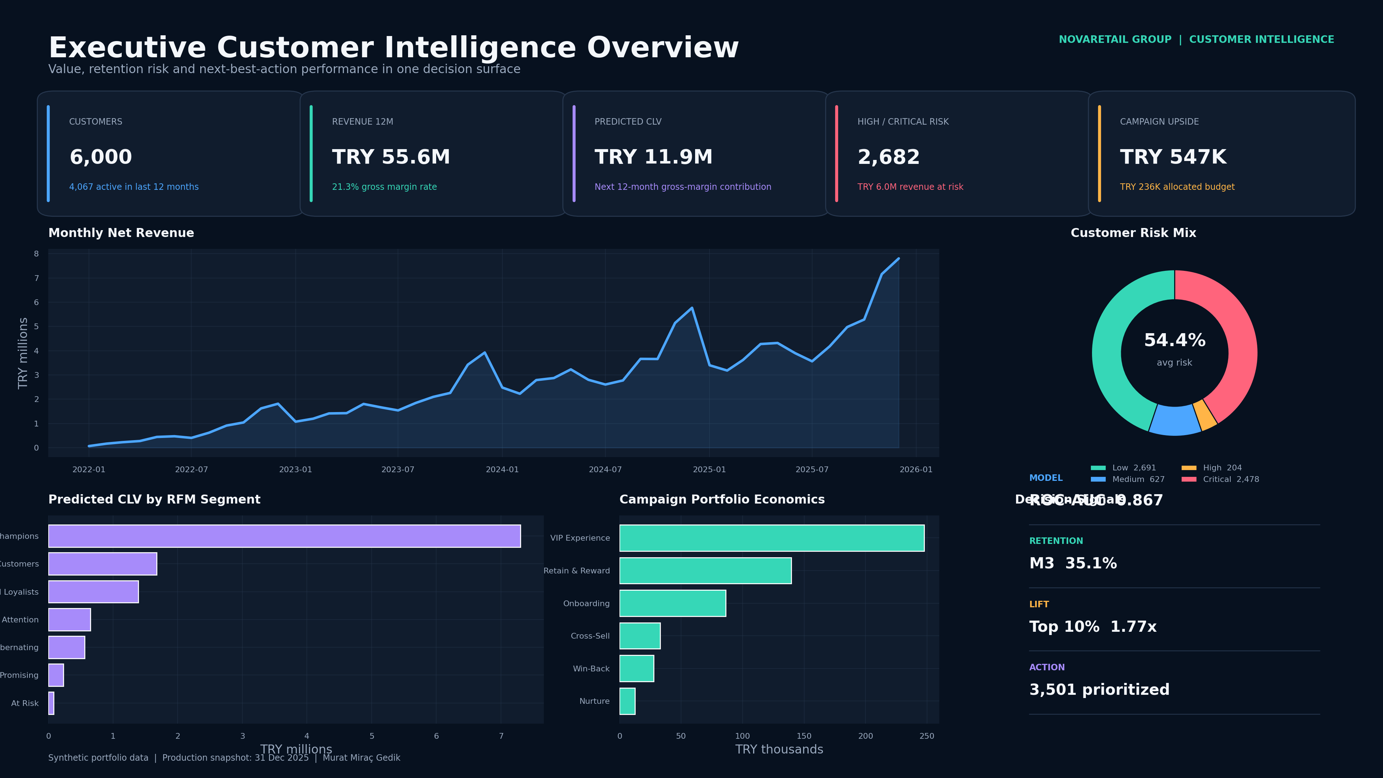
NOVARETAIL GROUP | CUSTOMER INTELLIGENCE
Executive Decision Summary
Value, risk, retention and campaign economics in one view
CUSTOMERS
NET REVENUE / 12M
PREDICTED CLV / 12M
CAMPAIGN UPSIDE
6,000
TRY 55.6M
TRY 11.9M
TRY 547K
4,067 active customers / 12M
21.3% gross-margin rate
Forward gross-margin contribution
TRY 236K allocated budget
Management message
2,682 customers are high or critical risk, representing TRY 6.0M of revenue exposure. Risk should be read together with value and intervention economics.
Decision priority
3,501 customers are prioritized for action. The churn champion delivers 0.867 ROC-AUC and 1.77x lift in the top decile.
Synthetic portfolio data • 2022–2025 • Production snapshot: 31 Dec 2025 • Currency: TRY
02
Notes:
[Sources]
- Internal synthetic project source: Data/Processed/executive_kpis.csv
- Internal synthetic project source: Images/executive-overview.png
[/Sources]

Slide 3
NOVARETAIL GROUP | CUSTOMER INTELLIGENCE
Business Problem
Turn fragmented customer signals into prioritized commercial action
Fragmented customer view
Reactive churn management
Customer value is incomplete when purchase, digital, support and campaign signals remain disconnected.
Acting after the customer leaves makes retention spend inefficient.
Value-blind targeting
Explainability and control
Using risk alone can overinvest in low-value customers and miss profitable interventions.
Business teams cannot trust a score when its drivers and usage boundaries are invisible.
Core decision question
Which customer should receive which intervention, at what time and with what budget?
Synthetic portfolio data • 2022–2025 • Production snapshot: 31 Dec 2025 • Currency: TRY
03
Notes:
[Sources]
- Internal synthetic project source: Docs/methodology.md
- Internal synthetic project source: Docs/campaign_playbook.md
[/Sources]

Slide 4
NOVARETAIL GROUP | CUSTOMER INTELLIGENCE
Scope & Deliverables
An end-to-end analytical product, not a single dashboard
01
02
03
04
05
Data
→
Analytics
→
Decision
→
Delivery
→
Control
Synthetic but relational CRM, order and interaction data
RFM, cohort, CLV, churn and SHAP
Risk × value × ROI targeting logic
BI, Excel, API, SQL and reporting
Testing, drift, fairness and documentation
12-page Power BI PBIP plus reusable DAX measure library
Portfolio strength
24-sheet formula-backed Excel campaign planning model
The project does more than generate predictions: it unifies data engineering, model evaluation, explainability, business rules, visualization, API delivery, testing and governance in one product approach.
Tableau workbook, Streamlit app and FastAPI scoring service
20-slide English/Turkish decks and vector HD report
Synthetic portfolio data • 2022–2025 • Production snapshot: 31 Dec 2025 • Currency: TRY
04
Notes:
[Sources]
- Internal synthetic project source: README.md
- Internal synthetic project source: PowerBI/Customer_Intelligence_PBIP.zip
- Internal synthetic project source: Excel/Customer_Intelligence_CLV_Churn_Campaign_Planner.xlsx
[/Sources]

Slide 5
NOVARETAIL GROUP | CUSTOMER INTELLIGENCE
Data Landscape
Four years of governed, relational and privacy-safe portfolio data
CUSTOMERS
ORDERS
ORDER LINES
6,000
50,639
103,044
Demographics, consent and loyalty
Four-year commercial history
Product and margin granularity
MONTHLY INTERACTIONS
CAMPAIGN RESPONSES
CALENDAR DAYS
130,671
12,000
1,461
Sessions, email and support
Controlled response history
Time-intelligence backbone
Privacy by design
The dataset is fully synthetic and contains no real personal data. Customer keys are anonymous, while marketing consent remains an explicit feature and targeting control.
Synthetic portfolio data • 2022–2025 • Production snapshot: 31 Dec 2025 • Currency: TRY
05
Notes:
[Sources]
- Internal synthetic project source: Data/Raw/dim_customers.csv
- Internal synthetic project source: Data/Raw/fact_orders.csv
- Internal synthetic project source: Models/model_metadata.json
[/Sources]

Slide 6
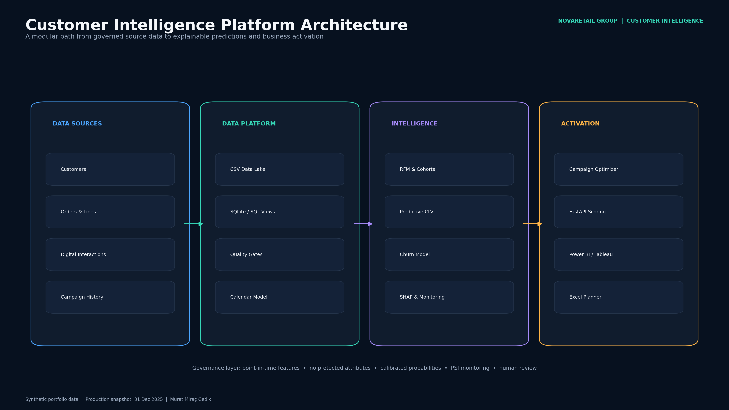
NOVARETAIL GROUP | CUSTOMER INTELLIGENCE
Solution Architecture
A reproducible path from transactions to decisions
Analytical layer
Python feature engineering, RFM/cohort analysis, churn classification, CLV regression and SHAP explanations.
Decision layer
Next-best-action rules combining risk, value, consent, cost and expected margin.
Delivery layer
Power BI, Excel, Tableau, Streamlit, FastAPI, SQL and executive reporting.
Synthetic portfolio data • 2022–2025 • Production snapshot: 31 Dec 2025 • Currency: TRY
06
Notes:
[Sources]
- Internal synthetic project source: Images/architecture.png
- Internal synthetic project source: Python/src/customer_intelligence/pipeline.py
- Internal synthetic project source: SQL/schema.sql
[/Sources]

Slide 7
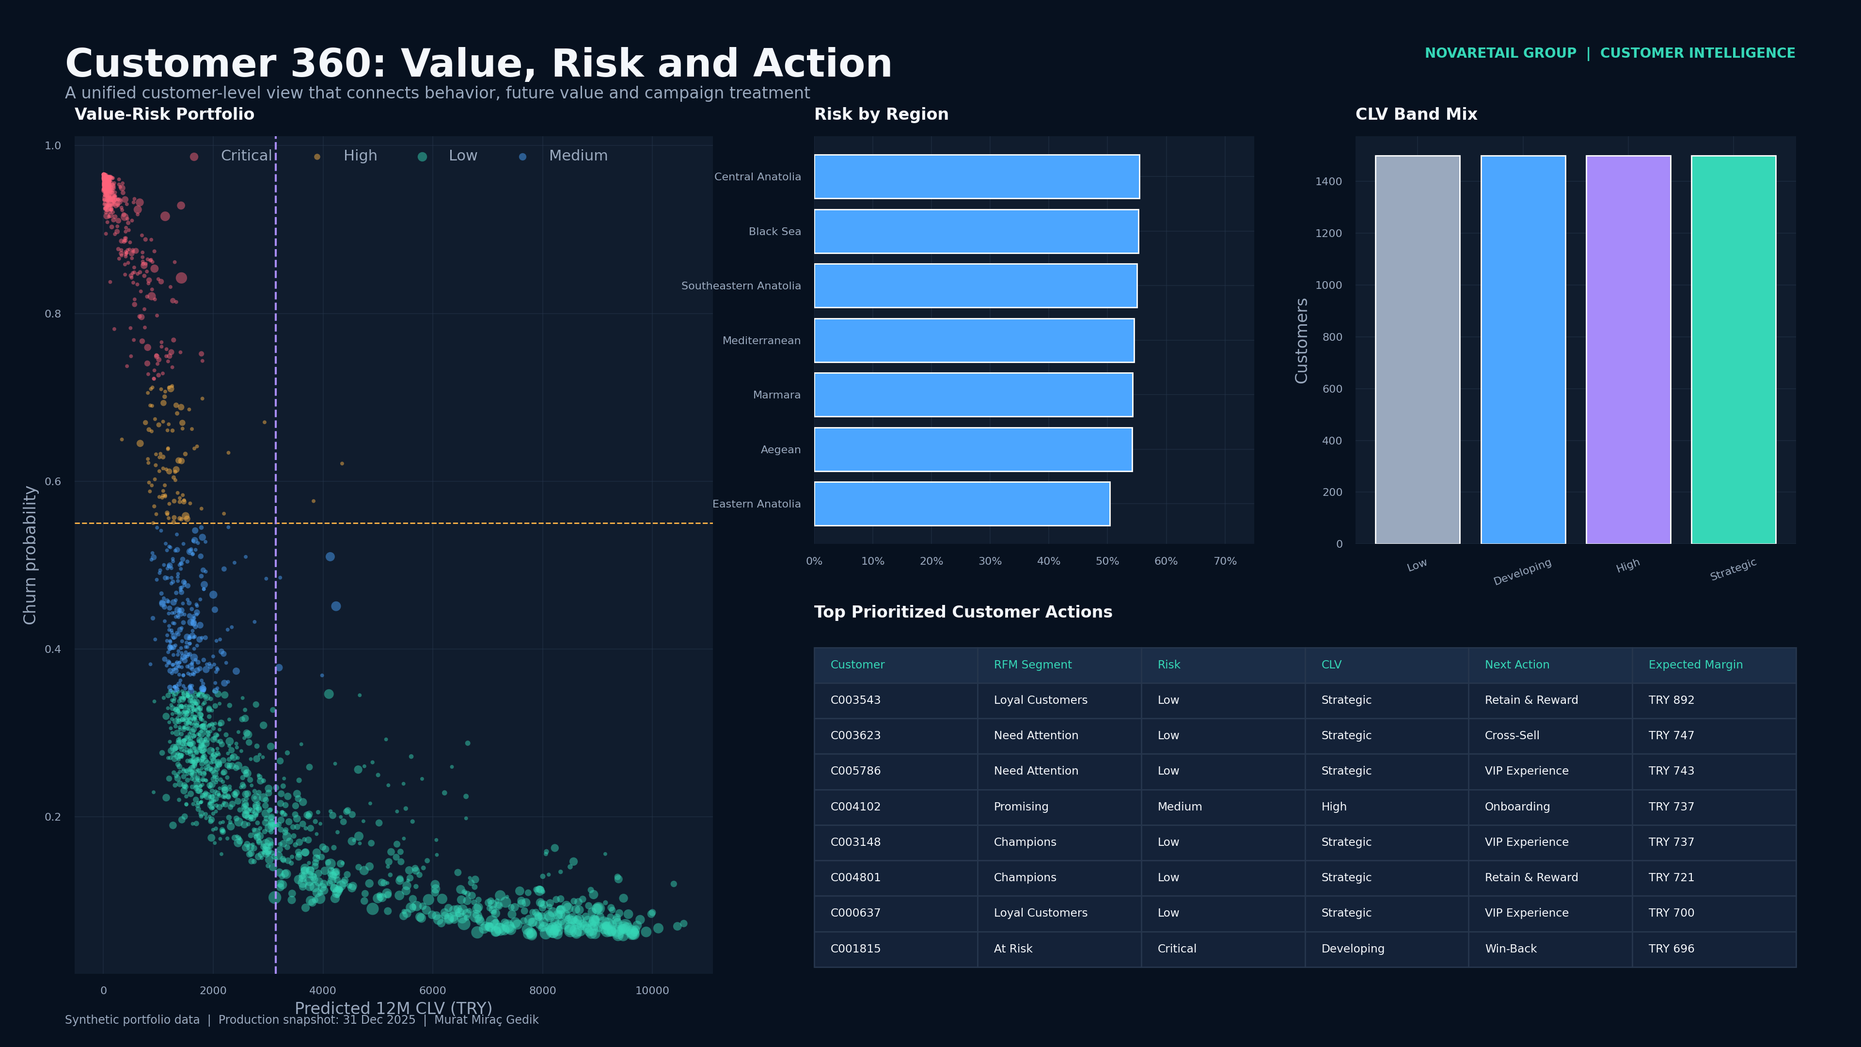
NOVARETAIL GROUP | CUSTOMER INTELLIGENCE
Customer 360 & Semantic Model
One customer-level decision record across value, risk and action
Who?
Region, channel, loyalty tier and marketing consent
What happened?
12-month orders, revenue, margin and returns
What is the value?
RFM segment, CLV forecast and value band
What is the risk?
90-day churn probability, risk tier and SHAP reasons
What next?
Recommended action, treatment cost and expected ROI
Synthetic portfolio data • 2022–2025 • Production snapshot: 31 Dec 2025 • Currency: TRY
07
Notes:
[Sources]
- Internal synthetic project source: Data/Processed/customer_360.csv
- Internal synthetic project source: Images/customer-360.png
- Internal synthetic project source: PowerBI/Customer_Intelligence_PBIP/Customer_Intelligence_Analytics.SemanticModel/model.bim
[/Sources]

Slide 8
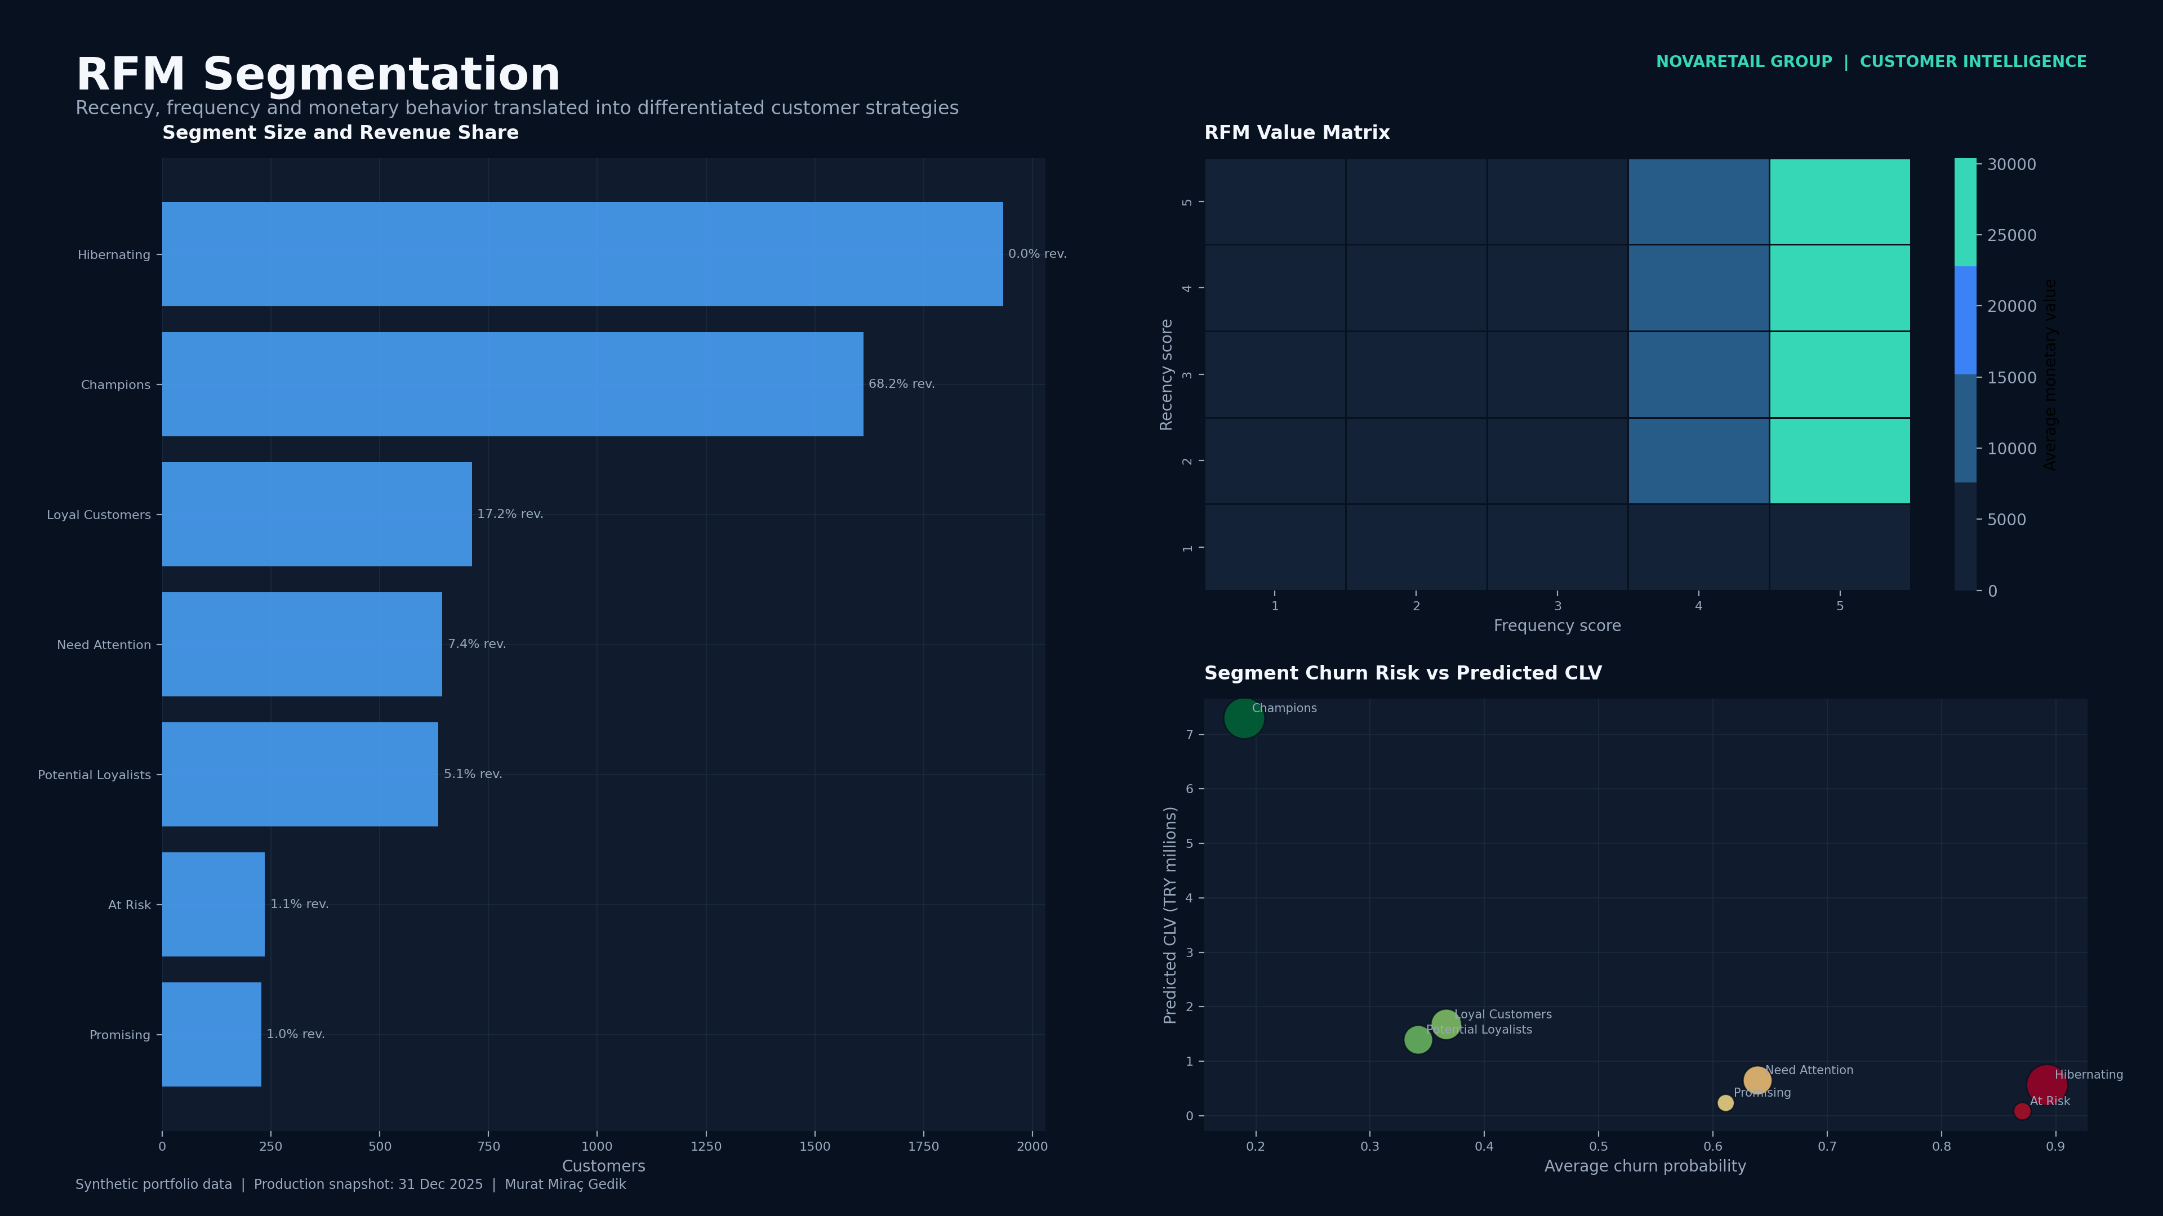
NOVARETAIL GROUP | CUSTOMER INTELLIGENCE
RFM Segmentation
Behavioral groups connect customer strategy to measurable economics
CHAMPIONS
TRY 7.3M
1,612 customers • 19.0% risk
LOYAL CUSTOMERS
TRY 1.7M
712 customers • 36.7% risk
POTENTIAL LOYALISTS
TRY 1.4M
635 customers • 34.2% risk
Commercial interpretation
Champions anchor the CLV portfolio; at-risk groups require selective, economics-led win-back.
Synthetic portfolio data • 2022–2025 • Production snapshot: 31 Dec 2025 • Currency: TRY
08
Notes:
[Sources]
- Internal synthetic project source: Data/Processed/rfm_scores.csv
- Internal synthetic project source: Data/Processed/segment_summary.csv
- Internal synthetic project source: Images/rfm-segmentation.png
[/Sources]

Slide 9
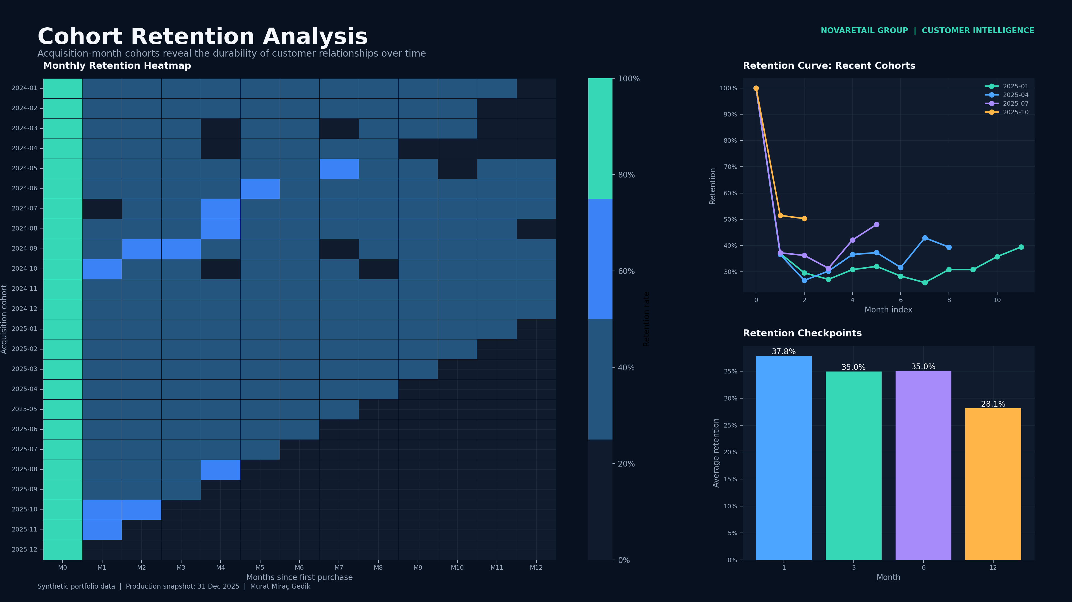
NOVARETAIL GROUP | CUSTOMER INTELLIGENCE
Cohort Retention
Acquisition quality is measured beyond the first purchase
MONTH-3 RETENTION
35.1%
Average across cohorts
COHORT HORIZON
M0–M12
Months after first purchase
How to use it
Compare acquisition months, link early decay to channel, offer and onboarding quality, and avoid relying on aggregate active-customer counts alone.
Synthetic portfolio data • 2022–2025 • Production snapshot: 31 Dec 2025 • Currency: TRY
09
Notes:
[Sources]
- Internal synthetic project source: Data/Processed/cohort_retention_matrix.csv
- Internal synthetic project source: Data/Processed/cohort_retention_long.csv
- Internal synthetic project source: Images/cohort-retention.png
[/Sources]

Slide 10
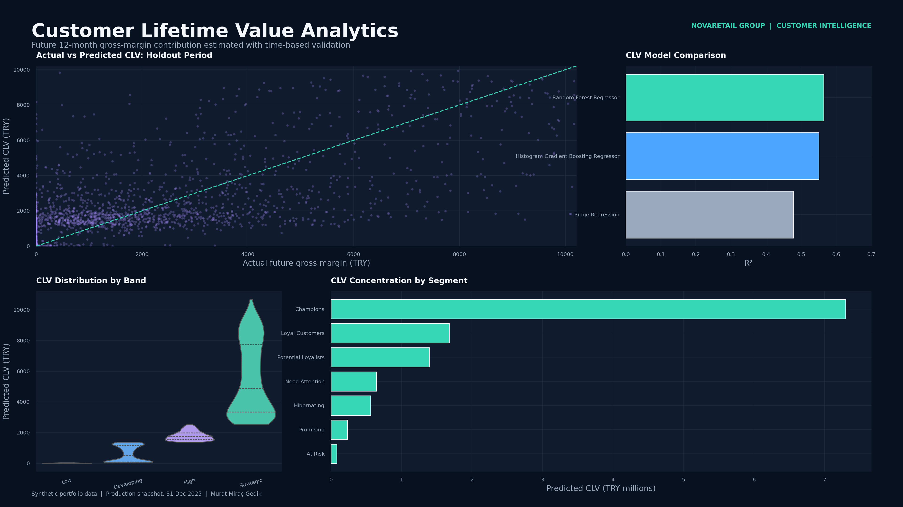
NOVARETAIL GROUP | CUSTOMER INTELLIGENCE
Predictive CLV
Twelve-month gross-margin contribution guides value-based prioritization
CHAMPION MODEL
Random Forest
12-month gross-margin target
MAE
R²
TRY 1.3K
0.564
Holdout error
Explained variance
SPEARMAN
PORTFOLIO CLV
0.792
TRY 11.9M
Ranking power
Forward 12M
Decision use
CLV is a prioritization factor for offer cost, service level and retention budget.
Synthetic portfolio data • 2022–2025 • Production snapshot: 31 Dec 2025 • Currency: TRY
10
Notes:
[Sources]
- Internal synthetic project source: Data/Processed/clv_model_comparison.csv
- Internal synthetic project source: Data/Processed/clv_predictions.csv
- Internal synthetic project source: Images/clv-analysis.png
[/Sources]

Slide 11
NOVARETAIL GROUP | CUSTOMER INTELLIGENCE
Churn Methodology
Time-aware labels, calibration and threshold governance reduce leakage
01
02
03
04
05
Build snapshots
→
Label
→
Validate
→
Calibrate
→
Score
Historical features from 2024 quarterly cutoffs
No purchase in next 90 days means churn
31 Dec 2024 time-based holdout
Probability quality and F1 threshold
31 Dec 2025 customer portfolio
FEATURES
PREDICTION HORIZON
DECISION THRESHOLD
CALIBRATION
16
90 days
0.33
Brier 0.145
Behavior, value and engagement
Forward-looking churn label
Selected on training data before holdout
Probability reliability
Leakage control
Every feature uses information available by the snapshot date. Threshold selection and model comparison are completed before the production snapshot.
Synthetic portfolio data • 2022–2025 • Production snapshot: 31 Dec 2025 • Currency: TRY
11
Notes:
[Sources]
- Internal synthetic project source: Python/src/customer_intelligence/features.py
- Internal synthetic project source: Python/src/customer_intelligence/modeling.py
- Internal synthetic project source: Models/model_metadata.json
[/Sources]

Slide 12
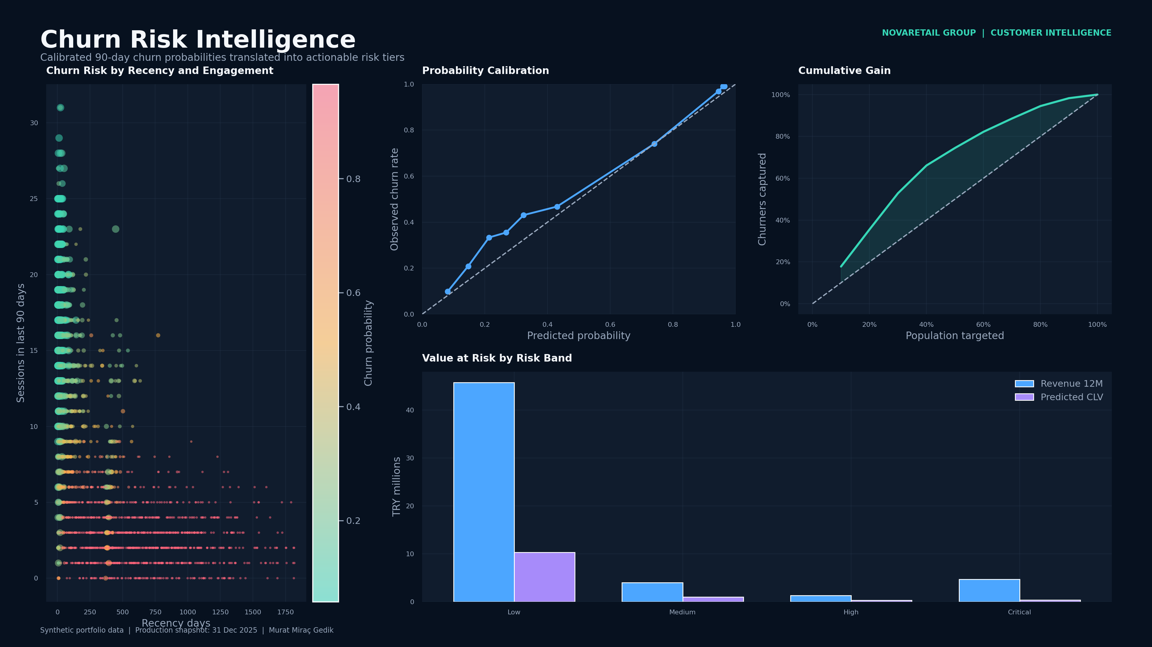
NOVARETAIL GROUP | CUSTOMER INTELLIGENCE
Risk Portfolio
Risk tiers focus retention effort where revenue exposure is greatest
HIGH / CRITICAL
2,682
Customers
REVENUE AT RISK
TRY 6.0M
Last-12-month revenue exposure
Priority logic
Critical risk does not automatically justify high spend. CLV, margin, consent and expected response are evaluated together; low-economic-value records may be suppressed.
Synthetic portfolio data • 2022–2025 • Production snapshot: 31 Dec 2025 • Currency: TRY
12
Notes:
[Sources]
- Internal synthetic project source: Data/Processed/churn_predictions.csv
- Internal synthetic project source: Data/Processed/risk_bands.csv
- Internal synthetic project source: Images/churn-risk.png
[/Sources]

Slide 13
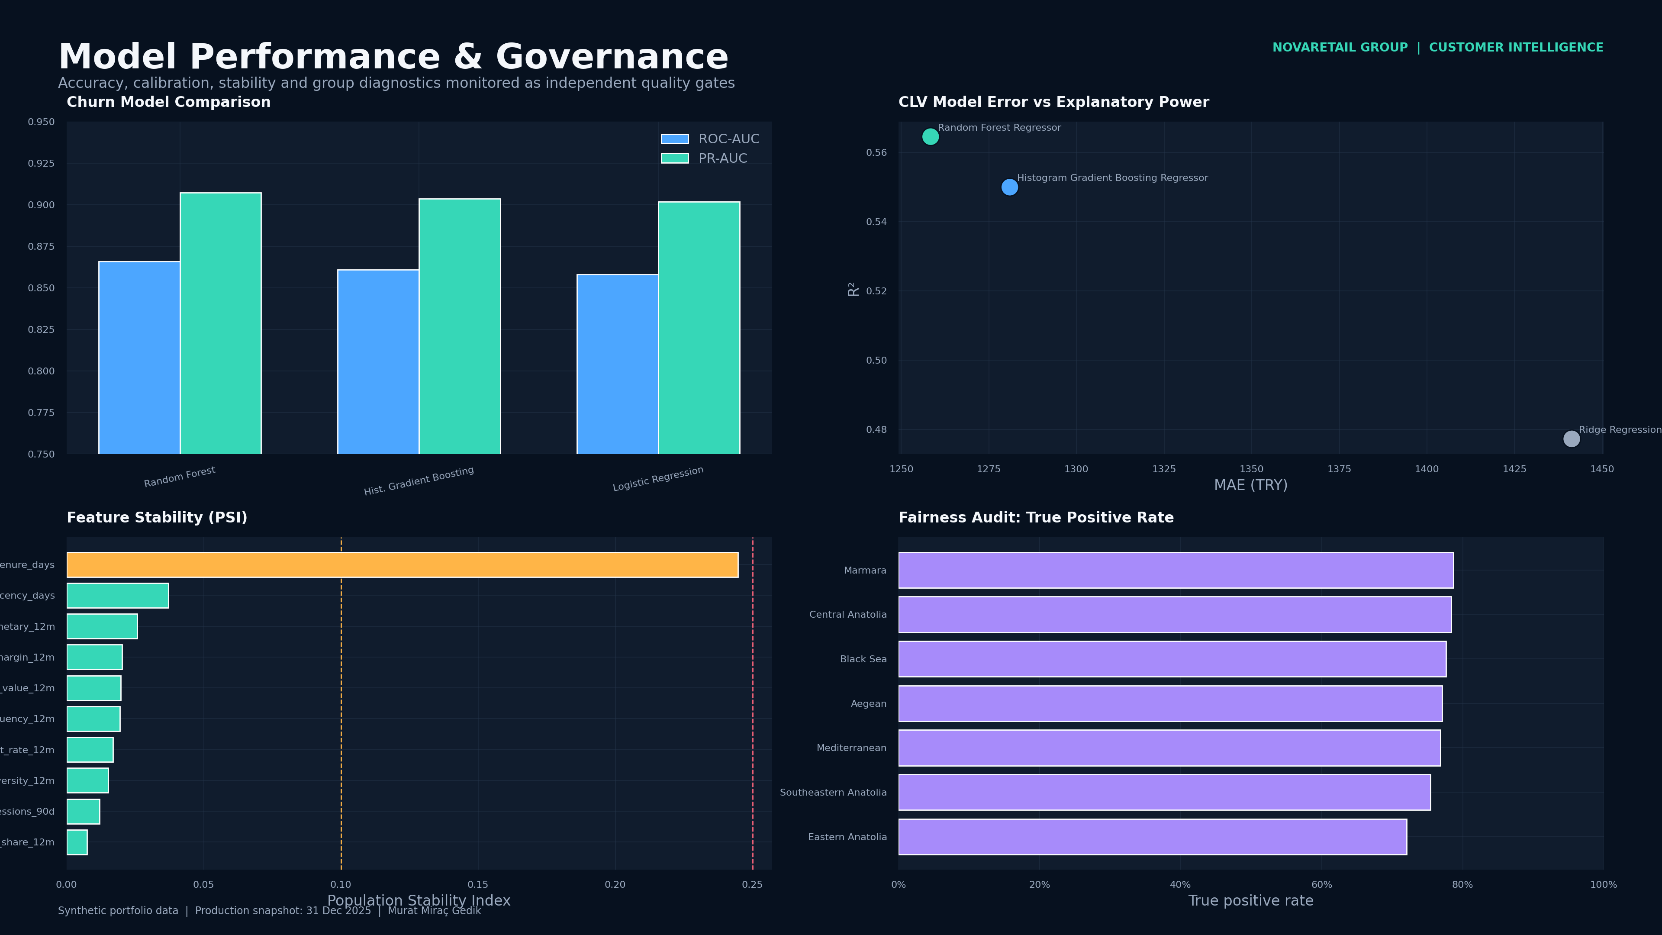
NOVARETAIL GROUP | CUSTOMER INTELLIGENCE
Model Performance
Champion selection balances discrimination, calibration and business lift
ROC-AUC
PR-AUC
0.867
0.908
Discrimination
Imbalanced class
TOP-10% LIFT
F1
1.77x
0.792
Targeting power
Balance metric
Champion selection approach
Calibrated Random Forest produced the strongest combined result. Selection was not based on ROC-AUC alone: PR-AUC, Brier, F1, lift and the operating threshold were considered together.
Synthetic portfolio data • 2022–2025 • Production snapshot: 31 Dec 2025 • Currency: TRY
13
Notes:
[Sources]
- Internal synthetic project source: Data/Processed/churn_model_comparison.csv
- Internal synthetic project source: Data/Processed/churn_calibration.csv
- Internal synthetic project source: Images/model-performance.png
[/Sources]

Slide 14
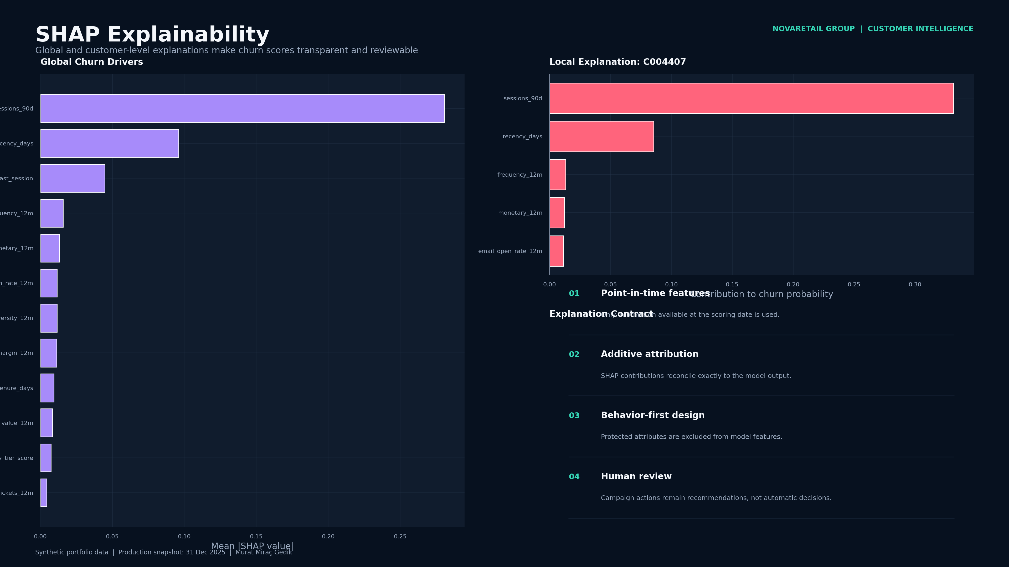
NOVARETAIL GROUP | CUSTOMER INTELLIGENCE
SHAP Explainability
Global and local drivers make risk scores operationally interpretable
SESSIONS 90D
53.8%
Global importance share
RECENCY DAYS
18.4%
Global importance share
DAYS SINCE LAST SESSION
8.6%
Global importance share
Usage boundary
SHAP explains model association, not causality. Human review and campaign controls remain above the score.
Synthetic portfolio data • 2022–2025 • Production snapshot: 31 Dec 2025 • Currency: TRY
14
Notes:
[Sources]
- Internal synthetic project source: Data/Processed/shap_global_importance.csv
- Internal synthetic project source: Data/Processed/shap_local_explanations.csv
- Internal synthetic project source: Python/src/customer_intelligence/explainability.py
[/Sources]

Slide 15
NOVARETAIL GROUP | CUSTOMER INTELLIGENCE
Fairness, Drift & Governance
Responsible use requires controls after model approval
Region
Customers
Observed Churn
Avg Risk
ROC-AUC
DRIFT WATCH
QUALITY GATES
Aegean
621
57.6%
52.0%
0.856
tenure days
10/10
Black Sea
367
54.8%
50.1%
0.885
PSI 0.245
All PASS
Central Anatolia
671
57.8%
51.4%
0.873
Eastern Anatolia
159
58.5%
48.1%
0.869
Fairness control
Marmara
1,549
54.2%
50.5%
0.865
Customer count, observed churn, average risk, ROC-AUC and true-positive rate are monitored by region and age band.
Mediterranean
486
56.0%
50.7%
0.871
Production rule
Monthly performance and data quality; quarterly drift/fairness review; retrain or withdraw when thresholds are exceeded.
Synthetic portfolio data • 2022–2025 • Production snapshot: 31 Dec 2025 • Currency: TRY
15
Notes:
[Sources]
- Internal synthetic project source: Data/Processed/fairness_audit.csv
- Internal synthetic project source: Data/Processed/drift_monitoring.csv
- Internal synthetic project source: Data/Processed/data_quality_report.csv
[/Sources]

Slide 16
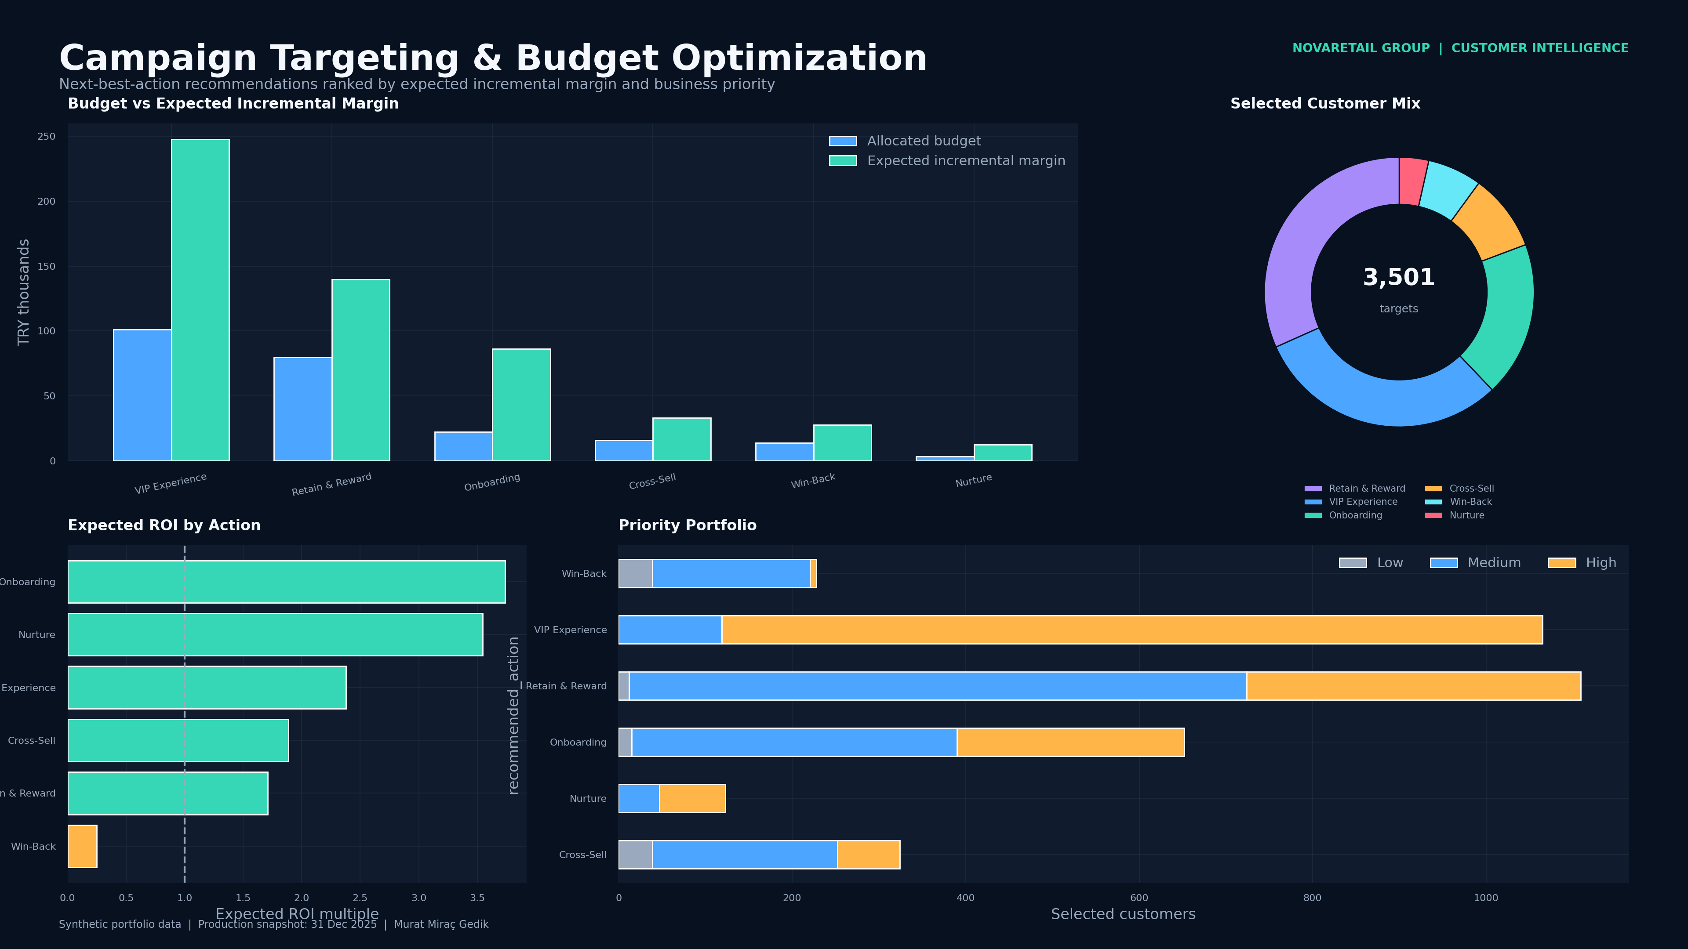
NOVARETAIL GROUP | CUSTOMER INTELLIGENCE
Campaign Targeting
Next-best-action rules convert predictions into controlled interventions
PRIORITIZED
3,501
Customer actions
ALLOCATED BUDGET
TRY 236K
Within model budget cap
EXPECTED MARGIN
TRY 547K
Incremental campaign contribution
Control
Customers without marketing consent are suppressed.
Synthetic portfolio data • 2022–2025 • Production snapshot: 31 Dec 2025 • Currency: TRY
16
Notes:
[Sources]
- Internal synthetic project source: Data/Processed/campaign_targets.csv
- Internal synthetic project source: Data/Processed/campaign_summary.csv
- Internal synthetic project source: Images/campaign-targeting.png
[/Sources]

Slide 17
NOVARETAIL GROUP | CUSTOMER INTELLIGENCE
Campaign Economics
Budget is allocated by expected incremental margin and ROI
Invest
ROI ≥ 1.0x and positive incremental margin
Test
ROI 0.25x–1.0x; controlled experiment
Hold
Negative economics or weak eligibility
Portfolio principle
The model selects; the budget constrains; experimentation validates.
Synthetic portfolio data • 2022–2025 • Production snapshot: 31 Dec 2025 • Currency: TRY
17
Notes:
[Sources]
- Internal synthetic project source: Data/Processed/campaign_summary.csv
- Internal synthetic project source: Excel/Customer_Intelligence_CLV_Churn_Campaign_Planner.xlsx
- Internal synthetic project source: Python/src/customer_intelligence/campaign.py
[/Sources]

Slide 18
NOVARETAIL GROUP | CUSTOMER INTELLIGENCE
Multi-Platform Delivery
Power BI, Excel, Tableau, SQL, API and documentation work as one system
Power BI
Excel
Tableau
12-page PBIP
DAX + semantic model
24-sheet decision model
Scenario and QA formulas
3 dashboards
8 analytical worksheets
Python & SQL
API & App
Governance
Reproducible pipeline
SQLite analytical layer
FastAPI scoring
Streamlit exploration app
Tests and model cards
Drift, fairness and CI
Single-source principle
Every channel uses the same business definitions, customer key and validated output tables.
Synthetic portfolio data • 2022–2025 • Production snapshot: 31 Dec 2025 • Currency: TRY
18
Notes:
[Sources]
- Internal synthetic project source: PowerBI/Customer_Intelligence_PBIP.zip
- Internal synthetic project source: Tableau/Customer_Intelligence_Dashboard.twb
- Internal synthetic project source: API/main.py
- Internal synthetic project source: App/streamlit_app.py
[/Sources]

Slide 19
NOVARETAIL GROUP | CUSTOMER INTELLIGENCE
90-Day Roadmap
A pragmatic path from portfolio prototype to an operating capability
Success criterion
Pilot success is judged by incremental margin, customer experience, operational adoption and absence of control breaches—not model metrics alone.
Days 0–30
Days 31–60
Days 61–90
Foundation & Pilot
Model & Experiment
Operate
Source mapping
KPI dictionary
Pilot cohort
Time-based validation
A/B design
Approval gate
BI release
API integration
Monitoring cadence
Synthetic portfolio data • 2022–2025 • Production snapshot: 31 Dec 2025 • Currency: TRY
19
Notes:
[Sources]
- Internal synthetic project source: Docs/model_monitoring.md
- Internal synthetic project source: Docs/campaign_playbook.md
- Internal synthetic project source: Docs/privacy_ethics.md
[/Sources]

Slide 20
THANK YOU
Know customer value.
Anticipate risk.
Act with discipline.
VALUE
+
RISK
→
ACTION
A portfolio-ready customer intelligence platform combining statistical analysis, machine learning, business intelligence, decision science and executive communication.
Murat Miraç Gedik
Python • SQL • Power BI • Excel • Tableau • Scikit-learn • SHAP
Synthetic portfolio data • 2022–2025 • Production snapshot: 31 Dec 2025 • Currency: TRY
Notes:
[Sources]
- Internal synthetic project source: README.md
[/Sources]

