Slide 1
GEOSPATIAL DECISION INTELLIGENCE
Istanbul Site Selection
& Market Expansion
Network accessibility, demand prediction, explainable scoring and constrained portfolio optimization
MarmaraMart • Executive decision-support deck • 29 July 2026
Deterministic synthetic commercial data
Notes:
Frame the deck as a reproducible decision-support system, not a site-acquisition recommendation.
[Sources]
- Local pipeline: artifacts/metrics/pipeline_summary.json

Slide 2
The base scenario funds four complementary sites
The optimized portfolio stays within budget and expands network coverage, but site-level economics still require validation.
4
TRY 93.4m
1,329,291
23.1%
new stores in the base portfolio
of TRY 110.0m budget
incremental people in 10-minute drive catchments
total metro population covered by existing + selected stores
Ikitelli Industry leads at 81.2/100; Sultanbeyli is the only base-selected site with positive three-year ROI in the controlled assumptions.
Decision implication: approve field validation and commercial diligence—not capital commitment.
Synthetic decision support • Human review required
02
Notes:
Lead with the portfolio answer, then emphasize that ROI uncertainty is a deliberate decision gate.
[Sources]
- Local pipeline: artifacts/data/scenario_summaries.csv
- Local pipeline: artifacts/data/candidate_scores.csv

Slide 3
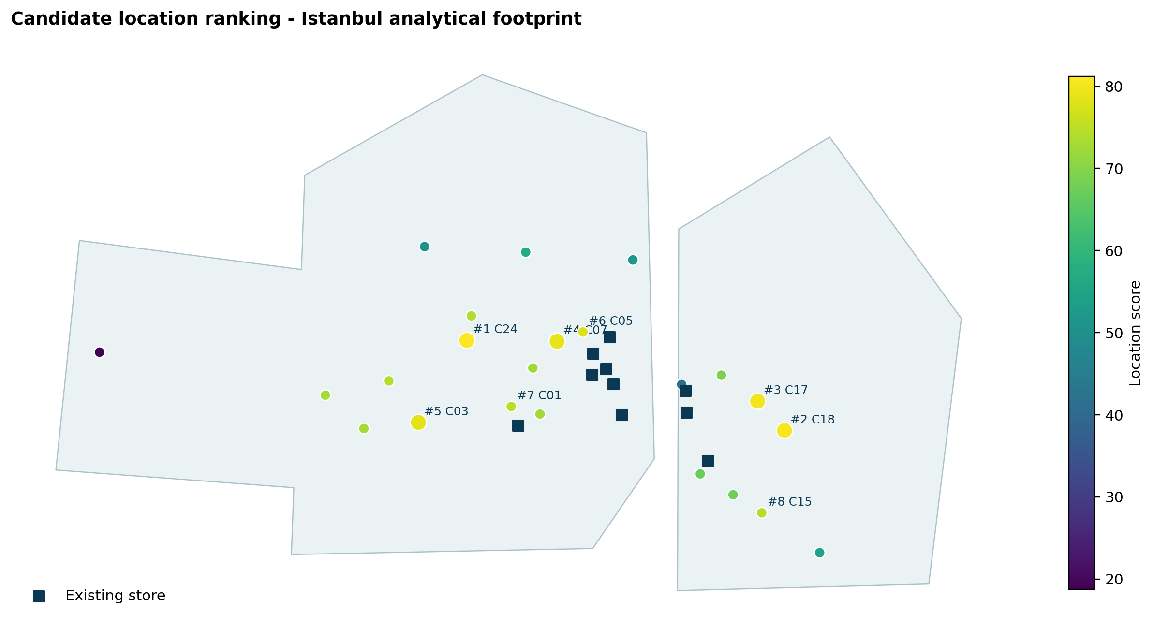
A city-scale microzone model replaces district averages
5,965 H3 cells preserve local differences in demand, access, cost and competitive pressure.
5,965
H3 resolution-8 microzones
24
candidate sites ranked
10 / 96 / 720
existing stores / competitors / POIs
Synthetic decision support • Human review required
03
Notes:
Explain that the footprint is analytical—not an administrative boundary—and all coordinates are WGS84.
[Sources]
- Local map: artifacts/figures/candidate_rank_map.png
- Local pipeline: artifacts/metrics/pipeline_summary.json

Slide 4
Four layers turn geography into an auditable decision
Every output is traceable from source assumptions through network, model, score and optimization artifacts.
01
02
03
04
Spatial foundation
Demand & access
Explainable scoring
Portfolio allocation
→
→
→
WGS84 storage
EPSG:32635 metrics
H3 microzones
Network isochrones
Huff customer share
Spatial block CV
SHAP demand drivers
AHP weights
Sensitivity testing
Budget and distance
Maximum coverage
Scenario portfolios
Audit spine • data contracts • quality gates • model card • runbook • monitored API
Synthetic decision support • Human review required
04
Notes:
Walk left to right. The audit spine is continuous across every analytical stage.
[Sources]
- Local architecture: docs/architecture.md
- Local pipeline: src/site_intelligence/

Slide 5
Commercial outcomes remain synthetic by design
The separation prevents personal-data exposure and keeps every business result reproducible.
Layer | What is used | Governance control
Geographic frame | Approximate public-place coordinates; WGS84 | No address-level customer or device data
Business attributes | Population, income, rent, demand and sales | Deterministic generator; seed 20260729
Network | H3 adjacency plus explicit bridge links | Projected centroid distance in EPSG:32635
Map context | OpenStreetMap tiles in interactive HTML | Attribution and ODbL link included
Decision outputs | Scores, forecasts and selected portfolios | Human review; not investment advice
Source/license crosswalk records access date, use, origin and license for each external component.
Synthetic decision support • Human review required
05
Notes:
Call out the analytical-boundary limitation and the absence of real customer data.
[Sources]
- OpenStreetMap attribution: https://www.openstreetmap.org/copyright
- H3 license: https://h3geo.org/docs/
- GeoPandas license: https://geopandas.org/en/stable/about.html
- Shapely license: https://shapely.readthedocs.io/
- Local crosswalk: docs/data_source_license_crosswalk.md

Slide 6
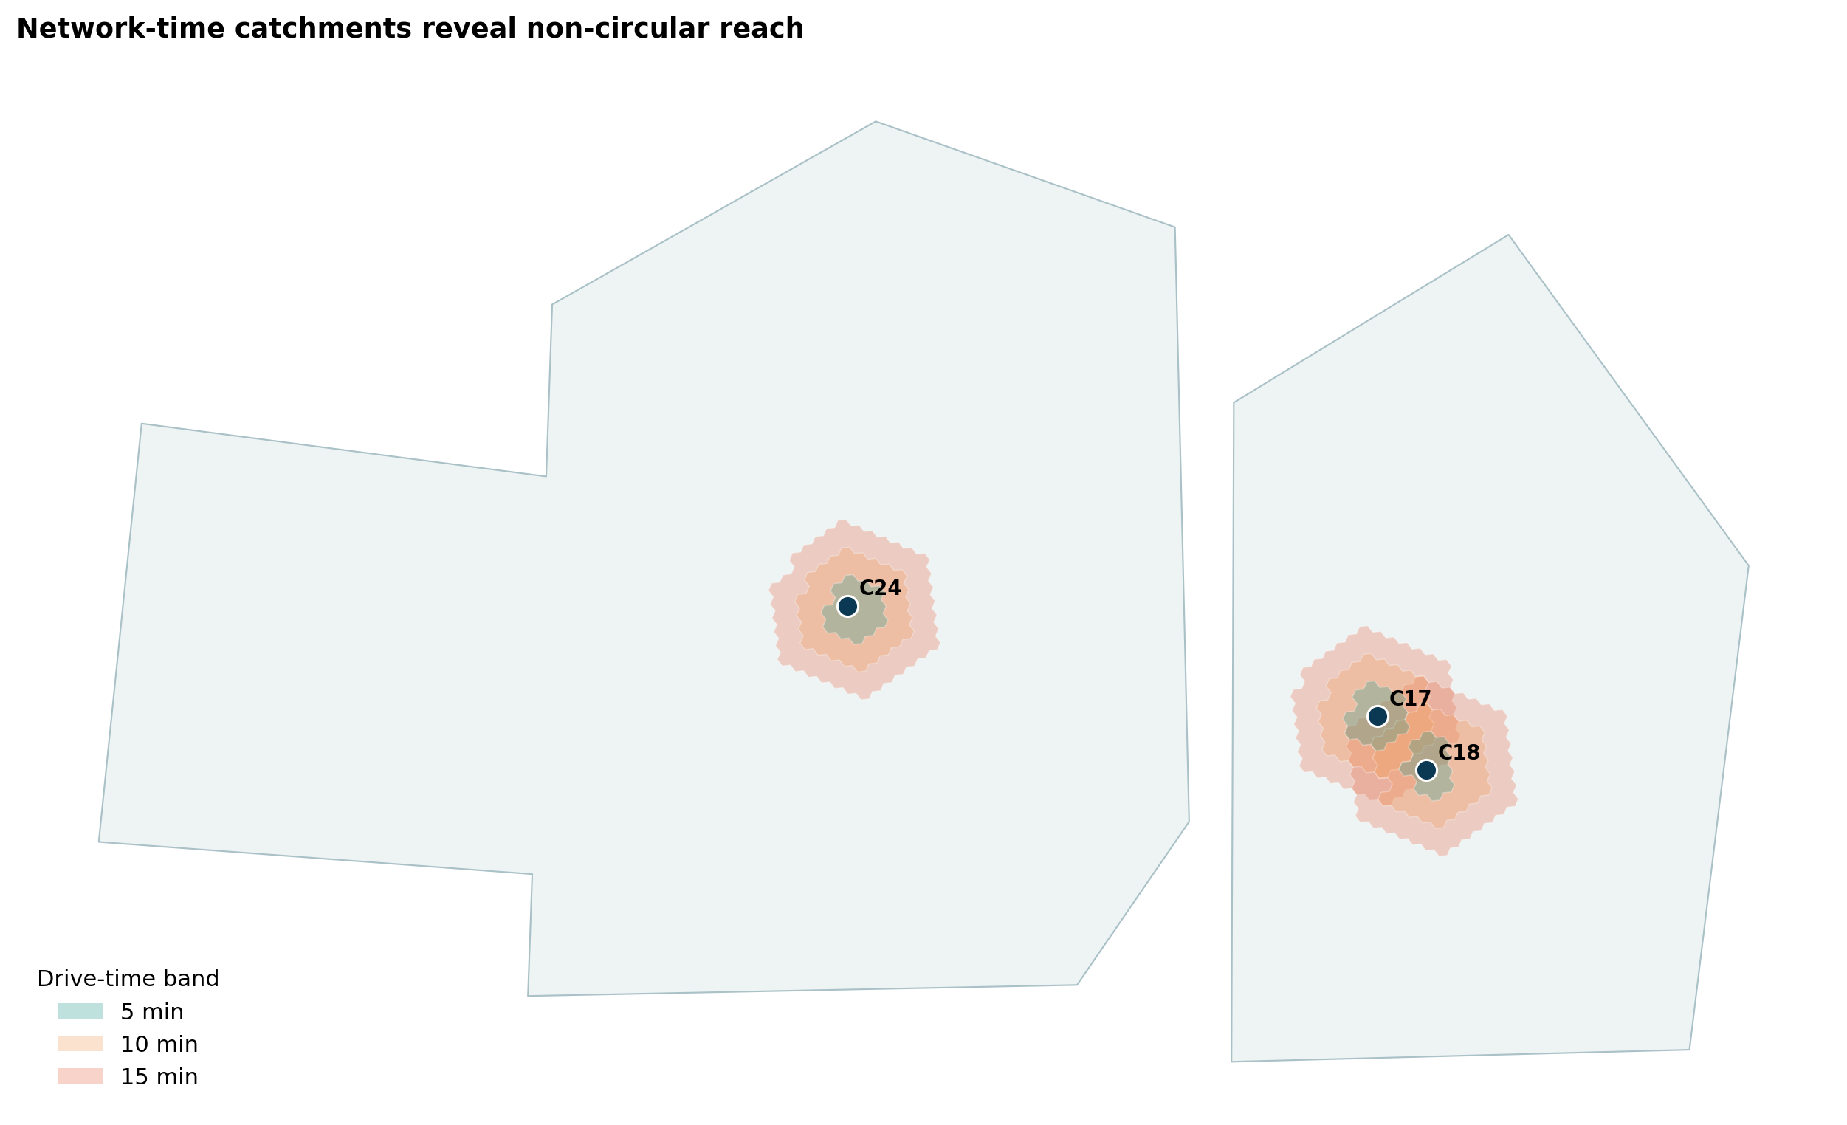
Network time exposes reach that circular buffers cannot
Ikitelli Industry reaches 396,396 people in 10 minutes by the modeled drive network.
118,859
5-minute drive
396,396
10-minute drive
823,788
15-minute drive
66.1% fewer people than the naïve straight-line radius estimate
Synthetic decision support • Human review required
06
Notes:
Stress that travel times come from a deterministic H3 network proxy, not live routing or current traffic.
[Sources]
- Local map: artifacts/figures/network_isochrones.png
- Local accessibility: artifacts/data/candidate_accessibility.csv

Slide 7
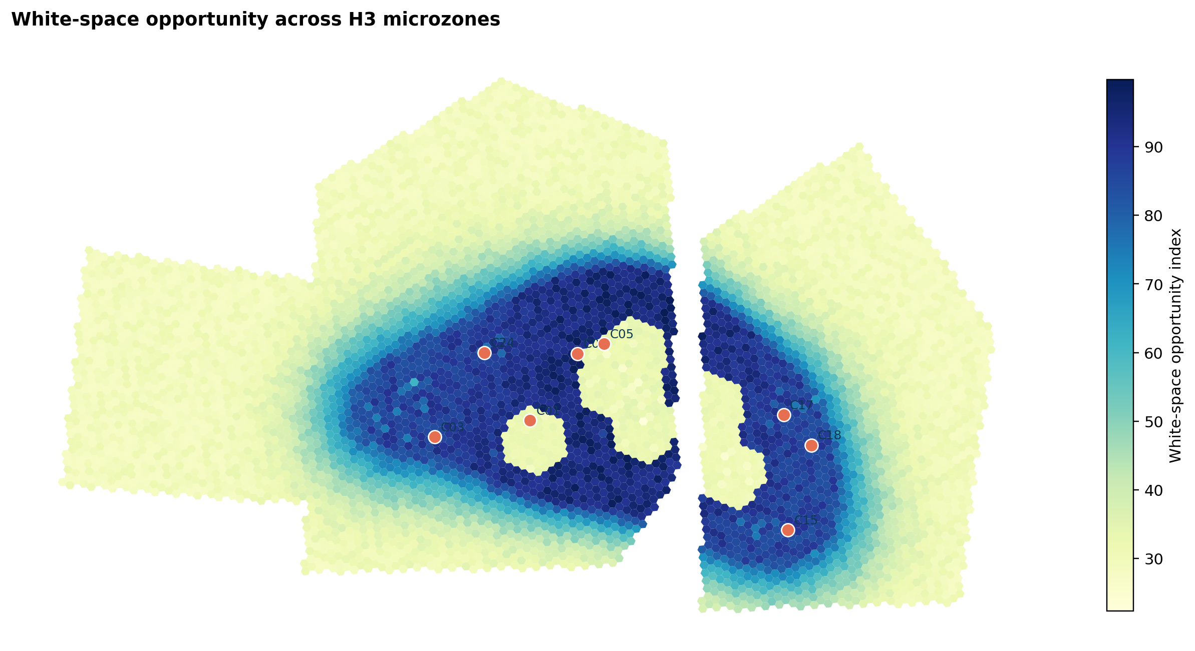
White-space scoring rewards uncovered demand
Opportunity combines demand weight, competition headroom and an explicit penalty for existing-store coverage.
Candidate | White-space norm. | Rank
Avcilar University | 1.000 | #5
Buyukcekmece Center | 0.988 | #12
Arnavutkoy Center | 0.790 | #22
Gokturk Center | 0.611 | #18
A high white-space score is necessary but not sufficient: cost, delivery and profitability remain independent gates.
Synthetic decision support • Human review required
07
Notes:
Use the map to distinguish microzone opportunity from the final candidate rank.
[Sources]
- Local map: artifacts/figures/white_space_opportunity_map.png
- Local H3 data: data/processed/h3_microzones.geojson

Slide 8
Cannibalization distinguishes growth from estate overlap
The risk combines 10-minute population overlap and distance decay to the nearest existing store.
Candidate | Risk | Nearest store
Ikitelli Industry | 1.0% | 12.5 km
Sultanbeyli Square | 1.8% | 10.4 km
Eyupsultan Hub | 34.9% | 4.8 km
Kagithane Axis | 61.0% | 3.0 km
Huff diversion is reported separately, so customer-share transfer is not hidden inside one overlap metric.
Synthetic decision support • Human review required
08
Notes:
Contrast C24 and C18 with Kagithane: similar demand, very different estate overlap.
[Sources]
- Local candidates: artifacts/data/candidate_scores.csv
- Local method: docs/methodology.md

Slide 9
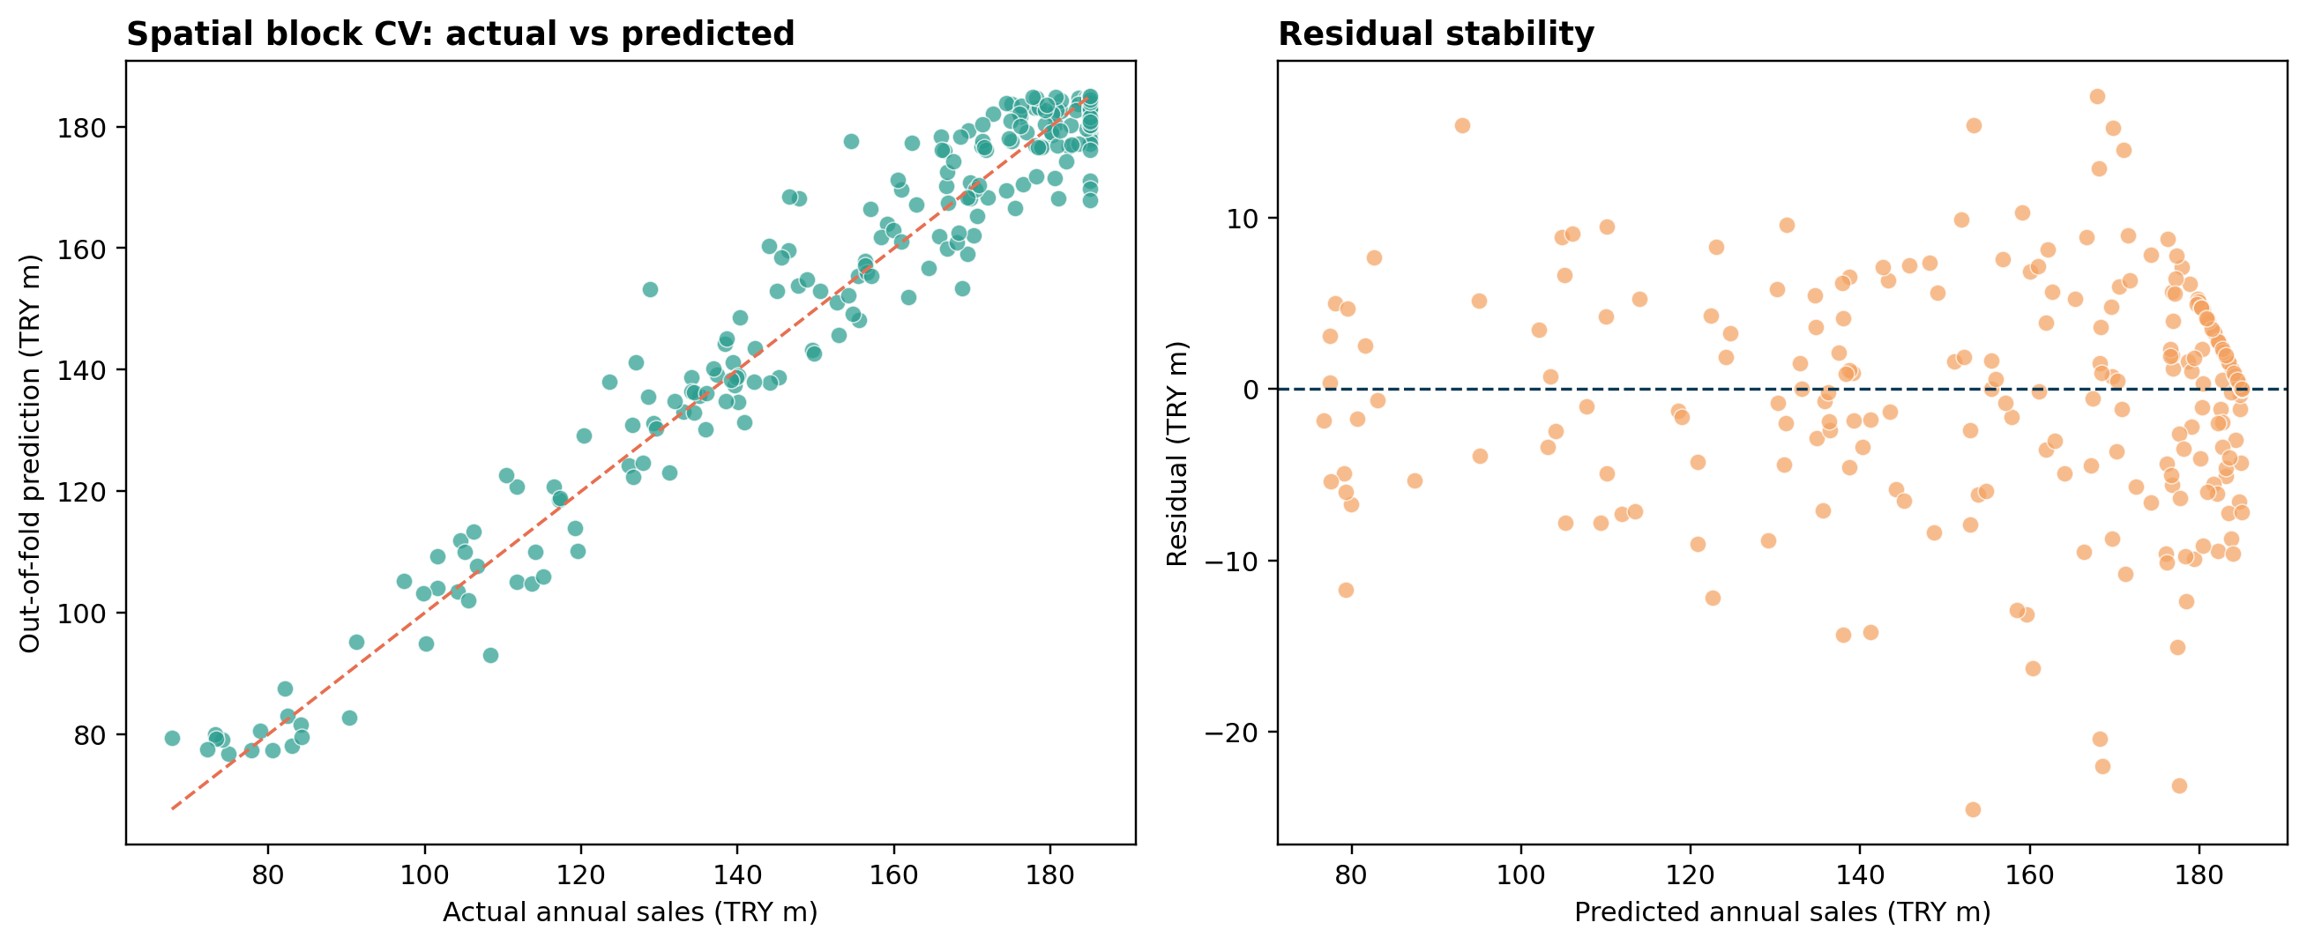
Spatial folds prevent neighboring-site leakage
Five GroupKFold splits use 12 km projected blocks to reduce spatial leakage.
3.82m
MAE (TRY)
5.73m
RMSE (TRY)
0.964
out-of-fold R²
High fit is expected in a deterministic synthetic benchmark and must not be extrapolated to real stores.
Synthetic decision support • Human review required
09
Notes:
Explain that spatial validation is correctly implemented but synthetic targets make the metric optimistic.
[Sources]
- Local figure: artifacts/figures/model_validation.png
- Local metrics: artifacts/metrics/model_metrics.json
- Local out-of-fold data: artifacts/data/model_out_of_fold_predictions.csv

Slide 10
Accessible population drives Ikitelli demand
SHAP reconciles the TRY 162.8m model baseline to a TRY 183.1m prediction.
+17.4m
10-minute population
+3.1m
walkability
-1.2m
cannibalization term
Synthetic decision support • Human review required
10
Notes:
SHAP explains the demand model, while AHP contributions explain the final location score.
[Sources]
- Local SHAP: artifacts/data/shap_contributions.csv

Slide 11
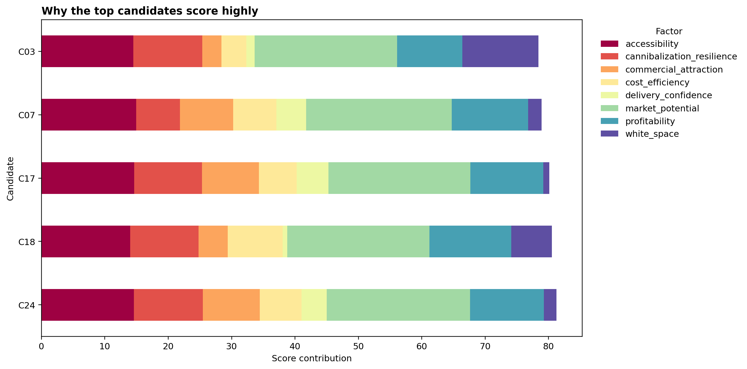
AHP makes the score inspectable
Market potential receives 23% weight; accessibility, profitability and white space jointly shape the decision.
AHP consistency ratio: effectively 0.000 • threshold < 0.10 • PASS
Synthetic decision support • Human review required
11
Notes:
Clarify that exact reciprocal ratios make the pairwise matrix fully consistent by construction.
[Sources]
- Local factor specification: artifacts/data/factor_specification.csv
- Local contributions: artifacts/data/score_contributions.csv
- Local AHP check: artifacts/metrics/ahp_consistency.json

Slide 12
Ikitelli stays top-five across weight samples
750 Dirichlet draws quantify rank stability around the approved AHP weights.
Candidate | Mean rank | P05–P95 | #1 probability
C24 | 1.67 | 1–3 | 53.5%
C18 | 2.63 | 1–5 | 30.9%
C17 | 3.13 | 2–5 | 2.7%
C07 | 4.35 | 3–6 | 0.0%
C03 | 4.86 | 1–9 | 10.4%
Stable does not mean investment-ready; it means the ranking is not fragile to modest weight changes.
Synthetic decision support • Human review required
12
Notes:
Separate ranking robustness from real-world validity.
[Sources]
- Local sensitivity: artifacts/data/weight_sensitivity.csv

Slide 13
Optimization balances economics and coverage
Binary location-allocation chooses sites while preventing infeasible distance and budget combinations.
MAXIMIZE
expected EBIT + location score + uncovered population − cannibalization penalty
Budget
Portfolio capacity
TRY 75m / 110m / 150m by scenario
Maximum 4 / 5 / 6 stores
Minimum distance
Coverage
4.5 km pairwise conflict constraint
10-minute network catchments counted once
Synthetic decision support • Human review required
13
Notes:
Explain that CBC solves the checked-in deterministic binary program to optimality for all three scenarios.
[Sources]
- Local optimizer: src/site_intelligence/optimization.py
- Local scenario results: artifacts/data/scenario_summaries.csv

Slide 14
Downside economics turn negative
The pessimistic portfolio stays feasible but produces -TRY 2.1m expected EBIT under controlled assumptions.
Scenario | Sites | Budget used | Sales | Expected EBIT | Coverage
Pessimistic | 3 | TRY 74.5m | TRY 466.6m | TRY -2.1m | 20.4%
Base | 4 | TRY 93.4m | TRY 732.6m | TRY 28.8m | 23.1%
Optimistic | 6 | TRY 135.8m | TRY 1256.3m | TRY 81.5m | 27.8%
Scenario outputs are comparative stress tests—not probability-weighted forecasts.
Synthetic decision support • Human review required
14
Notes:
Use the negative pessimistic EBIT to reinforce the commercial validation gate.
[Sources]
- Local scenarios: artifacts/data/scenario_summaries.csv

Slide 15
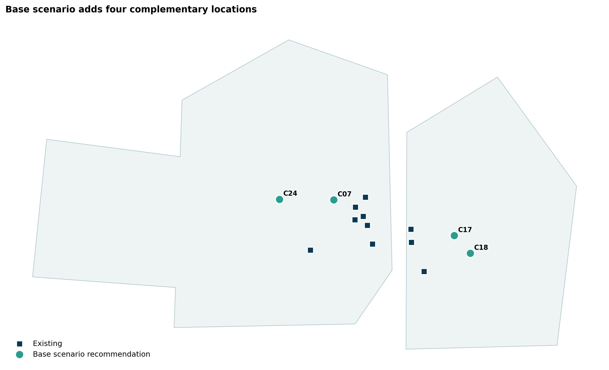
Four sites anchor the base portfolio
Ikitelli, Sultanbeyli, Sancaktepe and Eyupsultan form the optimized TRY 93.4m portfolio.
Priority | Site | Score | Cost | Risk
P1 | Ikitelli Industry | 81.2 | TRY 23.4m | 1.0%
P2 | Sultanbeyli Square | 80.5 | TRY 22.3m | 1.8%
P3 | Sancaktepe Hub | 80.1 | TRY 24.3m | 2.6%
P4 | Eyupsultan Hub | 78.9 | TRY 23.4m | 34.9%
Eyupsultan contributes reach but carries 34.9% cannibalization risk; validate estate overlap before approval.
Synthetic decision support • Human review required
15
Notes:
Explain why optimization can include a site with higher cannibalization: portfolio-level coverage and score trade-offs.
[Sources]
- Local map: artifacts/figures/base_portfolio_map.png
- Local selections: artifacts/data/scenario_selections.csv

Slide 16
Demand strength does not ensure site economics
Three of four base-selected sites have negative controlled three-year ROI before field validation.
TRY 28.8m
base portfolio expected EBIT
42.9 mo
Ikitelli payback proxy
Required validation: binding rent quote, fit-out capex, staffing plan, unit margin and opening ramp.
C24 -16.0% • C18 14.7% • C17 -20.1% • C07 -6.6%
Synthetic decision support • Human review required
16
Notes:
The portfolio can be positive in aggregate while individual sites miss the three-year hurdle.
[Sources]
- Local candidates: artifacts/data/candidate_scores.csv
- Local scenarios: artifacts/data/scenario_summaries.csv

Slide 17
Operational controls keep the decision system reviewable
Data quality, model drift, API health and incident ownership are treated as production concerns.
DATA
46 checks • 44 pass • 2 non-critical spatial-coverage warnings
Geometry, CRS, duplicates, missing values and joins
MODEL
Spatial CV • SHAP • weight sensitivity • model card
Monitor residual drift, rank stability and feature distributions
SERVICE
FastAPI • Prometheus • Grafana • runbook
Health, latency, errors, artifact freshness and rollback
Open warnings: 7 synthetic competitors and 16 synthetic POIs fall outside the analytical footprint; no critical failures.
Synthetic decision support • Human review required
17
Notes:
The warnings are retained because transparent scope mismatch is preferable to silently clipping generated points.
[Sources]
- Local QA: artifacts/qa/data_quality_checks.csv
- Local runbook: docs/monitoring_runbook.md
- Local incident response: docs/incident_response.md

Slide 18
Four gates precede capital approval
The analytical portfolio is ready for review; publication and investment decisions remain explicitly separate.
01
Site survey
Validate visibility, footfall, access, parcel constraints and address accuracy.
02
Independent routing
Rebuild drive/walk isochrones with a current road network and live traffic assumptions.
03
Commercial diligence
Replace synthetic rent, capex, opex, margin and ramp inputs with binding evidence.
04
Investment committee
Review portfolio synergies, downside case, cannibalization and implementation capacity.
PROJECT STATUS • READY FOR REVIEW • NOT PUBLISHED
Synthetic decision support • Human review required
18
Notes:
Close by asking for review of the analytical assumptions and deliverables, not approval to publish or invest.
[Sources]
- Local limitations: docs/limitations.md
- Local risk register: docs/risk_register.md
- Local project status: docs/review_handoff.md

