Slide 1

Web Based Remote Control RC Car Using 3G
Subject : Assembly Language
Project Subject : USB Programming
Name : Murat Necip Arcan
Project : Web Based Remote Control RC Car Using 3G

Slide 2

Introduction
Technologies used:
Platforms ;
Hardware and Mechanic Side ;
Android Phone (Native Java) – Socket IO Programming – USB Port Programming
Arduino (Native Assembly) – USB Port Programming (UART)
Atmega328p – 8 bit – 16 Mhz Clock Time Accuracy
Printer USB Cable and mini USB converter (To communicate with the phone) – (USB 2.0)
Bare Car (Car Skeleton)
Sim Card
L9110 Dual Channel Motor Control Driver
2 AC Motor
1 Shopping Car Wheel
Web Controller Side ;
Atom and Atmel Studio (Editors)
Node Js (Server Side Javascript)
Client Side Javascript
Html
Css

Slide 3
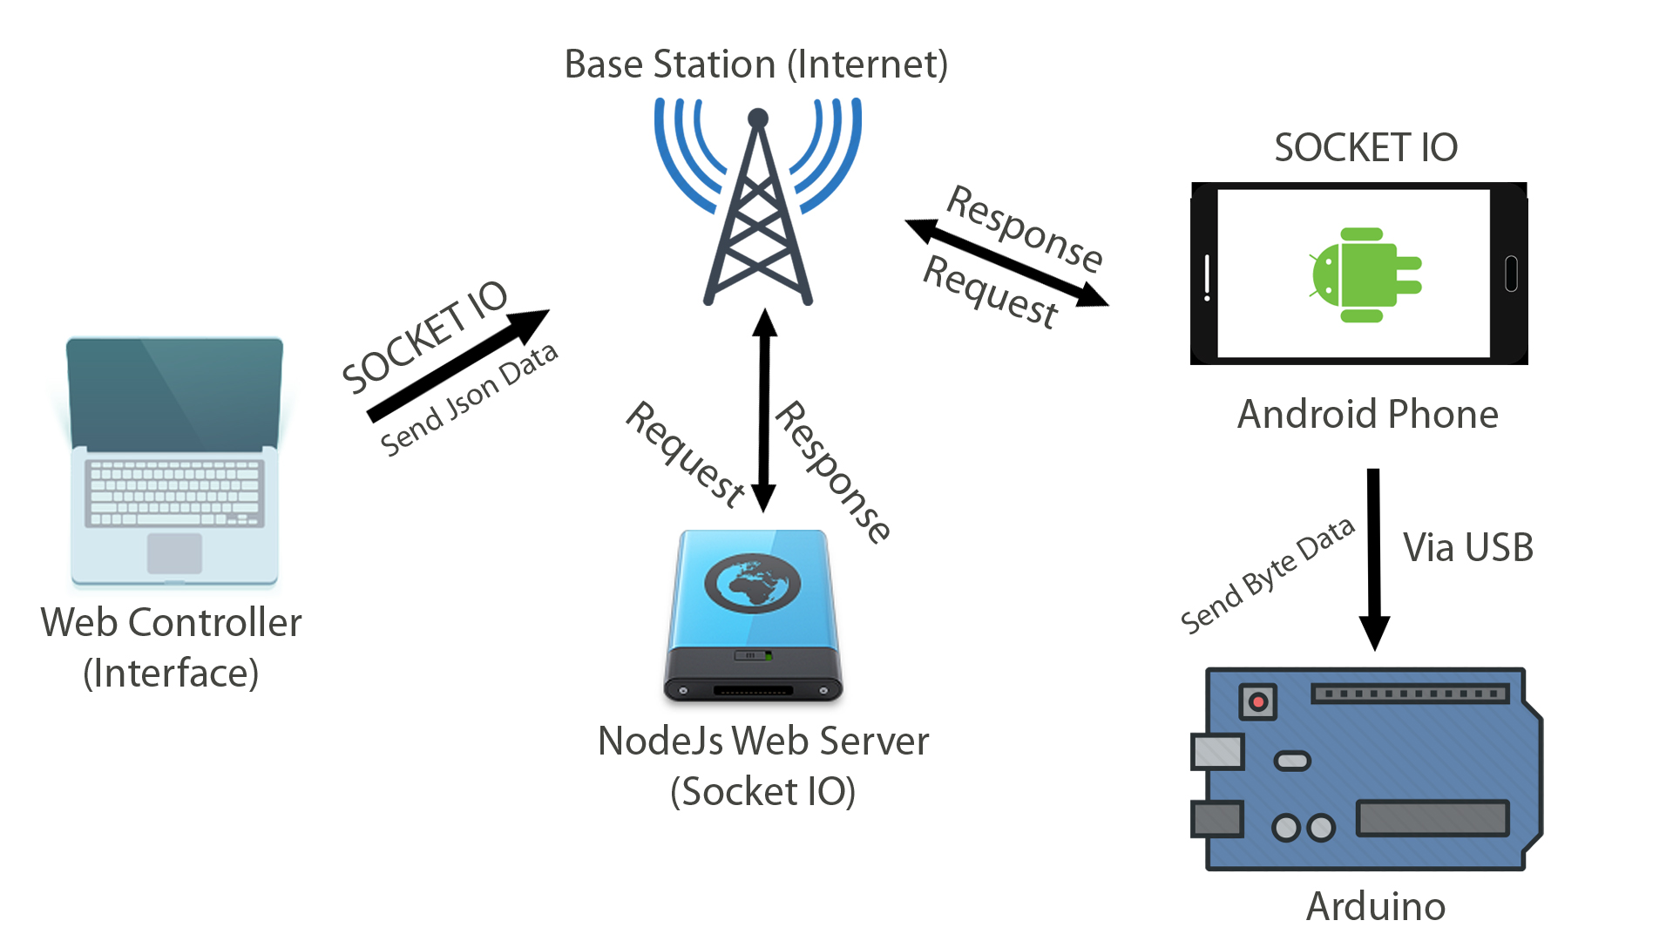
How It Works ? Graphic Algorithm of the System

Slide 4
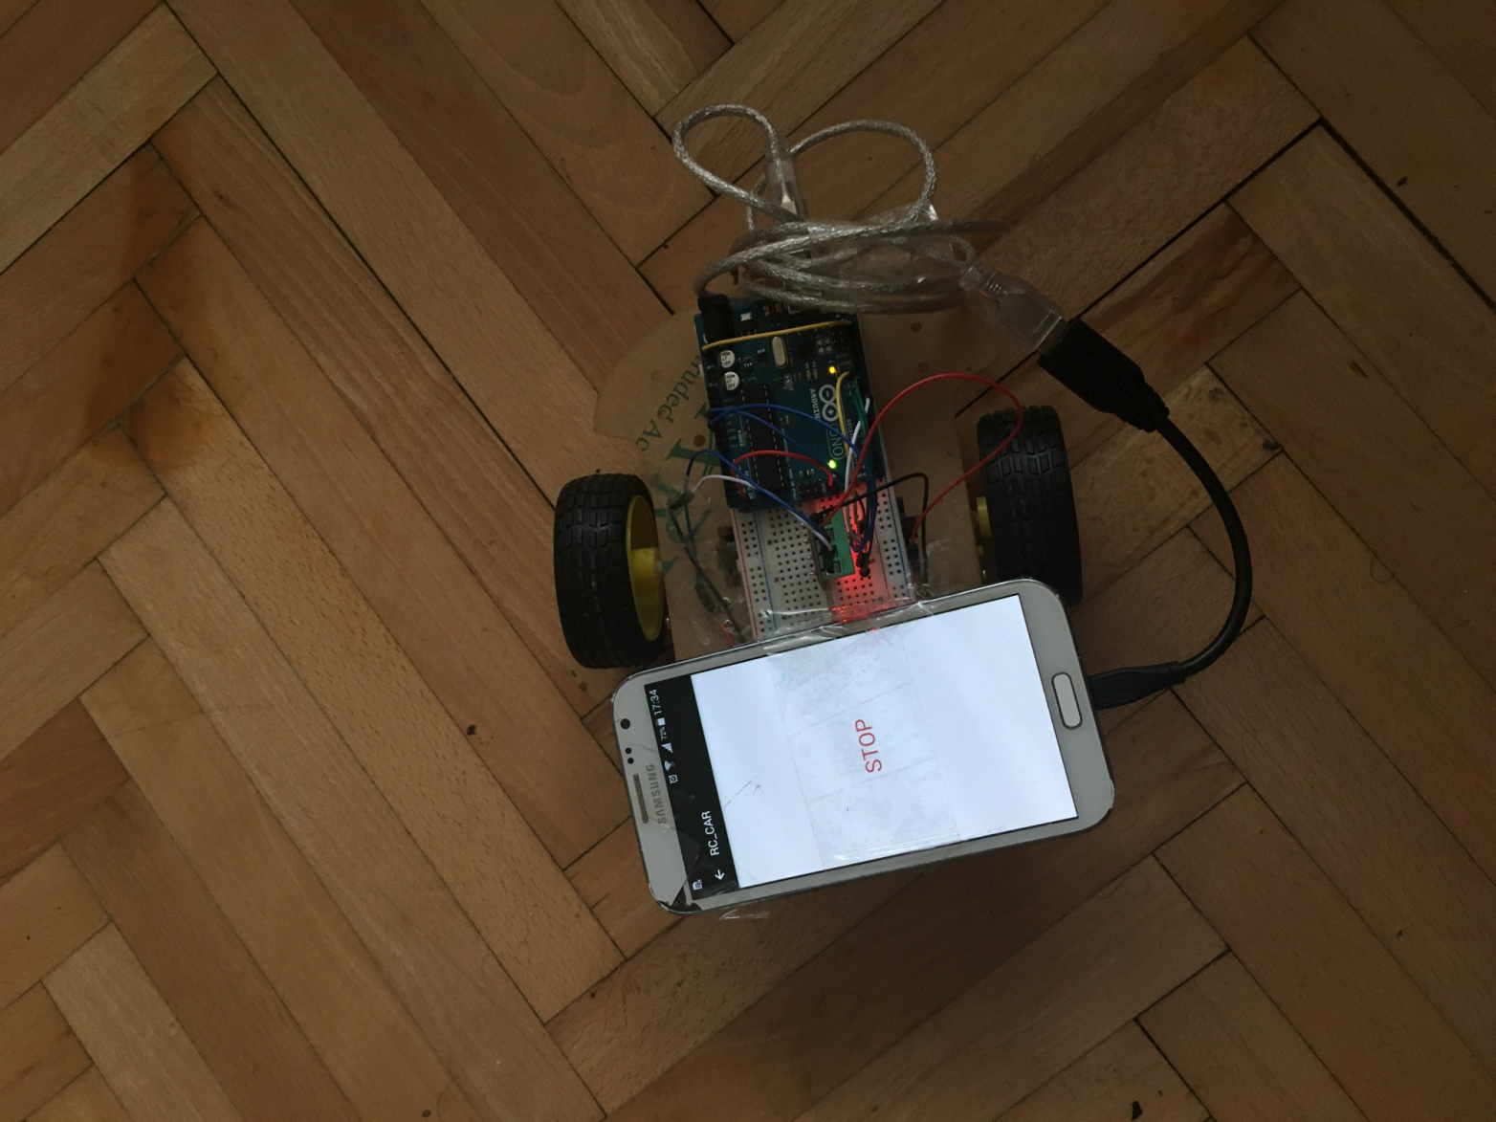
How It Works ?
Picture hardware side of RC car
Android – Arduino connection with printer cable and usb mini converter

Slide 5
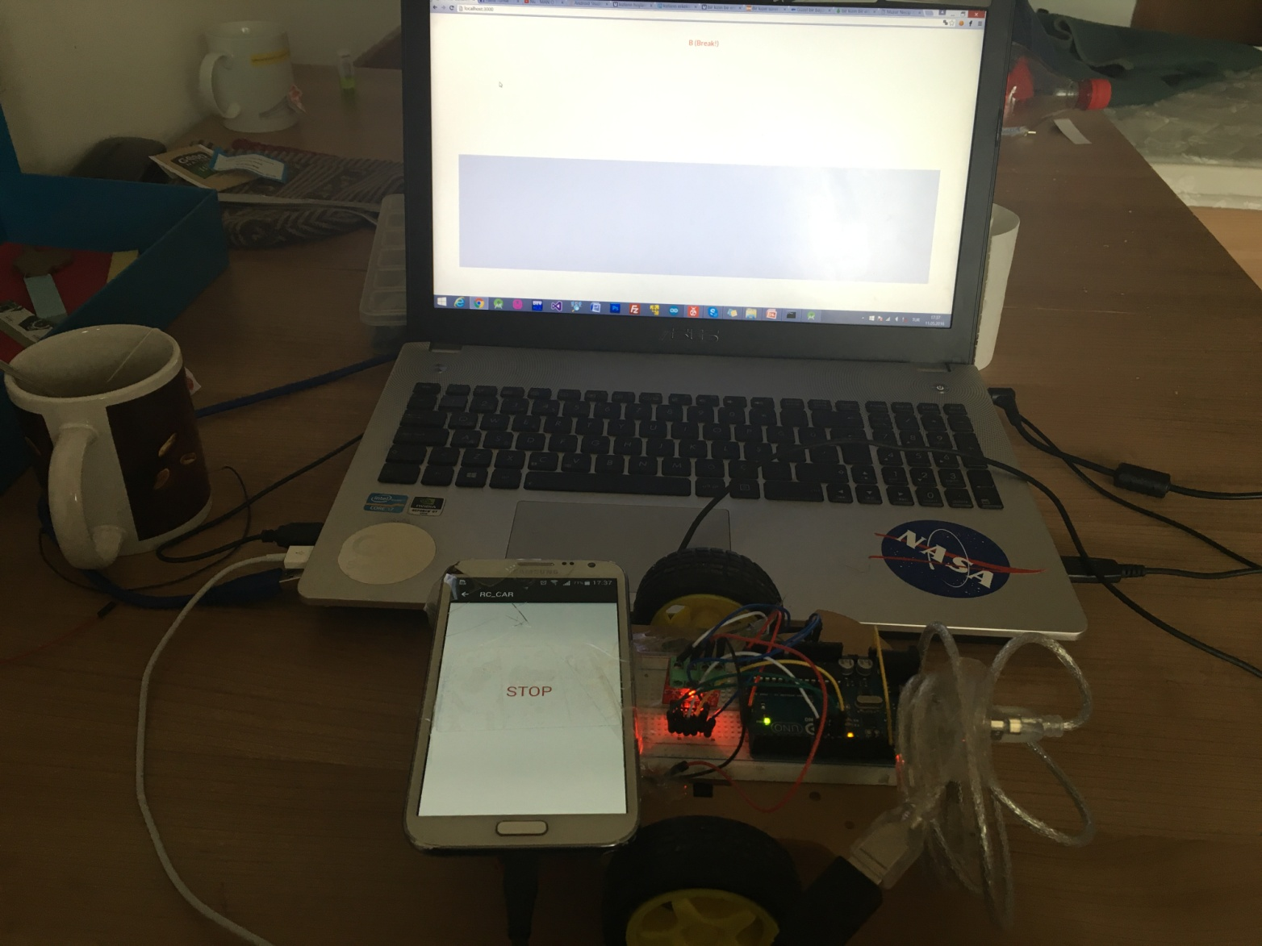
How It Works ?
Picture hardware side of RC car
Control Station of RC Car

Slide 6
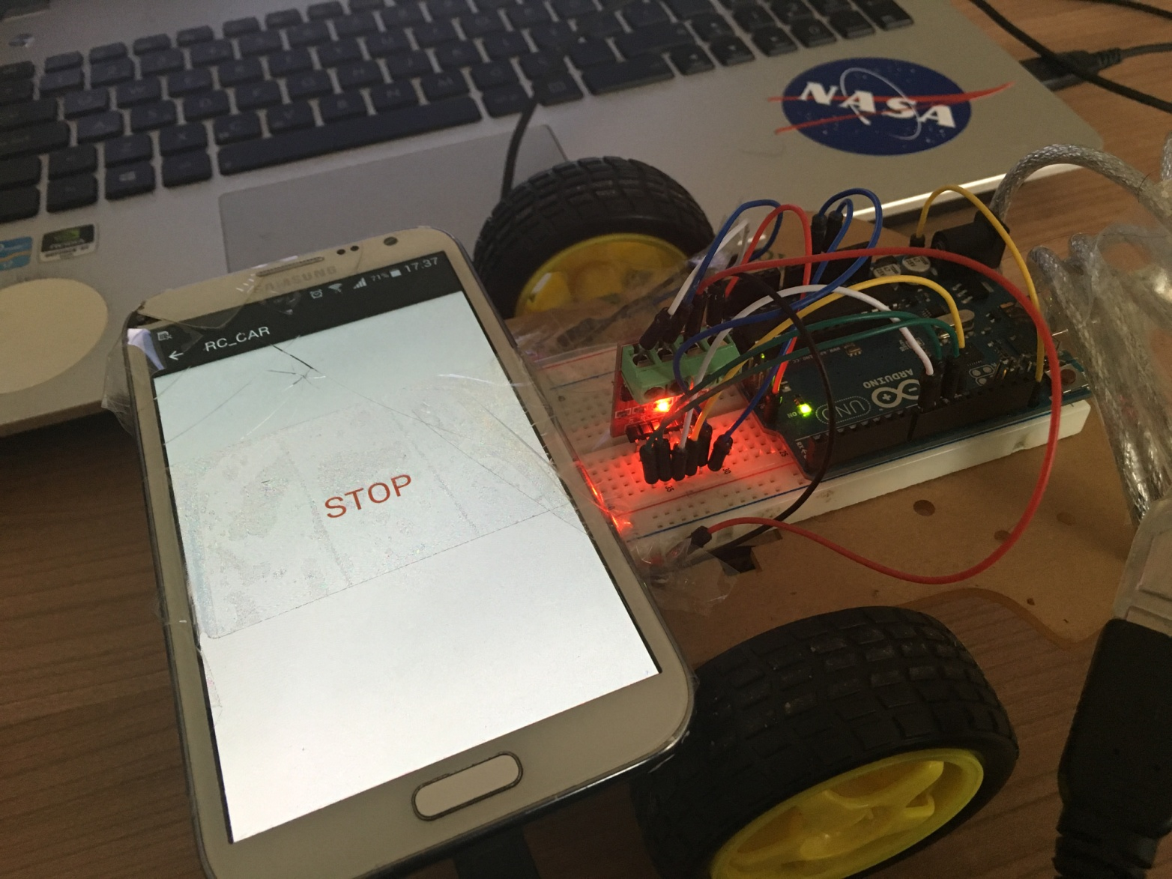
How It Works ?
Picture hardware side of RC car
L9110 motor driver and arduino connection

Slide 7

How It Works ?
Keyboard Controls:
W
(FORWARD)
S
(BACKWARD)
A
(LEFT)
D
(RIGHT)
Space
(Break!)

Slide 8
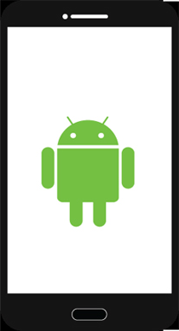
Hardware
Android Phone Application
The android application listens to predetermined ip address and port
Socket IO is used to communicate with server as real time
Json parser is used for parse the json object and return to byte
Usb programming is used to send the data to arduino.

Slide 9
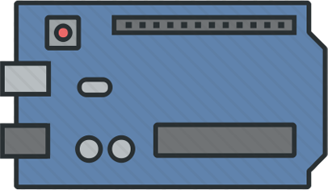
Hardware
Arduino
Usb programming (UART) uses with assembly language to get the data from the android phone, according to the value, arduino sets the target ports and sends voltage to digitalpins.
In the project the codes wrote in native assembly language according to 8 bit arduino instructions.

Slide 10
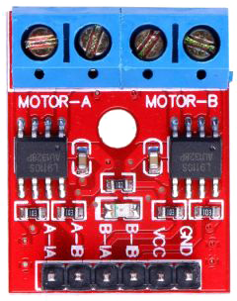
Hardware
L9110 Dual Channel Motor Driver
L9110 provides two different control motors
IA2: Left motor First Input
IB2: Left motor Second Input
IA1: Right motor First Input
IB1: Right motor First Input
GND: Ground ( - )
Vcc: + Voltage

Slide 11

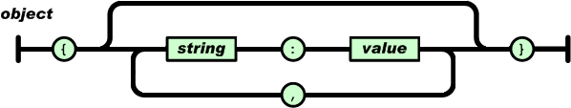
Software
JSON is a syntax for storing and exchanging data.
In the project, data is sent in json format from computer to server, then server represents the data on the cache memory, at the same time, android phone listens to the socket io port and gets the data from the server after this, side of android applies the data parsing and return byte to be meaningful data for arduino.

Slide 12

Software
Node Js
Node.js is a JavaScript runtime built in Chrome's V8 JavaScript engine.
In the project, the socket io server created using Node Js
When the server recognizes some value from client, it’s represented on the cache memory then android application takes the data from the node Js server to procces it.
In the Project code is writting in Javascript language.

Slide 13
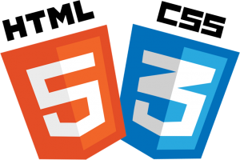
Software
HTML – CSS
Interface of Web Application
HTML is a markup language for describing web pages
CSS stands for Cascading Style Sheets
In the project,
It provides creating a graphic interface to driver the car

Slide 14

In the future
Developing Structure of the System
That structure can be applied on remote control cars, drones and
Internet of Things
Missing
Encryption Algorithms (Security) between control station and RC car

Slide 15

THANK YOU
Web Based Remote Control RC Car Using 3G
Subject : Assembly Language
Project Subject : USB Programming
Name : Murat Necip Arcan

