Slide 1
CENG401 MACHINE LEARNING AND ARTIFICIAL INTELLIGENCE
WEEK-11
MACHINE LEARNING
Boosting Algorithms
Asst.Prof.Dr. Murat ŞİMŞEK

Slide 2
Supervised Learning

Slide 3
Boosting

Slide 4
How Boosting Algorithms works?
To find weak rule, we apply base learning algorithms with a different distribution.
Each time base learning algorithm is applied, it generates a new weak prediction rule. This is an iterative process.
After many iterations, the boosting algorithm combines these weak rules into a single strong prediction rule.
For choosing the right distribution, here are the following steps:
Step 1: The base learner takes all the distributions and assign equal weight or attention to each observation.
Step 2: If there is any prediction error caused by first base learning algorithm, then we pay higher attention to observations having prediction error. Then, we apply the next base learning algorithm.
Step 3: Iterate Step 2 till the limit of base learning algorithm is reached or higher accuracy is achieved.

Slide 5
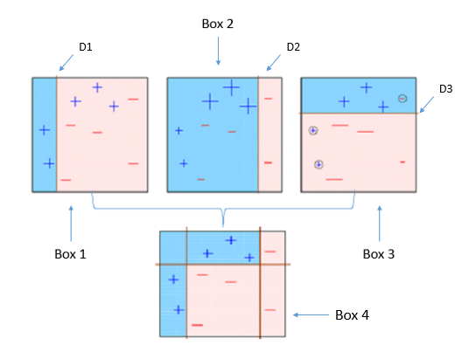
How Boosting Algorithms works?
Finally, it combines the outputs from weak learner and creates a strong learner which eventually improves the prediction power of the model.
Boosting pays higher focus on examples which are misclassiﬁed or have higher errors by preceding weak rules.

Slide 6
Types of Boosting Algorithms
There are primarily 5 boosting algorithms in machine learning. These are as follows:
AdaBoost (Adaptive Boosting)
Gradient Boosting Machine (GBM)
Extreme Gradient Boosting Machine (XGBM)
Light GBM
CatBoost

Slide 7
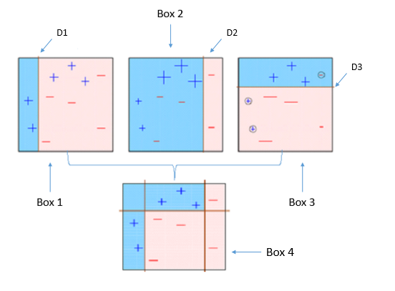
AdaBoost
Box 1: You can see that we have assigned equal weights to each data point and applied a decision stump to classify them as + (plus) or – (minus). The decision stump (D1) has generated vertical line at left side to classify the data points.
We see that, this vertical line has incorrectly predicted three + (plus) as – (minus). In such case, we’ll assign higher weights to these three + (plus) and apply another decision stump.

Slide 8
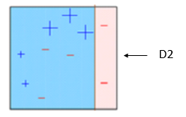
AdaBoost
Box 2: Here, you can see that the size of three incorrectly predicted + (plus) is bigger as compared to rest of the data points. In this case, the second decision stump (D2) will try to predict them correctly. Now, a vertical line (D2) at right side of this box has classified three misclassified + (plus) correctly. But again, it has caused misclassification errors. This time with three -(minus). Again, we will assign higher weight to three – (minus) and apply another decision stump.

Slide 9
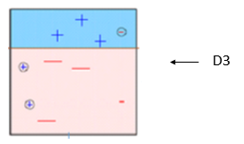
AdaBoost
Box 3: Here, three – (minus) are given higher weights. A decision stump (D3) is applied to predict these misclassified observation correctly. This time a horizontal line is generated to classify + (plus) and – (minus) based on higher weight of misclassified observation.

Slide 10
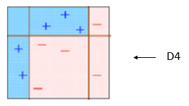
AdaBoost
Box 4: Here, we have combined D1, D2 and D3 to form a strong prediction having complex rule as compared to individual weak learner. You can see that this algorithm has classified these observation quite well as compared to any of individual weak learner.

Slide 11
AdaBoost (Adaptive Boosting)
It fits a sequence of weak learners on different weighted training data.
It starts by predicting original data set and gives equal weight to each observation. If prediction is incorrect using the first learner, then it gives higher weight to observation which have been predicted incorrectly. Being an iterative process, it continues to add learner(s) until a limit is reached in the number of models or accuracy.
Mostly, we use decision stamps with AdaBoost. But, we can use any machine learning algorithms as base learner if it accepts weight on training data set. We can use AdaBoost algorithms for both classification and regression problem.

Slide 12
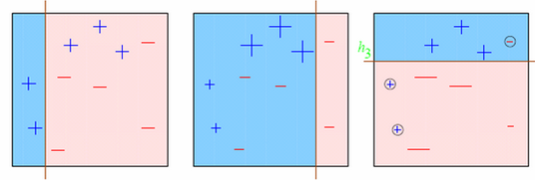
Let’s try to visualize one Classification Problem
Look at the below diagram :
We start with the first box. We see one vertical line which becomes our first week learner. Now in total we have 3/10 mis-classified observations. We now start giving higher weights to 3 plus mis-classified observations. Now, it becomes very important to classify them right. Hence, the vertical line towards right edge. We repeat this process and then combine each of the learner in appropriate weights.

Slide 13


Explaining underlying mathematics
How do we assign weight to observations?
We always start with a uniform distribution assumption.
Lets call it as D₁ which is 1/n for all n observations.
Step 1 . We assume an alpha(t)
Step 2: Get a weak classifier h(t)
Step 3: Update the population distribution for the next step
where

Slide 14

Explaining underlying mathematics
Step 4 : Use the new population distribution to again find the next learner
Step 5 : Iterate step 1 – step 4 until no hypothesis is found which can improve further.
Step 6 : Take a weighted average of the frontier using all the learners used till now.
But what are the weights? Weights are simply the alpha values.
Alpha is calculated as follows:

Slide 15
Explaining underlying mathematics
Output the final hypothesis

Slide 16
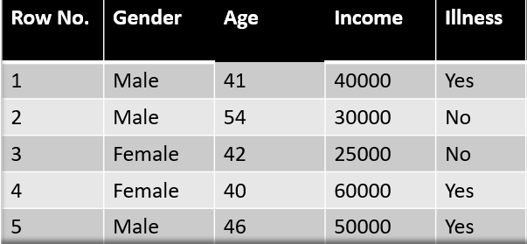
Example

Slide 17

Example
The formula to calculate the sample weights is:
Where N is the total number of datapoints
Here since we have 5 data points so the sample weights assigned will be 1/5.

Slide 18
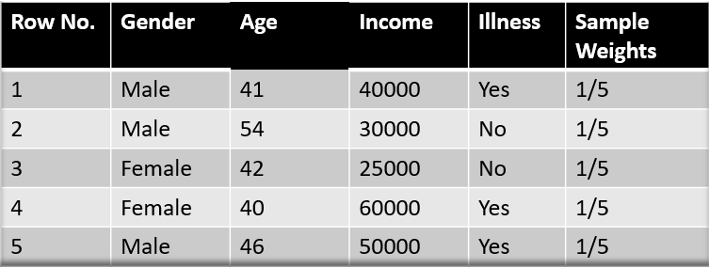
Example

Slide 19
Example
Step 2 – We start by seeing how well “Gender” classifies the samples and will see how the variables (Age, Income) classifies the samples.
We’ll create a decision stump for each of the features and then calculate the Gini Index of each tree. The tree with the lowest Gini Index will be our first stump.
Here in our dataset let’s say Gender has the lowest gini index so it will be our first stump.

Slide 20
Example
Step 3 – We’ll now calculate the “Amount of Say” or “Importance” or “Influence” for this classifier in classifying the datapoints using this formula:

Slide 21
Example
The total error is nothing, but the summation of all the sample weights of misclassified data points.
Here in our dataset let’s assume there is 1 wrong output, so our total error will be 1/5, and alpha(performance of the stump) will be:

Slide 22
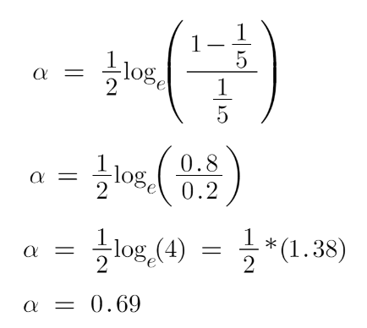
Example

Slide 23
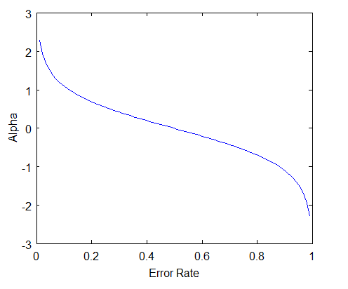
Example
Note: Total error will always be between 0 and 1.
0 Indicates perfect stump and 1 indicates horrible stump.

Slide 24
Example
Step 4 -Need to update the weights because if the same weights are applied to the next model, then the output received will be the same as what was received in the first model.
The wrong predictions will be given more weight whereas the correct predictions weights will be decreased.
Now when we build our next model after updating the weights, more preference will be given to the points with higher weights.
After finding the importance of the classifier and total error we need to finally update the weights and for this, we use the following formula:

Slide 25
Example
The amount of say (alpha) will be negative when the sample is correctly classified.
The amount of say (alpha) will be positive when the sample is miss-classified.
There are four correctly classified samples and 1 wrong, here the sample weight of that datapoint is 1/5 and the amount of say/performance of the stump of Gender is 0.69.

Slide 26
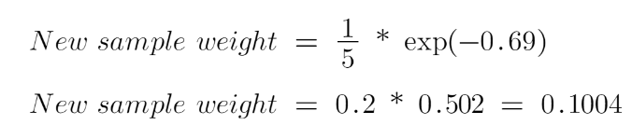
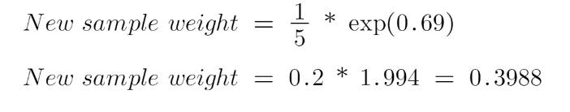
Example
New weights for correctly classified samples are:
For wrongly classified samples the updated weights will be:

Slide 27
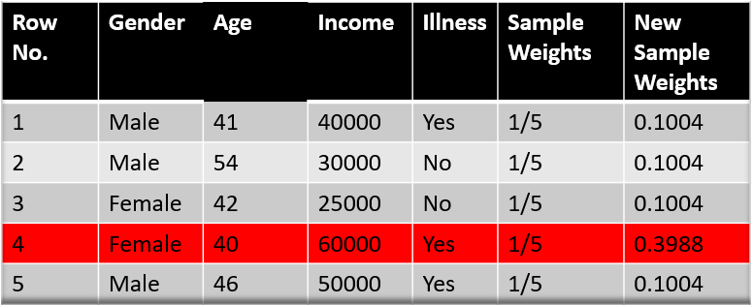
Example
Note: See the sign of alpha when putting the values, the alpha is negative when the data point is correctly classified, and this decreases the sample weight from 0.2 to 0.1004.
It is positive when there is misclassification, and this will increase the sample weight from 0.2 to 0.3988.

Slide 28
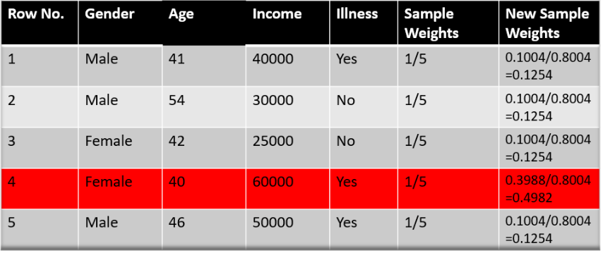
Example
The total sum of the sample weights must be equal to 1 but here if we sum up all the new sample weights, we will get 0.8004.
To bring this sum equal to 1 we will normalize these weights by dividing all the weights by the total sum of updated weights that is 0.8004.
So, after normalizing the sample weights we get this dataset and now the sum is equal to 1.

Slide 29
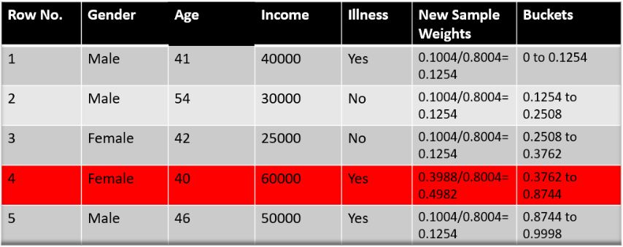
Example
Step 5 –To make a new dataset to see if the errors decreased or not.
Remove the “sample weights” and “new sample weights” column and then based on the “new sample weights” we will divide our data points into buckets.

Slide 30
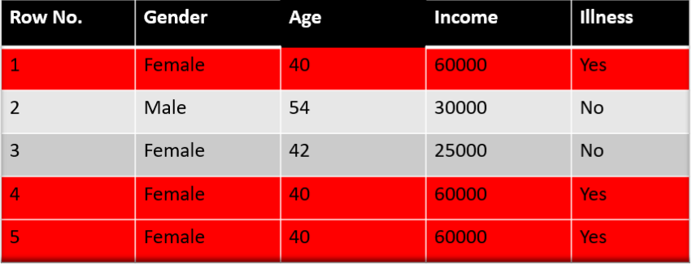
Example
Step 6 –now what the algorithm selects random numbers from 0-1.
Since incorrectly classified records have higher sample weights, the probability to select those records is very high.
Suppose the 5 random numbers our algorithm take is 0.38,0.26,0.98,0.40,0.55.
Now we will see where these random numbers fall in the bucket and according to it, we’ll make our new dataset shown below.

Slide 31
Gradient Boosting
In gradient boosting, it trains many models sequentially. Each new model gradually minimizes the loss function (y = ax + b + e, e needs special attention as it is an error term) of the whole system using Gradient Descent method.
The learning procedure consecutively fit new models to provide a more accurate estimate of the response variable.
The principle idea behind this algorithm is to construct new base learners which can be maximally correlated with negative gradient of the loss function, associated with the whole ensemble.

Slide 32
Gradient Boosting
Type of Problem – You have a set of variables vectors x1 , x2 and x3. You need to predict y which is a continuous variable.
Steps of Gradient Boost algorithm
Step 1 : Assume mean is the prediction of all variables.
Step 2 : Calculate errors of each observation from the mean (latest prediction).
Step 3 : Find the variable that can split the errors perfectly and find the value for the split. This is assumed to be the latest prediction.
Step 4 : Calculate errors of each observation from the mean of both the sides of split (latest prediction).
Step 5 : Repeat the step 3 and 4 till the objective function maximizes/minimizes.
Step 6 : Take a weighted mean of all the classifiers to come up with the final model.

Slide 33
EXTREME GRADIENT BOOSTING MACHINE (XGBM)
XGBM is the latest version of gradient boosting machines which also works very similar to GBM.
In XGBM, trees are added sequentially (one at a time) that learn from the errors of previous trees and improve them.

Slide 34
EXTREME GRADIENT BOOSTING MACHINE (XGBM)
Although, XGBM and GBM algorithms are similar in look and feel but still there are a few differences between them as follows:
XGBM uses various regularization techniques to reduce under-fitting or over-fitting of the model which also increases model performance more than gradient boosting machines.
XGBM follows parallel processing of each node, while GBM does not which makes it more rapid than gradient boosting machines.
XGBM helps us to get rid of the imputation of missing values because by default the model takes care of it. It learns on its own whether these values should be in the right or left node.

Slide 35
Light Gradient Boosting Machines (Light GBM)
Light GBM is a more upgraded version of the Gradient boosting machine due to its efficiency and fast speed.
Unlike GBM and XGBM, it can handle a huge amount of data without any complexity.
On the other hand, it is not suitable for those data points that are lesser in number.

Slide 36
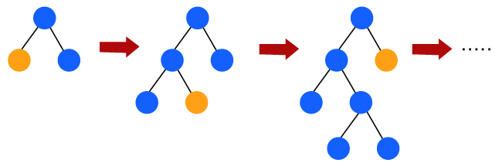
Light Gradient Boosting Machines (Light GBM)
Instead of level-wise growth, Light GBM prefers leaf-wise growth of the nodes of the tree.
Further, in light GBM, the primary node is split into two secondary nodes and later it chooses one secondary node to be split.
This split of a secondary node depends upon which between two nodes has a higher loss.
Hence, due to leaf-wise split, Light Gradient Boosting Machine (LGBM) algorithm is always preferred over others where a large amount of data is given.

Slide 37
CATBOOST
The catboost algorithm is primarily used to handle the categorical features in a dataset.
Although GBM, XGBM, and Light GBM algorithms are suitable for numeric data sets, Catboost is designed to handle categorical variables into numeric data.
Hence, catboost algorithm consists of an essential preprocessing step to convert categorical features into numerical variables which are not present in any other algorithm.

Slide 38
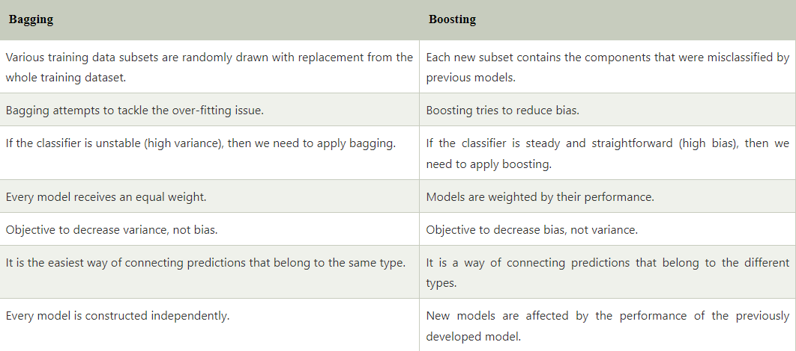
Difference between Bagging and Boosting:

