Slide 1
CENG401 MACHINE LEARNING AND ARTIFICIAL INTELLIGENCE
WEEK-13
MACHINE LEARNING
Unsupervised Learning
Asst.Prof.Dr. Murat ŞİMŞEK

Slide 2
Unsupervised Learning

Slide 3
Supervised learning vs. unsupervised learning
Supervised learning: discover patterns in the data that relate data attributes with a target (class) attribute.
These patterns are then utilized to predict the values of the target attribute in future data instances.
Unsupervised learning: The data have no target attribute.
We want to explore the data to find some intrinsic structures in them.

Slide 4
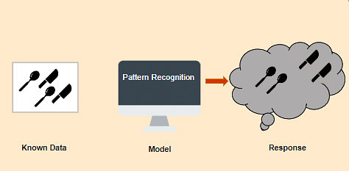
What is Unsupervised Learning?
In Unsupervised Learning, the machine uses unlabeled data and learns on itself without any supervision.
The machine tries to find a pattern in the unlabeled data and gives a response.

Slide 5
Why use Unsupervised Learning?
Some main reasons which describe the importance of Unsupervised Learning:
Unsupervised learning is helpful for finding useful insights from the data.
Unsupervised learning works on unlabeled and uncategorized data which make unsupervised learning more important.
In real-world, we do not always have input data with the corresponding output so to solve such cases, we need unsupervised learning.

Slide 6
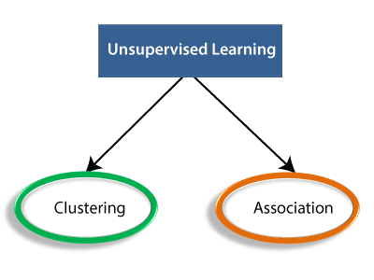
Types of Unsupervised Learning Algorithm
The unsupervised learning algorithm can be further categorized into two types of problems:

Slide 7
Unsupervised learning
Unsupervised learning is classified into two categories of algorithms:
Clustering: A clustering problem is where you want to discover the inherent groupings in the data, such as grouping customers by purchasing behavior.
Association: An association rule learning problem is where you want to discover rules that describe large portions of your data, such as people that buy X also tend to buy Y.

Slide 8
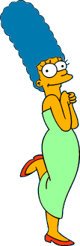




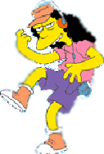



What is a natural grouping of these objects?

Slide 9



What is a natural grouping of these objects?
Clustering is subjective
Simpson's Family
School Employees
Females
Males

Slide 10
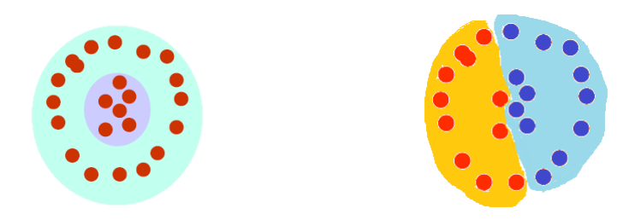
Clustering
The organization of unlabeled data into similarity groups called clusters.
A cluster is a collection of data items which are “similar” between them, and “dissimilar” to data items in other clusters.

Slide 11
Types of Clustering Methods
Main clustering methods used in Machine learning:
Partitioning Clustering
Density-Based Clustering
Distribution Model-Based Clustering
Hierarchical Clustering
Fuzzy Clustering

Slide 12
Partitioning Clustering
It is a type of clustering that divides the data into non-hierarchical groups. It is also known as the centroid-based method.
The most common example of partitioning clustering is the K-Means Clustering algorithm.
In this type, the dataset is divided into a set of k groups, where K is used to define the number of pre-defined groups.
The cluster center is created in such a way that the distance between the data points of one cluster is minimum as compared to another cluster centroid.

Slide 13
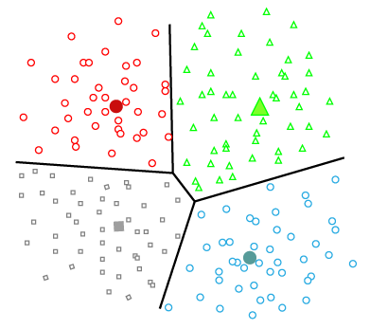
Partitioning Clustering
The cluster center is created in such a way that the distance between the data points of one cluster is minimum as compared to another cluster centroid.

Slide 14







Partitional Clustering
Nonhierarchical, each instance is placed in exactly one of K non-overlapping clusters.
Since only one set of clusters is output, the user normally has to input the desired number of clusters K.

Slide 15
Density-Based Clustering
The density-based clustering method connects the highly-dense areas into clusters, and the arbitrarily shaped distributions are formed as long as the dense region can be connected.
This algorithm does it by identifying different clusters in the dataset and connects the areas of high densities into clusters.

Slide 16
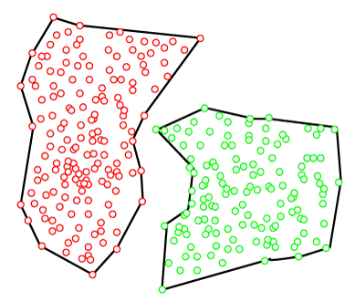
Density-Based Clustering
The dense areas in data space are divided from each other by sparser areas.
These algorithms can face difficulty in clustering the data points if the dataset has varying densities and high dimensions.

Slide 17
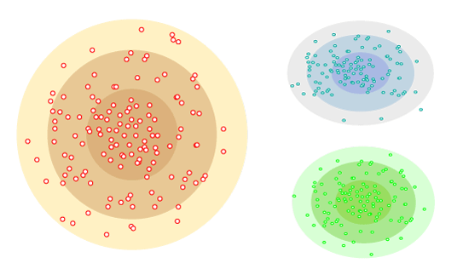
Distribution Model-Based Clustering
In the distribution model-based clustering method, the data is divided based on the probability of how a dataset belongs to a particular distribution.
The grouping is done by assuming some distributions commonly Gaussian Distribution.
The example of this type is the Expectation-Maximization Clustering algorithm that uses Gaussian Mixture Models (GMM).

Slide 18
Hierarchical Clustering
Hierarchical clustering can be used as an alternative for the partitioned clustering as there is no requirement of pre-specifying the number of clusters to be created.
In this technique, the dataset is divided into clusters to create a tree-like structure, which is also called a dendrogram.

Slide 19
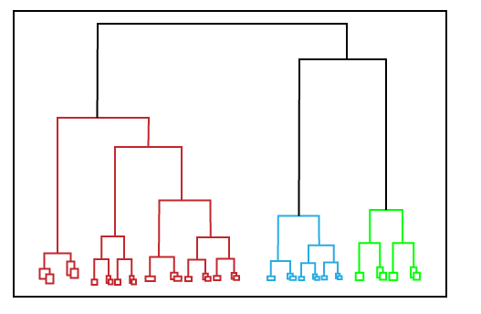
Hierarchical Clustering
The observations or any number of clusters can be selected by cutting the tree at the correct level.
The most common example of this method is the Agglomerative Hierarchical algorithm.

Slide 20
Fuzzy Clustering
Fuzzy clustering is a type of soft method in which a data object may belong to more than one group or cluster.
Each dataset has a set of membership coefficients, which depend on the degree of membership to be in a cluster.
Fuzzy C-means algorithm is the example of this type of clustering; it is sometimes also known as the Fuzzy k-means algorithm.

Slide 21
Clustering Algorithms
The Clustering algorithms can be divided based on their models that are explained above.
There are different types of clustering algorithms published, but only a few are commonly used.
The clustering algorithm is based on the kind of data that we are using.
Such as, some algorithms need to guess the number of clusters in the given dataset, whereas some are required to find the minimum distance between the observation of the dataset.

Slide 22
Clustering Algorithms
K-Means algorithm: The k-means algorithm is one of the most popular clustering algorithms.
It classifies the dataset by dividing the samples into different clusters of equal variances.
The number of clusters must be specified in this algorithm. It is fast with fewer computations required, with the linear complexity of O(n).

Slide 23
K-means algorithm
Given k, the k-means algorithm works as follows:
Randomly choose k data points (seeds) to be the initial centroids, cluster centers
Assign each data point to the closest centroid
Re-compute the centroids using the current cluster memberships.
If a convergence criterion is not met, go to 2).

Slide 24
Stopping/convergence criterion
no (or minimum) re-assignments of data points to different clusters,
no (or minimum) change of centroids, or
minimum decrease in the sum of squared error (SSE),
C_{i} is the jth cluster, m_{j} is the centroid of cluster C_{j} (the mean vector of all the data points in C_{j}), and dist(x, m_{j}) is the distance between data point x and centroid m_{j}.
(1)

Slide 25
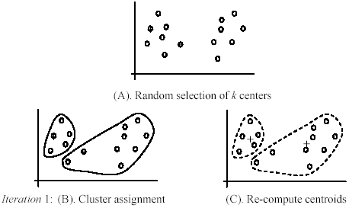
An example
+
+

Slide 26
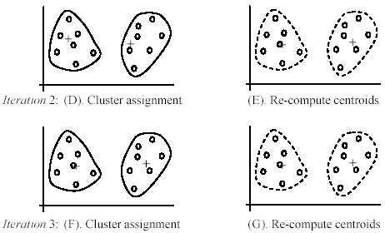
An example (cont …)

Slide 27
Partition Algorithm 1: k-means
1. Decide on a value for k.
2. Initialize the k cluster centers (randomly, if necessary).
3. Decide the class memberships of the N objects by assigning them to the nearest cluster center.
4. Re-estimate the k cluster centers, by assuming the memberships found above are correct.
5. If none of the N objects changed membership in the last iteration, exit. Otherwise goto 3.

Slide 28
K-means Clustering: Step 1
Algorithm: k-means, Distance Metric: Euclidean Distance
5
4
k₁
3
k₂
2
1
k₃
0
0
1
2
3
4
5

Slide 29
K-means Clustering: Step 2
Algorithm: k-means, Distance Metric: Euclidean Distance
5
4
k₁
3
k₂
2
1
k₃
0
0
1
2
3
4
5

Slide 30
K-means Clustering: Step 3
Algorithm: k-means, Distance Metric: Euclidean Distance
5
4
k₁
3
2
k₃
k₂
1
0
0
1
2
3
4
5

Slide 31
K-means Clustering: Step 4
Algorithm: k-means, Distance Metric: Euclidean Distance
5
4
k₁
3
2
k₃
k₂
1
0
0
1
2
3
4
5

Slide 32
K-means Clustering: Step 5
Algorithm: k-means, Distance Metric: Euclidean Distance
k₁
k₂
k₃

Slide 33
Clustering Algorithms
DBSCAN Algorithm: It stands for Density-Based Spatial Clustering of Applications with Noise.
It is an example of a density-based model similar to the mean-shift, but with some remarkable advantages.
In this algorithm, the areas of high density are separated by the areas of low density.
Because of this, the clusters can be found in any arbitrary shape.

Slide 34
Clustering Algorithms
Expectation-Maximization Clustering using GMM: This algorithm can be used as an alternative for the k-means algorithm or for those cases where K-means can be failed.
In GMM, it is assumed that the data points are Gaussian distributed.

Slide 35
Clustering Algorithms
Agglomerative Hierarchical algorithm: The Agglomerative hierarchical algorithm performs the bottom-up hierarchical clustering.
In this, each data point is treated as a single cluster at the outset and then successively merged.
The cluster hierarchy can be represented as a tree-structure.

Slide 36
Clustering Algorithms
Affinity Propagation: It is different from other clustering algorithms as it does not require to specify the number of clusters.
In this, each data point sends a message between the pair of data points until convergence.
It has O(N2T) time complexity, which is the main drawback of this algorithm.

Slide 37
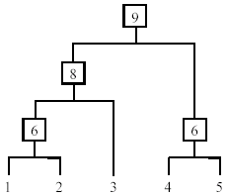
Hierarchical Clustering
Produce a nested sequence of clusters, a tree, also called Dendrogram.

