Slide 1
MACHINE LEARNING
PCA
Asist.Prof.Dr. Murat ŞİMŞEK

Slide 2
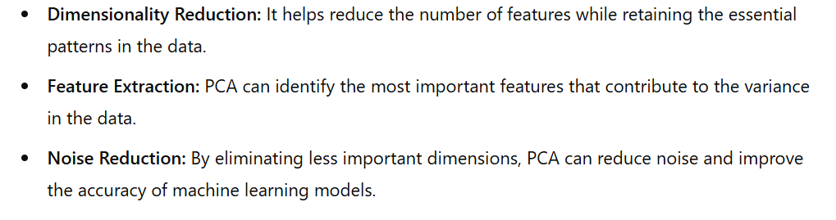
Principal Component Analysis
PCA is a statistical technique that transforms a dataset into a new set of variables, called principal components, which are orthogonal (uncorrelated) and ordered by the amount of variance they capture from the data.
The first principal component captures the largest possible variance,
the second one captures the next largest, and so on.

Slide 3
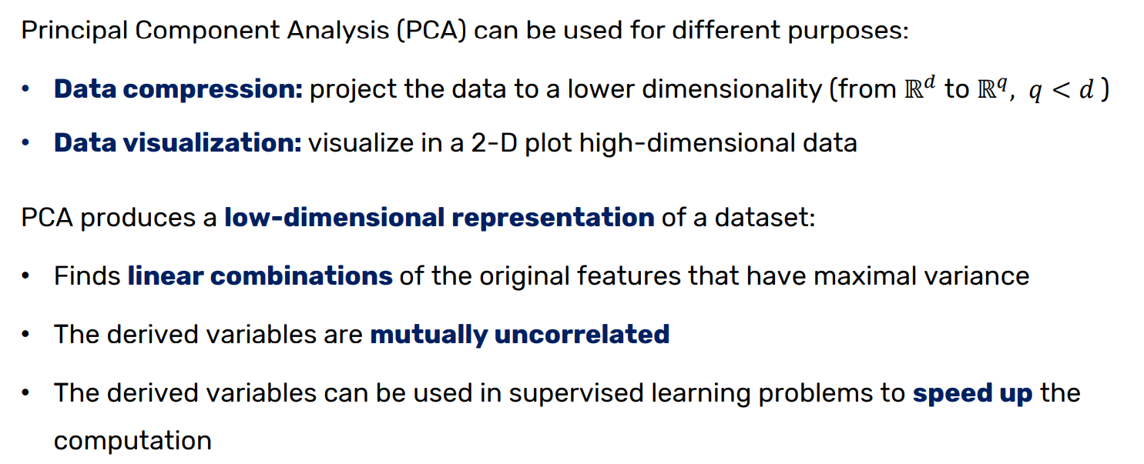
Principal Component Analysis

Slide 4
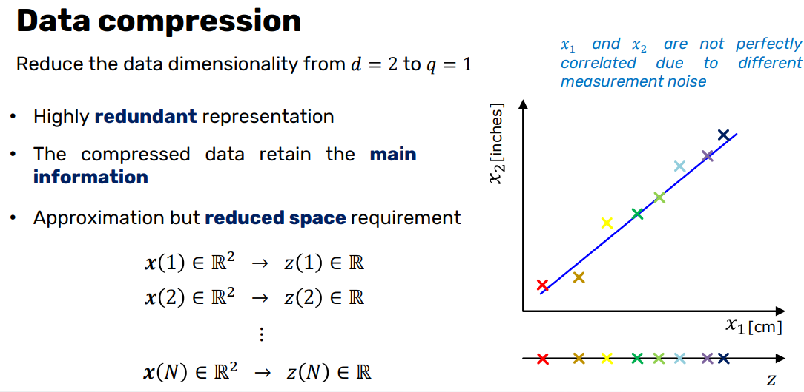
Principal Component Analysis

Slide 5
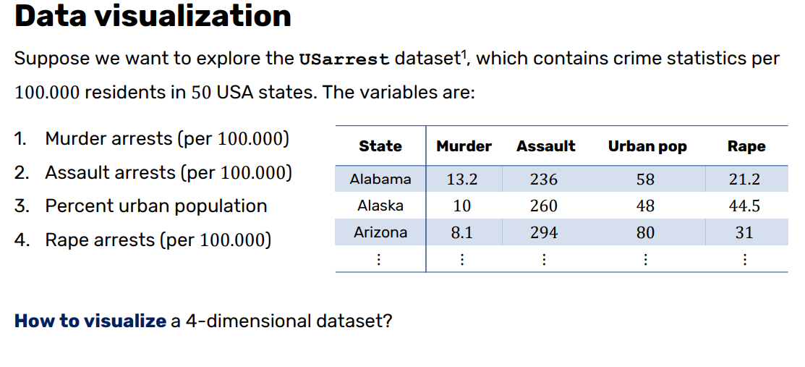
Principal Component Analysis

Slide 6
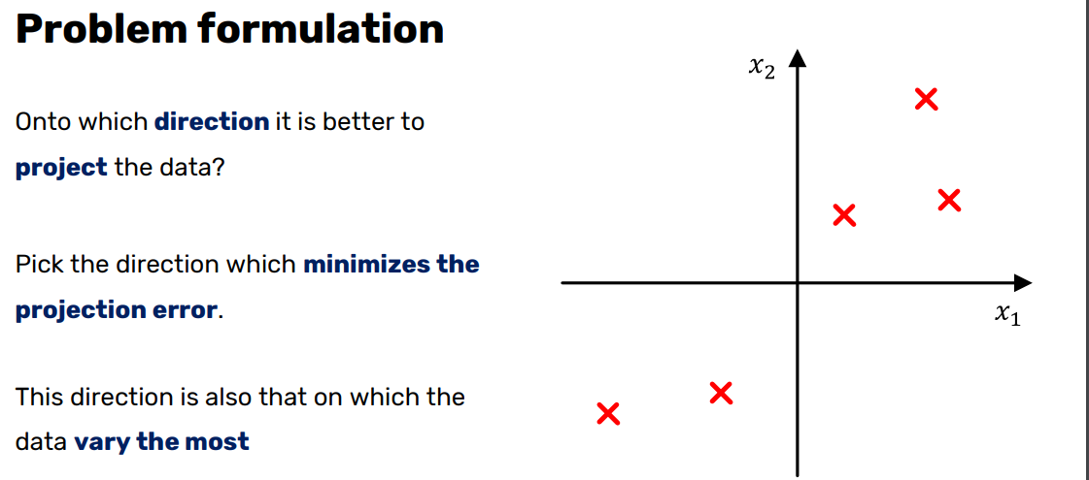
Principal Component Analysis

Slide 7
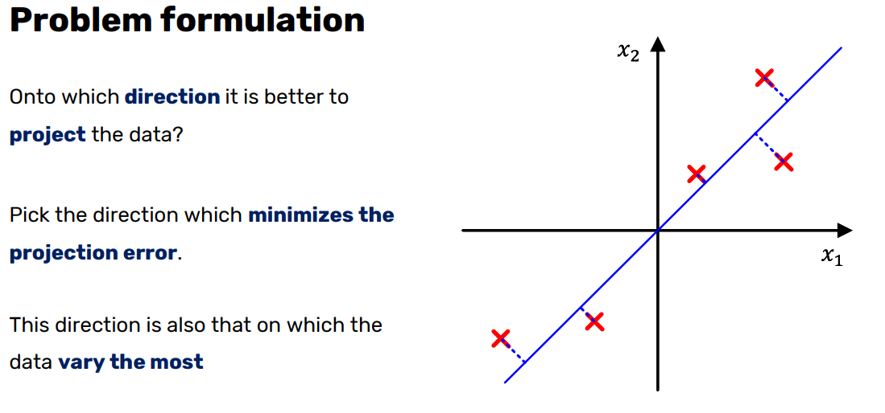
Principal Component Analysis

Slide 8
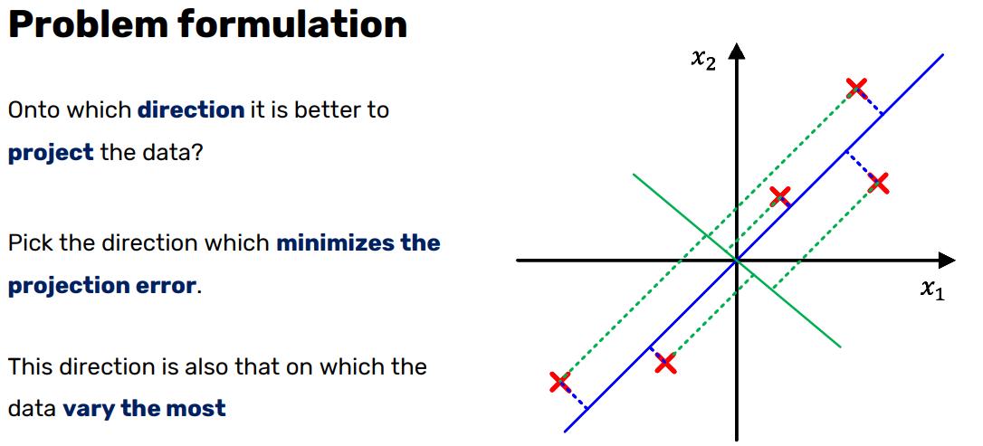
Principal Component Analysis

Slide 9
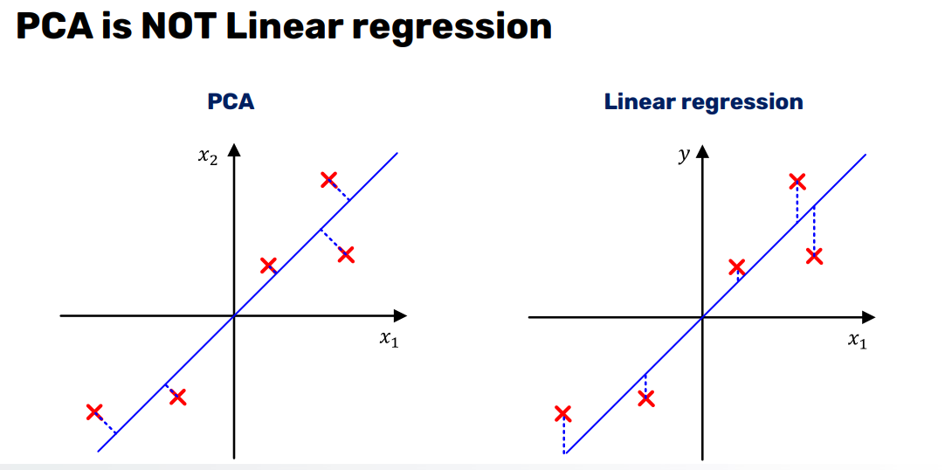
Principal Component Analysis

Slide 10
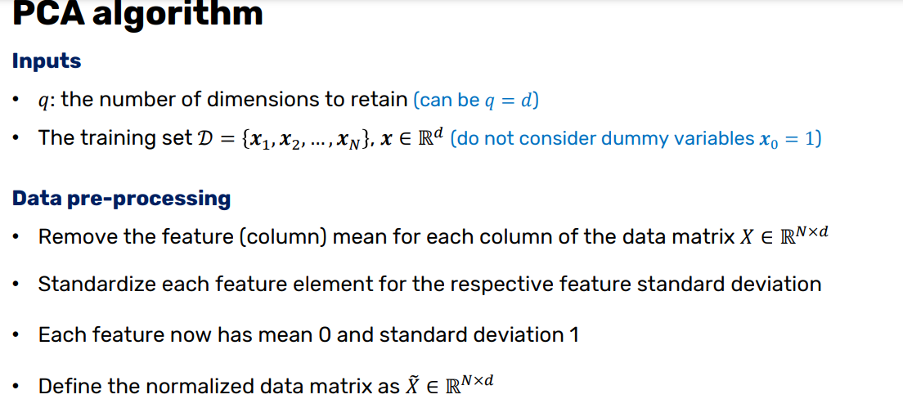
Principal Component Analysis

Slide 11
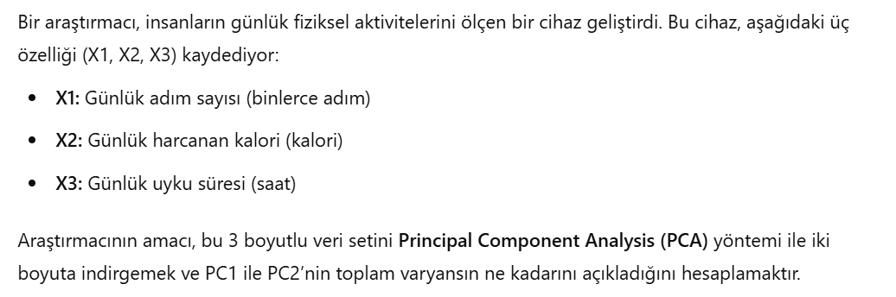
Principal Component Analysis-SORU-1

Slide 12
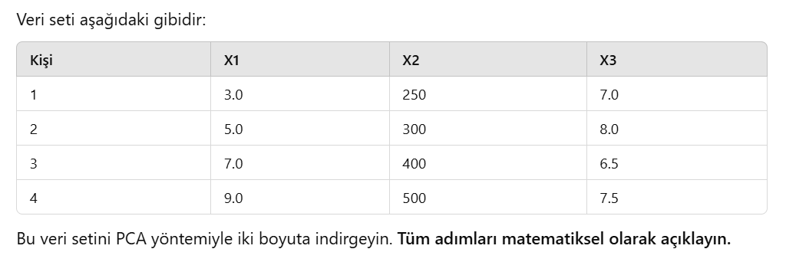
Principal Component Analysis-SORU-1

Slide 13
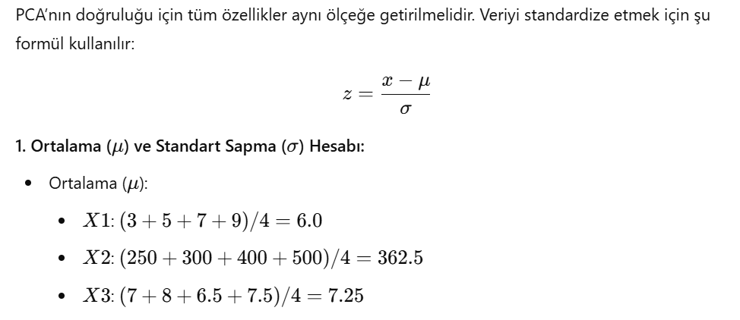
Principal Component Analysis-CEVAP-1

Slide 14
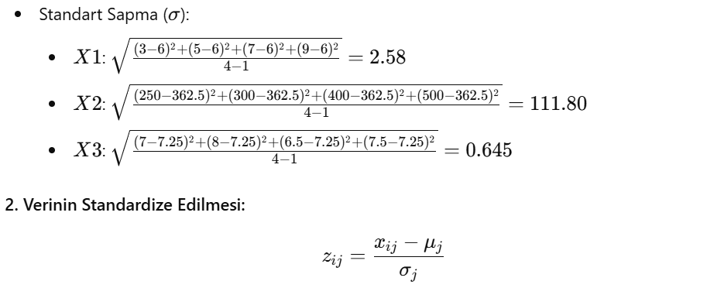
Principal Component Analysis-CEVAP-1

Slide 15
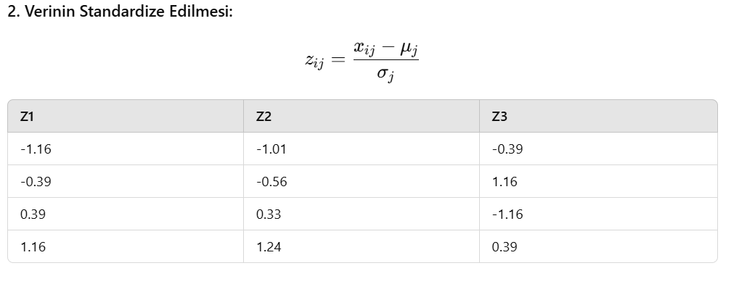
Principal Component Analysis-CEVAP-1

Slide 16
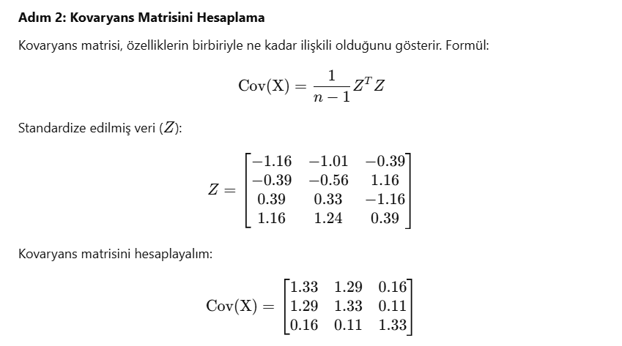
Principal Component Analysis-CEVAP-1

Slide 17
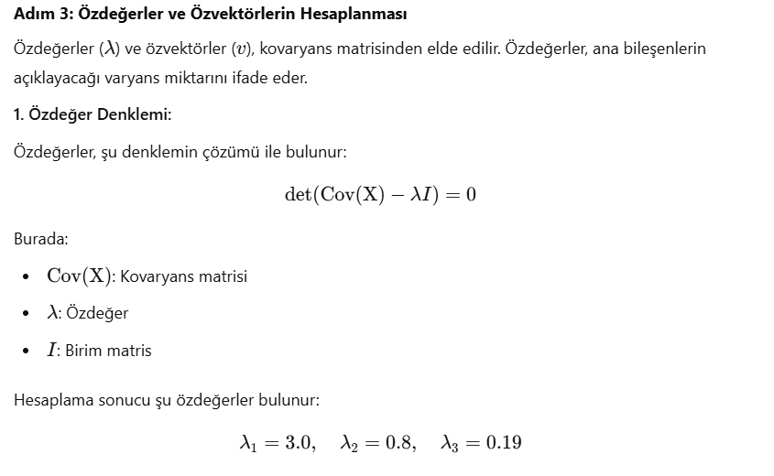
Principal Component Analysis-CEVAP-1

Slide 18
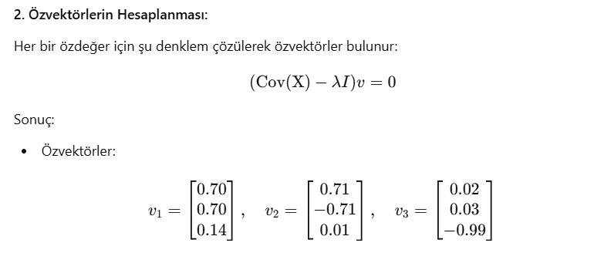
Principal Component Analysis-CEVAP-1

Slide 19
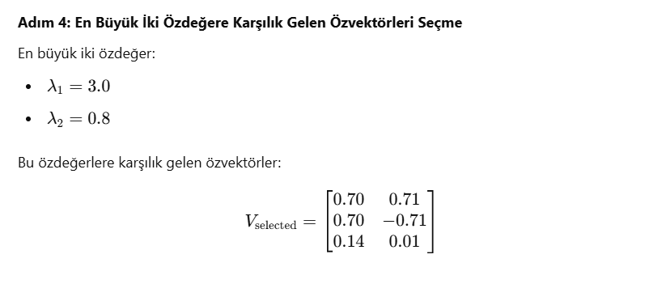
Principal Component Analysis-CEVAP-1

Slide 20
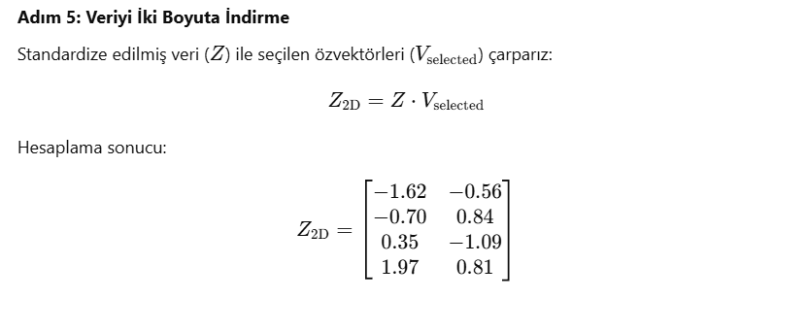
Principal Component Analysis-CEVAP-1

Slide 21
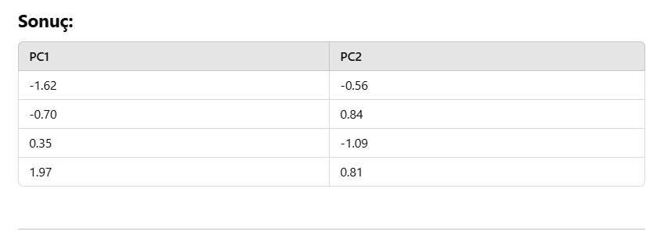
Principal Component Analysis-CEVAP-1

Slide 22
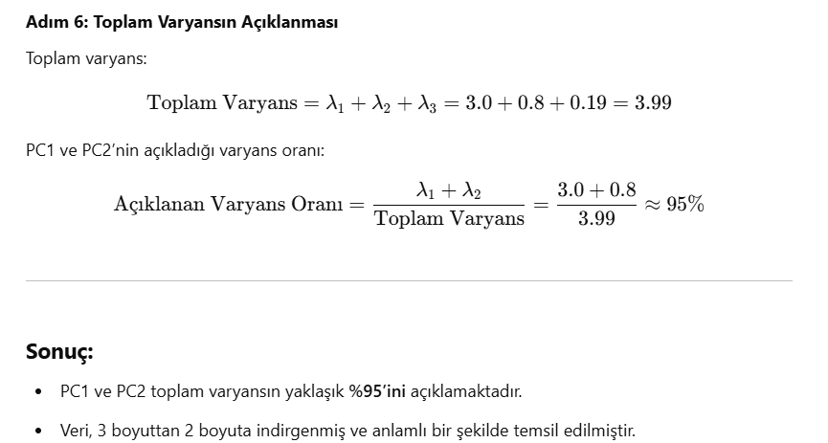
Principal Component Analysis-CEVAP-1

Slide 23
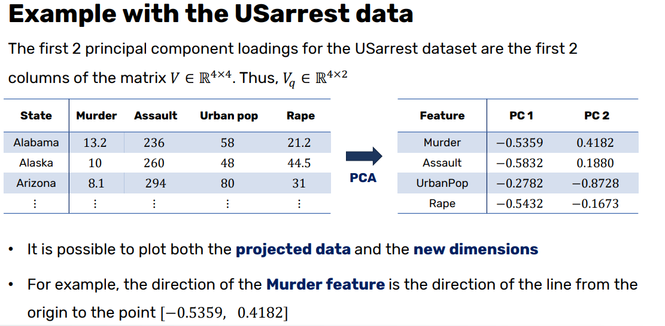
Principal Component Analysis

Slide 24
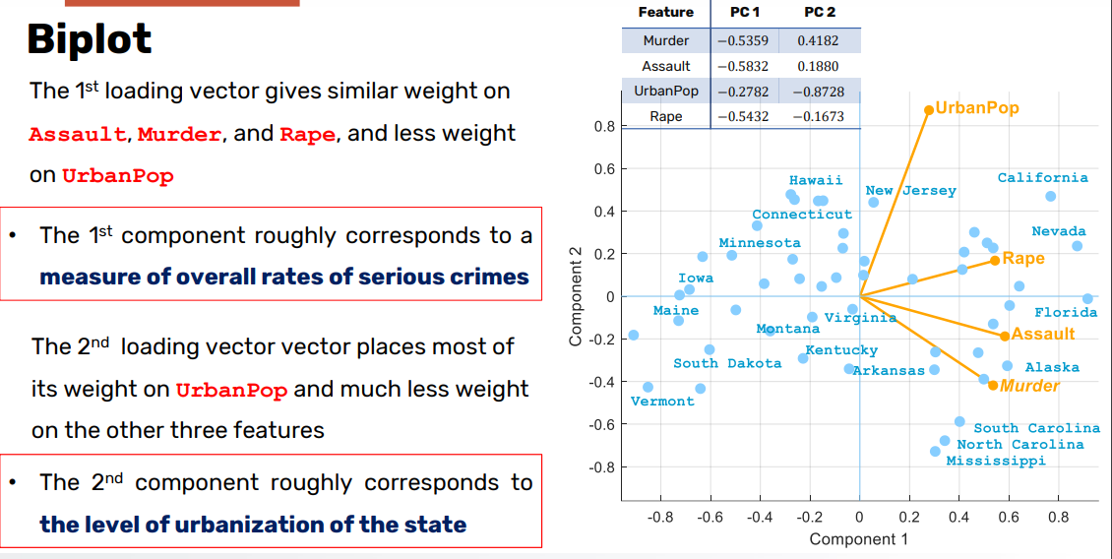
Principal Component Analysis

Slide 25
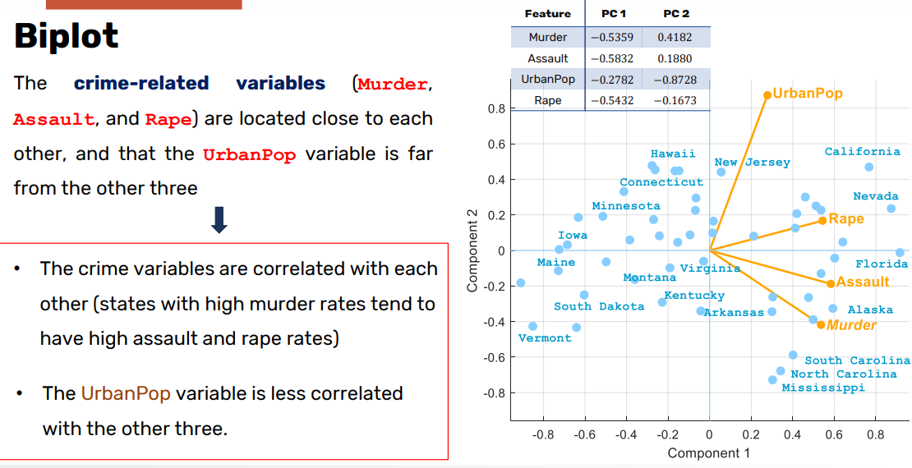
Principal Component Analysis

Slide 26
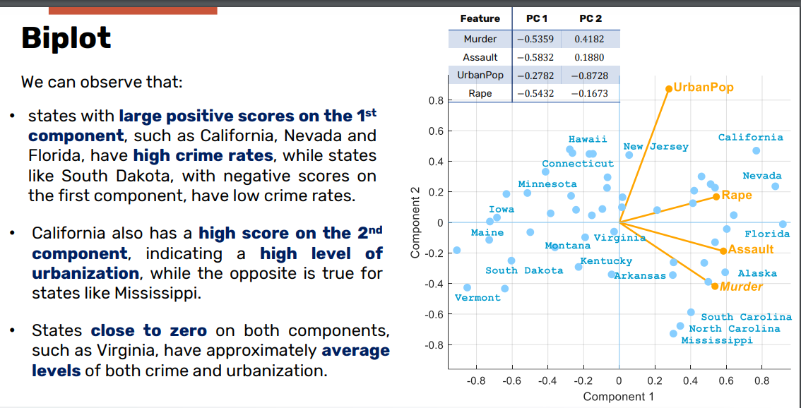
Principal Component Analysis

