Slide 1
GENERATIVE AI
WEEK-7
Asst.Prof.Dr.Murat ŞİMŞEK

Slide 2
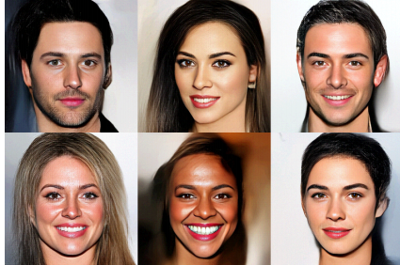
Normalizing Flow Models
Over the years, many methods have been introduced to learn the probability distribution of large datasets. Such techniques include Generative Adversarial Networks (GANs), Variational Auto Encoders (VAEs), and Normalizing Flows.

Slide 3
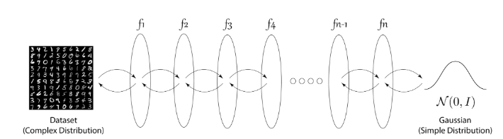
Normalizing Flow Models
In simple words, normalizing flows is a series of simple functions which are invertible, or the analytical inverse of the function can be calculated.
For example, f(x) = x + 2 is a reversible function because for each input, a unique output exists and vice-versa whereas f(x) = x² is not a reversible function. Such functions are also known as bijective functions.

Slide 4
Normalizing Flow Models
From the above figure, it can be seen that the normalizing flows transform a complex data point such as MNIST Image to a simple Gaussian Distribution or vice-versa.
A stark difference can be seen from GANs where the generator is trained, which takes a random vector and produces an image where the flow-based models during training transform from data point to simple distribution.
Random samples are drawn from the Gaussian distribution to obtain MNIST images from the model backward during testing.

Slide 5
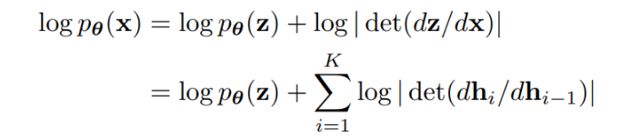
Normalizing Flow Models
Flow-based models are trained using the negative log-likelihood loss function where p(z) is the probability function. The below loss function is obtained using the change of variables formula from basic statistics.
Notes:
GANs and VAEs have shown awe-inspiring results for learning complex data distributions and having simple inference methods. However, both GAN and VAE lack the exact evaluation and inference of the probability distribution, which often results in low-quality blur results in VAEs and challenging GAN training in GANs with challenges such as mode collapse and vanishing gradients posterior collapse, etc. Normalizing flows were proposed to solve many of the current issues with GANs and VAEs by using reversible functions.

Slide 6


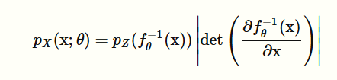
Normalizing Flow Models
Notes:
GANs and VAEs have shown awe-inspiring results for learning complex data distributions and having simple inference methods. However, both GAN and VAE lack the exact evaluation and inference of the probability distribution, which often results in low-quality blur results in VAEs and challenging GAN training in GANs with challenges such as mode collapse and vanishing gradients posterior collapse, etc. Normalizing flows were proposed to solve many of the current issues with GANs and VAEs by using reversible functions.

Slide 7
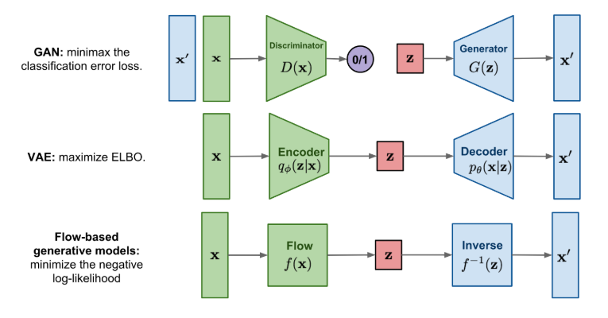
Normalizing Flow Models
Notes:
GANs and VAEs have shown awe-inspiring results for learning complex data distributions and having simple inference methods. However, both GAN and VAE lack the exact evaluation and inference of the probability distribution, which often results in low-quality blur results in VAEs and challenging GAN training in GANs with challenges such as mode collapse and vanishing gradients posterior collapse, etc. Normalizing flows were proposed to solve many of the current issues with GANs and VAEs by using reversible functions.

Slide 8
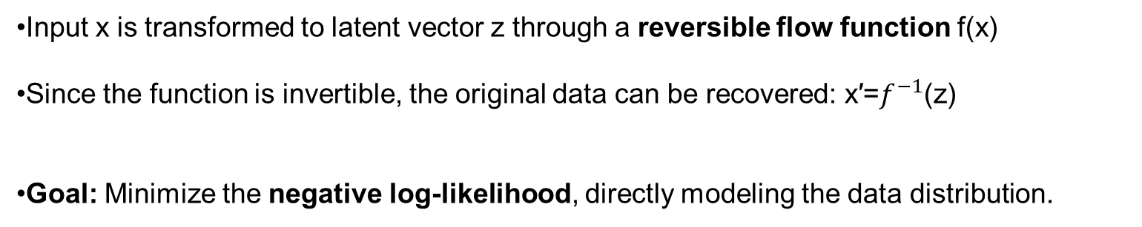
Normalizing Flow Models
Input x is transformed to latent vector z through a reversible flow function f(x)
Since the function is invertible, the original data can be recovered: x′=$f^{−1}$(z)
Goal: Minimize the negative log-likelihood, directly modeling the data distribution.
Notes:
GANs and VAEs have shown awe-inspiring results for learning complex data distributions and having simple inference methods. However, both GAN and VAE lack the exact evaluation and inference of the probability distribution, which often results in low-quality blur results in VAEs and challenging GAN training in GANs with challenges such as mode collapse and vanishing gradients posterior collapse, etc. Normalizing flows were proposed to solve many of the current issues with GANs and VAEs by using reversible functions.

Slide 9
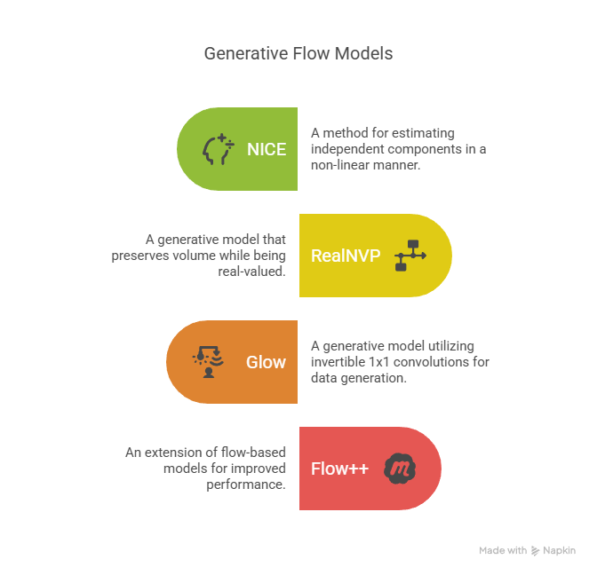
Popular Normalizing Flow Models Methods
Notes:
GANs and VAEs have shown awe-inspiring results for learning complex data distributions and having simple inference methods. However, both GAN and VAE lack the exact evaluation and inference of the probability distribution, which often results in low-quality blur results in VAEs and challenging GAN training in GANs with challenges such as mode collapse and vanishing gradients posterior collapse, etc. Normalizing flows were proposed to solve many of the current issues with GANs and VAEs by using reversible functions.

Slide 10
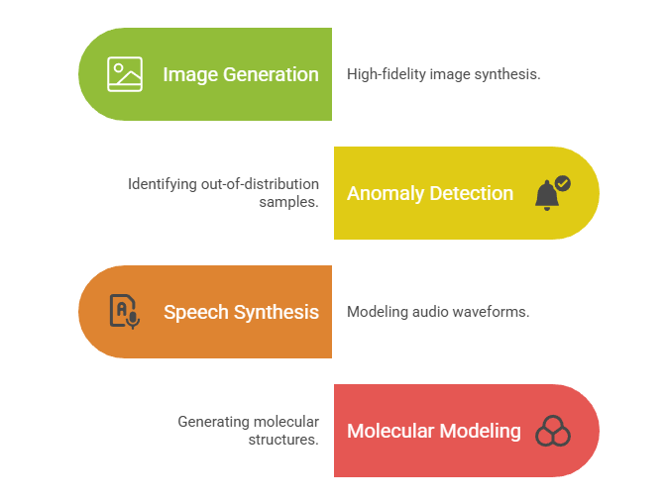
Applications of Normalizing Flow Models
Notes:
GANs and VAEs have shown awe-inspiring results for learning complex data distributions and having simple inference methods. However, both GAN and VAE lack the exact evaluation and inference of the probability distribution, which often results in low-quality blur results in VAEs and challenging GAN training in GANs with challenges such as mode collapse and vanishing gradients posterior collapse, etc. Normalizing flows were proposed to solve many of the current issues with GANs and VAEs by using reversible functions.

Slide 11
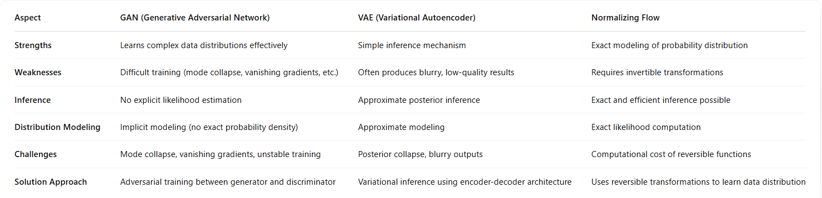
Normalizing Flow Models
Notes:
GANs and VAEs have shown awe-inspiring results for learning complex data distributions and having simple inference methods. However, both GAN and VAE lack the exact evaluation and inference of the probability distribution, which often results in low-quality blur results in VAEs and challenging GAN training in GANs with challenges such as mode collapse and vanishing gradients posterior collapse, etc. Normalizing flows were proposed to solve many of the current issues with GANs and VAEs by using reversible functions.

Slide 12
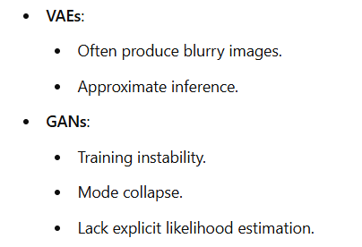
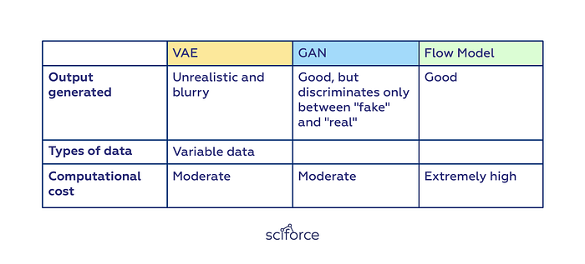
Normalizing Flow Models
Notes:
GANs and VAEs have shown awe-inspiring results for learning complex data distributions and having simple inference methods. However, both GAN and VAE lack the exact evaluation and inference of the probability distribution, which often results in low-quality blur results in VAEs and challenging GAN training in GANs with challenges such as mode collapse and vanishing gradients posterior collapse, etc. Normalizing flows were proposed to solve many of the current issues with GANs and VAEs by using reversible functions.

