Slide 1


NHS Appointments Analysis
A data-driven investigation of service utilisation, missed appointments, and capacity
By Monica Baracho | LSE DA201 Assignment

Slide 2
NHS Appointments: Context and Key Questions
Context & Problem:
The NHS is currently facing significant challenges in meeting the increasing healthcare demands with limited resources. This situation has led to missed appointments and capacity imbalances, resulting in avoidable costs and service delays.
Business Questions:
Is NHS capacity adequate?
How are resources being used?
What explains missed appointments?
Can Twitter sentiment support NHS planning?
Data & Methodology:
-appointments_regional.csv: GP appointment records from 2020 to 2022
-actual_duration.csv: Time durations of GP visits
-national_categories.xlsx: Service setting, context, and national category
-tweets.csv: Public NHS-related Twitter sentiment
-metadata_nhs.txt: Dataset documentation
-Logistic regression
Notes:
My project focuses on four key business questions:
Are NHS resources being effectively utilized?
Is there enough capacity and staff?
What are the main drivers of missed appointments?
Can public sentiment from social media help inform strategy?
I used NHS appointment records from 2020 to 2022, GP visit durations, national service categories, and a sample of NHS-related tweets.

Slide 3
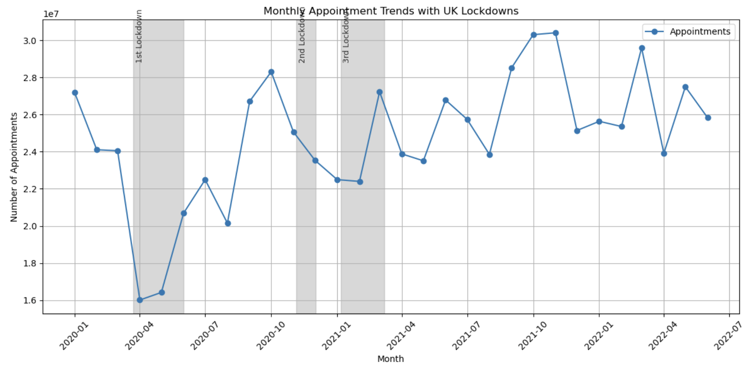
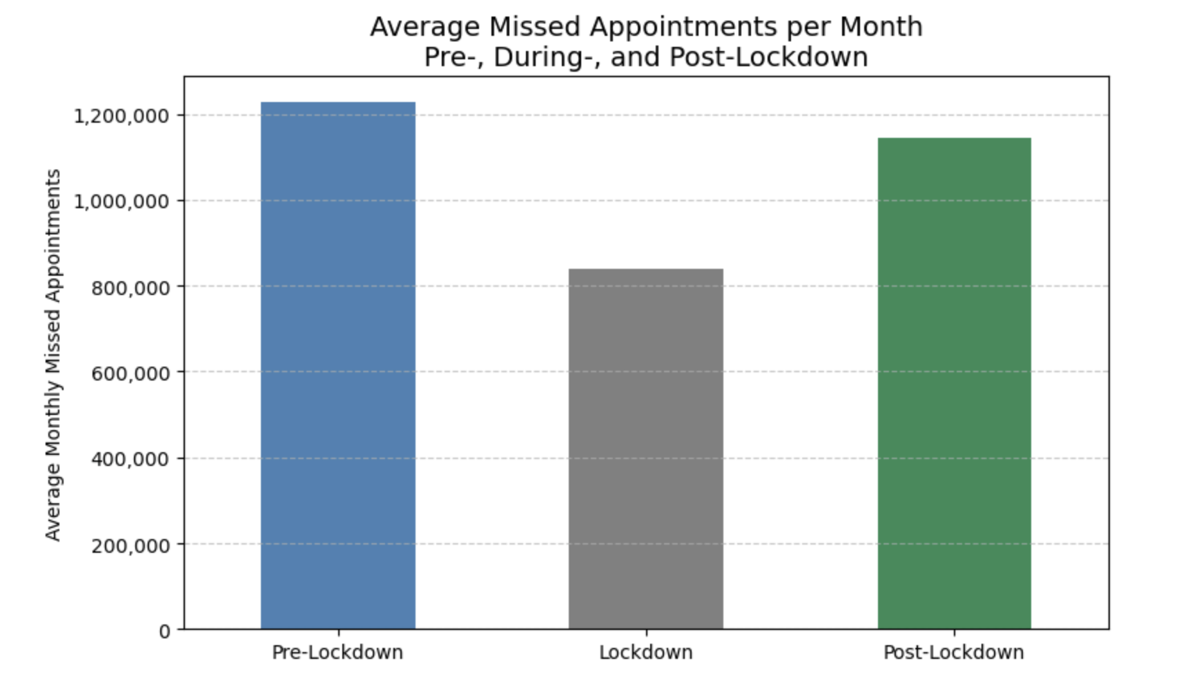
Monthly NHS Appointment Volumes (2020–2022)
Notes:
This chart shows the full timeline of NHS appointments from January 2020 through mid-2022. We can see three distinct lockdown periods marked in grey, with a sharp drop in activity during the first one. After these disruptions, appointment volumes not only recovered but stabilised at higher-than-pre-pandemic levels, especially from August 2021 onward. Below, we also see that missed appointments—though lower during lockdown—rose again after, averaging over 1.1 million per month post-lockdown. That’s why, for the rest of this analysis, we’ll focus specifically on the post-lockdown period — to better understand how the NHS is functioning under ‘normalised’ operational pressure

Slide 4
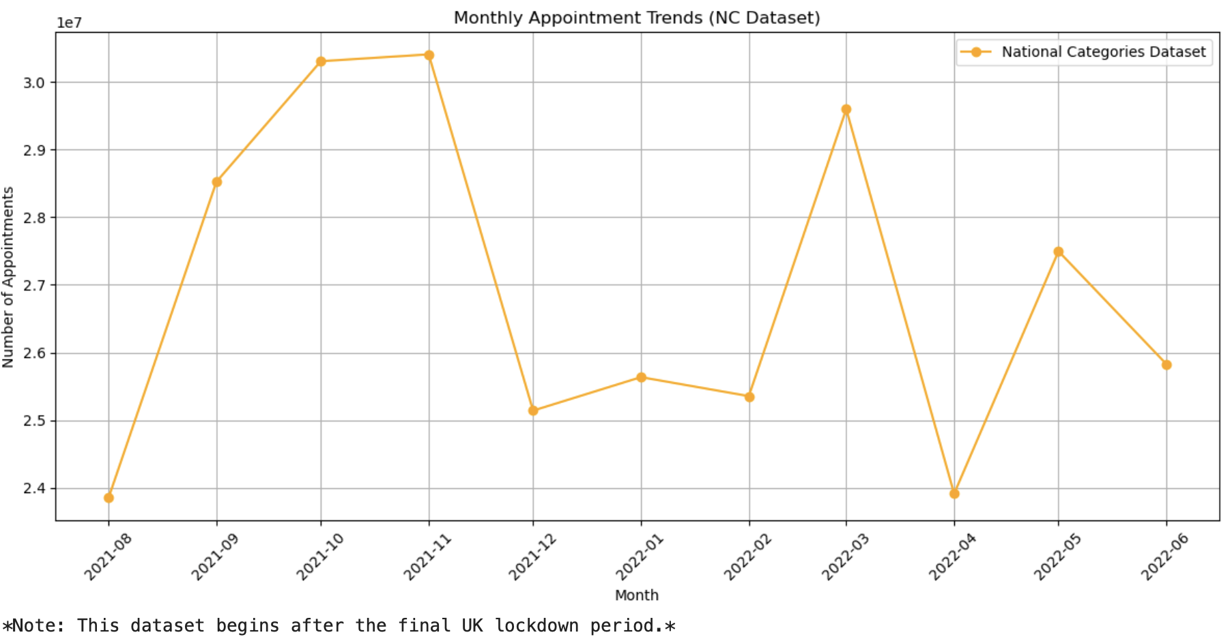
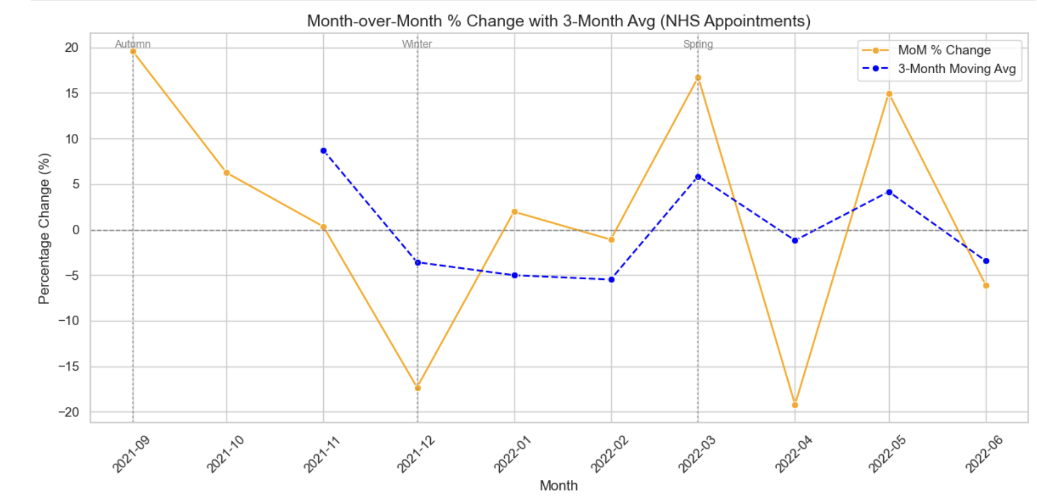
Volatility Persists: NHS Appointments Struggled to Stabilise Post-Lockdown
Notes:
Here we’re looking at how appointment volumes change month to month after lockdown. The orange line shows very sharp swings — including a 17% drop in December and spikes again in March and May. This pattern suggests the NHS faces recurring seasonal strain. Even the 3-month moving average, shown in blue, fails to stabilise — pointing to a system under sustained and unpredictable demand.

Slide 5

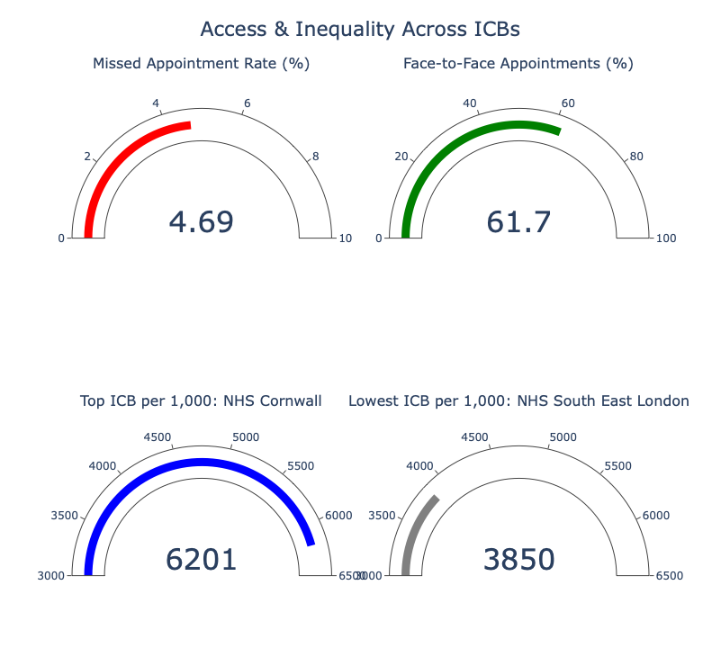
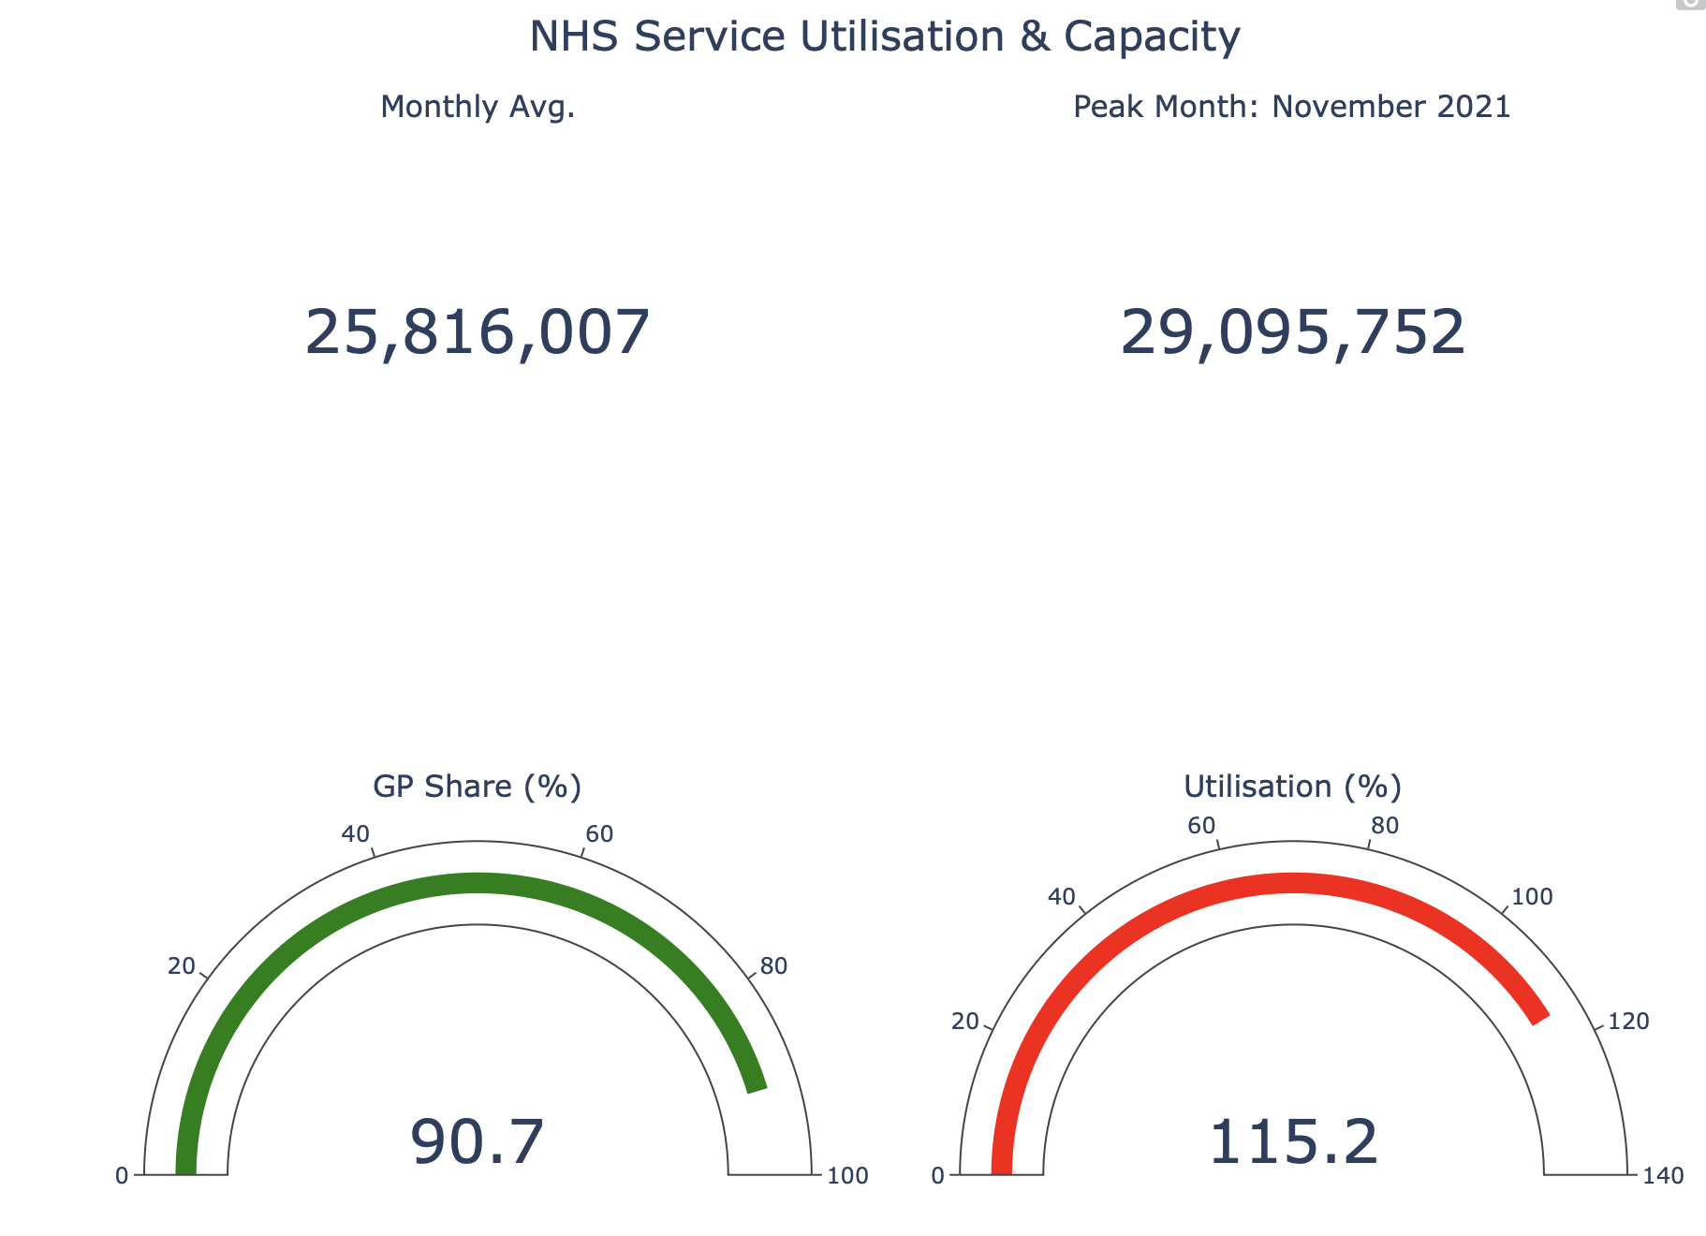
NHS KPIs (Aug 2021–Jun 2022): System Pressure & Inequality
Notes:
Now that we've seen how volatile appointment demand remains post-lockdown, let's look at how the system is coping overall. This dashboard summarizes the key NHS metrics during the same post-lockdown period — August 2021 to June 2022
Even under strain, the NHS delivers nearly 26 million appointments a month — but missed appointments, overutilisation, and regional inequality all point to structural limits in the system.

Slide 6
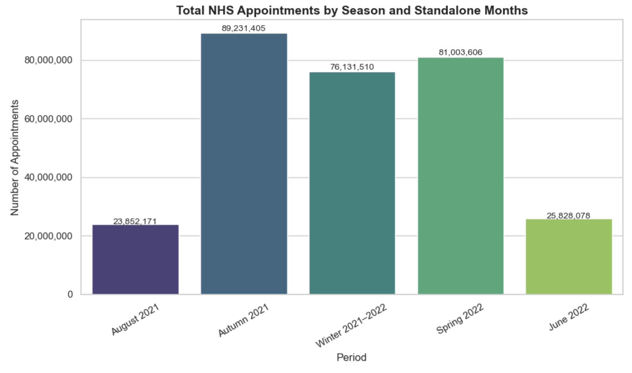
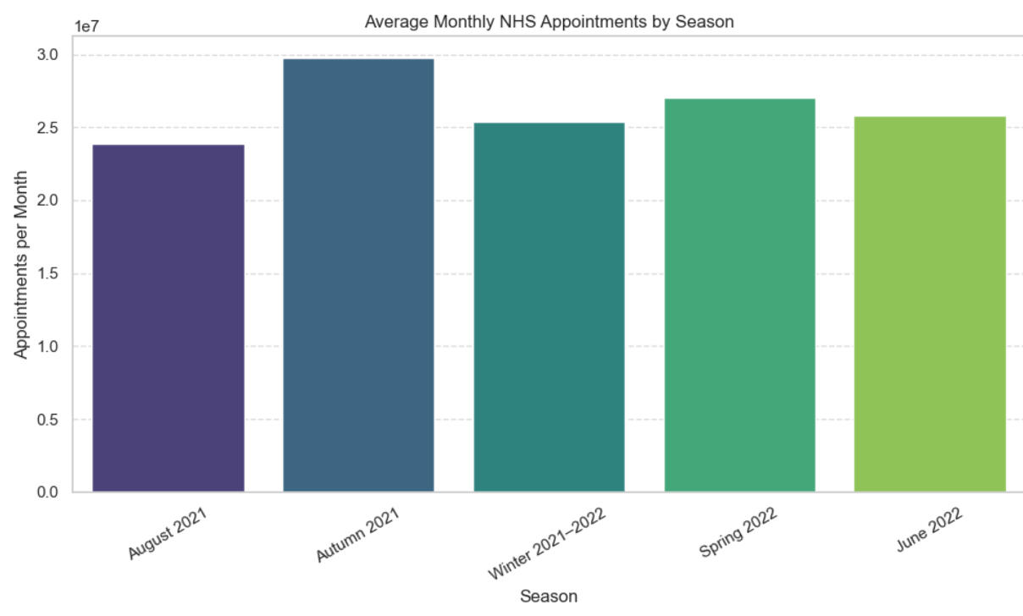
Appointments by Season: Total and Average
Notes:
To contextualize NHS service demand, I analysed seasonal appointment trends. Autumn 2021 showed the highest workload with over 89 million appointments. However, when we normalize per month, the seasonal pattern remains strong, with Autumn again leading, followed by Spring and Winter. August 2021 and June 2022 had lower volumes as they fall outside of full quarters — useful to consider when planning resource allocation.

Slide 7
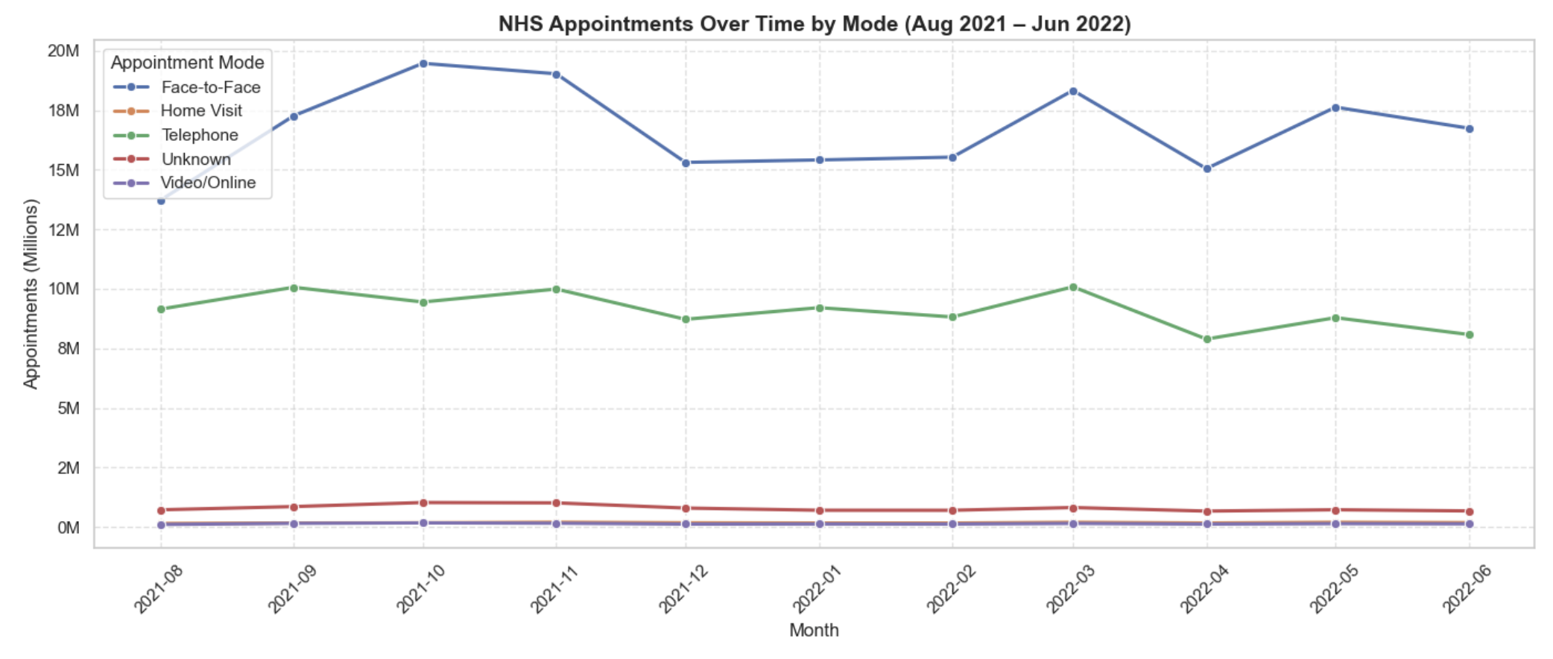
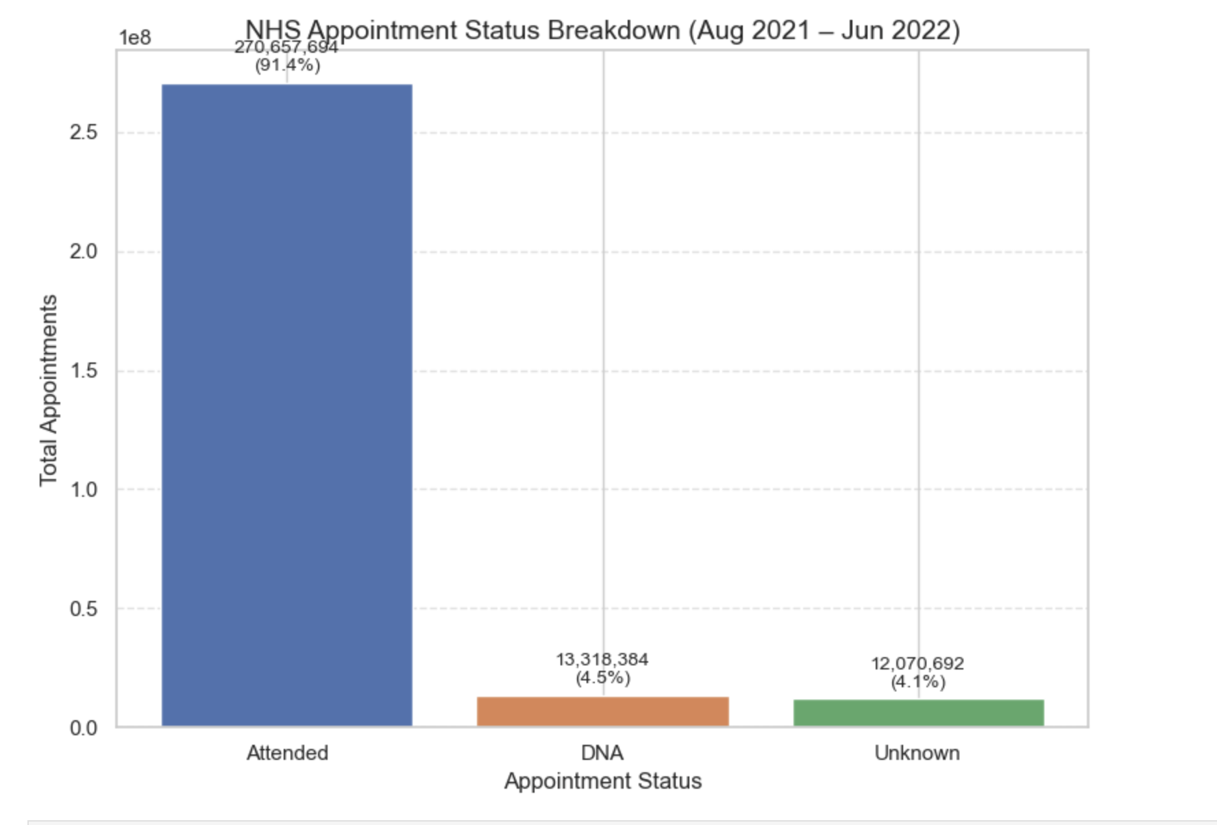
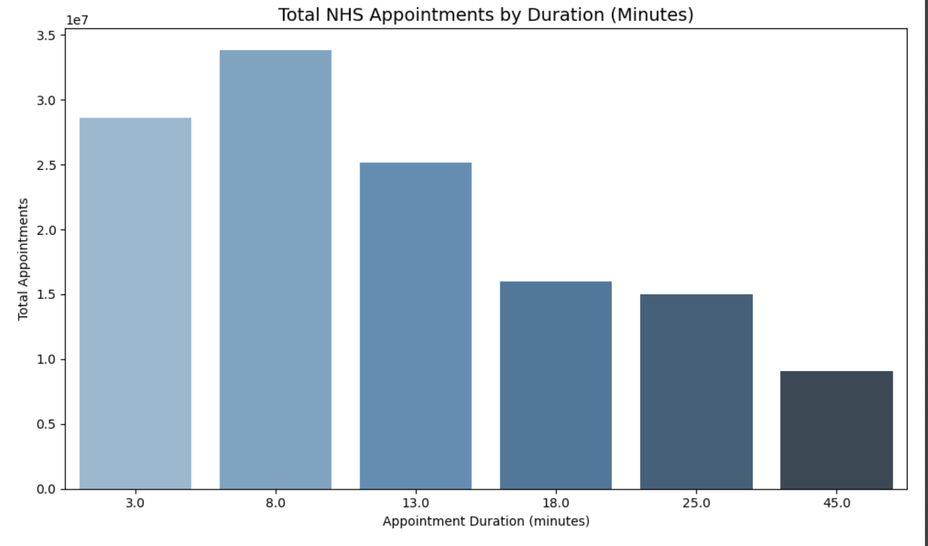
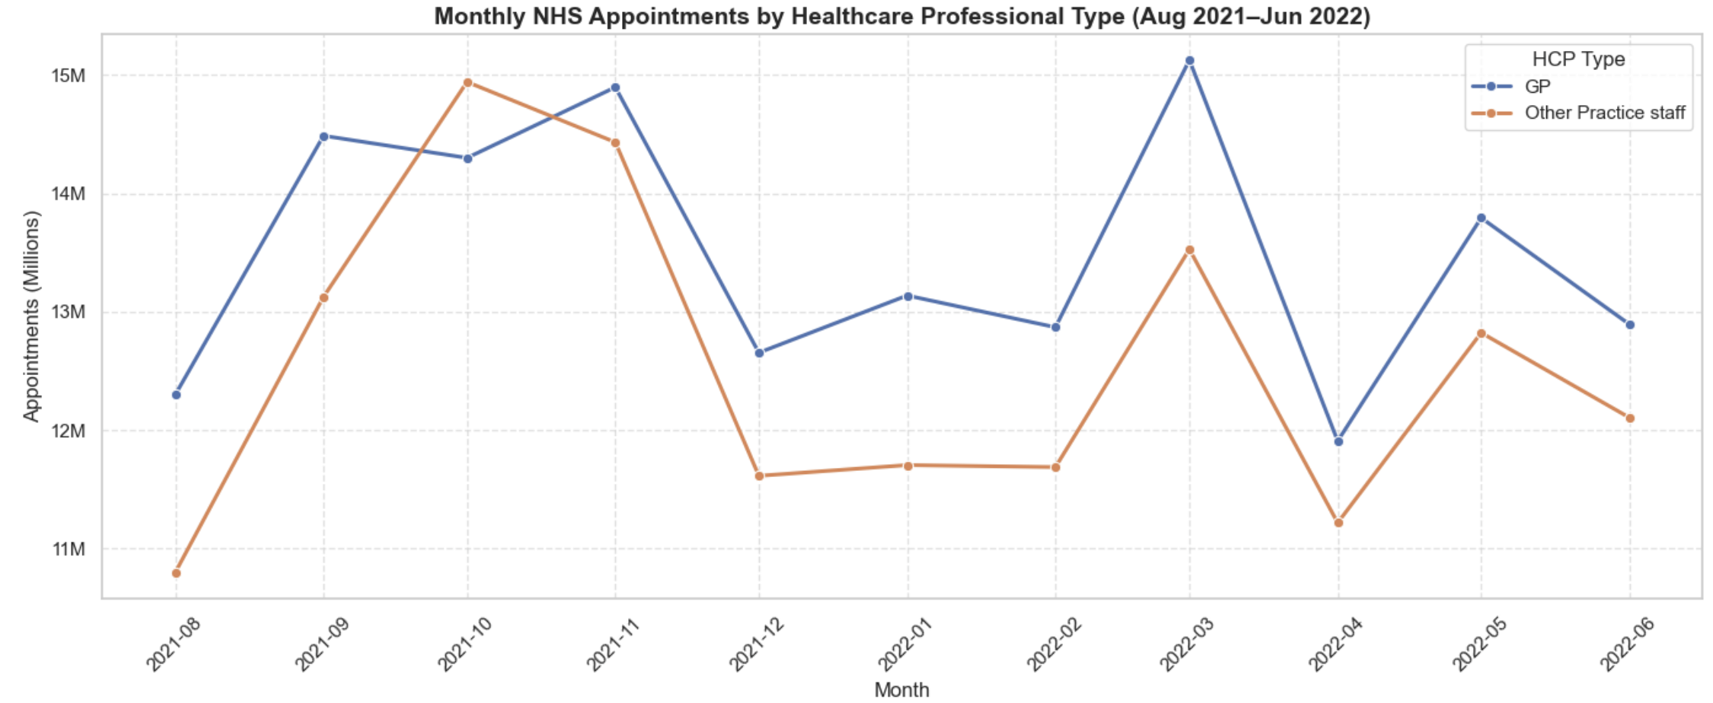
Distribution of NHS Appointments by Mode, Status, Duration, and Professional Type - Most appointments were short, face-to-face and handled by GPs.
Notes:
Zooming into the post-lockdown period, this slide gives a more detailed breakdown of how NHS appointments were delivered. Face-to-face consultations dominate throughout, though telephone appointments also maintain steady volume. In terms of status, the vast majority of appointments were attended, though missed and unknown-status appointments still account for over 25 million instances combined. Most appointments lasted 3 to 13 minutes, reinforcing the quick turnover nature of GP services. We also see that GPs delivered the bulk of appointments, but other practice staff consistently handle a large share — nearly 50% in some months

Slide 8
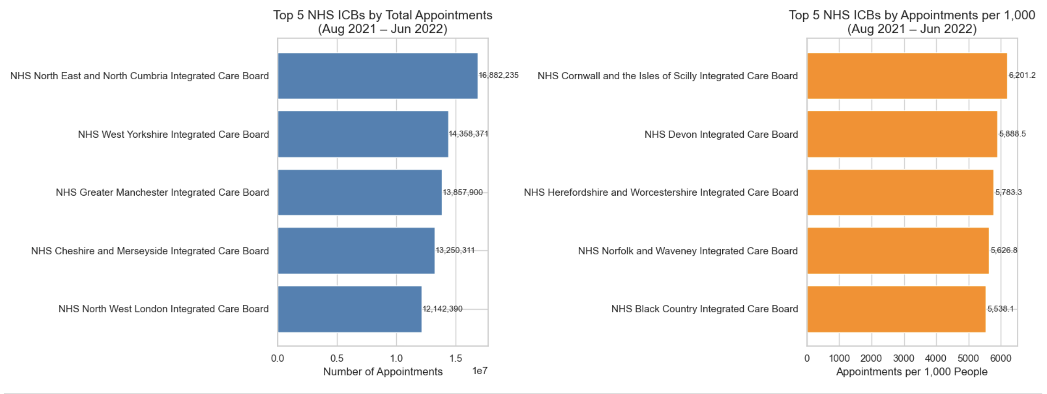
Service Inequality: High Volume ≠ High Access
- High-volume regions like North West London do not always align with those offering the most appointments per 1,000 patients, indicating disparities in service provision and population density.
📍 Unequal Access High total appointment counts in urban regions mask lower per-person access. Resource planning should consider population-adjusted service levels.
Notes:
So far, we’ve seen the overall volume and how appointments are distributed — but now let’s look at who actually has access to those appointments. On the left, we see the top 5 ICBs by total appointments. Unsurprisingly, these are large urban areas like North West London and Manchester. But when we adjust for population and look at appointments per 1,000 residents — shown on the right — the top ICBs completely change. Rural areas like Cornwall and Devon actually offer much higher access per capita, while high-volume urban centres fall off the list. This highlights a critical policy issue: appointment volume does not equal equitable access..

Slide 9
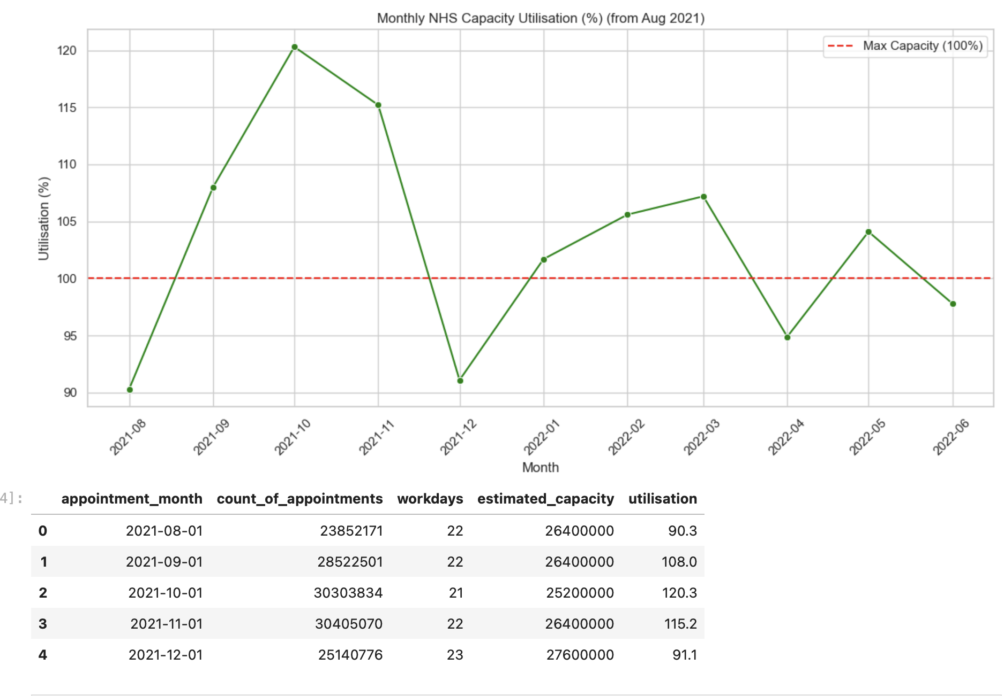
Capacity Overload: NHS Operates Above Safe Limits
-Overcapacity is the Norm NHS operated at or above 100% capacity in 9 out of 11 months post-lockdown, signalling systemic strain.
Notes:
We’ve seen that access isn’t evenly distributed across regions — but even more concerning is that the system as a whole is over capacity. Here we see the NHS operating above 100% capacity for most of the post-lockdown period — peaking at 120% in October 2021. Even quieter months like March and May hover well above the planned limits. This chart clearly shows that overutilisation isn’t a one-off — it’s sustained. This kind of pressure increases risk of burnout, delays, and missed appointments.

Slide 10
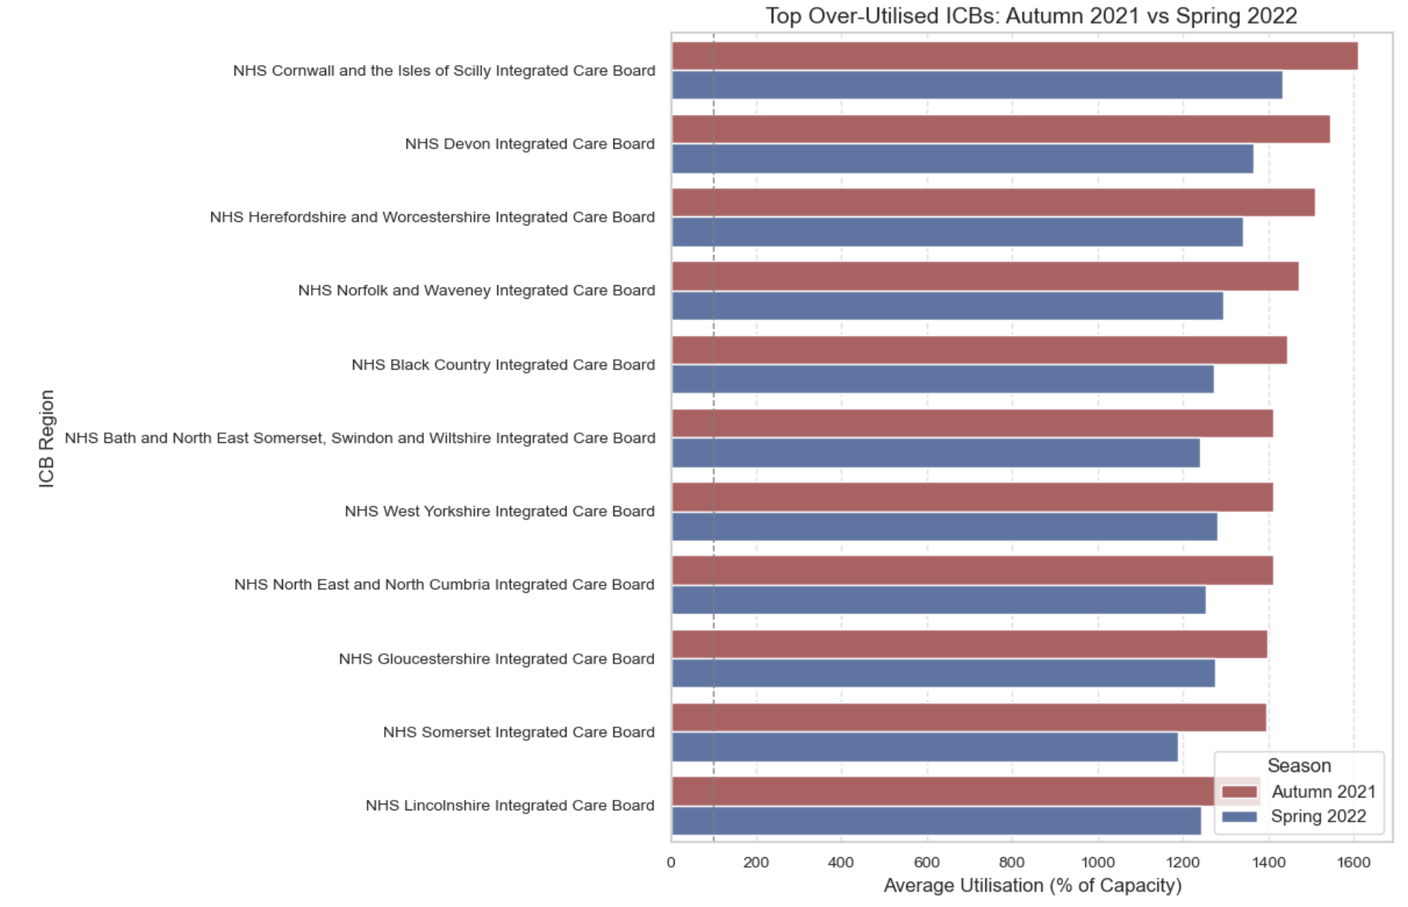
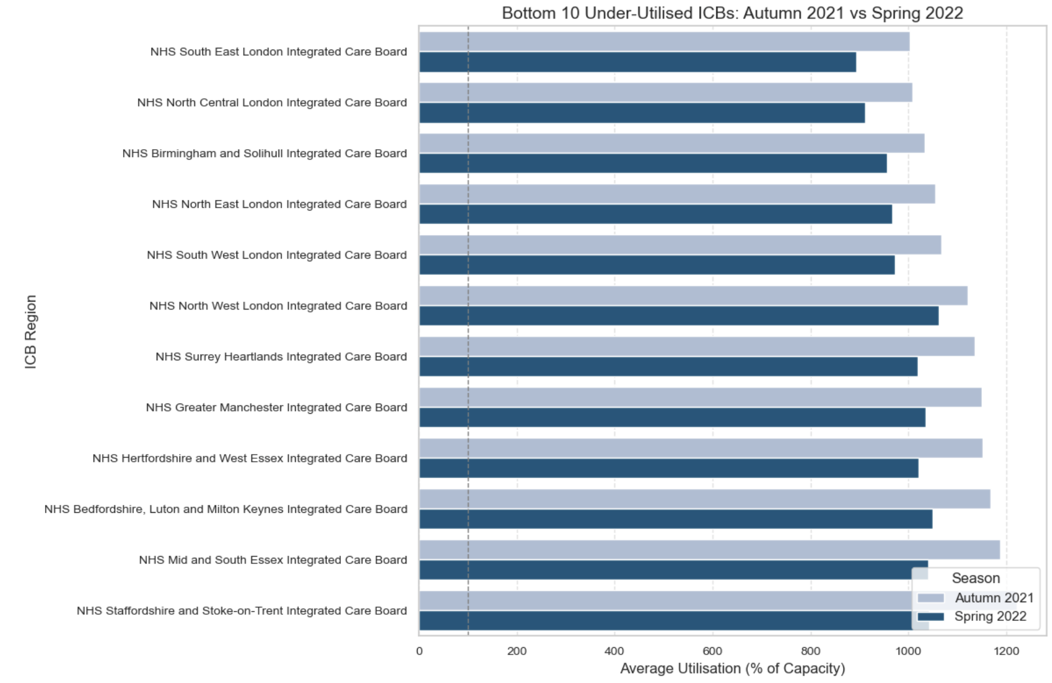
ICB-Level Disparities in Capacity Utilisation: Autumn vs Spring
Notes:
Here we look at the top ICBs by average capacity utilisation during autumn and spring. Many are rural or smaller areas like Cornwall and Devon — exceeding 1400% utilisation relative to baseline. This kind of pressure is consistent across seasons and suggests chronic understaffing or unmatched demand.
Conversely, these ICBs — mostly in major urban areas like London and Birmingham — show consistent underutilisation. This raises questions around how resources are distributed. It also supports the earlier point: high volume doesn’t mean high access — and in this case, it may also mask underperformance.

Slide 11
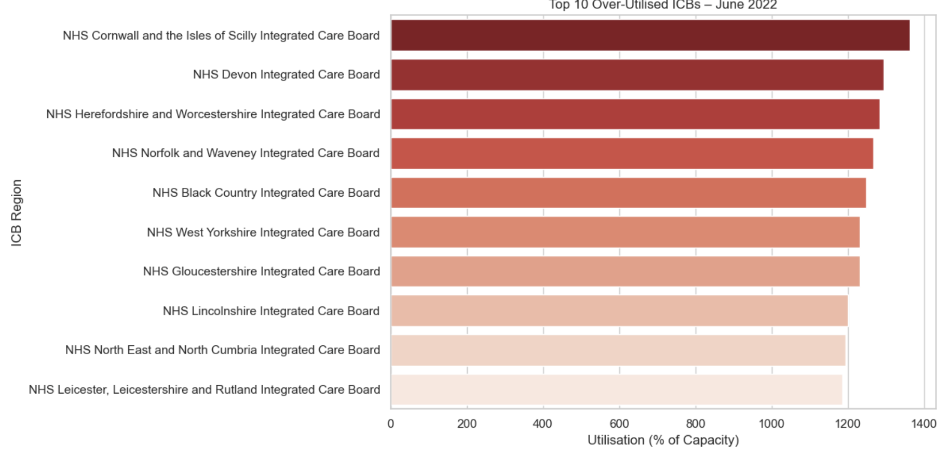
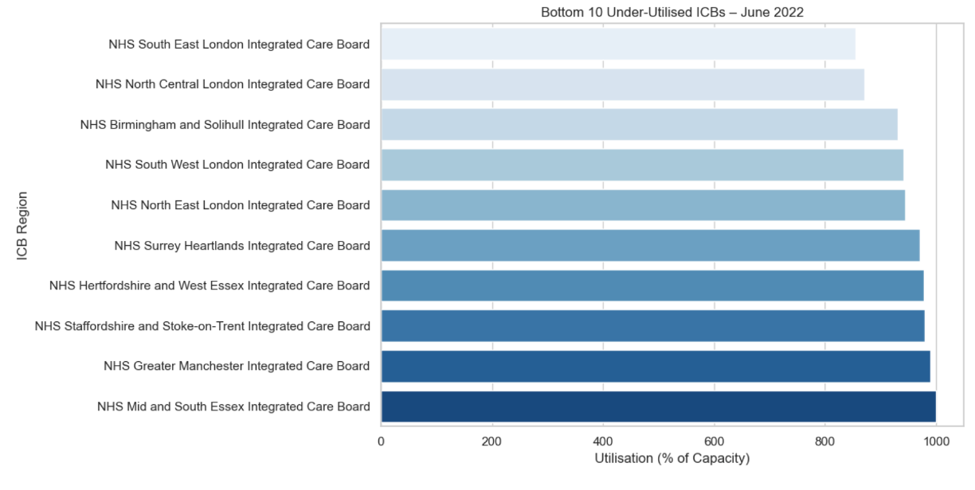
ICB Capacity Utilisation Snapshot: June 2022
🔍 Latest Data Check (June 2022): Cornwall and Devon remain top over-utilised ICBs, while 5 London regions continue underperforming.
Notes:
And here’s the most recent data — it confirms the trend hasn’t improved.

Slide 12
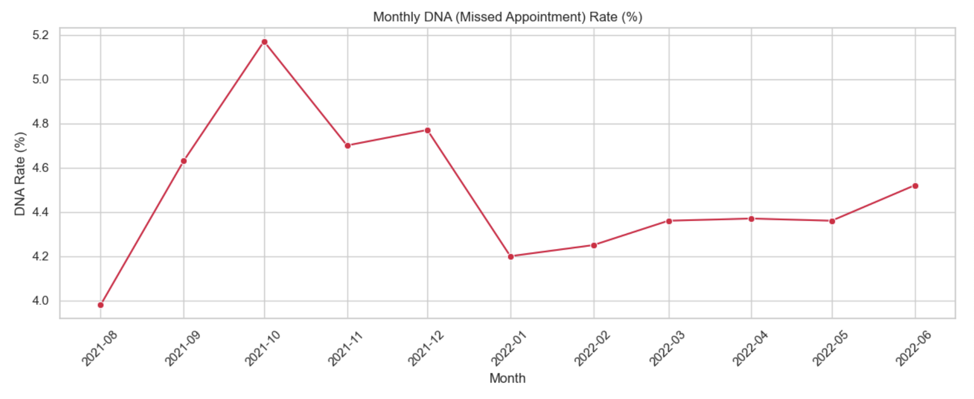
Missed Appointments by Month
• 📈 October 2021 had the highest DNA rate: 5.18% • 📉 The rate dropped post-winter to 4.2% in January but has since remained above 4.3% • This suggests a consistent missed appointment problem, with seasonal variation • Missed appointments are costly and disruptive to already strained NHS capacity
Notes:
Another major challenge NHS faces under this strain is missed appointments — also known as DNAs, or 'Did Not Attends.' In October 2021, the missed rate peaked at 5.18%. After dipping slightly in winter, the rate has remained consistently above 4.3% — even in quieter months like April and May. This indicates that missed appointments aren’t random — they follow seasonal trends and reflect a persistent operational challenge. Each missed appointment wastes scarce NHS capacity and contributes to backlogs and delays.”
📉 Persistent Missed Appointments DNA rates remain above 4.3% across most of the post-lockdown period, peaking in October and never dropping below August levels.

Slide 13
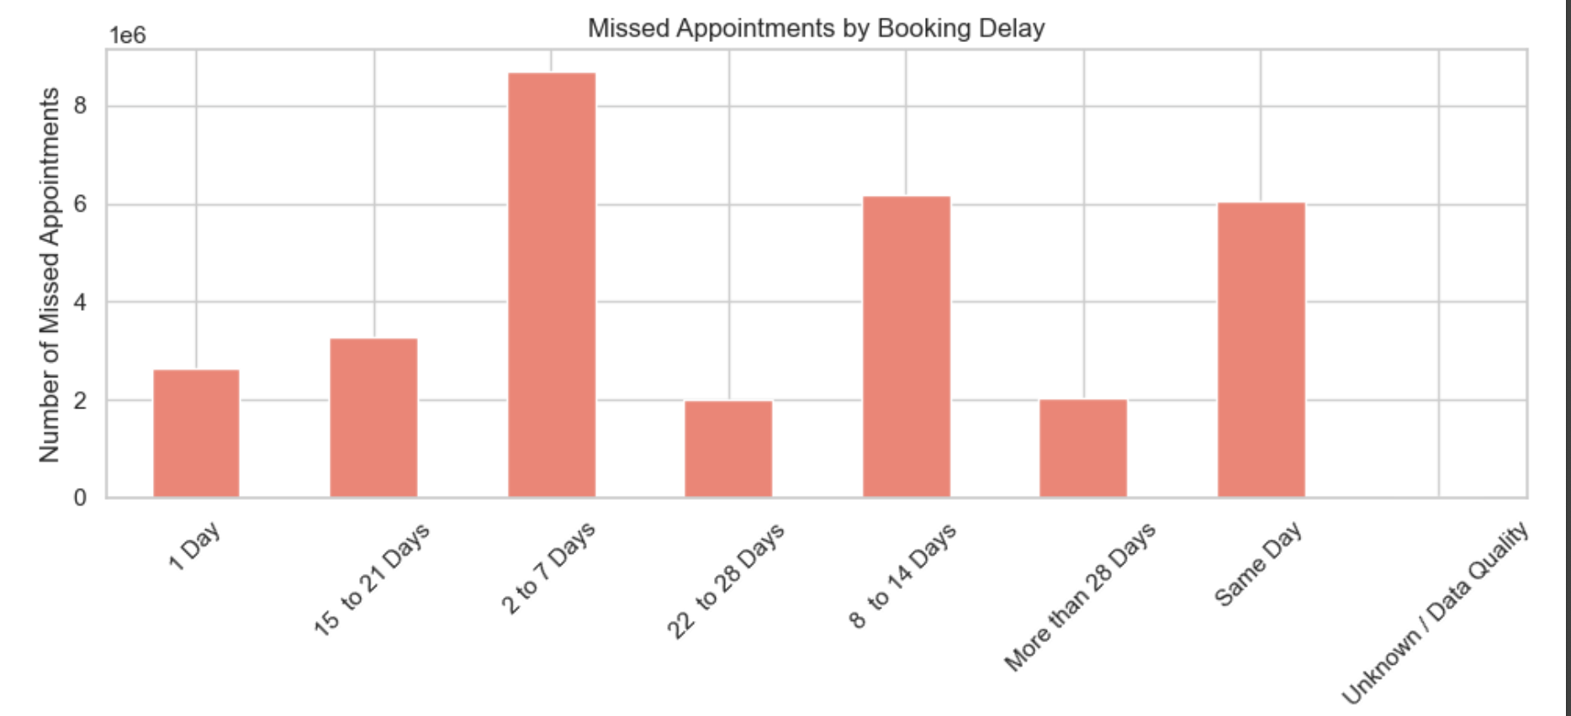
Missed Appointments by Booking Lead Time
🕑 Timing Matters Short-notice and near-term bookings drive the majority of missed appointments — calling for better patient engagement around these slots.
Notes:
To understand what might be driving these missed appointments, we looked at booking lead time. The results are clear: appointments scheduled 2 to 7 days in advance are the most likely to be missed — over 8 million DNAs. Same-day appointments are also among the highest, which may reflect last-minute or lower-commitment bookings. This indicates that timing plays a critical role in attendance — and suggests targeted reminder or follow-up strategies could be most effective for these windows.”

Slide 14
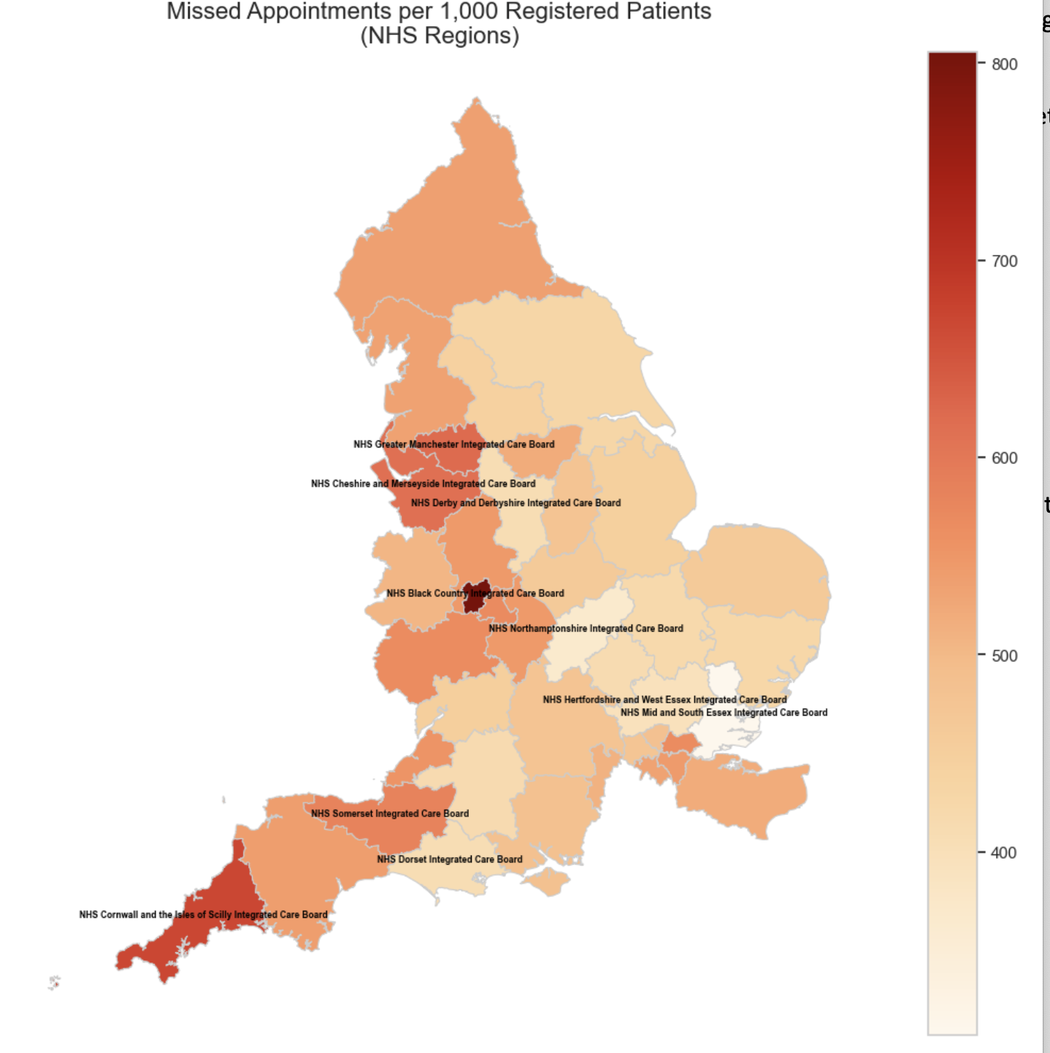
Map: Missed Appointments per 1,000 Patients
Notes:
We’ve looked at when appointments are missed and how lead time influences it. But missed appointments also vary significantly across regions. This map shows missed appointments per 1,000 registered patients. We can clearly see higher DNA rates concentrated in areas like Cornwall, Devon, and parts of the Midlands. These patterns align closely with earlier over-utilisation trends, suggesting that system strain and DNA rates are spatially correlated. It also reinforces the need for place-specific strategies, not just general policies

Slide 15
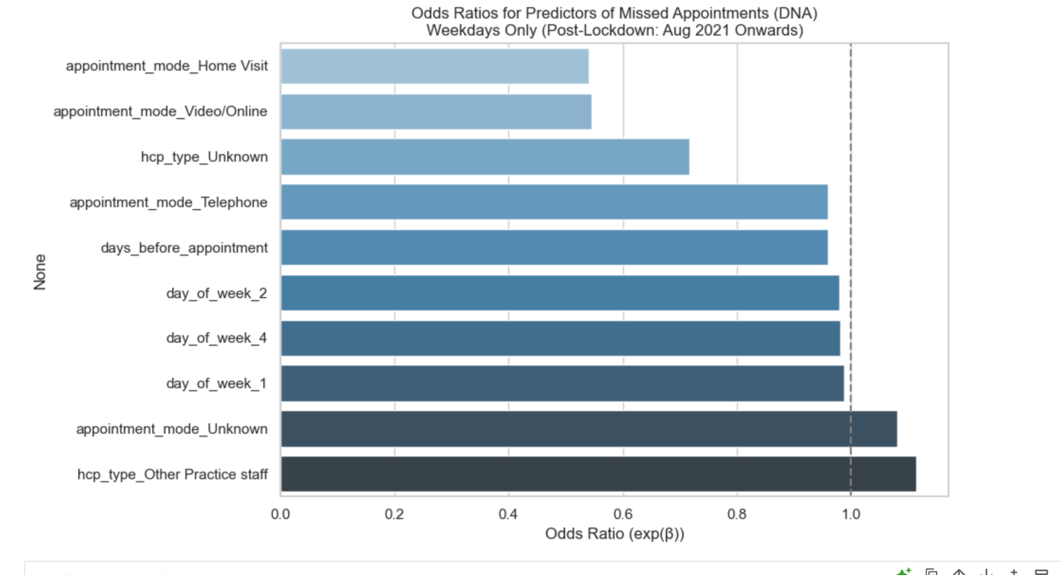
Predicting Missed Appointments: Logistic Regression Insights
Factor | Effect vs Baseline | Insight
Home Visit | −46% lower DNA odds | Highest attendance. Suggests convenience or medical necessity.
Video/Online | −45% lower | Digital formats greatly reduce no-shows — strong case for hybrid care.
Telephone | Slightly lower | Still better than face-to-face, though less impactful than video.
Days Before Appointment | Each day earlier = −4% DNA odds | Short-notice bookings have higher DNA risk. Encourage advance booking.
Unknown HCP Type | Lower odds | Possibly reflects system-default or triage bookings. Review practice logs.
Other Practice Staff | +12% higher | Patients more likely to miss these. Improve visibility and value messaging.
Unknown Mode | Slightly higher | Could indicate appointment booking inconsistencies. Data quality issue.
Tuesday–Friday | No significant difference from Monday | Weekday alone does not affect likelihood of DNA.
Notes:
To quantify what factors most influence missed appointments, we ran a logistic regression model using post-lockdown data. We converted variables like appointment mode, professional type, and day of the week into predictors, and modelled the odds of a DNA event. As shown here, appointments with home visits or video/online modes were significantly less likely to be missed. Each additional day between booking and appointment also slightly reduced the risk. Conversely, appointments booked with 'Other Practice Staff' and those with an unknown mode were the most likely to be missed. These insights support targeted improvements in how and when appointments are offered.

Slide 16
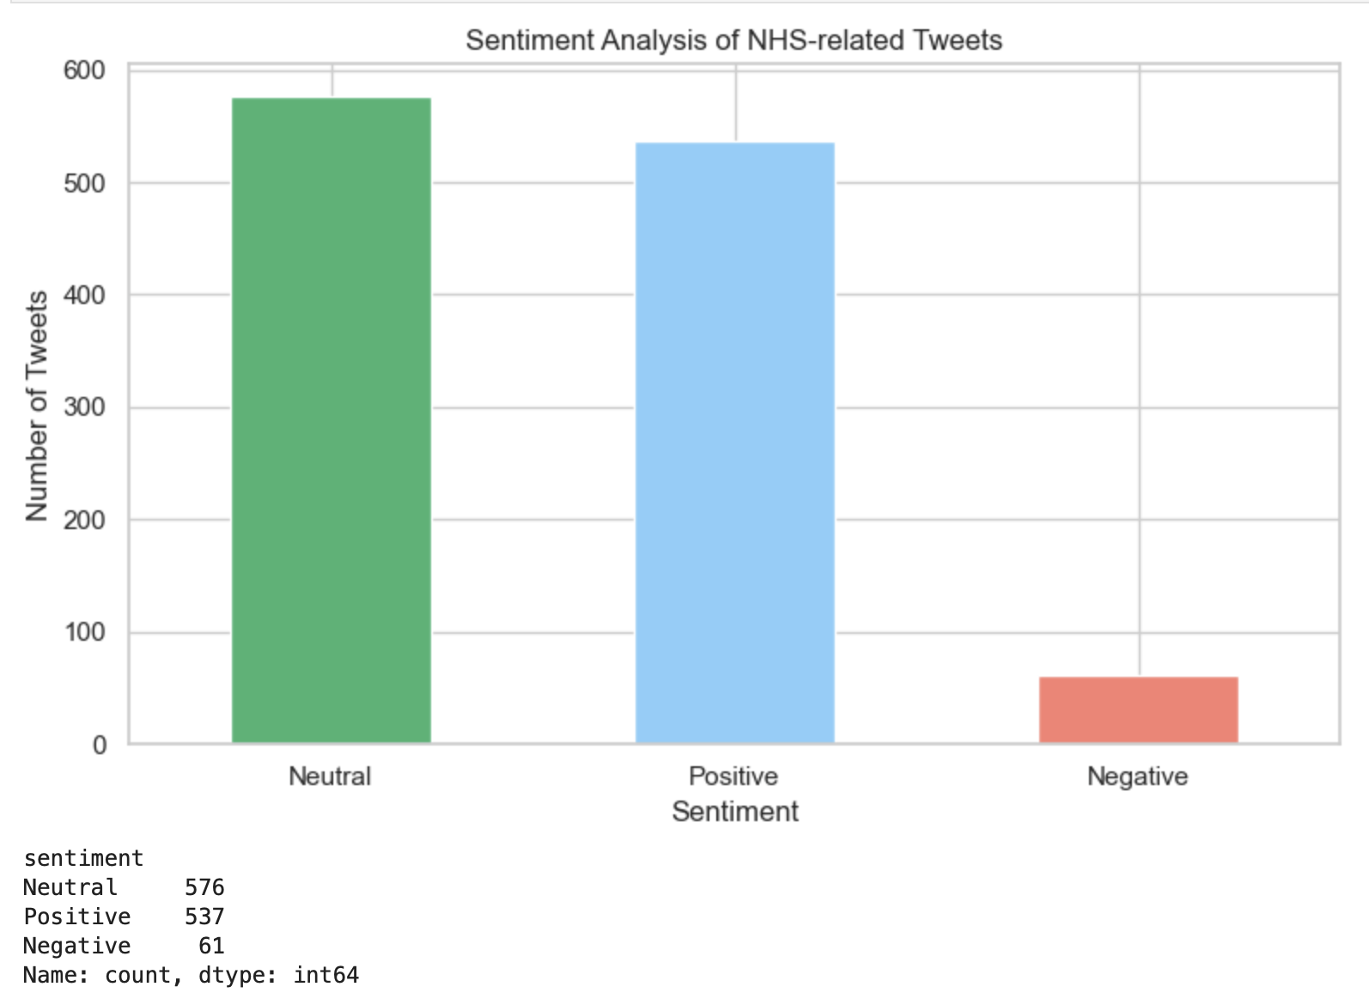
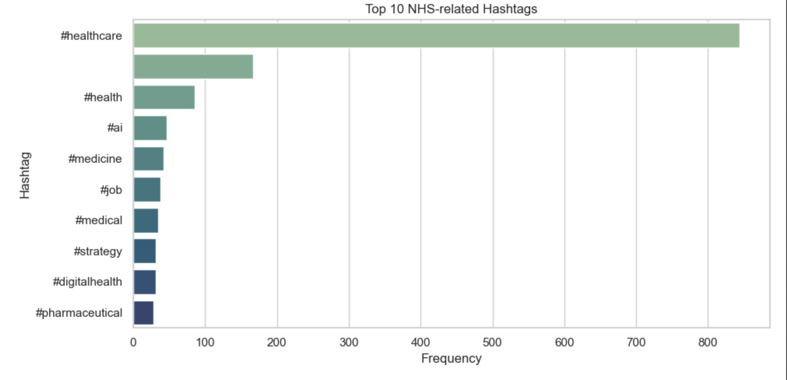
Public Sentiment: Top NHS-Related Hashtags
Notes:
To complement our internal NHS data, we also looked at Twitter to see what people are talking about in relation to the NHS. Here are the top 10 hashtags used in NHS-related tweets. #Healthcare and #Health dominate the conversation, but we also see emerging themes like #AI, #DigitalHealth, and even #Strategy. This shows that public and professional discourse is increasingly focused not just on care delivery, but on innovation, technology, and system-level reform

Slide 17
Recommendations
Action Area | Recommendation | Impact
- Reduce Missed Appointments | Send SMS/app reminders for appointments booked ≤ 7 days. Use confirmation steps for telephone and online slots. | Reclaim capacity lost to no-shows (~4.7%)
- Rebalance Staff Deployment | Allocate extra GPs and care staff to high-demand but under-served ICBs. Use flexible rostering during seasonal peaks. | Alleviate systemic strain and regional pressure
- Address Inequality | Track and respond to ICB-level appointment per capita metrics. Fund access improvements in low-performing areas. | Improve equity and access across NHS geographies
- Use Public Sentiment | Monitor Twitter hashtags weekly to detect rising frustration or praise. Align public messaging and services. | Build trust and respond proactively to public concern
- Improve Data Quality | Enhance recording of appointment mode, HCP type, and duration. Integrate more demographic variables. | Enable more accurate forecasting and DNA risk analysis

Slide 18
Limitations
Data Coverage
Missing or Incomplete Fields
Estimated Capacity Assumptions
Capacity was estimated using workdays × baseline appointment assumptions
Did not factor in staff absence (e.g. illness, holidays, strikes), or local service disruptions
Twitter Data Bias

Slide 19

Thank You!!

