Slide 1

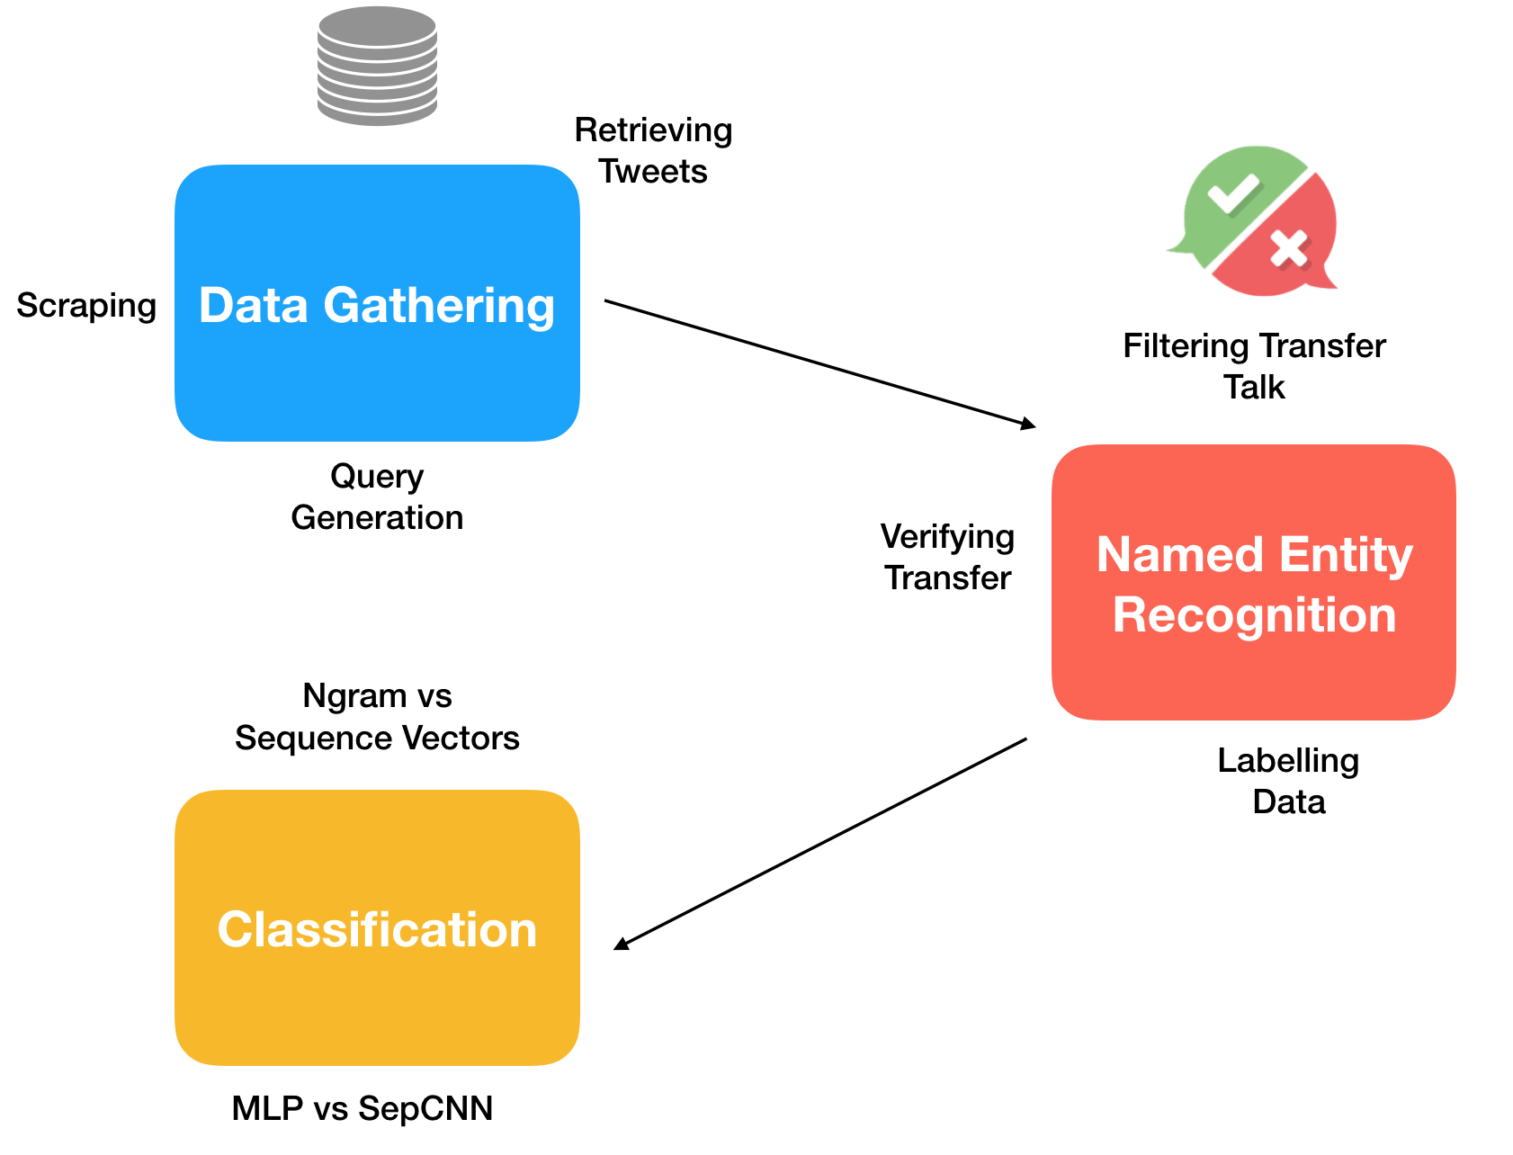
“Fake news” detection, in the context of football transfer tweets, using supervised machine learning approaches.
Mark Murtagh. Supervisor: Séamus Lawless
Introduction
Implementation
Overview:
2016 US Election saw the rise of polarising social media content on the popular platforms. Individuals who had no affiliation to the election could take advantage of ranking algorithms to get clicks on their web pages. The current protocol to dealing with fake news involves manual human intervention, with very little efforts in deploying an automated approach to filtering out “fake news” content.
Key Points:
Fake news prevalent on social media platforms.
Current agreed upon code of conduct not an automated approach.
Potential solution in using supervised ML approach.
Gather corpus of previous transfer window Tweets.
Label whether the transfer happened or it was a rumour to a satisfactory accuracy.
Compare two classification approaches. One simple approach which doesn’t take into account sequences, and one which aims to exploit word odering.
MLP n-gram model vs Separated CNN model.
Background
Football Transfer Window:
Windows in the calendar year where players transfer between clubs.
This period comes with a lot of speculation from media outlets and individuals.
Similarities:
Tactics involved in football transfer rumours similar to ones used in US Election.
Both types of post have the intention of misinforming and redirecting the user.
Many tabloids, news outlets and social media accounts post transfer rumours with almost no merit.
Detection:
Research question: “To what extent can supervised machine learning approaches be used to predict the accuracy of a Tweet or twitter account, in relation to a football transfer.”
Findings
N-gram MLP:
- Vocabulary of Tweet corpus was quite small, so overly complex model overfit data significantly.
- Simple model with few layers performed best in training.
- Larger value for n seemed to learn club/player
relationship.
Separated CNN:
- Embedding layer attempting to use semantically similar words in-effective.
- Lower scores that n-gram MLP implementation.
- Overly complex approach for problem case.
Future Work
Same dataset with player names and clubs blanked. Aim to detect sensationalised language of rumour.
Different data set which provides a larger vocabulary of words. Word embedding performs better with larger vocabulary.
Investigate input features other than text. (retweets, followers, reach, account.)
Larger dataset to compensate for overfitting.
M.Sc. in Computer Science

