Slide 1
#InTheKnow
Examination into “fake news” detection, in the context of football transfer twitter content, using supervised machine learning approaches.
Mark Murtagh
Date 09/04/19

Slide 2
Overview
Background
Motivation
Design
Implementation
Implementation Issues
Evaluation
Conclusions

Slide 3

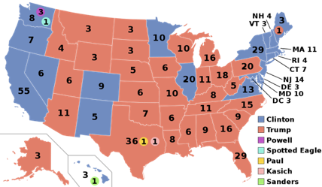

Background
Polarising fake news posts used to take advantage of social media ranking algorithms.
Individuals with no interest in election outcome influenced for personal financial gain.

Slide 4
What does this have to do with
football transfer rumours ?

Slide 5
Motivation
Fake news code of conduct vague, no automated approach suggested.
Football transfer rumour speculation on Twitter has been prevalent for years.
Fake news tactics used in US Election have been used in this space.
Sensationalised headlines, statements used to misinform and re-direct user.

Slide 6
Motivation
Research Question: “To what extent can supervised machine learning approaches be used to predict the accuracy of a Tweet or Twitter account, in relation to a football transfer?”

Slide 7
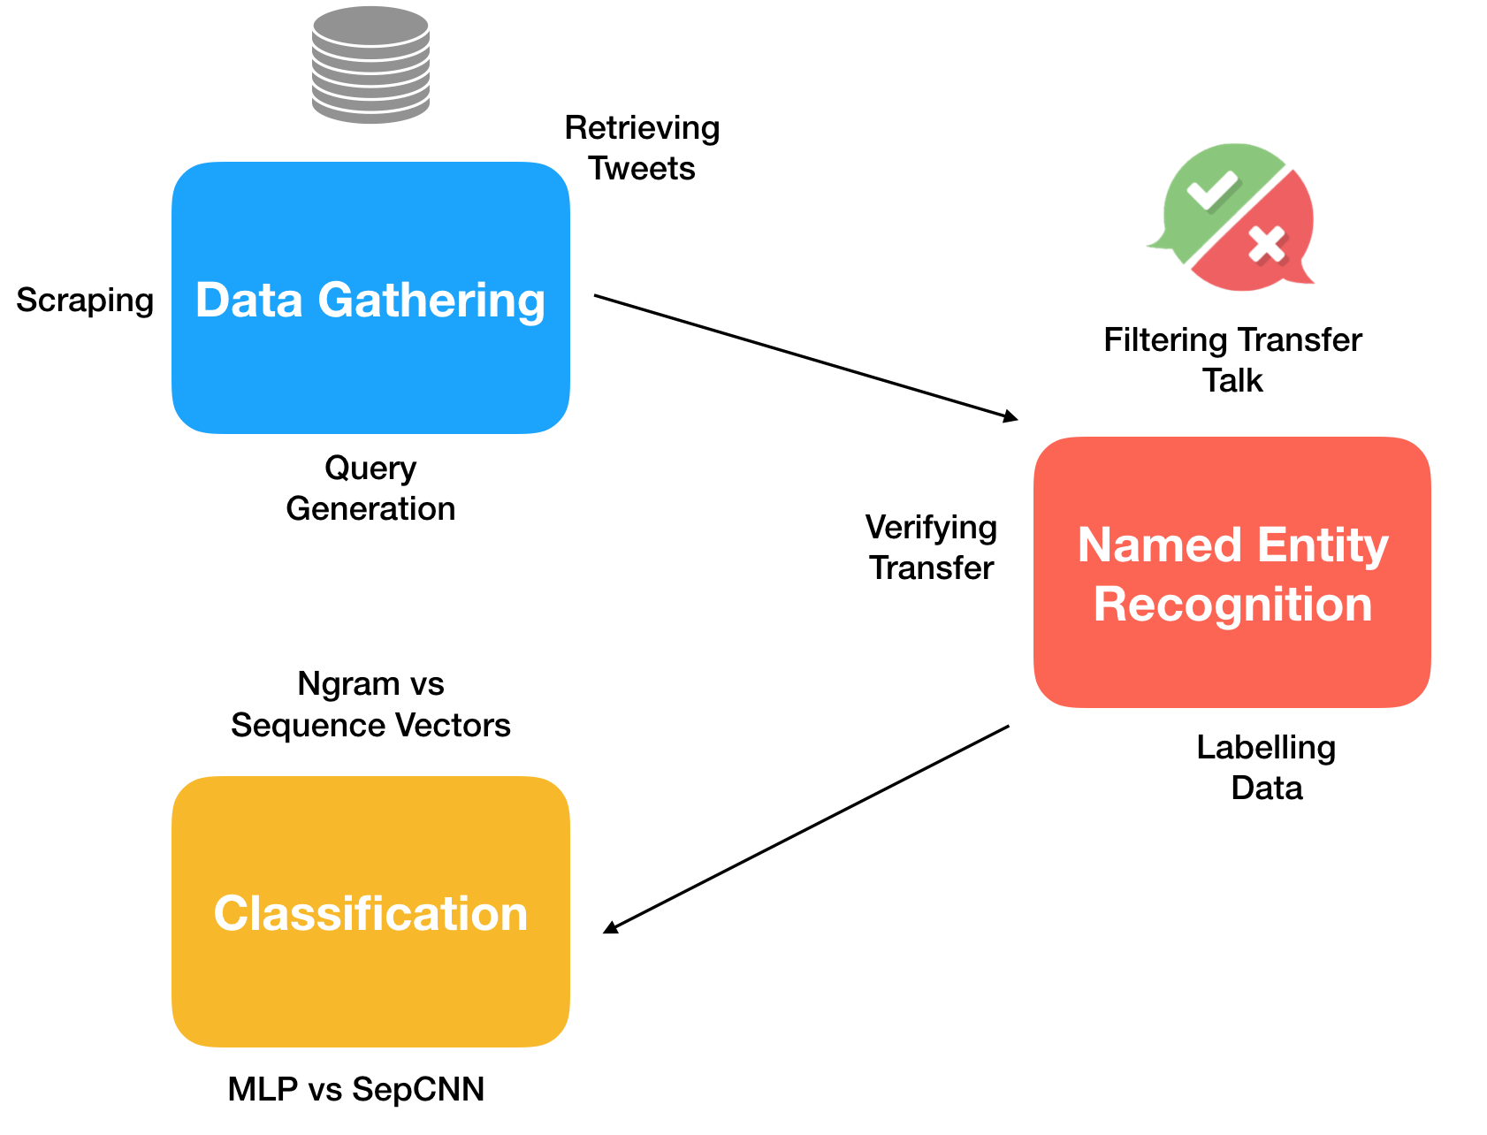
Design

Slide 8
Implementation
Data gathering done using scraping and Twitter API “work around”.
Labelling done using custom scripts which used NER and cross referenced with confirmed transfers of that window.
Two different approaches to classification.

Slide 9
Implementation
Classification approach A: (Bag of words)
Represented tweets texts as n-grams. Simple MLP architecture for model.
Easy to train, effective.
Discards important information like word ordering, semantics, grammar.

Slide 10
Implementation
Classification approach B:
Separated CNN architecture.
Aim to take advantage of semantically similar words using word embeddings.
Take into account sequences of words.

Slide 11
Implementation Issues
Labelling implementation, correctly labelling. Blurry line drawn between “true” and “rumour”.
Overfitting: Small vocabulary of transfer talk from tweets gathered. Lot of retweets. Learned player club relationships.

Slide 12
Evaluation
Approach A
Simple model showed less overfitting.
High accuracy scores in testing (≈ 0.80 ) and significantly lower loss that other architectures.
Approach B
Vocabulary size not big enough to take advantage of word embeddings.
Varying model architectures showed poor accuracy scores ≈ 0.5

Slide 13
Conclusions
Simple approach more suited to test case.
Different test set with larger vocabulary suited to more complex approach.
Future work:
Blank entity name: “A̶r̶s̶e̶n̶a̶l̶ X makes bid for K̶a̶r̶i̶m̶ ̶B̶e̶n̶z̶e̶m̶a̶ Y”
Same approach on different corpus.

Slide 14
Questions ?

Slide 15
Thank You

