Slide 1
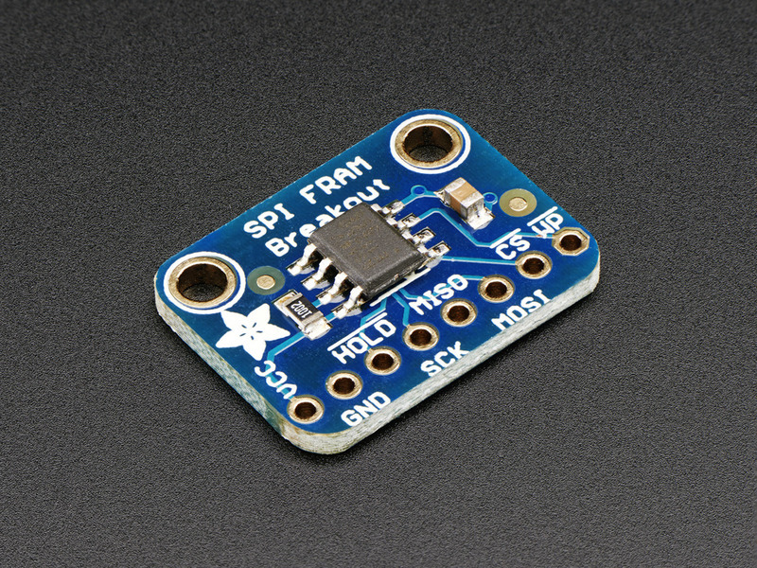
This particular FRAM chip has 64 Kbits (8 KBytes) of storage, interfaces using SPI, and can run at up to 20MHz SPI rates. Each byte can be read and written instantaneously (like SRAM) but will keep the memory for 95 years at room temperature. Each byte can be read/written 10,000,000,000,000 times so you don't have to worry too much about wear leveling.
Power Pins:
VCC - this is the power pin. Since the chip uses 3-5VDC you should pick whatever the logic voltage you're using. For most Arduino's that's 5V.
GND - common ground for power and logic
SPI Logic pins:
All pins are 3-5V compliant and use whatever logic level is on VCC
HOLD - this is a 'wait' pin for the SPI bus. When pulled low, it puts the SPI bus on hold. This is different than the CS pin because it doesnt stop the current transaction. Its good if you want to talk to other SPI devices and stream data back and forth without stopping and starting transactions.
SCK - This is the SPI clock pin, its an input to the chip
MISO - this is the Master In Slave Out pin, for data sent from the FRAM to your processor
MOSI - this is the Master Out Slave In pin, for data sent from your processor to the FRAM
CS - this is the chip select pin, drop it low to start an SPI transaction. Its an input to the chip
WP - Write Protect pin. This is used to write protect the status register only! This pin does not directly affect write protection for the entire chip. Instead, it protects the block-protect register which is configured however you want (sometimes only half the FRAM is protected)
https://learn.adafruit.com/adafruit-spi-fram-breakout/overview
R$ 28 reais pronta entrega !!!!
https://www.usinainfo.com.br/arduino-e-eletroeletronica/modulo-de-memoria-fram-fm24c04b-com-maior-eficiencia-que-eeprom-retencao-de-dados-por-ate-38-anos--4466.html
Connect Vcc to the power supply, 3V or 5V is fine. Use the same voltage that the microcontroller logic is based off of. For most Arduinos, that is 5V
Connect GND to common power/data ground
Connect the SCK pin to the SPI clock pin on your Arduino. We'll be using Digital #13 which is also the hardware SPI pin on an Uno
Connect the MISO pin to the SPI MISO pin on your Arduino. We'll be using Digital #12 which is also the hardware SPI pin on an Uno.
Connect the MOSI pin to the SPI MOSI pin on your Arduino. We'll be using Digital #11 which is also the hardware SPI pin on an Uno.
Connect the CS pin to the SPI CS pin on your Arduino. We'll be using Digital #10 but any pin can be used later

