Slide 1


Deadline Aware Scheduling using In-band Network Telemetry
Hua Sun
ECE Department
New York University

Slide 2
DAS In INT
Introduction
Motivation
Related Work
Contribution
Design and methodology
In-band Network Telemetry
Deadline Aware Scheduling
Implementation and Evaluation
Simple Test on small scale topology
Fat Tree Simulation

Slide 3



Introduction
The development of Online Data-Intensive(OLDI) applications and other distributed cloud computing applications have imposed constrain on the network flow that it has to complete within a specific deadline to be useful.

Slide 4
Current Approach
One of the earliest and intuitive work is Earliest Deadline First, which means always prioritize those flows with tight deadline.
Another scheme, D³, propose the concept of rate reservation. It estimates the bandwidth for a flow using its flow size and deadline.
PDQ, i.e. Preemptive Distributed Quick, uses EDF and SJF(Shortest Job First) in the switch to schedule the flow.
D²TCP is another deadline-aware scheme using ECN to control congestion in Data Center.

Slide 5
Motivation
The rapid development of IoT and cloud computing apply more and more stringent requirements on the completion time of the flow.
Current technique often addresses requirement of deadline of the flow from the hosts’ perspective.
The emergence of INT gives us possibility of using information along the routing path to schedule packets in a better manner.

Slide 6
Contribution
In this project, we propose a scheme, DAS(Deadline Aware Scheduling), and try to use INT for collecting delay information along the routing path to schedule packet delivery in a high-precision manner.
To evaluate the performance of our scheme, we implement it in NS-3 and experiment in different scenario to determine its value.
We compare its performance with EDF, the most straightforward scheduling algorithm and found that although in some cases, DAS outperforms EDF, in general cases, it failed to beat EDF.

Slide 7
Design and methodology
In-band Network Telemetry
In-band Network Telemetry(INT) is a framework designed to allow the collection and reporting of network state, by the data plane, without requiring intervention or work by the control plane.
Typical network state to collect:
Switch ID, Ingress port ID, …
Hop Latency
Egress Link Utilization, Queue Occupancy

Slide 8
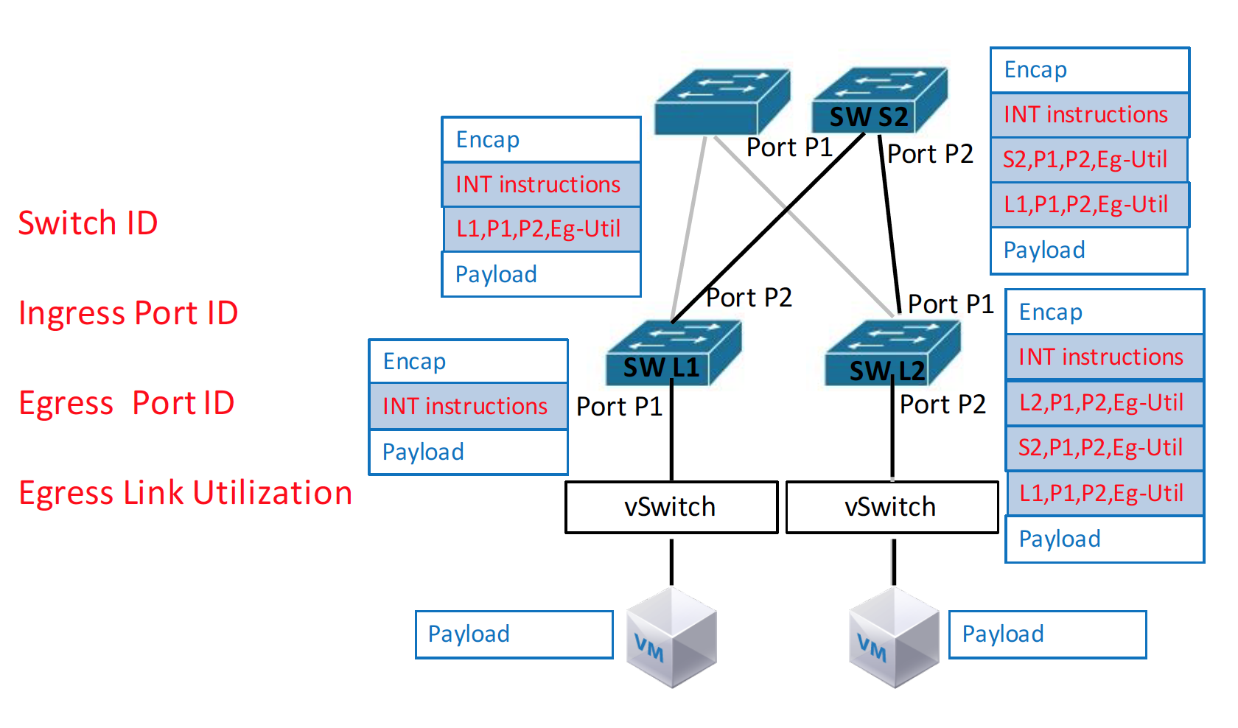
In-band Network Telemetry

Slide 9
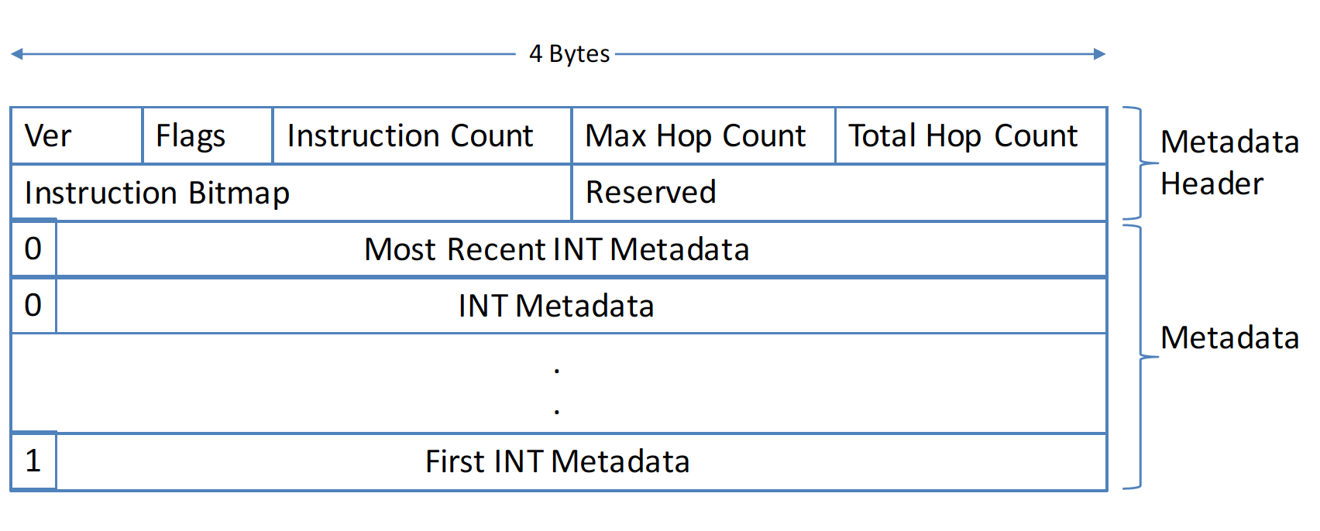
In-band Network Telemetry
A typical INT Header consists of two parts, Metadata Header and Metadata.
Metadata Header is constructed at end host to store instruction and other information.
Metadata is inserted per hop, including various customized data.

Slide 10
Deadline Aware Scheduling
Deadline Aware Scheduling Design
Based on INT, we propose a scheme ---- Deadline Aware Scheduling(DAS).
In DAS, we utilize INT to collect network status, and use a global knowledge of the congestion level to precisely schedule packet priority at each hop based on its delay and deadline.
We use INT to collect per hop delay, and calculate the estimated delivery time window, i.e. the maximum time a packet can wait at this hop, as the urgency.
Then we use urgency to schedule packets delivery at switch, which allows that the switch always egress the most urgent packet first.
Notes:
DAS applies per packet delay, requiring no knowledge of flow size.

Slide 11


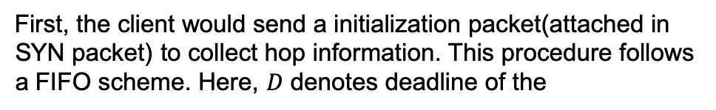
Deadline Aware Scheduling
H1
First, the client would send a initialization packet(attached in SYN packet) to collect hop information. This procedure follows a FIFO scheme. Here, $D$ denotes deadline of the
H2
Encapsulation
deadline
Hop number
S1
S2
S3
payload

Slide 12

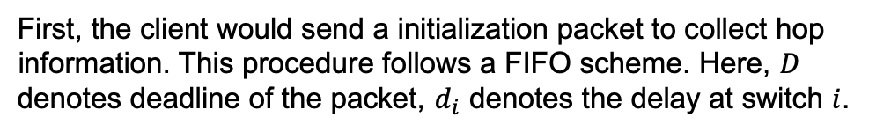
Deadline Aware Scheduling
H1
First, the client would send a initialization packet to collect hop information. This procedure follows a FIFO scheme. Here, $D$ denotes deadline of the packet, $d_{i}$ denotes the delay at switch $i$.
H2
S1
S2
S3
Encapsulation
S1
deadline
$$d_{1}$$
Hop number
payload

Slide 13
Deadline Aware Scheduling
H1
First, the client would send a initialization packet to collect hop information. This procedure follows a FIFO scheme. Here, $D$ denotes deadline of the packet, $d_{i}$ denotes the delay at switch $i$.
H2
S1
S2
S3
Encapsulation
S1
$$d_{1}$$
deadline
Hop number
payload

Slide 14


Deadline Aware Scheduling
H1
First, the client would send a initialization packet to collect hop information. This procedure follows a FIFO scheme. Here, $D$ denotes deadline of the packet, $d_{i}$ denotes the delay at switch $i$.
H2
S1
S2
S3
Encapsulation
S1
$$d_{1}$$
S2
$$d_{2}$$
deadline
Hop number
payload

Slide 15
Deadline Aware Scheduling
H1
First, the client would send a initialization packet to collect hop information. This procedure follows a FIFO scheme. Here, $D$ denotes deadline of the packet, $d_{i}$ denotes the delay at switch $i$.
H2
S1
S2
S3
Encapsulation
S1
$$d_{1}$$
S2
$$d_{2}$$
deadline
Hop number
payload

Slide 16



Deadline Aware Scheduling
H1
First, the client would send a initialization packet to collect hop information. This procedure follows a FIFO scheme. Here, $D$ denotes deadline of the packet, $d_{i}$ denotes the delay at switch $i$.
H2
S1
S2
S3
Encapsulation
S1
$$d_{1}$$
S2
$$d_{2}$$
S3
$$d_{3}$$
deadline
Hop number
payload

Slide 17





Deadline Aware Scheduling
H1
After collecting all hop‘s delay, the packet will arrive at the end host, the end host will insert all INT header and metadata into ACK packet and send back to client.
H2
S1
S3
ACK
S2
S1
$$d_{1}$$
Encapsulation
S2
$$d_{2}$$
S1
$$d_{1}$$
S3
$$d_{3}$$
S2
$$d_{2}$$
deadline
Hop number
S3
$$d_{3}$$
deadline
Hop number
payload

Slide 18

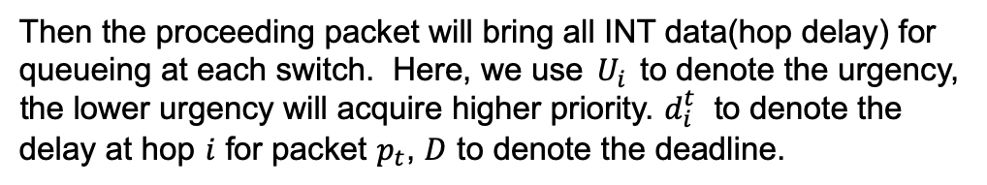
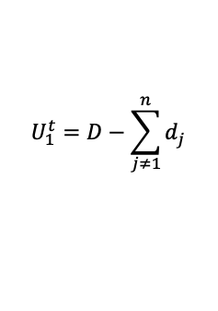


Deadline Aware Scheduling
H1
Then the proceeding packet will bring all INT data(hop delay) for queueing at each switch. Here, we use $U_{i}$ to denote the urgency, the lower urgency will acquire higher priority. $d_{i}^{t}$ to denote the delay at hop $i$ for packet $p_{t}$, $D$ to denote the deadline.
H2
Encapsulation
S1
$$d_{1}^{0}$$
S1
S2
S3
S2
$$d_{2}^{0}$$
S3
$$d_{3}^{0}$$
deadline
Hop number
payload
$$U_{1}^{t}=D−\sum_{j≠1}^{n}{d_{j}}$$

Slide 19



Deadline Aware Scheduling
H1
We use the following formula to calculate urgency for a packet. Specifically, this urgency reflects the maximum remaining time a packet will have at current hop. The less it is, the urgent a packet will be. Therefore we should prioritize those packets with less urgency value.
H2
S1
S2
S3
Encapsulation
S1
$$d_{1}^{0}$$
S2
$$d_{2}^{0}$$
$$U_{1}^{t}=D−\sum_{j≠1}^{n}{d_{j}}$$
S3
$$d_{3}^{0}$$
deadline
Hop number
payload

Slide 20

Deadline Aware Scheduling
H1
Then, while a packet is transmitted from the queue, the switch will update its delay at current hop to the latest value. This value will be used in proceeding calculation of urgency.
H2
S1
S2
S3
Encapsulation
S1
$$d_{1}^{0}$$
$$d_{1}^{1}$$
S2
$$d_{2}^{0}$$
S3
$$d_{3}^{0}$$
deadline
Hop number
payload

Slide 21

Deadline Aware Scheduling
H1
This will be done all over the routing path until the packet reached the destination host. The host will put the newest data into ACK packet to send back to host.
H2
S1
S2
S3
Encapsulation
S1
$$d_{1}^{1}$$
S2
$$d_{2}^{0}$$
S3
$$d_{3}^{0}$$
deadline
Hop number
payload

Slide 22




Deadline Aware Scheduling
H1
This will be done all over the routing path until the packet reached the destination host. The host will put the newest data into ACK packet to send back to host.
H2
S1
S2
S3
Encapsulation
S1
$$d_{1}^{1}$$
S2
$$d_{2}^{1}$$
$$d_{2}^{0}$$
S3
$$d_{3}^{0}$$
deadline
Hop number
payload

Slide 23

Deadline Aware Scheduling
H1
This will be done all over the routing path until the packet reached the destination host. The host will put the newest data into ACK packet to send back to host.
H2
S1
S2
S3
Encapsulation
S1
$$d_{1}^{1}$$
S2
$$d_{2}^{1}$$
S3
$$d_{3}^{0}$$
deadline
Hop number
payload

Slide 24




Deadline Aware Scheduling
H1
This will be done all over the routing path until the packet reached the destination host. The host will put the newest data into ACK packet to send back to host.
H2
S1
S2
S3
Encapsulation
S1
$$d_{1}^{1}$$
S2
$$d_{2}^{1}$$
S3
$$d_{3}^{1}$$
$$d_{3}^{0}$$
deadline
Hop number
payload

Slide 25




Deadline Aware Scheduling
H1
This will be done all over the routing path until the packet reached the destination host. The host will put the newest data into ACK packet to send back to host. This procedure will repeat until the flow has completed.
H2
ACK
S1
S2
S3
S1
$$d_{1}^{1}$$
S2
$$d_{2}^{1}$$
Encapsulation
S3
$$d_{3}^{1}$$
S1
$$d_{1}^{1}$$
deadline
Hop number
S2
$$d_{2}^{1}$$
S3
$$d_{3}^{1}$$
deadline
Hop number
payload

Slide 26
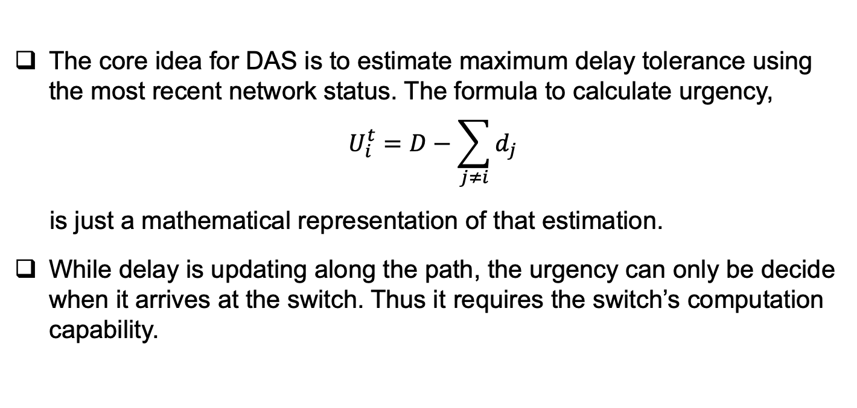
Deadline Aware Scheduling
The core idea for DAS is to estimate maximum delay tolerance using the most recent network status. The formula to calculate urgency,
$$U_{i}^{t}=D−\sum_{j≠i}{d_{j}}$$
is just a mathematical representation of that estimation.
While delay is updating along the path, the urgency can only be decide when it arrives at the switch. Thus it requires the switch’s computation capability.
Notes:
In a typical transmitting in Data Center, a packet usually will go through 6- 8 hops, which means 6-8 times additional add/subtract per packet.

Slide 27
Implementation and Evaluation
Implementation and Evaluation
Implementation
To evaluate the performance of DAS, we implement DAS in ns-3, and build an echo-ping application to test several metrics.
The echo-ping application inherits typical Linux socket parameters setting, using TCP Cubic as the congestion control algorithm.
We use a TCP option field to indicate the usage of DAS. Once an INT header is received, the receiver will attach it to the ACK packet and send it back to the sender.

Slide 28
Evaluation
Metrics we use in evaluation:
Percent of flows met the deadline: This metric is commonly used in D3, D²TCP, PDQ and other deadline-aware schemes.
Throughput while >99% of flows that met the deadline: This metric can reflect the capacity for the network while ensuring most of the flows to meet the deadline.

Slide 29
To simulate the performance in the real scenario, we evaluate the performance in Fat Tree topology with 8 fabric switches in the core switch and 25 hosts under each ToR switch. That is, 8 core switches, 32 aggregate switches and edge switches and 800 hosts in total.
The bandwidth between switches is 400 Gbps, and the bandwidth between switch to host is 100 Gbps. The link delay is 1 us, which makes the maximum RTT 12 us.
All switches have buffer size 32 MB.

Slide 30
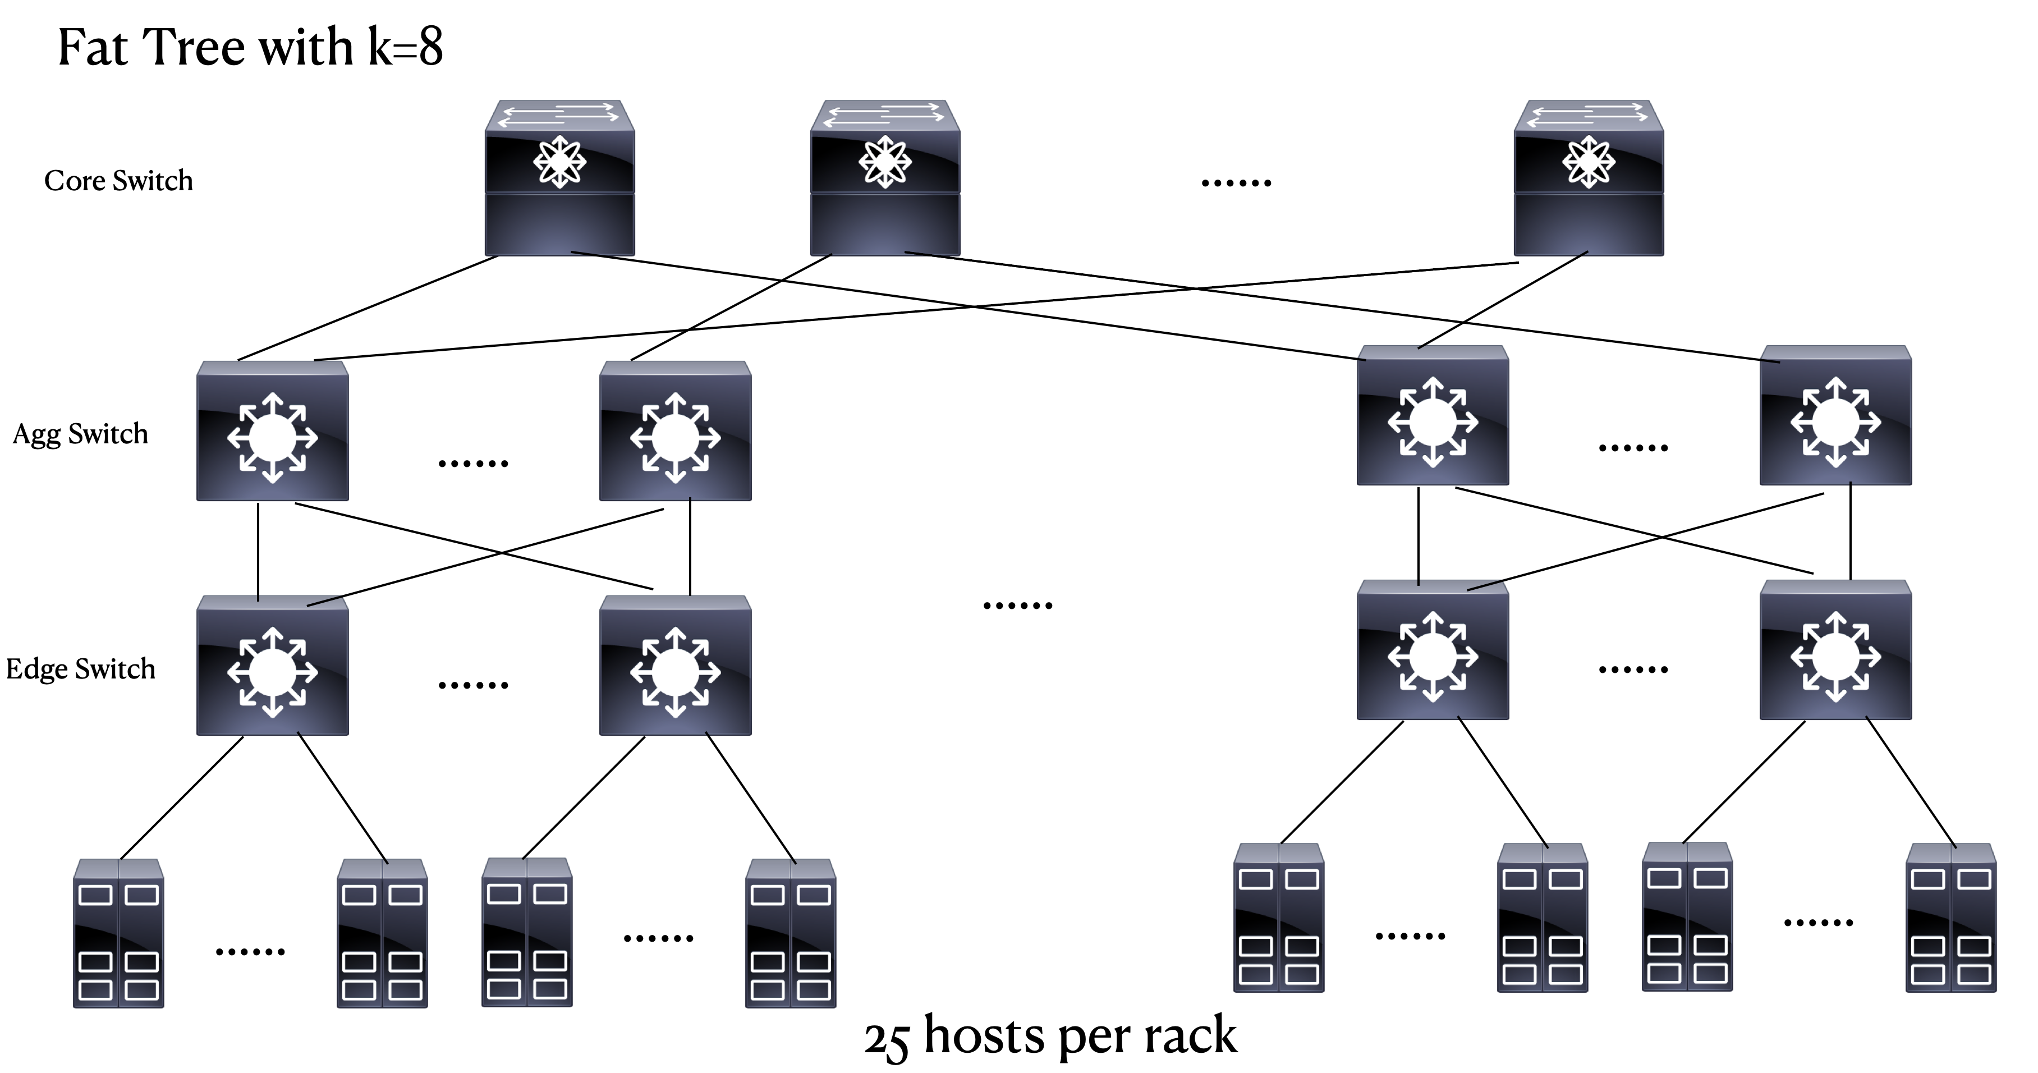
Large Scale Fat Tree Simulation
Notes:
500 flows

Slide 31
Fat Tree Simulation
For traffic generation, we randomly generate 2 kinds of flows, deadline-aware flows and deadline-agnostic flows.
For deadline-aware flow, flow size uniformly ranges from 2 KB to 198 KB. For deadline agnostic flows, flow size are also uniformly drawn from 100 KB to 1000 KB.
Flow deadlines are exponentially drawn with mean value 3ms with at least 0.5ms bounded.

Slide 32
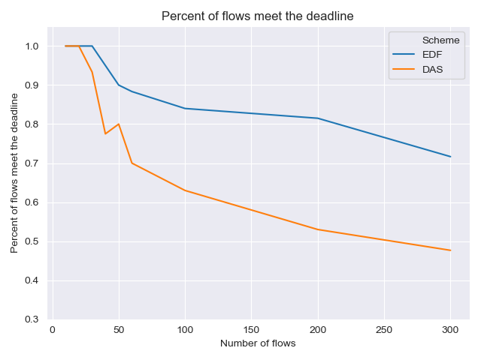
We compare DAS with EDF in terms of number of flows meet the deadline.
However, DAS failed to reach the expected performance. It degrades drastically when we increase the number of flows in the network.

Slide 33
Limitation
Reason for the failure
A major limitation for DAS is that it doesn’t have admission control, thus a large flow with tight deadline could take all the network resource with no possibility of finishing on time.
Besides, similar as EDF, DAS will also suffer from dominating issues.
Priority inversion issue can also happen in DAS.

Slide 34
Possible Cause
Although DAS can adjust the urgency of the packets along the route, it failed to consider the impact of flow size when delivering the packet.
Lack of centralized control also degrades the performance when there are flows with unreasonable deadline.
Directly using the delay information in the last trip could be inaccurate.
When network is congested, the packet with low urgency could be stuck in the queue, causing the increase in the flow completion time.

Slide 35
Conclusion
In this project, we propose a scheduling scheme, Deadline Aware Scheduling, using In-band Network Telemetry.
We implement DAS in ns-3, evaluate its performance under a near-real network scenario.
Although DAS works in certain cases, it doesn’t function well in general cases, which requires additional improvement on the foundation of the scheme.

