Slide 1
PENN COURSE ALERT +
BROUGHT TO YOU BY –
CHARLEY CUNNINGHAM
CONSTANCE WANG
ARYAN CHAUHAN

Slide 2
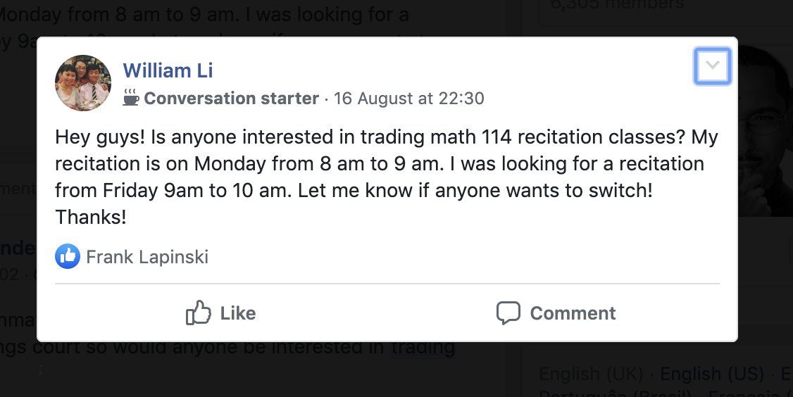

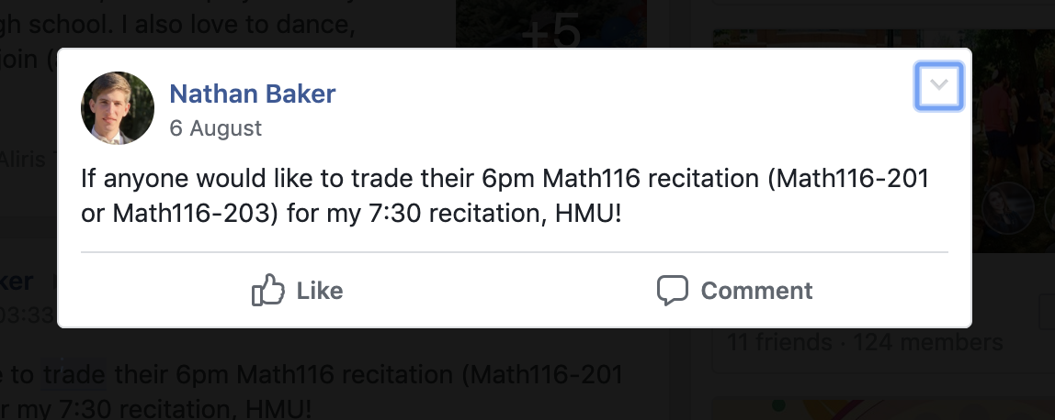
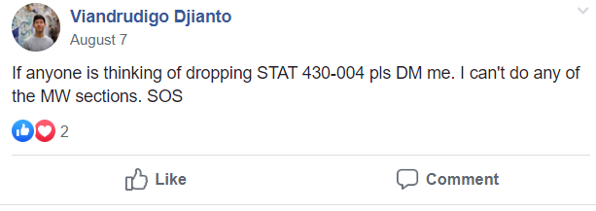


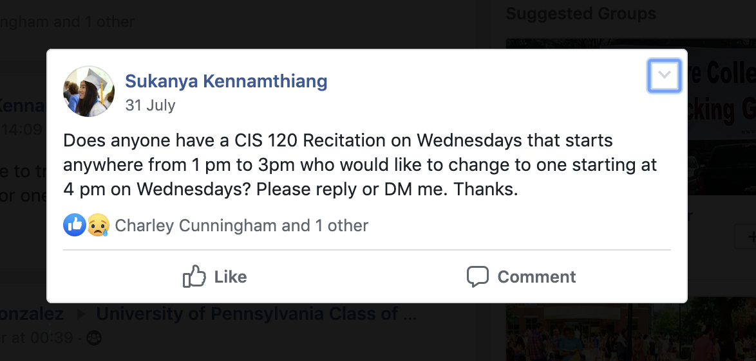
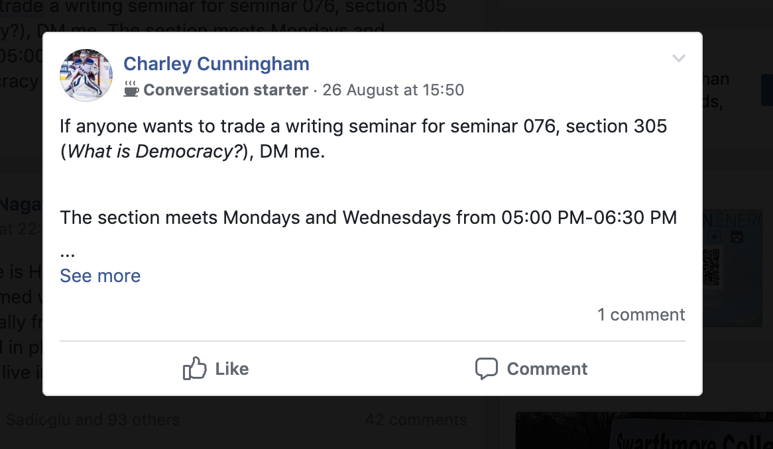
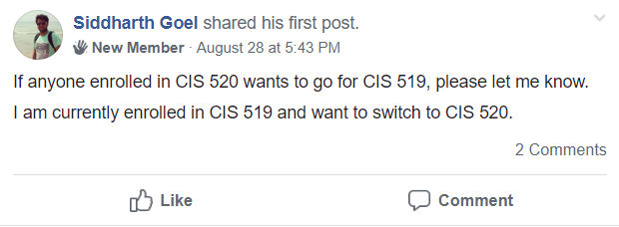
PROBLEMS FACED

Slide 3
THE SOLUTION

