Slide 1
Sports Balls
Final Project Report
GDD3400
Murphy Dudevoir

Slide 2
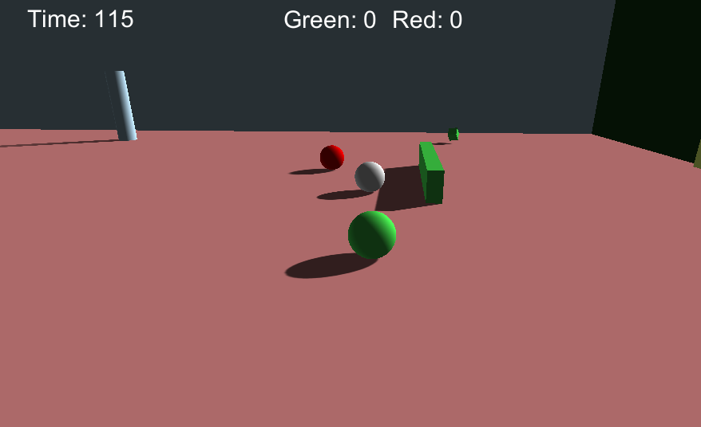
Sports Balls
Challenge artificial intelligence, in a sporting match it was literally created to play, to prove you are the ultimate Sports Ball champion.
Insert a screenshot of your game here

Slide 3
Description
You play as a modern day athlete trying to prove they are the greatest at what they do. Someone has created an artificial intelligence to play the game, and in order to prove you are the best, you must compete against it. You must train against the less intelligent versions to prepare yourself to fight the greatest challenge the bots have to offer.
The sport you are trying to master takes place in a flat arena with various obstacles stopping you from getting the ball into the opponent’s goal. You must do your best to get the ball into the opponent’s goal more times than they can in the allotted time to win. Defeat all of the AI and you will be crowned Sports Ball Champion.

Slide 4
Features
Slide around the sports arena
Hit the ball into the opposing goal
Sprint for a large boost of speed
Compete against an AI agent

Slide 5
Maps
Insert screenshots of your 3 maps here
Rectangular arena with increasing complexity of obstacles

Slide 6
Advancements
Reduce cool down of ‘Kick’

Slide 7
Agent Design
Easy- Always aggressive
Medium- Aggressive or defensive based on position of ball
Hard- Two agents that coordinate their movements

Slide 8
Individual Agent Movement
Agents move by applying physics forces to themselves
They avoid collisions with ‘whiskers’

Slide 9
Agent Decision Making
If MeToBall > MeToPowerUp && PowerUp ! Max THEN GetPowerUp()
If BallOn OpponentsSide THEN Aggressive()
The game is all about positioning
Agents make decisions based on that

