Slide 1
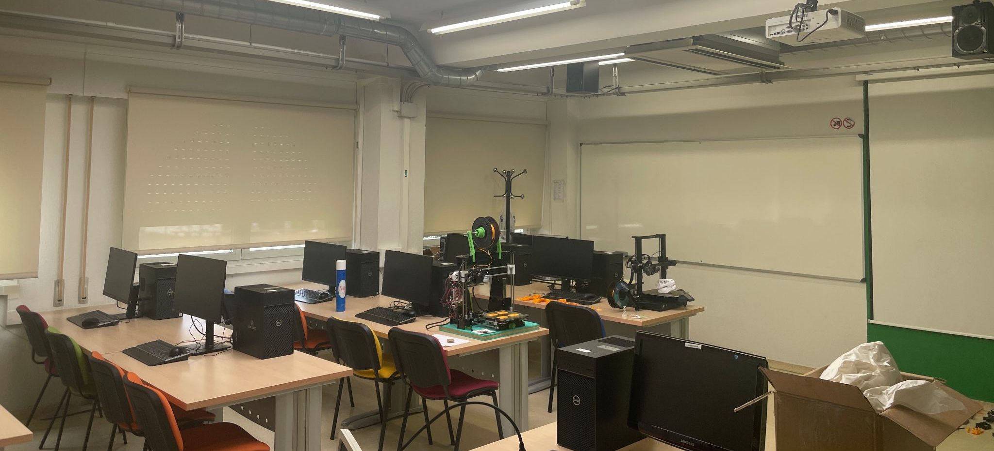
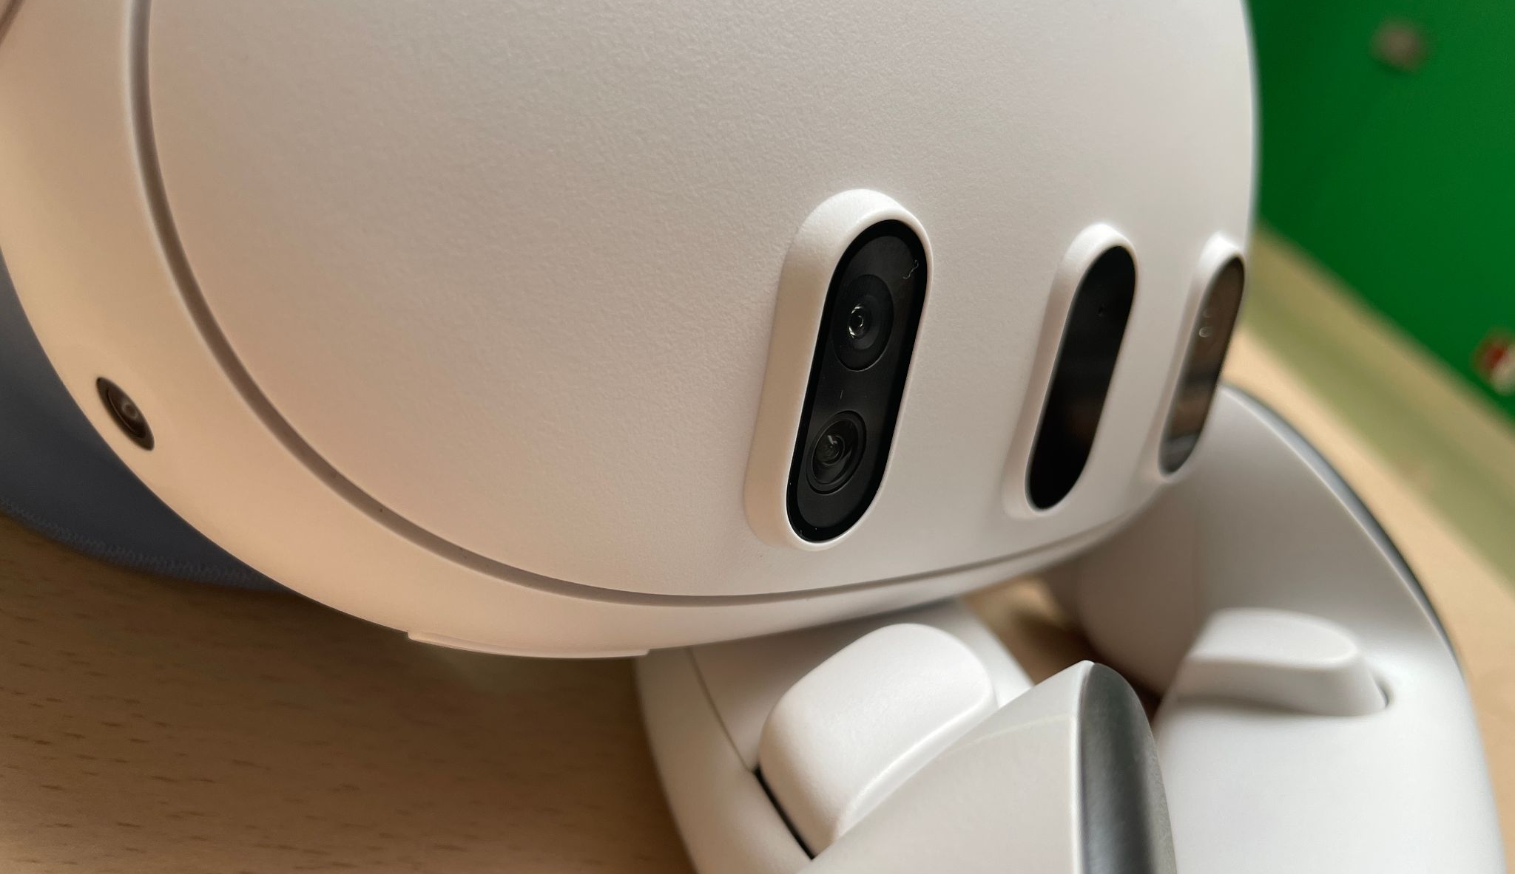
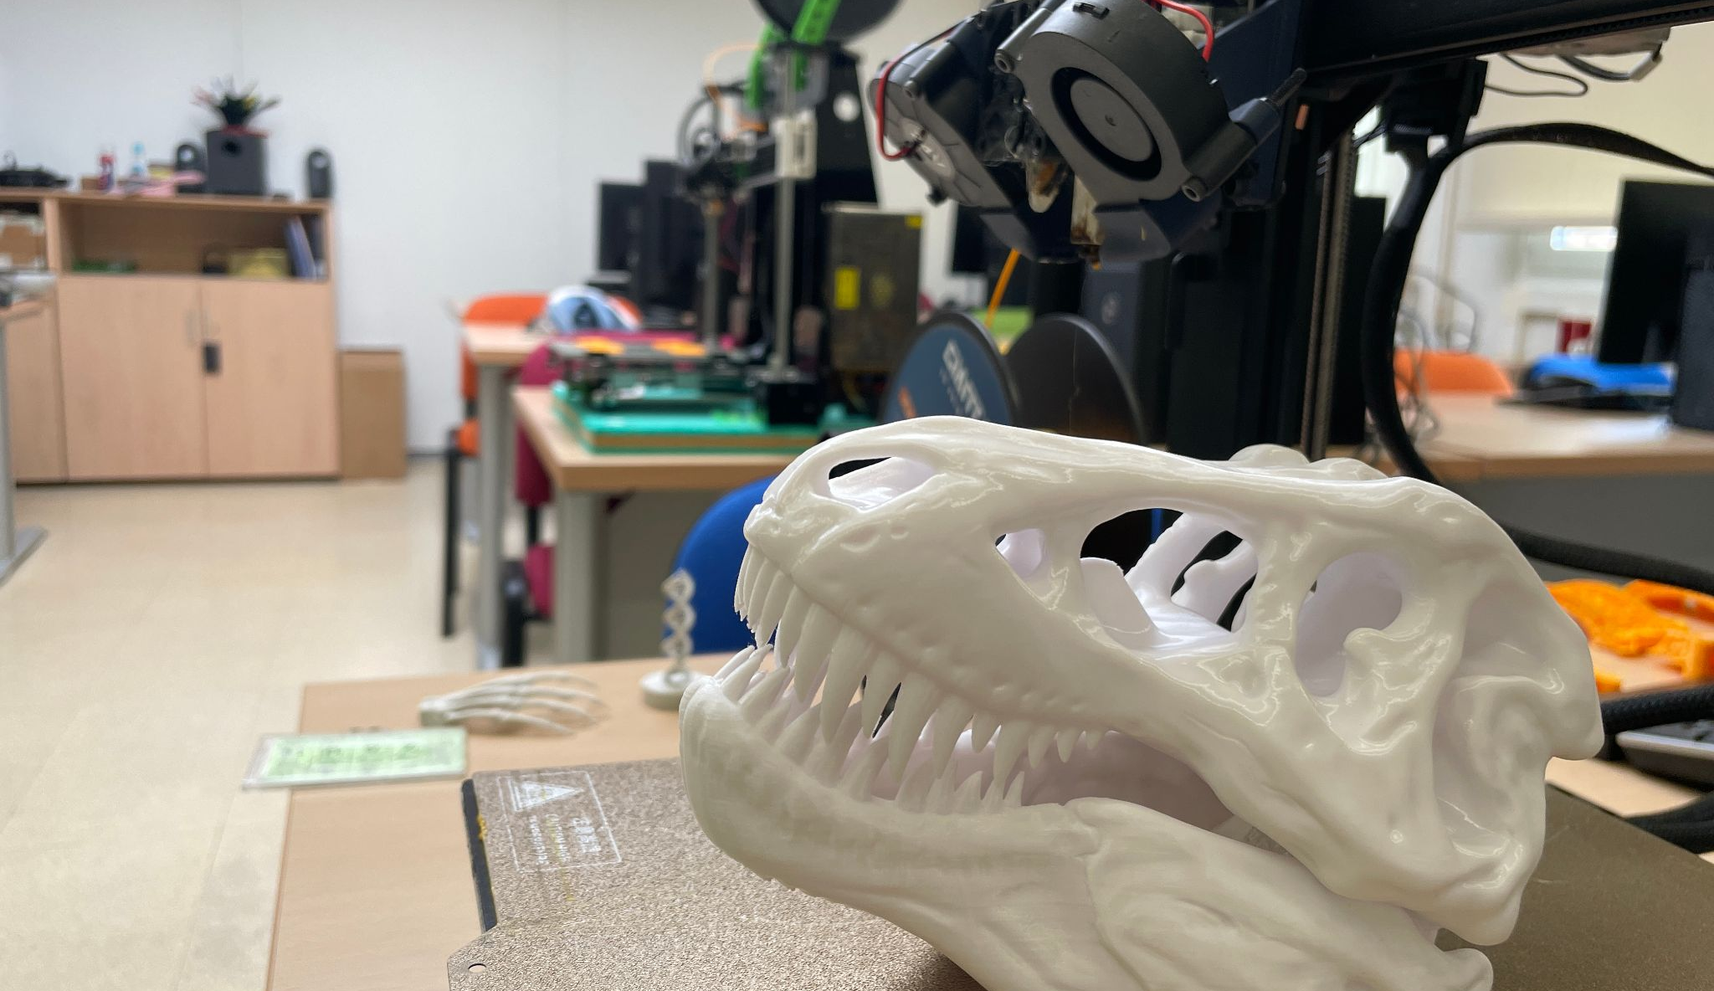

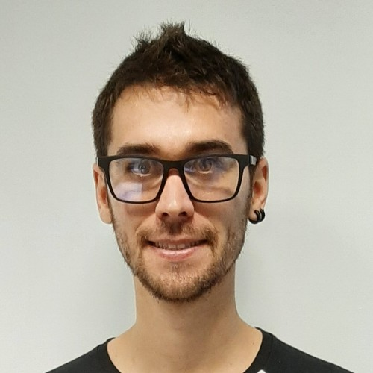
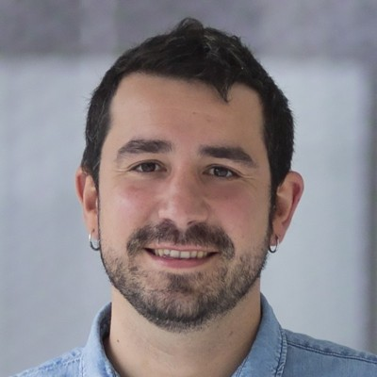
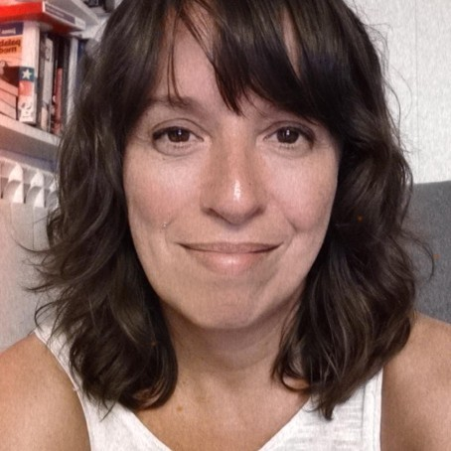
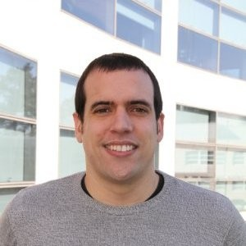
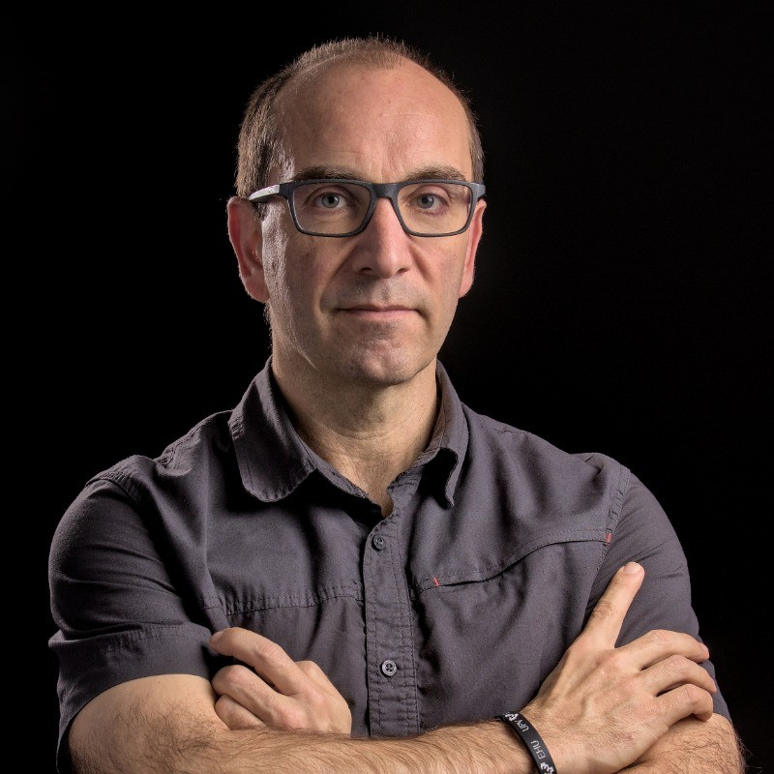
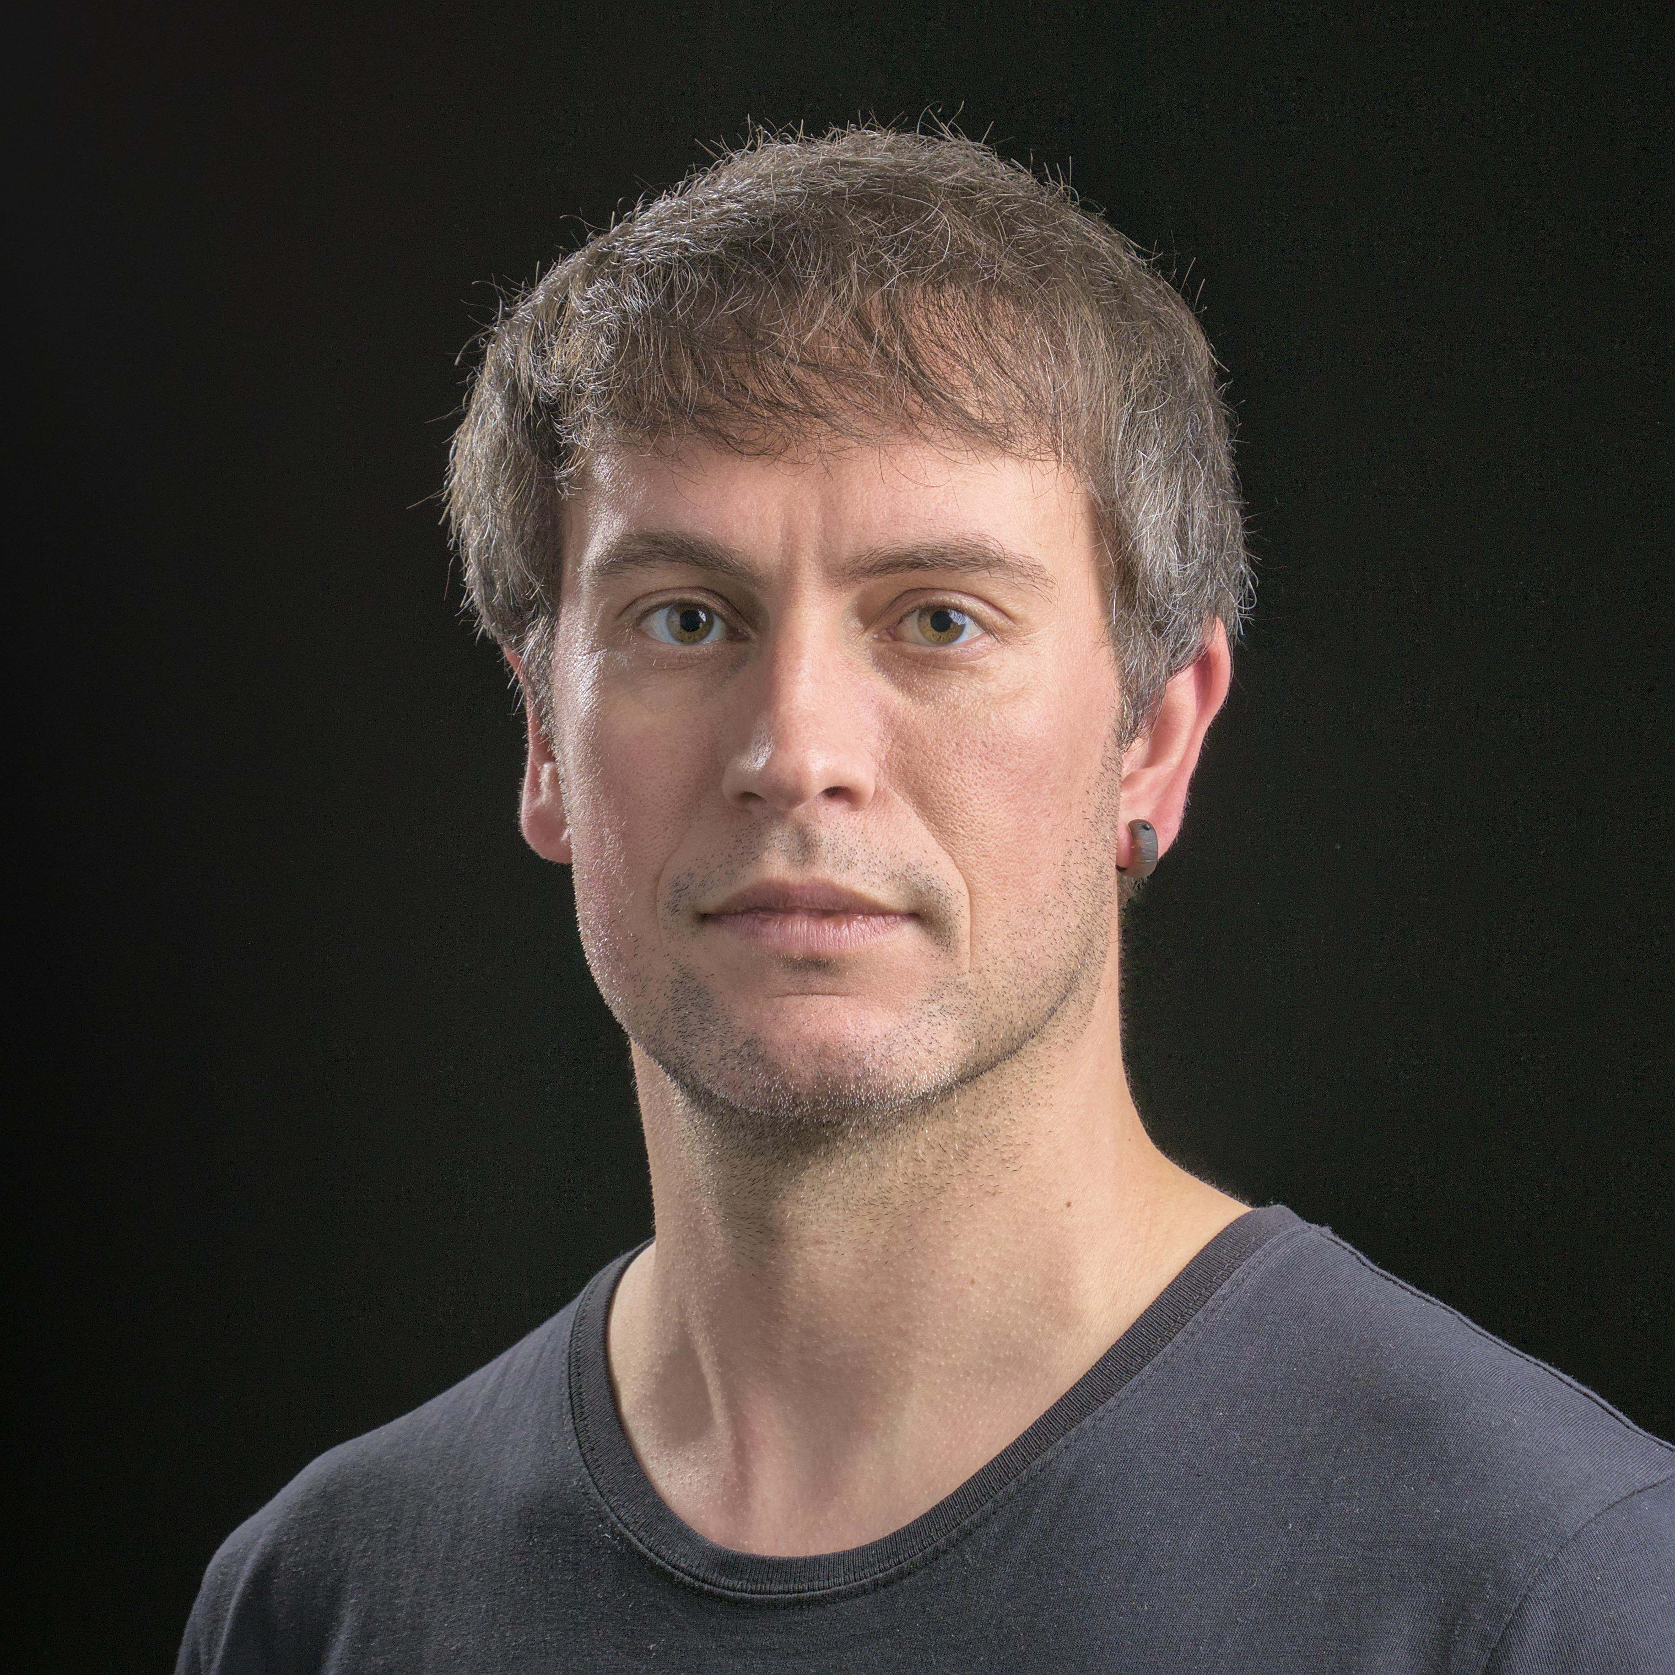
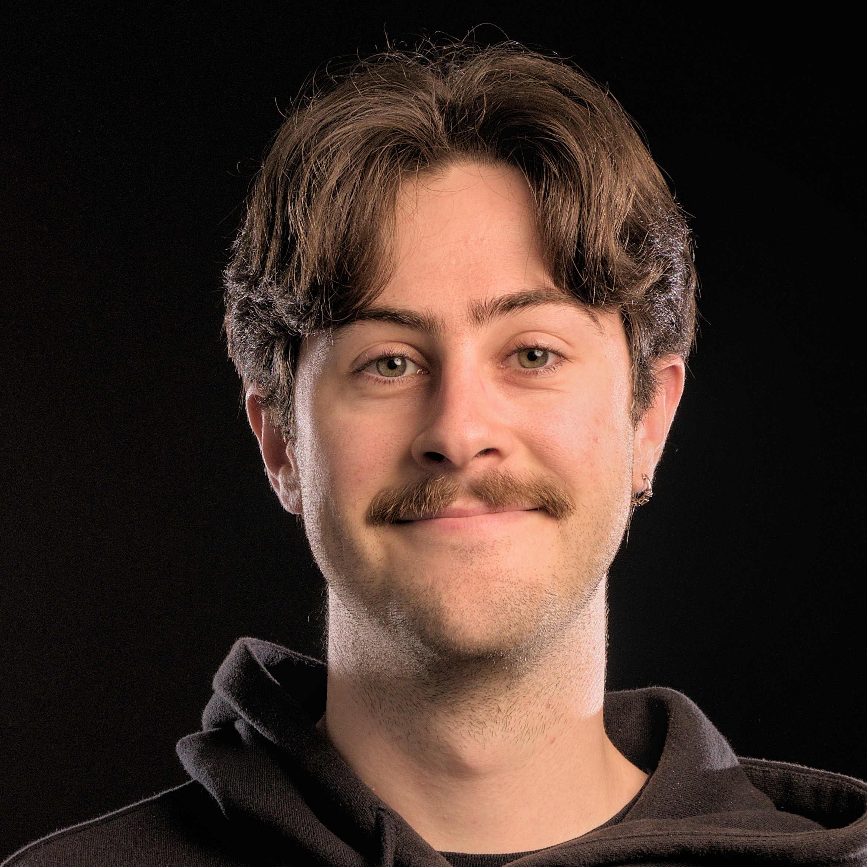
WELCOME TO THE LAB
MURGILDU
A space for 3D, VR
and curious minds.
Create games and immersive experiences.
Explore graphics, AI and 3D modelling.
Degree (TFG) · Master’s (TFM) · Practice
Faculty of Informatics · EHU
Lab E08 · Donostia–San Sebastián
murgildu.github.io
MEET THE TEAM
Inigo Lopez-Gazpio
Unai Elordi
Elsa Fernández
Andoni Mujika
Borja Calvo
Igor Rodriguez
Eneko Atxa
MURGILDU / EHU / 2026–2027
01 / 04
Notes:
Lab photographs: supplied presentation, slide 5. Team portraits and names: local MURGILDU website author profiles. General lab information: supplied presentation and site contact page. Website: https://murgildu.github.io/
Original presentation: https://docs.google.com/presentation/d/1eS09sbmh8s3pvsqib_2wOWm0rNBwVszZyWN-RD-Xn2I/edit

Slide 2
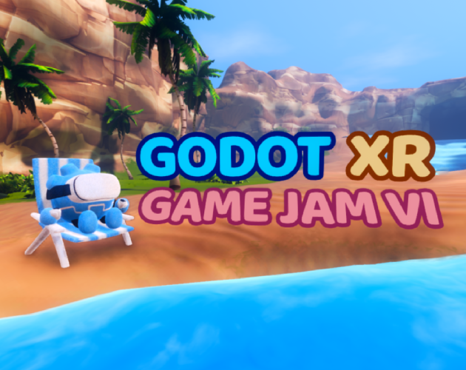
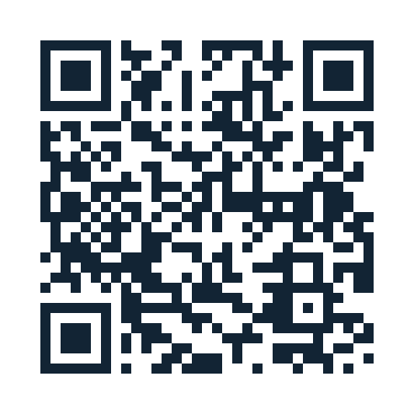
NEXT WEEK · GODOT XR COMMUNITY
One week.
Your first XR game.
21–28 SEPTEMBER 2026
Build an AR or VR game in Godot.
The theme is revealed when the jam starts.
01
JOIN
Create an itch.io account and join the jam.
02
MAKE
Pick one mechanic and a supported XR platform.
Cover art: Daniel SND
GODOT XR GAME JAM · SIXTH EDITION
03
SHARE
Submit your game, then play and rate other entries.
Hosted by the Godot XR Community
and Bastiaan Olij
Templates and asset packs are welcome.
Start a new game for the announced theme.
Scan to join →
Official jam page · dates and local deadline
MURGILDU / EHU / 2026–2027
02 / 04
Notes:
Official source, checked 17 September 2026: https://itch.io/jam/godot-xr-game-jam-sep-2026
Submission window displayed by itch.io: 21 September 2026 00:00 to 28 September 2026 00:00. Exact local times should be checked on the event page. Theme announced at start. Any Godot version; AR/VR entry; supported platform required. Toolkits, template projects and asset packs allowed, but do not reuse an existing game project. Voting follows submissions. Cover/logo credit on the official page: Daniel SND; Godot Plush by Fr3nkd. No local lab event schedule is implied.

Slide 3
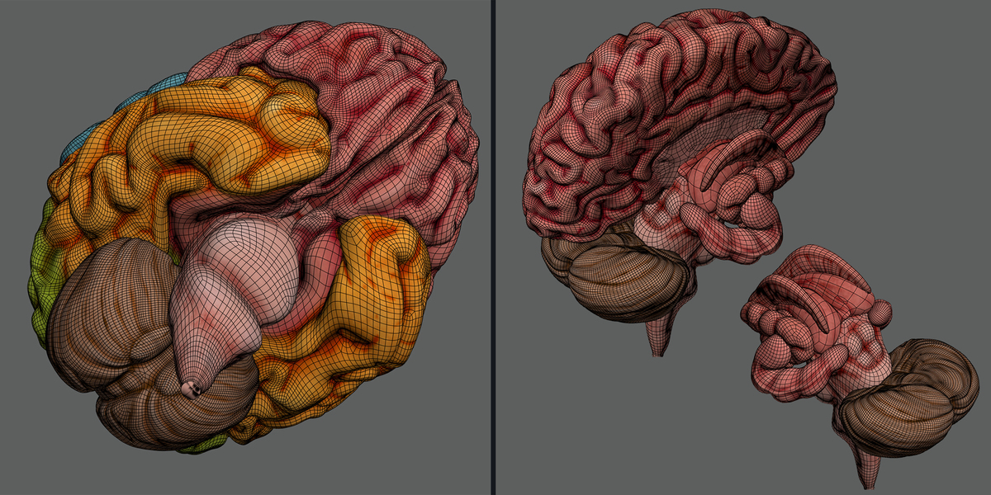
STUDENT PROJECTS · MEDICAL XR
Graphics technologies
applied to healthcare
Make complex data easier to see, explore and understand.
VISUALISE
Reconstruct anatomy and explore
medical scans, EEG or fatigue data.
INTERACT
Annotate in 3D and create immersive
learning or simulated practice tasks.
EVALUATE
Compare tools and study how people
understand and use the experience.
From medical images to interactive 3D
TFG / TFM · 3D modelling, VR, data visualisation and interaction
Inigo Lopez-Gazpio
Unai Elordi
Elsa Fernández
inigo.lopez@ehu.eus
unai.elordi@ehu.eus
elsa.fernandez@ehu.eus
MURGILDU / EHU / 2026–2027
03 / 04
Notes:
Anatomy image: supplied lab presentation, slide 11. Project directions summarise the user-supplied 2026–2027 medical proposals: anatomical reconstruction, medical scan viewing, EEG/fatigue visualisation, immersive annotation, simulated practice, interaction and evaluation. These are educational/research project ideas. Portraits and emails are from the local author profiles. Website: https://murgildu.github.io/proposals/

Slide 4
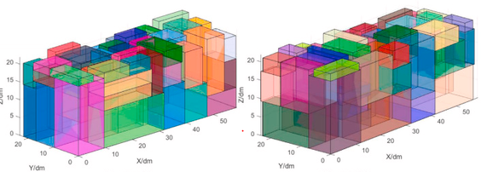
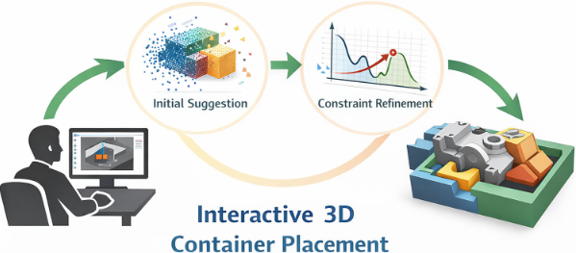
STUDENT PROJECTS · 3D OPTIMISATION + VR
Better use of space.
Arrange objects efficiently. Explore and improve the solution in 3D.
TFG · DEGREE PROJECT
TFM · MASTER’S THESIS
Start with boxes
Go beyond regular shapes
Build an interactive VR environment for packing
rectangular objects into a container.
Explore irregular packing with optimisation
methods and user interaction in 3D or VR.
Andoni Mujika
Algorithms + AI + interaction
andoni.mujika@ehu.eus
Bring your curiosity. Let’s define the project together.
MURGILDU / EHU / 2026–2027
04 / 04
Notes:
Text and both illustrations supplied in the optimisation document: https://docs.google.com/document/d/1WAJudzh3GA8g3tmQVcMx86lFYybXgw2pTtFSYCXaGFI/edit
TFG: regular rectangular containers and objects in an interactive VR environment. TFM: irregular case, combining heuristics or machine-learning methods with user interaction in 3D or VR. The document contains low-resolution raster figures, reproduced without modifying their content. Contact and portrait: local Andoni Mujika author profile.

