Slide 1
THE GREAT AMERICAN COFFEE SALES

Slide 2
Agenda
PROJECT BREIF
DASHBOARDS
PATTERN OR TRENDS
RECOMMENDATIONS

Slide 3
PROJECT BREIF

Slide 4
Objective: Analyze coffee sales data from 2019 to 2022 to extract insights for strategic decision-making.
Goals: Understand customer behavior, product preferences, and regional trends to optimize sales strategies and drive business growth.
Importance: Analyzing coffee sales data is crucial for staying competitive in the dynamic market landscape, allowing us to uncover patterns and trends that inform strategic decisions.

Slide 5
DASHBOARDS

Slide 6
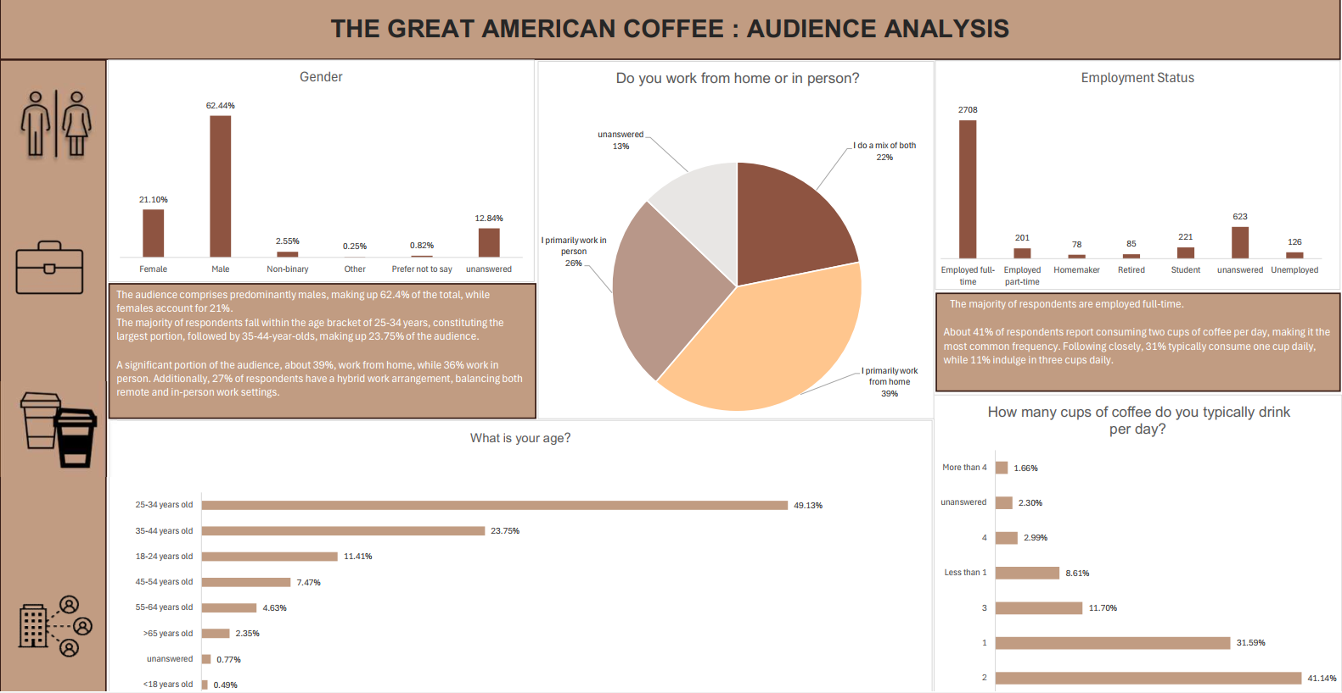

Slide 7
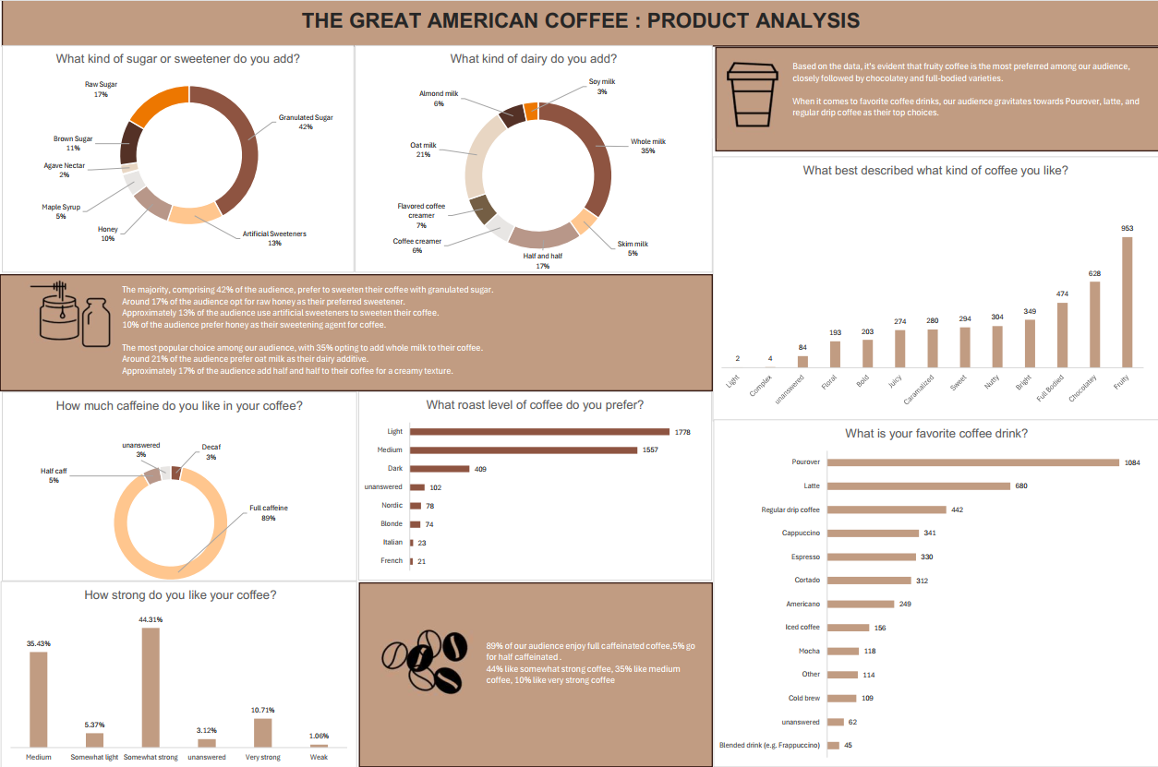
PROJECT BREIF

Slide 8
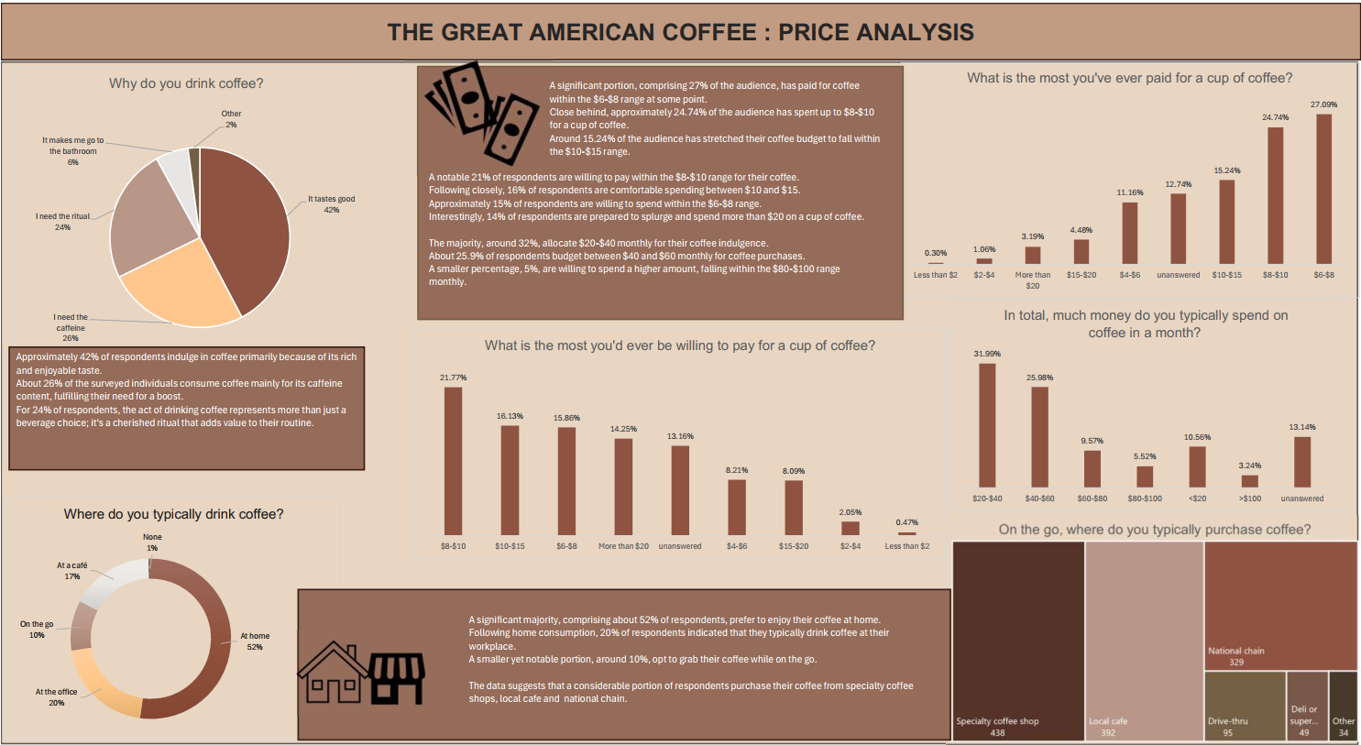

Slide 9
PATTERNs and TRENDS

Slide 10
Demographic Shifts:
Gender: The data reveals a higher representation of males (62.4%) compared to females (21%), indicating a potential gender disparity in coffee consumption habits.
Age Distribution: The majority of respondents fall within the age range of 25-34 years (largest portion), followed by 35-44-year-olds, suggesting a preference for coffee among younger and middle-aged demographics.
Product Preferences:
Flavor Profiles: Fruity coffee emerges as the most preferred flavor among respondents, followed by chocolatey and full-bodied varieties, indicating a preference for diverse taste experiences.
Favorite Coffee Drinks: Pourover, latte, and regular drip coffee are the top choices among respondents, highlighting a preference for both traditional and specialty coffee beverages.

Slide 11
Sweetening and Dairy Preferences:
Sweetening Agents: Granulated sugar is the preferred sweetener for coffee among respondents (42%), followed by raw honey (17%), artificial sweeteners (13%), and honey (10%).
Dairy Additives: Whole milk is the most popular dairy additive (35%), followed by oat milk (21%) and half and half (17%), indicating a preference for creamy textures and dairy alternatives.
Caffeine and Strength Preferences:
Caffeine Content: The majority of respondents (89%) prefer full caffeinated coffee, while a smaller percentage (5%) opt for half-caffeinated options, indicating a strong preference for caffeinated beverages.
Strength Preferences: Somewhat strong coffee is favored by 44% of respondents, followed by medium coffee (35%), suggesting a preference for moderately strong flavors.

Slide 12
Price Sensitivity and Spending Habits:
Price Range: A significant portion of respondents (27%) has paid between $6-$8 for coffee, with 24.74% spending up to $8-$10, indicating a preference for mid-range pricing.
Monthly Spending: The majority (32%) allocate $20-$40 monthly for coffee purchases, while 25.9% spend between $40 and $60 monthly, suggesting moderate spending habits among respondents.
Location and Consumption Habits:
Preferred Locations: Home emerges as the top location for coffee consumption (52%), followed by the workplace (20%), indicating a preference for convenience and comfort.
Purchasing Behavior: Specialty coffee shops, local cafes, and national chains are the preferred locations for purchasing coffee, suggesting a preference for quality and variety.

Slide 13
RECOMMENDATIONS

Slide 14
Given the popularity of fruity, chocolatey, and full-bodied coffee flavors, we recommend diversifying our product offerings to cater to these preferences. Introducing new blends and specialty drinks that align with these flavor profiles can attract more customers and enhance our market presence.
Providing extensive customization options for sweeteners and dairy additives can enhance customer satisfaction. Consider offering a variety of sweetening agents and dairy alternatives to accommodate diverse preferences and dietary restrictions Maintain good posture

Slide 15
With a significant portion of respondents willing to spend between $6-$10 for coffee, we suggest promoting mid-range pricing strategies to attract price-sensitive consumers while maintaining profitability. Special promotions and loyalty programs can incentivize repeat purchases and increase customer retention.
Since a majority of respondents prefer consuming coffee at home, prioritize convenience by offering subscription services, online ordering platforms, or ready-to-drink options for home delivery. Streamlining the purchasing process and ensuring timely delivery can improve customer convenience and satisfaction

Slide 16
Recognizing the popularity of coffee consumption at the workplace, consider offering tailored solutions for office environments.
We can utilize the demographic insights to tailor marketing strategies and product offerings to specific target audiences. Develop targeted campaigns and promotions aimed at younger demographics (25-34 years) and explore niche markets based on gender-specific preferences to maximize engagement and sales.

Slide 17
Thank you

