Slide 1
Numerical optimization
MURILO AUGUSTO PINHEIRO

Slide 2
Summary
Problem definition
Problem solution
Results
Performance metrics & evaluation

Slide 3
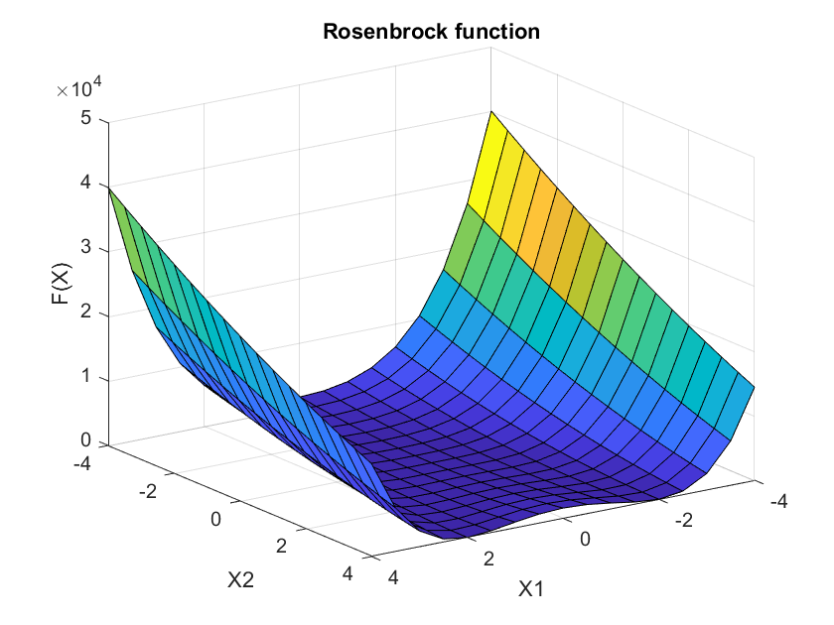
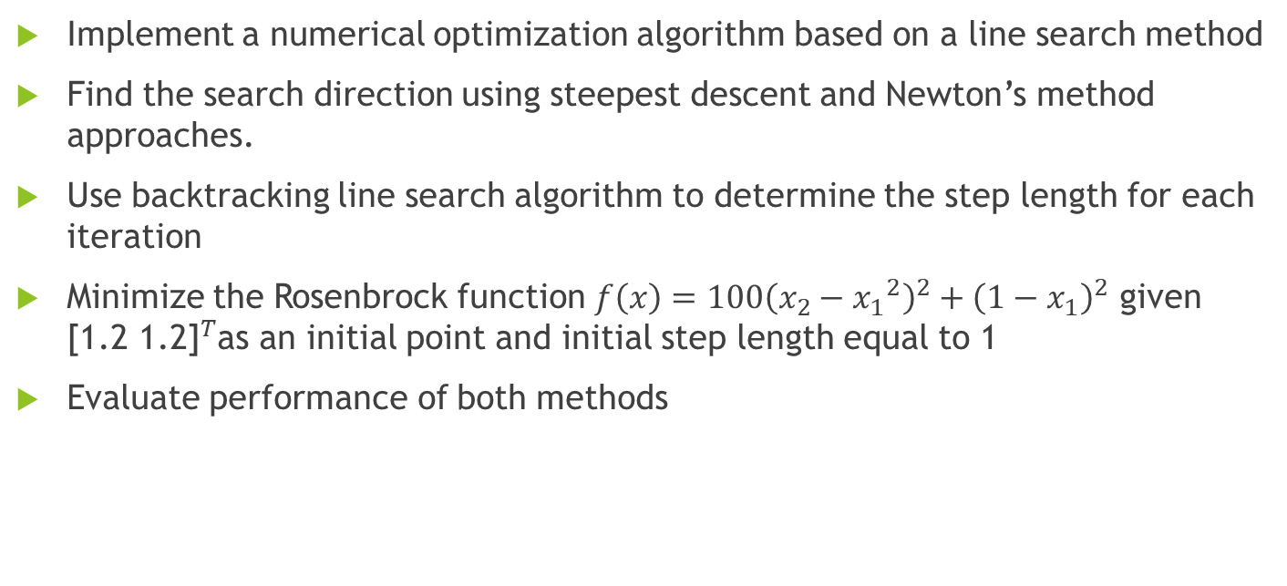
Problem definition
Implement a numerical optimization algorithm based on a line search method
Find the search direction using steepest descent and Newton’s method approaches.
Use backtracking line search algorithm to determine the step length for each iteration
Minimize the Rosenbrock function $f\left(x\right)=100{\left(x_{2}−{x_{1}}^{2}\right)}^{2}+{\left(1−x_{1}\right)}^{2}$ given ${\text{[1.2 1.2]}}^{T}$as an initial point and initial step length equal to 1
Evaluate performance of both methods
Notes:
Interesting function since it is almost flat for X1 close to zero.

Slide 4
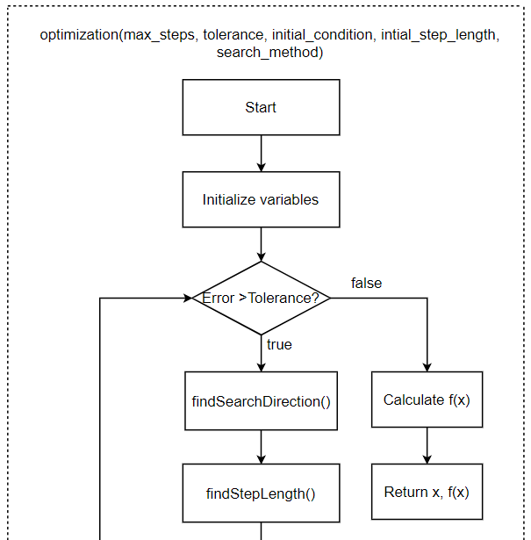
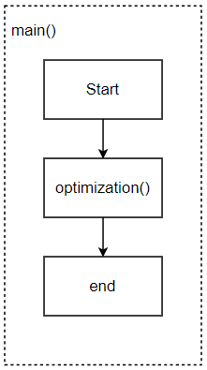
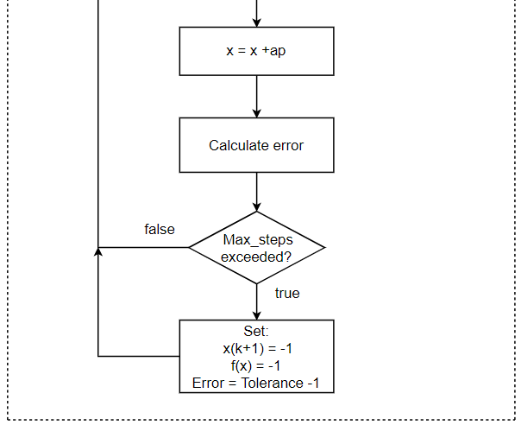

Implementation

Slide 5
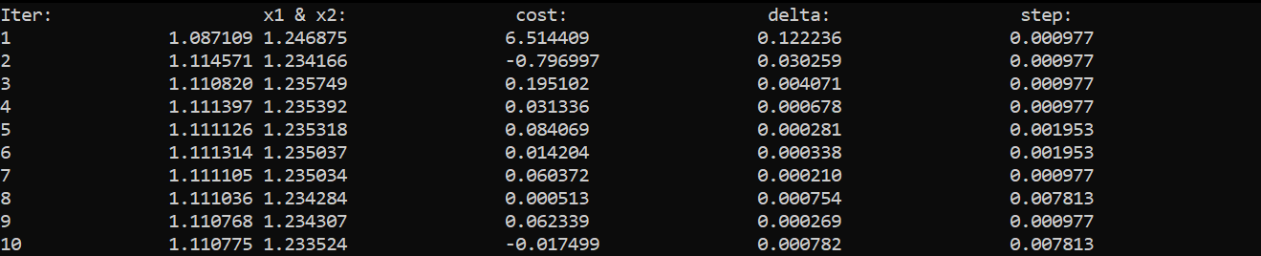
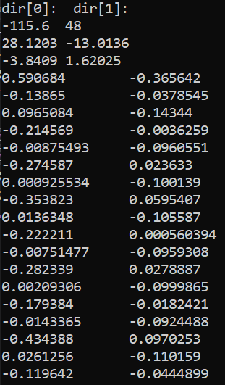
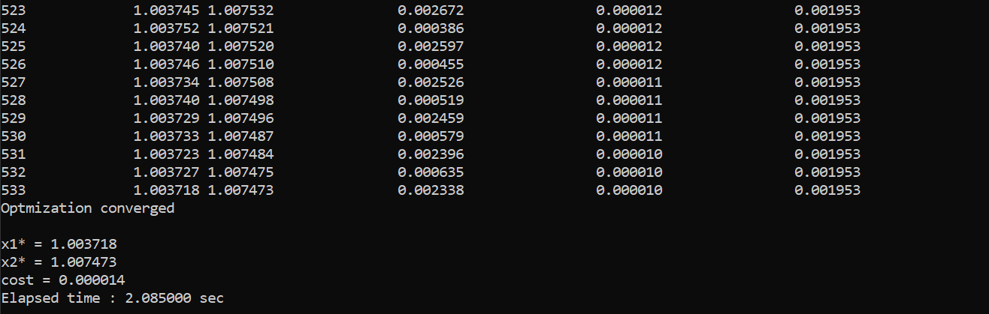
Results
Steepest descent result

Slide 6
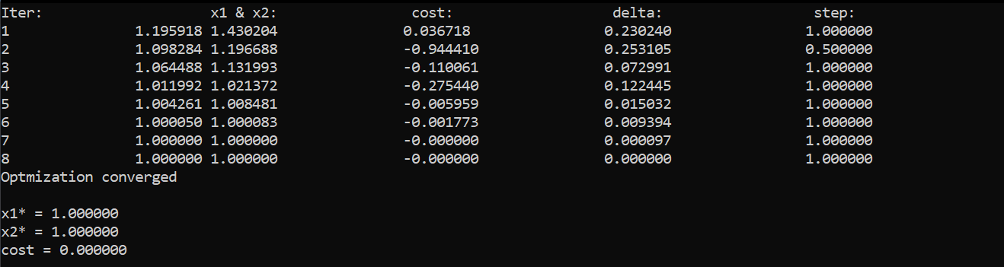
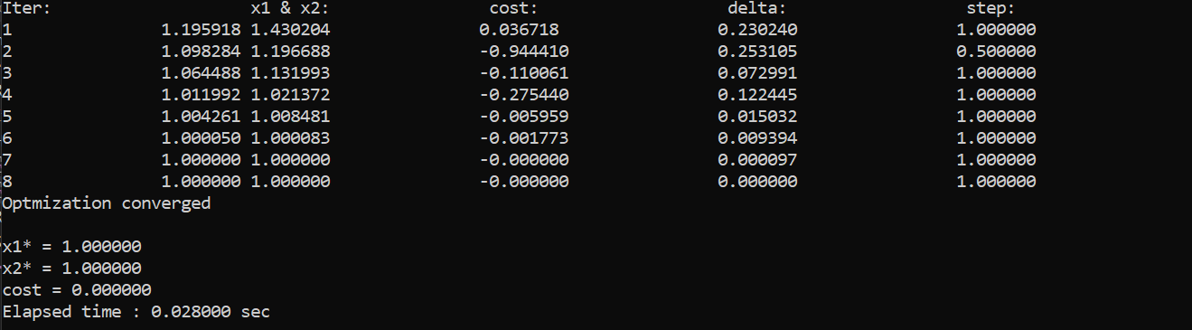
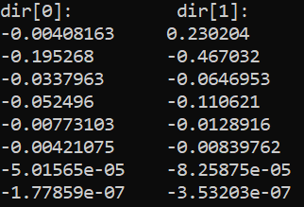
Results
Newton’s method result

Slide 7
Performance metrics & evaluation
Both methods can be analyzed based on the following aspects:
 |  | Steepest descent | Newton’s method | Winner
Accuracy |  | X1 = 1.0037178 X2 = 1.007473 F(X) = 1.38758e-05 | X1 = 0 X2 = 0 F(X) = 1.08828e-25 | Newton
Convergence speed | Execution time | Tens of milliseconds | ~2 seconds | Newton
Convergence speed | # of steps | 533 | 8 | Newton
Step size | Step size | mostly <= 0.1* | >= 0.5 | Newton
 | Step direction | Oscillatory* | Steady
Convergence |  | Local | Local | Tie
* inefficient
Notes:
- It is important to remember that the newton’s method requires matrix inversion which is an intense computational task.
- This may compromise convergence speed for higher dimensional problems.
- May cause problems, if matrix is not invertible.

