Slide 1
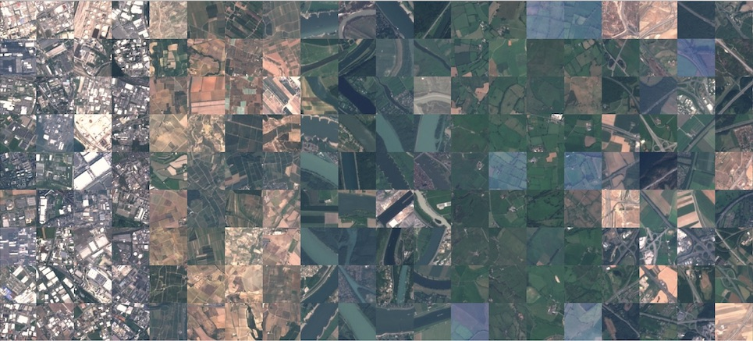
Deep Learning-based Computational Vision for Satellite Imagery Classification
EUROSAT RGB

Slide 2
Overview
Objective
Develop a model with an accuracy exceeding 80% for classifying satellite imagery into 10 distinct land cover categories.
Data
EUROSAT RGB is the RGB version of the EUROSAT dataset based on Sentinel-2 satellite images covering 13 spectral bands and consisting of 10 classes with 27000 labeled and geo-referenced samples. Classes: AnnualCrop, Forest, HerbaceousVegetation, Highway, Industrial, Pasture, PermanentCrop, Residential, River, SeaLake
huggingface.co/datasets/blanchon/EuroSAT_RGB
https://arxiv.org/abs/1709.00029
https://github.com/phelber/EuroSAT
Tools
Hugging Face (data collection), Git (version control), Python (programming), PyTorch (deep learning framework), NVIDIA CUDA (GPU processing), Jupyter Notebook, and VSCode (development environment).

Slide 3

Process Flowchart
Model Development
Data Collection
Extraction, Splitting and Organization of Images
Neural Network Modeling
Model Construction
Training
Evaluation
Deployment and Testing
Code Structure
01_DataManipulation.ipynb
02_DLModeling.ipynb
03_TrainingModel.ipynb
04_DeployModel.ipynb
Extract and download dataset.
Organize images for training/testing.
Map land cover types to IDs.
Dataset description and download link
Construct neural network with torch.nn.
Define layers and activation functions.
Modularize code in landneuralnetwork.py for easy reuse
Preprocess data.
Initialize model using defined structure.
Implement Cross-Entropy Loss and Adam optimizer.
training process and evaluate accuracy.
Save model post-training.
Load trained model with preserved weights.
Classify new images to assess applicability.
Process test images for model compatibility.

Slide 4
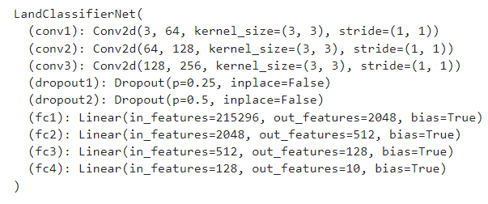
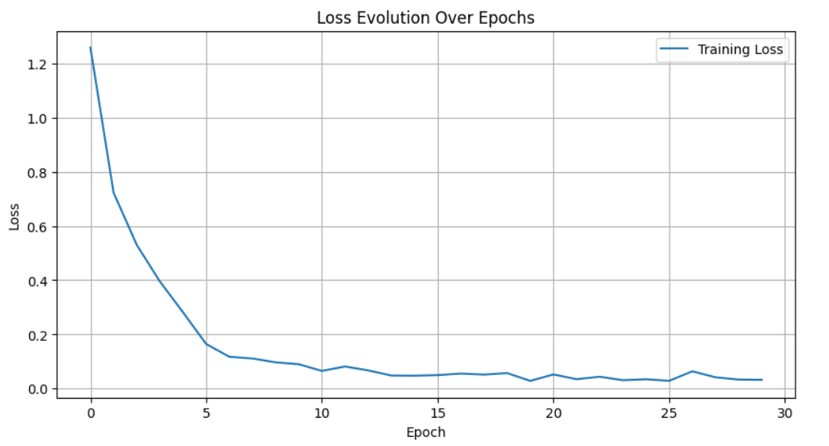
Model and Training
Model Structure
This neural network, constructed with PyTorch for land cover classification, is composed of the following layers:
Three convolutional layers (conv1, conv2, conv3) with increasing filter sizes (64, 128, 256) and kernel size 3x3 for feature extraction. Each convolutional layer is followed by a ReLU activation function and uses a stride of (1,1).
Two dropout layers (dropout1, dropout2) with probabilities of 0.25 and 0.5, respectively, to prevent overfitting by randomly zeroing some of the elements of the input tensor.
Four fully connected layers (fc1, fc2, fc3, fc4) that decrease in neuron count from 215296 to 2048, then to 512, and to 128, with the final layer reducing to 10 output features, corresponding to the 10 classes of land cover. The presence of bias in all fully connected layers enables the model to learn appropriate shifts in the decision boundary.
Training
Accuracy
82.21%

Slide 5
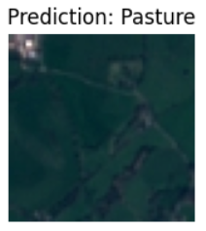
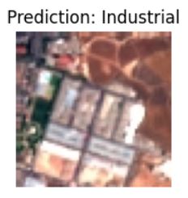
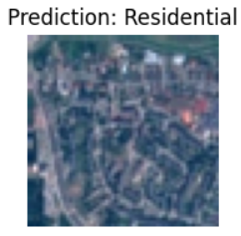
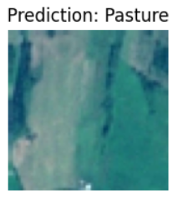
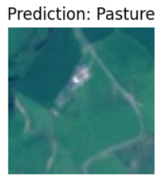
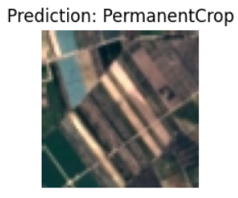
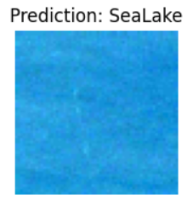
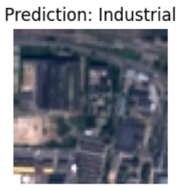
Deploy
The model has been saved to 'nn_model.pth' and is now being imported into the development environment to simulate a deployment. Below are images from the test database, along with their respective classifications as predicted by the model.

Slide 6


