Slide 1

TJ VanToll 🚀
@tjvantoll

Slide 2


Slide 3
Agenda
Options for NativeScript development
CLI
Sidekick
Connecting to backends
Kinvey
Working with plugins

Slide 4
How to be successful building apps with NativeScript

Slide 5
Options for NativeScript development

Slide 6
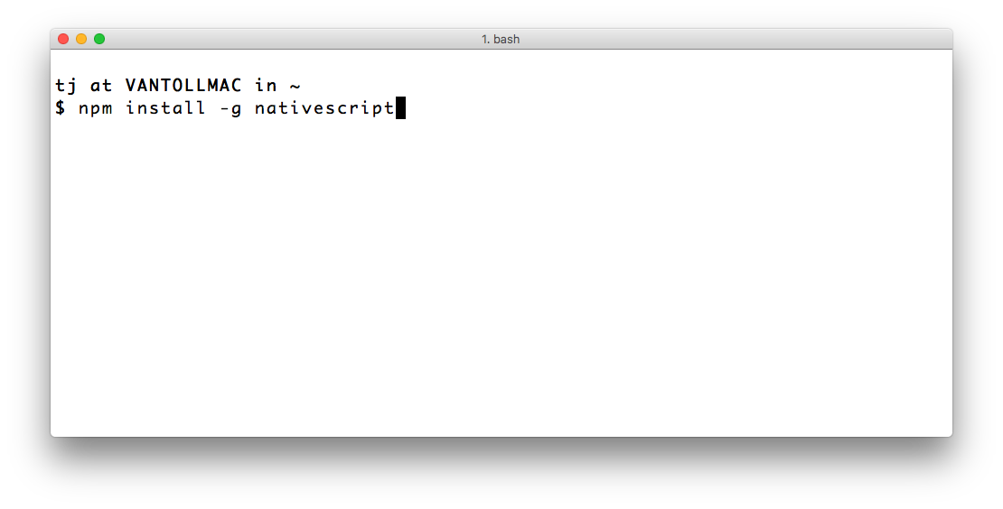

Slide 7
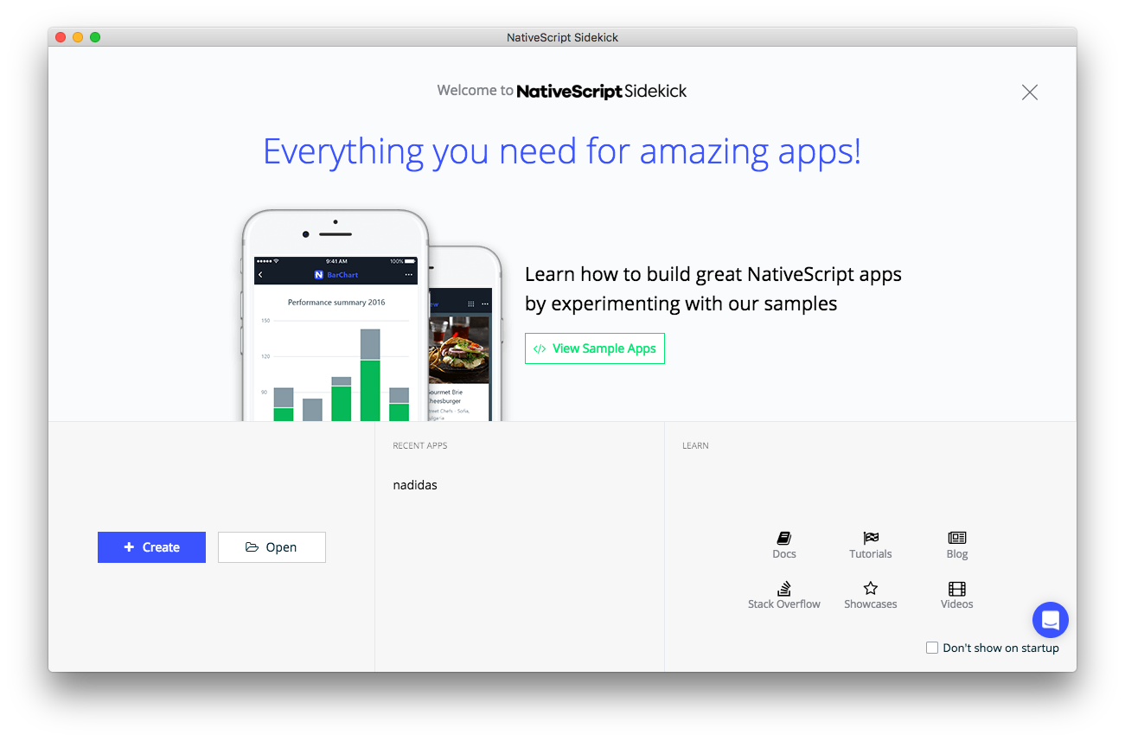

Slide 8
Agenda
Options for NativeScript development
Connecting to backends
Working with plugins

Slide 9
Connecting to backends
RESTful APIs
SQLite
Plugins
Firebase
Couchbase
Azure
Kinvey

Slide 10


Slide 11







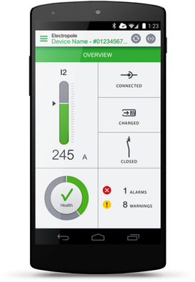
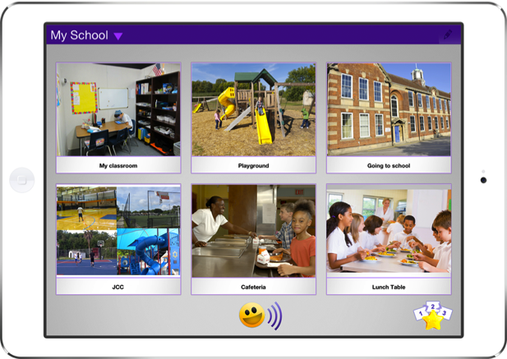
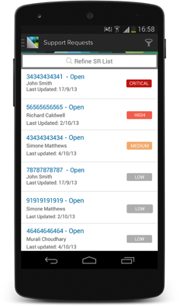
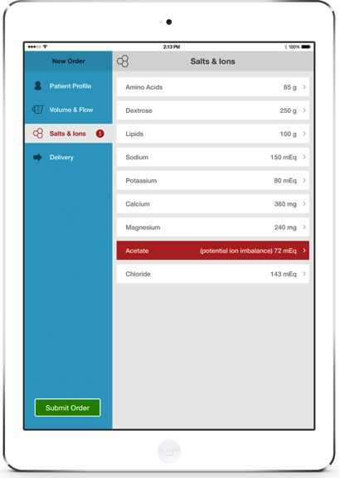















KINVEY: A MODERN APP DELIVERY PLATFORM
App1
App2
App3
Kinvey Client Libraries
OPERATIONAL INTELLIGENCE
DIGITAL LIFECYLE MANAGEMENT
Identity Connect
Engagement
Services
Business Logic
Data Store
File Store
RAPID and FLEX Service Integration
ENTERPRISE DATA & AUTH
Active Directory
API Mgmt
© Kinvey 2017

Slide 12
Requirements
Connect to an existing product catalog
Make the shopping cart work offline
Give users a personalized experience

Slide 13
Agenda
Options for NativeScript development
Connecting to backends
Working with plugins

Slide 14
Follow NativeScript!
nativescript.org/nativescript-newsletter
twitter.com/nativescript

Slide 15
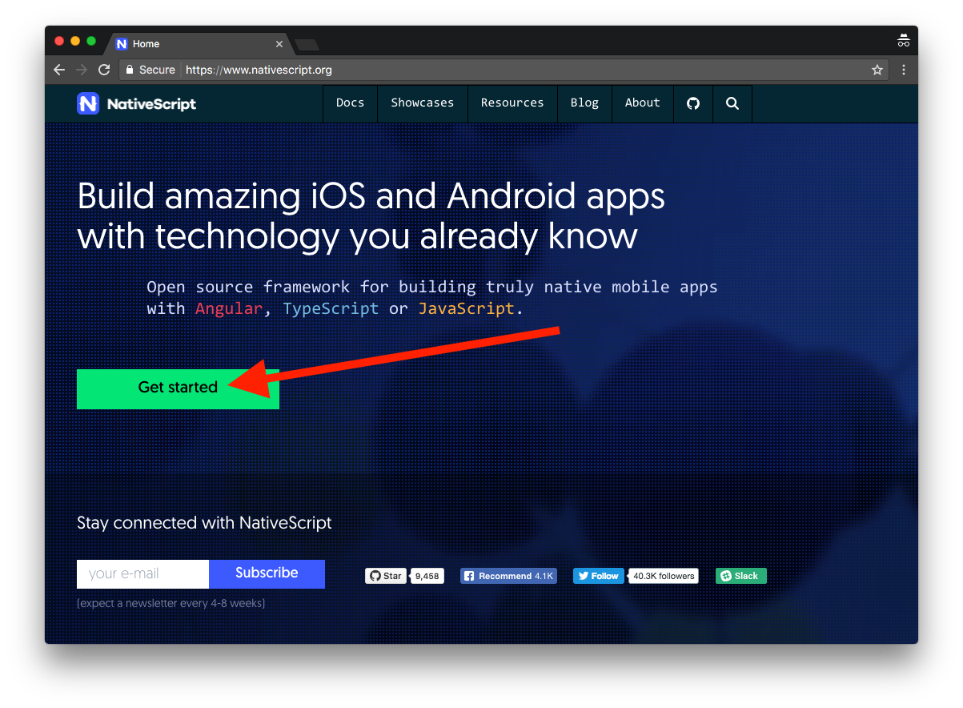
Get Started
Notes:
If you’re interested in what you’ve heard today and want to try NativeScript out, head to nativescript.org and hit the big Get started button. From there go through one of the two tutorials, NativeScript with JavaScript, or NativeScript with TypeScript and Angular.

Slide 16
Thanks! 😊
http://bit.ly/DR2017-looper-vantoll

