Slide 1

Why I Was Wrong About TypeScript
TJ VanToll

Slide 2
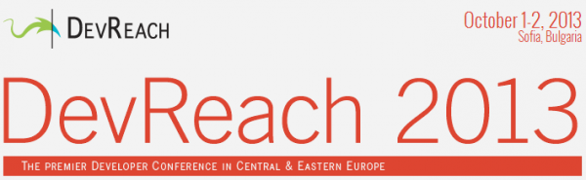

Slide 3
TypeScript

Slide 4
TypeScript
Triple-Slash Directives
Declaration files
Namespaces
Structural detection
Classes
Compiler options
Type Inference
Modules
Generators
Declaration merging
Decorators
Generics
Mixins
Sequential piping
Symbols

Slide 5
TypeScript
Triple-Slash Directives
Declaration files
Namespaces
Structural detection
Classes
Compiler options
Type Inference
Modules
Generators
Declaration merging
Decorators
Generics
Mixins
Sequential piping
Symbols

Slide 6
Why I Was Wrong About TypeScript

Slide 7
Whether TypeScript is a good fit for your next project

Slide 8
Why I Was Wrong About TypeScript

Slide 9
“A typed superset of JavaScript that compiles to plain JavaScript”

Slide 10
“A typed superset of JavaScript that compiles to plain JavaScript”

Slide 11


Slide 12
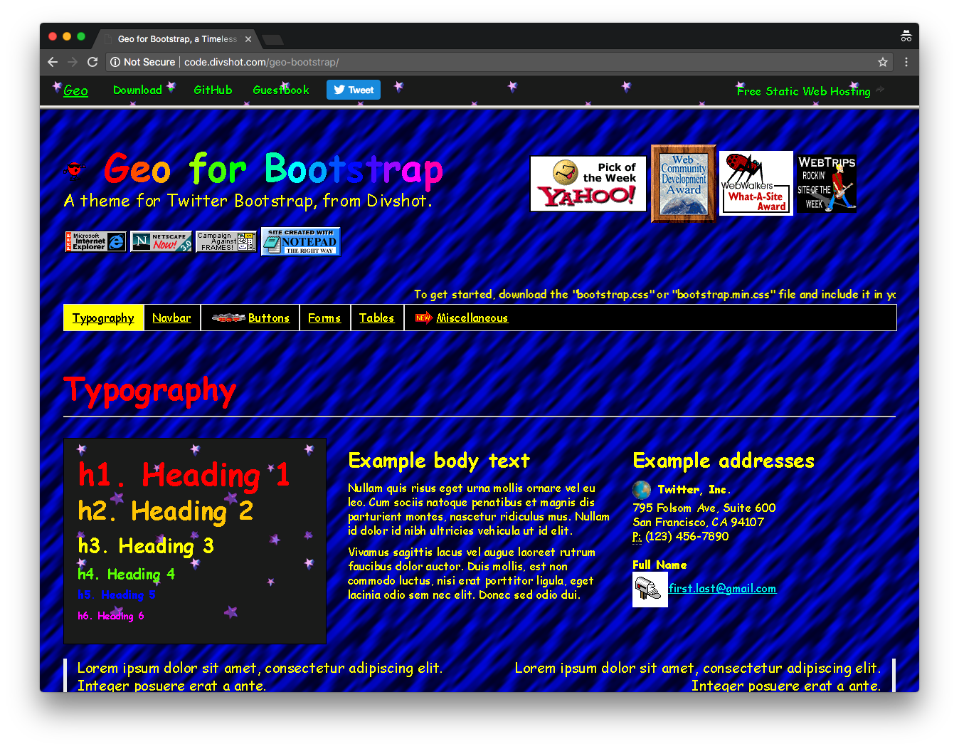

Slide 13
👨‍💼👩‍💼

Slide 14
😍

Slide 15
😠

Slide 16
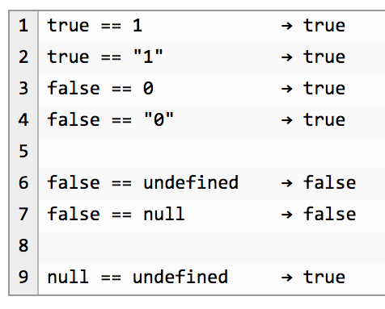

Slide 17
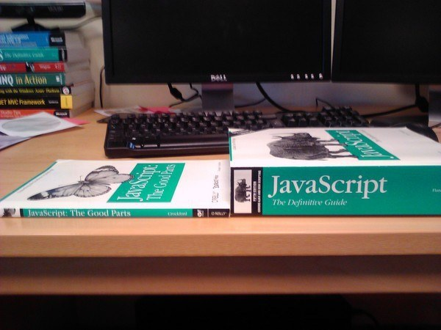
Notes:
34

Slide 18
Compile to JavaScript tools
There are a lot.
345
Source: https://github.com/jashkenas/coffeescript/wiki/List-of-languages-that-compile-to-JS
Ruby, Python, Erlang, Java, Scala, C#, F#, Lisp, Scheme, Haskell, Smalltalk, C, C++, Basic, Go, PHP, and way more.

Slide 19
Fun names of compile-to-JS tools
treehugger
jangaroo
Waterbear

Slide 20
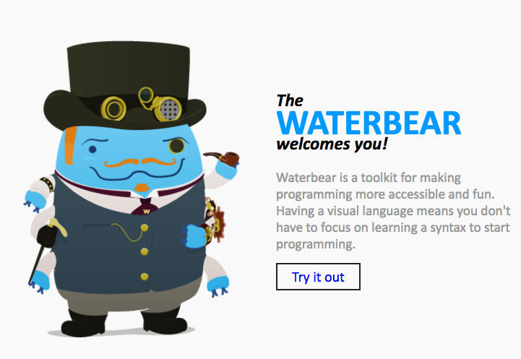
http://waterbearlang.com/

Slide 21
Compile to JavaScript tools
There are a lot.
345
Source: https://github.com/jashkenas/coffeescript/wiki/List-of-languages-that-compile-to-JS
Ruby, Python, Erlang, Java, Scala, C#, F#, Lisp, Scheme, Haskell, Smalltalk, C, C++, Basic, Go, PHP, and way more.

Slide 22
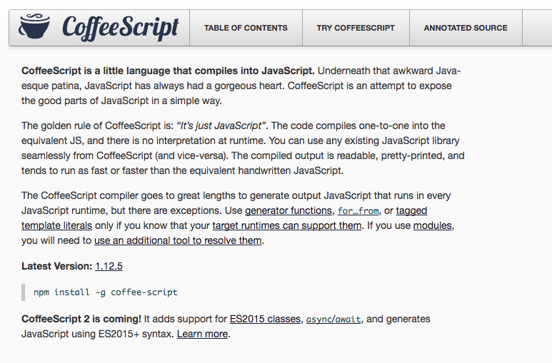
Notes:
2009

Slide 23
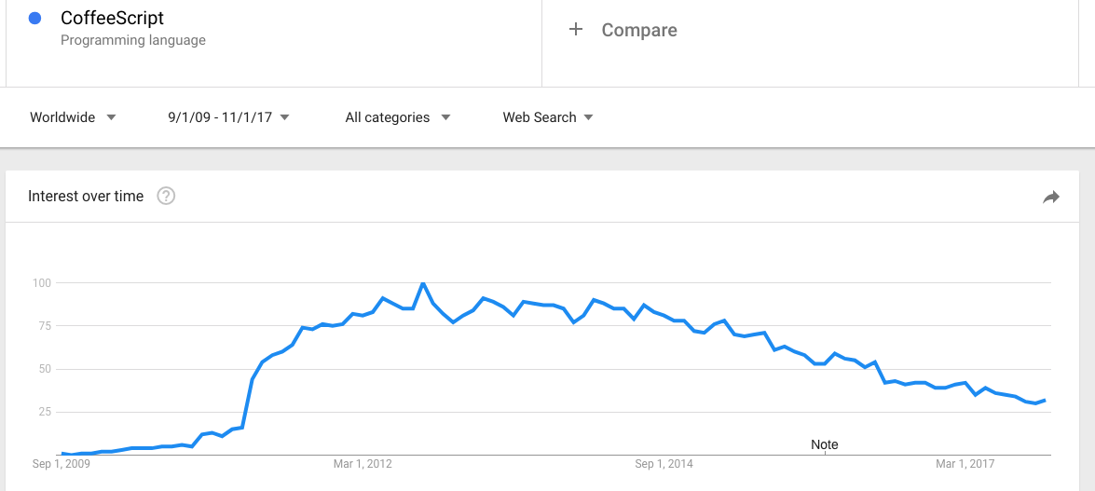

Slide 24
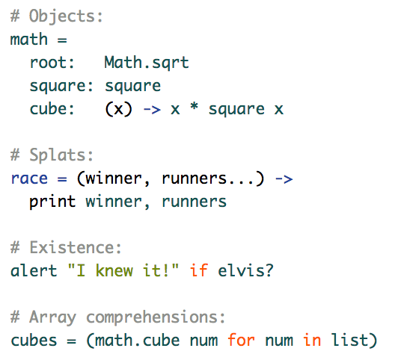

Slide 25
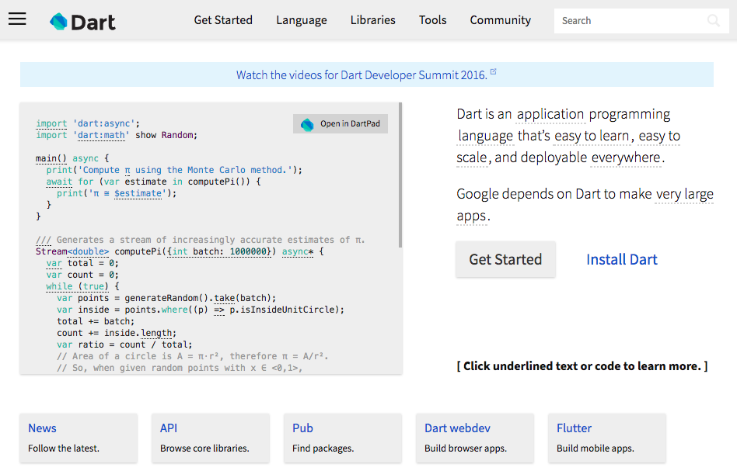
Notes:
2011

Slide 26
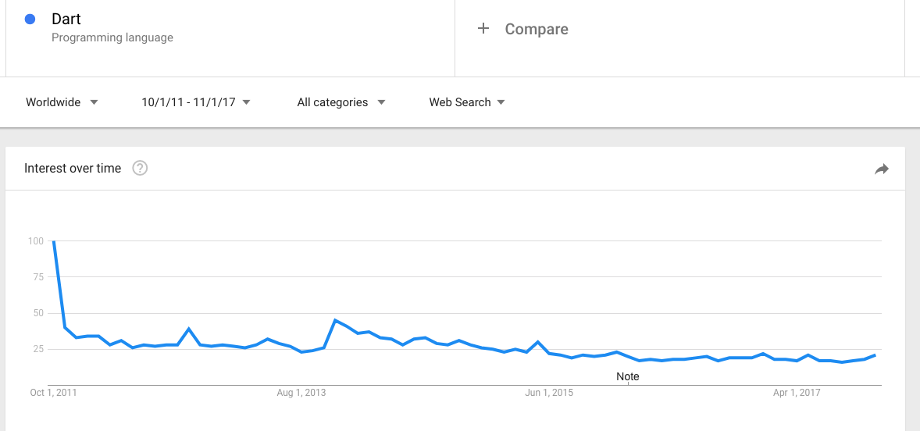

Slide 27
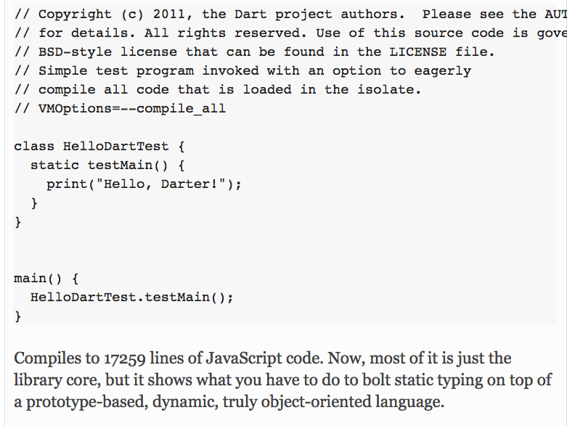

Slide 29


Slide 30
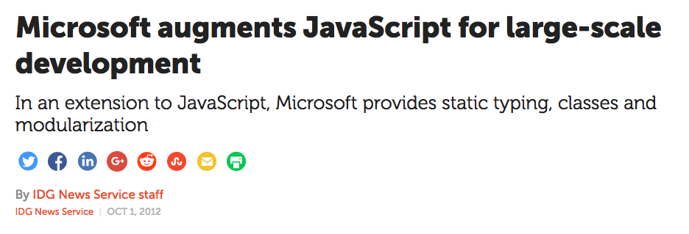
Notes:
October 2012

Slide 31
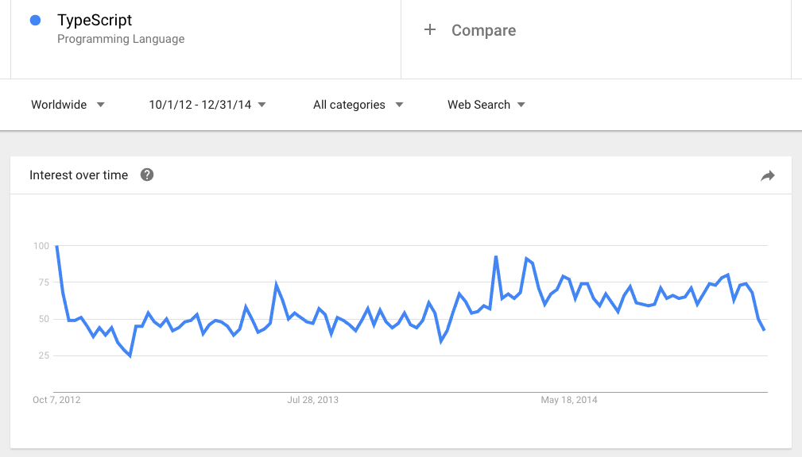

Slide 32
Why I Was Wrong About TypeScript

Slide 34


Slide 36


Slide 37


Slide 38
✉️

Slide 39
“We risk a lot by building our core on top of TypeScript.”

Slide 40
“I don’t hear anyone talking about TypeScript.”

Slide 41
“I like to keep my JavaScript pure, as God intended.”

Slide 42
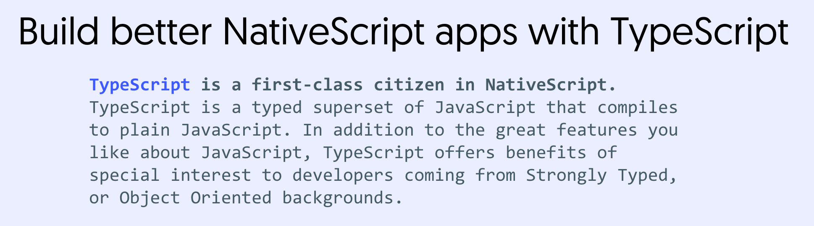

Slide 43
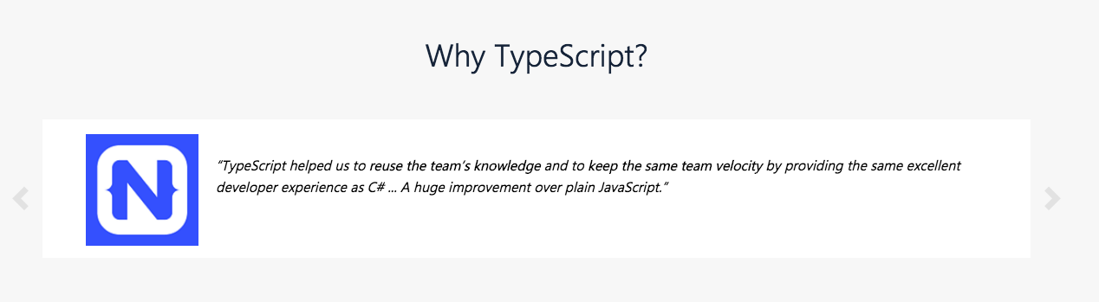

Slide 44
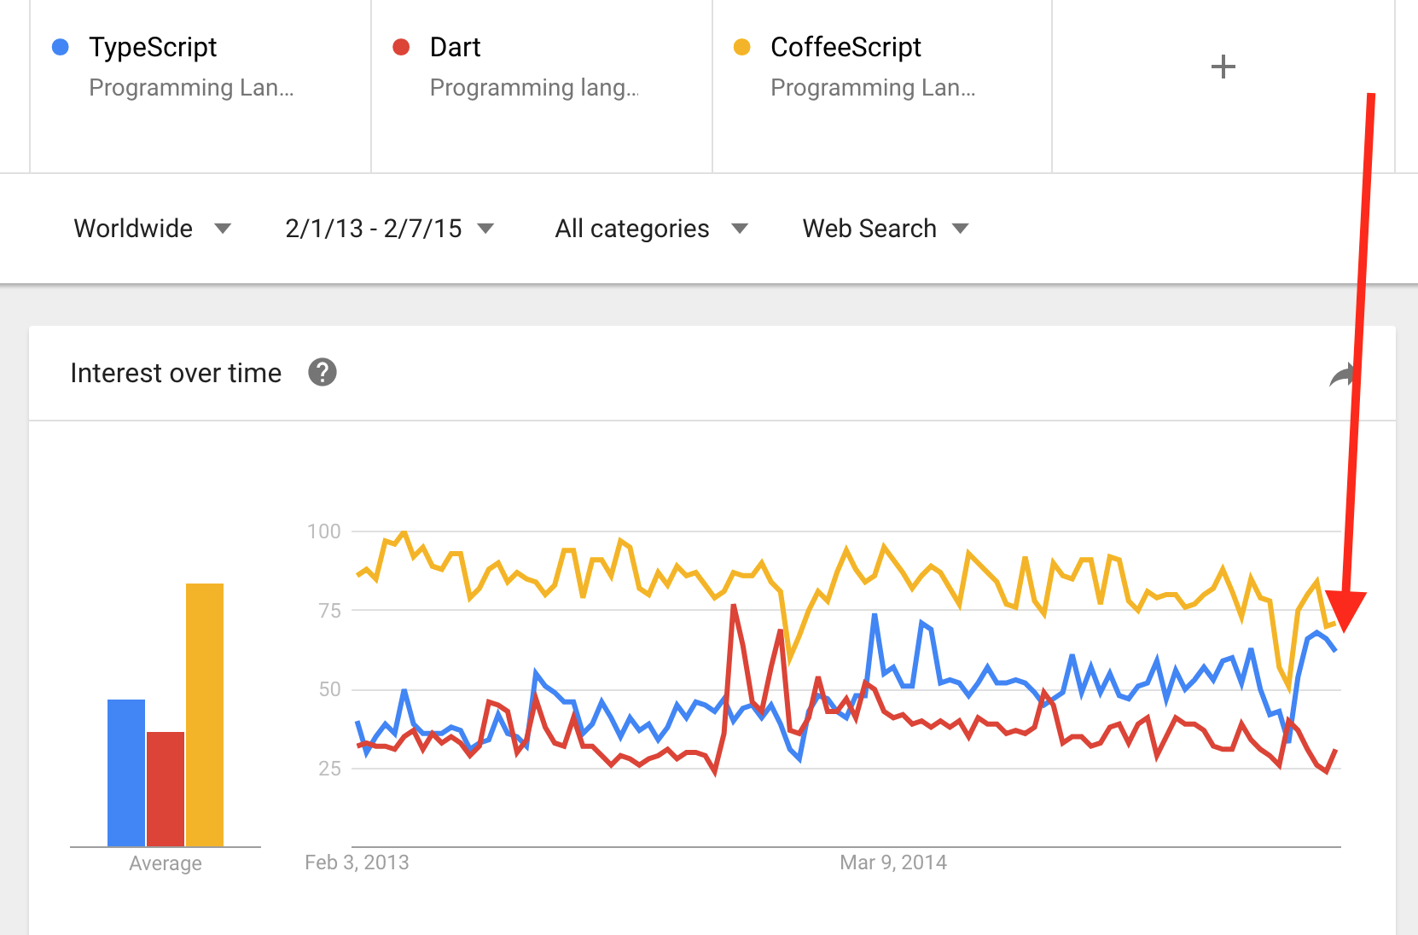

Slide 45
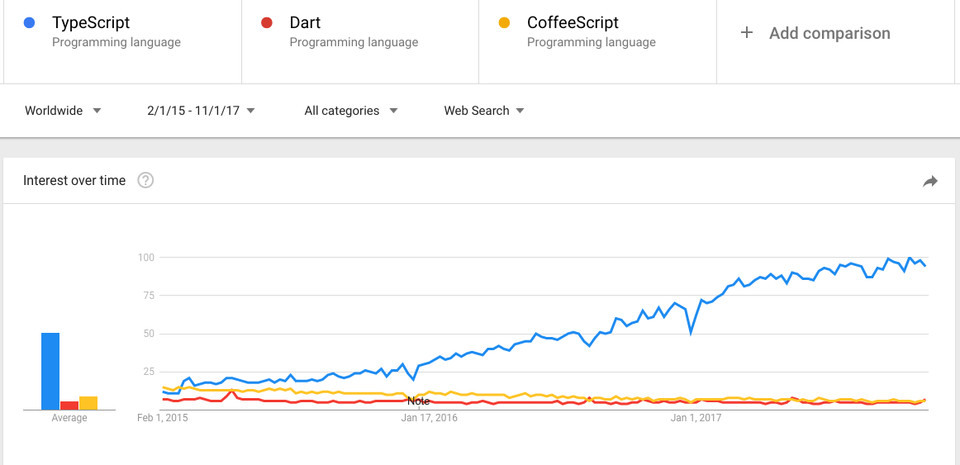

Slide 46
Why I Was Wrong About TypeScript

Slide 47
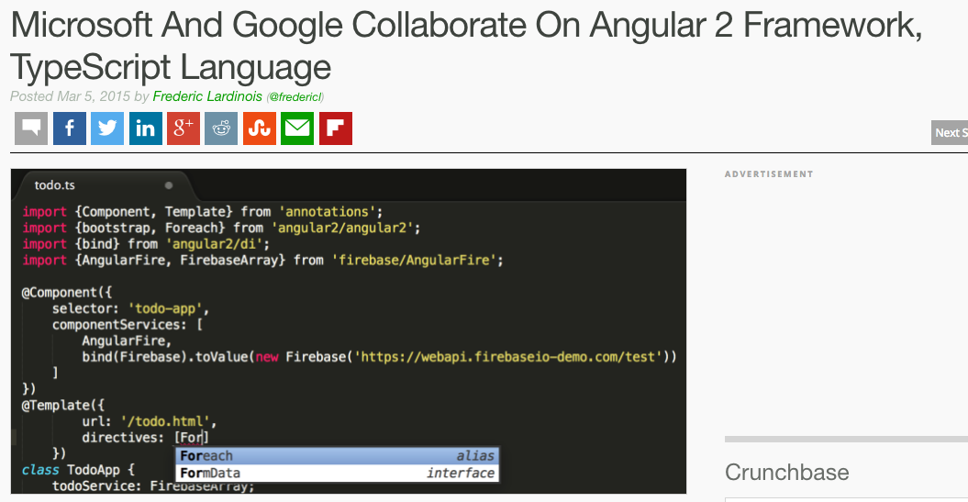

Slide 48
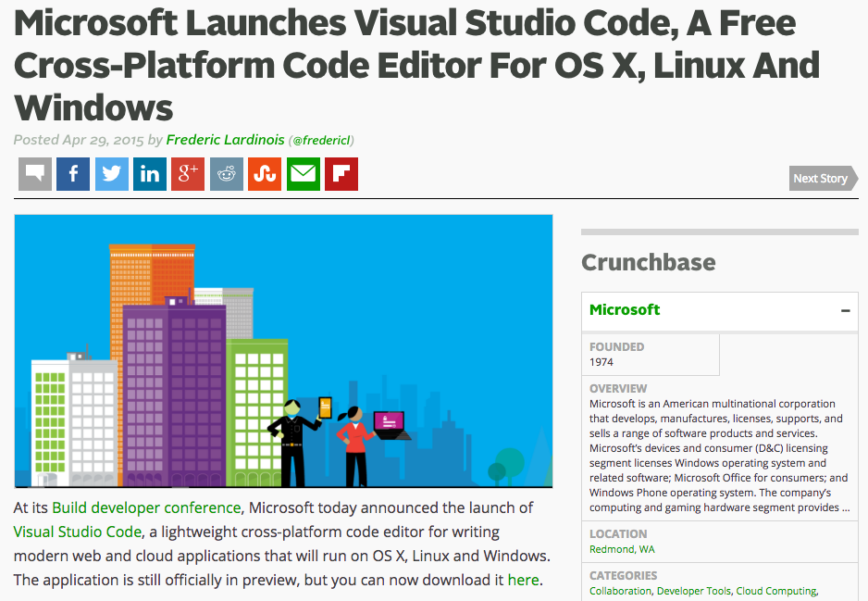

Slide 49
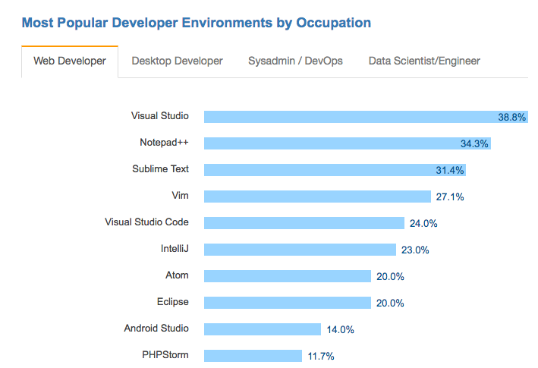

Slide 50
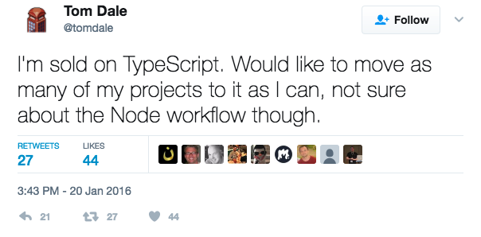

Slide 51
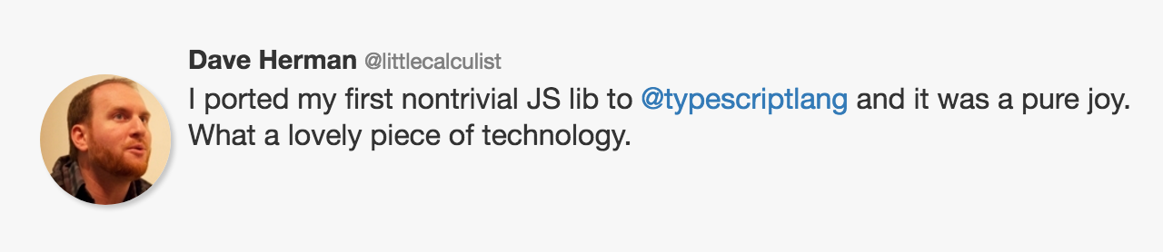

Slide 52
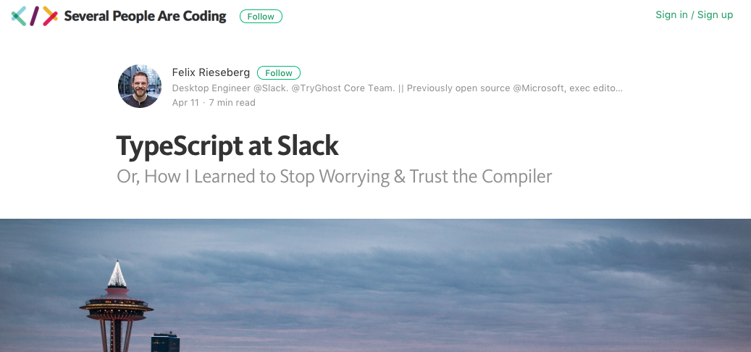

Slide 53
Why?

Slide 54
3 reasons

Slide 55
1) Commitment to the ECMAScript standard

Slide 56
“Some examples [of compile-to-JavaScript frameworks], like Dart, portend that JavaScript has fundamental flaws and to support these scenarios requires a “clean break” from JavaScript in both syntax and runtime. We disagree with this point of view. We believe that with committee participant focus, the standards runtime can be expanded and the syntactic features necessary to support JavaScript at scale can be built upon the existing JavaScript standard.”

Slide 57
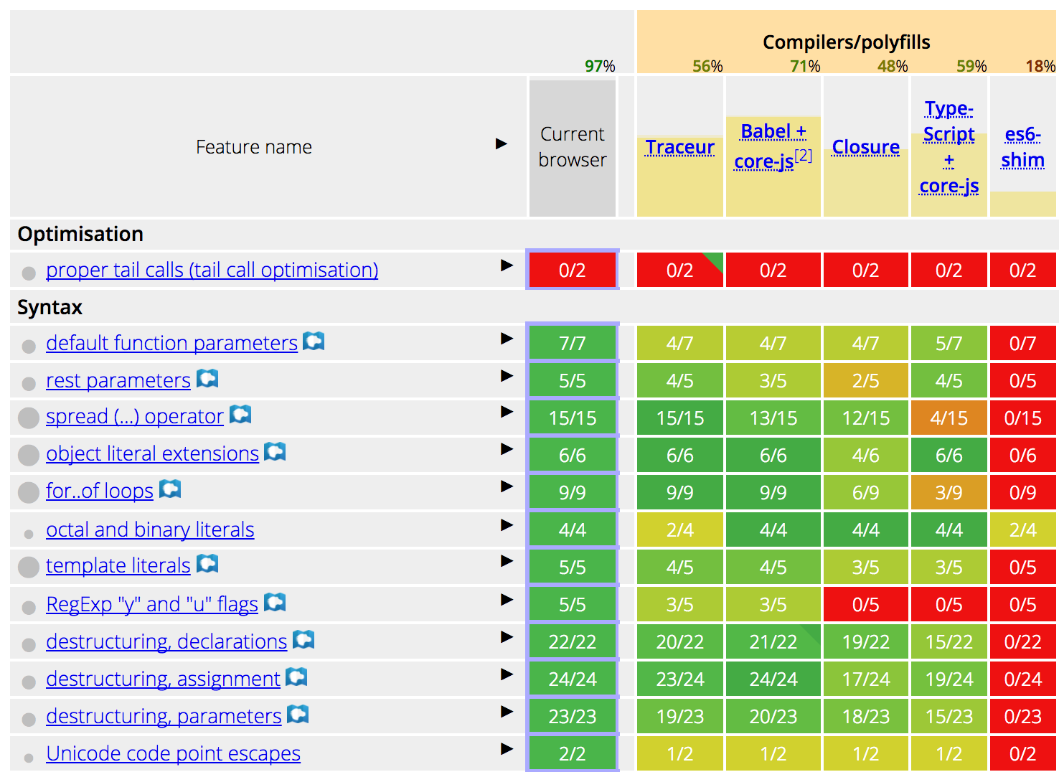

Slide 58
2) Types are opt-in

Slide 59
3) Tooling

Slide 60
So should you use TypeScript?
Are your apps big?
Do you work on a team?
Unfamiliar codebases?
Non JS developers that need to write JS code?

Slide 61
Thanks!
@tjvantoll
http://bit.ly/DR2017-vantoll

