Slide 1
Network Sentinel
ML + RAG for Intrusion Detection & Incident Intelligence
SHARMILA MURISETTY - 041200488
BUSINESS INTELLIGENCE PROGRAM ADVANCED CONCEPTS - CST2213_300
ALGONQUIN COLLEGE

Slide 2
PROBLEM STATEMENT
The Gap Between Detection and Decision
Traditional Intrusion Detection Systems were built to raise alarms not to explain them. Security teams are left with raw alerts and no actionable context, creating a critical gap that slows response and increases risk.
Traditional IDS
Intelligent Insight
Generates alerts only - no explanation
Lacks contextual intelligence
Requires manual, expert interpretation
Slow incident response cycle
Predicts attack type with confidence score
Provides severity classification
Delivers contextual explanation automatically
Recommends mitigation steps instantly

Slide 3
SOLUTION OVERVIEW
Network Sentinel bridges the detection gap by combining the predictive power of Machine Learning with the contextual depth of Retrieval-Augmented Generation. The result is a system that doesn't just detect threats it explains them and guides response.
Prediction
Confidence & Severity
Classifies attack type with XGBoost at 99.97% accuracy
Scores each detection with probability and risk level
Contextual Explanation
Mitigation Guidance
RAG retrieves relevant threat knowledge automatically
LLM generates actionable, human-readable response steps

Slide 4
DATASET & FEATURES
CICIDS Dataset - Scale & Scope
Dataset Specifications
Attack Classes Detected
Source: CICIDS - Wednesday-workingHours.pcap_ISCX.csv
DoS / DDoS
Heartbleed
692K
Volume-based denial attacks
Memory disclosure exploit
Raw Rows
Web Attacks
Infiltration
Original dataset records
SQL Injection, XSS, Brute Force
Lateral movement patterns
80
Engineered Features: Total Packets · Packets per Second - capturing traffic intensity and flow behavior.
Final Features
After preprocessing & engineering
After preprocessing: ~610,794 rows · 80 features · cleaned, scaled, and label-encoded.

Slide 5
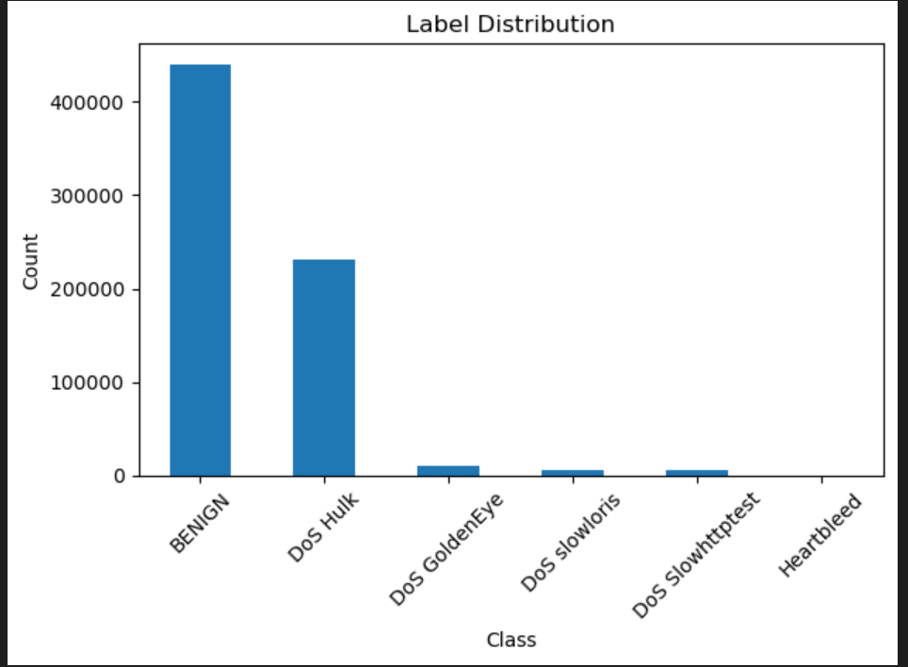
Classes & Distribution Insight
Dataset is highly imbalanced
Imbalance impact:
Model may bias toward majority class
Accuracy alone can be misleading
Mitigation approach:
Used Stratified Train-Test Split
Applied Cross-Validation for stability

Slide 6
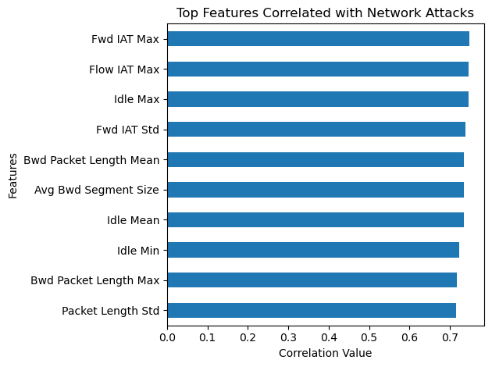
Feature Engineering
Features are strongly correlated with attack behavior
Key insights:
Time-based features dominate (IAT, Idle metrics)
Packet length and flow size are critical indicators
Interpretation:
Attacks create abnormal traffic timing patterns
Sudden spikes or irregular intervals signal anomalies
Why this matters:
Model learns behavioral patterns, not just raw values Improves detection of DoS-style attacks
Feature engineering impact:
Added Total Packets
Added Packets per Second

Slide 7
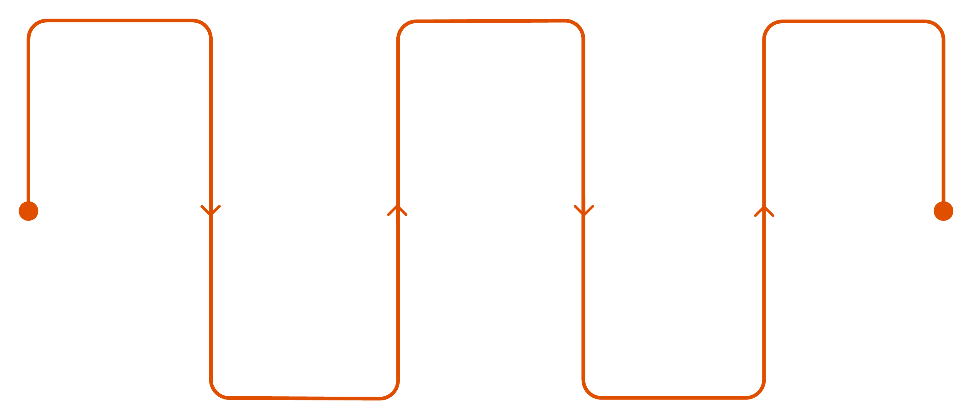
METHODOLOGY
ML Pipeline - From Raw Data to Prediction
Data Cleaning
Scaling
Validation
Remove nulls, duplicates, infinities
StandardScaler normalization
CV accuracy, test accuracy, stability
Feature Engineering
Model Training
Total packets, packets/sec, label encoding
Logistic, Random Forest, XGBoost with CV
Preprocessing Techniques
Validation Strategy
Label Encoding - converts categorical attack classes to numeric targets
StandardScaler - zero mean, unit variance normalization
Removed infinite values and null records before scaling
Stratified 5-fold cross-validation across all models
Held-out test set for final generalization check
Compared CV mean, CV std, and test accuracy together

Slide 8
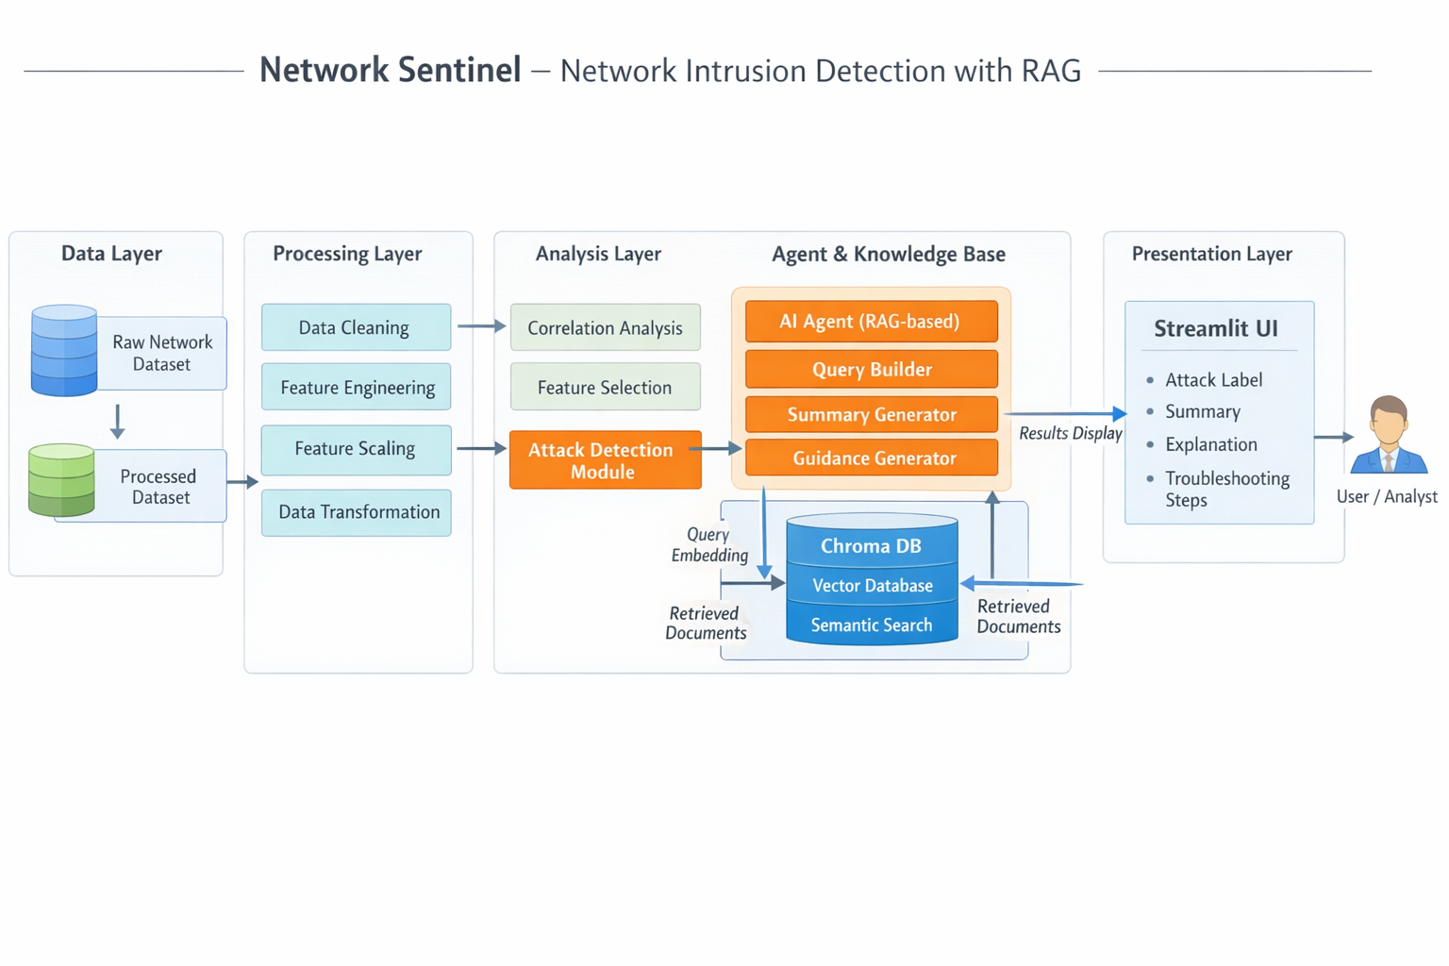
System Architecture
ML detects attack
RAG generates explanation using Chroma DB

Slide 9
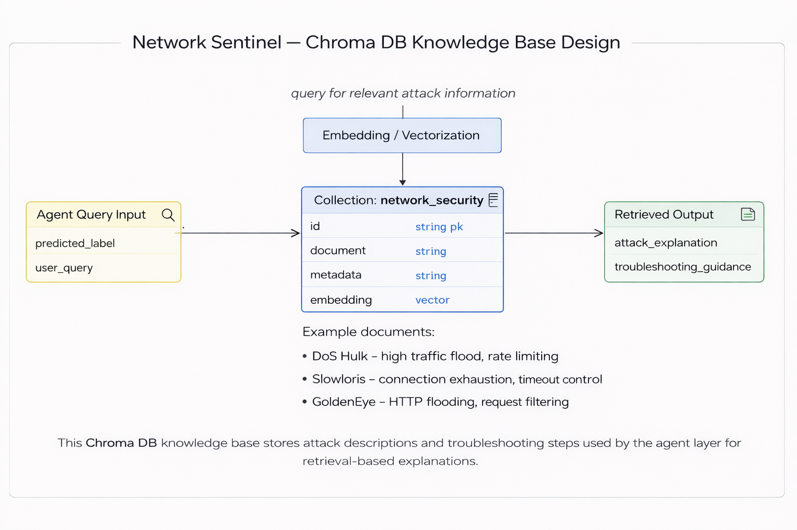
Intelligence Layer - Chroma DB Knowledge Base
Purpose
Stores cybersecurity knowledge (attack descriptions, mitigation)
Technology
Chroma DB (Vector Database)
Uses embeddings for semantic search
Input
Predicted attack label
User query
Output
Attack explanation
Troubleshooting guidance

Slide 10
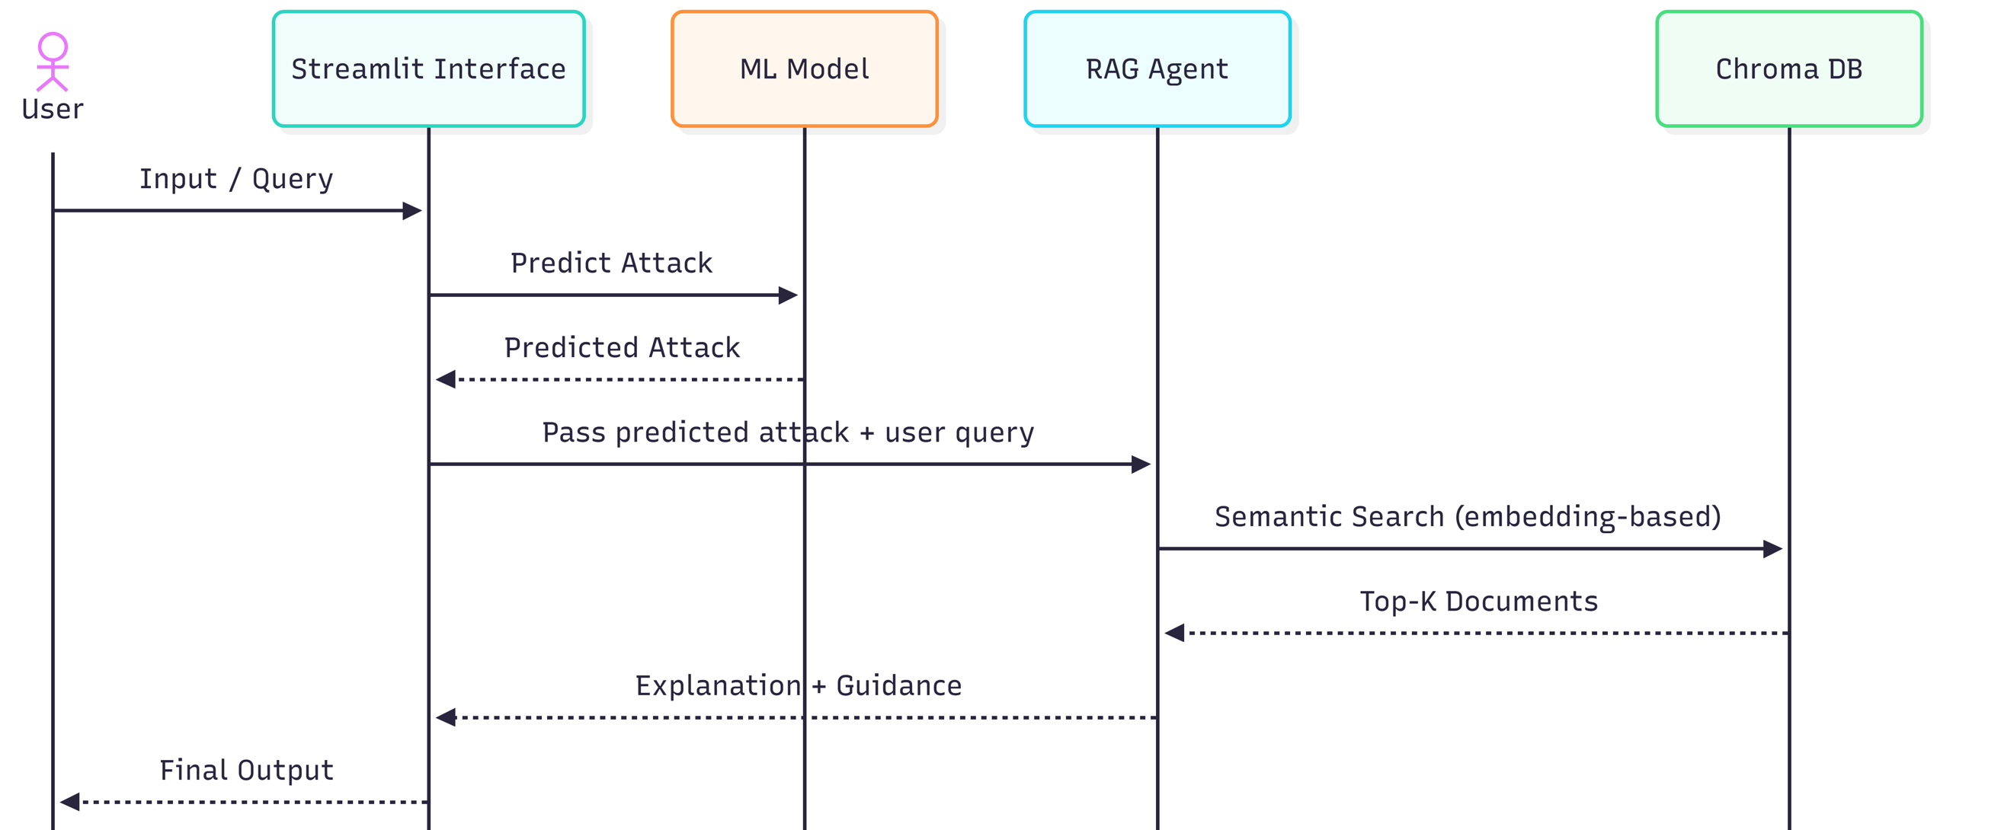
System Sequence Diagram – Network Sentinel (RAG-based Intrusion Detection)
Illustrates interaction between UI, ML model, RAG agent, and vector database for attack detection and explanation

Slide 11
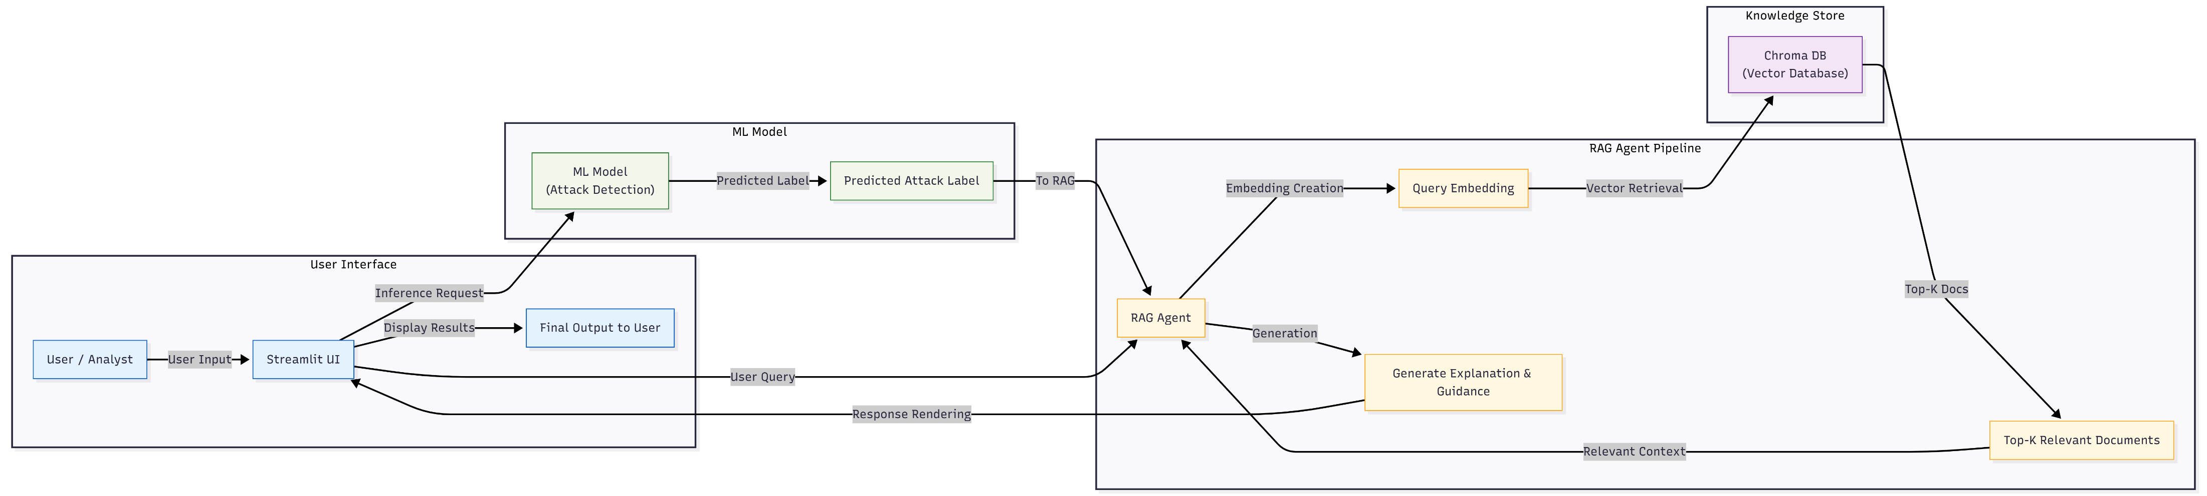
System Workflow
Key Components:
ML Model - Attack Detection
RAG Agent - Contextual reasoning
Chroma DB - Knowledge storage
Streamlit - User interface

Slide 12
CODE BASE STRUCTURE
Modular & Scalable
Network-Sentinel/
│── app.py
│── data/
│ ├── raw/
│ └── processed/
│── models/
│ ├── model.pkl
│ ├── scaler.pkl
│ ├── label_encoder.pkl
│ └── feature_columns.pkl
│── rag/
│ ├── knowledge_base.py
│ └── retriever.py
│── src/
│ ├── data/
│ │ ├── loader.py
│ │ └── preprocessing.py
│ ├── models/
│ │ ├── train.py
│ │ └── predict.py
│ ├── agent/
│ │ ├── incident_agent.py
│ │ └── llm_agent.py
│ └── utils/
│ └── logger.py
│── logs/
│── README.md

Slide 13
WORKFLOW & INTELLIGENCE LAYER
From Upload to Intelligent Output
Upload CSV
Analyst uploads raw network traffic file via the Streamlit interface
Predict Attack
XGBoost classifies each row — attack type, confidence score, and severity level
Retrieve Context
ChromaDB performs semantic search to pull relevant threat documentation
Generate Explanation
LLM synthesizes prediction + retrieved context into a plain-language incident summary
Display Results
Dashboard surfaces attack details, explanation, and prioritized mitigation steps

Slide 14
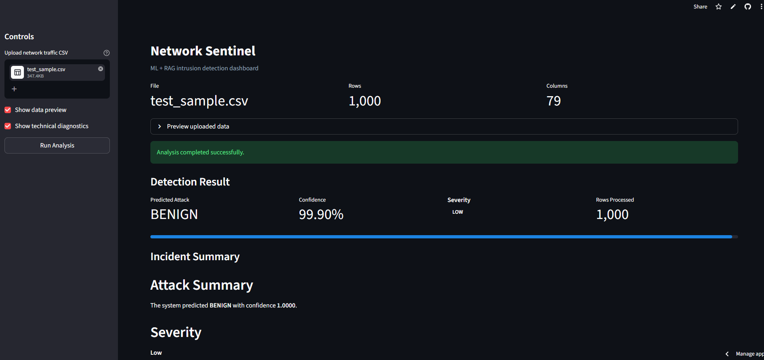
App Interface

Slide 15
RESULTS & KEY INSIGHTS
Performance That Earns Trust
99.97%
0.9965
0.0019
Test Accuracy
CV Mean Score
CV Std Deviation
XGBoost on held-out CICIDS data
Averaged across 5 stratified folds
Near-zero variance, highly stable
Tree-Based Models Dominate
RAG Elevates Usability
Modular Design Scales
Non-linear architectures (RF, XGBoost) dramatically outperform Logistic Regression on complex, high-dimensional network traffic data.
Contextual retrieval transforms raw predictions into analyst-ready intelligence — reducing time-to-action without requiring expert interpretation.
Each system layer (ML, RAG, LLM) can be independently upgraded — enabling integration of new models or knowledge bases without full system rework.

Slide 16
LIMITATIONS & FUTURE WORK
Current Limitations
Future Improvements
Limited knowledge base - RAG retrieval constrained by curated threat documents only
No full distribution analysis - class imbalance effects not fully characterized
Accuracy-focused evaluation - F1-score, precision, and recall not yet reported
Static pipeline - no real-time streaming or live PCAP ingestion
1
Confusion Matrix & F1-Score
Add per-class metrics to surface edge cases and minority-class detection quality
2
Analyst Query Interface
Allow analysts to ask natural language questions about detected incidents
3
Downloadable Reports
Export structured incident summaries as PDF or JSON for SOC workflow integration

Slide 17
Thank you

