Slide 1
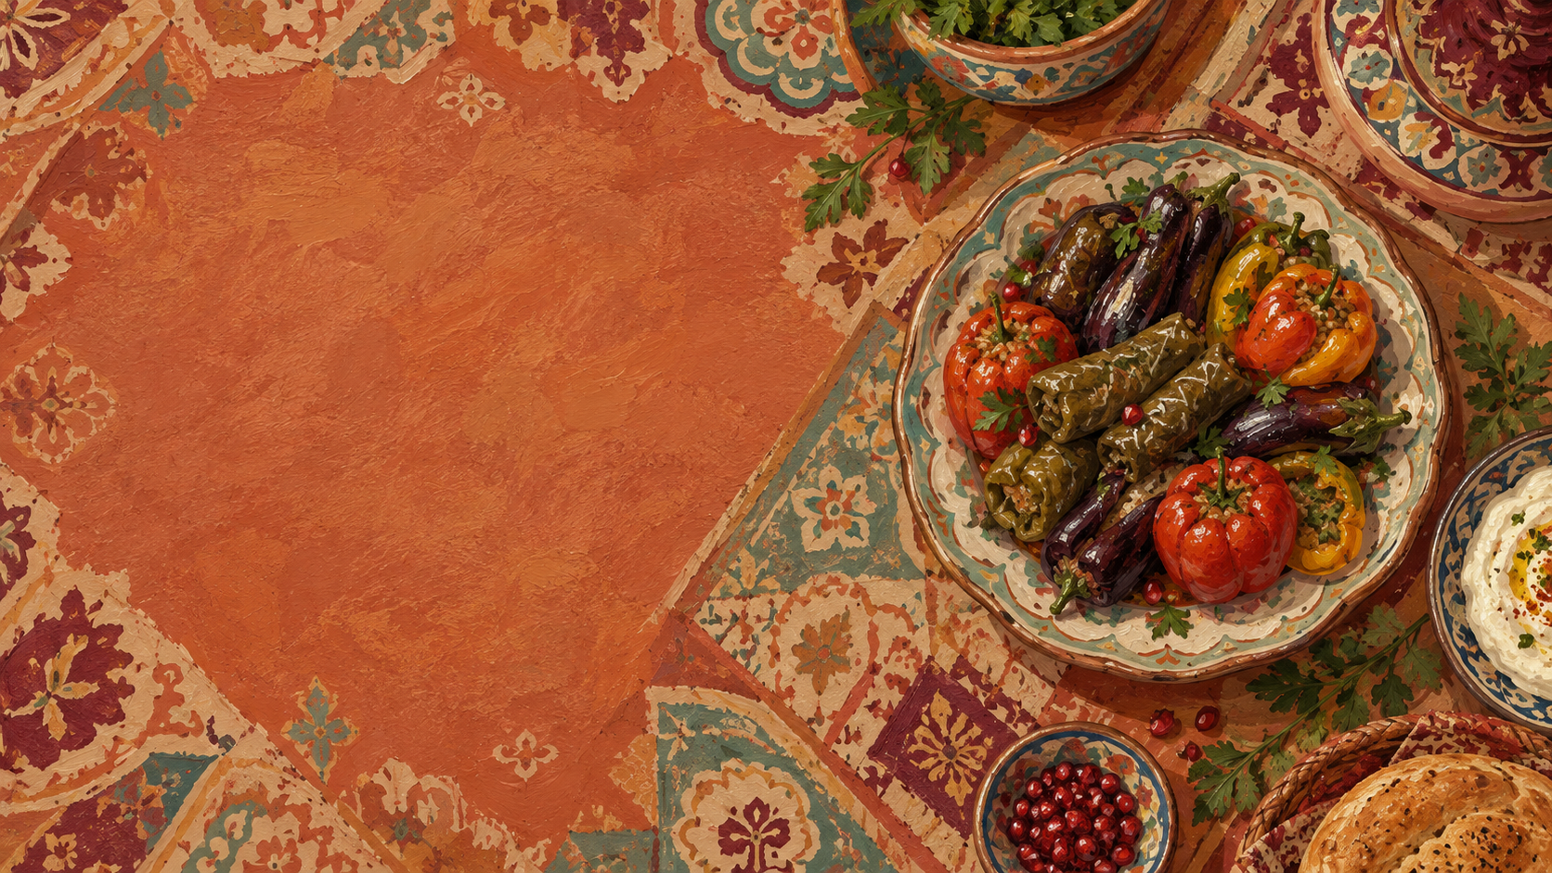
AZERBAIJANI CUISINE
My Favourite Food:
Üç Bacı Dolması
A simple introduction to Azerbaijani cuisine through one traditional stuffed-vegetable dish.
Murad Rahimov
587-R1
Notes:
Introduce the dish as a personal favourite. Say that it gives us a simple way to enter Azerbaijani food culture.

Slide 2



Fresh and varied
Regional character
Shared at home
THE FOOD AROUND THE DISH
Meals connect with family, hospitality and celebrations.
Vegetables, herbs, rice, meat, dairy products and spices all have a place.
Recipes change because climate and local farming are different.
Azerbaijani Cuisine Is Rich and Regional
The same ingredients can tell different stories in different parts of the country.
Notes:
Use the three tiles to show that cuisine is more than a list of ingredients. It also reflects place, agriculture and social life.

Slide 3
A CUISINE WITH MANY ROOTS
Food History Comes from Many Influences
Azerbaijan lies between Europe and Asia, so its food has developed through contact between different cultures.
Traditional cooking grew from local agriculture, seasonal products and family recipes.
Food was cooked slowly in pots and shared at weddings, holidays and family gatherings.
Local products and contact between Europe and Asia helped shape the food people cook and share.
Notes:
Point to the centre of the visual: Azerbaijan sits between Europe and Asia. Then connect the wider influences to local agriculture, seasonal products and family recipes.

Slide 4
THE WORD BEHIND THE DISH
Dolma Means “Stuffed”
Many forms, many fillings
Ways to make dolma
The filling may include
The word comes from the Turkic word “doldurma”, meaning “stuffed”.
It can be made with grape leaves or vegetables.
Meat, onion, rice and spices.
In Azerbaijan, dolma is a central culinary tradition and was added to UNESCO’s Intangible Cultural Heritage list in 2017.
Notes:
Explain the word first, then show how broad the dish family is. Dolma may use leaves, vegetables or fruit, with different fillings.

Slide 5
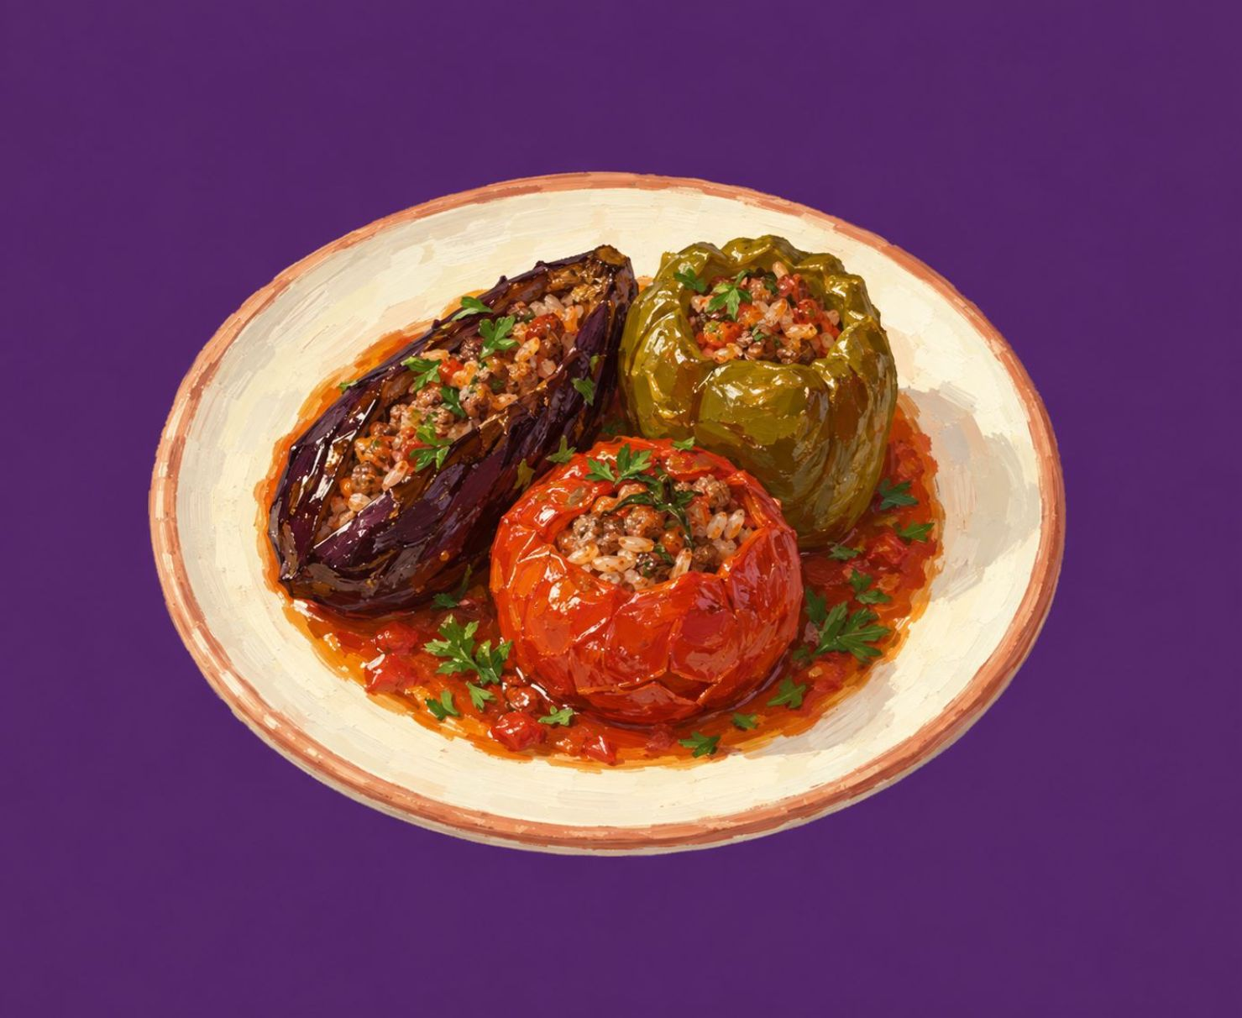
ONE NAME, THREE VEGETABLES
Üç Bacı Dolması: Three Vegetables, One Dish
1
2
Three sisters
One shared filling
“Üç bacı” means “three sisters”. It usually combines eggplant, tomato and bell pepper.
They are filled with a seasoned mixture, often including minced meat, onion, herbs and rice. Their flavours mix as they cook together.
Notes:
Introduce the name as a memorable image: three vegetables sharing one dish. Point out that the filling can vary, but the vegetables cook together.

Slide 6
FROM PREPARATION TO PLATE
How It Is Prepared
1
2
3
4
Wash
Mix
Fill
Cook
Wash the vegetables and make space for the filling.
Prepare meat or vegetables with onion, herbs, rice and spices.
Fill the eggplant, tomato and pepper.
Cook slowly until soft and full of flavour.
The exact recipe can change from family to family.
Notes:
Move through the four stages from left to right. Emphasize that slow cooking brings the vegetables and filling together, while families may change the exact recipe.

