Slide 1

Project
Foodie.com

Slide 2

TEAM:
1.Harshal
2.Theeksha
3.Murali

Slide 3

Privileges:
By using an online food ordering system, you give your clients the flexibility to place and convenient time the orders.
These platforms also supports small and Local restaurants to reach a wider customer base. By ordering through these platforms you are also providing a direct support to these restaurants.

Slide 4






CONTENT
1. Introduction
2.Features
3.Technologies
4.Architecture
5.Future Scope

Slide 5
Introduction:
The project “FoodieApp” is a food application with dynamic website inspired by Zomato & Swiggy, The popular food discovery and delivery platform. Our website focuses on revolutionizing the way users explore and order food online
Our main focus is to provide our customer with healthy, hygienic and tasty food. Even our moto is “Your tasty, hot, and hygienic food is just one click away.”
Our Platform facilitates two types of User i.e. Vendor and Customer.

Slide 6
Features:
We have tried to provide most of the essential functionalities to our customers and Vendor.
Customer:
Customer can search Restaurants by Cuisine and Location.
Customer can Order multiple Food items from multiple restaurants.
Customer can add items to his Cart.
Customer can also view his orders.
Vendor:
Vendor can Add Restaurants in the database.
Vendor can Add Item/Cuisines In his Restaurant.

Slide 7
Architecture:
Eureka Server
Services get registered on Eureka
MYSQL
API
G
A
T
E
W
A
Y
Login
User Auth Service
/login
Feign Client
Client
/crud
Register
MONGO
DB
Customer Service
/register
Client Requests through controller
search/add
Restaurant Service

Slide 8
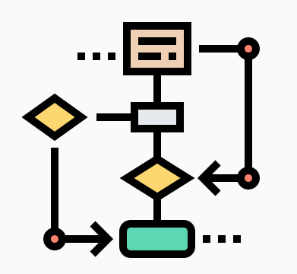
WorkFlow:
Add Item/Cuisine to Restaurant
Vendor
Role
Add Restaurants
Vendor
User
login
User
View Cuisines/Restaurants
Add Items to Cart
View Orders
Registration Page

Slide 9
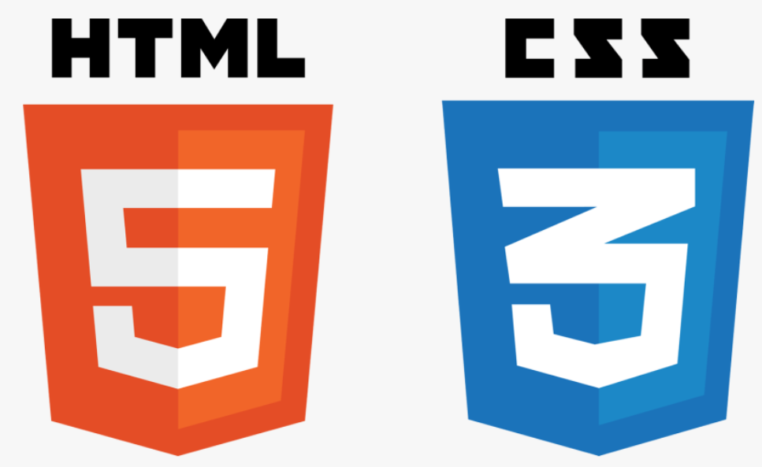







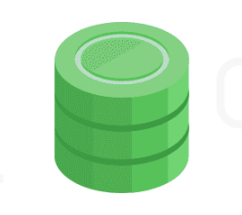


Technologies Used:
JavaScript
TypeScript
Angular
Spring Boot
Spring Data JPA

Slide 10
TECHNOLOGIES USED IN THE FRONTEND:
ANGULAR
HTML & CSS

Slide 11
ANGULAR :
Angular is a development platform, built on TypeScript.
A component-based framework for building scalable web applications.
Its primary purpose is to develop Single-Page Applications(SPA’s).
Angular is cross-platform and compatible with multiple browsers.

Slide 12
HTML & CSS:
HTML (Hypertext Markup Language) is the code that is used to structure a web page and its content.
HTML is necessary to build, manage or improve websites.
CSS is a computer language for laying out and structuring web pages (HTML or XML).
CSS is used to define styles for your web pages, including the design, layout and variations in display for different devices and screen sizes.

Slide 13




FUNCTIONALITIES USED IN THE BACKEND SPRINGBOOT PROJECT:
Eureka Server
2. API Gateway
3. JWT for Authentication
4. Feign Client

Slide 14
EUREKA :
Eureka Server is also known as Discovery Server.
Eureka server acts as a Registry where all the microservices are registered.
The registered services can be discovered by other registered microservices for effective communication between them.

Slide 15
API GATEWAY SERVICE:
An API Gateway is a server that is the single entry point into the system.
We have used Spring Cloud’s API Gateway Service.
It is a tool that sits between Client and a collection of Backend Services.

Slide 16
JWT FOR AUTHENTICATION:
It is a standard for token-based authentication.
It uses the HMAC SHA-256 signing algorithm .
We have implemented JWT for authentication of user in our project.

Slide 17
FEIGN CLIENT:
Synchronous communication between microservices is possible by using Feign Client.
In this approach the calling service will wait until the caller service responds.
In Synchronous communication , a chain of requests is created between the microservices while serving the client request.

Slide 18

DATABASES USED :
MySQL
MongoDB

Slide 19
MYSQL:
MySQL is an open-source Relational Database Management System (RDBMS).
It is one of the most popular open source RDBMS.
A Relational Database stores Data in seperate tables rather than putting all the data in one big store room.
It is developed, distributed, and supported by Oracle Corporation.

Slide 20
MONGODB:
MongoDB is an object-oriented, simple, dynamic, and scalable NoSQL database.
MongoDB is highly flexible and enables us to combine and store multiple type of data.
It is mainly used for the storage of Unstructured and semi-structured data.
Schema less − MongoDB is a document database in which one collection holds different documents.
Number of fields, content and size of the document can differ from one document to another.

Slide 21
FUTURE ENHANCEMENTS :
In the coming version of this application we are trying to implement the feed back section from the customers.
We are also planning to improve the cart experience in the future.
To deliver in a more accurate way we are thinking to implement maps in our application in our updated version.

Slide 22


