Slide 1
Social Topic Distributions
Hakan Akyürek
Mürüvvet Hasanbaşoğlu
May 04, 2020

Slide 2
Overview
Project Goal
Outcomes
Methodology
Evaluation
Next Tasks - for the next 2 weeks
<number>

Slide 3
1. Project Goal: What are we going to do?
Topic Modeling: aims to extract topics/clusters from a corpus of texts.
<number>

Slide 4




1. Project Goal: What are we going to do?
Topic Modeling: aims to extract topics/clusters from a corpus of texts.
Derive social topic distributions of:
1- news and social media articles
2- social media users
using their word or sentence vector representations.
<number>

Slide 5
1. Project Goal: What are we going to do?
Topic Modeling: aims to extract topics/clusters from a corpus of texts.
Derive social topic distributions of:
1- news and social media articles
2- social media users
using their word or sentence vector representations.
Analyze the topic distributions of different sets of articles and users
<number>

Slide 6

2. Outcomes: What will we analyze?
Analyze if news articles attract the users who have similar topics of interest
Analyze if relevant users have more similar topic distributions compared to the random users
Repeat and report the analysis among different news and social media resources
<number>

Slide 7
2. Outcomes: What will we analyze?
Analyze if news articles attract the users who have similar topics of interest
Analyze if relevant users have more similar topic distributions compared to the random users
Repeat and report the analysis among different news and social media resources
Additionally:
Group individual social media users that have similar topics of interest
Group social media and news articles that have similar topics of interest
<number>

Slide 8
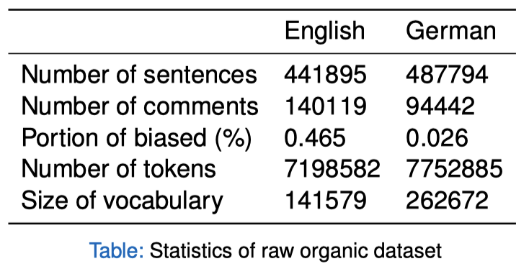
3. Methodology: How are we going to do it?
Raw Organic Dataset:
Forums, blogs, news sites, social media
Biased : more strict opinions towards organic food
Unbiased : less strict opinions towards organic food
<number>

Slide 9
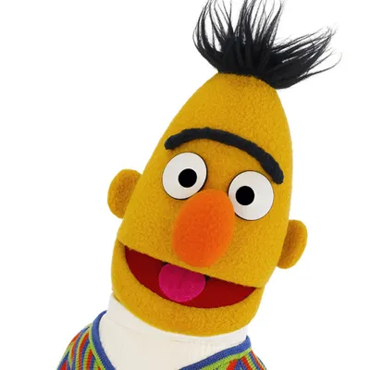
3. Methodology: How are we going to do it?
Raw Organic Dataset:
Forums, blogs, news sites, social media
Biased : more strict opinions towards organic food
Unbiased : less strict opinions towards organic food
Features:
Fine-tune the language model from BERT/GloVe on the whole dataset
Word and sentence embeddings
<number>

Slide 10
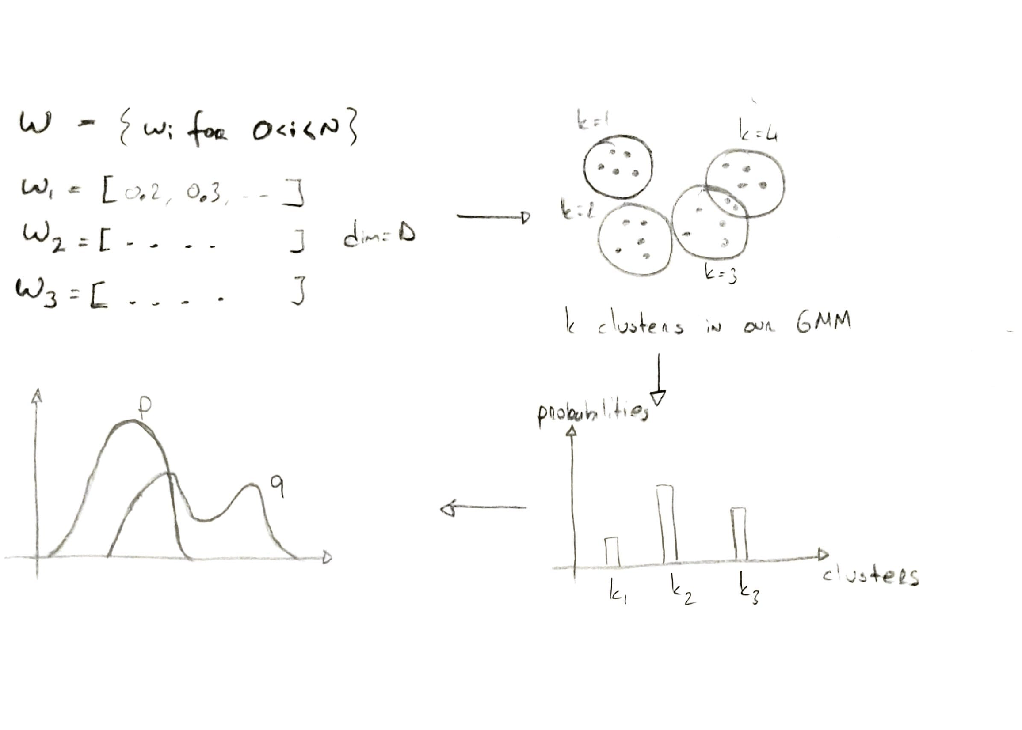
3. Methodology: How are we going to do it?
Classifier: Gaussian Mixture Model
<number>

Slide 11
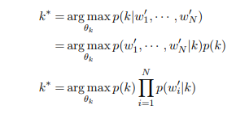
3. Methodology: How are we going to do it?
Histogram Generation:
Calculate the probability that an article is about topic k
We are able to get necessary probabilities from our GMM model

Slide 12
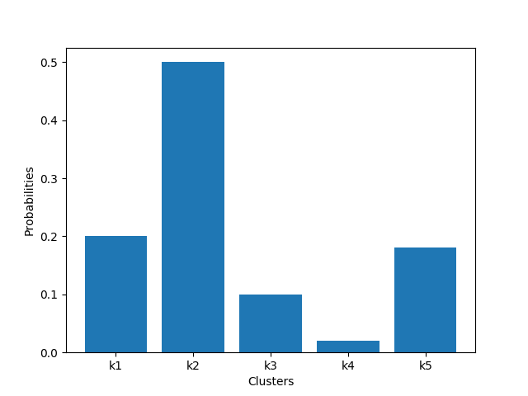
3. Methodology: How are we going to do it?
Histogram Generation:
Calculate the probability that an article is about topic k
We are able to get necessary probabilities from our GMM model
Generate a histogram

Slide 13
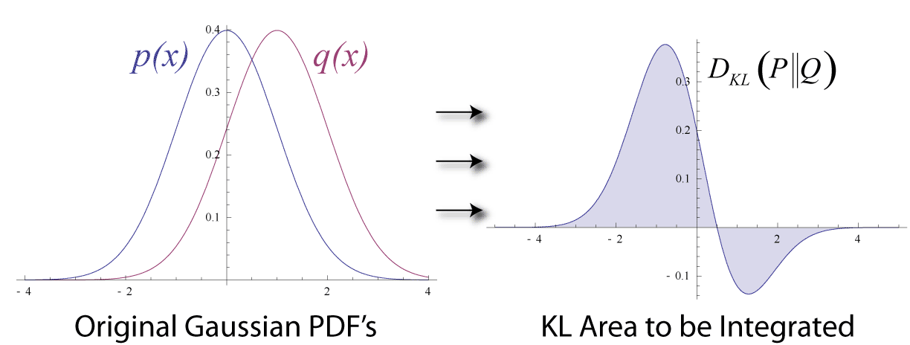
4. Evaluation: How are we going to measure our results?
Performance metrics:
Jensen Shannon or KL divergence to calculate similarity between distributions
How similar are p and q distributions?
In our case p would be an article and q, one of it’s comments.
<number>

Slide 14
5. Next Tasks:
Set up Colab environment
Prepare the dataset:
cleaning
preprocessing
create random user dataset
Get the vector representations for our data
Further reading about the task
<number>

Slide 15
References
Document Classification with Distributions of Word Vectors
Unsupervised Topic Modeling for Short Texts Using Distributed Representations of Words
<number>

