Slide 1
Social Topic Distributions
Hakan Akyürek
Mürüvvet Hasanbaşoğlu
May 18, 2020

Slide 2
Overview
Data structure
Preprocessing
Statistics of the dataset
Fine-tuning GloVe Embeddings
Next Tasks - for the next 2 weeks
‹#›

Slide 3
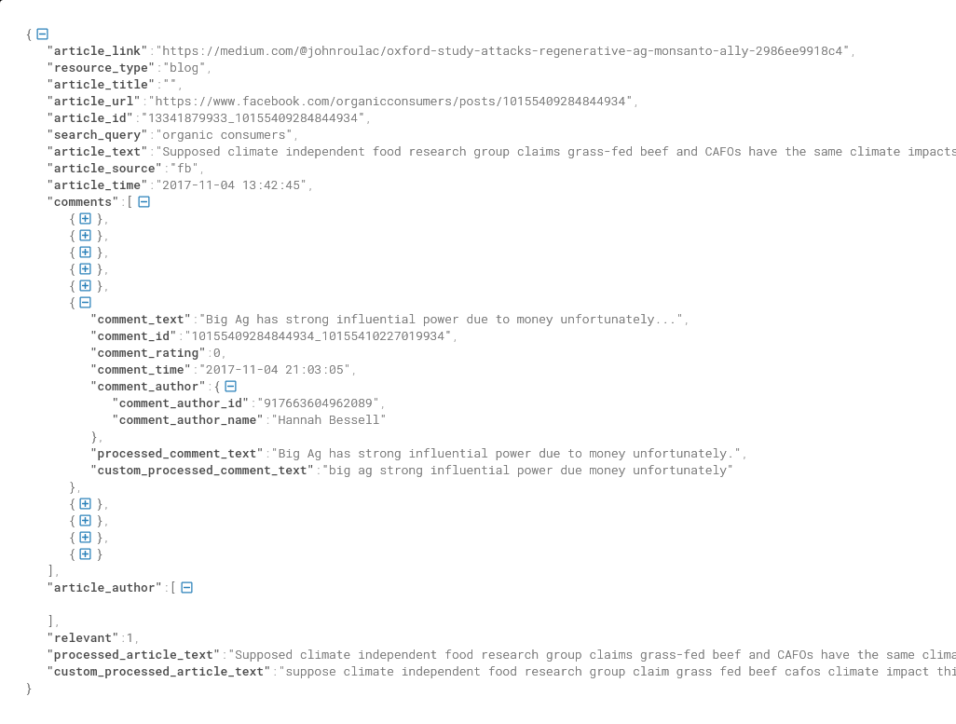
1. Data Structure
Json files that contain some number of articles from a social media website
A number of comments for each article
Relevance flag: 1 or 0
‹#›

Slide 4
2. Preprocessing
Spelling Corrections(it cannot detect all of the spelling errors)
Contractions(can’t ---> cannot)
Language Curation
There are Hindi and English comments(though most of hindi ones are removed)
Some social terms are replaced(btw ---> by the way)
‹#›

Slide 5
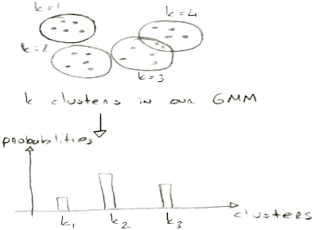
2. Preprocessing
Lemmatization
Stopword and punctuation removal
2 main ideas:
Syntactic and semantic features aren’t musts for us.
No topic labeling -- Probability distributions
Reducing the vocabulary size, more specifically oov words.
‹#›

Slide 6
3. Statistics of the datasets
Raw Organic Dataset:
Quora has balanced
user distribution
4 datasets without comments
1 dataset without article
Data set |  |  | # of articles | # of articles with comments | # of answering user comments | # of all user comments
Biased |  | Facebook | 5,013 | 4,705 | 298,996 | 299,126
 |  | Food Babe | 15 | 15 | 3,944 | 3,944
 |  | Food Revolution | 78 | 60 | 2,966 | 2,966
 |  | Organic Authority | 66 | 0 | 0 | 0
 |  | Organic Consumers | 64 | 0 | 0 | 0
Unbiased | Forum | Cafe Mom | 86 | 85 | 1,962 | 1,983
 |  | Disqus | 36 | 36 | 6,150 | 7,984
 |  | Quora | 567 | 523 | 4,196 | 9,591
 |  | Reddit | 81 | 78 | 2,371 | 9,291
 |  | US Message Board | 0 | 0 | 0 | 78,044
 | News sites | Chicago Tribune | 2,283 | 78 | 281 | 281
 |  | Huffington Post | 880 | 0 | 0 | 0
 |  | LA Times | 1,522 | 77 | 374 | 374
 |  | NY Post | 106 | 0 | 0 | 0
 |  | NY Times | 438 | 137 | 16,128 | 16,128
 |  | USA Today | 95 | 22 | 259 | 259
 |  | Washington Post | 1,563 | 943 | 84,669 | 84,669
‹#›

Slide 7
3. Statistics of the datasets
Raw Organic Dataset:
Quora has balanced user distribution
4 datasets without comments
1 dataset without article
Spiegel is in German
Data set |  |  | # of articles | # of articles with comments | # of answering user comments | # of all user comments
Biased |  | Facebook | 5,013 | 4,705 | 298,996 | 299,126
 |  | Food Babe | 15 | 15 | 3,944 | 3,944
 |  | Food Revolution | 78 | 60 | 2,966 | 2,966
 |  | Organic Authority | 66 | 0 | 0 | 0
 |  | Organic Consumers | 64 | 0 | 0 | 0
Unbiased | Forum | Cafe Mom | 86 | 85 | 1,962 | 1,983
 |  | Disqus | 36 | 36 | 6,150 | 7,984
 |  | Quora | 567 | 523 | 4,196 | 9,591
 |  | Reddit | 81 | 78 | 2,371 | 9,291
 |  | US Message Board | 0 | 0 | 0 | 78,044
 | News sites | Chicago Tribune | 2,283 | 78 | 281 | 281
 |  | Huffington Post | 880 | 0 | 0 | 0
 |  | LA Times | 1,522 | 77 | 374 | 374
 |  | NY Post | 106 | 0 | 0 | 0
 |  | NY Times | 438 | 137 | 16,128 | 16,128
 |  | USA Today | 95 | 22 | 259 | 259
 |  | Washington Post | 1,563 | 943 | 84,669 | 84,669
‹#›

Slide 8
3. Statistics of the datasets
Raw Organic Dataset:
Data sets |  | # of words | Vocabulary size | # of rare words
All datasets |  | 27,902,480 | 881,644 | 549,304
After custom preprocessing | All datasets | 16,807,519 | 226,734 | 119,693
 | Sub-datasets: Facebook, Quora, Reddit, NYTimes | 6,039,245 | 106,579 | 56999
Rare words examples: 'lettuse', 'qoxt3iyqip', 'featherweight', 'cafeviennachicago', 'والخنازير', 'farmhaus'
‹#›

Slide 9
3. Fine-tuning GloVe Embeddings
Available GloVe embeddings:
Data sets |  | # of words | Vocabulary size | # of rare words | Out of Vocabulary size
 |  |  |  |  | Twitter 1.2M | Common Crawl 1.9M | Common Crawl 2.2M
All datasets |  | 27,902,480 | 881,644 | 549,304 | - | - | -
After custom preprocessing | All datasets | 16,807,519 | 226,734 | 119,693 | 142,906 | 82,801 | 109,751
 | Sub-datasets: Facebook, Quora, Reddit, NYTimes | 6,039,245 | 106,579 | 56,999 | 53,232 | 30,585 | 39,195
‹#›

Slide 10
3. Fine-tuning GloVe Embeddings
Available GloVe embeddings:
Common Crawl: 42B tokens, 1.9M vocab, uncased, 300d vectors, 1.75 GB
Data sets |  | # of words | Vocabulary size | # of rare words | Out of Vocabulary size
 |  |  |  |  | Twitter 1.2M | Common Crawl 1.9M | Common Crawl 2.2M
All datasets |  | 27,902,480 | 881,644 | 549,304 | - | - | -
After custom preprocessing | All datasets | 16,807,519 | 226,734 | 119,693 | 142,906 | 82,801 | 109,751
 | Sub-datasets: Facebook, Quora, Reddit, NYTimes | 6,039,245 | 106,579 | 56,999 | 53,232 | 30,585 | 39,195
‹#›

Slide 11
3. Fine-tuning GloVe Embeddings
Available GloVe embeddings:
Common Crawl: 42B tokens, 1.9M vocab, uncased, 300d vectors, 1.75 GB
Data sets |  | # of words | Vocabulary size | # of rare words | Out of Vocabulary size
 |  |  |  |  | Twitter 1.2M | Common Crawl 1.9M | Common Crawl 2.2M
All datasets |  | 27,902,480 | 881,644 | 549,304 | - | - | -
After custom preprocessing | All datasets | 16,807,519 | 226,734 | 119,693 | 142,906 | 82,801 / 16,675 | 109,751
 | Sub-datasets: Facebook, Quora, Reddit, NYTimes | 6,039,245 | 106,579 | 56,999 | 53,232 | 30,585 / 5,777 | 39,195
‹#›

Slide 12

3. Fine-tuning GloVe Embeddings
Fine-tuning:
Load pre-embeddings
Build co-occurrence matrix:
Compute word list and find oov’s
Construct a corpus from the word list
Compute the co-occurrence matrix based on the corpus with batches of oov’s
Train new embeddings using the co-occurrence matrix, pre-embeddings and oov’s
‹#›

Slide 13
3. Next Tasks
Figure out how to connect to the docker container
Probably rerun the fine-tuning based on the feedback
Train our GMM model
Get probability distributions for each article and comments
‹#›

Slide 14
References
Pennington, Jeffrey, Richard Socher, and Christopher D. Manning. "Glove: Global vectors for word representation." Proceedings of the 2014 conference on empirical methods in natural language processing (EMNLP). 2014.
Fine tune GloVe embeddings using Mittens
roamanalytics/mittens: A fast implementation of GloVe, with optional retrofitting
‹#›

Slide 15
Questions
General:
As a preprocessing step, does it make sense to remove the rare words in the entire dataset?
When constructing the co-occurrence matrix, should we specify the corpus per dataset? Would this produce more sensible embeddings?
Is it relevant for us for the moment to consider ‘relevant’ ‘irrelevant’ information of articles?
Team Specific:
If random users are all users, then it includes also the relevant users. How do we define the random users?
Should all users and relevant users be from the same dataset?
Any idea why we get connection error on VPN when trying to connect to docker container?
Distribution graph can be observed for:
all comments of a given user among different articles
all users(random users)
answering users(relevant users)
‹#›

