Slide 1
Social Topic Distributions
Hakan Akyürek
Mürüvvet Hasanbaşoğlu
June 2, 2020

Slide 2
Overview
Finalize pre-processing
Finalize fine-tuning GloVe Embeddings
Train GMM
Calculating Probability Distributions
Next Tasks - for the next 2 weeks
‹#›

Slide 3
1. Finalize pre-processing
Tokenization
r"[a-zA-Z0-9]+|\.|\?|\!"
Lowercase
Stop word removal
List taken from nltk.corpus
Rare word removal (<=2)
No lemmatization
“Here's something quite similar from Berkley:. http://newscenter.berkeley.edu/2014/12/09/organic-conventional-farming-yield-gap/”
“Here s something quite similar from Berkley . http newscenter . berkeley . edu 2014 12 09 organic conventional farming yield gap”
“here something quite similar berkley . http newscenter . berkeley . edu 2014 12 09 organic conventional farming yield gap”
 | Tokens | Vocabulary
Processed | 27M | 220,518
Custom Processed | 19M | 88,119
‹#›

Slide 4
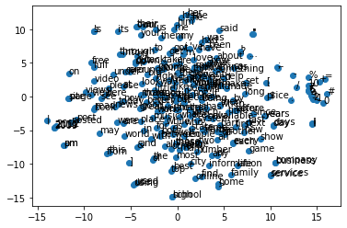
2. Finalize fine-tuning GloVe Embeddings
Common Crawl pre-trained word vectors
42B tokens
1.9M vocab
uncased
300d vectors
Out-of-Vocabulary size: 7013 -> fine-tuned
Size of word embeddings: 1,924,507
First 250 word embeddings into 2d
‹#›

Slide 5
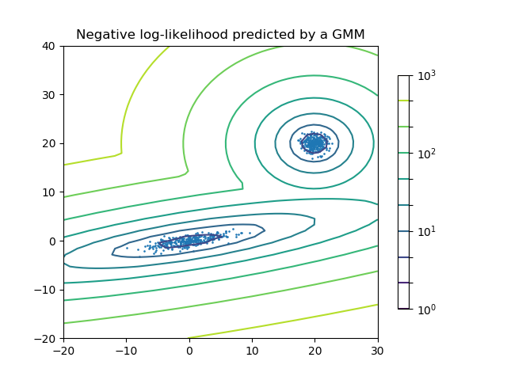
3. Train GMM
Gaussian Mixture models from sklearn
implements the expectation-maximization
algorithm for fitting mixture-of-Gaussian models
Bayesian Information Criterion (BIC)
in order to select the number of clusters
‹#›

Slide 6
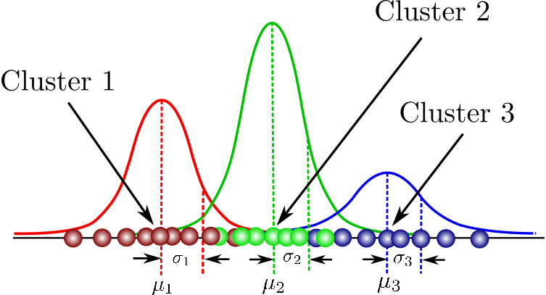


3. Train GMM
Expectation Maximization:
Initialize random clusters by mean (μ),
covariance (Σ) and mixing probability (π)
For each data point, compute a probability
of being generated by each cluster
Adjust the parameters in order to maximize
the likelihood of the data - iteratively
‹#›

Slide 7
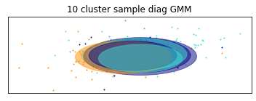
3. Train GMM
GaussianMixture(covariance_type='diag', init_params='kmeans', max_iter=100,
means_init=None, n_components=10, n_init=1,
precisions_init=None, random_state=None, reg_covar=1e-06,
tol=0.001, verbose=2, verbose_interval=1, warm_start=False,
weights_init=None)
Covariance Types:
Full: Each cluster has it’s own covariance matrix
Tied: All clusters share the same covariance matrix
Diagonal: Each cluster has its own diagonal covariance matrix
Spherical: Each cluster has a single variance
Initializing cluster means are done by k-means algorithm before the EM algorithm.
‹#›

Slide 8
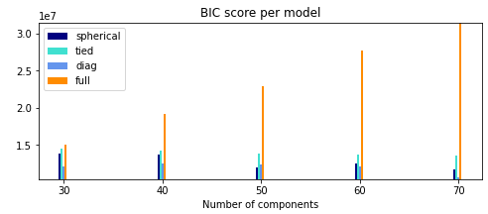
3. Train GMM
While training we used the vocabulary instead of the whole words.
It doesn’t make sense to use duplicate data points while training a GMM.
It makes easier for k-means to converge.
We trained about 20 models in total and took the one with lowes Bayesian Information Criterion(BIC).
The best model we found has 70 clusters and the covariance type for that model is diagonal.
‹#›

Slide 9
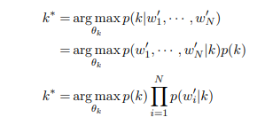
4. Calculating Probability Distributions
We aren’t able to get the likelihoods we want: p(x|k_{n}).
Instead we can directly get posterior probabilities: P(k_{n}|x).
‹#›

Slide 10
5. Next Tasks
Define datasets to perform experiments: answering users, random users
Implement Jensen-Shannon distance computation
Implement topic labeling
‹#›

Slide 11
References
Pennington, Jeffrey, Richard Socher, and Christopher D. Manning. "Glove: Global vectors for word representation." Proceedings of the 2014 conference on empirical methods in natural language processing (EMNLP). 2014.
Fine tune GloVe embeddings using Mittens
roamanalytics/mittens: A fast implementation of GloVe, with optional retrofitting
https://medium.com/analytics-vidhya/basics-of-using-pre-trained-glove-vectors-in-python-d38905f356db
https://scikit-learn.org/stable/modules/mixture.html
‹#›

Slide 12
Questions
‹#›

