Slide 1
Social Topic Distributions
Hakan Akyürek
Mürüvvet Hasanbaşoğlu
June 2, 2020

Slide 2
Overview
Cluster labeling
Some more GMM training
Jensen Shannon Distance
Next Tasks - for the next 2 weeks
‹#›

Slide 3
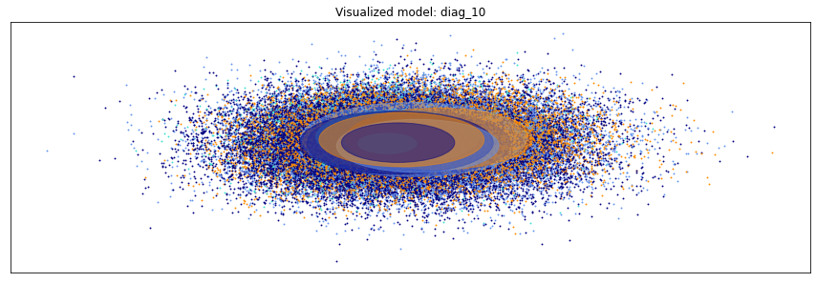
1. Cluster Labeling
Gaussians in the model overlap... a lot.
Some words are close to huge number of the gaussian centroids.
Empty strings exist in the dataset.
It’s embedding is really close to zero point.
No meaningful labeling!
<empty-string>, trumpster, illuminati
<empty-string>, illuminati, malta
<empty-string>, trumpster, blasting
‹#›

Slide 4
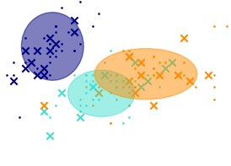
1. Cluster Labeling
Cluster labeling done in two steps:
Predict a label for each of the words in the vocabulary.
For each gaussian check the closest words that were labeled that gaussian’s centroid.
Do not check all data points in the space for each gaussian.
Some examples of labeled clusters:
multicolored, peacock, adorn, jewels
dimwits, simpletons, interlopers
racoon, hedgehogs, squirrel
haha, lol, lolol, anyhoo, ahaha
‹#›

Slide 5
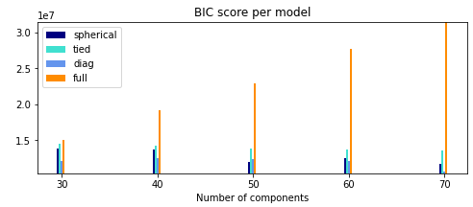
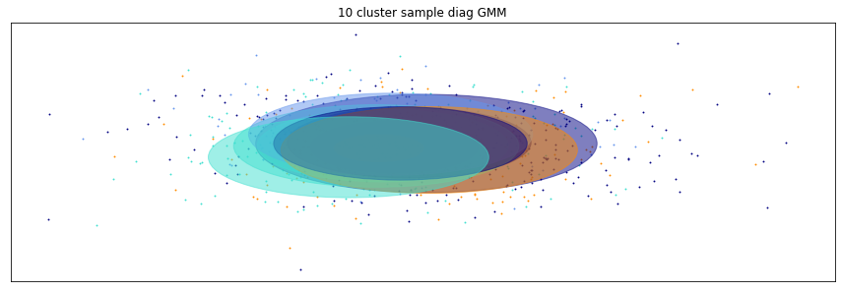
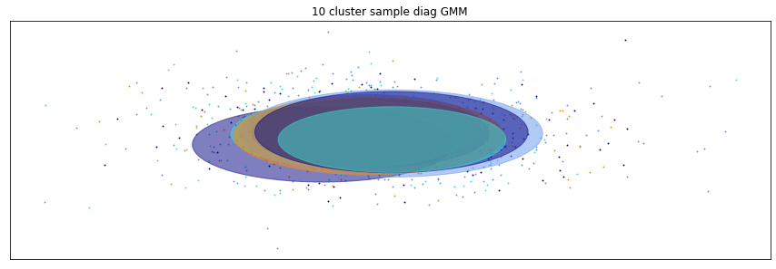
2. Some more GMM training
In last sprint:
covariance types = ‘spherical’, ‘full’, ‘diag’, ‘tied’
n_components range: 30, 40, … , 70
Selected ‘diag’ covariance type but what is the
right n_component actually?
Same model fit with the same data but produced different distributions:
More automated method for finding the right n_components!
‹#›

Slide 6
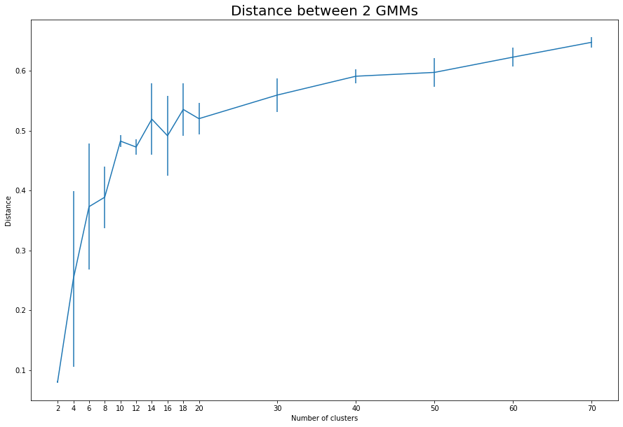
2. Some more GMM training
n_components range: 2, 4, 6, …, 18, 20, 30, …, 70
Fit models 10 times with same configuration per component
Select the best 5 out of 10
GMMs distance check per cluster with random data
for n_component in n_components_range:
dist = []
for iteration in range(iterations):
data_1, data_2 = train_test_split(X, test_size=0.5)
gmm_1 = GaussianMixture(n_components=n_component,
covariance_type='diag',
init_params='kmeans',
verbose=1).fit(data_1)
gmm_2 = GaussianMixture(n_components=n_component,
covariance_type='diag',
init_params='kmeans',
verbose=1).fit(data_2)
dist.append(gmm_js(gmm_1, gmm_2))
select = SelBest(np.array(dist), int(iterations/2))
results.append(np.mean(select))
res_sigs.append(np.std(select))
‹#›

Slide 7
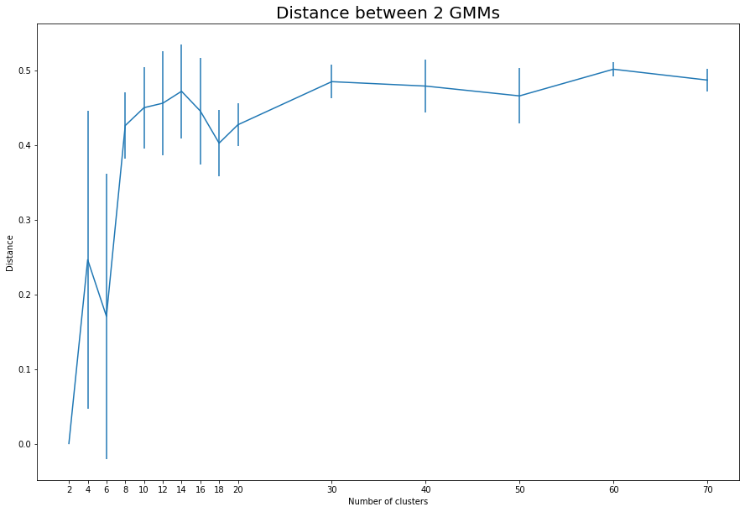
2. Some more GMM training
n_components range: 2, 4, 6, …, 18, 20, 30, …, 70
Fit models 10 times with same configuration per component
Select the best 5 out of 10
GMMs distance check per cluster with same data
for n_component in n_components_range:
dist = []
for iteration in range(iterations):
gmm_1 = GaussianMixture(n_components=n_component,
covariance_type='diag',
init_params='kmeans').fit(X)
gmm_2 = GaussianMixture(n_components=n_component,
covariance_type='diag',
init_params='kmeans').fit(X)
dist.append(gmm_js(gmm_1, gmm_2))
select = SelBest(np.array(dist), int(iterations/2))
results.append(np.mean(select))
res_sigs.append(np.std(select))
‹#›

Slide 8
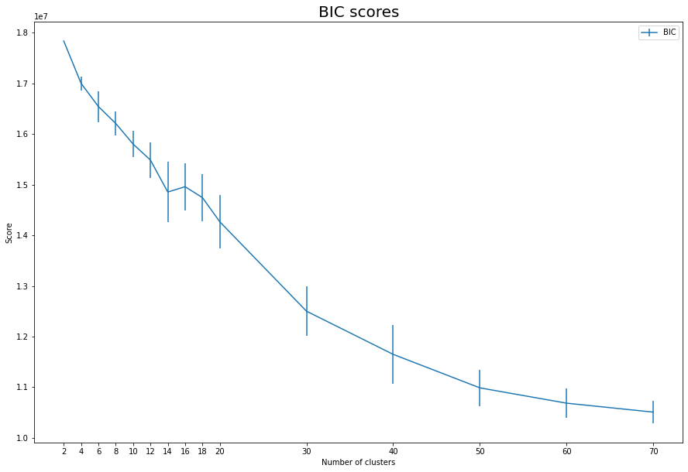
2. Some more GMM training
n_components range: 2, 4, 6, …, 18, 20, 30, …, 70
Fit models 10 times with same configuration per component
Select the best 5 out of 10
BIC score
for n_component in n_components_range:
tmp_bic = []
for iteration in range(iterations):
gmm = GaussianMixture(n_components=n_component,
covariance_type='diag',
init_params='kmeans',
n_init=2).fit(X)
tmp_bic.append(gmm.bic(X))
val = np.mean(SelBest(np.array(tmp_bic), int(iterations/2)))
err = np.std(tmp_bic)
bics.apped(val)
bics_err.append(err)
‹#›

Slide 9
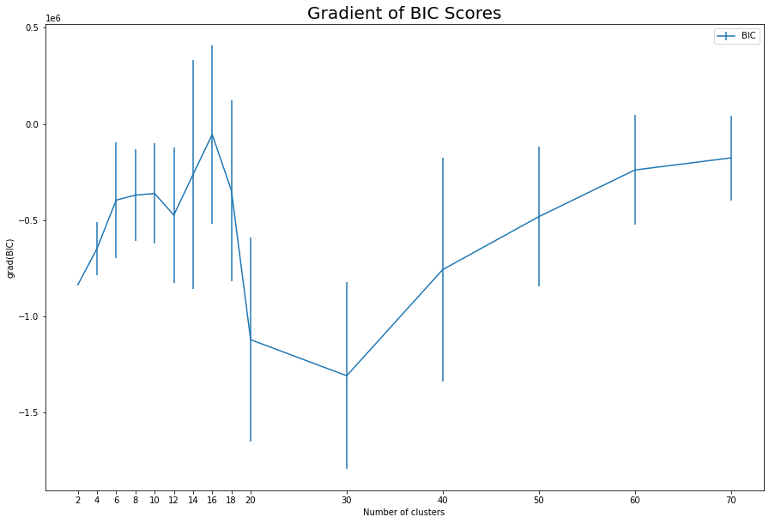
2. Some more GMM training
n_components range: 2, 4, 6, …, 18, 20, 30, …, 70
Fit models 10 times with same configuration per component
Select the best 5 out of 10
BIC score
for n_component in n_components_range:
tmp_bic = []
for iteration in range(iterations):
gmm = GaussianMixture(n_components=n_component,
covariance_type='diag',
init_params='kmeans',
n_init=2).fit(X)
tmp_bic.append(gmm.bic(X))
val = np.mean(SelBest(np.array(tmp_bic), int(iterations/2)))
err = np.std(tmp_bic)
bics.apped(val)
bics_err.append(err)
‹#›

Slide 10

3. Jensen Shannon Distance
Compute text probabilities from word probabilities
JSDistance = sqrt(JSDivergence)
Select:
1 article from Quora dataset
20 answering user comments
20 random user comments
 |  | Diag - 20 | Diag - 70
Answering User | mean | 0.300 | 0.445
 | stddev | 0.075 | 0.079
Random User | mean | 0.327 | 0.469
 | stddev | 0.056 | 0.057
‹#›

Slide 11
4. Next Tasks
Start experiments on different sets of datasets
‹#›

Slide 12
References
Pennington, Jeffrey, Richard Socher, and Christopher D. Manning. "Glove: Global vectors for word representation." Proceedings of the 2014 conference on empirical methods in natural language processing (EMNLP). 2014.
Sridhar, Vivek Kumar Rangarajan. "Unsupervised topic modeling for short texts using distributed representations of words." Proceedings of the 1st workshop on vector space modeling for natural language processing. 2015.
Fine tune GloVe embeddings using Mittens
roamanalytics/mittens: A fast implementation of GloVe, with optional retrofitting
https://medium.com/analytics-vidhya/basics-of-using-pre-trained-glove-vectors-in-python-d38905f356db
https://scikit-learn.org/stable/modules/mixture.html
https://towardsdatascience.com/gaussian-mixture-model-clusterization-how-to-select-the-number-of-components-clusters-553bef45f6e4
https://stackoverflow.com/questions/26079881/kl-divergence-of-two-gmms
https://medium.com/@sourcedexter/how-to-find-the-similarity-between-two-probability-distributions-using-python-a7546e90a08d
‹#›

Slide 13
Questions
Different word embeddings - BERT?
Sentence embeddings?
Analysis based on single users or based on social medias?
‹#›

