Slide 1
Social Topic Distributions
Hakan Akyürek
Mürüvvet Hasanbaşoğlu
June 29, 2020

Slide 2
Overview
Sentence embeddings
Sentence preprocessing
Universal Sentence Encoder
Find optimal n_component
Experiments
Experiments where random users are selected from the same dataset
Experiments where random users are selected from other datasets
Analogy Experiments
Next Tasks - for the next 2 weeks
‹#›

Slide 3
1. Sentence Embeddings
Retrieve the sentence vocabulary
Curated organic data = ~2.5M sentences
Sentence preprocessing: remove only punctuation, one word and duplicate sentences and sentences that contain less than 15 characters. ➔ ~1.6M sentences
‹#›
Notes:
warm_start() -> train GM in batches. iterate over the dataset and continue training from where it left in the last iteration

Slide 4
1. Sentence Embeddings
Retrieve the sentence vocabulary
Curated organic data = ~2.5M sentences
Sentence preprocessing: remove only punctuation, one word and duplicate sentences and sentences that contain less than 15 characters. ➔ ~1.6M sentences
Compute sentence embeddings
Universal Sentence Encoder, 512dim
import tensorflow_hub as hub
universal_sentence_encoder = hub.load("https://tfhub.dev/google/universal-sentence-encoder/4")
train_embeddings = np.empty((0, 512), float)
for sentence, _ in sentence_vocabulary.items():
embedding = universal_sentence_encoder([sentence])
embedding = np.array(list(embedding)).astype(float)
train_embeddings = np.append(train_embeddings, embedding, axis=0)
~6h/200k sentence ➔ too long!
Training in sentence batches:
~1min/1000 sentence ➔ 1.6M sentence = 26h39min
‹#›
Notes:
warm_start() -> train GM in batches. iterate over the dataset and continue training from where it left in the last iteration

Slide 5
1. Sentence Embeddings
Retrieve the sentence vocabulary
Curated organic data = ~2.5M sentences
Sentence preprocessing: remove only punctuation, one word and duplicate sentences and sentences that contain less than 15 characters. ➔ ~1.6M sentences
Compute sentence embeddings
Universal Sentence Encoder, 512dim
import tensorflow_hub as hub
universal_sentence_encoder = hub.load("https://tfhub.dev/google/universal-sentence-encoder/4")
train_embeddings = np.empty((0, 512), float)
for sentence, _ in sentence_vocabulary.items():
embedding = universal_sentence_encoder([sentence])
embedding = np.array(list(embedding)).astype(float)
train_embeddings = np.append(train_embeddings, embedding, axis=0)
~6h/200k sentence ➔ too long!
Training in sentence batches:
~1min/1000 sentence ➔ 1.6M sentence = 26h39min ➔ not sure if possible on CoLabs
‹#›
Notes:
warm_start() -> train GM in batches. iterate over the dataset and continue training from where it left in the last iteration

Slide 6
1. Sentence Embeddings
3. Train GMM with all sentences
Problem 1: More non-convergence issues
Problem 2: Ram crashes
Solutions:
➔ Maybe also training in batches using warm_start()
or
➔ fit a random sample and predict all dataset
‹#›
Notes:
warm_start() -> train GM in batches. iterate over the dataset and continue training from where it left in the last iteration

Slide 7
1. Sentence Embeddings
3. Train GMM with all sentences
Problem 1: More non-convergence issues
Problem 2: Ram crashes
Solutions:
➔ Maybe also training in batches using warm_start()
or
➔ fit a random sample and predict all dataset
Stuck in 2nd step !
➔ Select optimal n_component using a randomly selected set of sentences
‹#›
Notes:
warm_start() -> train GM in batches. iterate over the dataset and continue training from where it left in the last iteration

Slide 8
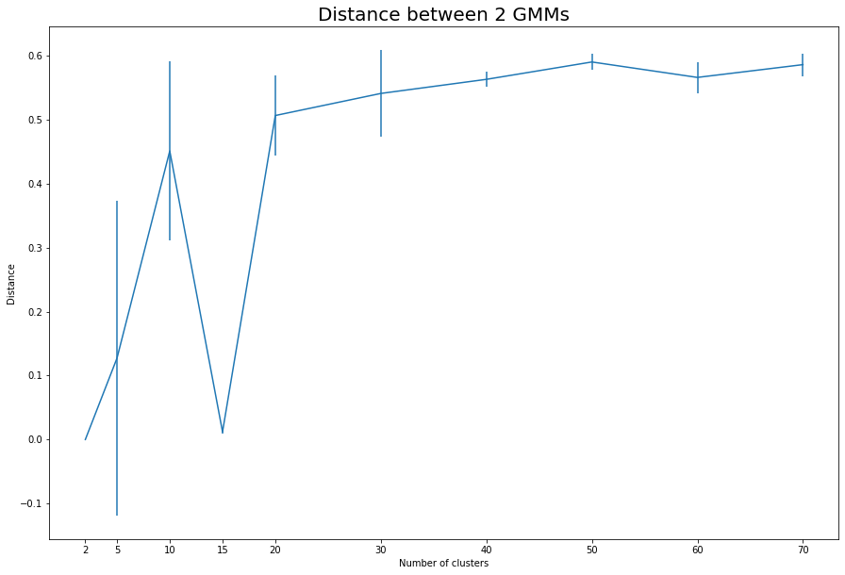
1. Sentence Embeddings
Optimal n_component for sentence embeddings:
Randomly selected 100k sentences
range: 2, 5, 10, 20, …, 70
‹#›

Slide 9
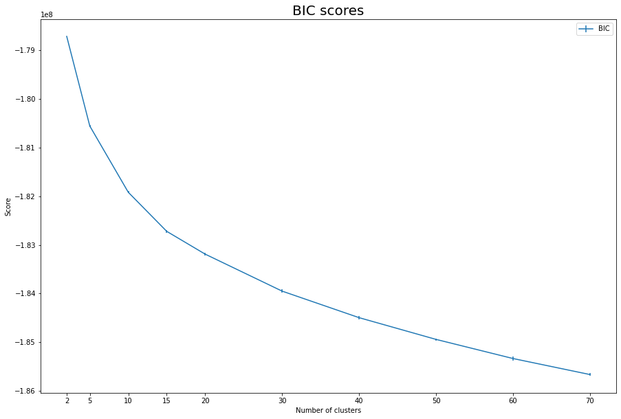
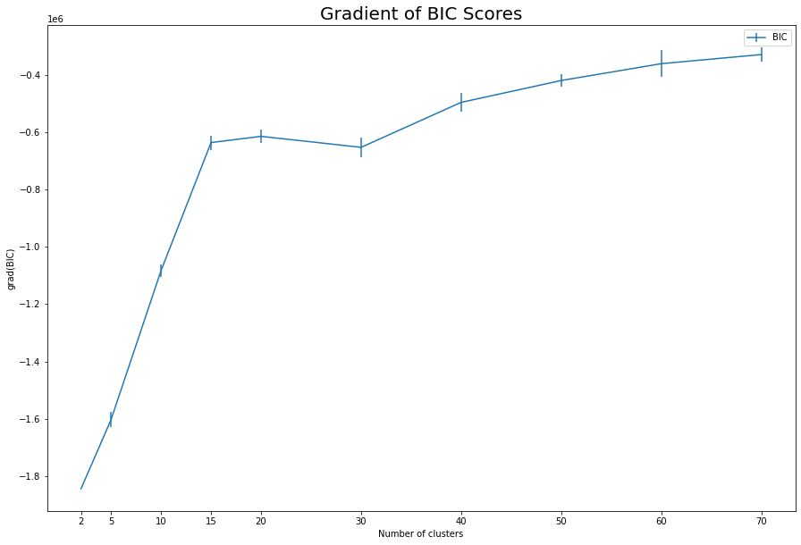
1. Sentence Embeddings
Optimal n_component for sentence embeddings:
Randomly selected 100k sentences
range: 2, 5, 10, 20, …, 70
‹#›

Slide 10
2. Experiments
Experiments where random users are selected from the same dataset
Got the random and answering users from the same dataset
Got 10 random comments from the article
Got 10 random comments from the rest of the comments in the dataset
Done 10 times in order to avoid effects of randomness
General purpose social media sites tend to not follow the general pattern
 | Answering |  | Random
 | Mean | STD | Mean | STD
chicagotribune | 0.384988575 | 0.1201952149 | 0.475516536 | 0.1156128185
latimes | 0.4014499837 | 0.1102942562 | 0.4520089944 | 0.1169824563
reddit | 0.3995765351 | 0.131873915 | 0.5002881615 | 0.1426158464
disqus | 0.4026876656 | 0.1295383024 | 0.393727771 | 0.1040792169
foodbabe | 0.3674852275 | 0.1108248364 | 0.5035238198 | 0.1331969733
foodrevolution | 0.4438731436 | 0.1460208042 | 0.5325115038 | 0.09594465136
cafemom | 0.4013961526 | 0.1603765152 | 0.467886504 | 0.1009873944
usatoday | 0.4282095614 | 0.1648158043 | 0.4710413858 | 0.10318971
washingtonpost | 0.3646384987 | 0.1291438602 | 0.4243904343 | 0.07344797032
facebook | 0.5600918023 | 0.1159878002 | 0.5479025758 | 0.09357742856
nytimes | 0.3591360881 | 0.1053282714 | 0.3561619568 | 0.09566741463
quora | 0.4863544111 | 0.1106167707 | 0.500968684 | 0.1160446393
‹#›

Slide 11
2. Experiments
2. Experiments where random users are selected from different datasets
Got 10 random comments from the article
Got 10 random comments from the rest of the comments in the all of the datasets
Again, done 10 times in order to avoid effects of randomness
General purpose social medias now follow the pattern.
All of the datasets have similar means and std’s with random users
 | Answering |  | Random
 | Mean | STD | Mean | STD
chicagotribune | 0.4118508929 | 0.1270097128 | 0.5214000578 | 0.1230789816
latimes | 0.3932762817 | 0.09671429079 | 0.5268595905 | 0.1272388429
reddit | 0.4087522402 | 0.1226142016 | 0.5177329269 | 0.1175239242
disqus | 0.3885129398 | 0.1008069235 | 0.5070583155 | 0.1218285359
foodbabe | 0.3779045535 | 0.09983987744 | 0.4976785046 | 0.1377173898
foodrevolution | 0.4768770954 | 0.0981976633 | 0.5479795009 | 0.1316775007
cafemom | 0.4010923075 | 0.1240303848 | 0.5183366842 | 0.1356301526
usatoday | 0.4275641005 | 0.1112574329 | 0.5245200577 | 0.1302652644
washingtonpost | 0.3878200908 | 0.1013928891 | 0.531840918 | 0.1394747124
facebook | 0.4709319705 | 0.1636872796 | 0.550621792 | 0.1467391067
nytimes | 0.4003628918 | 0.1084330895 | 0.5564675406 | 0.12994026
quora | 0.3238557891 | 0.08514398147 | 0.5061730248 | 0.1530962292
‹#›

Slide 12
2. Experiments
3. Analogy Experiments
JS(A1|C1) < JS(A1|C2)
JS(A2|C1) > JS(A2|C2)
A1 and C1 should be in the same distribution
A2 and C2 should be in the same distribution
JS(A1|A2) ~ JS(C1|C2)
JS(A1|A2) | JS(C1|C2)
0.4601 | 0.3587
0.4817 | 0.5645
0.3649 | 0.3334
0.4911 | 0.8305
0.5566 | 0.3749
‹#›

Slide 13
3. Next Tasks
Experiments per dataset cluster e.g:
biased vs unbiased
forums vs news sites
Experiments with sentence embeddings
Maybe do analogy Task on multiple datasets
Maybe try out fasttext
‹#›

Slide 14
Questions
How to do the topic labeling for sentence embeddings model?
‹#›

Slide 15
References
Pennington, Jeffrey, Richard Socher, and Christopher D. Manning. "Glove: Global vectors for word representation." Proceedings of the 2014 conference on empirical methods in natural language processing (EMNLP). 2014.
Sridhar, Vivek Kumar Rangarajan. "Unsupervised topic modeling for short texts using distributed representations of words." Proceedings of the 1st workshop on vector space modeling for natural language processing. 2015.
Fine tune GloVe embeddings using Mittens
roamanalytics/mittens: A fast implementation of GloVe, with optional retrofitting
https://medium.com/analytics-vidhya/basics-of-using-pre-trained-glove-vectors-in-python-d38905f356db
https://scikit-learn.org/stable/modules/mixture.html
https://towardsdatascience.com/gaussian-mixture-model-clusterization-how-to-select-the-number-of-components-clusters-553bef45f6e4
https://stackoverflow.com/questions/26079881/kl-divergence-of-two-gmms
https://medium.com/@sourcedexter/how-to-find-the-similarity-between-two-probability-distributions-using-python-a7546e90a08d
Cer, D., Yang, Y., Kong, S. Y., Hua, N., Limtiaco, N., John, R. S., ... & Sung, Y. H. (2018). Universal sentence encoder. arXiv preprint arXiv:1803.11175.
‹#›

