Slide 1
Social Topic Distributions
Hakan Akyürek
Mürüvvet Hasanbaşoğlu
July 13, 2020

Slide 2
Overview
Sentence embeddings
GMM training
Topic labeling
User Clustering
Experiments
Next Tasks - for the next weeks
‹#›

Slide 3
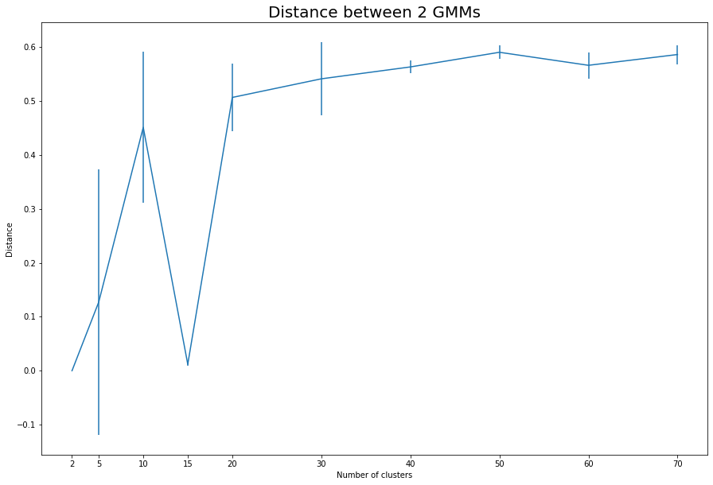
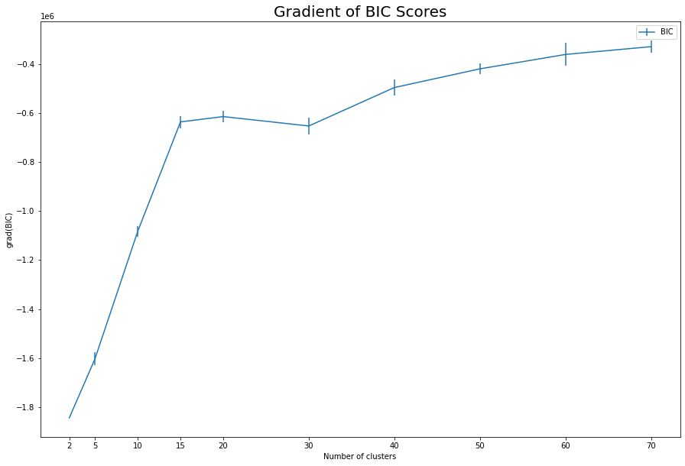
1. Sentence Embeddings
Train the GMM sentence embeddings models for n_component=15 and n_component=30 using the entire dataset
‹#›

Slide 4

1. Sentence Embeddings
Topic Labeling:
Predict the cluster of all sentence embeddings
Compute the Clarity Score
Clarity Scoring:
vectorizer = TfidfVectorizer(norm='l1', dtype=np.float32, stop_words='english')
vectorizer.fit(list_of_sentences)
tw = vectorizer.transform([' '.join(list_of_sentences)]).toarray()[0]
tw_word_dict = dict(zip(vectorizer.get_feature_names(), tw))
taw_per_cluster = []
for cluster, sentences in clustered_sentences.items():
taw = vectorizer.transform([' '.join(sentences)]).toarray()[0]
taw_word_dict = dict(zip(vectorizer.get_feature_names(), taw))
taw_per_cluster.append(taw_word_dict)
‹#›
Notes:
taw is the l1 normalized tfidf values of words in the sentences wihtin a cluster.
tw is the l1 normalized tfidf values of words in the sentences in the entire dataset.

Slide 5
1. Sentence Embeddings
Top 10 seed words of GMM n_component=15 model:
food, eat, eating, meat, foods, diet, healthy, vegan, meals, meal
milk, cheese, sugar, chocolate, butter, cream, sauce, chicken, oil, tomatoes
people, money, need, let, change, going, vote, time, stop, way
new, city, park, year, restaurant, university, center, 000, wine, chicago
stores, store, buy, grocery, products, market, foods, shop, buying, walmart
organic, pesticides, food, foods, conventional, certified, produce, non, farming, buy
http, com, www, org, st, https, ave, 10, los, 11
people, like, want, time, need, think, going, know, really, make
god, science, evidence, logic, scientific, argument, facts, believe, existence, truth
know, think, really, read, wrong, question, answer, right, good, post
farmers, farm, farming, farms, agriculture, crops, farmer, soil, crop, grow
cancer, chemicals, water, disease, health, vaccines, toxic, chemical, fda, bacteria
government, tax, corporations, money, people, federal, taxes, capitalism, country, america
gmo, monsanto, gmos, genetically, labeling, modified, non, crops, seeds, corn
trump, obama, republicans, president, republican, democrats, liberals, hillary, gop, clinton
‹#›
Notes:
monsanto - agrochemical and agricultural company
gmo - Genetically modified organism

Slide 6
1. Sentence Embeddings
Top 10 seed words of GMM n_component=30 model:
food, eat, eating, foods, healthy, meals, meal, nutrition, cooking, processed
cheese, sugar, sauce, butter, milk, chocolate, salad, cream, bread, sweet
people, let, time, money, change, world, going, need, life, work
michael, john, david, ben, jerry, george, chris, paul, mike, justin
stores, store, grocery, foods, buy, products, shop, walmart, shopping, amazon
money, tax, pay, taxes, jobs, income, capitalism, wage, economy, wealth
organic, food, foods, certified, conventional, buy, organics, produce, non, usda
com, http, www, st, org, 10, ave, 30, 11, saturday
park, city, restaurant, new, chicago, wine, chef, county, center, york
want, care, money, need, make, know, pay, people, kill, control
water, drink, milk, coffee, drinking, tea, like, plastic, oil, bottle
people, want, like, time, think, going, need, know, really, things
stupid, ignorant, sad, ignorance, idiot, dumb, bad, fucking, stupidity, shame
cancer, health, disease, vaccines, medical, diseases, vaccine, fda, medicine, antibiotics
argument, evidence, logic, facts, truth, true, false, proof, arguments, prove
article, read, post, link, thanks, thank, information, reading, comments, comment
know, think, really, good, right, like, sure, thing, agree, wrong
farmers, farm, farming, farms, agriculture, farmer, crops, agricultural, local, land
pesticides, pesticide, herbicides, organic, fertilizers, use, glyphosate, toxic, herbicide, chemicals
process, technology, company, research, data, development, percent, information, study, results
climate, warming, global, water, earth, carbon, co2, change, planet, fracking
plants, plant, bees, garden, soil, seeds, grow, compost, weeds, seed
israel, war, jews, hamas, religion, gay, palestinians, people, marriage, rights
meat, vegan, cows, animals, chickens, beef, animal, fed, vegetarian, eat
science, god, scientific, scientists, universe, evolution, existence, theory, evidence, logic
republicans, liberals, republican, liberal, democrats, conservatives, gop, conservative, party, democrat
gmo, gmos, genetically, non, labeling, modified, foods, crops, label, corn
government, federal, congress, vote, politicians, constitution, state, corporations, democracy, political
trump, obama, president, hillary, clinton, bernie, bush, sanders, romney, donald
monsanto, fda, seeds, gmo, bayer, dow, seed, roundup, companies, evil
‹#›
Notes:
monsanto - agrochemical and agricultural company
gmo - Genetically modified organism

Slide 7
2. User Clustering
Define the user dataset:
{
dataset_name: {
author_id+’$$’+author_name: concatenated user comments
}
}
Compute probabilities of Users
Get probability distribution of Users per cluster
Max probability cluster is the cluster that the User belongs to
‹#›
Notes:
monsanto - agrochemical and agricultural company
gmo - Genetically modified organism

Slide 8
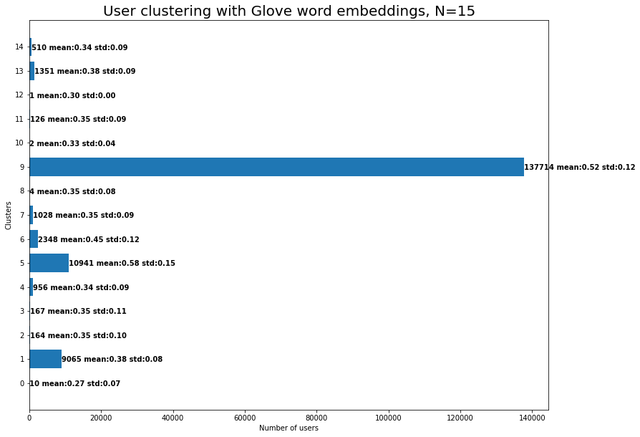
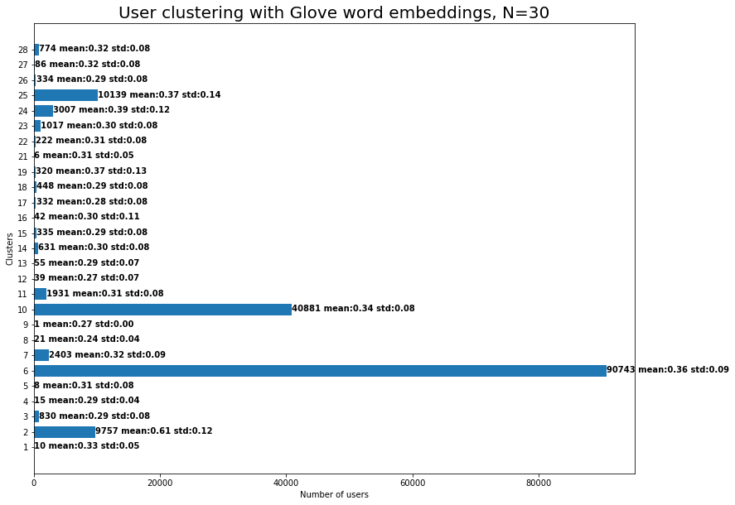
2. User Clustering
‹#›
Notes:
monsanto - agrochemical and agricultural company
gmo - Genetically modified organism

Slide 9
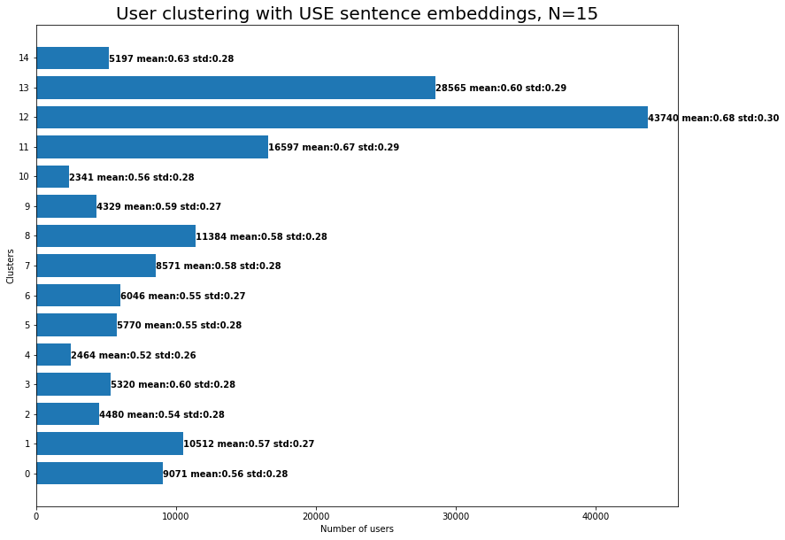
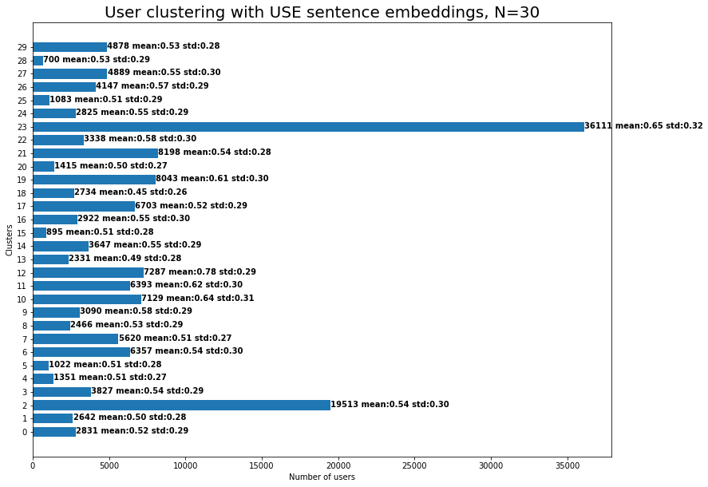
2. User Clustering
‹#›
Notes:
monsanto - agrochemical and agricultural company
gmo - Genetically modified organism

Slide 10
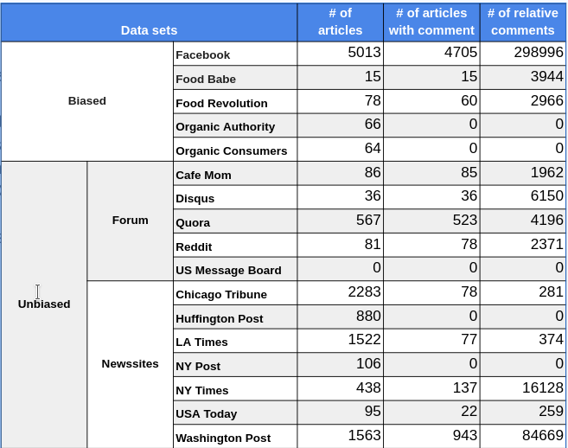
3. Experiments
We migrated all experiments to user basis from comment basis.
Comments for each user is concatenated
3 different datasets; Facebook, Quora, Washington post
User counts mostly aren’t enough in the others
2 models, more incoming next week: GMM’s with word embeddings, 15 and 30 clusters
5 random user sets; general, biased, unbiased, forum, news
Predefined articles, selected randomly
150 articles per dataset
‹#›
Notes:
warm_start() -> train GM in batches. iterate over the dataset and continue training from where it left in the last iteration

Slide 11
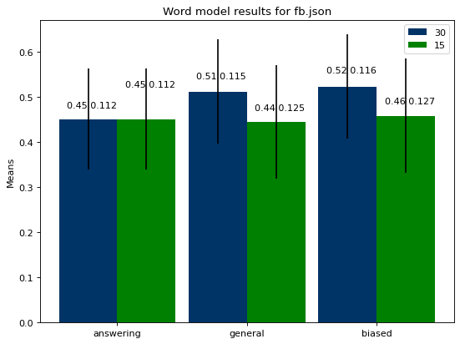
3. Experiments
Facebook
Got the worst results.
Got even worse scores in biased subset.
While mean is highest, std in average is lowest.
‹#›
Notes:
warm_start() -> train GM in batches. iterate over the dataset and continue training from where it left in the last iteration

Slide 12
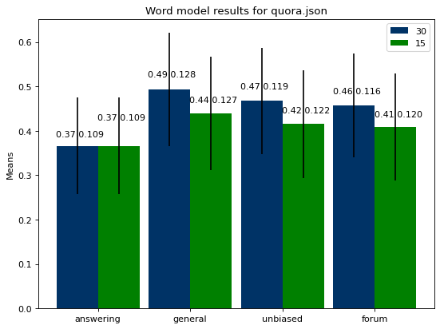
3. Experiments
Quora
Got better results in unbiased subset and even better results in forum subset.
Users tend to stick to the article topic more.
Got the closest result to answering users.
‹#›
Notes:
warm_start() -> train GM in batches. iterate over the dataset and continue training from where it left in the last iteration

Slide 13
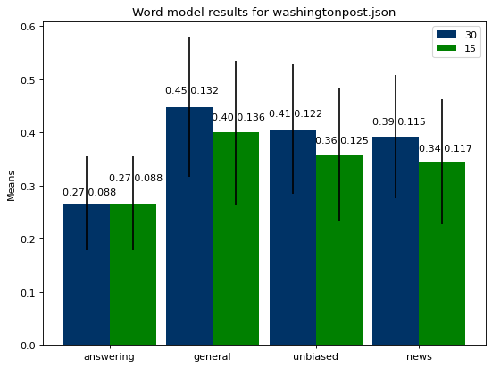
3. Experiments
Washington post
Got the best results.
Std is higher in model with 15 clusters.
‹#›
Notes:
warm_start() -> train GM in batches. iterate over the dataset and continue training from where it left in the last iteration

Slide 14
3. Experiments
Generally GMM models with 15 clusters return less mean but higher standard deviation.
Sentence experiments take a long time, because of embedding calculation. However, early results show that sentence embeddings have larger distances.
The expectation is actually fulfilled for users when word embeddings are used.
Standard deviations tend to become smaller as the random user set becomes more specific.
‹#›
Notes:
warm_start() -> train GM in batches. iterate over the dataset and continue training from where it left in the last iteration

Slide 15
4. Next Tasks
Tidy up the code in the notebook
Prepare for the final presentation
Start working on the report
‹#›

Slide 16
Questions
‹#›

Slide 17
Experiments
Topic labeling using sentence embeddings:
Calculate Clarity Score for each Word
Sentence Embeddings
Gaussian Prediction
Take the Highest Scoring N Words
Manually Assign Topic
Notes:
How much a word in a sentence decides that sentence belongs to the respective gaussian.

Slide 18
References
Pennington, Jeffrey, Richard Socher, and Christopher D. Manning. "Glove: Global vectors for word representation." Proceedings of the 2014 conference on empirical methods in natural language processing (EMNLP). 2014.
Sridhar, Vivek Kumar Rangarajan. "Unsupervised topic modeling for short texts using distributed representations of words." Proceedings of the 1st workshop on vector space modeling for natural language processing. 2015.
Fine tune GloVe embeddings using Mittens
A fast implementation of GloVe, with optional retrofitting
Basics of using pre-trained glove vectors in python
Sklearn Gaussian Mixture Model
Gaussian Mixture Model Clusterization how to select the number of components clusters
Kl divergence of two gmms
How to find the similarity between two probability distributions using python
Cer, D., Yang, Y., Kong, S. Y., Hua, N., Limtiaco, N., John, R. S., ... & Sung, Y. H. (2018). Universal sentence encoder. arXiv preprint arXiv:1803.11175.
Angelidis, Stefanos, and Mirella Lapata. "Summarizing opinions: Aspect extraction meets sentiment prediction and they are both weakly supervised." arXiv preprint arXiv:1808.08858 (2018).
Kim, Han Kyul, Hyunjoong Kim, and Sungzoon Cho. "Bag-of-concepts: Comprehending document representation through clustering words in distributed representation." Neurocomputing 266 (2017): 336-352.
‹#›

Slide 19
Results
Extremely imbalanced
CF-IDF Probabilities
Better User Distribution
Notes:
Calculating how much a word’s presence effects the text to be in the gaussian that the word is in.

Slide 20
Experiments
Topic labeling using word embeddings:
Normalized Embeddings
Word Embeddings
Gaussian Prediction
Cosine Distance
Take Closest N Words
Manually Assign Topic
Gaussian Mean

