Slide 1

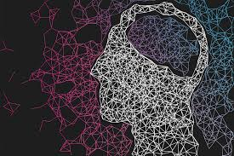
Deep Learning
Bank Loan
Repayment Prediction
AAKASH SAINI 2K18/IT/003
AMITOJ SINGH 2K18/IT/019

Slide 2
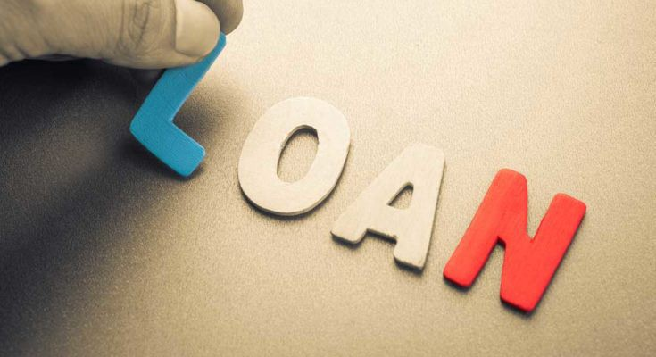
INTRODUCTION
~ The prime objective in banking environment is to invest their assets in safe hands where it is. Today many banks/financial companies approves loan after a regress process of verification and validation but still there is no surety whether the chosen applicant is the deserving right applicant out of all applicants. Through this system we can predict whether that particular applicant is safe or not and the whole process of validation of features is automated by machine learning technique. The disadvantage of this model is that it emphasize different weights to each factor but in real life sometime loan can be approved on the basis of single strong factor only, which is not possible through this system.
The Loan Prediction System can automatically calculate the weight of each features taking part in loan processing and on new test data same features are processed with respect to their associated weight .A time limit can be set for the applicant to check whether his/her loan can be sanctioned or not.

Slide 3

Circumstances where we require Loan:
In recent times there has been a noticeable increase in consumers applying for loans. Loans are provided to people for such circumstances which may occur at any time. In anyone's life a situation may come when all of a sudden you require cash. Thus in such life scenario people take the required amount of loan they need.

Slide 4
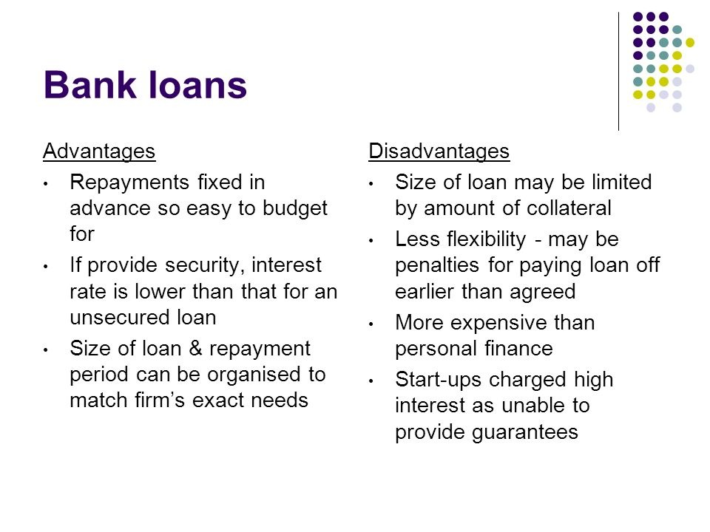

Advantages & Disadvantages of Bank Loan

Slide 5
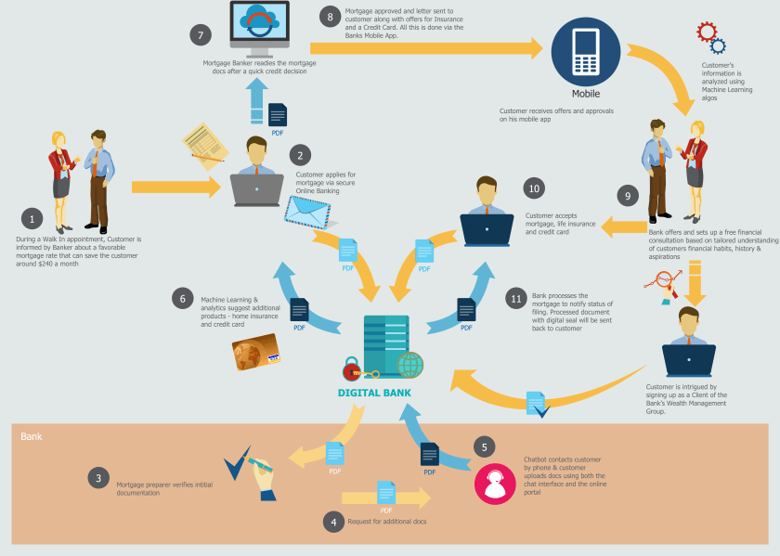
Journey of a Customer

Slide 6
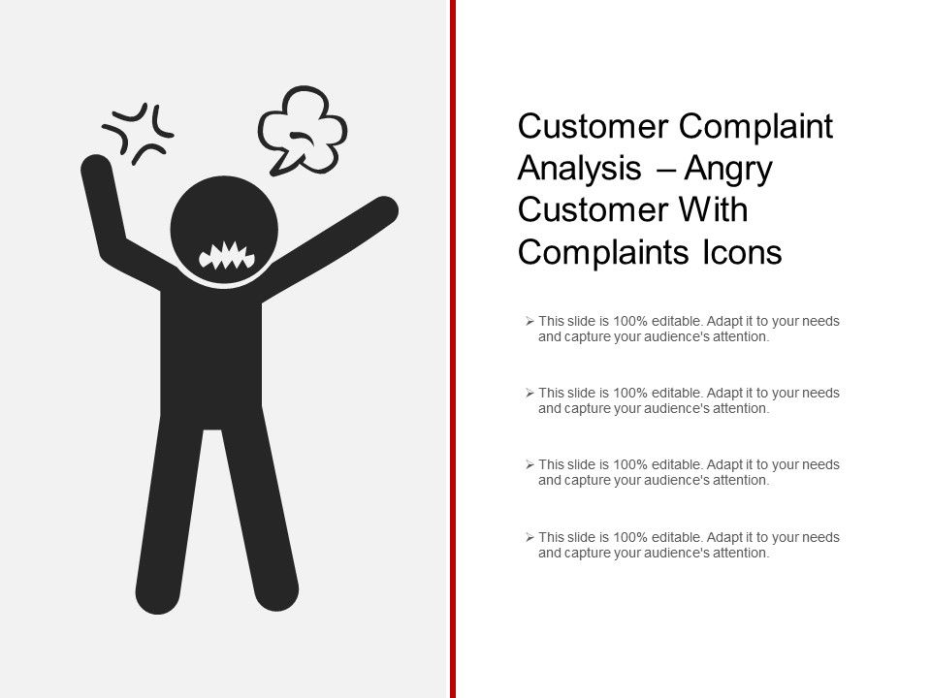
When Working Manually-:
Lots of Time waste during paper work and for analysing whether the customer is
able to repay the loan amount in
fixed amount of time period or not.
What Now???

Slide 7
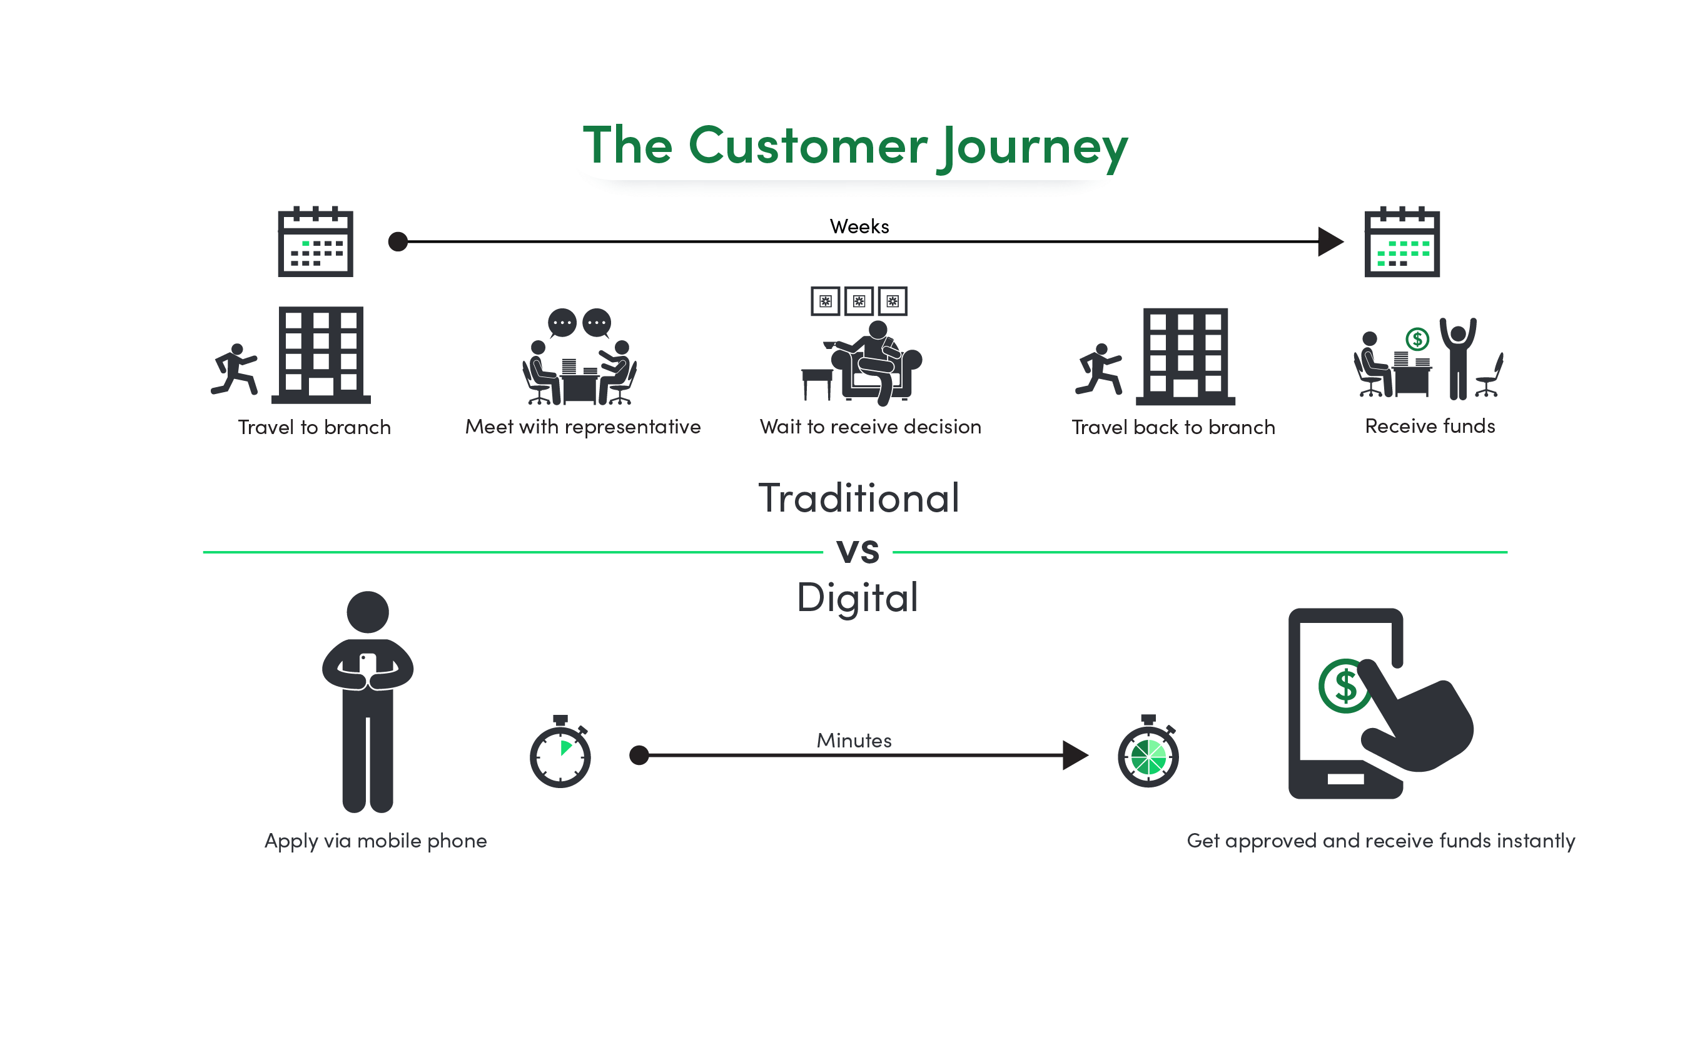

Slide 8

What can we do now???
Objective of project –:
The objective of this project is to make sure that the person decided by the bank whose loan is passed must be able to and sufficient enough to pay the money back on time.

Slide 9
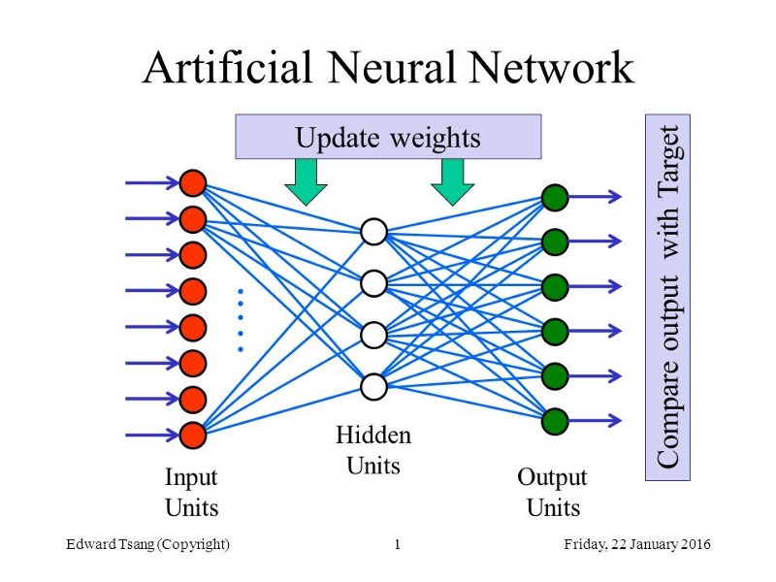
What can we do now???
Now, after seeing all the problems faced by the customers, we are going to make a machine learning (deep learning) model based on Artificial Neural Network(ANN).The objective of this project is to analyze customer data and predict whether the customer is able to repay the loan amount in fixed amount of time period or not. In order to test the proposed algorithm we performed experiment on dataset from “kaggle.com” . For training and testing the data, the dataset we used is a .csv file. Dataset contains 3,96,030 rows and 27 columns . We have 2 types of datasets, the “Training” data and “Testing” data.”Testing ”data is 20% and “Training” data is 80%.

Slide 10
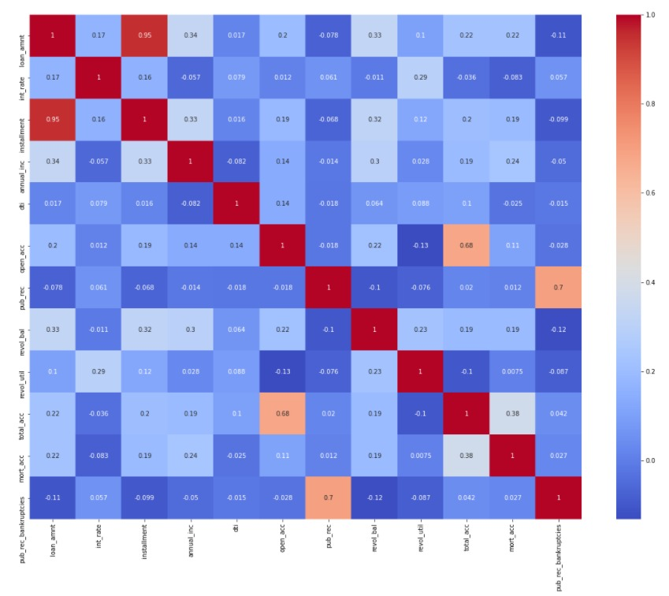
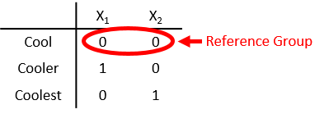
What we had done in our model....
Data Analysis : First we analysed the data by making
different plots like count plot, figure, distplot, heatmap,
scatter plot, box plot etc.
Data Preprocessing : First we calculate the NULL
percentage of data, where 'lambda' expression is used
to ‘impute’ the average value of all the values of that
column where we found a NULL entry. Rows containing
more NULL values are removed with the help of
dropna() function. Now are dataset is preprocessed with
no NULL values.
Dummy Variable : To make our dataset to comprehend
the variables and their values we used Dummy encoding.
It helps to alter the human-readable form to numeric form.

Slide 11
What we had done in our model....
Train Test Split : Now, we split our dataset into test and train, where random 20% of
the dataset goes into test while the rest 80% goes into train for validation.
Normalizing Dataset : Then, we start normalizing the data using MinMaxScaler() function. MinMaxScalar() function converts the data within [0,1], and for negatives [-1,1]. Then we start fitting the data using fit_transform() function, it helps machine to learn their learning parameters from dataset and transform() function is used to fit test data.
DATASET
TRAINING (80%)
TEST (20%)

Slide 12
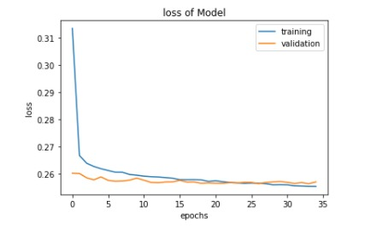
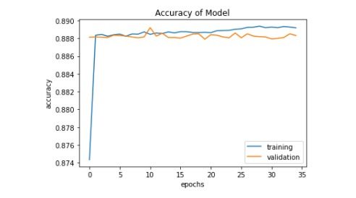
What can we do now???
Creating the model : We create a model and used machine learning algorithm named Artificial Neural Network (ANN) in which we used 3 hidden layers and we used Sequential(), Dense() ,Activation() and Dropout(), functions to find the accuracy of our data. Sequential function is used to create our model. Activation Functions we used in our model is Relu and Sigmoid, optimizer we had used is Adam while binary_crossentropy is the loss function we used.

Slide 13
Result
Classification Report
 | precision | recall | f1-score
0 | 0.99 | 0.43 | 0.60
1 | 0.88 | 1.00 | 0.93
Confusion Matrix
 | True | False
Positive | 6800 | 8858
Negative | 57 | 63329
True Positive value in confusion matrix is 6800,
False Positive value in confusion matrix is 8858,
False Negative value in confusion matrix is 57,
True Negative value in confusion matrix is 63329
The accuracy of our model is 89%.

Slide 14
And then, Customer and Bank
become
happy.
The resources of the bank won't be wasted.
Loans can be provided to the people who really need them.
We can help the banks to a great extend to select a trustworthy person.
What after doing So.....???

Slide 15
THANK
YOU

