Slide 1
3-DES
Seth Bontrager
Anthony Kang
Eric Murphy
Isaac Sheeley

Slide 2
Why 3DES
The 3DES algorithm was designed for hardware implementation
It is still a widely used encryption method
Current technology is not able to break it

Slide 3
Main Features
Encryption of data using 3DES
Pipelining to increase speed
Data transfer over AHB-Lite

Slide 4
What is DES
Data Encryption Standard
Does encryption with a 56-bit encryption key
Employs the Feistel cipher structure
Has 16 rounds of processing

Slide 5
DES in Hardware
Designed for hardware implementation
Main operations
Bit permutation, XOR, Look up tables
Allows for very, very, fast operations
Use registers between steps in each round
Allows for pipelining
Match processing speed to data i/o speed

Slide 6
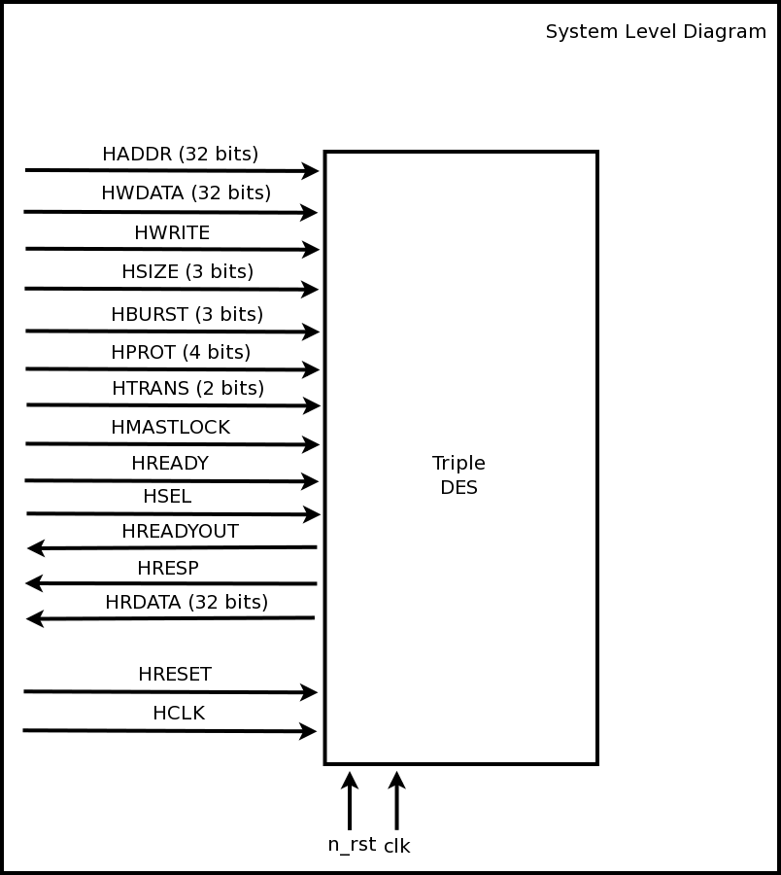
System Level Diagram

Slide 7
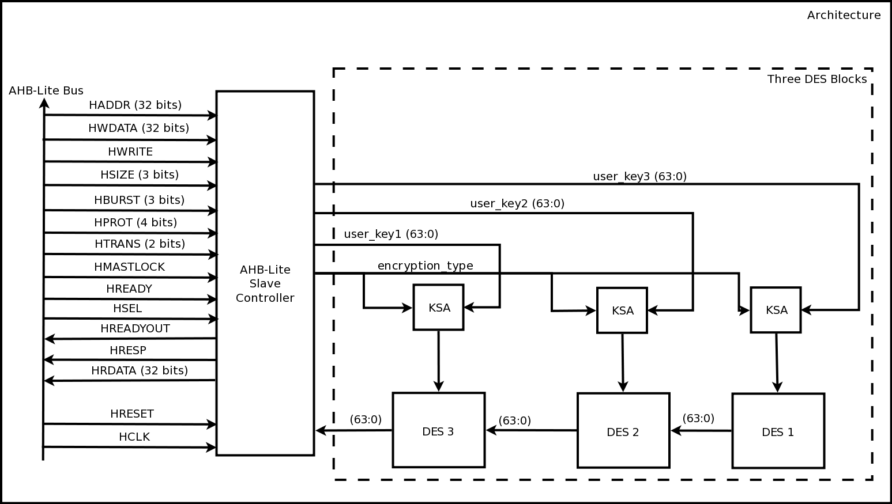
Architecture Diagram

Slide 8
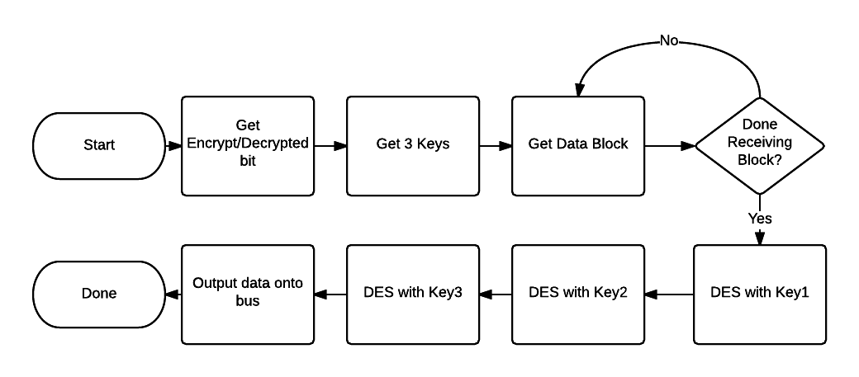
Design Flow Chart

Slide 9
AHB-Lite
Using the AHB-Lite specification
Data bus is 32-bits wide

Slide 10
AHB-Lite Slave Controller

Slide 11
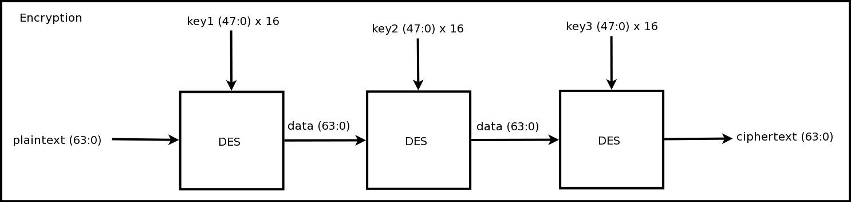
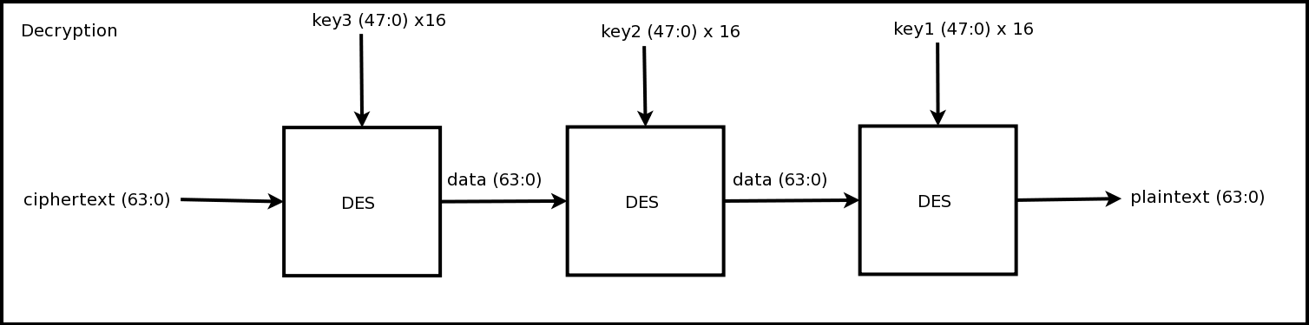
Encryption and Decryption

Slide 12
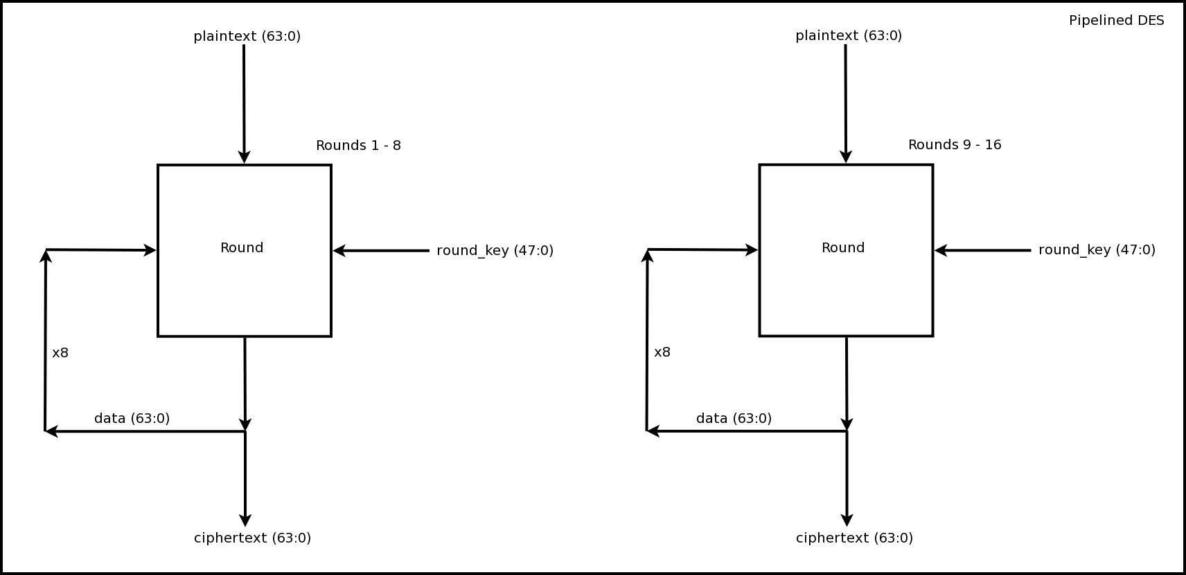
Pipelined
DES
Design is pipelined so that each block of data is run through 8
rounds at a time (as opposed to
16 rounds)
Flex counter (not pictured) is used to keep track of the current round

Slide 13
Whiteboard Drawing

Slide 14
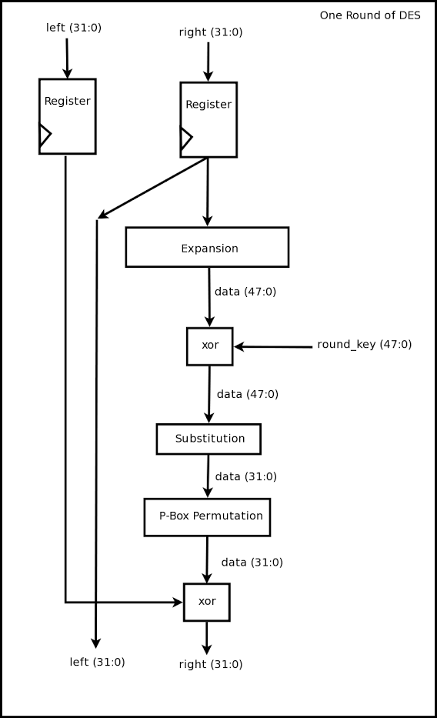
Single DES round
One round of DES processing
Registers included to reduce the critical path

Slide 15
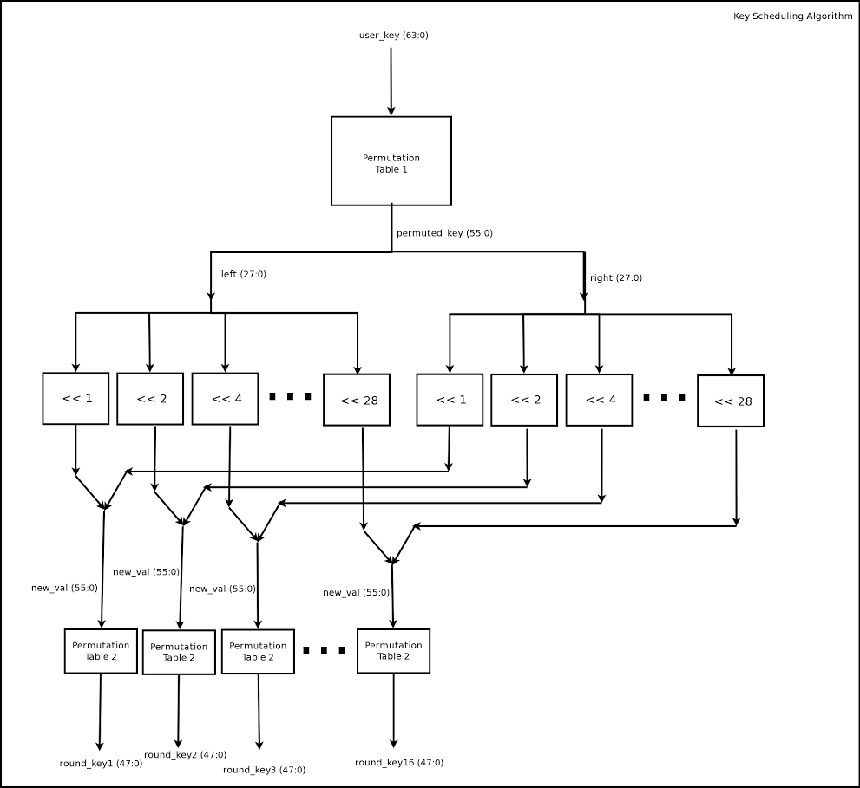
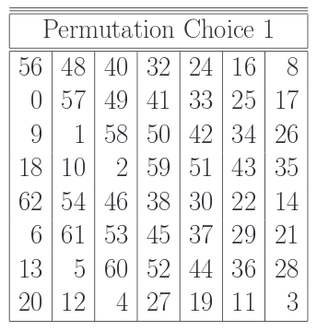
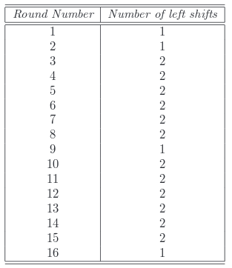
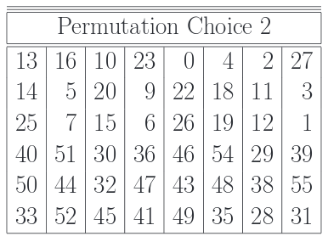
KSA

Slide 16
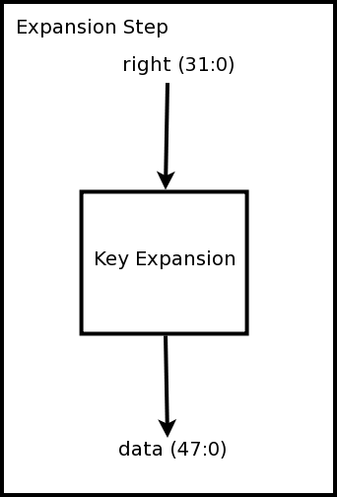
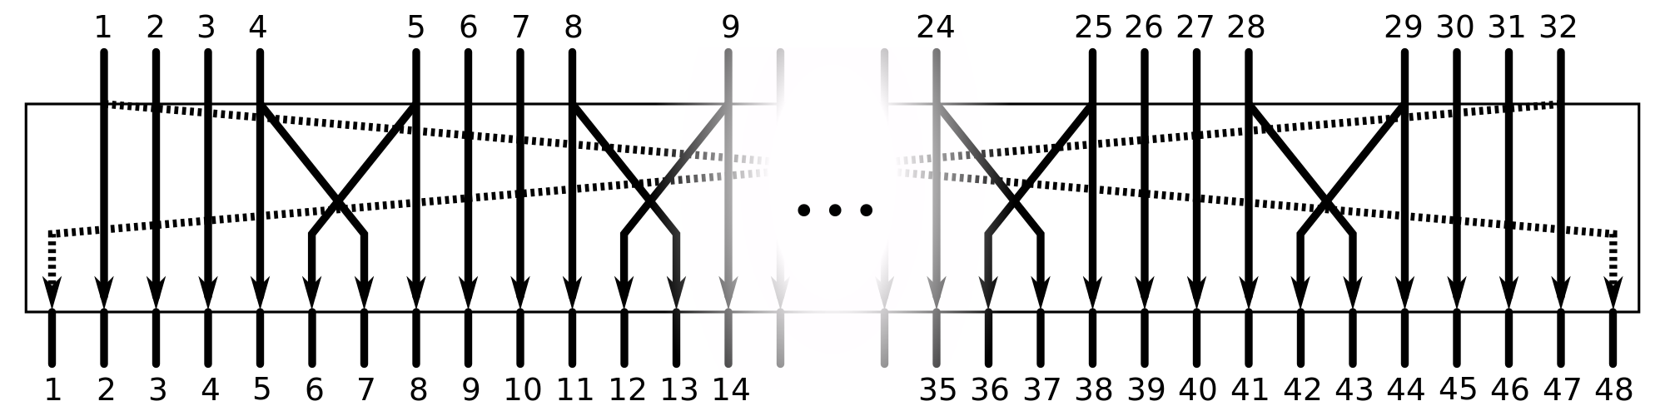
Expansion Permutation

Slide 17
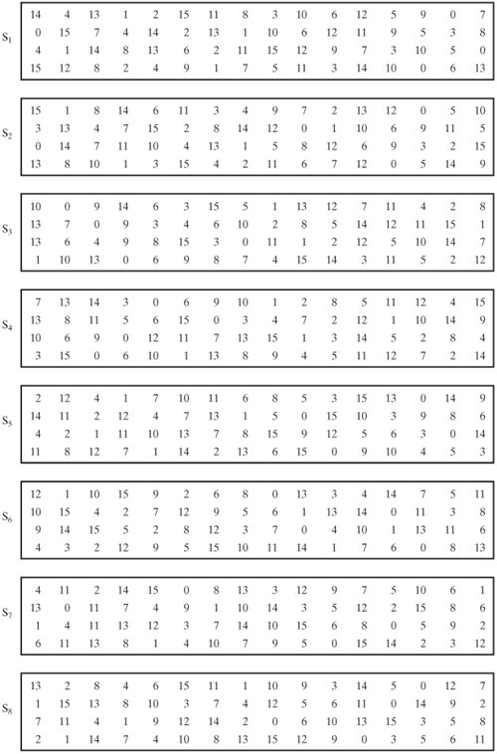
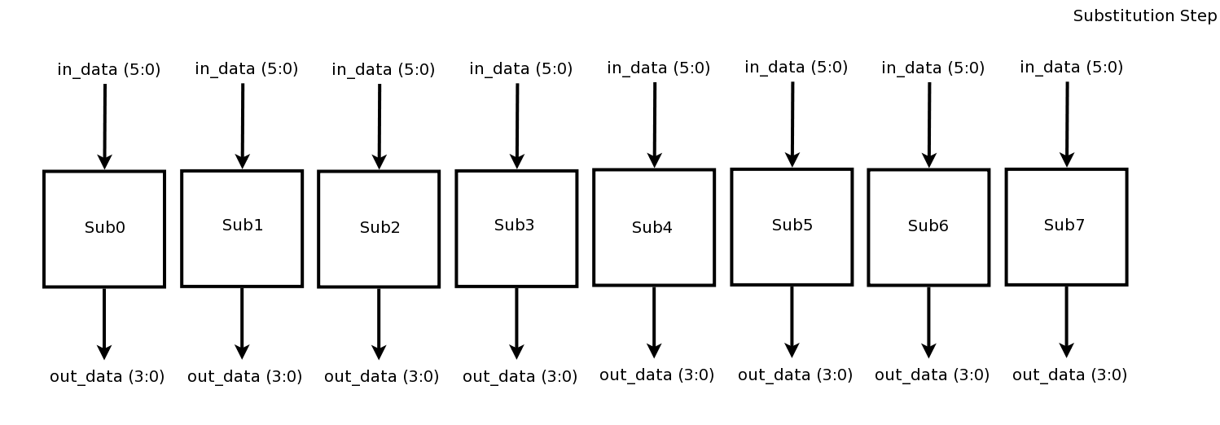
Substitution Box

Slide 18
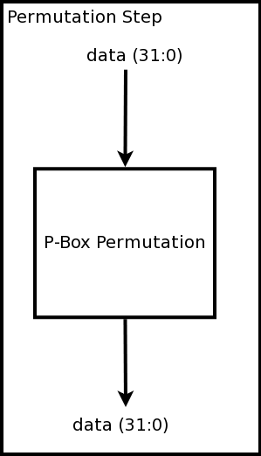
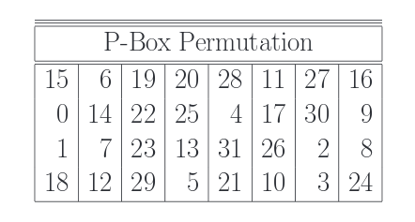
Permutation Box

Slide 19
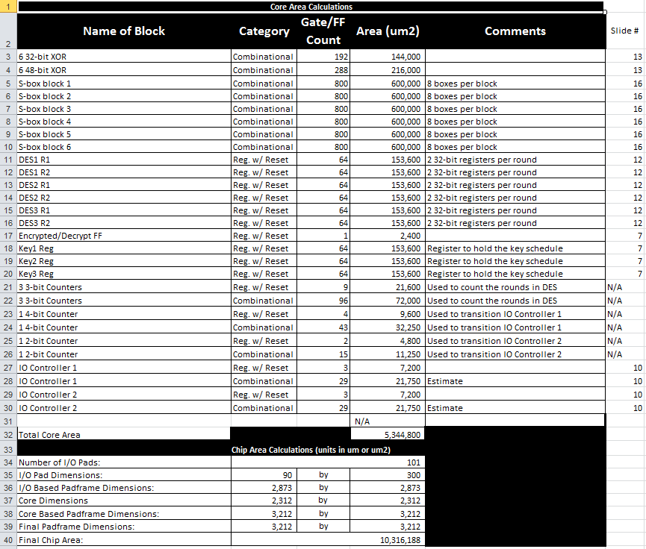
Area Budget

Slide 20

Timing Budget
Our critical path yields a clock speed of ~513 MHz, which is just fast enough to meet USB 2.0 specification

Slide 21
Data Sheets
AHB-Lite Specification http://nineways.co.uk/ARM_IHI0033A_AMBA_AHB-Lite_SPEC.pdf
USB 2.0. Specification
http://sdphca.ucsd.edu/Lab_Equip_Manuals/usb_20.pdf

