Slide 1
Create your Centos homelab in an hour.
Slides available at
github.com/murphnj/hourlab
Introductions will happen…
while we install our first VM.

Slide 2
What is required:
A downloaded .iso file of the distro that you want to run your lab on (RedHat, Centos, Scientific or a related version)
A host computer with virtualization software loaded.:
My example will use Fedora for the host, and KVM for the virtualization software.
Centos would work basically the same.
Other computers such as Windows or Mac would be OK, but you will have to change a few of the implementation details to suit your platform.

Slide 3
First, we'll create our local repository VM.
Start virt-manager, and select a new VM.
Select "Local install media" and Press "Forward"
Select "Use ISO image" and browse.
At the "Choose local Storage Volume" select "Browse local" and navigate to the .iso for your distro.
Select "Forward"

Slide 4
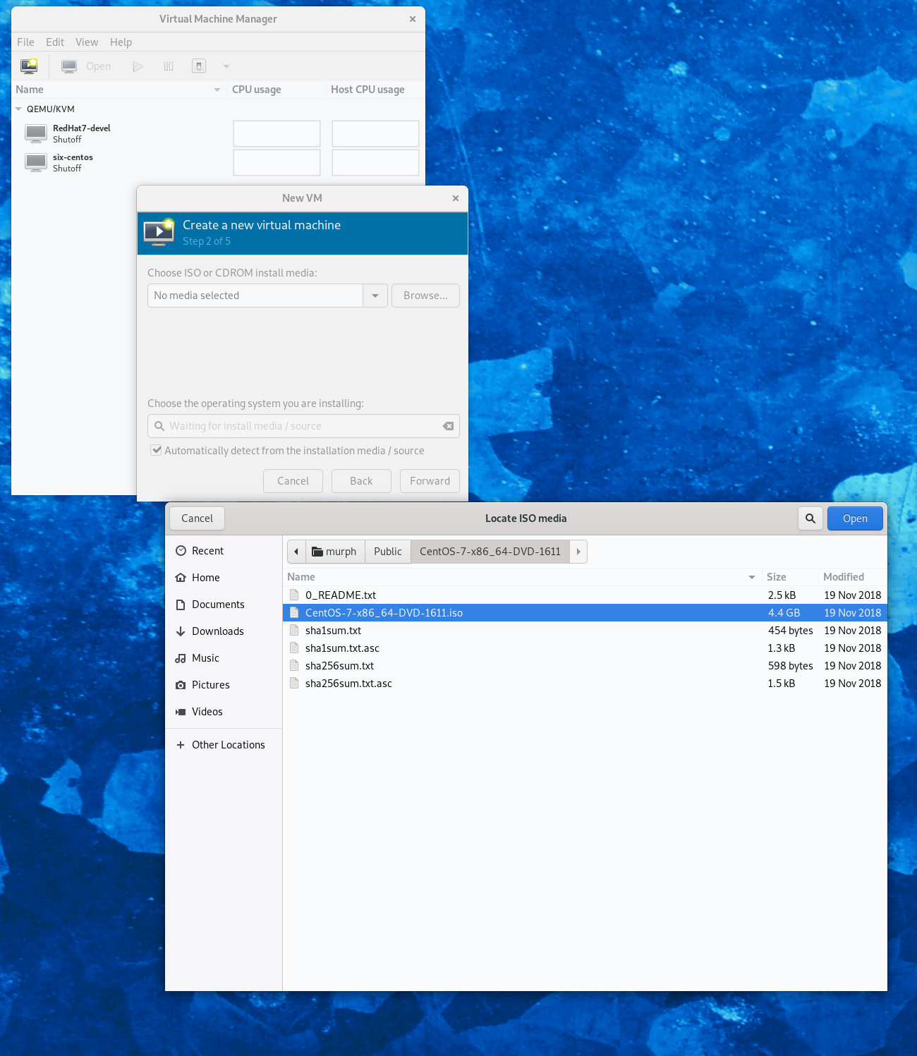

Slide 5
VM details
Choose your memory and CPU options, 1G and 1 cpu is fine for the repo, less may even work. Select Forward
For the Disk image, I'd recommend about 16G, so that you have room for the files. Select forward
Then name your VM, something that will show you that it is the repo. Press finish

Slide 6
Now, install the repo OS
Select Install CentOS 7.
Select your language and continue
Select installation destination, allow the installer to do Automatic installation, and click done in the upper left hand corner.
Under Software installation, select "infrastructure server" and be sure to select the "FTP server" checkbox, and click "done"
"Network and host name" , make sure that ethernet is enabled.

Slide 7
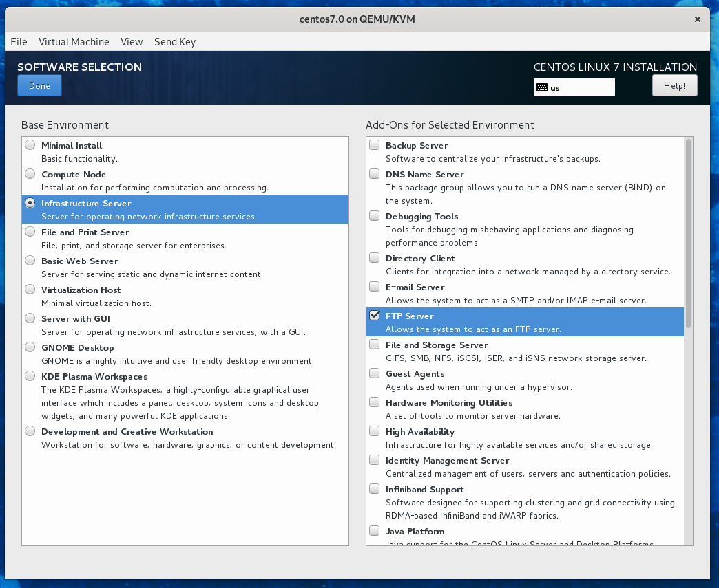

Slide 8
Continue installing
Click “Begin Installation”
You have an opportunity to create accounts and passwords for root, and a user account, this is a good opportunity to do so.
Now we wait (5 minutes or so.)
When it is finished, select Reboot
When it reboots, log in with the root account that you set.

Slide 9
Who is this?
Bob Murphy
  Linux user since Slackware 3.6
  Linux Sysadmin
  Current RHCE student
  Contact
    murph@member.fsf.org
    Fediverse: @murph@fosstodon.org

Slide 10
What we’re doing
Create new repo server
  Start and enable FTP service
  Open firewall port for ftp
  Copy files from .iso file to server
  Create repo file to tell OS to use ftp for getting updates and software

Slide 11
Setting up your ftp server
Start the ftp server : systemctl start vsftpd
Enable it for next time : systemctl enable vsftpd
Check it : systemctl status vsftpd
Set firewall : firewall-cmd --add-service=ftp --permanent
Enable firewall changes : firewall-cmd --reload
Get your IP address: ip a
(We will need it in a few minutes)

Slide 12
Copy files for repo
Go to "View->details" select ide cdrom1 - click connect - browse (just like the initial iso selection) click OK
Go to "View->console" to go back to your VM.
mkdir /root/temp ; mount /dev/cdrom /temp;
rsync -avhP /temp/ /var/ftp/pub/
We wait.

Slide 13
Why set up a homelab like this?
  Allows easy setup and rebuilding
  Stability in versions of OS
  No network needed for installing new packages.

Slide 14
Create the local repo
cd /etc/yum.repos.d ; mv * ~
<edit> network.repo
[network]
name=network
baseurl=ftp://192.168.122.<your ip>/pub
gpgcheck=0
save and quit
Yum clean all ; yum install ftp ; ftp localhost

Slide 15
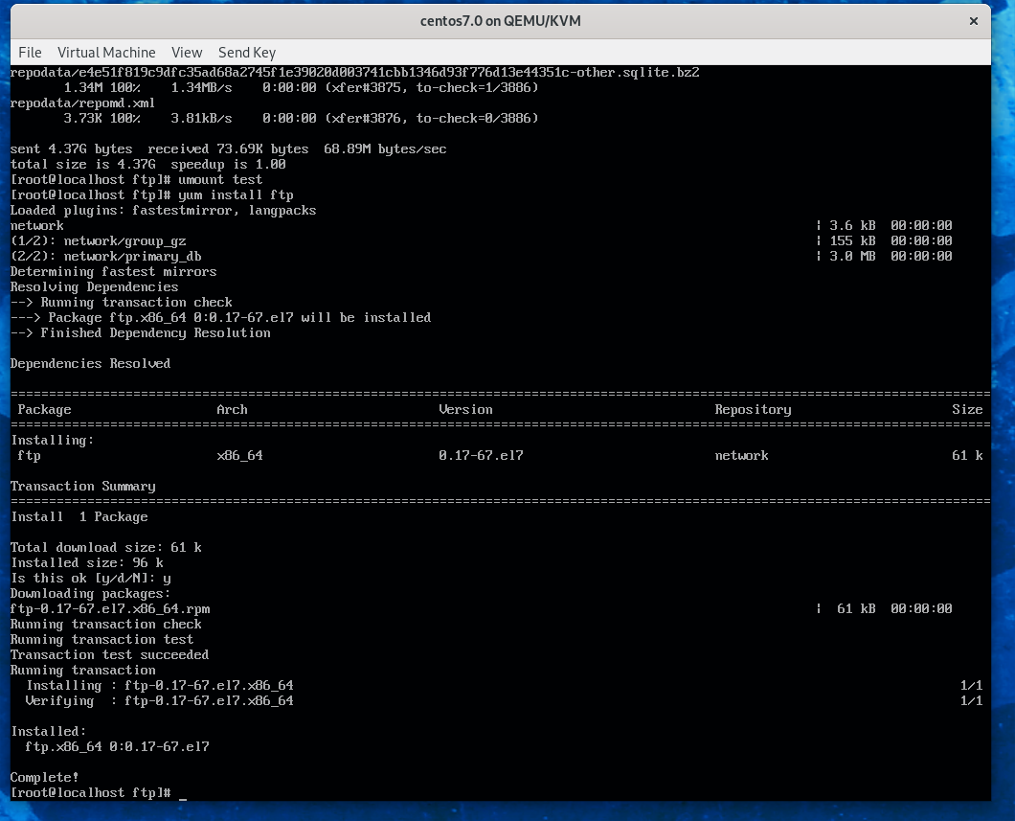

Slide 16
Repo done ; new VM
Go back to the Virtual machine manager:
Select a new VM as before, but instead of local CD, we are going to select a network install:
For URL, we will type: ftp://192.168.122.<repo>/pub
Memory, cpus, and disk to taste, forward, forward , Name the VM, and Finish
Time for questions.

Slide 17
Make new VM use repo
We can copy the repo file from our server, to use here.
scp root@192.168.122.<repo ip>:/etc/yum.repos.d/network.repo /etc/yum.repos.d/
or, recreate it as follows:
[network]
name=network
baseurl=ftp://192.168.122.<repo ip>/pub
Gpgcheck=0
yum clean all ; yum install screen

Slide 18
Success!
We now have a complete, self contained Linux network, with local repositories, so that we can install software without a network connection.
All new VMs will now get new software from our local repo, not the repositories on the internet, so all versions will stay in sync.

Slide 19
Questions
Slides available at github.com/murphnj/hourlab
Contact me at:
murph@member.fsf.org <email>
@murph@fosstodon.org <fediverse>

