Slide 1

The Fediverse
An introduction to the Fediverse.
Logo By Eukombos [CC0], from Wikimedia Commons

Slide 2
Introduction:
murph
System administrator in New Jersey
Long-time Linux user, long time Fediverse denizen.
@murph@fosstodon.org
https://identi.ca/murph
Email: murph@weirdness.com

Slide 3
Overview
The fediverse is a collection of protocols, servers, and users.
Together they form networks that can communicate together.
Users can exchange short messages, blog-style posts, music, and videos throughout.

Slide 4
Some history
In 2008, Evan Prodromou created a twitter-like service called identi.ca. It used the Ostatus protocol.
In about 2012, he changed his service to use a new protocol, pump.io. He released the status.net protocol to the FSF, renamed as GNU/social. The fediverse continued along for several years.
March 2016, Eugen Rochco (Gargron) created Mastodon, which used GNU/social with a tweetdeck-like interface. This gained some popularity.
2018, ActivityPub, a new protocol was accepted as a standardized protocol. Most fediverse platforms have adopted it. Authored by Evan P., Chris Lemmer-Weber and others, it expanded upon the previous into a better protocol.

Slide 5
Federation
Most services are run by a single company or organization A single silo that your data is trapped in, the only way to share with others is to have them join that service.
Federation allows users of different services to inter-operate with one another, without creating an account for each shared resource. (Largely)
System operators can block other instances in case of egregious issues, and users can likewise block users or instances to improve their experience.

Slide 6

Illustration of federation

Slide 7
Services available (partial)
Mastodon, pleroma, misskey
Pixelfed
Lemmy
Write.as, read.as
Peertube
Funkwhale
Mobilizon, gettogether.community
Microblogging
Image hosting
Link aggregator
Blogging
Video Hosting
Audio Hosting
Event planning

Slide 8
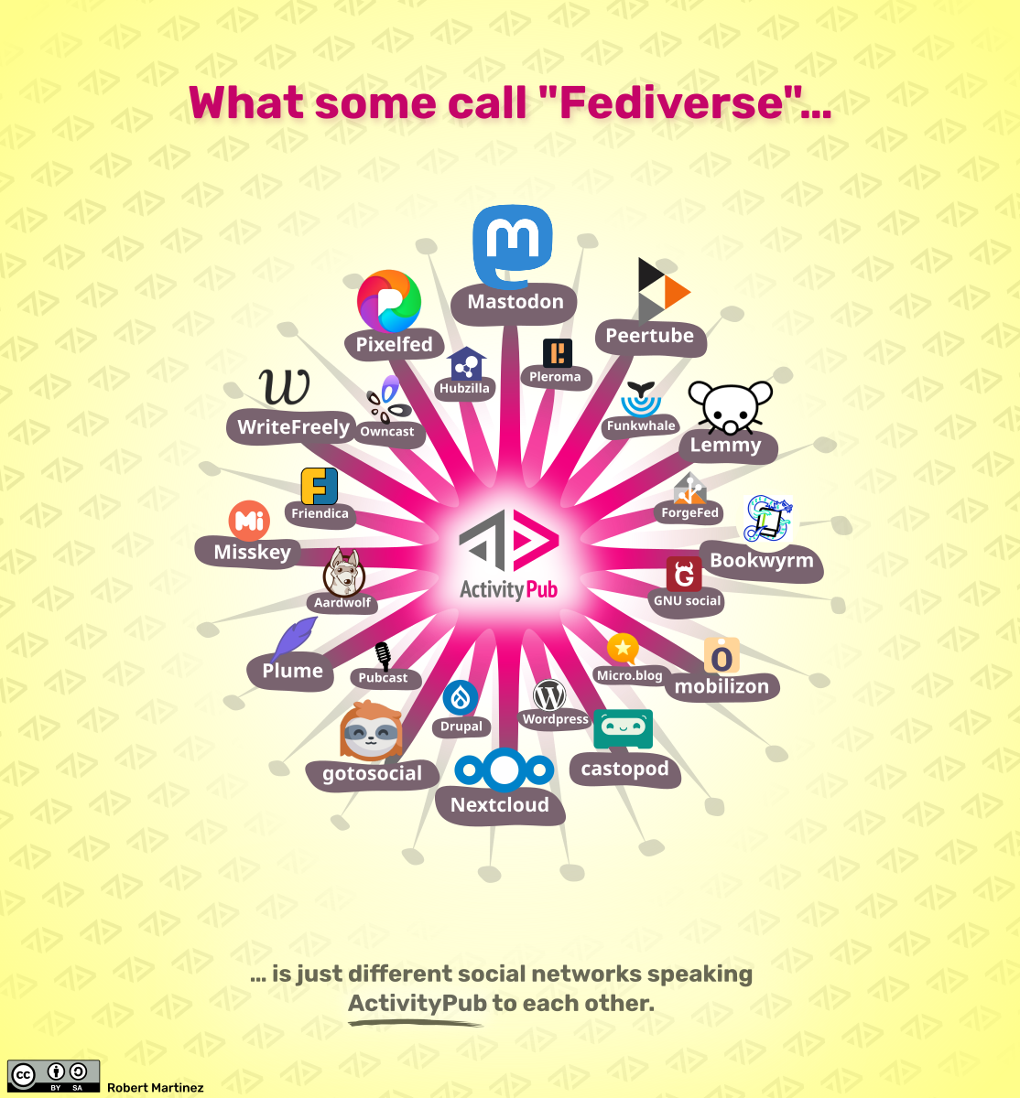
More services
There are many new
services that all use the
ActivityPub protocol
to work together

Slide 9
Hosting
Join an instance
  https://joinmastodon.org/
  https://Fediverse.party/
Create your own instance
  Bare metal
  VPS
  Container
Hosted Mastodon
  https://masto.host/
    Various levels
    Starting at 6euro
    They maintain it

Slide 10

How the timelines work:
Chart by:
@cassolotl@dev.glitch.social/

Slide 11

Example: Mastodon

Slide 12
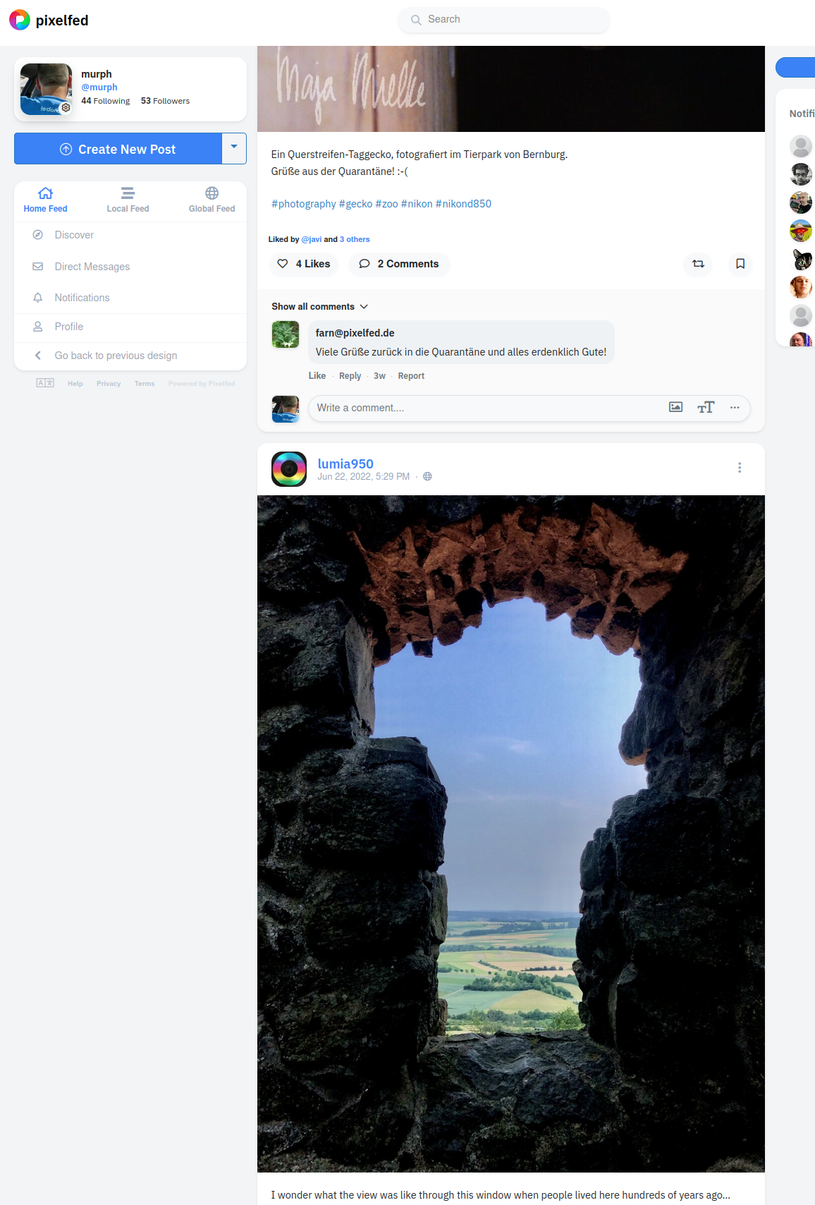
Example: Pixelfed

Slide 13

Example: Peertube

Slide 14
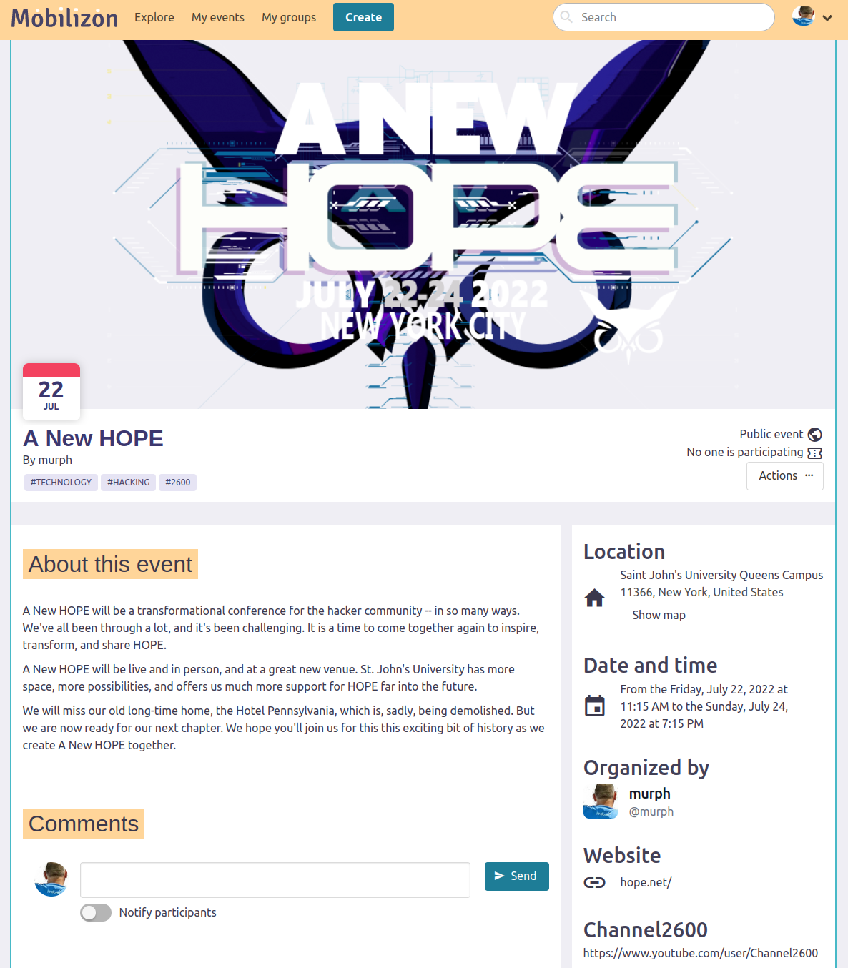
Example: Mobilizon

Slide 15
Where to start
joinmastodon.org
https://fediverse.party/en/portal/servers
fediverse.info
joinfediverse.wiki

Slide 16
Conclusion:
The Fediverse is a way to use the web in a more individual way, either by choosing an instance with a community that suits your needs, or running your own server, and making it exactly the way you want.
It avoids the advertising, algorithms, and other unpleasantries that plague some other social networks.

Slide 17
Where to learn more:
A few links to find more about the Fediverse:
  General info:
    https://fediverse.party
    https://feneas.org
  News about the Fediverse: (appears to be down)
    https://wedistribute.org
  Which instance to join (assuming you don’t want to spin up your own just yet):
    https://fediverse.party/en/portal/servers
  Tool to visualize networks, communities on the Fediverse:
    https://www.fediverse.space
    https://kumu.io/wakest/fediverse
  Stats, monitoring service, and list/map of the known Fediverse:
    https://the-federation.info
    this slide shamelessly stolen from Mauricio Uribe (with permission) https://mxuribe.com

Slide 18
Thank you.
I’ll be happy to entertain any questions, or further demonstrate what I can on the fediverse.
Contact information:
  https://identi.ca/murph
  @murph@fosstodon.org https://fosstodon.org/@murph
  murph@weirdness.com

