Slide 1

Mastodon and the Fediverse
An introduction to Mastodon and the Fediverse.
Logo By Eukombos [CC0], from Wikimedia Commons

Slide 2
Introduction:
Bob Murphy
System administrator in New Jersey
Long-time Linux user, long time Fediverse denizen.
@murph@hackers.town
@murph@gardenstate.social
https://identi.ca/murph
Email: murph@weirdness.com
Slides available at murphnj.neocities.org

Slide 3
Overview
The fediverse (a portmanteau of "federated" and "universe") is a collection of protocols, servers, and users.
Together they form communities that can communicate together.
Users can exchange short messages, blog-style posts, music, and videos between services.

Slide 4
Some history
In 2008, Evan Prodromou created a microblogging service called identi.ca using the Ostatus protocol and status.net server software.
In about 2012, he changed his service to use a new protocol, pump.io. He released the Ostatus protocol to the Free Software Foundation, where it got incorporated into GNU/social. The fediverse continued along for several years.
March 2016, Eugen Rochco (Gargron) created Mastodon, which used GNU/social with a tweetdeck-like interface. This gained some popularity.
In 2018, a new protocol called ActivityPub was accepted as a standardized protocol by the W3C. Most Fediverse platforms have adopted it. It was authored by Evan Prodromou, Christine Lemmer-Weber, and others, and it expanded upon the previous services to provide a better and more flexible protocol.

Slide 5
Federation
Most services are run by a single company or organization A single silo that your data is trapped in, the only way to share with others is to have them join that service.
Federation allows users of different services to inter-operate with one another, without creating an account for each shared resource. (Largely)
System operators can block other instances in case of egregious issues, and users can likewise block users or instances to improve their experience.

Slide 6

Illustration of federation

Slide 7
Services available (partial)
Mastodon, pleroma, misskey
Pixelfed
Lemmy
Writefreely.org, Wordpress(plugin)
Peertube
Funkwhale
Mobilizon, gettogether.community
Microblogging
Image hosting
Link aggregator
Blogging
Video Hosting
Audio Hosting
Event planning

Slide 8
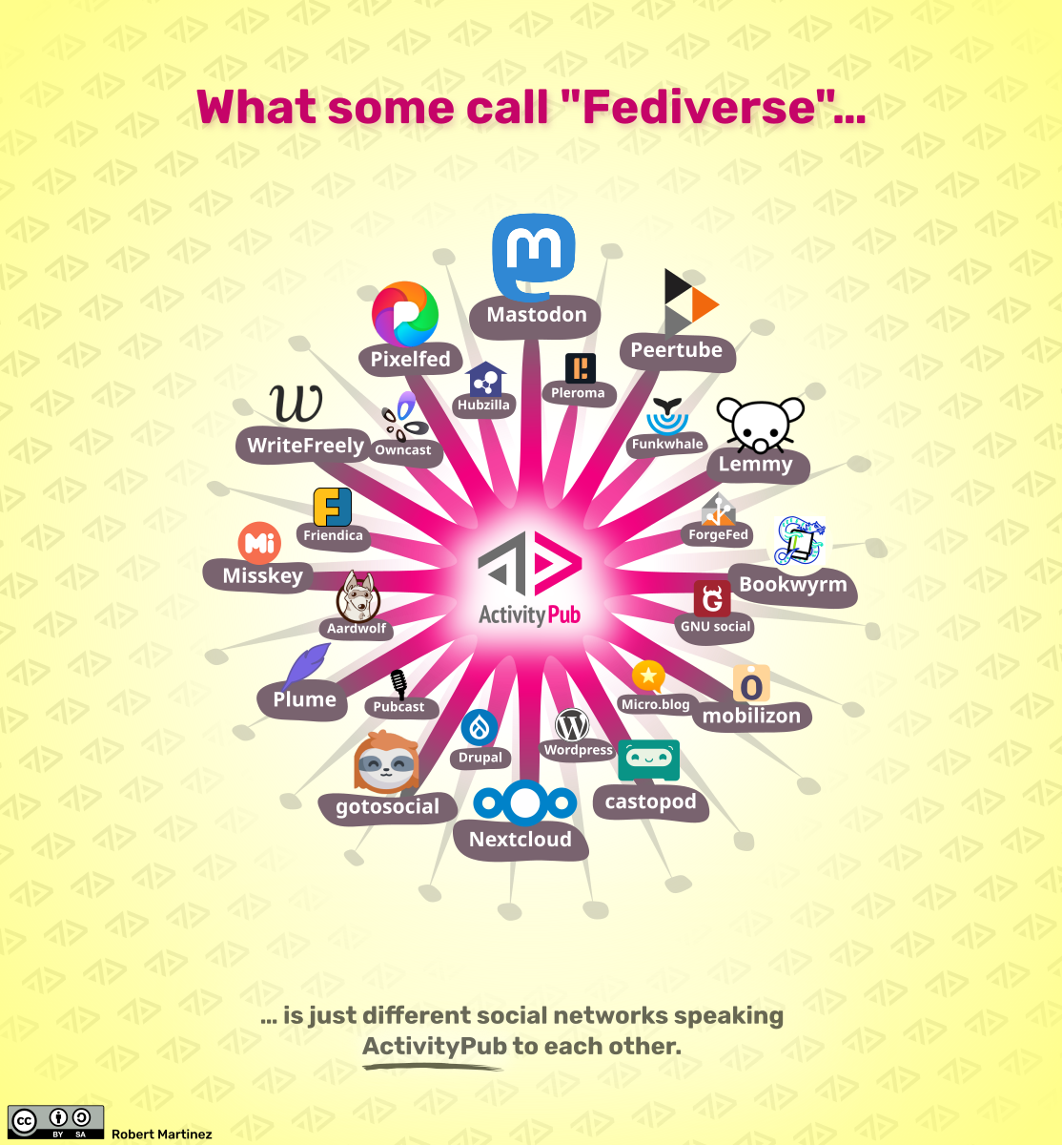
More services
There are many new
services that all use the
ActivityPub protocol
to work together
More are being created every day, development is rapid.

Slide 9
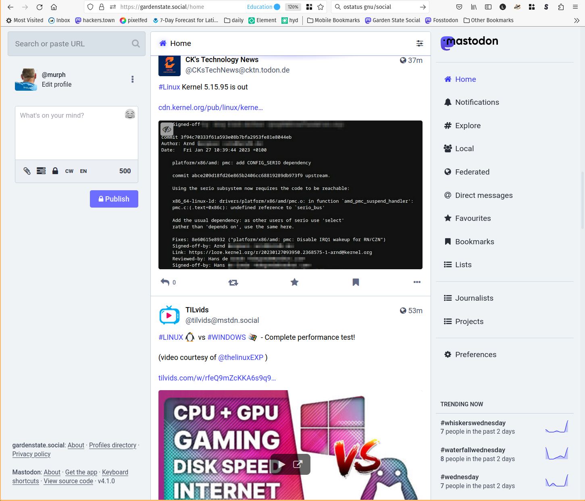
Example: Mastodon (default)

Slide 10
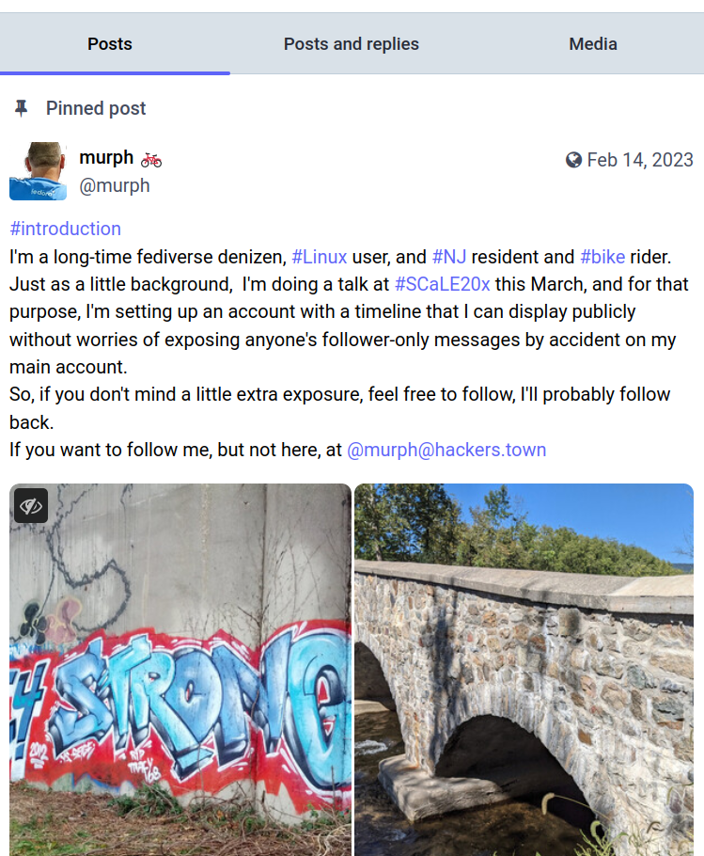
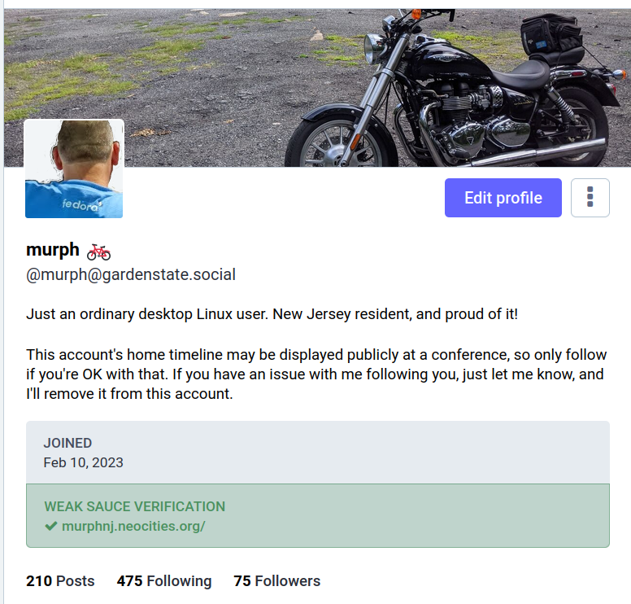
Profile example

Slide 11

Example: Mastodon (advanced)

Slide 12
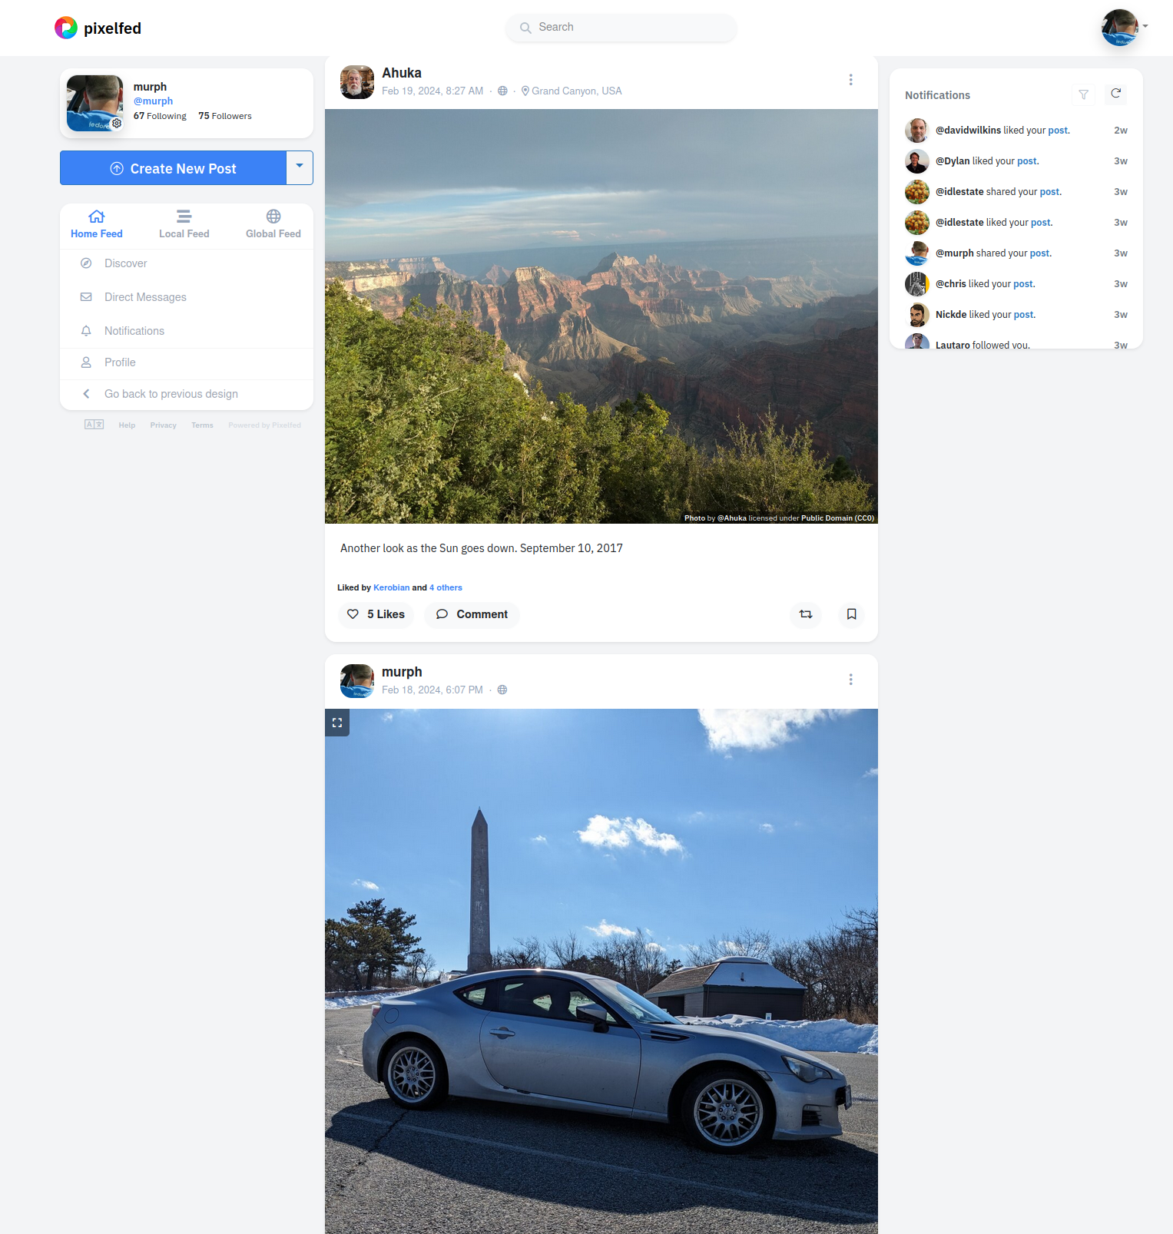
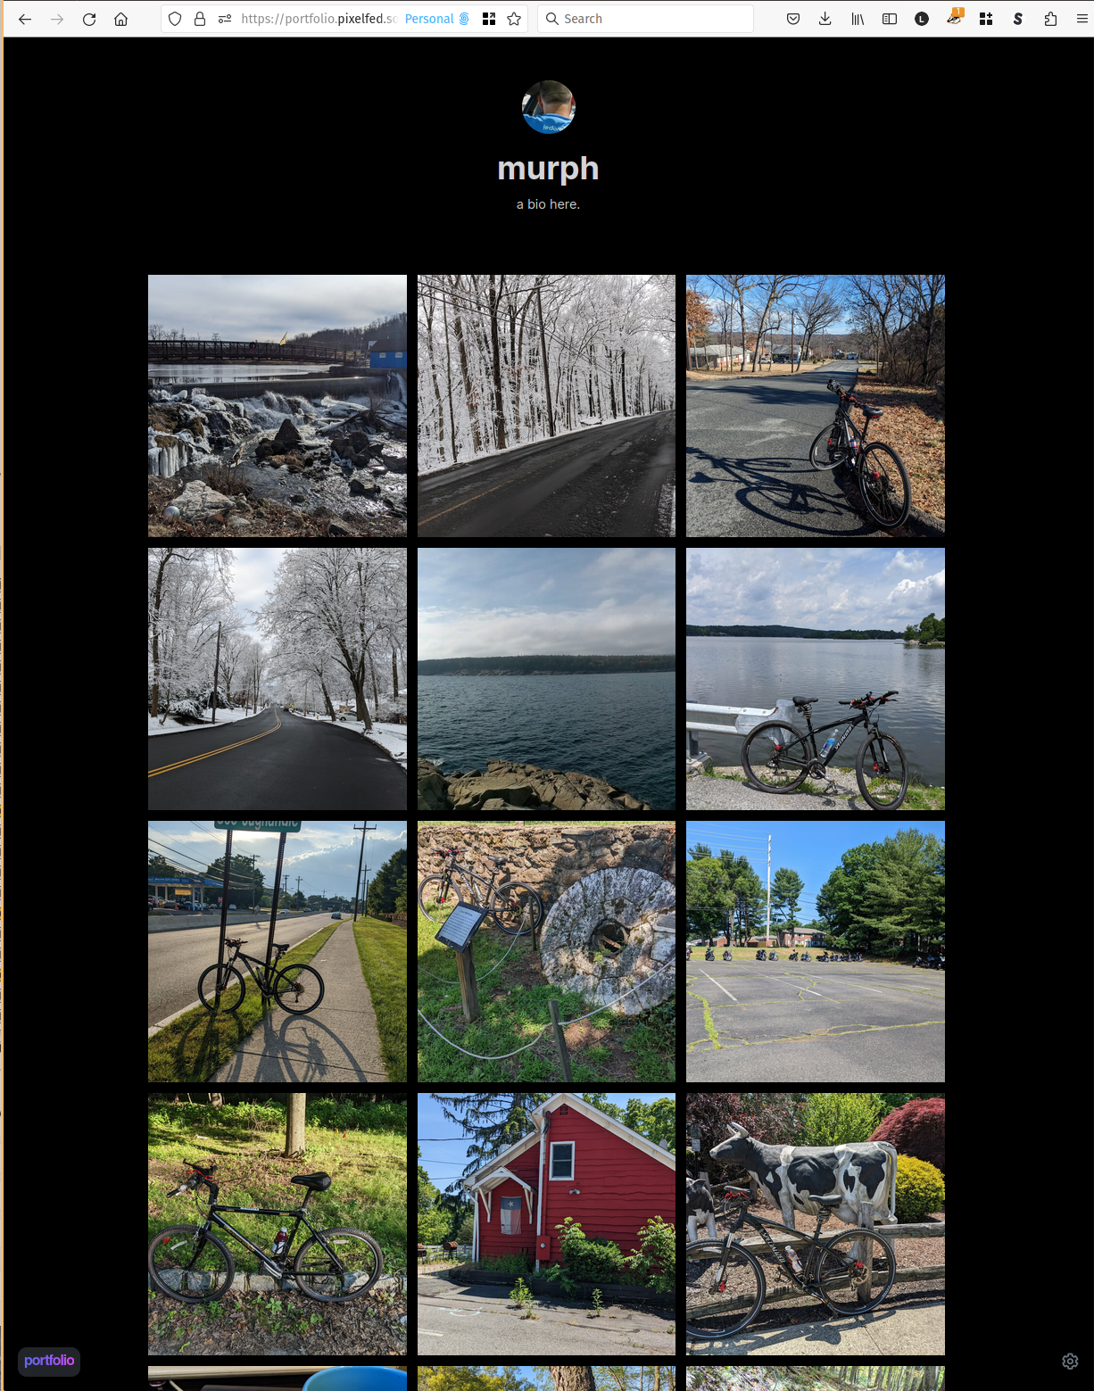
Example: Pixelfed

Slide 13
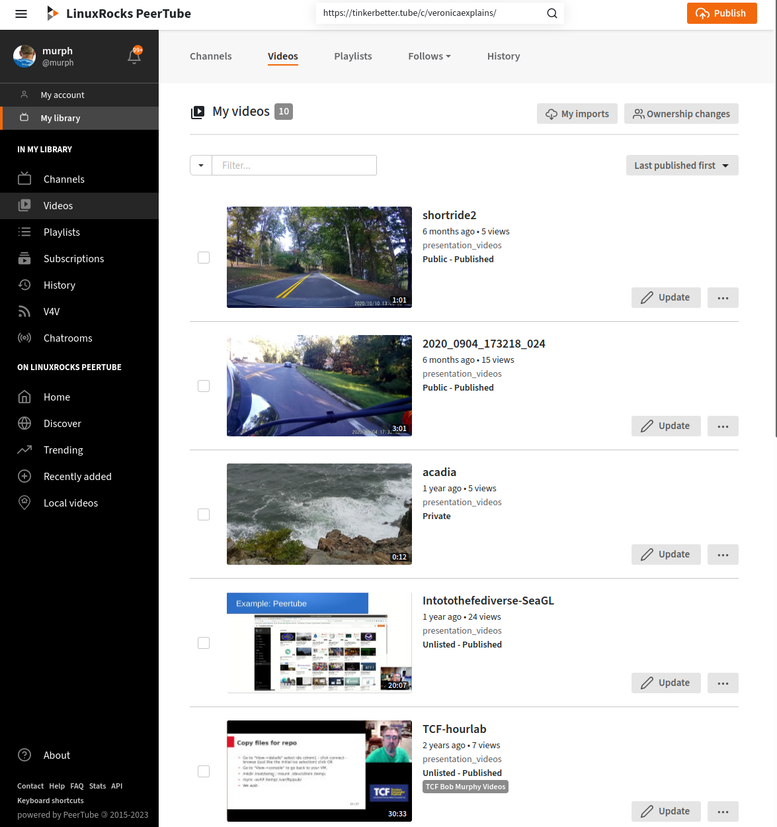
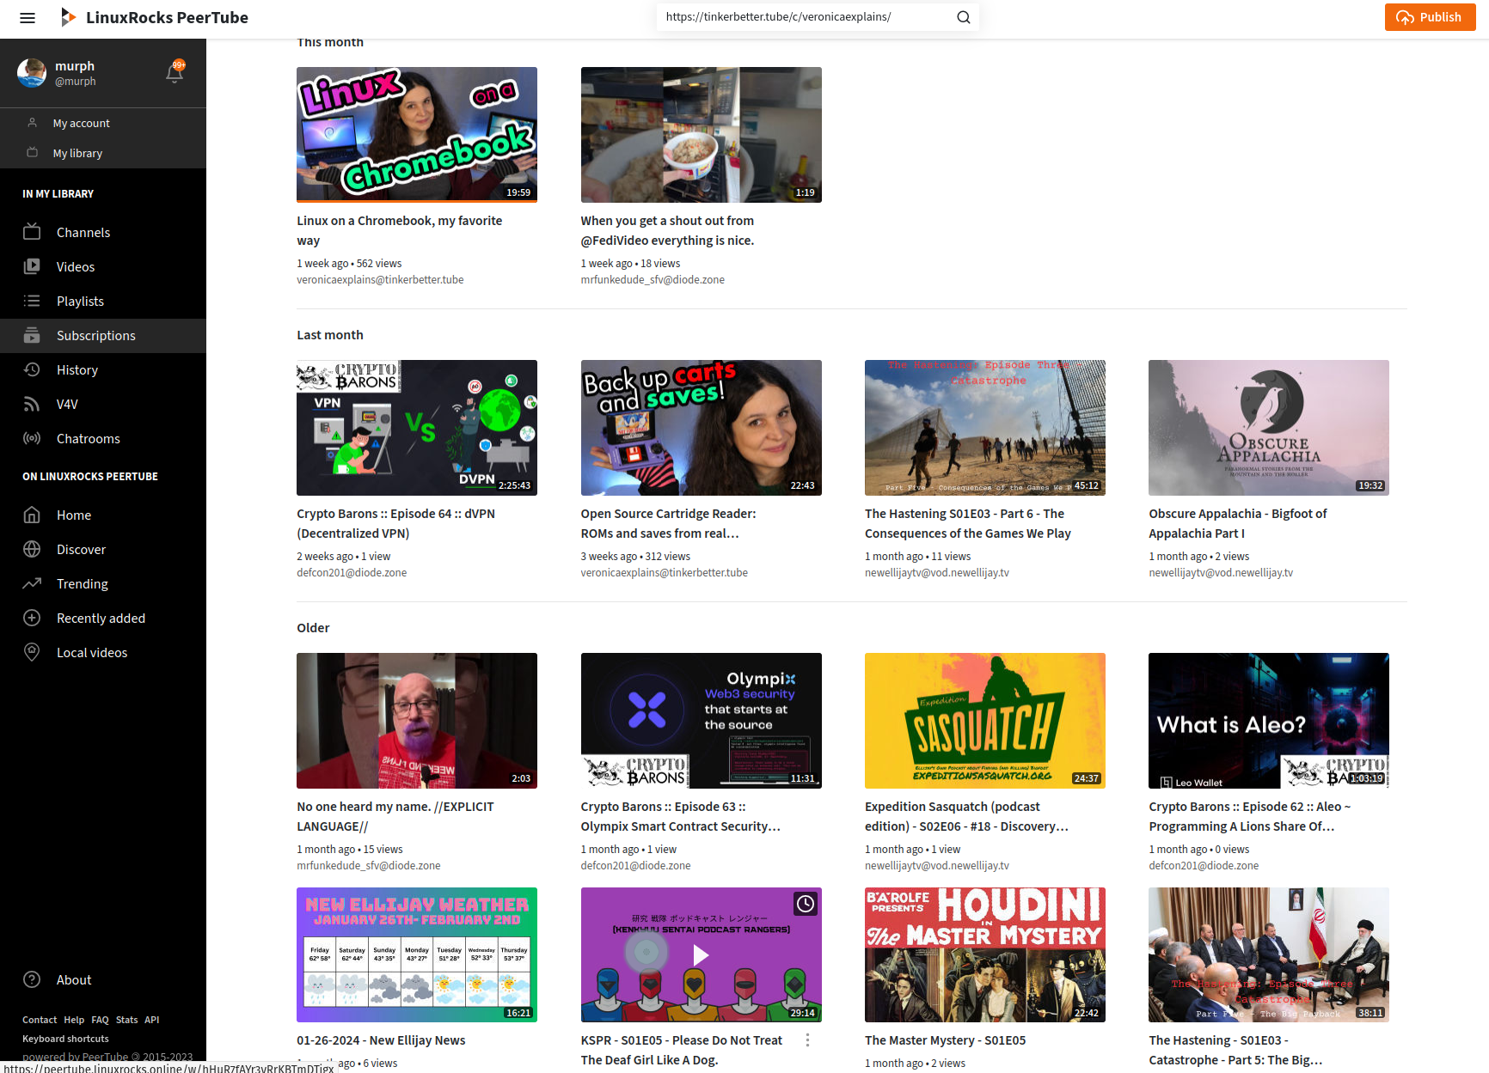
Example: Peertube

Slide 14
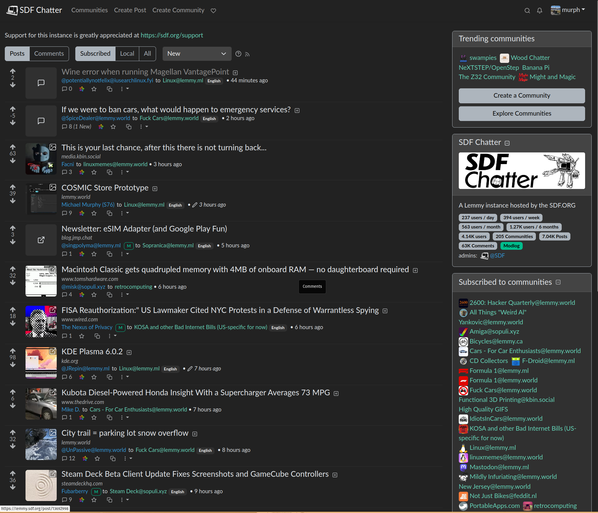
Lemmy

Slide 15
How to find people to follow
Look in your local timeline.
Find interesting people, and follow them.
See what they post and boost, and look at the people that follow them.
Search for hashtags that interest you.
You can follow hashtags in your Home timeline.
From there, find the people posting about what interests you.

Slide 16
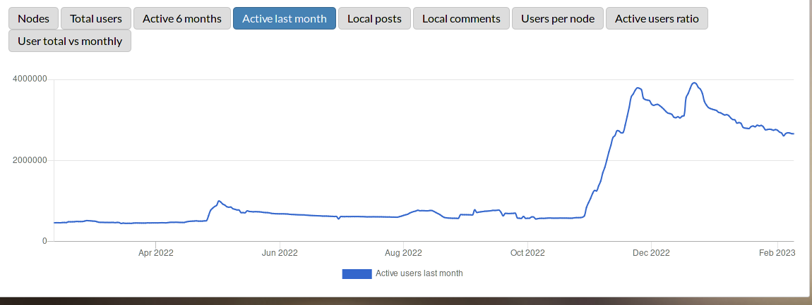
Will the Fediverse stick around?
Some people reported that since many of the Twitter users that tried Mastodon moved back, that Mastodon is doomed to fail.
Since the fediverse is not tied to a company that has to provide immediate
profits, slow growth
is OK, it allows
communities to work
to accept new people
graph from the-federation.info

Slide 17
New services that federate?
Bluesky
Controlled by a small number of people.
Not yet federated with anyone.
Moderation seems iffy
Threads
Controlled by one rich dude (Sound familiar?)
Seems to have died down after a big initial splash
Also does not federate with anyone yet. (They have been experimenting though)

Slide 18
Conclusion:
The Fediverse is a way to use the web in a more individual way, either by choosing an instance with a community that suits your needs, or running your own server, and making it exactly the way you want.
It avoids the advertising, algorithms, and other unpleasantries that plague some other social networks.
When you join the fediverse, you are joining a community of the instance that you choose, you are not a way for a company to figure out how to make profit from your communication.

Slide 19
Where to learn more:
A few links to find more about the Fediverse:
  General info:
    fediverse.info -- Nice video explanation, also, subject-based way to find (self-selected) users.
    fedi.tips -- Comprehensive guide for users.
  Where to start
    joinmastodon.org -- largest list of Mastodon servers
    joinfediverse.wiki-- Great information on different fediverse services and instances
    Fedi.garden – well-curated list of instances
  Which instance to join (assuming you don’t want to spin up your own just yet):
    fediverse.party/en/portal/servers
  Biased recommendation for this audience
    gardenstate.social
  Stats, monitoring service, and list of the known Fediverse:
    the-federation.info - charts and graphs of fediverse use.
    this slide shamelessly stolen from Mauricio Uribe (with permission) and subsequently vandalized beyond recognition.

Slide 20
Thank you.
I’ll be happy to entertain any questions, or further demonstrate what I can on the fediverse.
Contact information:
  @murph@hackers.town https://hackers.town/@murph
  @murph@gardenstate.social https://gardenstate.social/@murph
  murph@weirdness.com (email)

Slide 21

How the timelines work:
Chart by:
@cassolotl@dev.glitch.social/

Slide 22

"La grande vague" by David Revoy, framasoft.org − CC-BY 4.0

Slide 23


