Slide 1
SurakṣāMārga.ai (SuraksaMarga.ai)
5G INNOVATION HACKATHON 2026
A 5G-ENABLED AI SYSTEM FOR WOMEN SAFETY NAVIGATION
SAFETY
Great navigation should feel protective.
We re-engineer urban routing around the realities women face, weighing 157,160 real crime records to navigate around danger, not just toward a destination.
OVER
SPEED.
01
02
03
04
Safe Route Engine
Crime-Weighted Risk
5G SOS Layer
Live Safety Loop
KAARTHIKEYA PAHALWAN · NISARGA S

Slide 2
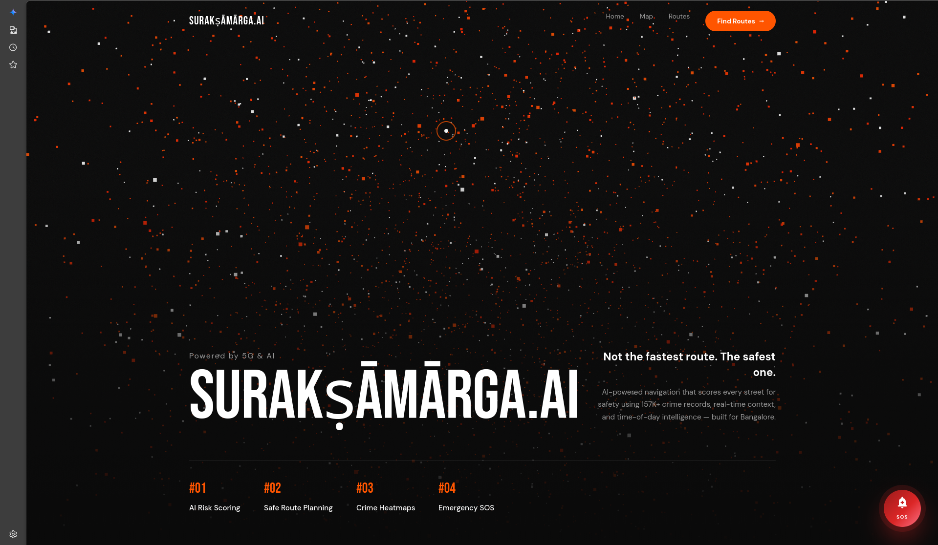
SurakṣāMārga.ai (SuraksaMarga.ai)
5G INNOVATION HACKATHON · 02
01
INTRODUCTION
NAVIGATION
WAS NEVER BUILT
FOR HER.
Modern mapping apps optimise for journey time, exposing women to isolated shortcuts, desolate backstreets and unlit alleys, especially after dark. SuraksaMarga.ai bridges geospatial routing with real-world danger prevention. It actively protects women by prioritising localised safety intelligence over arbitrary travel speed.
SURAKṢĀMĀRGA.AI · WOMEN-FIRST SAFE NAVIGATION
02 / 09

Slide 3
SurakṣāMārga.ai (SuraksaMarga.ai)
5G INNOVATION HACKATHON · 03
02
PROBLEM STATEMENT
THE MAP IGNORES
WHAT WOMEN ALREADY KNOW.
01
02
03
Time-Only Models
Forced Unsafe Shortcuts
No Protective Layer
Commercial systems apply rigid pedestrian models focused entirely on reducing time and distance, never on safety.
Women are routed into inherently threatening terrain without any advanced warning of crime hotspots or isolation.
Users must exit the map to formulate emergency communications when danger is imminent, a critical systemic failure.
SURAKṢĀMĀRGA.AI · WOMEN-FIRST SAFE NAVIGATION
03 / 09

Slide 4
SurakṣāMārga.ai (SuraksaMarga.ai)
5G INNOVATION HACKATHON · 04
03
OBJECTIVES
RAPID. SECURE.
WOMEN-FIRST TRANSIT.
01
02
03
04
Safe Route Recommendation
Women-Centric Crime Weighting
SOS Emergency System
5G Low-Latency Capability
Map the safest traversal, explicitly avoiding identified danger zones.
Penalise routes featuring histories of gender-based crime incidents.
Trigger live location tracking and responder alerts seamlessly.
Utilise 5G for immediate safety-system distress broadcasts.
SURAKṢĀMĀRGA.AI · WOMEN-FIRST SAFE NAVIGATION
04 / 09

Slide 5
SurakṣāMārga.ai (SuraksaMarga.ai)
5G INNOVATION HACKATHON · 05
04
EXISTING WORK & RESEARCH GAP
FAST, NOT SAFE.
EXISTING
OURS
WE BRIDGE THE GAP.
ROUTING BASIS
Time / distance
Crime-weighted safety
GENDER AWARENESS
Google Maps and OSRM rely exclusively on the "fastest route" mentality. They possess no capacity to distinguish a secure, well-lit main avenue from an inherently unsafe, desolate alleyway. Gender-specific risk is totally absent from modern mapping tools. Existing solutions treat all pedestrians uniformly. SuraksaMarga.ai directly enforces safety constraints first and speed constraints second.
None
Women-first weighting
NIGHT-TIME LOGIC
Static
Active multipliers
SOS INTEGRATION
External app
Built into route
LATENCY TARGET
Best-effort
5G edge ~10 ms
SURAKṢĀMĀRGA.AI · WOMEN-FIRST SAFE NAVIGATION
05 / 09

Slide 6
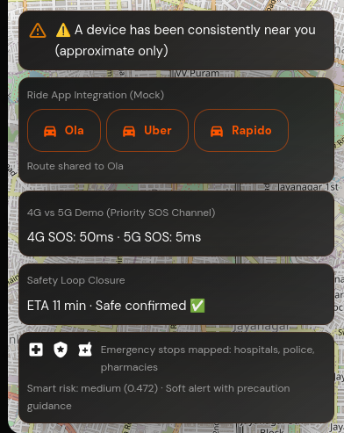
SurakṣāMārga.ai (SuraksaMarga.ai)
5G INNOVATION HACKATHON · 06
05
PROPOSED METHODOLOGY
SIX SUBSYSTEMS. ONE SAFE JOURNEY.
SAFETY LOOP CLOSURE · END-TO-END FLOW
01
02
03
Routing Engine
Risk Scoring
Temporal Intelligence
Prioritises safest paths over shortest distance by penalising high-risk segments derived from crime data.
Crimes targeting women receive maximum analytical weight, guaranteed circumvention of historically hostile streets.
Night-time multipliers redirect predictive paths heavily toward well-lit, trafficked thoroughfares.
04
05
06
SOS Emergency
5G Safety Layer
Scalable Scope
Long-press bypasses navigation to initiate live geo-tracking and transmit high-priority alerts to responders.
Removes data-transmission limits, split-second distress beacons without buffer wait times.
Demonstrated in Bengaluru on 157,160 records; architecture designed to expand to additional cities.
SURAKṢĀMĀRGA.AI · WOMEN-FIRST SAFE NAVIGATION
06 / 09

Slide 7
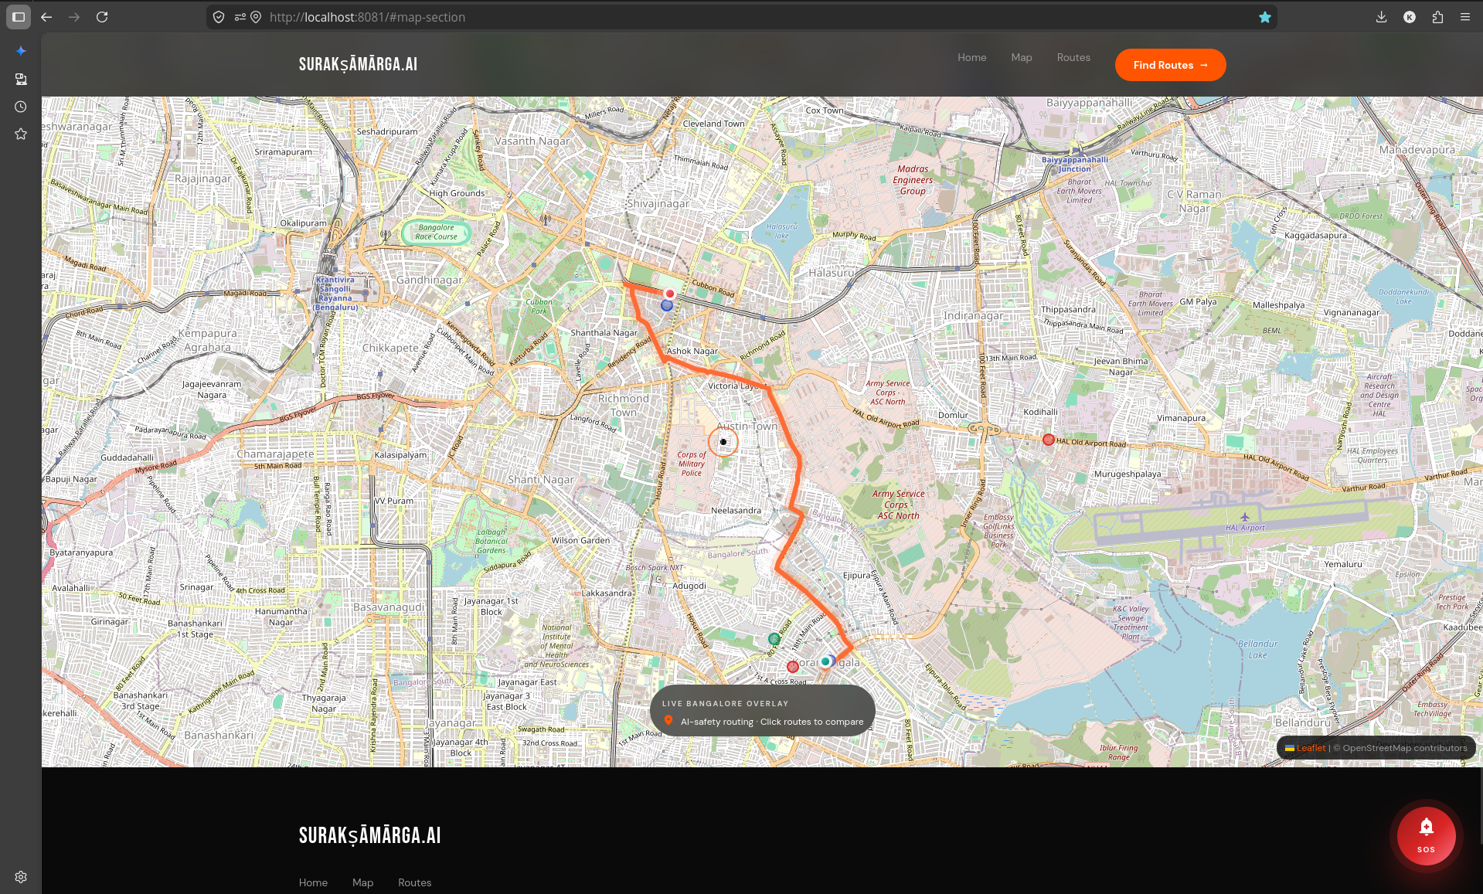
SurakṣāMārga.ai (SuraksaMarga.ai)
5G INNOVATION HACKATHON · 07
06
EXPERIMENTS & RESULTS
5G EDGE CHANGES
EVERYTHING.
COMPLETE ROUTE MATRIX · PROTECTIVE INTERVENTIONS
EMERGENCY RESPONSE LATENCY
Scenario
3G
4G
5G Edge
Route Safety Scoring
~700 ms
~250 ms
~50 ms
SOS Distress Broadcast
~400 ms
~150 ms
~10 ms
Live Tracker Updates
Every 30 s
Every 15 s
Every 2 s
5G bypasses 4G connectivity ceilings, directly accelerating emergency response for women in transit.
SURAKṢĀMĀRGA.AI · WOMEN-FIRST SAFE NAVIGATION
07 / 09

Slide 8
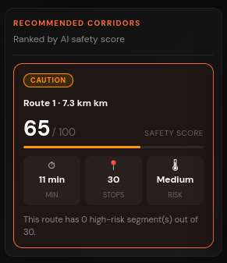
SurakṣāMārga.ai (SuraksaMarga.ai)
5G INNOVATION HACKATHON · 08
07
NOVELTY
BUILT UNIQUELY
FOR PROTECTION.
FIRST
Women-first safety routing system.
PRIORITY
Safety prioritised over speed.
INTEGRATED
SOS + navigation in a single layer.
REAL-TIME
5G-enabled real-time protection.
SURAKṢĀMĀRGA.AI · WOMEN-FIRST SAFE NAVIGATION
08 / 09

Slide 9
SurakṣāMārga.ai (SuraksaMarga.ai)
5G INNOVATION HACKATHON · 09
08
CONCLUSION
NAVIGATION,
REBUILT AS SAFETY
INFRASTRUCTURE.
By shifting the foundational routing algorithm to prioritise protection over proximity, SuraksaMarga.ai solves a critical real-world safety problem, transforming navigation from a convenience tool into real-time safety infrastructure for women.
FUTURE ENHANCEMENT
Real-time data integration enables predictive heat-mapping, anticipating risk zones dynamically by combining historical patterns with live situational awareness.
THANK YOU · KAARTHIKEYA PAHALWAN · NISARGA S
09 / 09

