Slide 1
Spotted Fever Rickettsiosis in the United States
Murphy John

Slide 2
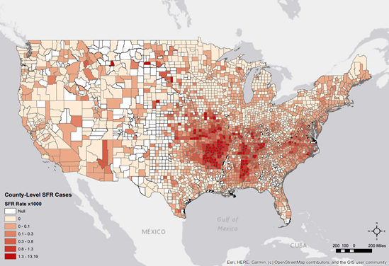
Introduction
Spotted Fever Rickettsiosis (SFR) refers to a group of tick-borne diseases caused by Rickettsia bacteria.
Recent Trends:
Significant surge in SFR cases over the past two decades.
Increase from 495 reported cases in 2000 to a peak of 6,248 in 2017.
Study Overview:
Used detailed social and environmental data from counties in the contiguous U.S.
Studied how canine hosts affect SFR rates, looking at county-level access to veterinary care and dog population.
Objectives:
Characterize SFR geographical patterns.
Identify contributing factors.
Analyze high-incidence SFR areas.
SFR Rate Data

Slide 3
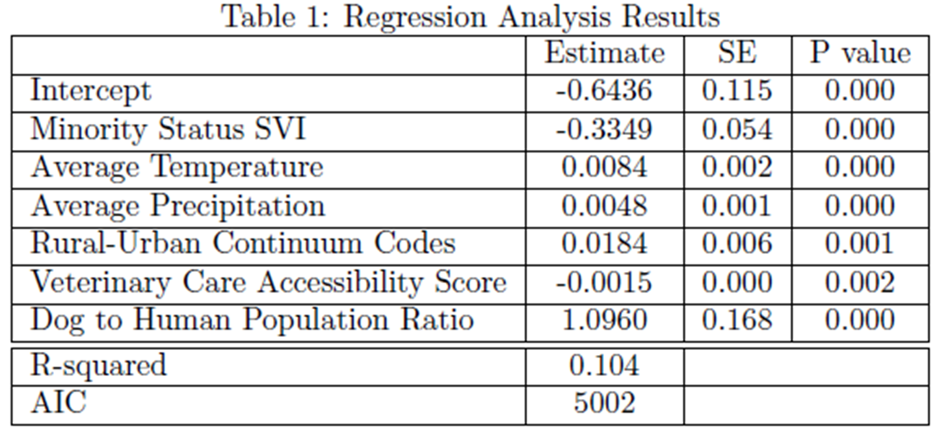
Regression Analysis
Factors that increase SFR Rate:
Temperature and Precipitation
Rural Areas
Dog Population
Factors that decrease SFR Rate:
Minority Status SVI (Social Vulnerability Index)
Veterinary Accessibility

Slide 4
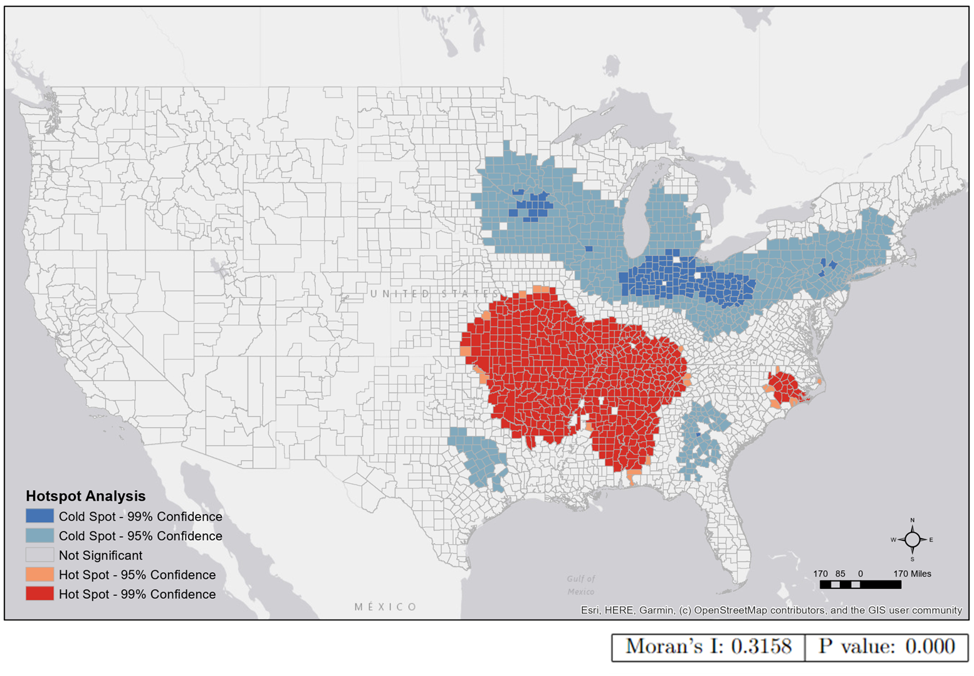
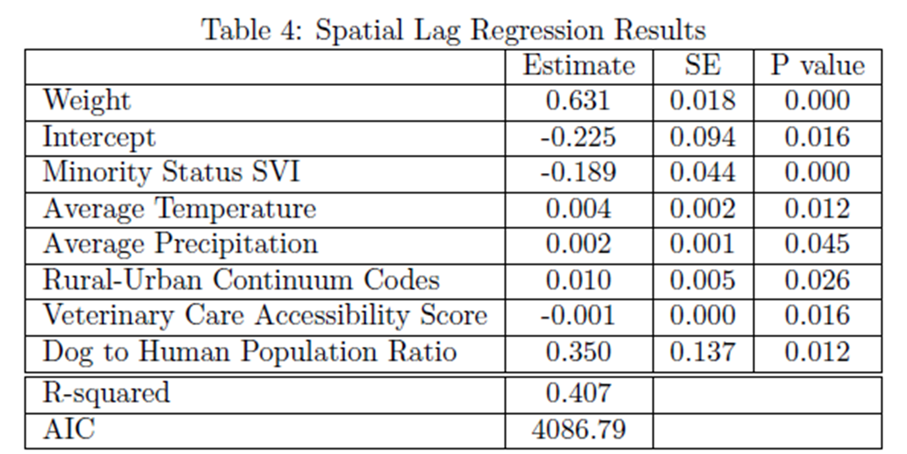
Spatial Analysis
Hotspot Analysis
Hot Spots: Areas with higher SFR rates.
Higher temperature and precipitation
Increased health shortage
More rural
Increased dog population
Cold Spots: Areas with lower SFR rates.
Increased minority populations
Greater veterinary accessibility
Spatial Lag Regression
Similar results to the regular regression model.
Including a spatial factor improves the model's accuracy.
This shows that location matters when predicting SFR rates.
Hotspot Analysis

Slide 5
Conclusions
Rural Influence and Population Demographic:
Rural areas and smaller minority populations have higher SFR rates.
A separate analysis finds that smaller minority populations are associated with rural areas.
The higher SFR rates in rural areas help explain why smaller minority populations are linked to increased SFR rates.
Canine Hosts:
The availability of veterinary care and dog population affect SFR rates.
When access to veterinary care is lower, SFR rates increase.
When there are more dogs, SFR rates also increases.

