Slide 1
Survey on AIOps(智能运维）
社外秘
開示範囲：
（HELC)(HCR&D）内
2021/4/14
(HCR&D)

Slide 2
１．AIOps
２．AIOps Design
３．AIOps Researches

Slide 3
１．AIOps
２．AIOps Design
３．AIOps Researches

Slide 4
1-1．IT System Operation
Modern IT environments—increasingly distributed, heterogeneous, and dynamic—show no signs of becoming easier to monitor and manage
Too much complexity.
Cloud and big data system
Container
Micro-services
Developers by Devops
Too much rapid Change
Too much data
Too many tools without unification

Slide 5
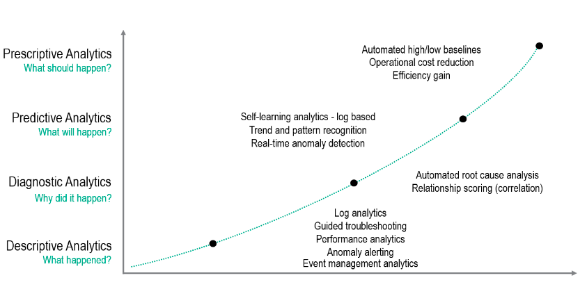
1-2．Transformation of IT Ops
A radical improvement in the speed and precision with which IT problems are detected, diagnosed, and resolved, resulting in dramatically fewer and shorter outages of critical apps and digital services.

Slide 6
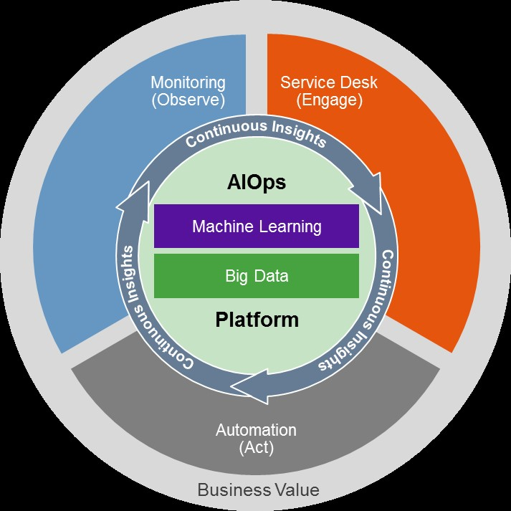
1-3．AIOps = Ops+AI
AIOps platforms utilize big data, modern machine learning and other advanced analytics technologies to directly and indirectly enhance IT operations functions with proactive, personal and dynamic insight.

Slide 7
1-4．Market of AIOps
The AIOps platform market size is expected to grow to USD 20.1 billion by 2027, at a Compound Annual Growth Rate of 31.2%.
MarketsandMarkets Research estimates that the global AIOps market will grow from $2.55 billion in 2018 to $11.02 billion by 2023, a jump representing a compound annual growth rate of 34%.
Yahoo!Finance reports that the Global AIOps Platform Market is expected to grow from USD 4,369.48 Million in 2020 to USD 9,851.15 Million by the end of 2025.
Amid the COVID-19 crisis, ResearchAndMarkets estimates that the global market for AIOps Platform estimated at US$3 Billion in the year 2020, is projected to reach a revised size of US$20.1 Billion by 2027, growing at a CAGR of 31.2% over the period 2020-2027.
And according to a May 2020 study from Digital Enterprise Journal (DEJ), there’s been an 83% increase since 2018 in the number of organizations deploying or looking to deploy AIOps.

Slide 8
１．AIOps
２．AIOps Design
３．AIOps Researches

Slide 9
2-1．AIOps design
Monitoring + Prediction + Automation
Capability
Features
Predictive Identification of Potential Risks to Services
Automate Root Cause Analysis Across Domains and Technologies
Establish Comprehensive, Contextual Automated Remediation
Dynamic, Policy-Based Configuration
Unified Monitoring and Analytics
Intelligent Automation
Extensibility

Slide 10
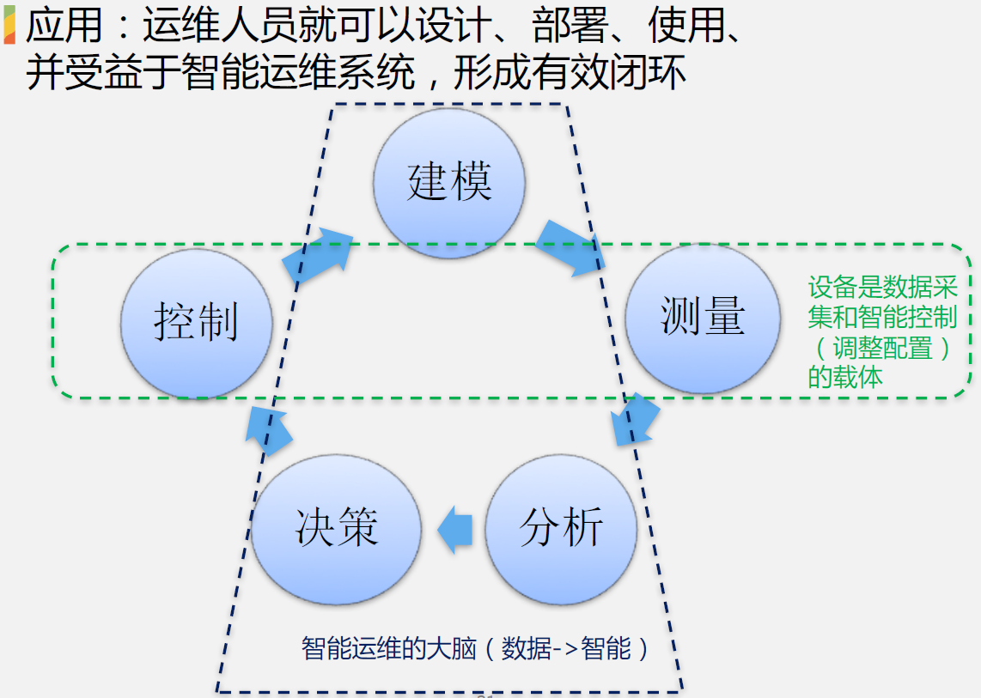
2-2．Information Cycle

Slide 11
１．AIOps
２．AIOps Design
３．AIOps Researches

Slide 12
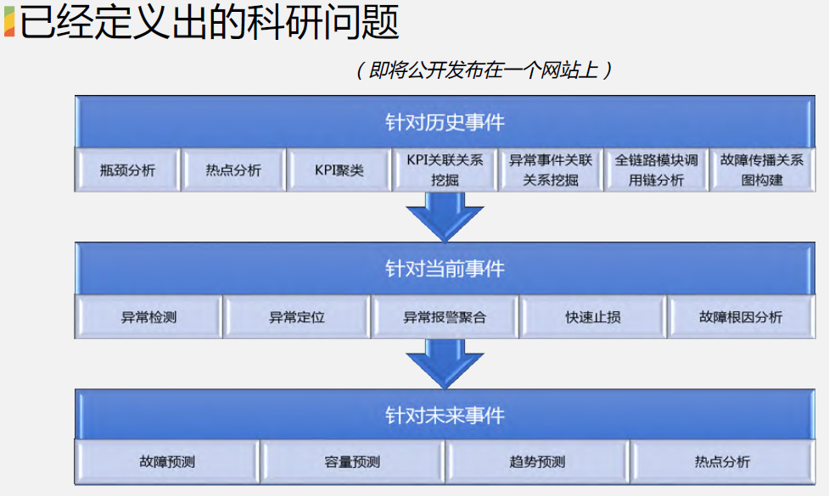
3-1．Research Themes
Groups by time-line of data generation
Detail explanation ( free format)
- Solution idea
- Assumed use case
-Applied technologies
-Benchmark (if possible)
詳細説明（フリーフォーマット）
-ソリューションアイデア
-想定するユースケース
-適用する技術
-ベンチマーク（可能であれば）

Slide 13
3-2．Open Source AIOps Themes
NO open source AIOps system available.
https://github.com/NetManAIOps by NetMan, THU
Focus on Anomaly Detection
Others
Loglizer:(797★)
一款基于AI的日志大数据分析工具, 能用于自动异常检测、智能故障诊断等场景
https://github.com/AmateurEvents/article/issues/2
Aiopstools: (230 ★)
aiops领域公开的工具包, https://github.com/jixinpu/aiopstools
功能包括：时间序列的预测；异常检测；报警收敛；报警关联分析
https://zhuanlan.zhihu.com/c_178702079
Logdeep
https://github.com/donglee-afar/logdeep
DeepLog/LogAnomaly/RobustLog
Log3C(131 ★)
https://github.com/logpai/Log3C
a general framework that identifies service system problems from system logs. Log3C consists of four steps: Log parsing, Sequence vectorization, Cascading Clustering and Correlation analysis.

Slide 14
3-2．Open Source AIOps Themes
NO open source AIOps system available.
Others
Seldon Core(2.2K★)
converts ML models into production REST/GRPC microservices
Advanced Metrics, Request Logging, Explainers, Outlier Detectors, A/B Tests, Canaries and more.
Log Anomaly Detector: (175 ★)
connect to streaming sources and produce predictions of abnormal log lines. Internally it uses unsupervised machine learning.
https://github.com/AICoE/log-anomaly-detecto
WhyLogs Library(334 ★)
an open source statistical logging library，java/python
https://github.com/whylabs/whylogs
Jumbune(66 ★)
https://github.com/Impetus/jumbune
an open-source Big Data APM
Anomaly Detection for Prometheus
https://github.com/AICoE/prometheus-anomaly-detector
From Redhat.com

