Slide 1
Bloom Filters:
A History and Modern Applications
Michael Mitzenmacher

Slide 2
The main point
Whenever you have a set or list, and space is an issue, a Bloom filter may be a useful alternative.

Slide 3
The Problem Solved by BF:
Approximate Set Membership
Given a set S = {x₁,x₂,…,x_{n}}, construct data structure to answer queries of the form “Is y in S?”
Data structure should be:
  Fast (Faster than searching through S).
  Small (Smaller than explicit representation).
To obtain speed and size improvements, allow some probability of error.
  False positives: y ∉ S but we report y ∈ S
  False negatives: y ∈ S but we report y ∉ S

Slide 4
Bloom Filters
Start with an m bit array, filled with 0s.
B
0
0
0
0
0
0
0
0
0
0
0
0
0
0
0
0
Hash each item x_{j} in S k times. If H_{i}(x_{j}) = a, set B[a] = 1.
B
0
1
0
0
1
0
1
0
0
1
1
1
0
1
1
0
To check if y is in S, check B at H_{i}(y). All k values must be 1.
B
0
1
0
0
1
0
1
0
0
1
1
1
0
1
1
0
Possible to have a false positive; all k values are 1, but y is not in S.
B
0
1
0
0
1
0
1
0
0
1
1
1
0
1
1
0
n items m = cn bits k hash functions

Slide 5
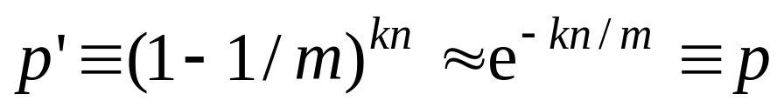
False Positive Probability
Pr(specific bit of filter is 0) is
If ρ is fraction of 0 bits in the filter then false positive probability is
Approximations valid as ρ is concentrated around E[ρ].
  Martingale argument suffices.
Find optimal at k = (ln 2)m/n by calculus.
  So optimal fpp is about (0.6185)^{m/n}
n items m = cn bits k hash functions

Slide 6
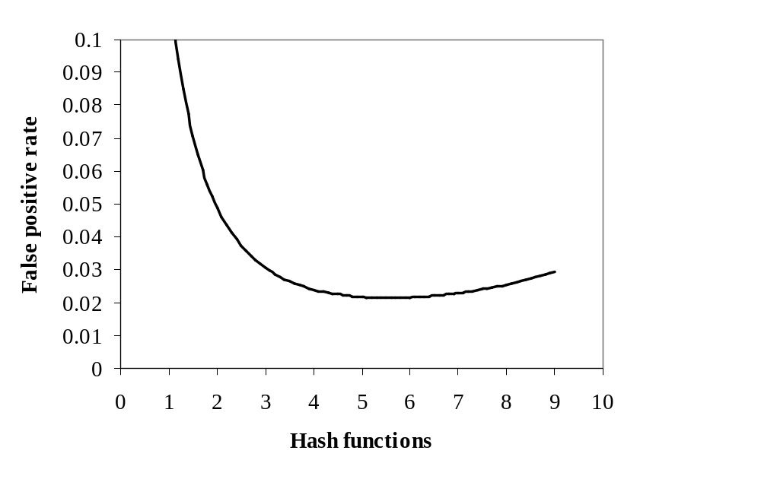
Example
m/n = 8
Opt k = 8 ln 2 = 5.45...
n items m = cn bits k hash functions

Slide 7
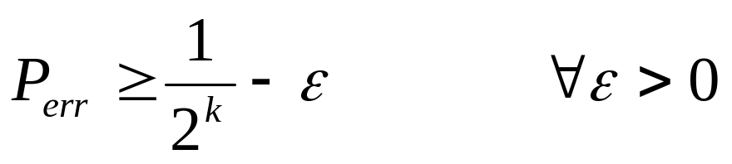
False Positives -- Theory
For large enough universes, a data structure to represent n keys using kn bits has false positive probability at least
Can be matched by perfect hashing.

Slide 8

Alternative Approach for
Bloom Filters
Folklore Bloom filter construction.
  Recall: Given a set S = {x₁,x₂,x₃,…x_{n}} on a universe U, want to answer membership queries.
  Method: Find an n-cell perfect hash function for S.
    Maps set of n elements to n cells in a 1-1 manner.
  Then keep bit fingerprint of item in each cell. Lookups have false positive < ε.
  Advantage: each bit/item reduces false positives by a factor of 1/2, vs ln 2 for a standard Bloom filter.
Negatives:
  Perfect hash functions non-trivial to find.
  Cannot handle on-line insertions.

Slide 9
Perfect Hashing Approach
Element 1
Element 2
Element 3
Element 4
Element 5
Fingerprint(4)
Fingerprint(5)
Fingerprint(2)
Fingerprint(1)
Fingerprint(3)

Slide 10
Why Aren’t Bloom Filters Taught in Algorithms 101 ?
Optimal false positive probability is 0.61^{m/n}
For theoretical analyses we usually want fpp of O(1/n) or even o(1/n)
This requires
m/n = Ω(log n)
Not interesting, since we can have exact representation using O(n log n) bits (with short keys), or use standard hashing.
Constant false positive rate fine for most applications, and then m/n = O(1).

Slide 11

Bloom filters and
some related schemes are covered in other texts

Slide 12
Classic Uses of BF: Spell-Checking
Once upon a time, memory was scarce...
/usr/dict/words -- about 210KB, 25K words
Use 25 KB Bloom filter
  8 bits per word.
  Optimal 5 hash functions.
Probability of false positive about 2%
False positive = accept a misspelled word
BFs still used to deal with list of words
  Password security [Spafford 1992], [Manber & Wu, 94]
  Keyword driven ads in web search engines, etc

Slide 13
Classic Uses of BF: Data Bases
Join: Combine two tables with a common domain into a single table
Semi-join: A join in distributed DBs in which only the joining attribute from one site is transmitted to the other site and used for selection. The selected records are sent back.
Bloom-join: A semi-join where we send only a BF of the joining attribute.

Slide 14
Example
Empl | Salary | Addr | City
John | 60K | … | New York
George | 30K | … | New York
Moe | 25K | … | Topeka
Alice | 70K | … | Chicago
Raul | 30K |  | Chicago
City | Cost of living
New York | 60K
Chicago | 55K
Topeka | 30K
Create a table of all employees that make < 40K and live in city where COL > 50K.
Join: send (City, COL) for COL > 50. Semi-join: send just (City).
Bloom-join: send a Bloom filter for all cities with COL > 50
Empl | Salary | Addr | City | COL

Slide 15
Mathematical and Practical Niceties
Alternative: use k hash functions, but each has a disjoint range of m/k bits.
  Still m total bits.
  Higher error rate, but asymptotically same.
  Easier to parallelize.
Can build a BF for A ∪ B by OR-ing BF(A) and BF(B)
  Must have same size, hash functions.
Halving operation: OR left and right halves, discard msb when hashing
  Halves the size (and increases error rate).

Slide 16
The main point (revised)
Whenever you have a set or list, and space is an issue, a Bloom filter may be a useful alternative.
Just be sure to consider the effects of the false positives!

Slide 17

A Modern Application:
Distributed Web Caches
The Web
Web Cache 1
Web Cache 2
Web Cache 3

Slide 18
Web Caching
Summary Cache: [Fan, Cao, Almeida, & Broder]
If local caches know each other’s content...
…try local cache before going out to Web
Sending/updating lists of URLs too expensive.
Solution: use Bloom filters.
False positives
  Local requests go unfulfilled.
  Small cost, big potential gain

Slide 19
Bloom Filters and Deletions
Cache contents change
  Items both inserted and deleted.
Insertions are easy – add bits to BF
Can Bloom filters handle deletions?
Use Counting Bloom Filters to track insertions/deletions at hosts; send Bloom filters.

Slide 20
Handling Deletions
Bloom filters can handle insertions, but not deletions.
If deleting x_{i} means resetting 1s to 0s, then deleting x_{i} will “delete” x_{j}.
x_{i} x_{j}
B
0
1
0
0
1
0
1
0
0
1
1
1
0
1
1
0

Slide 21
Counting Bloom Filters
Start with an m bit array, filled with 0s.
B
0
0
0
0
0
0
0
0
0
0
0
0
0
0
0
0
Hash each item x_{j} in S k times. If H_{i}(x_{j}) = a, add 1 to B[a].
B
0
3
0
0
1
0
2
0
0
3
2
1
0
2
1
0
To delete x_{j} decrement the corresponding counters.
B
0
2
0
0
0
0
2
0
0
3
2
1
0
1
1
0
Can obtain a corresponding Bloom filter by reducing to 0/1.
B
0
1
0
0
0
0
1
0
0
1
1
1
0
1
1
0

Slide 22
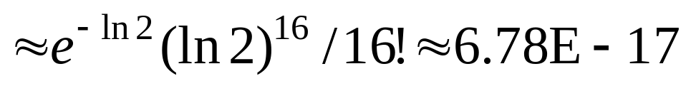
Counting Bloom Filters: Overflow
Must choose counters large enough to avoid overflow.
Poisson approximation suggests 4 bits/counter.
  Average load using k = (ln 2)m/n counters is ln 2.
  Probability a counter has load at least 16:
Failsafes possible.

Slide 23
Improved Counting Bloom Filter
Alternative construction that uses less space.
  Recent work (ESA 2006).
    In conjunction with a team from Cisco.
  Designed for hardware implementation in routers.
  Still based on hashing.

Slide 24
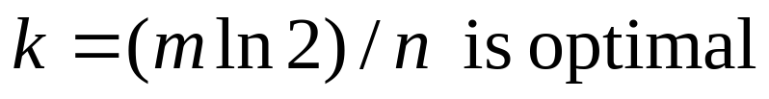
Compression
Caches send Bloom filters over the network. Can they be compressed?
  Compressing bit vectors is easy.
  Arithmetic coding gets close to entropy.
Recall optimization:
  At k = m (ln 2)/n, p = 1/2.
  Bloom filters look random = not compressible.
  Can we do anything?

Slide 25
Compressed Bloom Filters
“Error optimized” Bloom filter is ½ full of 0’s, 1’s.
  Compression would not help.
  But this optimization for a fixed filter size m.
Instead optimize the false positives for a fixed number of transmitted bits.
  Filter size m can be larger, but mostly 0’s
  Larger, sparser Bloom filter can be compressed.
  Useful if transmission cost is bottleneck.

Slide 26
Compressed Bloom Filters n=10,000
Array bits per/el | m/n | 8 | 14 | 92
Transmit bits per/el | z/n | 8 | 7.923 | 7.923
Hash functions | k | 6 | 2 | 1
False positive rate | f | 0.0216 | 0.0177 | 0.0108

Slide 27
Modern applications
Peer to peer (P2P) communication
Resource location
Routing
Measurement infrastructure

Slide 28
P2P Communication
P2P Keyword Search
Efficient P2P keyword searching [Reynolds & Vadhat, 2002].
  Distributed inverted word index, on top of an overlay network. Multi-word queries.
  Peer A holds list of document IDs containing Word1, Peer B holds list for Word2.
  Need intersection, with low communication.
  A sends B a Bloom filter of document list.
  B returns possible intersections to A.
  A checks and returns to user; no false positives in end result.
  Equivalent to Bloom-join

Slide 29
P2P Collaboration
Informed Content Delivery
  [Byers, Considine, Mitzenmacher, & Rost 2002].
  Delivery of large, encoded content.
    Redundant encoding.
    Need a sufficiently large (but not all) number of distinct packets.
  Peers A and B have lists of encoded packets.
  Can B send A useful packets?
  A sends B a Bloom filter; B checks what packets may be useful.
  False positives: not all useful packets sent
  Method can be combined with
    Recoded symbols (XOR of existing packets)
    Min-wise sampling (determine a-priori which peers are sufficiently different)

Slide 30
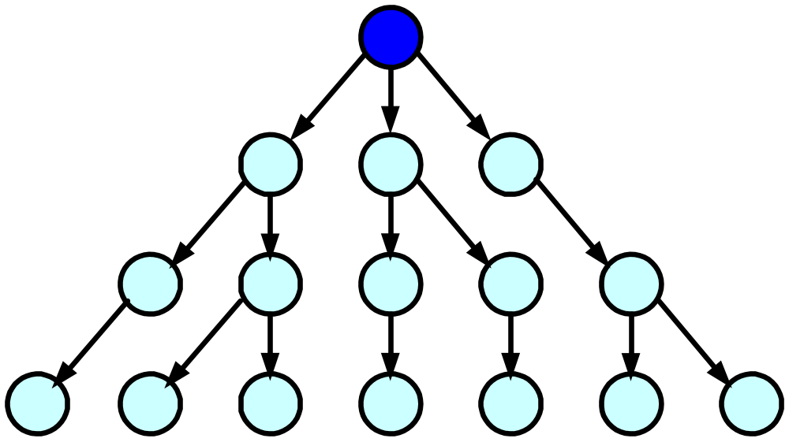
2. Resource Location: Framework
Queries sent to root.
Each node keeps a list of resources reachable through it, through children.
List = Bloom filter.

Slide 31
Resource Location: Examples
Secure Discovery Service
  [Czerwinski, Zhao, Hodes, Joseph, Katz 99]
  Tree of resources.
OceanStore distributed file storage
  [Kubiatowicz & al., 2000], [Rhea & Kubiatowicz, 2002]
  Attenuated BFs – go d levels down in the tree
Geographical region summary service
  [Hsiao 2001]
  Divide square regions recursively into smaller sub squares.
  Keep and update Bloom filters for each level in hierarchy.

Slide 32
3. Packet routing
Stochastic Fair Blue
Loop detection in Icarus
Scalable Multicast Forwarding

Slide 33
Loop detection in Icarus
[Whitaker & Wetherall]
Usual loop detection is via Time-to-Live field
Not very effective for small loops
Idea: Carry small BF in the packet header
Whenever passing a node, the node mask is OR-ed into the BF
If BF does not change there might be a loop

Slide 34
Scalable Multicast Forwarding
[Gronvall 02]
Usual arrangement for multicast trees: for each source address keep list of interfaces where the packet should go
  For many simultaneous multicasts, substantial storage required
Alternative idea: trade computation for space:
  For each interface keep BF of addresses
  Packets checked against the BF. Check can be parallelized
  False positives lead to (few) spurious transmissions

Slide 35
4. Measurement infrastructure
Hash-based IP traceback
  [Snoeren et al., 2001]
  For security purposes, would like routers to keep a list of all packets seen recently.
  Can trace back path of a bad packet by querying routers back through network.
  A Bloom filter is good enough to trace back source of a bad packet.
  False positives require checking some additional network paths.

Slide 36
Measurement Infrastructure
New Directions in Traffic Measurement and Accounting
  [Estan and Varghese, 2002]
  Use Counting Bloom filter variation to track bytes per flow.
  Potentially heavy flows are recorded.
  Additional trick: conservative update

Slide 37
Conservative Update
Increment +2
y
0
3
4
1
8
1
1
0
3
2
5
4
2
0
The flow associated with y can only have been responsible for 3 packets; counters should be updated to 5.
0
3
4
1
8
1
1
0
5
2
5
5
2
0

Slide 38
Hash-Based Approximate Counting
Use min-counter associated with flow as approximation.
  Yields approximation for all flows simultaneously.
  Gives lower bound, and good approx.
  Can prove rigorous bounds on performance.
This hash-based approximate counting structure has many uses.
  Any place you want to keep approximate counts for a data stream.
  Databases, search engines, network flows, etc.
See also Cormode-Muthurkrishnan, Count-Min Sketches.
  Same basic idea, different analysis.

Slide 39
Variations and Extensions
All sorts of new ideas in this area.
  Unifying theme: hashing!
Some examples…

Slide 40
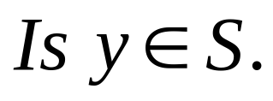
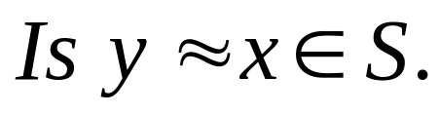
Extension :
Distance-Sensitive Bloom Filters
Instead of answering questions of the form
we would like to answer questions of the form
That is, is the query close to some element of the set, under some metric and some notion of close.
Applications:
  DNA matching
  Virus/worm matching
  Databases
Some initial results [KirschMitzenmacher]. Hard.

Slide 41
Extension: Bloomier Filter
Bloom filters handle set membership.
Counters to handle multi-set/count tracking.
Bloomier filter [Chazelle, Kilian, Rubinfeld, Tal]:
  Extend to handle approximate functions.
  Each element of set has associated function value.
  Non-set elements should return null.
  Want to always return correct function value for set elements.
  A false positive returns a function value for a non-null element.

Slide 42
Extension: Approximate Concurrent
State Machines
Model for ACSMs
  We have underlying state machine, states 1…X.
  Lots of concurrent flows.
  Want to track state per flow.
  Dynamic: Need to insert new flows and delete terminating flows.
  Can allow some errors.
  Space, hardware-level simplicity are key.
Extends Bloomier filter to dynamic functions.
  Considered by [BMPSV]

Slide 43
Motivation: Router State Problem
Suppose each flow has a state to be tracked. Applications:
  Intrusion detection
  Quality of service
  Distinguishing P2P traffic
  Video congestion control
  Potentially, lots of others!
Want to track state for each flow.
  But compactly; routers have small space.
  Flow IDs can be ~100 bits. Can’t keep a big lookup table for hundreds of thousands or millions of flows!

Slide 44
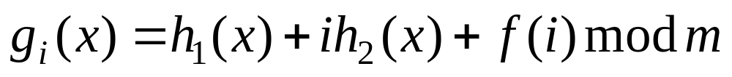
Variation: Simpler Hashing
[DillingerManolios],[KirschMitzenmacher]
Let h₁ and h₂ be hash functions.
For i = 0, 1, 2, …, k – 1 and some f, let
  So 2 hash functions can mimic k hash functions.
  Example: f(i) = i(i – 1)/2.
Dillinger/Manolios show experimentally, and we prove, no difference in asymptotic false positive probability.

Slide 45
The main point revised again
Whenever you have a set or list or function or concurrent state machine or whatever-will-be-next?, and space is an issue, an approximate representation, like a Bloom filter may be a useful alternative.
Just be sure to consider the effects of the false positives!

