Slide 1
FAULT 2
Probability Reversal
What is evidence for what?

Slide 2
The Two Questions
Two probabilities that sound the same and are not
WHAT CAN BE MEASURED
P( observation | condition )
When the condition is there, how often do we see this?
WHAT YOU WANT TO KNOW
P( condition | observation )
Having seen it, how likely is the condition?
The fault is reading one as if it were the other. They are different numbers, and how far apart they sit depends on something the observation never tells you: how common the condition is.

Slide 3
EACH SQUARE IS A MEMBER OF THE POPULATION
How to read a waffle chart
One square, one member. Call the two attributes A and B.
Two attributes, four groups
Both A and B
18%
of the population
A only
2%
of the population
B only
12%
of the population
Neither A nor B
68%
of the population
Writing it as a probability
P(A and B)
=
18%
P(A only)
=
2%
P(B only)
=
12%
P(neither)
=
68%
P(...) is just a name for a percentage of the grid. The four add to 100%: every square is counted once.

Slide 4
EACH SQUARE IS A MEMBER OF THE POPULATION
P(A|B): restricting the population
The bar means given: stop looking at the whole grid, look only at part of it.
Before any condition: all 100
Both A and B
18
in A and in B
A only
2
in A, not B
B only
12
in B, not A
Neither
68
in neither
The condition shrinks the population
P(B | A)
P(A | B)
Throw away the 80 non-A. 20 left.
Throw away the 70 non-B. 30 left.
18 of the 20 A are B = 90%
18 of the 30 B are A = 60%
Conditioning is a decision about who stays in the picture, not arithmetic on a fraction.

Slide 5
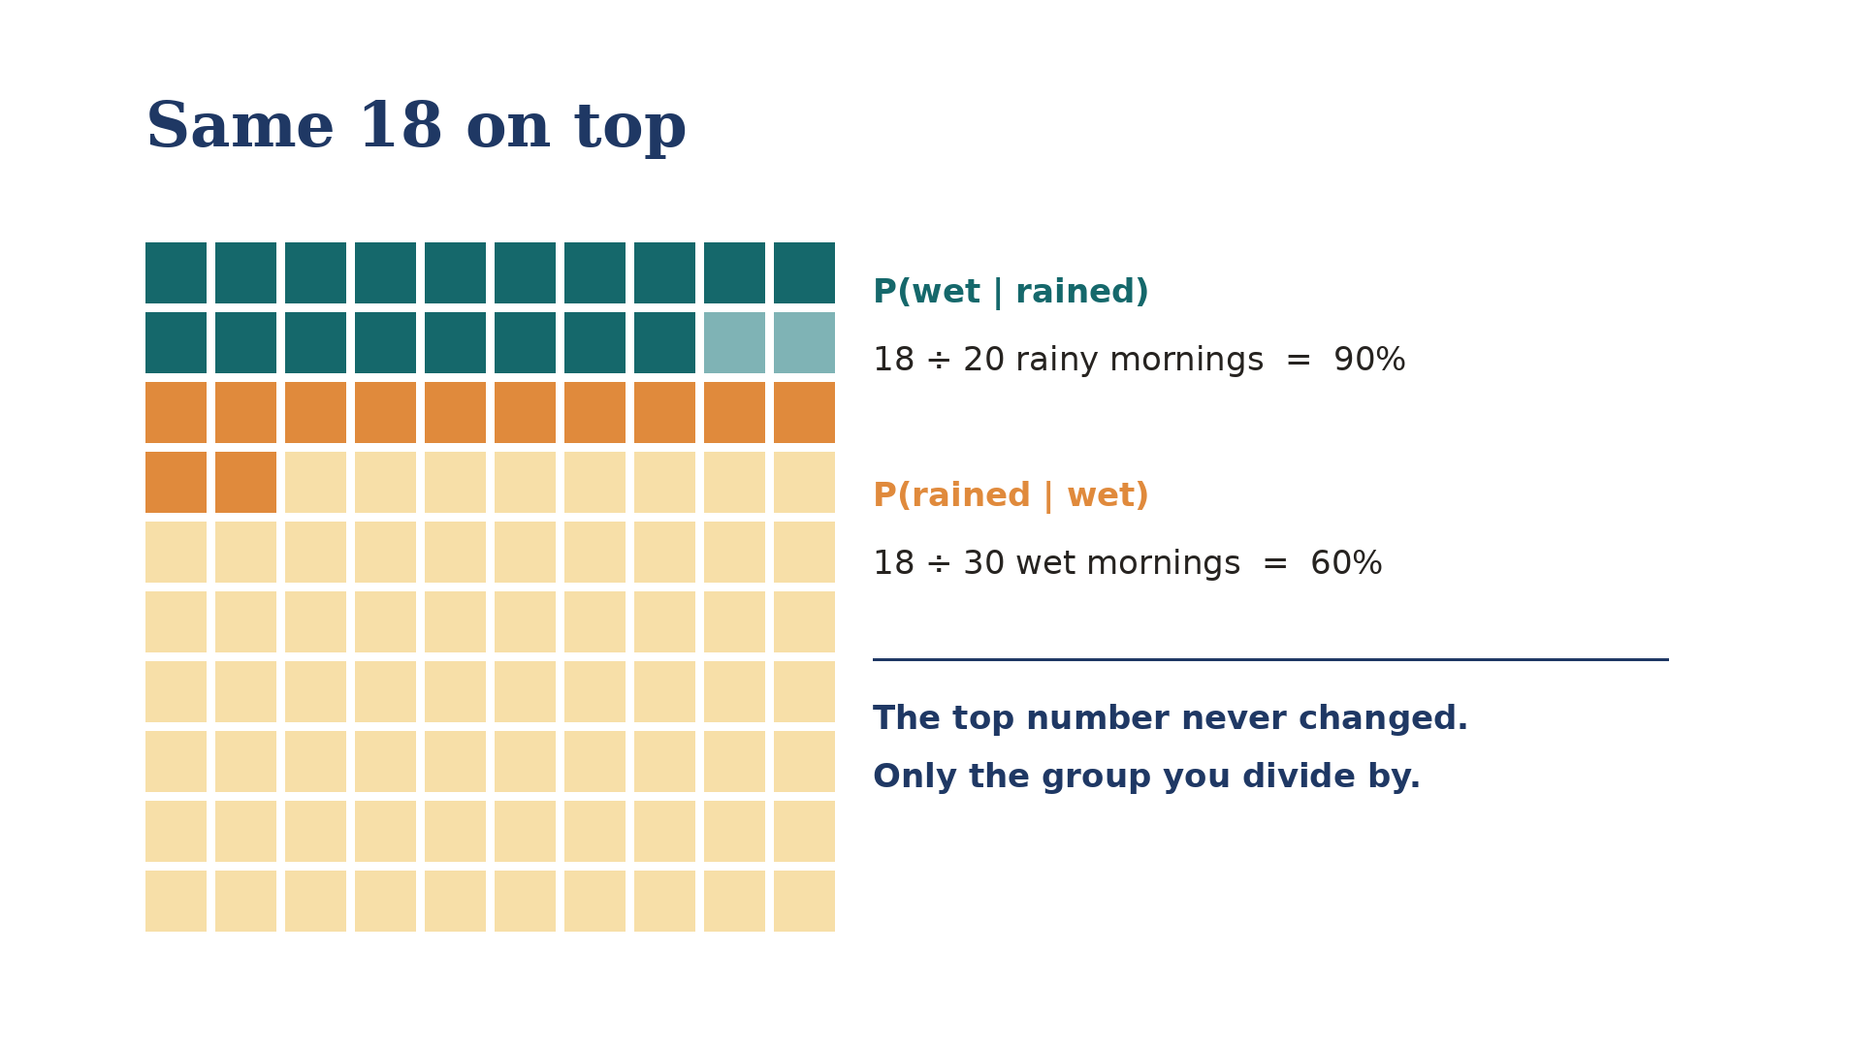
COUNT THE MORNINGS
The Wet Lawn Waffle Chart
Each square is one morning. Every probability here is one count divided by another: 18/20 is P(lawn wet | rain), 18/30 is P(rain | lawn wet). Two minutes.

Slide 6
FROM THE LAWN TO THE CLINIC
Every test reports two numbers, and each one flips
SENSITIVITY
SPECIFICITY
P( test positive | have the cause )
P( test negative | no cause )
what the test is measured on
what the test is measured on
↓ reversed
↓ reversed
P( have the cause | test positive )
P( no cause | test negative )
Each reversal is undone by the other number. A positive is undone by the false positives. A negative is undone by the false negatives.
A Sensitive test with a Negative result rules out. A Specific test with a Positive result rules in.

Slide 7
THE TWO EXAMPLES
Where each reversal does damage
A SCREENING MAMMOGRAM
A COVID RAPID TEST
Good at finding the cancers that are there.
Good at clearing the people who are well.
high sensitivity
high specificity
WHERE IT MISLEADS
WHERE IT MISLEADS
A positive.
A negative.
Every test has both reversals. We take each one where it does more damage.

Slide 8
THE FIRST REVERSAL
A Screening Mammogram
If it is positive, do I have cancer?

Slide 9
A REAL TEST, REAL NUMBERS
What the mammogram is measured on
A positive mammogram is a callback. The radiologist wants more pictures. It is not a diagnosis, and nothing has been found yet.
SENSITIVITY
P( called back | cancer )
This is the number the mammogram is judged on, and it is a good one. But notice where it starts: from already knowing she has cancer. That is the only direction a test can be measured in.
87 of every 100 women with cancer
the other 13 are missed
What we want is P( cancer | called back ): 4.4%
Same test, same day. Now we walk the reversal.
Sensitivity 86.9%. Lehman CD et al. National performance benchmarks for modern screening digital mammography, Breast Cancer Surveillance Consortium. Radiology 2017;283(1):49-58. 1,682,504 screens, 2007-2013.

Slide 10

AN ILLUSTRATIVE COHORT OF 10,000 WOMEN
Six in a thousand have it
Every square is one woman screened once. The teal sliver at the top is everyone who has cancer.
That is an average across ages 40 to 89. It climbs with age: nearer 4 per 1,000 in the fifties, 6 or 7 in the sixties.
has cancer, called back: 51
has cancer, not called back: 8
no cancer, called back anyway: 1,103
no cancer, all clear: 8,838
The amber band is eleven rows deep. It is more than twenty times the size of the group the test is looking for.
BCSC benchmarks applied to a 10,000-woman cohort. Lehman CD et al. National performance benchmarks for modern screening digital mammography, Breast Cancer Surveillance Consortium. Radiology 2017;283(1):49-58. 1,682,504 screens, 359 radiologists, 95 facilities, 2007-2013.

Slide 11
FIRST QUESTION
If you have cancer, how likely is a callback?
Look only at the 59 women who have cancer. Everyone else is set aside for now.
Of those 59, the ones called back: 51
P(callback | cancer) = 51 / 59 = 87%
The 59 women who have cancer, enlarged from the 10,000.
This is the number the mammogram is judged on, and it is a good one.
Sensitivity 86.9%. Lehman CD et al. National performance benchmarks for modern screening digital mammography, Breast Cancer Surveillance Consortium. Radiology 2017;283(1):49-58. 1,682,504 screens, 359 radiologists, 95 facilities, 2007-2013.

Slide 12
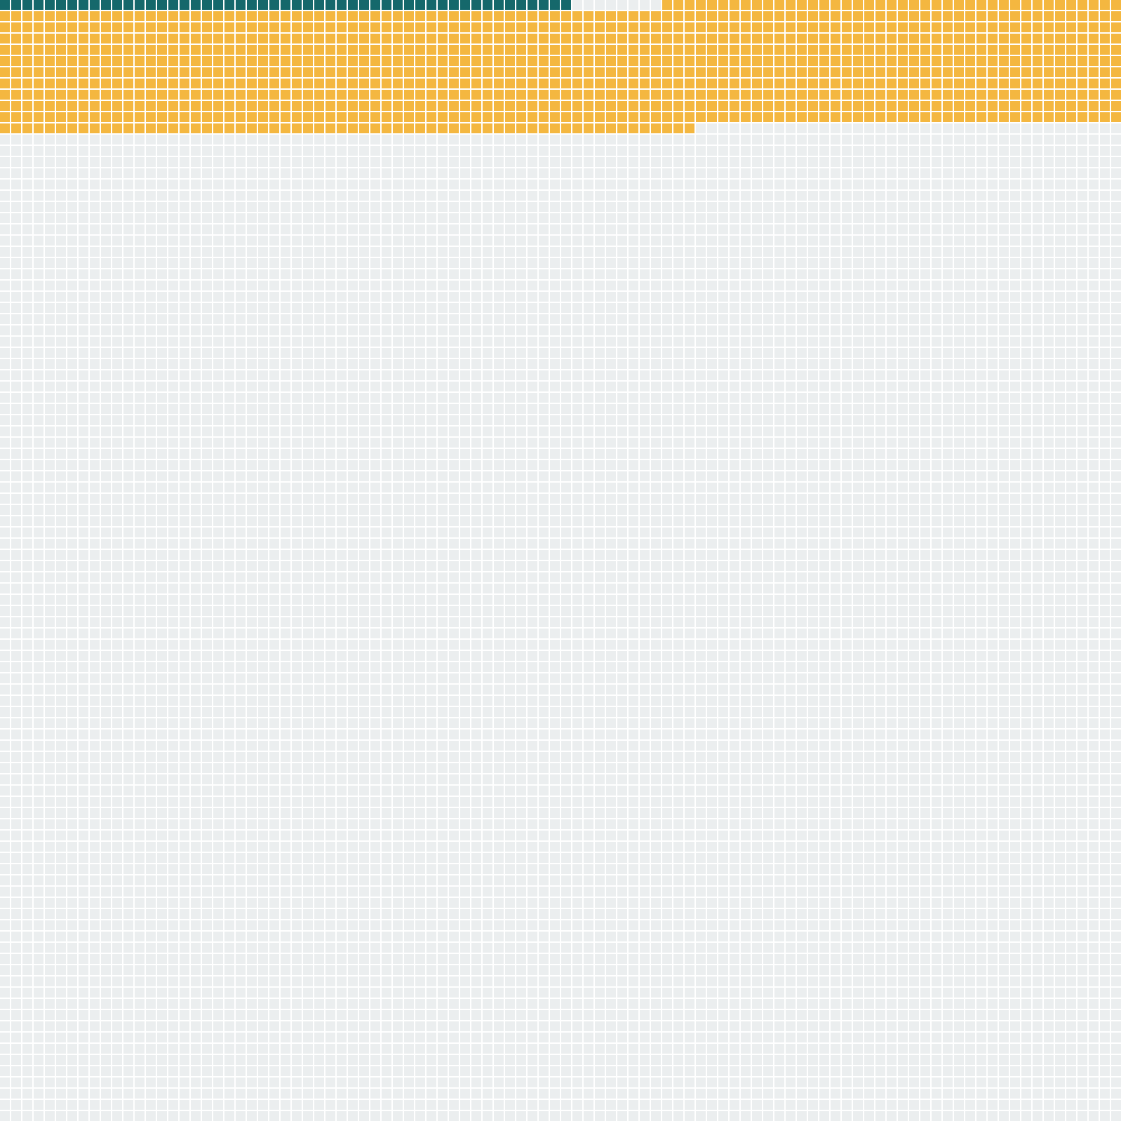
SECOND QUESTION, THE ONE PEOPLE GET BACKWARDS
If you get a callback, how likely is cancer?
Now look only at the women who get called back. Same picture, we just divide by a different group.
Of those 1,154, the ones who have cancer: 51
P(cancer | callback) = 51 / 1,154 = 4.4%
Twenty-two of every twenty-three callbacks are false alarms. This is the value the benchmark study itself publishes.
Positive predictive value of an abnormal interpretation, 4.4%. Lehman CD et al. National performance benchmarks for modern screening digital mammography, Breast Cancer Surveillance Consortium. Radiology 2017;283(1):49-58. 1,682,504 screens, 359 radiologists, 95 facilities, 2007-2013.

Slide 13
THE REVERSAL, FOR ONE WOMAN
Unlikely, but not ignorable
P( called back | cancer ) = 87%
↓ reversed becomes
P( cancer | called back ) = 4%
87% is what the mammogram was measured on. 4% is what her letter means. Same test, same day, same woman.
Unlikely is why she should not panic. Not ignorable is why the biopsy is warranted.
Positive predictive value of an abnormal interpretation 4.4%, of a biopsy recommendation 25.6%. Lehman CD et al., Breast Cancer Surveillance Consortium. Radiology 2017;283(1):49-58.

Slide 14
THE BIGGER PICTURE
Why reasonable people disagree
Of US women aged 50, screened every year for ten years:
avoid a breast cancer death
0.03% to 0.32%
have at least one false alarm
49% to 67%
are overdiagnosed, and treated for it
0.3% to 1.4%
Nobody in this argument disputes the sensitivity, the specificity, or the 4.4%. The disagreement is over how to weigh a false alarm for half of them against a death averted for a fraction of one percent.
So the guidance splits. The American College of Radiology recommends annual screening from 40. The Task Force says every two years from 40. The Nordic Cochrane group and the Swiss Medical Board have argued for not running screening programmes at all.
Ranges from published estimates for women aged 50 screened annually for a decade. Overdiagnosis is contested: the Canadian National Breast Screening Study's 25-year follow-up put 106 of 484 screen-detected cancers (21.9%) as overdiagnoses; Gotzsche and Jorgensen, Cochrane 2013 (CD001877), found no effect on overall mortality across ten trials. An 11.6% callback rate compounded over ten independent screens gives about 71%, near the top of the false-alarm range.

Slide 15
THE SECOND REVERSAL
A COVID Rapid Test
If it is negative, am I clear?

Slide 16
A REAL TEST, REAL NUMBERS
What the swab is measured on
That is about as specific as any test in common use. It is why a positive swab is worth believing.
SPECIFICITY
P( negative | no COVID )
But look where it starts: from already knowing the person is well. Nobody handed a negative result knows that.
99 of every 100 people who are well
almost nobody healthy is wrongly flagged
What we want is P( no COVID | negative ): 85%
Nowhere near certainty. Now we walk the reversal.
Rapid antigen tests in symptomatic people: specificity 99.1%, sensitivity 73.0% (95% CI 69.3 to 76.4). Dinnes et al., Cochrane Database of Systematic Reviews 2022;7:CD013705.

Slide 17

AN ILLUSTRATIVE COHORT OF 10,000 PEOPLE WITH SYMPTOMS
Four in ten of them have it
Everyone here feels ill during a wave, so the odds before testing are far higher than in the street outside.
has COVID, tests positive: 2,920
has COVID, tests negative: 1,080
no COVID, tests positive: 54
no COVID, tests negative: 5,946
The pale teal band is the one to watch. Eleven rows of people who have COVID and were told they did not.
Pre-test probability of 4 in 10 is illustrative, chosen to represent symptomatic testing during a wave. Test figures: Rapid antigen tests in symptomatic people: sensitivity 73.0% (95% CI 69.3 to 76.4), specificity 99.1%. Dinnes et al., Cochrane Database of Systematic Reviews 2022;7:CD013705.

Slide 18
THE REVERSAL, FOR ONE PERSON
A negative is not an all-clear
P( negative | no COVID ) = 99%
↓ reversed becomes
P( no COVID | negative ) = 85%
99% is what the swab was measured on. 85% is what your negative means.
More than one person in seven who was told they were negative had COVID and went out anyway. A negative narrows the odds. It does not clear you.
Counts carried from the previous slide: 7,026 negatives, of which 1,080 had COVID. Rapid antigen tests in symptomatic people: specificity 99.1%, sensitivity 73.0% (95% CI 69.3 to 76.4). Dinnes et al., Cochrane Database of Systematic Reviews 2022;7:CD013705.

Slide 19
WHEN NOBODY CATCHES IT
Courtrooms and Classrooms
What did the flip cost?

Slide 20
A CAUTIONARY TALE
When the reversal reaches a verdict
A RAPE TRIAL IN ENGLAND, CONVICTION QUASHED 1994
The forensic expert told the court that the likelihood of the sample coming from any man other than the accused was one in three million.
That number describes how rare the profile is. It was offered as the chance he was innocent, the judge repeated it to the jury, and the Court of Appeal quashed the conviction.
TRAFFIC STOPS IN HOUSTON, 2004 TO 2015
A two-dollar roadside kit turns blue for cocaine. It also turns blue for dozens of other things, which has been known since the 1970s.
Blue was taken to mean cocaine. The lab checked only afterwards, and found more than 250 people had already pleaded guilty to possessing nothing.
Both times a number about how often this happens to the innocent was read as the chance of innocence.
R v Deen, Court of Appeal, reported The Times 10 January 1994; rules on presenting DNA statistics were later set in Doheny and Adams [1997] 1 Cr App R 369. Houston: Houston Forensic Science Center and the Harris County conviction integrity unit, reported by ProPublica and The New York Times Magazine, 2016.

Slide 21
A THIRD CAUTIONARY TALE
The detector that cannot tell
WHAT THE VENDORS ADVERTISE
WHAT A FLAGGED STUDENT NEEDS
Turnitin has claimed 98%. Copyleaks 99.1%. GPTZero 99%. Winston AI 99.98%.
Every one of those is a statement about machines: if this text came from an AI, we will flag it.
Of the essays you flag, how many were actually written by an AI?
Vanderbilt ran that number. Even at a 1% false positive rate, their 75,000 submissions a year would falsely accuse 750 students. They switched the tool off in August 2023.
And 1% is generous. Stanford researchers ran seven detectors over 91 TOEFL essays, every one written by a human: 61.3% were flagged as machine-written, and about one in five was flagged by all seven. On essays by native English speakers the same detectors almost never erred.
The same flip, with a transcript at the end of it. A number about how often the tool catches machines, read as the chance that a student cheated.
Liang W, Yuksekgonul M, Mao Y, Wu E, Zou J. GPT detectors are biased against non-native English writers. Patterns 2023. Vanderbilt University disabled Turnitin's AI detection in August 2023. Johns Hopkins and international-student false positives reported by The Markup, 14 August 2023. Vendor accuracy figures are the vendors' own marketing claims.

Slide 22
What we’ve learned
One way a true number can mislead you, and a look ahead.
1 · Probability reversal
The trap: What the test reports gets flipped into what you asked. A positive is read as proof, a negative as the all-clear.
Ask: out of everyone who got this result, how many actually have it?
2 · Next week: Arbitrary categories
The trap: A line drawn across a continuous measurement is read as a fact about your body.
Ask: where do I sit on the curve, not which side of the line?

Slide 23
Questions, and a conversation
Murray Cantor PhD murray@murraycantor.com
Joel Keenan MD drkeenan@mdvip.com
Notes:
Closing slide. Leave it up during Q&A.

