Slide 1

Healthy Skepticism
Day 3
Murray Cantor, PhD & Joel Keenan, MD [venue and date]
Notes:
EDITING: The course mark (top-right) and white background live in the slide master — change them once under View > Slide Master. To reuse a layout, right-click a slide and Duplicate. Swap the bell-curve graphic for a topic image on other talks. Palette: teal 15686B, terracotta C2683F, ink 262320. Fonts: Bookman Old Style (headings), Calibri (body).

Slide 2
Disclaimer
This presentation is for educational purposes only.
The content does not constitute medical advice and is not a substitute for professional diagnosis, treatment, or care. Nothing presented here should be used to make decisions about your health or the health of others.
Always seek the advice of a qualified physician or other licensed healthcare provider with any questions you may have regarding a medical condition, test result, or treatment. Never disregard professional medical advice or delay seeking it because of something discussed in this presentation.

Slide 3
The Five Faults
1
Relative reporting
Day 1
What does a 36% improvement from taking a drug really mean?
2
Probability reversal
Day 2
What does a positive COVID test really mean?
3
Arbitrary categories
Day 3
How concerned should you be if your systolic BP goes from 119 to 120?
4
The Bernoulli fallacy
Day 3
Why does the published medical advice keep changing?
5
The causal leap
Day 4
Does bird watching prevent dementia?
Once you see them, you can’t unsee them.

Slide 4
Today’s Two Faults
3
Arbitrary categories
Blood pressure, body weight, and where the lines fall
4
The Bernoulli fallacy
The 0.05 line, and what a study can and cannot tell you

Slide 5
FAULT 3
Arbitrary Categories
Read the curve, not the cutoff

Slide 6
Where Does “High” Begin?
FAULT 3 · ARBITRARY CATEGORIES
  Systolic this year: 120. Last year: 119.
  Nothing about you changed. The label did.
Normal
Elevated
Stage 1
Stage 2
119 → 120
same risk, new label
One mmHg moved you across a line. It did not move your risk.
SCORE risk charts, low-risk regions: Conroy RM et al., Eur Heart J 2003;24:987-1003. Category boundaries: ACC/AHA 2017.

Slide 7
Systolic Categories Don’t Mean Much
FAULT 3 · ARBITRARY CATEGORIES
Normal
Elevated
Stage 1
Stage 2
SCORE risk charts, low-risk regions: Conroy RM et al., Eur Heart J 2003;24:987-1003. Category boundaries: ACC/AHA 2017 hypertension guideline.

Slide 8
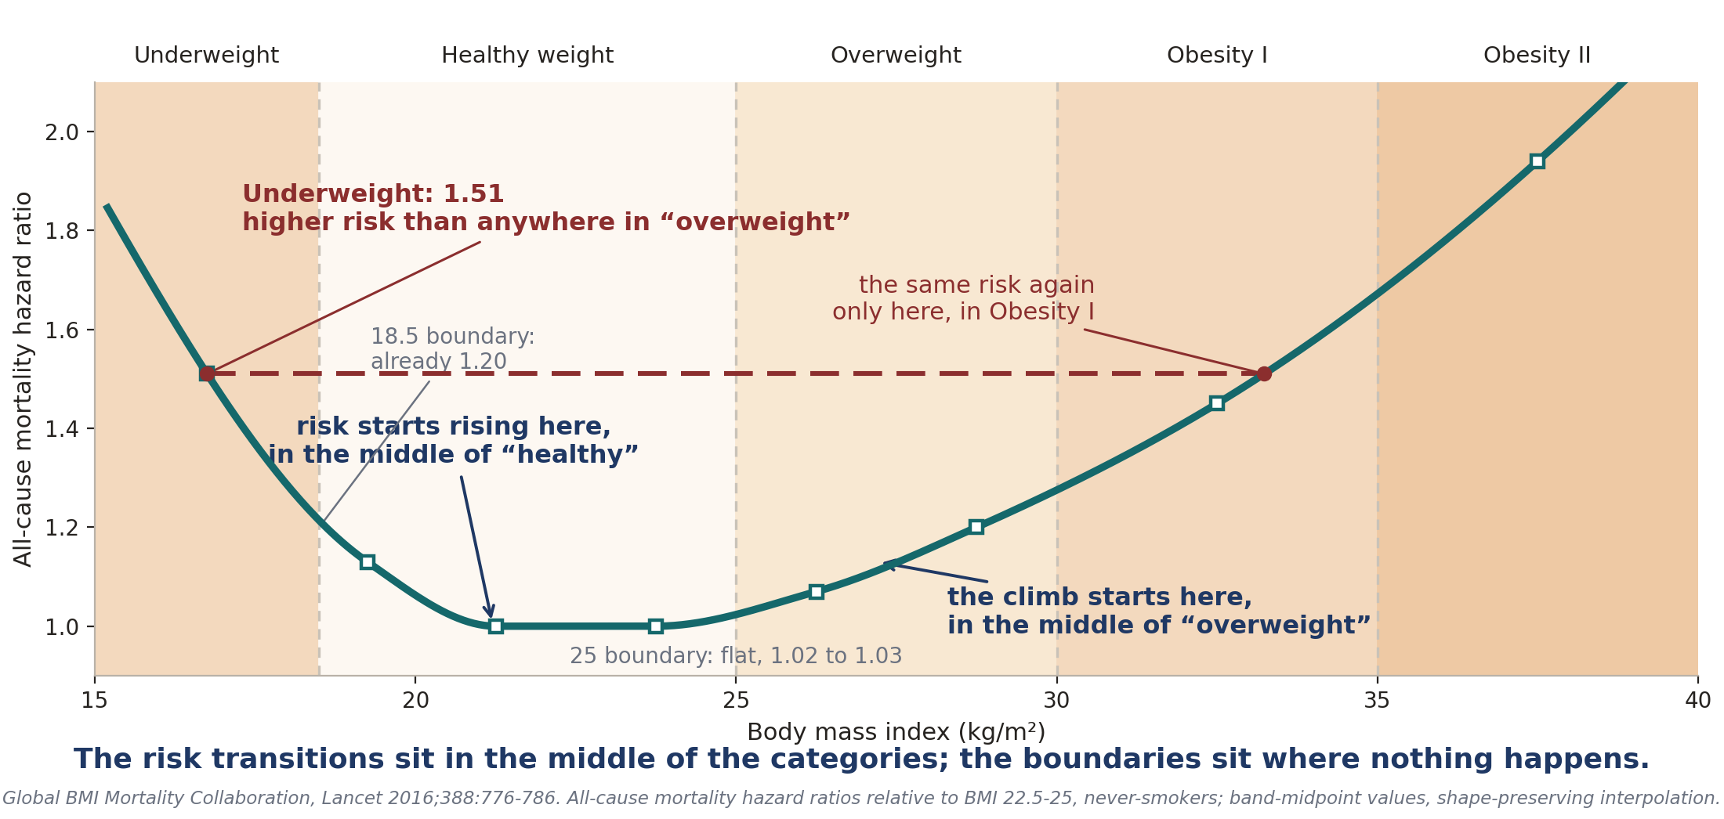
BMI Categories Are Worse
FAULT 3 · ARBITRARY CATEGORIES

Slide 9
So Why Have Categories at All?
FAULT 3 · ARBITRARY CATEGORIES
  A box is a decision rule: triage in three seconds.
  The trouble: the box gets read as a fact about your body.
  A box cannot say how much risk you carry.
Normal
Elevated
Stage 1
Stage 2
Ask where you sit on the curve, not which side of the line.
SCORE risk charts, low-risk regions: Conroy RM et al., Eur Heart J 2003;24:987-1003. Category boundaries: ACC/AHA 2017.
Notes:
I

Slide 10
FAULT 4
The Bernoulli Fallacy
Why medical advice keeps changing

Slide 11
FAULT 4 · THE BERNOULLI FALLACY
Published Papers with Findings That Could be Repeated
Only 6 of 53 landmark cancer findings were confirmed on rerun.
Just 35 of 97 psychology findings stayed significant on rerun.
This is the Irreproducibility Crisis
Begley CG, Ellis LM. Nature 2012;483:531-533. Open Science Collaboration, Science 2015;349:aac4716. Clayton A, Bernoulli's Fallacy, 2021.

Slide 12
An Important Aside: P(A|B) is The Core Element of Inference
FAULT 4 · THE BERNOULLI FALLACY
It is called 'conditional probability'
It means the probability of A if B is true
Sometimes shortened to the probability of A, given B
Depending on the circumstances, B may be observed, believed, or imagined for argument's sake
Examples:
Courtrooms: P(Criminal guilt | evidence)
Gambling: P(Rolling 7 with 2 dice | Dice are fair)
Science: P(Tested hypothesis | data)
Causality: P(drowning | warm weather)
For the course, you only need to be aware of the concept

Slide 13
FAULT 4 · THE BERNOULLI FALLACY
Sometimes We Want to Reverse Conditional Probability
Day 2 had 2 examples
As we saw in Day 2, we can reverse P(A|B) to P(B|A) if we also have P(B)
P(B) is sometimes called the 'prevalence' or 'prior' depending on the circumstances
For example, in the mammogram example
P(called back | cancer) = 87%
P(cancer) = 0.6% (6 in 1000)
We computed using ratios P(cancer | called back) = 4.4%
This sort of calculation, reversing using the prior, is called 'Bayesian Analysis'

Slide 14
FAULT 4 · THE BERNOULLI FALLACY
The Fallacy Stems From Frequentist Reasoning
They want to know if a hypothesis is true.
Rather than compute P(hypothesis | data), they compute p = P(data | hypothesis is false)
If p is low enough, they say the observations are 'statistically significant' and submit the result for publication.
In medicine and the social sciences, the significance criterion is p < .05: if the hypothesis were false, the data would arise only 5% of the time.
  In words: a false hypothesis would make this data very surprising, so treat it as true
This criterion means one would expect about 1 in 20 published experiments to be not reproducible.

Slide 15
FAULT 4 · THE BERNOULLI FALLACY
The Drawbacks
The significance setting is arbitrary, and often far too high. There is no formula or theorem that defines ‘significance’ .
1
Significance is not informative. Knowing P(hypothesis | data) enables risk-based decision support, like gambling; the p-value does not.
2
It invites p-hacking. Searching subsets of the data for those that meet the criterion by luck alone.
3
Together these feed the replication crisis
Five sigma, one-sided, corresponds to p = 0.000000287; ATLAS and CMS required it for the 2012 Higgs discovery. Ioannidis JPA. Why most published research findings are false. PLoS Med 2005;2:e124.

Slide 16
FAULT 4 · THE BERNOULLI FALLACY
Medical and Social Science Sets the p-value Far Too High for Significance
Medicine cannot wait for five-sigma data: patients are scarce, trials costly.
WHAT PHYSICS DEMANDS
p < 0.000000287
Five sigma: one chance in 3.5 million. The Higgs waited for that bar.
WHAT MEDICINE AND SOCIAL SCIENCE ACCEPT
p < 0.05
One chance in twenty. A no-effect test clears it 1 time in 20, by luck.
1 in 20 is the rate per test of nothing. The share of false findings is a reversal question: how many tested ideas were true? The prevalence, yet again.
Five sigma, one-sided, corresponds to p = 0.000000287; ATLAS and CMS required it for the 2012 Higgs discovery. Ioannidis JPA. Why most published research findings are false. PLoS Med 2005;2:e124.

Slide 17
FAULT 4 · THE BERNOULLI FALLACY
So Why Do They Adopt Frequentism?
Sometimes there is no prior:
  Industrial quality control
  Census survey sampling
  Particle physics (which sets the criterion at p < 0.000000287)
  Not using a prior is considered more objective and honest by its proponents.
As described in the book, a more rigorous standard disrupts the academic publication world.

Slide 18
FAULT 4 · THE BERNOULLI FALLACY
Evidence of p-hacking
Only 6 of 53 (11%) landmark cancer findings were confirmed on rerun.
Just 35 of 97 (36%) psychology findings stayed significant on rerun.
These are much lower than chance (95%)
Begley CG, Ellis LM. Nature 2012;483:531-533. Open Science Collaboration, Science 2015;349:aac4716. Clayton A, Bernoulli's Fallacy, 2021.

Slide 19
FAULT 4 · THE BERNOULLI FALLACY
Evidence for ‘p-hacking’, aka ‘data torturing’
The observed failure rate is far above the honest floor.
1 in 20
the failure rate honest testing would produce on its own, with no torturing at all.
47 of 53
landmark cancer findings that failed to repeat. Psychology: about 2 in 3.
The failure rate is too high for luck alone.
Begley CG, Ellis LM. Nature 2012;483:531-533. Open Science Collaboration, Science 2015;349:aac4716.

Slide 20
FAULT 4 · THE BERNOULLI FALLACY
The Baby Aspirin Recommendation Change
Trials stopped early tend to stop on a lucky high. On the retests, p never crossed the line again.
1988
Physicians' Health Study: aspirin cut first heart attacks 44%, p < 0.00001. Stopped early for benefit. Decades of daily-aspirin advice followed.
2018
The retests, ARRIVE and ASPREE: no net benefit (ARRIVE p = 0.60), more major bleeding. USPSTF 2022: do not start after 60.
The advice changed because the finding would not repeat, and the harm outweighed the benefit
Physicians' Health Study final report, N Engl J Med 1989;321:129-135. McNeil JJ et al. (ASPREE), N Engl J Med 2018;379:1509-1518. Gaziano JM et al. (ARRIVE), Lancet 2018;392:1036-1046. USPSTF, JAMA 2022;327:1577-1584.

Slide 21
FAULT 4 · THE BERNOULLI FALLACY
Autism: From a p-Value to Policy
31
autism cases, parent-reported, not medical records
3x
the reported odds, in boys only, not the full sample
p < 0.05
so it was written up as a finding
1
One study: 31 parent-reported cases.
2
One number: p below 0.05.
3
One citation: the CDC's Autism and Vaccines page.
4
One committee: ACIP, twice, days before a vote.
5
One policy: universal newborn hepatitis B vaccination, ended.
Never replicated. In May 2026 the journal retracted the paper, months after the vote.
Gallagher CM, Goodman MS. J Toxicol Environ Health A 2010;73(24):1665-1677; cited on the CDC Autism and Vaccines page, since retracted. No replication; large studies find no association (Price CS et al., Pediatrics 2010;126:656-664).

Slide 22
What We’ve Learned
Two faults, one shape.
1 · Arbitrary categories
1
The trap: A line drawn across a continuous measurement is read as a fact about your body.
Ask: What is my risk with my measurement?
2 · The Bernoulli fallacy
2
The trap: p below 0.05 is read as proof the effect is real, and that has made the medical literature unreliable.
Ask: Have these studies been replicated?

Slide 23
Questions, and a conversation
Murray Cantor PhD murray@murraycantor.com
Joel Keenan MD drkeenan@mdvip.com
Notes:
Closing slide. Leave it up during Q&A.

Slide 24
Backup Slides

Slide 25
A Line You Have Already Met
  Arbitrary categories came from clinical medicine: BMI 25, systolic 130.
  Statistics draws the same kind of line on itself. A study is "significant" if p falls below 0.05, and not otherwise.
  p is a continuous quantity. 0.05 is a convention, not a discovery. R. A. Fisher drew it in 1925 because it was convenient.
  Everything Fault 3 taught about cutoffs applies to the line the research itself is graded on.
Fisher RA. Statistical Methods for Research Workers. Oliver & Boyd, 1925. His word for the 0.05 level was "convenient".

Slide 26
Too Few Cases, Read as No Effect
  [Placeholder: ASCOT-LLA’s women.]
  Only 36 heart events among women in the whole trial. The label calls the result inconclusive.
  Correspondents read that as evidence the drug does not help women.
  The investigators replied that 36 events cannot show much, and that absent evidence of a different effect, the whole-trial result is the best estimate for women too.
  Source: Sever PS, et al. Lancet 2003;361:1986.

Slide 27
Sixty Side Effects at Once
  [Placeholder: the 2026 statin label meta-analysis.]
  More than sixty labelled side effects tested, with a strict bar to avoid finding things by luck.
  Six survived. The conclusion drawn was that the labels should be trimmed.
  A strict bar also means real effects get missed, and that rate was never reported.
  Source: Cholesterol Treatment Trialists’ Collaboration, Lancet 2026;407:689-703.

