Slide 1

Healthy Skepticism
Session 1
The five faults, and the first worked example
Murray Cantor, PhD & Joel Keenan, MD [venue and date]
Notes:
EDITING: The course mark (top-right) and white background live in the slide master — change them once under View > Slide Master. To reuse a layout, right-click a slide and Duplicate. Swap the bell-curve graphic for a topic image on other talks. Palette: teal 15686B, terracotta C2683F, ink 262320. Fonts: Bookman Old Style (headings), Calibri (body).

Slide 2


About Us
Dr. Murray Cantor
PhD, Mathematics — UC Berkeley
Dr. Joel Keenan
MD, Univ of Vermont
Not anti-vax or MAHA
From that perspective, there is a lot of confusion about medical claims
Respect for the challenge of medical research
Practicing physician with direct patient-care experience
Translates clinical evidence into plain-language guidance
Shares a commitment to honest, balanced medical communication
Notes:
Standard content layout. Title is a placeholder — click and type. Points left, one big number right.

Slide 3
Disclaimer
This presentation is for educational purposes only.
The content does not constitute medical advice and is not a substitute for professional diagnosis, treatment, or care. Nothing presented here should be used to make decisions about your health or the health of others. Always seek the advice of a qualified physician or other licensed healthcare provider with any questions you may have regarding a medical condition, test result, or treatment. Never disregard professional medical advice or delay seeking it because of something discussed in this presentation.

Slide 4
Why the Course
Empower patients to:
Empower patients to have informed discussions with their doctors
Make better health decisions
Be aware, but not cynical
Healthy skepticism
Blind trust
Cynicism
Ask hard questions — without dismissing good science
Notes:
Standard content layout. Title is a placeholder — click and type. Points left, one big number right.

Slide 5

What to Expect
We do the math so you don’t have to — figures, not formulas
A lot of real-world examples
Hopefully, lots of discussion
All assertions will be backed up
A companion website with the slides
A take-home summary paper for each day
Deeper whitepapers on single topics, for the curious
Not this
This
σ² = Σ(x − μ)² / N
Percentages you can count
Notes:
Standard content layout. Title is a placeholder — click and type. Points left, one big number right.

Slide 6
The Five Faults
1
Relative reporting
Day 1
What does a 36% improvement from taking a drug really mean?
2
Probability reversal
Day 2
What does a positive COVID test really mean?
3
Arbitrary categories
Day 3
How concerned should you be if your systolic BP goes from 119 to 120?
4
The Bernoulli fallacy
Day 3
Why does the published medical advice keep changing?
5
The causal leap
Day 4
Does bird watching prevent dementia?
Once you see them, you can’t unsee them.

Slide 7
FAULT 1
Relative Reporting
Relative vs. absolute risk

Slide 8

Addressing Uncertainty
Medicine is uncertain. Every claim is a claim about chances.
The mathematics of uncertainty is probability theory, which can be abstract and obtuse.
Fortunately, every concept we need can be explained by counting.
No equations or formulas. Pictures and a few videos.
Each square is one person. A hundred squares, a hundred people.
Shaded squares are the ones it happens to. Here, 3 in 100.
Illustrative. Every idea in this course is a picture like this.

Slide 9

“Lipitor reduces Your Risk of Heart Attack by 36%!”
Why the number in the ad isn't the number that matters to you
“In patients with multiple risk factors for heart disease, Lipitor reduces the risk of heart attack by 36%.”
36% of what?
Your baseline is hidden
The fine print tells on it
A relative cut, not 36 fewer per 100. It shrinks a small base, from 3.0% to 1.9% over about three years.
The headline never states the starting risk, nor that it applies to high-risk hypertensive patients.
The ad's own asterisk: 3% of placebo patients had a heart attack, versus 2% on Lipitor.
Sources: actual Lipitor advertisement (Pfizer, c. 2003); ASCOT-LLA (Sever et al., Lancet 2003) and Lipitor prescribing label, 36% relative risk reduction, 1.9% vs 3.0%, p = 0.0005.

Slide 10
The Same 36%: Risk Falls From 3.0% to Just 1.9%
That 36% cut = 11 fewer heart attacks per 1,000 over ~3 years; 989 in 1,000 see no difference
Without Lipitor
With Lipitor

Slide 11
How to Read the Next “36%” You See
Three questions that turn any relative-risk headline into a real one
“New study: cuts your risk by a third!”
Percent of what?
Find the absolute gap
Then weigh it for you
A percent with no starting number can't be judged. Find the two actual rates being compared.
Subtract them. That difference, per 100 or per 1,000, is the benefit you would actually get.
Against your own baseline risk, the side effects, and the cost. The headline never does this.
The method applies to any relative-risk claim. Worked example throughout: Lipitor, ASCOT-LLA (Lancet 2003).
You now have the tool for the next one →

Slide 12
What we’ve learned
One way a true number can mislead you, and a look ahead.
1 · Relative reporting
The trap: A big-sounding percentage is usually relative, a tiny absolute change made to sound big.
Ask: how many real people does it move? (absolute change, NNT)
2 · Next week: Probability reversal
The trap: A number about a crowd gets read as a probability about you.
Ask: given what? What does a positive test actually mean for me?

Slide 13
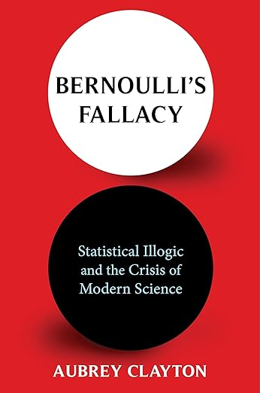
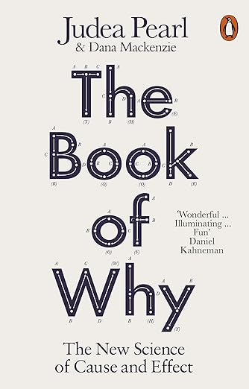
Good Background Texts
How a 300-year-old logical error fuels today’s replication crisis
How to reason about cause and effect

Slide 14
Questions, and a conversation
Murray Cantor PhD murray@murraycantor.com
Joel Keenan MD drkeenan@mdvip.com
Notes:
Closing slide. Leave it up during Q&A.

Slide 15
Backup Slides

Slide 16
FAULT 3
Arbitrary Categories
Read the curve, not the cutoff

Slide 17
Where Does “High” Begin?
Your systolic reads 120. Last year it read 119.
Nothing about you changed. The label did.
Every number a doctor measures is continuous. Every label is a box.
Someone had to decide where the boxes begin, and the curve was not consulted.

Slide 18
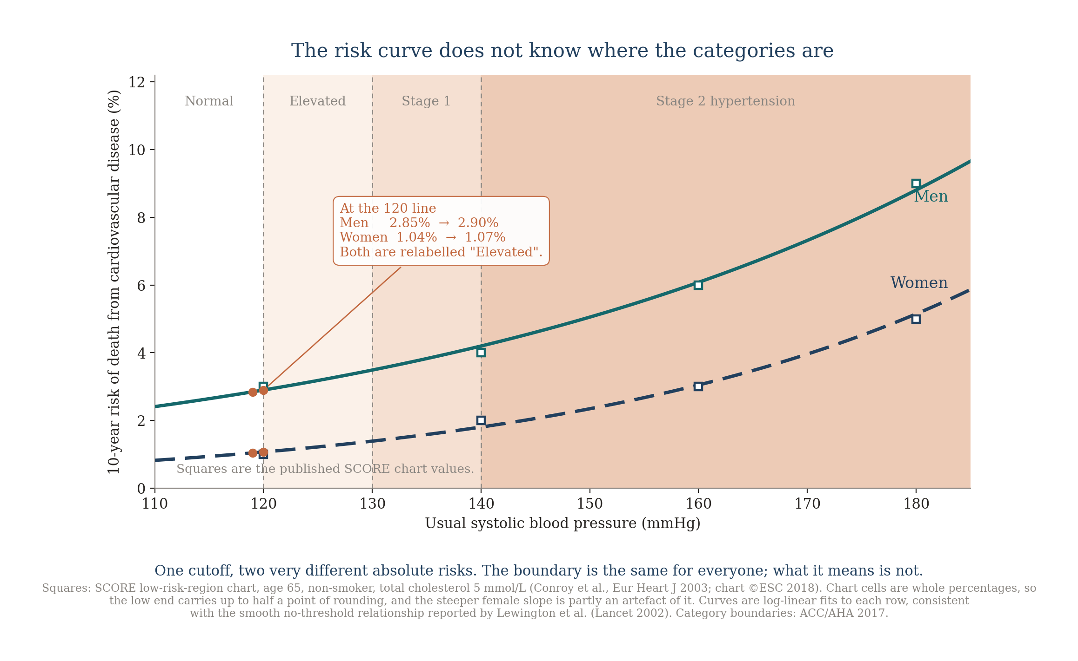
Where the categories fall

Slide 19
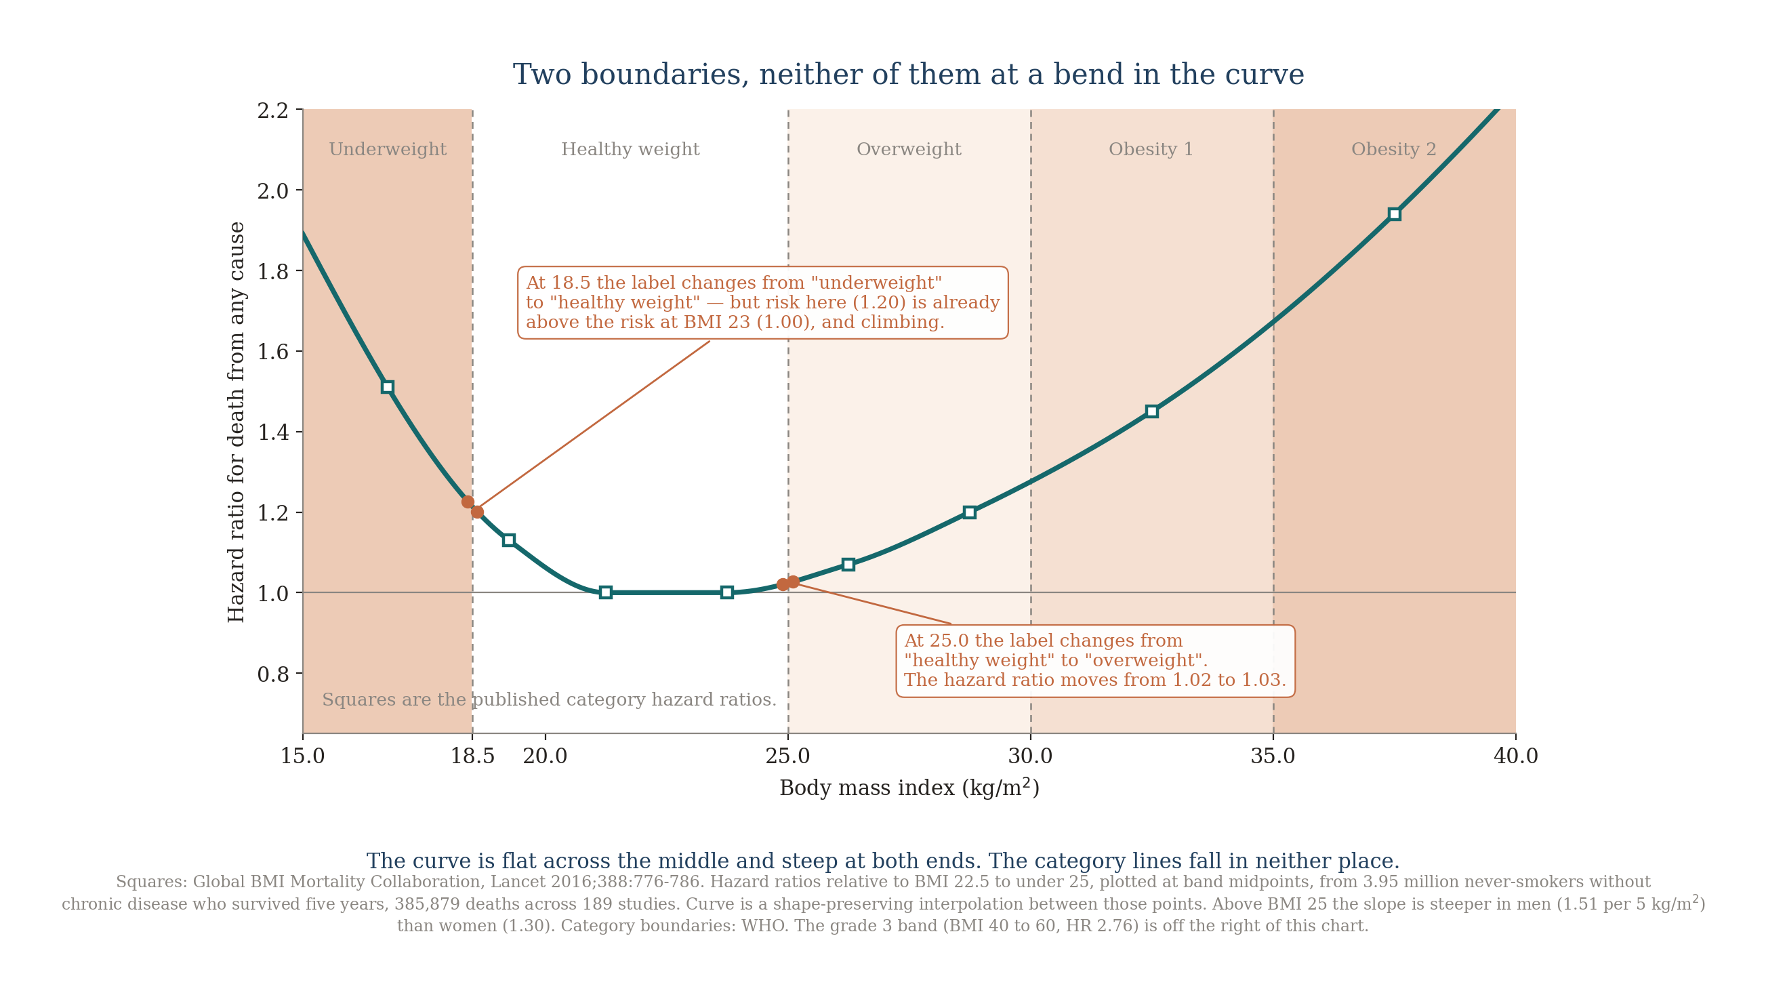
The Same Problem in BMI

Slide 20
The Lines Move
June 1998: the NIH lowered the “overweight” line from 27.8 to 25. About 25 million Americans became overweight overnight, without gaining a pound.
2017: the ACC/AHA lowered “hypertension” from 140/90 to 130/80, reclassifying 31 million Americans, 14% of all adults.
Neither curve moved. Only the lines did.
Sources: NIH/NHLBI Clinical Guidelines, June 1998 (contemporaneous press reports put the figure near 25 million); Whelton et al., 2017 ACC/AHA guideline, and Muntner et al.

Slide 21
So Why Have Categories At All?
A box is a decision rule. It tells a busy clinic who to look at twice, and it makes a chart readable in three seconds.
That is a real use, and a good one. The trouble starts when the box is read as a fact about your body.
A box cannot tell you how much risk you carry, or how much of it you picked up by crossing the line.
Ask where you sit on the curve, not which side of the line you are on.

Slide 22
The Same Result, Told Honestly
What a 36% reduction actually buys the person who takes it
“Over about three years, Lipitor prevented a heart attack in roughly 11 of every 1,000 similar patients treated.”
The real numbers
Number needed to treat
Same fact, two faces
30 in 1,000 had a heart attack without it, 19 with it. The drug spared 11 of them.
Treat about 91 such patients for three years to prevent one heart attack (NNT 91).
36% and 11 in 1,000 are the identical result. One sounds dramatic, one is honest.
Source: ASCOT-LLA, atorvastatin 10 mg vs placebo, 1.9% vs 3.0% over 3.3 years; absolute reduction 1.1%, NNT 91. Lancet 2003; Lipitor prescribing label.
Next: a real benefit still has to be weighed against your own risk and the harms →

Slide 23
How to Read the Headline
1
2
3
4
Baseline risk
About 3 in 100 untreated patients had a heart attack — a 3.0% absolute risk.
What “36%” means
36% OF 3.0% (=1.1%), not 36 points off it — leaving 1.9% risk.
Absolute reduction
3.0% − 1.9% = 1.1 percentage points — the real individual benefit.
Decision support
Weigh 1.1 points against side effects and cost; higher-risk people gain more.
A “36% risk reduction” only lowers absolute risk from 3.0% to 1.9% — a real gain of 1.1 points, so about 11 of every 1,000 treated actually benefit.

Slide 24
A Real Headline: A Proposed New Flu Shot
The same lesson as the 36% Lipitor ad — now on a real 2026 trial
“New flu shot is 27% more effective for seniors, trial finds”
Illustrative headline, representative of the coverage — not a quotation. The 27% is real.
27% of what?
More effective than what?
Your decision needs more
A relative figure comparing two shots. The base it shrinks is small, so the percentage alone tells you little.
The yardstick was a standard-dose shot, not the high-dose one adults 65+ are already advised to get.
How many people are actually helped, the side effects, and whether any shot beats no shot at all.
Source: Fluent trial (mRNA-1010), New England Journal of Medicine, May 7, 2026 (NEJMoa2516491).

Slide 25
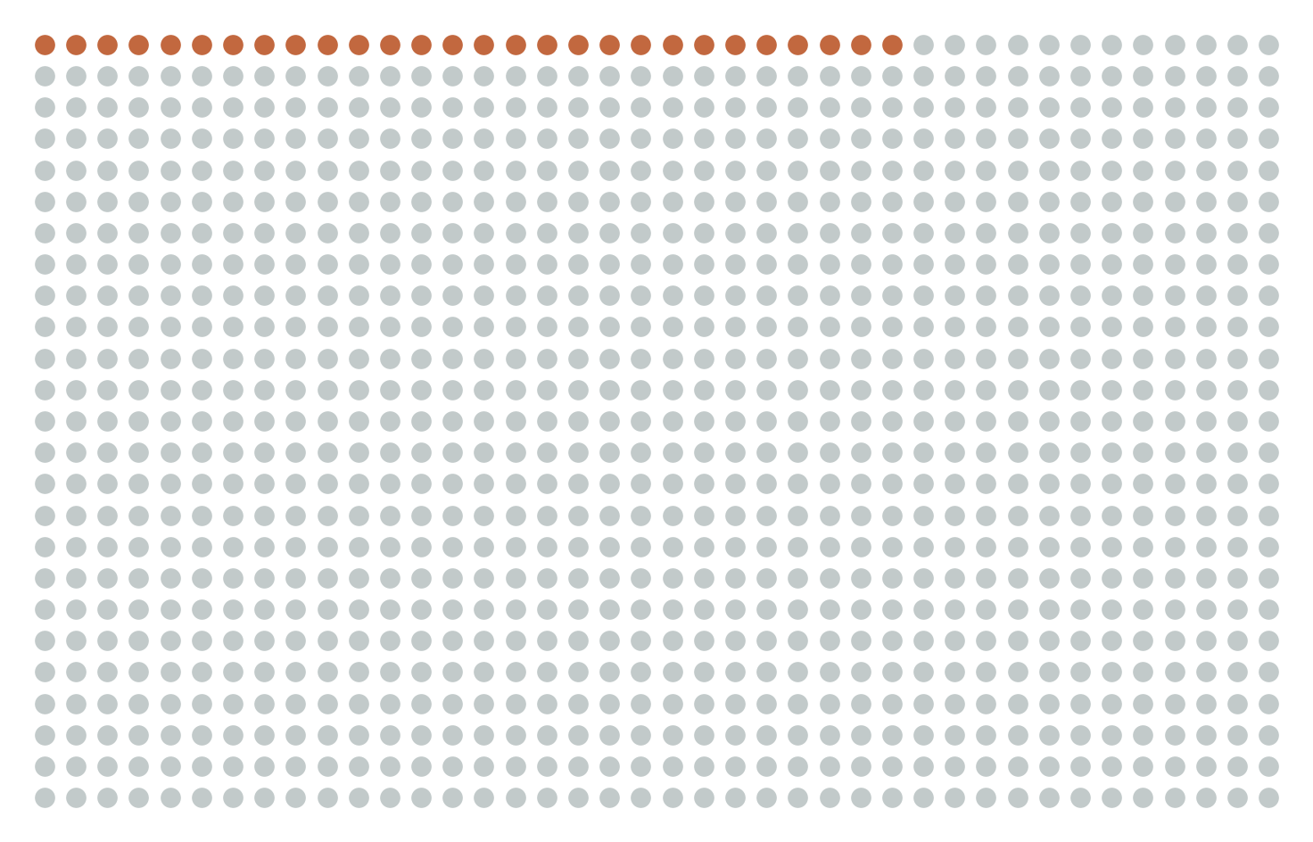
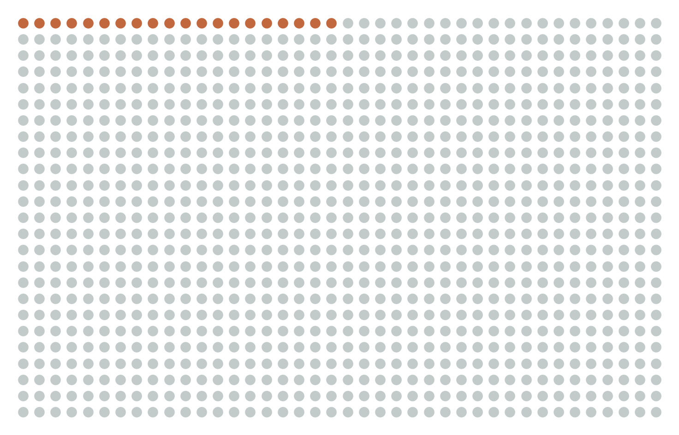
From 27% to People
What “27% more effective” looks like per 1,000 seniors vaccinated
Standard-dose shot
mRNA shot
8
in 1,000
fewer flu-like illnesses with the mRNA shot — the real, absolute gain.
About 125 seniors switched from standard-dose to mRNA to prevent one extra case (NNV ≈ 125).
28 in 1,000 get flu-like illness
20 in 1,000 get flu-like illness
Source: Fluent trial, NEJM 2026 (NEJMoa2516491). Per-protocol flu-like illness 2.0% (mRNA) vs 2.8% (standard-dose).
“27% more effective” = about 8 fewer flu cases per 1,000. Both describe the same result.

Slide 26
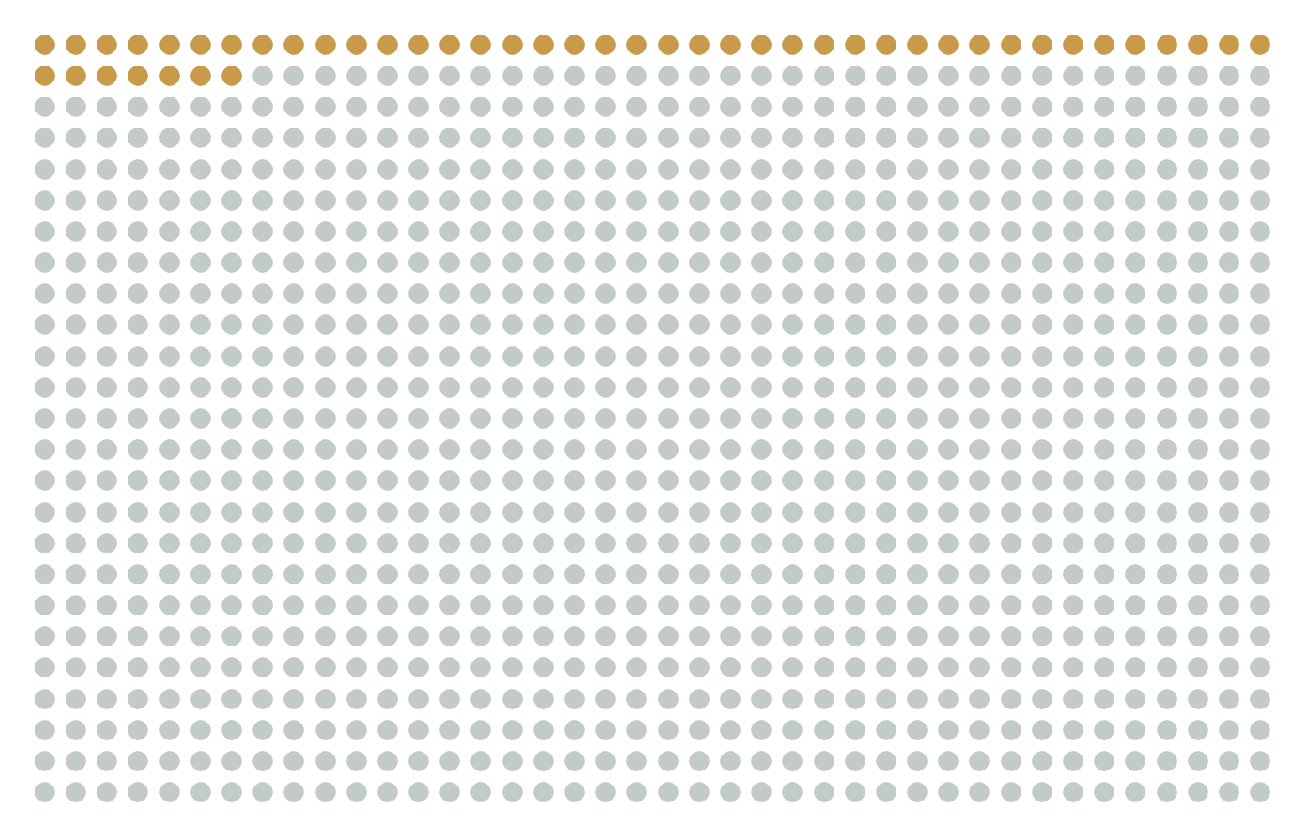
The Bigger Question: A Shot, or None?
The headline compares two shots. The bigger choice is a shot versus nothing.
No shot
Standard-dose shot
mRNA shot
~47 in 1,000 (estimated)
28 in 1,000
20 in 1,000
≈19 / 1,000
≈8 / 1,000
Estimate
any shot vs none — the big lever
mRNA vs standard — the headline
no-shot bar has no trial control; from CDC ~40% effectiveness in seniors, and it swings by season
Sources: mRNA vs standard measured in Fluent trial (NEJM 2026). No-shot column modeled from CDC vaccine-effectiveness for ages 65+ (≈40% in 2024-25; 30–41% interim 2025-26).
The big decision is whether to get a shot at all. The headline is only about which one.

Slide 27
Count the Cost, Too
If the benefit gets an absolute number, so should the side effects
Reaction (first week) | mRNA | Standard | Extra
Sore arm | 65.8% | 29.8% | +36 / 100
Fatigue | 45.1% | 20.3% | +25 / 100
Headache | 37.8% | 18.0% | +20 / 100
Muscle aches | 35.4% | 11.6% | +24 / 100
The honest ledger
Most reactions were mild and lasted a couple of days. Serious events did not differ (2.2% vs 1.9%).
The shot prevents roughly 8 to 27 flu cases per 1,000, while adding several hundred short-lived reactions per 1,000.
Weigh by severity, not by raw count.
A sore arm is common but brief; a prevented flu case is rarer but heavier. That trade is the decision.
Source: Fluent trial, NEJM 2026 — solicited reactions, first week; serious adverse events 2.2% (mRNA) vs 1.9% (standard).

Slide 28
Looking Forward, We will Discuss:
The state of medical literature
Why public health recommendations often flip
1
2
The importance of low probabilities
Causality versus correlation
3
4
Reading positive test results (COVID, pregnancy)
Responding to measurements outside the normal range
5
6
‘Syndrome’, ‘disorder’ and ‘spectrum’: what doctors mean
7
Notes:
Standard content layout. Title is a placeholder — click and type. Points left, one big number right.

Slide 29
More Effective Than What?
The comparison behind the headline isn’t the shot you’d actually be offered
What the headline implies
What the trial actually tested
A new shot that beats your current flu protection by about a quarter.
The mRNA shot versus a standard-dose shot. Adults 65+ are already advised to get a high-dose or adjuvanted shot, which was not the comparison.
For ages 65 and older, approval leaned on antibody levels measured against the high-dose shot, not on a head-to-head count of who actually caught the flu.
A win over the weaker option is not the same as a win over the option you’d actually get.
Source: Fluent trial, NEJM 2026; FDA Vaccines and Related Biological Products Advisory Committee briefing, June 18, 2026.

